Slide 1
CURRENT TRENDS IN MEDICAL MANAGEMENT
Ron Melton, OD, FAAO
Randall Thomas, OD, MPH, FAAO
www.eyeupdate.com

Slide 2
Financial Disclosure
Drs Ron Melton and Randall Thomas are consultants to, on the speakers bureau of, on the advisory committee of, or involved in research for the following companies: ICARE and B+L

Slide 3
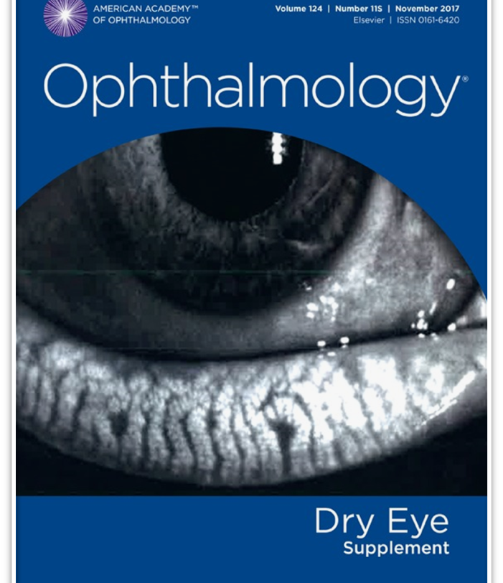
Dry Eye Disease
“Dry eye disease is a heterogeneous disorder of the ocular surface in which the common denominator is inflammation.”
“Topical corticosteroids also play an important role in breaking the inflammatory cycle.” “Repeated short-term pulse therapy has produced a disease-free state for more than 1 year in a study of patients with Sjögren’s syndrome.”
“Inflammation is one of the major targets in treating DED, and breaking the cycle of inflammation is crucial in improving symptoms. All patients DED deserve a trial of anti-inflammatory therapy at some point during their treatment.” “Corticosteroids are one of the most effective and rapid therapies available for suppressing inflammation on the ocular surface.”
“Treatment of DED is based on minimizing inflammation and optimizing various components of the tear film.”

Slide 4
Discordance Between Symptoms and Signs
Patients with chronic pain syndromes (CPSs) had 30% greater symptoms than signs.
Important CPSs are irritable bowel syndrome, fibromyalgia, chronic pelvic pain and osteoarthritis.
There is “growing evidence that part of the dry eye population may show signs of dysfunctional somatosensory pathways, indicating neuropathic ocular pain.”
It is thought that “patients with atopy or allergy have a sensitized ocular surface because of inflammatory processes influencing corneal nerves, which can lead to symptoms of dry eye even when the homeostasis of the ocular surface is minimally compromised.”
Ophthalmology, March 2017
Notes:
Vehof J, Smitt-Kamminga NS, Nibourg SA, Hammond CJ. Predictors of discordance between symptoms and signs in dry eye disease. Ophthalmology 2017;124(3):280-286.

Slide 5
“Consensus Report Simplifies Dry Eye Diagnosis”**
“No new equipment is required”
“All that’s needed to diagnose dry eyes are a history, slit lamp, and a fluorescein strip.”
“An unstable tear film, when accompanied by ocular discomfort or impaired vision is sufficient to diagnose DED.”
“Inflammation can perpetuate the vicious cycle of chronic DED.”
“Controlling inflammation, whether over the long-term or during disease flare-ups, is a must to prevent ocular damage and to rein in symptoms.”
EyeNet Magazine, November, 2022

Slide 6
Topical Therapies for Ocular Surface Dryness
Aqueous-based PF artificial tears did little or nothing to alleviate symptoms.
Adding a topical steroid, signs and symptoms were improved.
The majority of dry eye sufferers use AT’s, yet many still experience exacerbations of irritation and ocular surface disease in low-humidity environments.
Moore QL, et al. Am J Ophthalmol 2015;160(1):135-42.

Slide 7
Steroids and Dry Eye Disease (DED)
“Because chronic inflammation at the ocular surface plays an essential role in the pathogenesis of DED, topical steroids have been commonly used in these patients.”
“Although the pathogenesis of DED is multifactorial and not fully understood, inflammation has been recognized as a key mechanism in its development and propagation.”
Am J Ophthalmol, June, 2018
Notes:
Yin J, Kheirkhah A, Dohlman T, et al. Reduced Efficacy of Low-dose Topical Steroids in Dry Eye Disease Associated With Graft-versus-Host Disease. Am J Ophthalmol 2018;190:17-23.

Slide 8
*Steroids for DED
“Treat any inflammation on the ocular surface, of course. Start with a topical steroid in “pulse” mode, attempting to quell both the visible inflammation and symptoms quickly without ongoing prescription therapy.”
Ocular Surgery News, July 25, 2023
Notes:
White DE. Time to talk about evaporative dry eye disease. Ocular Surgery News, July 25, 2023.

Slide 9
Our Dry Eye Management Algorithm
All therapy – dry eye included – should be individualized to the patient.
Here is our usual approach to dry eye management.
Two Weeks
Two Weeks
Indefinitely
Lipid-Based Artificial Tear
Four to six times a day as needed
Lipid-Based Artificial Tear
Three to four times a day as needed
Lipid-Based Artificial Tear
Two to four times a day as needed
Loteprednol*
Four times a day
Loteprednol Two times a day
(Consider punctal plugs if needed)
Discontinue Loteprednol
If symptoms break through or continue, then pulse dose loteprednol four times a day for one week or consider loteprednol once daily as needed.
The risk of increased IOP with loteprednol is uncommon at high dosage and rare at low dosage.
Our experience has been that if an increase in IOP is going to occur, it will do so at the initial one-month follow-up, and not later.
Omega-3 essential fatty acids (derived from fish and/or flaxseed oil) can be initiated at any stage, based on clinical judgment.
*Alternatively, instill loteprednol ointment daily at bed-time for two weeks, then M-W-F for two weeks.

Slide 11
Innovation in Dry Eye Therapy
Uniquely “preservative-free” in a multi-use bottle
Contains trehalose which addresses hyperosmolarity
Contains HA + Povidone which bind water and enhances ocular surface lubrication
Provides extended ocular surface residency time
300 drops in a 10mL bottle
Can use with contact lenses
Marketed as iVIZIA by Thea Pharmaceuticals

Slide 12
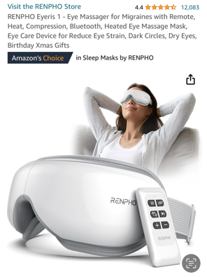
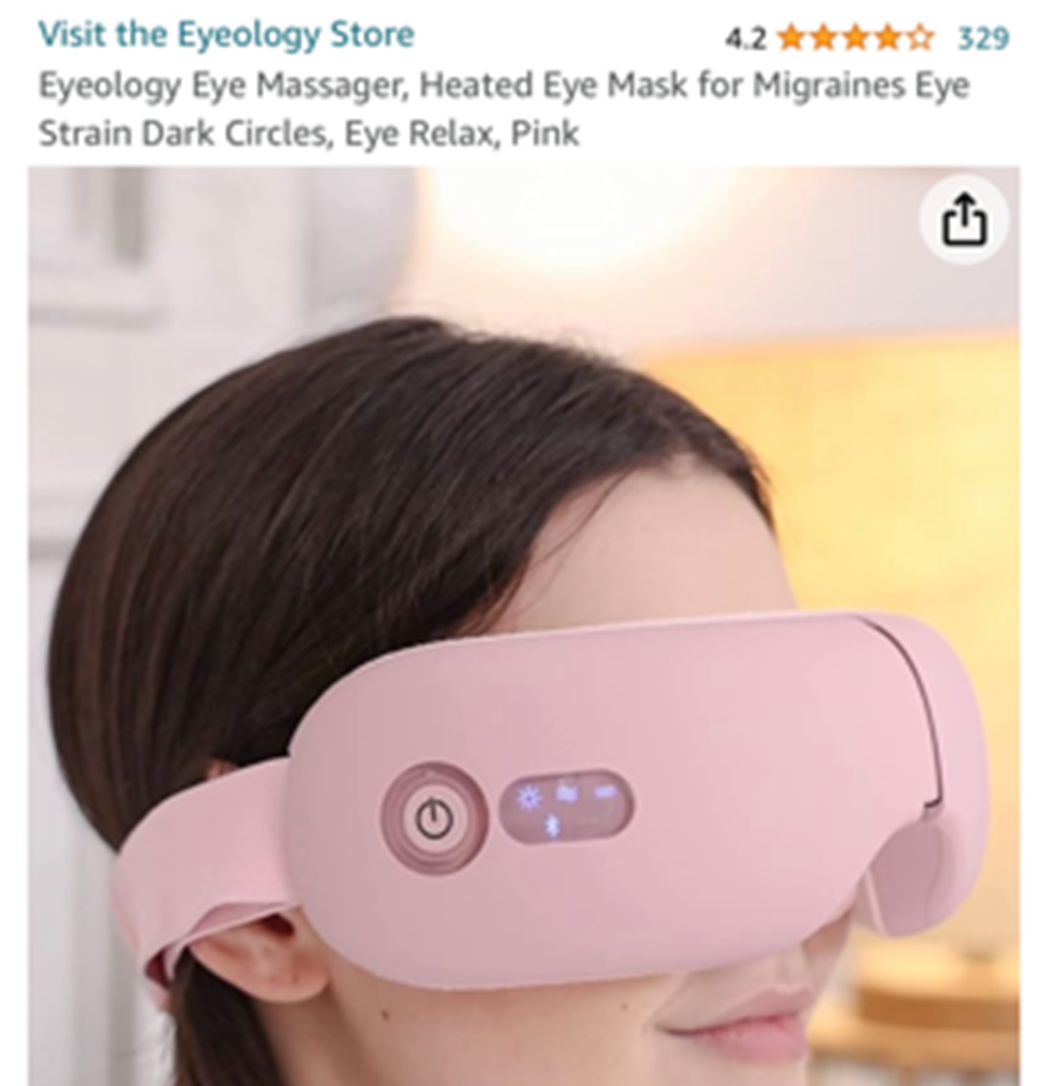

Slide 13
Loteprednol Approved for Dry Eye
October, 2020 marks the first FDA-approved steroid treatment for DED
A 0.25% ophthalmic suspension formulation, however, only 2 or 3 shakes is necessary
Unique “Mucus Penetrating” nanoparticle formulation enhances tear film residency time
Approved for up to 2 weeks of QID therapy
Can be “re-pulsed” as needed over time
“Adverse events and IOP increases were comparable to those seen with vehicle.”
Marketed by Kala as Eysuvis Ophthalmic Suspension

Slide 14
Literature Perspective on Steroids and Elevated IOP
“IOP elevation is much more common with older steroids such as dexamethasone, prednisolone and fluorometholone, compared to newer steroids such as loteprednol, difluprednate or rimexolone.”
A note about difluprednate: “Though the occurrence of increased IOP is about 3%, the IOP elevation may be significantly higher compared to the other newer steroids.” Only about 2% of patients experience “a clinically significant IOP increase” with loteprednol.
“Post-operatively, loteprednol did not induce a significant IOP elevation and when used as a replacement for older steroids led to a significant IOP reduction in known steroid responders.”
Survey Ophthalmol. March/April 2020
Notes:
Roberti G, Oddone F, Agnifili L, et al. Steroid-induced glaucoma: Epidemiology, pathophysiology, and clinical management. Surv Ophthalmol. 2020;65(4):458-472.

Slide 15
Alternative Supplementation
Orally administered omega-3 essential fatty acids
May take 3 - 4 months to obtain a significant clinical effect
Liquid formulations are available for those patients who have difficulty swallowing large capsules.

Slide 16
Benefits of Punctal Plugs
“Plug placement resulted in greater than 50% improvement of symptoms, improvement in ocular-surface health, reduction in artificial tear use, and improved contact lens comfort in patients with dry eye.”
“The plugs are well tolerated, with only approximately 10% requiring removal for irritation.”
Ophthalmology, August 2015

Slide 17
Cyclosporine 0.05% Ophthalmic Emulsion
Topical immunomodulator with anti-inflammatory effects – exact mechanisms unknown
Indication: “to increase tear production in patients whose tear production is presumed to be suppressed due to ocular inflammation”
Available in 0.4 ml unit dose vials by Allergan. Supplied in 30-vial tray.
Dosage: one drop to affected eye(s) b.i.d. Usually takes 4-6 months to reach full therapeutic effect
Concurrent treatment with ester-based steroid for the first 1-2 months may hasten results
Available in multi-dose, non-preserved 5.5 ml bottle and unit-dose PF vials

Slide 18
*Vevye™ (Cyclosporine Solution 0.1%)
Cyclosporine is insoluble in water, however this newer formulation is soluble in water-free, preservative-free “inactive” perfluorobutylpentane (PFBP)
PFBP by itself is beneficial in treating DED
Since no water, there is no pH or osmolarity
“Medical treatment for dry eye has become extraordinarily expensive for patients. Water-free cyclosporine, 0.1% may represent a marginal improvement over Restasis emulsion.”
M+T: We just don’t see another cyclosporine bringing anything new to the table.
JAMA Ophthalmol. May, 2023

Slide 19
*The Effect of Topical Cyclosporine
MOA: ”Increases tear production in patients where it’s presumed to be suppressed due to ocular inflammation associated with DED.”
What is the predominant cause of most cases of DED? It’s not lack of tear production, but increased evaporation secondary to MGD!
Better plan: Address inflammation with a month long course of loteprednol along with warm soaks and MG expression. Continue control with a PF lipid based artificial tear and punctal plugs.
Rev Optom, March 15th 2023

Slide 20
Xiidra (lifitegrast 5%)
Only FDA-approved drug to treat both signs and symptoms of DED
A lymphocyte function-associated antigen antagonist
5%, unit-dose (0.2ml), PF, foil-pouched solution
Dosage is approximately every 12 hours for many months or years
Takes 2-4 weeks to achieve clinical results
Stored at room temperature – protect from light
Side effects seen in 5-25% of patients include instillation site irritation, taste perversion (dysgeusia), and transient blurred vision
Marketed as Xiidra by Alcon (1 carton contains 12 foil packs holding 5 unit-dose containers)
Notes:
ziidra

Slide 21
A Nose for Dry Eye
Tyrvaya™ (varenicline 0.03%) nasal spray (Varenicline is the same drug as Chantix)
A cholinergic agonist (parasympathomimetic)
Used bid, with effectiveness in 4-6 weeks
Main side effect: sneezing (over 80%)
Do not shake the bottle
Store at room temperature
Two bottles; each good for 15 days 60 sprays/bottle
Consult tyrvaya.com for more information
Marketed as Tyrvaya nasal spray by Oyster Point Pharma

Slide 22
Regener-Eyes for DED
First in class eye drop
Contains numerous anti-inflammatory cytokines and growth factors from placental-derived tissue
Hyaluronic acid for lubrication
Enhances the lipid layer
Helps the body to regenerate itself
Available as Regener-Eyes and Regener-Eyes Lite in a 3 ml sterile bottle
See regenereyes.com

Slide 23
*Perfluorohexyloctane = Meibo
A new and unique treatment for DED
Specifically designed to target MGs
“Meibo demonstrated statistically and clinically meaningful improvements in the signs and symptoms of DED associated with MGD.”
“Meibo is thought to spread over the ocular surface to form a long-lasting anti-evaporative barrier.”
Dosage is QID for at least 8 weeks
Meibo contains no water or preservative
Ophthalmology, May, 2023
Notes:
Tauber J, Berdy GJ, Wirta DL, Krösser S, Vittitow JL, GOBI Study Group. NOV03 for dry eye disease associated with meibomian gland dysfunction: Results of the randomized Phase 3 GOBI Study. Ophthalmology. 2023;130(5):516-524. https://doi.org/10.1016/j.ophtha.2022.12.021

Slide 24
Update on Miebo®
Regarding corneal fluorescein staining at week 8, 50% of Miebo treated patients improved vs. 31% of the saline control group. (signs)
Regarding symptoms (burning/stinging), the portion of eye dryness responders (at least a 30% reduction in symptoms) at week 8 was 65% Miebo vs. 45% in the saline control group.
These benefits have not been achieved for “other approved prescription DED therapies.”
While yet another option to help with DED, the separation from vehicle is not robust.
Am J Ophthalmol, August, 2023
Notes:
Sheppard J, Kurata F, Epitropoulos AT, Krösser S, Vittitow JL. NOV03 for Signs and Symptoms of Dry Eye Disease Associated With Meibomian Gland Dysfunction: The Randomized Phase 3 MOJAVE Study. Am J Ophthalmol 2023;252:265-274.

Slide 25
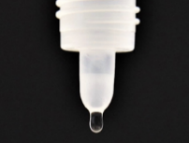
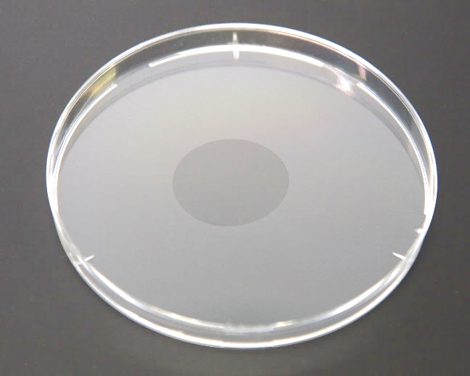
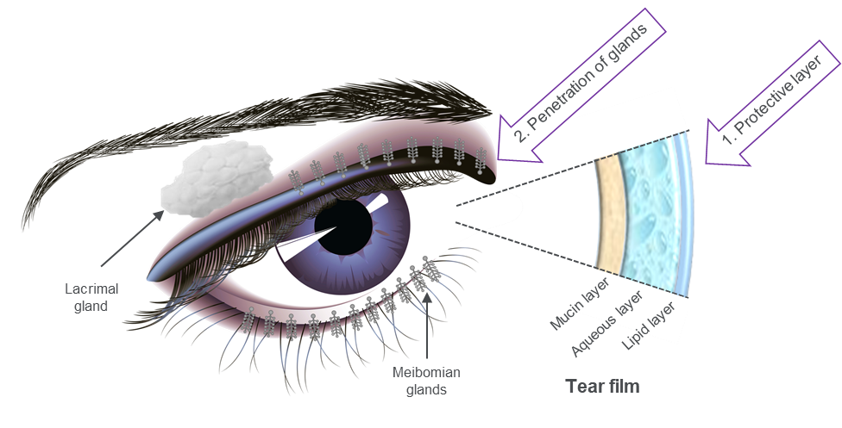
NOV03 (Perfluorohexyloctane) – Dual Mode of Action
Long-lasting film formation
Supplements the lipid layer
Penetrates meibomian glands
Protects the ocular surface and promotes healing
Reduces evaporation of the aqueous layer
 | NOV03
Drop Size | < 12 µL (Blink reflex not activated)
Drug Residual Time | Long ~ 240 min
Spreading | Fast spreading Film forming properties
Other features | Preservative free No vision blurring
Krösser S, et al. Invest Ophthalmol Vis Sci. 2018;59:2656.
Broniatowski M, et al. J Phys Chem B 2004;108:13403-13411.
Liu X, et al. Bull Chem Soc Jpn. 2018;91(5):846-857.
Gaines G Jr. Langmuir 1991;7(12):3054-3056.
Meinert H, et al. Eur J Ophthalmol. 2000;10(3):189-197.
Notes:
Perfluorohexyloctane or NOV03 is a novel molecule with characteristics advantageous for treatment of ocular surface disease, particularly of the evaporative type.
NOV03 is a single chemical entity, not a mixture of active and inactive ingredients in water.
NOV03 has a low surface tension, permitting rapid spreading and coating of the ocular surface with a very long residual time, approximately four hours. In part, this is due to the small drop size and lack of stimulation of blink response but also to the film-forming properties of NOV03.
NOV03 may be described as a “shield” drop for the ocular surface.

Slide 26
Phase 3 Trials: All Primary and Secondary Endpoints Achieved
In both studies
NOV03 QID was significantly better vs control (saline) on both co-primary endpoints of CFB in tCFS and CFB in dryness score at week 8 (P<0.001)
NOV03 met all four prespecified secondary endpoints, which all demonstrated statistical superiority over saline:
CFB in tCFS at week 2 (P=0.001);
CFB in dryness score at week 2 (P≤0.009)
CFB in VAS burning/stinging at Week 8 (P≤0.006);
CFB in central Corneal Fluorescein Staining (cCFS) at week 8 (P<0.001).
NOV03 was well tolerated with instillation site reactions <0.5%. No adverse events reported by >2% of subjects in either treatment group. Overall, the number of patients reporting ≥1 ocular TEAE was similar between the NOV03 and saline (GOBI: 9.6% and 7.5%; MOJAVE: 12.9% and 12.3%).

Slide 27
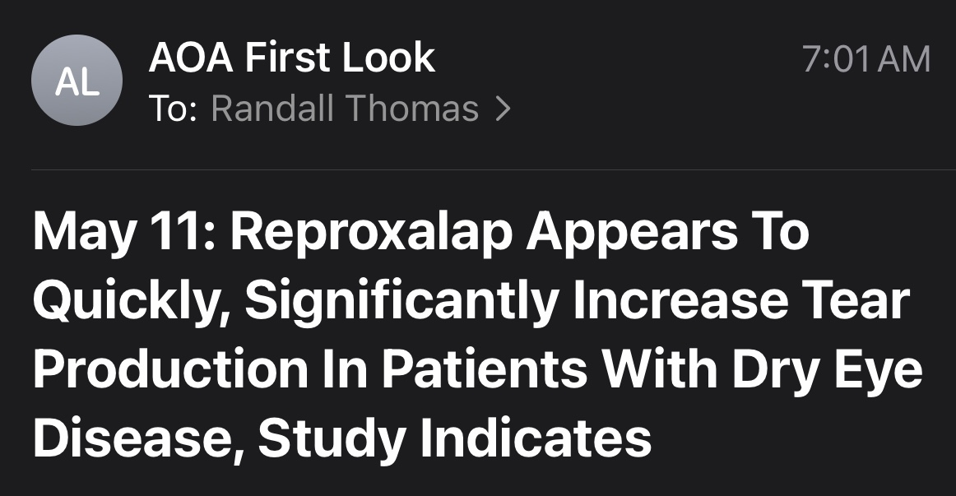
*

Slide 29
*Oral Azithromycin vs Oral Doxycycline in Treating MGD
Doxycycline 100 mg twice a day for 6 weeks or oral azithromycin 1g once a week for 3 weeks
With equivalent efficacy, fewer frequent side effects and a less frequent dosing regimen, azithromycin could be an attractive alternative to doxycycline in patients with MGD. “However, long-term follow-up in each group would be needed to determine if these outcomes persist for this chronic condition.”
OSN, July 23, 2023

Slide 30
Alternative Supplementation
Orally administered omega-3 essential fatty acids
May take 3 - 4 months to obtain a significant clinical effect
Liquid formulations are available for those patients who have difficulty swallowing large capsules.

Slide 31
Role of Omega 3 EFA’s in DED
30% reduction in the risk of DED for each gram consumed per day
Recommend: about 1000mg of EPA and about 500mg of DHA per day
Tear film BUT highly sensitive and specific
Onset of benefits, including hyperemia; 30-60 days
Loteprednol .5% QID x 2 weeks reduces ocular surface inflammation
Krill oil appears to be slightly more effective than fish oil.
Reference: Oph. January 2017

Slide 32
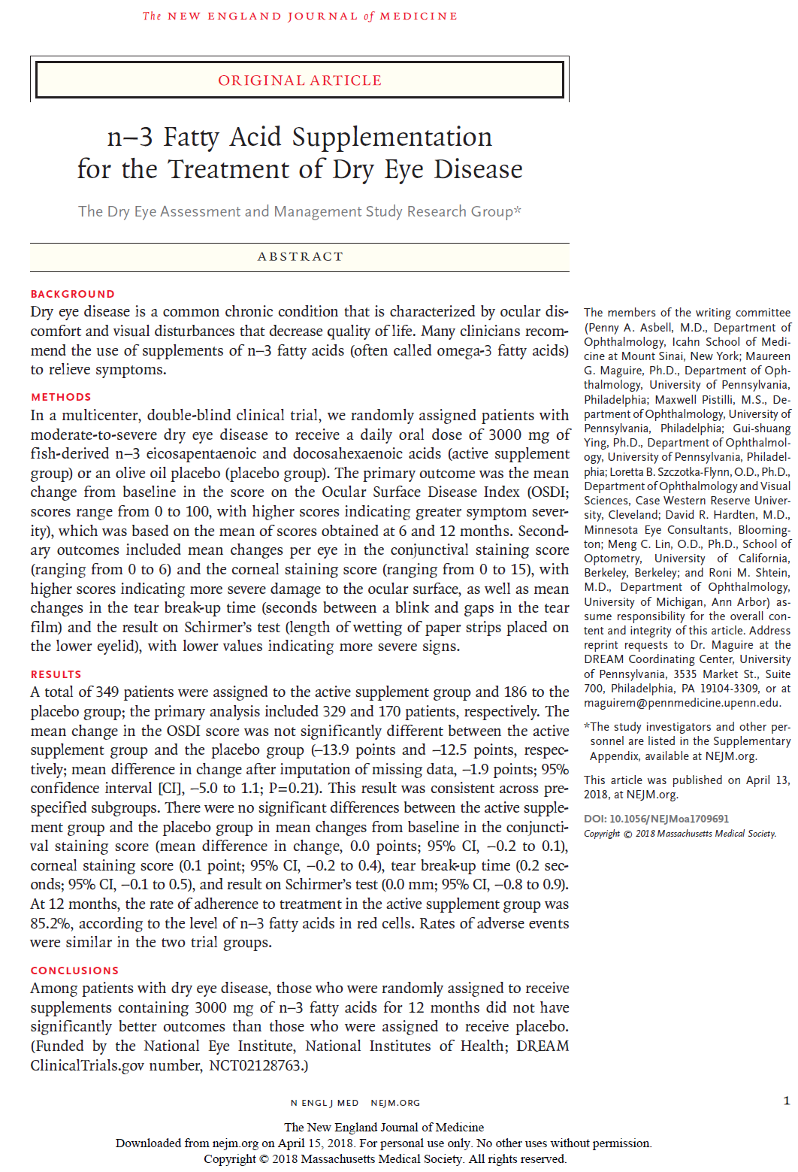

Slide 33
Disturbing News on DED and Fish Oil
Fish oil supplementation provides no benefit in treating DED!
Conclusions: “Among patients with DED, those who were randomly assigned to receive supplements containing 3000mg of fish oil for 12 months did not have significantly better outcomes than those who were assigned to receive placebo.”
NEJM, April, 2018

Slide 34
The Benefits of Drinking Water
“Clinicians should use simple, clear messaging on the role of water as the primary drink for all children, adolescents, and young adults when discussing healthy habits with families.”
JAMA Pediatrics, April, 2019
Drink Water, Not Soft Drinks
“This study found that consumption of total, sugar-sweetened, and artificially sweetened soft drinks was positively associated with all-cause deaths in this large European cohort.”
JAMA Internal Medicine, Nov. 2019
Notes:
Asher Y. Rosinger, Hilary Bethancourt, Lori A. Francis. Association of Caloric Intake From Sugar-Sweetened Beverages With Water Intake Among US Children and Young Adults in the 2011-2016 National Health and Nutrition Examination Survey
JAMA Pediatr. Published online April 22, 2019.
Mullee A, Romaguera D, Pearson-Stuttard J, et al. Association Between Soft Drink Consumption and Mortality in 10 European Countries. JAMA Intern Med. 2019;179(11):1479-1490. doi:10.1001/jamainternmed.2019.2478

Slide 35
Benefits of Punctal Plugs
“Plug placement resulted in greater than 50% improvement of symptoms, improvement in ocular-surface health, reduction in artificial tear use, and improved contact lens comfort in patients with dry eye.”
“The plugs are well tolerated, with only approximately 10% requiring removal for irritation.”
Ophthalmology, August 2015

Slide 36
*Oral Azithromycin vs Oral Doxycycline in Treating MGD
Doxycycline 100 mg twice a day for 6 weeks or oral azithromycin 1g once a week for 3 weeks
With equivalent efficacy, fewer frequent side effects and a less frequent dosing regimen, azithromycin could be an attractive alternative to doxycycline in patients with MGD. “However, long-term follow-up in each group would be needed to determine if these outcomes persist for this chronic condition.”
OSN, July 23, 2023

Slide 37
*Neuropathic (DED) Eye Pain
The best article we have found on this topic is available from:
https://www.ncbi.nlm.nih.gov/books/NBK542282/
Moshirfar M, Benstead EE, Sorrentino PM, et al. Ocular Neuropathic Pain. [Updated 2023 Feb 22]. In: StatPearls [Internet]. Treasure Island (FL): StatPearls Publishing; 2023 Jan.

Slide 38
Oxervate (cenegermin) 0.002% solution for Neurotrophic Keratitis
FDA-approved in August 2018
Eye drop delivery of human nerve growth factor
Dosage: 6 x D (2 hour intervals) for 8 weeks
Do Not Shake – Very complex administration protocol
70% “complete healing” in 8 weeks
“Orphan Drug” – marketed by Dompe U.S., Boston

Slide 41
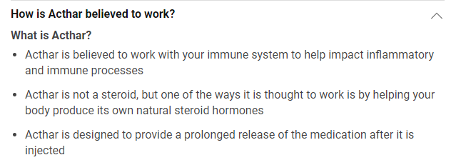

Slide 42
Lid Margin Debridement - Scaling
“Hypothetically, early and frequent debridement-scaling of the Line of Marx (i.e., the muco-cutaneous junction) and lid margin could prevent or delay the cascade of increased osmolarity, tissue desiccation, and ultimately inflammation and tissue damage simply because of mechanical barriers to oil entering the tear film.”
“The single debridement-scaling procedure improved comfort and improved MG function.”
“There are significant benefits to a single D-S of the LOM and keratinized lid margin.”
Cornea, December, 2013
Notes:
Korb DR, Blackie CA. Debridement-Scaling: A New Procedure That Increases Meibomian Gland Function and Reduces Dry Eye Symptoms. Cornea 2013;32(12):1554-1557.

Slide 43
MG Scraping in Treating DES
“In the future, the health and maintenance of the MCJ and keratinized lid margin may be considered integral to routine eye care. This shift in our culture will involve improvements in our observation skills and also the willingness to incorporate novel techniques such as debridement-scaling of the MCJ and keratinized lid margin in our clinical practice.”
Korb/Blackie. Cornea. December 2013

Slide 44
*Inflammation and Eyelid Scraping
“For years, we have understood that inflammation is the underlying pathophysiology responsible for the signs and symptoms of dry eye disease (DED).”
“A supermajority of people in the developed world spend almost all their work time looking at screens. Most people who spend their days in front of a computer blink neither frequently nor completely enough to release the oil sequestered in the glands, producing chronic obstruction at the mouth of the gland.”
Ocular Surgery News, July 25, 2023
Notes:
White DE. Time to talk about evaporative dry eye disease. Ocular Surgery News, July 25, 2023.

Slide 45
Korb’s Lid Wiper Epitheliopathy
“Consistently and accurately assessing LWE is fast becoming an important component of DED identification and treatment.”
(You don’t hear much about this because there is no drug or device - profit motive - to using LG dye!)
We recommend generous application of LG dye, wait 3-4 minutes, and evert the lid.
“Steroids can reduce para-inflammation from microtrauma of the shearing forces during blinks.”
Lipid based artificial tear lubrication and Lotemax SM Q.I.D for two weeks is our typical approach.
Review of Optometry, November 15, 2020
Notes:
Lievens C, Roberts L, Rayborn E, et al. Lid Wiper Epitheliopathy: What the OD Needs to Know. Rev Optom. November 15, 2020. Pg. 62-68.

Slide 46
Hyperkeratinization and MGD
“Hyperkeratinization of the orifice and ductal epithelium, leading to meibomian gland obstruction, is considered the primary cause of meibomian gland disease. This directly results in decreased meibomian lipids on the ocular surface, resulting in an unstable tear film and evaporative dry eye conditions. Further, the increased internal pressure from the obstruction leads to atrophic changes and squamous metaplasia within the meibomian acini, causing a secondary hyposecretion.”
Survey of Ophthalmology, March-April 2015

Slide 47
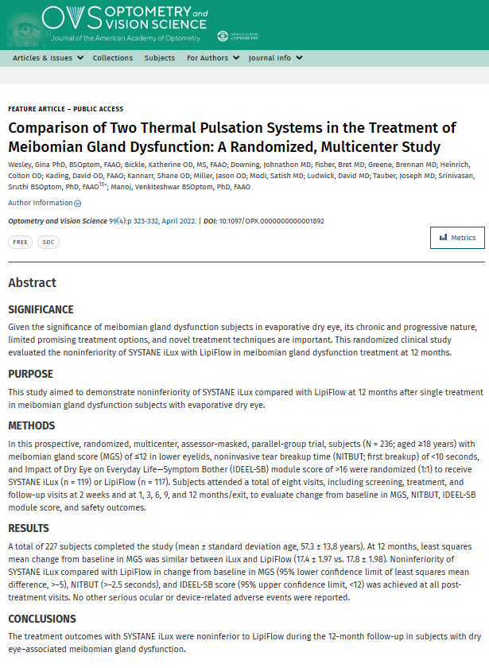

Slide 48
The Benefits of Home-based “Warm Soaks”
Heat application to the meibomian glands is a well-established therapeutic intervention
All varieties of heat applications (warm soaks, etc.) fall short of ideal
There is an evolving need to facilitate this therapeutically beneficial intervention
EverTears technology is a self-contained, rapid-onset, heat-maintaining “pad” that patients can use to help maintain meibomian gland function at home
OTC – Manufactured by THERMAMEDX

Slide 49
Thermal Systems to Treat DED
Lipiflow®, Ilux®, TearCare®, and home self treatments were evaluated.
All treatments were safe, effective and relatively similar.
Most in-office treatments provided 6-12 months of improvement.
“There are currently no conclusive results on which baseline characteristics may predict patient response to in-office thermal treatment.”
Costs (to doctor and patient) are high. Like life in general, decisions are based on a balance of cost vs. convenience.
Survey Ophthalmol, Sep-Oct, 2022
Notes:
Beining MW, Magnø MS, Moschowits E, et al. In-office thermal systems for the treatment of dry eye disease. Surv Ophthalmol. 2022;67(5):1405-1418.

Slide 50
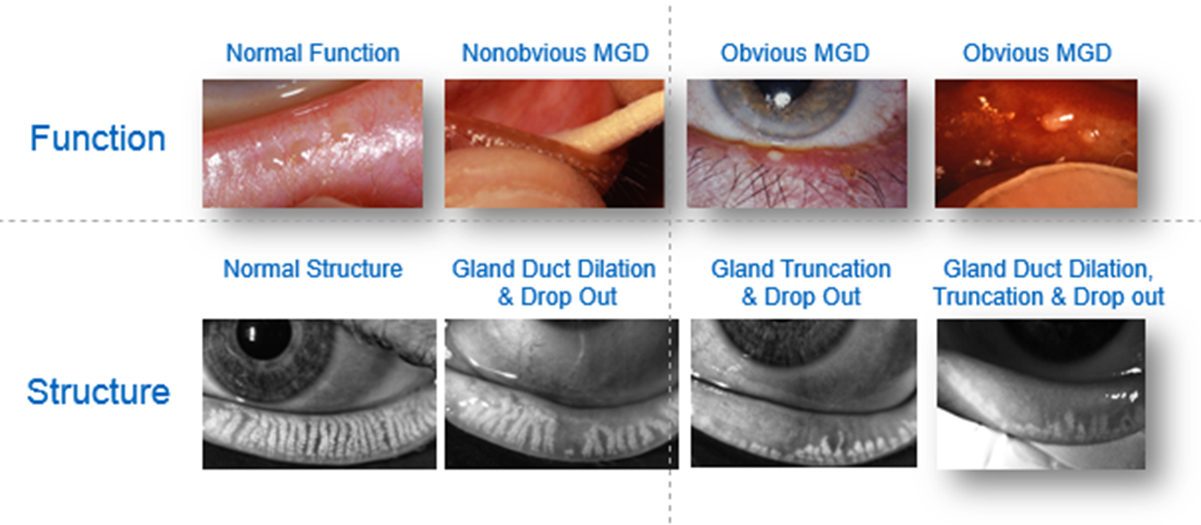
*
“As we move up the “sexy” scale, in-office direct-to-gland heating treatments are a full order of magnitude more effective than any at home thermal therapy.”

Slide 51
Thermal Pulsation Treatment Increases CL Wearing Time
“Conclusion: In SCL wearers with MGD, a single VTP treatment significantly improved mean meibomian gland function and significantly reduced dry eye signs and symptoms compared to an untreated control. The treatment increased mean comfortable lens wearing time by 4 hours (approximately doubling the pretreatment findings). This was sustained for up to 3 months post-treatment on average.”
Clinical Ophthalmology, Jan, 2018

Slide 52
In-office Procedure for Meibomian Gland Dysfunction
Focused heat application followed by doctor-delivered meibomian gland expression is a critical intervention for moderate to advanced dry eye disease
TearCare® (SightSciences) is an in-office procedure where heat strips are strategically placed over the eyelids to achieve optimum liquefaction of meibum
Once liquefaction is quickly achieved, the doctor then properly expresses the meibum contents, thus allowing more physiological meibum to be produced.

Slide 53
IPL and Dry Eye

Slide 54
Pediatric DED and Risk Factors: Things to Ponder
“Multi-screen” lifestyle – major risk factor
Vegetarian and vegan lifestyle – insufficient consumption of Omega 3 EFA’s
Meibography revealed that about 10% of grade school children had compromised meibomian glands.
This compromise was directly correlated to the amount of time looking at screens
“Evaporative DED associated with smartphone use is a lifestyle disease.”
Reference: OSN, January 25, 2016

Slide 55
Lumify (brimonidine 0.025%) Ophthalmic Solution
FDA approved in December 2017 – OTC product
Major upgrade to help the chronic red eye
Venular constriction is the mechanism of action, therefore …
No rebound hyperemia
Used once or twice a day PRN
Marketed as Lumify OTC by Bausch & Lomb
Notes:
To drug lecture

Slide 56
Brimonidine Dermatologic Gel
Used to address the erythema and flushing commonly expressed in facial and eyelid rosacea
Causes microvascular vasoconstriction
Comes in a 30 gram tube – applied once daily
Provides a “somewhat effective” clinical response
Available as a .33% gel (Mirvaso) by Gladerma

Slide 57
Eyelid Cleansing Treatments for Blepharitis
Study compared “dedicated eyelid cleanser to diluted baby shampoo”
Cleaning was done bid for four weeks
Conclusion: improvements occurred with both treatments. “However only the dedicated eyelid cleanser proved effective in reducing inflammation and was the preferred therapy.”
The Ocular Surface, October, 2017

Slide 58
Demodex Blepharitis
Caused by an infestation of the eyelashes and eyelash follicles by Demodex mites, the most common ectoparasite found in humans
Reasonably common, accounting for 45% of blepharitis cases overall, and 84% in people aged 60 and older
Symptoms: eyelid margin inflammation, redness, and ocular irritation
Commonly occurs with rosacea or conditions such as diabetes

Slide 59
Lotilaner Ophthalmic Solution 0.25%
FDA-approved July 25, 2023
Lotilaner 0.25% is an anti-parasitic ophthalmic solution to treat demodex blepharitis
Mechanism of action: inhibits the gamma-aminobutyrid acid (GABA)-gated chloride channels in the Demodex mites to cause paralysis in the mite and its death
Administered BID for 6 weeks
Side Effects: instillation site stinging and burning (10%); chalazions and punctate keratitis (<2%)
Marketed as Xdemvy by Tarsus Pharmaceuticals

Slide 60
Phthiriasis Palpebrarum
Phthirus Pubis (crab louse) eyelid infestation
Uncommon form of blepharitis
Symptoms: intense itching (pruritus)
Signs: nits (louse egg cases) and reddish sanguinofecal debris at base of eyelashes classic slit lamp findings
Treatment
Forceps to remove lice at slit lamp
Standard lid scrubs and aggressive ointment to lid margins bid x 7 days
Consult with primary care physician

