Slide 1
THERAPEUTIC STRATEGIES IN CLINICAL EYE CARE
Ron Melton, OD, FAAO
Randall Thomas, OD, MPH, FAAO
www.eyeupdate.com

Slide 2
Financial Disclosure
Dr. Ron Melton and Dr. Randall Thomas are consultants to, on the speakers bureau of, on the advisory committee of, or involved in research for the following companies: ICARE, B+L

Slide 3
No Clinical Advantage to Femto Cataract Surgery
“Study finds no differences in vision, adverse postoperative events or patient perceptions of quality between FLACS and conventional phaco at 12 months.”
“The authors concluded that FLACS was not superior to conventional phaco, as it did not provide any benefits in outcomes and it incurred higher costs.”
Br J Ophthalmol, May 2021
Notes:
Stanojcic N, Roberts HW, Wagh VK, et al. A randomised controlled trial comparing femtosecond laser-assisted cataract surgery versus conventional phacoemulsification surgery: 12-month results. Br J Ophthalmol. Epub ahead of print.

Slide 4
Clinical Guidance on HCQ Use
Recommended dosage 5mg/Kg/day
Excessive dosing is now based on a dose greater than 300mg/day; a significant reduction from the historic use of 400 mg/day.
High daily dosage relative to body weight and cumulative dose are the primary risk factors for retinopathy
“Asians represent a vulnerable population because of the combination of possibly increased excessive dosing and an atypical disease pattern.
Kidney disease and concurrent use of tamoxifen risk factors
1 in 4 patients currently overdosed, especially by dermatologists
Low actual body weight is uniformly a major risk factor
Never stop HCQ without consultation with the prescriber
Effective communication within the patient care team is critical
Proper dosing key to avoiding retinopathy
Ophthalmology, July, 2021

Slide 5
Pentosan Polysulfate Sodium (Elmiron) Maculopathy
Only FDA-approved drug to treat interstitial cystitis (painful inflammation of the bladder)
FDA-approved in 1996 (same as Xalatan) 100 mg TID
Like Plaquenil, extended use (about 4 years) can cause a toxic (geographic) maculopathy in approximately 20% of patients.
Like Plaquenil, visual acuity is initially preserved even with visible maculopathy
Evaluate annually with OCT and fundus photographs
Bottom line: in patients taking Pentosan, educate the patient and communicate with their urologist.
Ophthalmology June 2020
Notes:
Vora RA, Patel AP, Melles R. Prevalence of Maculopathy Associated with Long-Term Pentosan Polysulfate Therapy. Ophthalmology 2020;127(6):835-836.

Slide 6
Further Insights Regarding Pentosan Maculopathy
Patients with high cumulative doses are at greatest risk (>3000 grams)
Symptoms:
Blurry vision
Adjusting to light
Difficulty reading
Even after cessation, symptoms progressed during the 2-year follow-up
Early detection is critical to diminishing risk of permanent visual compromise
FAF, OCT, OCT-A are key to diagnostic detection and quantification.
**
Am J Ophthalmol. Nov, 2023
Notes:
Somisetty S, Santina A, Au A, Romero-Morales V, Bousquet E, Sarraf D. Progression of Pentosan Polysulfate Sodium Maculopathy in a Prospective Cohort. Am J Ophthalmol. 2023;255:57-67.

Slide 11
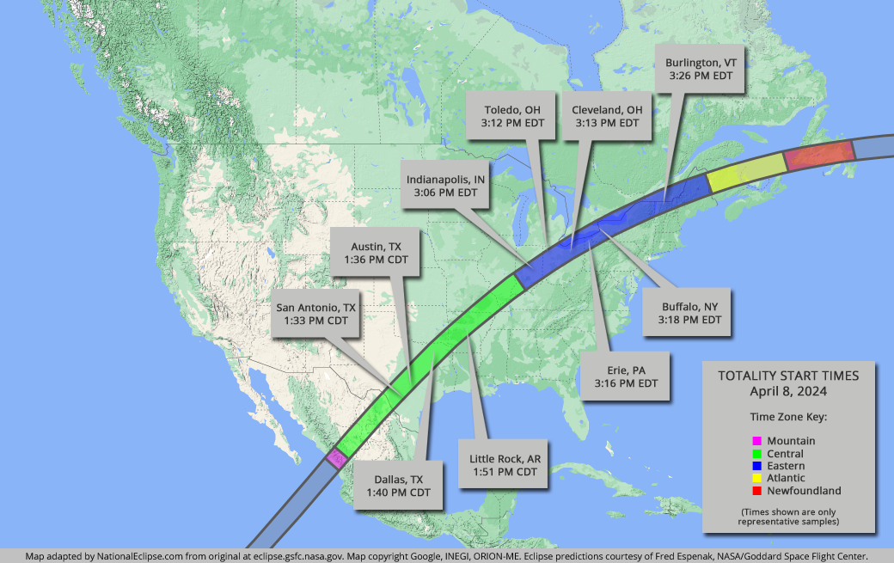
*National Eclipse Map

Slide 12
Solar and Laser Retinopathy
Similar pathophysiology: DDx- good Hx
Central scotoma with mild to moderate reduction in BVA
Small, focal yellowish macular lesion
OCT: Compromise to RPE and outer layers
Inner layer involvement in severe damage
Light energy is absorbed by RPE resulting in heat damage to the tissue
Some recovery of vision may occur over several months

Slide 13
Adenoviral Infections
Common cause of “red eyes”
Assume adenovirus until proven otherwise
Often have pre-auricular node
Non-purulent watery discharge
Usually starts in one eye and spreads to fellow eye in a few days
Always evert lids to survey tarsal conjunctiva
With EKC, spotty sub-epithelial infiltration in 50 to 75% of untreated cases

Slide 14
Literature on Adenoviral Keratoconjunctivitis
Pseudo-membranes are a frequent complication of EKC
In untreated cases, 50% of corneas develop subepithelial infiltrates – a cellular immune reaction against viral antigens
AdenoPlus® is highly sensitive, specific, simple and inexpensive
Bacterial superinfection is rare
“Topical steroids relieve symptoms, and 5% betadine kills the virus in tears, thus reducing the risk of disease spread.”
Restasis does not affect the natural course of the disease.
Jhanji V, et al. Survey Ophthalmol. 2015;60(5):435-43.
Notes:
Jhanji V, Chan TC, Li EY, Agarwal K, Vajpayee RB. Adenoviral keratoconjunctivitis. Survey Ophthalmol. 2015;60(5):435-43.

Slide 15
Povidone - Iodine 5% ophthalmic solution
Broad spectrum microbicide
Indicated for “irrigation of the ocular surface”
“Off label” use: Tx adenoviral keratoconjunctivitis
- Anesthetize with proparacaine
- Instill 1 or 2 drops of NSAID
- Instill several drops Betadine 5% in eye(s), close eye(s)
- Swab or rub excess over eyelid margin
- After 1 minute, irrigate with sterile saline
- Instill 1 or 2 drops of NSAID
- Rx steroid qid x 4 days
No reports in clinical trials of adverse reactions.
Marketed as Betadine 5% ophthalmic prep solution (30 ml opaque bottle) by Alcon surgical
CPT 99070 supply code

Slide 16
Latest on Betadine and Iodine Allergy
Seafood allergy is caused by various protein allergens. Therefore, an allergy to seafood is not a contraindication to the use of betadine.
Allergy to iodinated contrast media is not related to the iodine, but to other intrinsic chemicals.
“The current literature suggests that iodine itself is not an allergen; it is required for thyroid function and other normal biological processes and does not have the complexity necessary for antigenicity.”
“There are currently no reports of anaphylaxis secondary to topical ophthalmic use of povidone–iodine.”
J Cataract Refract Surg. 2020;46(5):795-796.
Notes:
Bellchambers AS, Wearne MJ. Intraocular surgery endophthalmitis prophylaxis with self-reported iodine allergy. J Cataract Refract Surg. 2020;46(5):795-796.

Slide 17
Insights Into Povidone-Iodine (Betadine)
5% Betadine works well on the ocular surface
Betadine is a broad spectrum antimicrobicide
“Brief application of povidone iodine (PI), 5% - 10%, to the ocular surface is commonly used world wide since the 1980s.”
Toxicity is concentration and duration dependent
It is preoperative standard-of-care
Effectively kills bacteria that are resistant to topical antibiotics
“Dilute PI solution is widely available, easy to make, inexpensive, and has been studied extensively.”
Survey Ophthalmol, Nov-Dec, 2018
Notes:
Koerner JC, George MJ, Meyer DR, Rosco MG, Habib MM. Povidone-iodine concentration and dosing in cataract surgery. Survey Ophthalmol. 2018;63(6):862.868.

Slide 18
Intranasal Betadine: Effects on Covid-19
“Povidone-iodine nasal antiseptic solutions at concentrations as low as 0.5% rapidly inactivate SARS-CoV-2 at contact times as short as 15 seconds.”
Virus transmission pathway: “Infection of ciliated cells of the upper airway within the nose as the dominant site of infection, followed by subsequent aspiration and seeding of the lungs.”
Perhaps betadine has another role in addition to its effect on adenoviral ocular infection.
JAMA Otolaryngol Head Neck Surg, October 2020
Notes:
Frank S, Brown SM, Capriotti JA. In Vitro Efficacy of a Povidone-Iodine Nasal Antiseptic for Rapid Inactivation of SARS-CoV-2. JAMA Otolaryngol Head Neck Surg. Published online September 17, 2020. doi:10.1001/jamaoto.2020.3053

Slide 19
Hypochlorous Acid
Pure hypochlorous acid (HOCl) is released from neutrophils
Essential part of body’s immune response
In the body, HOCl:
Kills microorganisms
Neutralizes inflammatory toxins released from pathogens
Helps suppress the body’s inflammatory response
Prevents biofilm formation
Ophthalmic strength HOCl has comparable microbial spectrum to Betadine
Covers some bacterial strains missed by Betadine (Serratia marcescens)
Onset of activity twice as fast as Betadine (1 min vs 2 min)
Remains active with a toxicity level 1000x lower than Betadine
Antimicrobial Activity Comparison of Pure HypoChlorous Acid (0.01) with other Wound and Skin Cleansers at Non-Toxic Concentrations. Hoon, Rani, Najafi, Wang, Debabov; SAWC Spring 2013 and WHD
Klocek, MS, et al. Time-Kill Comparison of Povidone Iodine to Hypochlorous Acid Against Endophthalmitis Isolates of Staphylococci. ARVO Annual Mtg 2016 Abstract Number 5861

Slide 20
Perspective on PosteriorVitreous Detachment
Occurs mostly between ages 50 and 70 (peak incidence 62)
No association with refractive error, except patients with -3.00D or more go to P.V.D. 5-10 years earlier
80-90% of breaks associated with P.V.D. are in the superior quadrants
Ophthalmology, January 2018

Slide 21
Acute PVD and Retinal Tears
The rate of an acute retinal tear associated with an acute symptomatic PVD is about 8% at the initial visit, and 1.5% of eyes without a tear on the initial visit are found to have a tear on follow-up examination.
Ophthalmology, January 2018
Notes:
Yannuzzix NA, Chang JS, Brown GC, Smiddy WE. Cost-Utility of Evaluation for Posterior Vitreous Detachment and Prophylaxis of Retinal Detachment. Ophthalmology 2018;125(1):43-50.

Slide 22
AAO-PPP on PVD Patient Care
“Patients presenting with an acute PVD and no retinal breaks have a small chance (~2%) of developing retinal breaks in the weeks that follow. Selected patients, particularly those with any degree of vitreous pigment, vitreous or retinal hemorrhage, or visible vitreoretinal traction, should be asked to return for a second examination promptly if they have new symptoms or within 6 weeks following the onset of PVD symptoms.”
Preferred Practice Guidelines, AAO, Oct, 2019
Notes:
AAO PPP Retina/Vitreous Committee, Hoskins Center for Quality Eye Care. Posterior Vitreous Detachment, Retinal Breaks, and Lattice Degeneration PPP 2019

Slide 23
Follow-up After Initial PVD Event
About 2% of patients with normal findings will develop a subsequent retinal tear.
In this study, 45% of these retinal breaks “were found more than 6 weeks after presentation.”
At the Wills Eye Hospital Retina Service; “60% of patients in our study had at least a 4-6 week follow-up. Most physicians in our practice do not routinely follow up patients beyond this timeframe.”
Only about half of these subsequent events were symptomatic, therefore there may be a need to re-evaluate acute PVD patients more frequently than is currently common practice.
Ophthalmology, April 2020
Notes:
Uhr JH, Obeid A, Wibbelsman TD, et al. Delayed Retinal Breaks and Detachments after Acute Posterior Vitreous Detachment. Ophthalmology 2020;127(4):516-522. https://doi.org/10.1016/j.ophtha.2019.10.020

Slide 24
What About Scleral Depression
“An examination using a 28 diopter lens with scleral depression did not provide any additional benefit to an examination without depression during indirect ophthalmoscopy.”
“In many areas around the world ophthalmologists have progressively shifted from indirect ophthalmoscopy with 28 diopter-type lenses to new fundus lenses at the slit lamp to improve the comfort of the patient without scleral depression.”
Am J Ophthalmol. November 2018
Notes:
Tran KD, Schwartz SG, Smiddy WE, Flynn HW, Jr. The Role of Scleral Depression in Modern Clinical Practice. Am J Ophthalmol. 2018;195:xviii-xix.

Slide 25
Treatment of Vitreous Floaters
Treatment options:
Live with them
Vitrectomy
Vitreolysis
YAG laser – angle of focus can be changed to reach floaters; special vitreous lenses allow the laser beam to focus on floater
Advantages: simple, noninvasive, no pain or discomfort
Disadvantages: healthy eyes getting elective surgery, risk of retinal detachment, possibly worsening of symptoms
Clear visualization of floaters key to successful treatment
Treatment may require more than one laser session; symptomatic vitreous opacifications (SVO); only SVO’s > 4mm from retina treated
Patient decision on benefits vs risks CRST, May 2016 (Stonecipher)

Slide 26
Vitreolysis for Symptomatic Floaters
Two options: YAG laser or vitrectomy
Newer “Reflex Technology” enhances YAG success
Floater material is both fractionated and vaporized
Multiple sessions may be required
Weiss ring easier to treat than amorphous clouds
About half of patients obtain symptomatic relief
Complications are few, but can be serious
Survey Ophthalmol, March 2020
Notes:
Singh IP. Modern vitreolysis—YAG laser treatment now a real solution for the treatment of symptomatic floaters. Survey Ophthalmol 2020;65(5):581-588.

Slide 27
Insights into Myodesopsia
“In bothersome cases there is profound degeneration in contrast sensitivity function qualifying the condition as a disease that can be referred to as vision-degrading myodesopsia, so as to distinguish such cases from vitreous floaters that are not clinically significant.”
Limited vitrectomy has demonstrated a high safety profile with exceptional efficacy and cost-efficiency.
About 15% of patients developed cataracts in about 1 year.
Am J Ophthalmol., August, 2019
Notes:
Rostami B, Nguyen-Cuu J, Brown G, et al. Cost-Effectiveness of Limited Vitrectomy for Vision-Degrading Myodesopsia. Am J Ophthalmol 2019;204:1-6.

Slide 28
Timing and RD Repair: Is there a hurry?
Preoperative VA is the strongest predictor of postoperative VA
When central vision is affected, about 30% of patients ultimately achieve 20/40 or better
“There is no difference in VA outcomes among patients who underwent repair within the first week of onset.”
VA can improve for months to years after surgical repair
There was no association between duration of macular detachment and postoperative VA
“Clinical evidence suggests that the duration of macular detachment has a minor, if any, effect on visual outcome when repair is performed within about one week. Similarly, many fovea-sparing RD’s can likely be deferred for a short period without affecting visual outcomes.”
JAMA Oph. November 2013

Slide 29
Malpractice Risks Regarding Retinal Detachments
Uptick in legal claims for diagnostic errors
Especially retinal detachments
“And by far the most frequently missed diagnosis in our entire study was RD– nothing else came close.”
85% or these missed RD’s presented with risk factors specific to RD
“The primary pathogenic mechanism– and the biggest risk factor– for RD is PVD.”
Comprehensive ophthalmologists (and optometrists) should have a low threshold for referral to a retinal subspecialist.”
Reference: EyeNet, April, 2018

Slide 30
Limitations of Ultra-Widefield Fundus Photography**
These devices can capture more than 80% and up to 200º of the retinal surface area.
However, “visualization of the inferior and superior sectors is often limited.”
In fact: Nearly half of horseshoe tears were missed by UWF imaging; the majority in the superior quadrant.
“UWF imaging should not be relied upon as a substitute for funduscopic examination in the evaluation of PVD or symptoms indicative of a retinal tear. This cautionary note is essential, as a negative UWF image can provide false reassurance, potentially leading to delayed diagnosis and management of a critical retinal condition.
Am J Ophthalmol. Nov, 2023
Notes:
Lin AC, Kalaw FGP, Schönbach EM, et al. The Sensitivity of Ultra-Widefield Fundus Photography Versus Scleral Depressed Examination for Detection of Retinal Horseshoe Tears. Am J Ophthalmol, 2023;255:155-160.

Slide 31
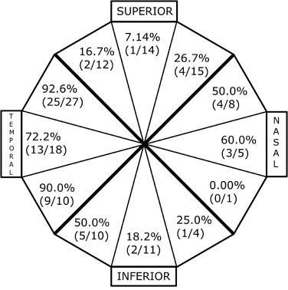
FIGURE 3. Sensitivity of ultra-widefield (UWF) imaging for detection of horseshoe tears (HSTs). Sensitivities of HSTs detected on foveal-centered UWF imaging per clock-hour and grouped into superior, nasal, inferior and temporal quadrants with respect to the orientation of the right eye.**
Am J Ophthalmol. July 17, 2023
Notes:
Lin AC, Kalaw FGP, Schönbach EM, et al. The Sensitivity of Ultra-Widefield Fundus Photography Versus Scleral Depressed Examination for Detection of Retinal Horseshoe Tears. Am J Ophthalmol, 2023;255:155-160.

Slide 32
Bacterial Conjunctivitis
Unilateral or bilateral red eye(s) with purulent or mucopurulent discharge of varying degree
In subtle cases, carefully examine the lacrimal lake under high magnification and look for microparticulate debris which can be evidence of bacterial infection.
Preauricular lymphadenopathy is uncommon, but can be present in hyperacute cases
Chemosis may be present in more severe cases
SPK can be present, especially if staphylococcal etiology. This is usually the result of staph exotoxin chemotoxicity, and tends to be seen mostly inferionasally because of tear film dynamics
Common etiology: Adults: Staph aureus, Staph epidermidis, Strep pneumoniae
Children: Strep pneumoniae, Haemophilus
Therapy: Adults: Tobramycin, Polytrim, or Fluoroquinolone
Children: Polytrim or Polysporin ung
Treat for five to seven days as a rule

Slide 33
Superior Limbic Keratoconjunctivitis
Both sexes affected, women more
Main symptoms: distressingly irritated eyes
Dry eyes common companion finding
Symptoms disproportionate to clinical findings
Spontaneous exacerbations and remissions
25-40% have some thyroid dysfunction
Tx: difficult- .5% AgNO3, optimum lubrication, pressure patching, therapeutic soft lenses, surgical resection, cryotherapy

Slide 34
*SLK: A Comprehensive Review
No familial or ethnic relationships; F>M
Pathology: mechanical/friction with DED leading to keratinization of conjunctival tissues.
Prognosis: Good Duration: 1-10 years
“A high rate of associated autoimmune thyroid disease” is not well understood. All patients should be evaluated for thyroid disease.
Tx: Punctal plugs, lipid ATs, large diameter SCLs, 0.5% silver nitrate and others.
Surgical conjunctival resection “may be considered when patients are not responsive to medical therapy.”
Survey Ophthalmol. Mar/Apr, 2022
Notes:
Lahoti S, Weiss M, Johnson DA, Kheirkhah A. Superior limbic keratoconjunctivitis: a comprehensive review. Surv Ophthalmol. 2022 Mar-Apr;67(2):331-341.

Slide 35
Antibacterial Medications
Sulfa Preparations
Erythromycin
Bacitracin
Bacitracin / Polymyxin B
Bacitracin / Polymyxin B / Neomycin
Chloramphenicol
Gentamicin
Tobramycin
Trimethoprim / Polymyxin B
Fluoroquinolones
Azithromycin
Oral antibiotics

Slide 36
Antibiotic Resistance Monitoring in Ocular micRorganisms (ARMOR) Study
Prospective, multicenter, longitudinal survey of antibiotic susceptibility trends
Participating sites in the US include community hospitals, university hospitals, and ocular centers
ARMOR isolates:
Staphylococcus aureus
Coagulase-negative staphylococci (CoNS)
Streptococcus pneumoniae
Haemophilus influenzae
Pseudomonas aeruginosa
Thomas, Melton, Vollmer (Optom Vis Sci: Vol 00 (00)

Slide 37
MIC₉₀ Comparisons for ARMOR Surveillance Study Isolates

Slide 38
Differential Diagnosis of Corneal Ulcers vs. Infiltrates
Ulcer (Infection) | Infiltrate (Inflammation)
Rare | Common
Usually painful | Mild pain
Tend to be central | Tend to be peripheral
1 to 1 staining defect to lesion ratio | Staining defect size relatively small
Cells in anterior chamber | Rare cells in anterior chamber
Generalized conjunctival injection | Sector skewed injection pattern
Usually solitary lesion | Can be multiple lesions
Possible tear lake debris | Clear tear lake
Notes:
38

Slide 39
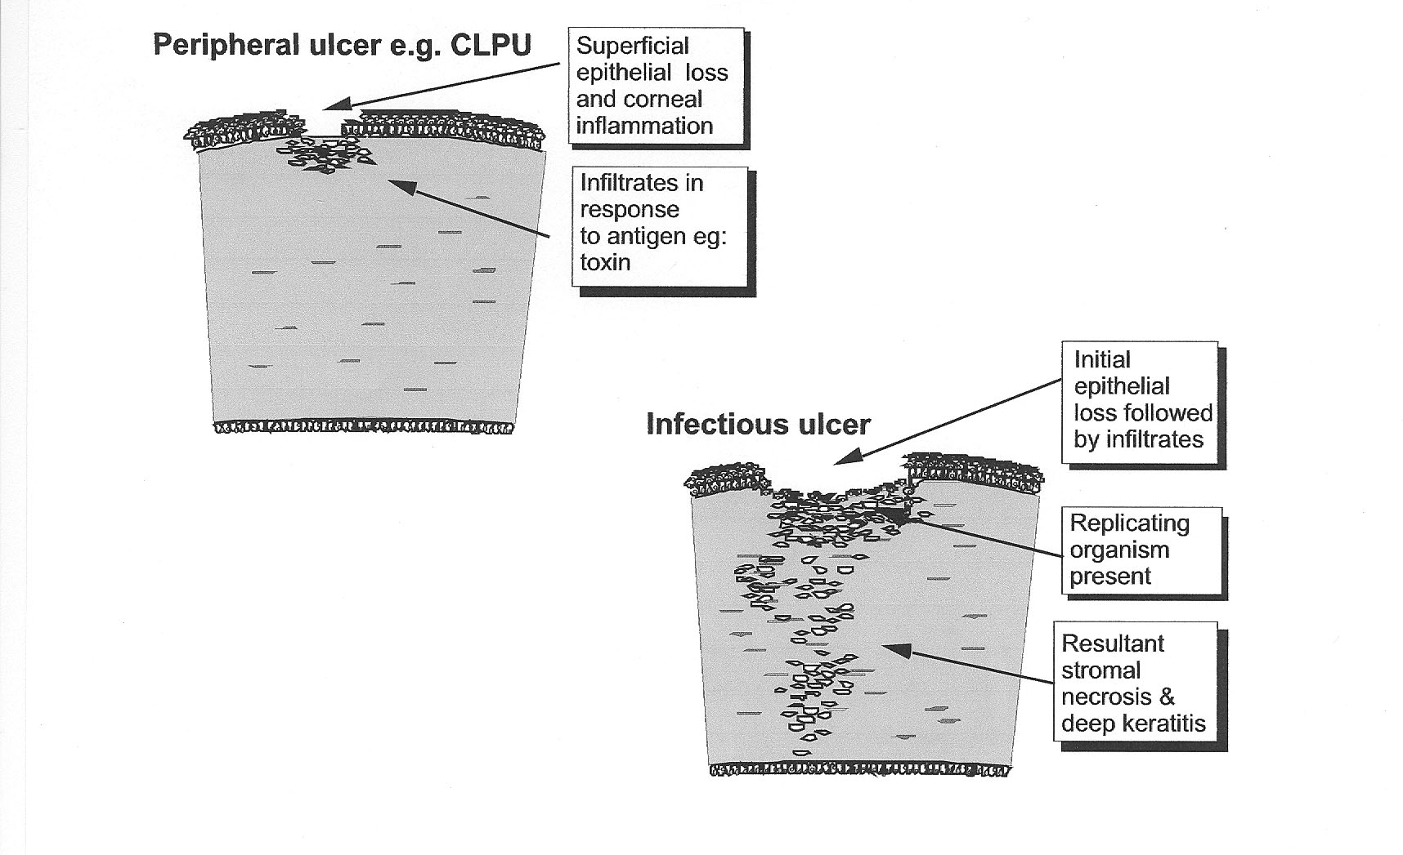

Slide 40
*New Combination for Corneal Ulcers
Dual therapy for bacterial corneal ulcers has been the standard for decades.
Tobramycin for gram negative coverage
Vancomycin for gram positive coverage
New combination is pre-fortified!
Tobramycin is 1.5% (standard is 0.3%)
Vancomycin is 5% (there is no standard)
Marketed as Fortisite™ ophthalmic solution by ImprimisRx (owned by Harrow Health)
Must be ordered directly (503A) via Imprimisrx.com or 844-446-6979

Slide 41
*An Updated Perspective on Treating Pseudomonal Infection
“Multiple studies have shown high minimal inhibitory concentrations for moxifloxacin in P. aeruginosa as well as a sharp increase in the percentage of P. aeruginosa isolates that are resistant to moxifloxacin.”
It seems likely that Fortisite is superior to moxifloxacin but no comparative studies have been done.
JAMA Ophthalmol, June, 2023

Slide 42
“Culturing” is Being Eclipsed
PCR is eclipsing traditional culturing
Test results by next morning
Targets most relevant micro-organisms
There is only one universal collection device
Provides a personalized antibiotic summary of effectiveness
See www.healthtrackrx.com for details

Slide 43
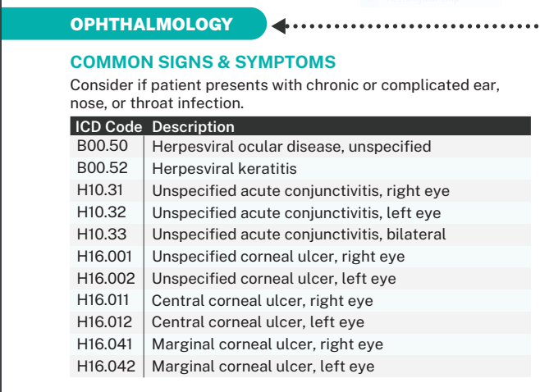
Notes:
https://www.healthtrackrx.com/wp-content/uploads/2023/10/MenuPers-v1118-v7-092723.pdf

Slide 44
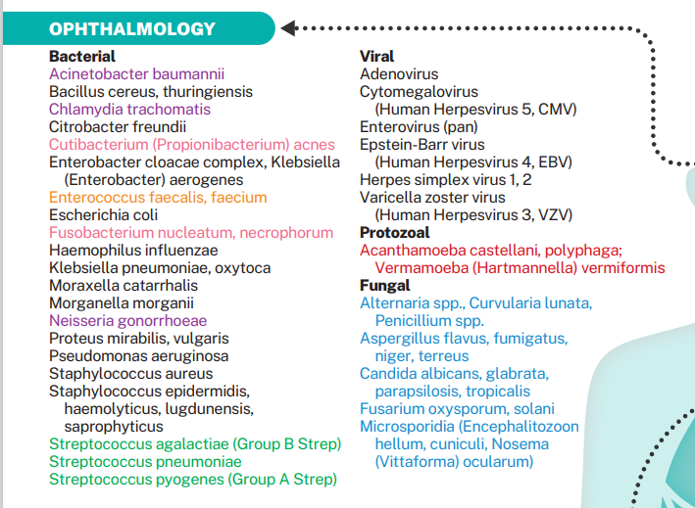

Slide 45
Antibiotics - Systemic
Penicillins
Cephalosporins
Tetracyclines
Macrolides
Fluoroquinolones

Slide 46
Keflex® (Cephalexin)
Children > 2 months
For skin and soft tissue infections, may be given every 12 hours
Weight (LBs) | Dose (250 mg/5ml)
11 | ¼ tsp
22 | ½ tsp
33 | ¾ tsp
44 | 1 tsp (250 mg cap)
66 | 1 ½ tsp
88+ | 2 tsp (500 mg cap)

Slide 47
Statement by the American College of Physicians: Key Recommendations
*
For non-purulent cellulitis (skin infections)
“Recommended antimicrobials: Cephalosporin (e.g. Cephalexin)”
“Recommended duration: 5 days”
Journal Watch-General Medicine May, 2021

Slide 48
Overview of Penicillin “Allergy”
“Severe anaphylactic reactions to oral amoxicillin are rare.”
“IgE – mediated penicillin allergy (the real deal) wanes over time, with 80% of patients becoming tolerant after a decade. Cross-reactivity between penicillin and cephalosporin drugs occurs in about 2% of cases.”
“Many patients report they are allergic to penicillin but few have clinically significant reactions.”
JAMA, January 2019
Notes:
Shenoy ES, Macy E, Rowe T, et al. Evaluation and Management of Penicillin Allergy. A Review. JAMA 2019;321(2):188-199.

Slide 49
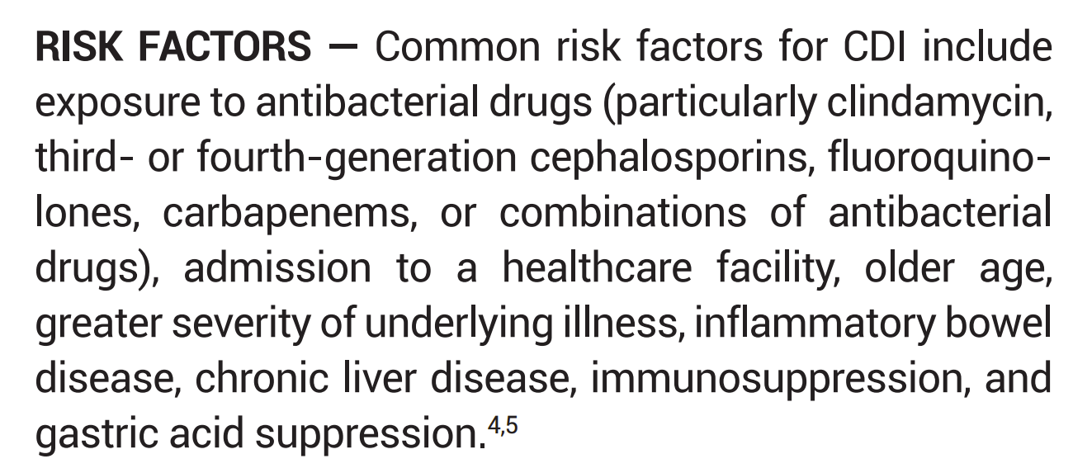
Clostridioides (formerly Clostridium) difficile infection (CDI)

