Slide 1
Seeing Stars: A review of the white dot syndromes
Andrew Zheng, MD
14 March 2026
Winter Ophthalmic Summit

Slide 2
Objectives
At the end of this talk, audience members should be able to…
Appreciate phenotypic differences among the white dot syndromes
Possess a cursory understanding of treatment approaches for the white dot syndromes
Understand the importance of distinguishing white dot syndromes from infectious masquerades

Slide 3
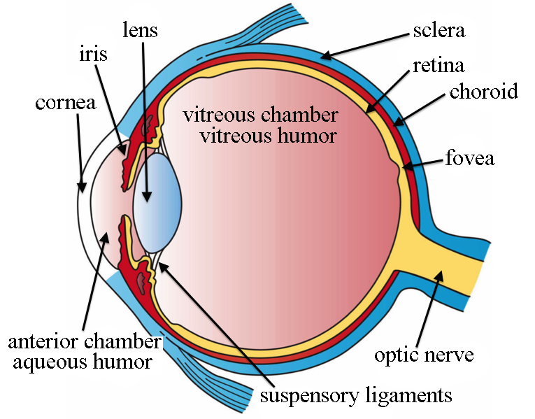
Introduction
White dot syndromes = a heterogenous collection of posterior uveitides characterized by white spots and dots in the retina/choroid
Posterior uveitis involves inflammation in the retina and/or choroid and is generally much more vision-threatening than anterior or intermediate uveitis
Approximately 30 000 cases of posterior uveitis per year in the US
Ciliary body
Notes:
WDS are a subset of posterior uveitis more broadly;
when primary site of inflammation is retina, it is a chorioretinitis, when primary site is choroid, it is a retinochoroiditis
Posterior uveitis is much more sight threatening due to the structures involved.
Not all posterior uveitis is WDS, WDS are generally fairly rare

Slide 4
OVERVIEW OF IMAGING MODALITIES

Slide 5
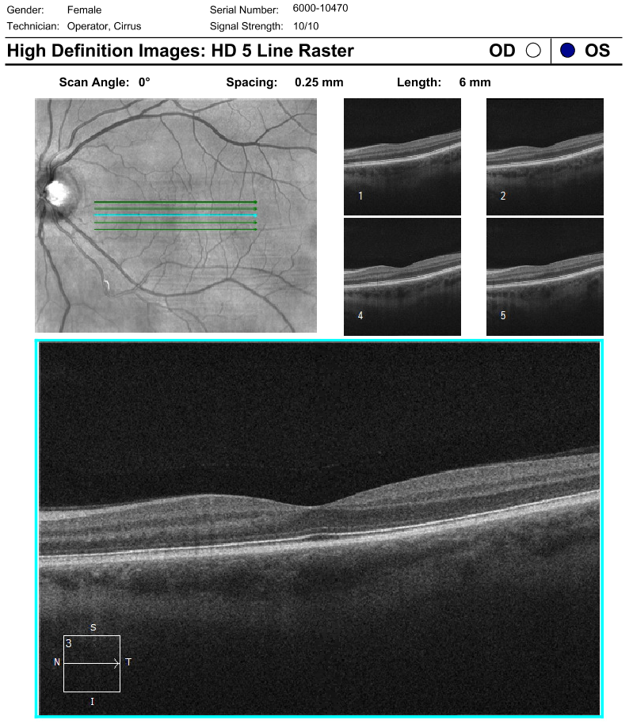
Optical coherence tomography (OCT)
Cross-sectional, anatomic/structural view of retina and choroid
Uses near-IR light to measure reflectance from tissue layers
Provides high-resolution intraretinal detail and some choroidal detail
Limited utility for vascular imaging
Limited field of view (central macula or occasionally mid-periphery)
Notes:
Point out: OPL has different thickness due to artifact from incident angle of the near-IR beam

Slide 6
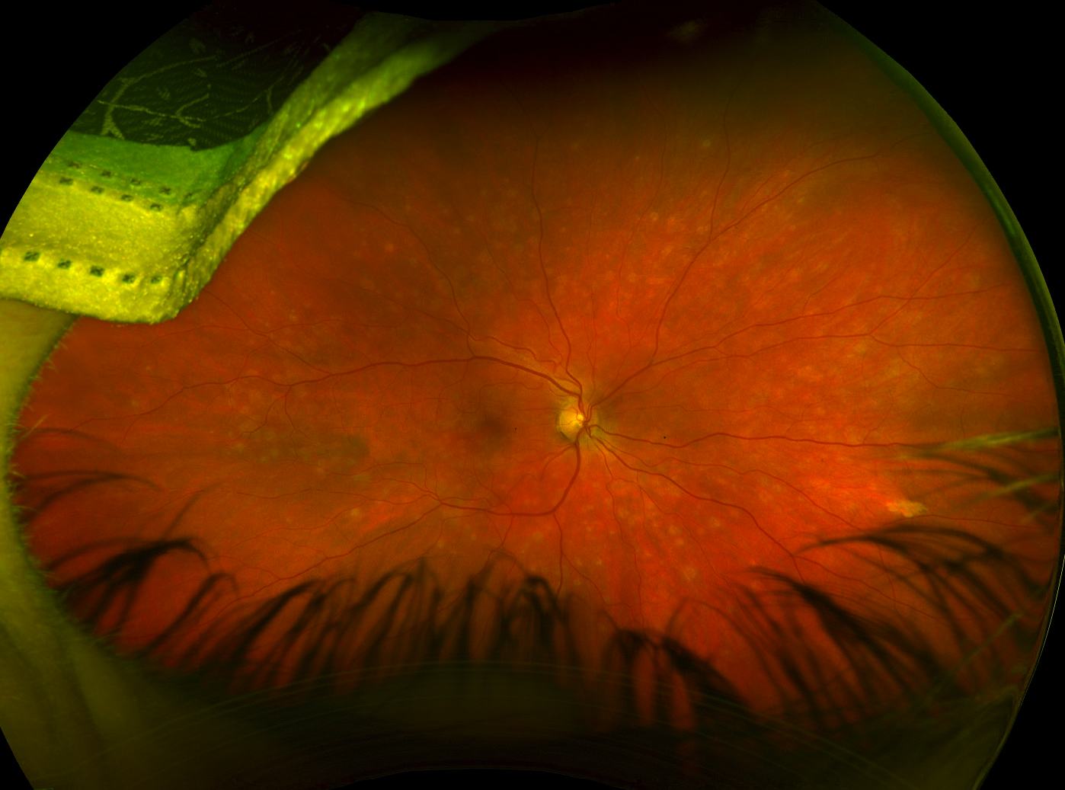
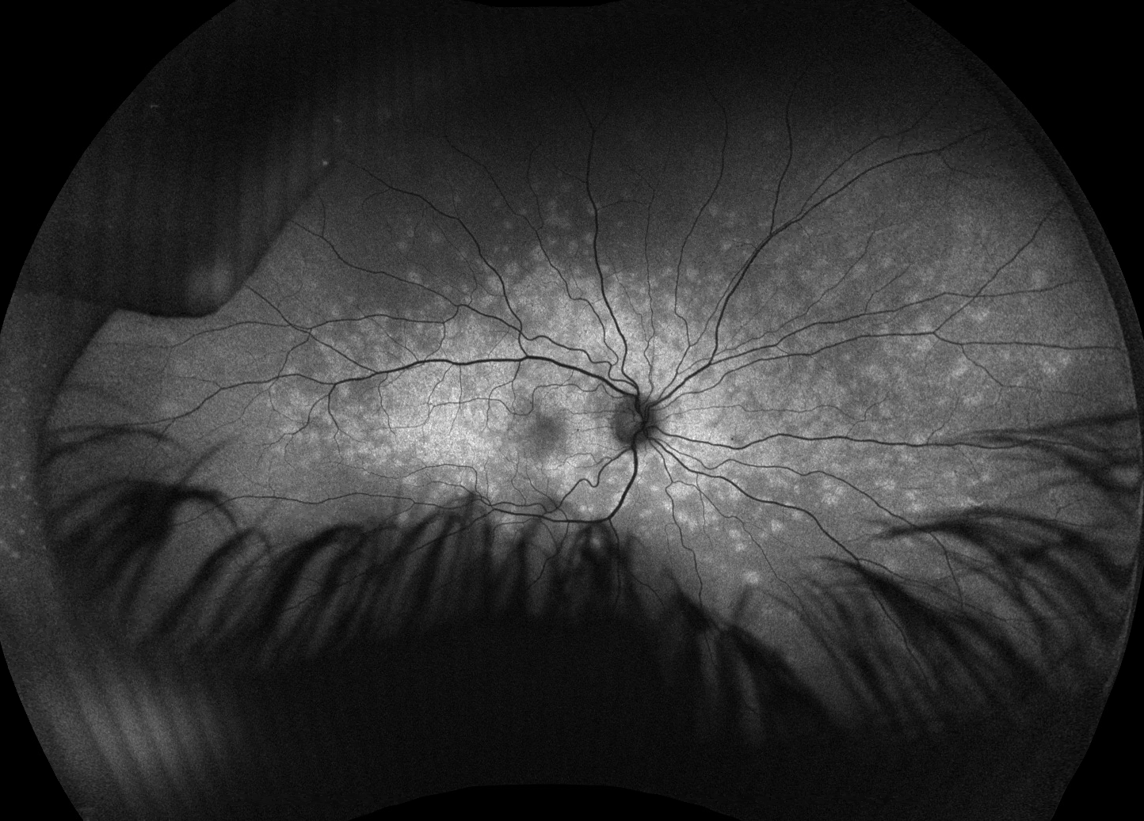
Fundus photography and autofluorescence (FAF)
Wide-angle two-dimensional views of posterior segment structures
Optos photos are not true-color (lack a blue channel so image is biased towards red/green)
Autofluorescence detects RPE, metabolic activity, lipofuscin
Autofluorescence can highlight lesions that are not readily apparent on photos

Slide 7
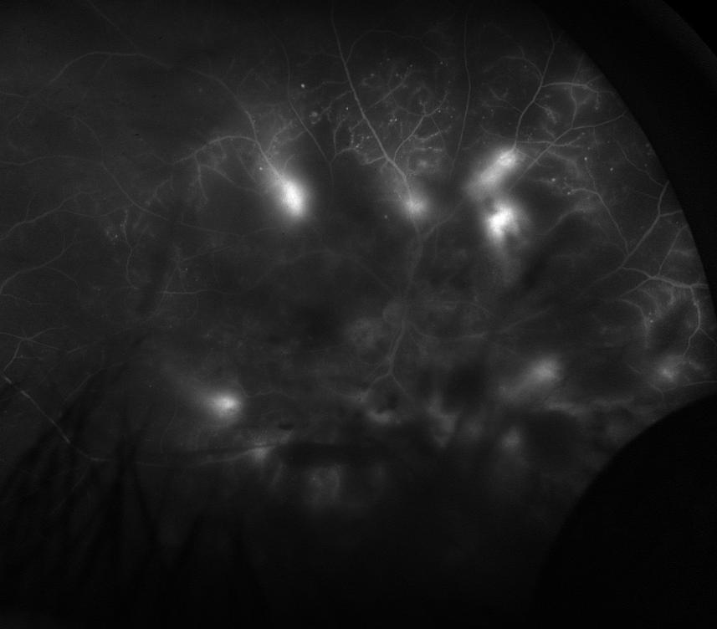
Fluorescein angiography (FA)
Great for imaging retina and vasculature, provides less information on choroid
Light-sensitive, light-emitting dye that illuminates the path of blood flow through the retinal vessels
Dark hypofluorescent findings
Blockage from vitreous hemorrhage
Areas of ischemia and capillary non-perfusion
Bright hyperfluorescent findings
Staining of scars and lesions
Leakage in areas of vasculitis, retinal edema, inflammation

Slide 8
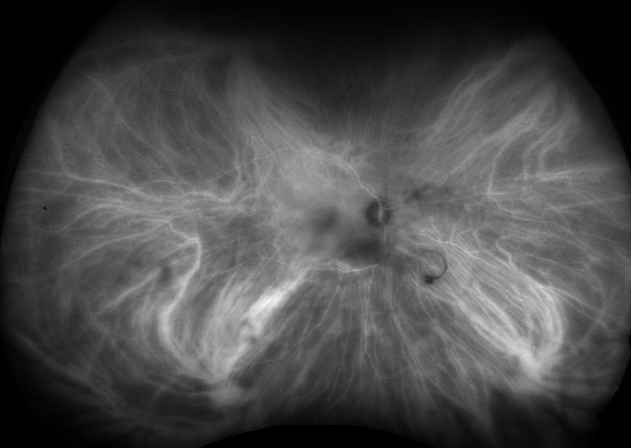
Indocyanine green angiography (ICGA)
Great for choroidal vascular imaging
ICG binds to proteins and is less “leaky” than fluorescein so better for imaging choroidal vessels
Excitation/emission wavelengths are different from FA and result in less interference from the overlying RPE
Can show lesions in the choroid as areas of hypocyanescence
Few side effects than fluorescein

Slide 9
THE WHITE DOT SYNDROMES

Slide 10
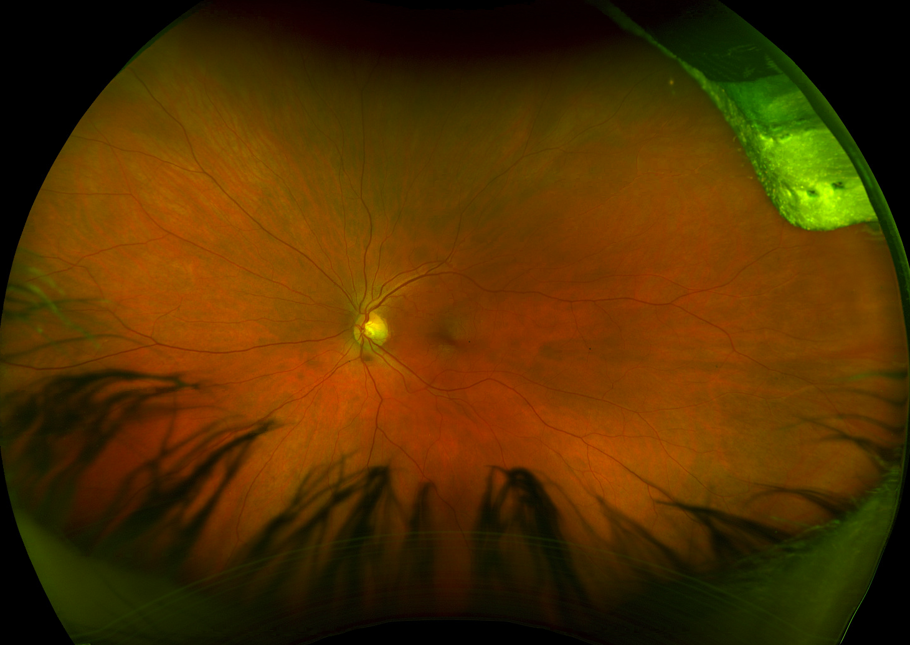
Case 1
41F w/ new onset “speckles of light” in right eye only
20/60
IOP 15
No cell
20/20
IOP 15
No cell

Slide 11
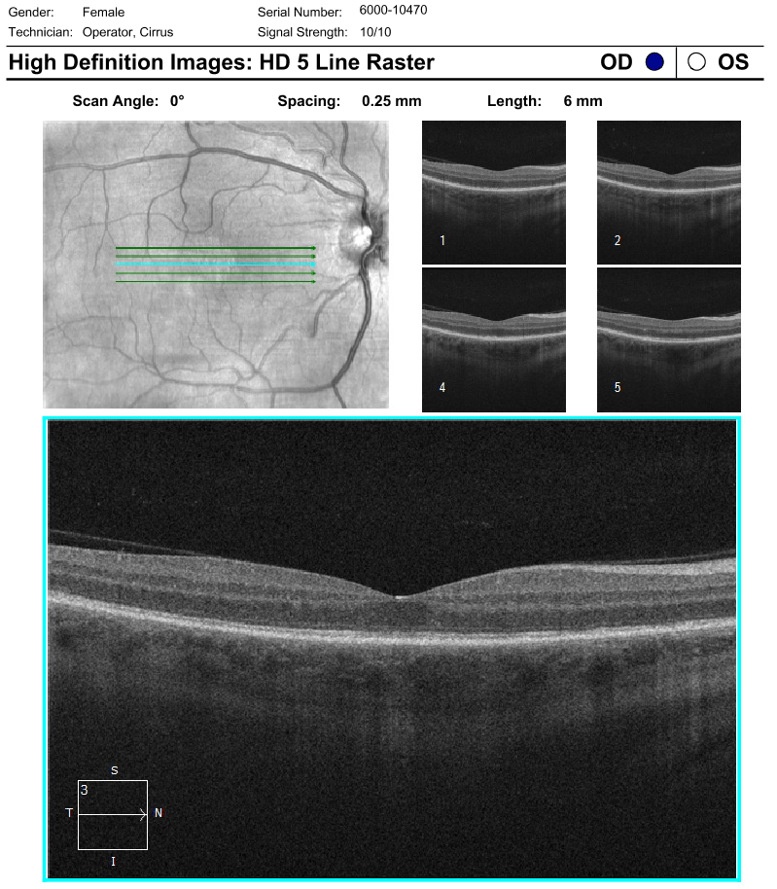
Case 1 OCT

Slide 12
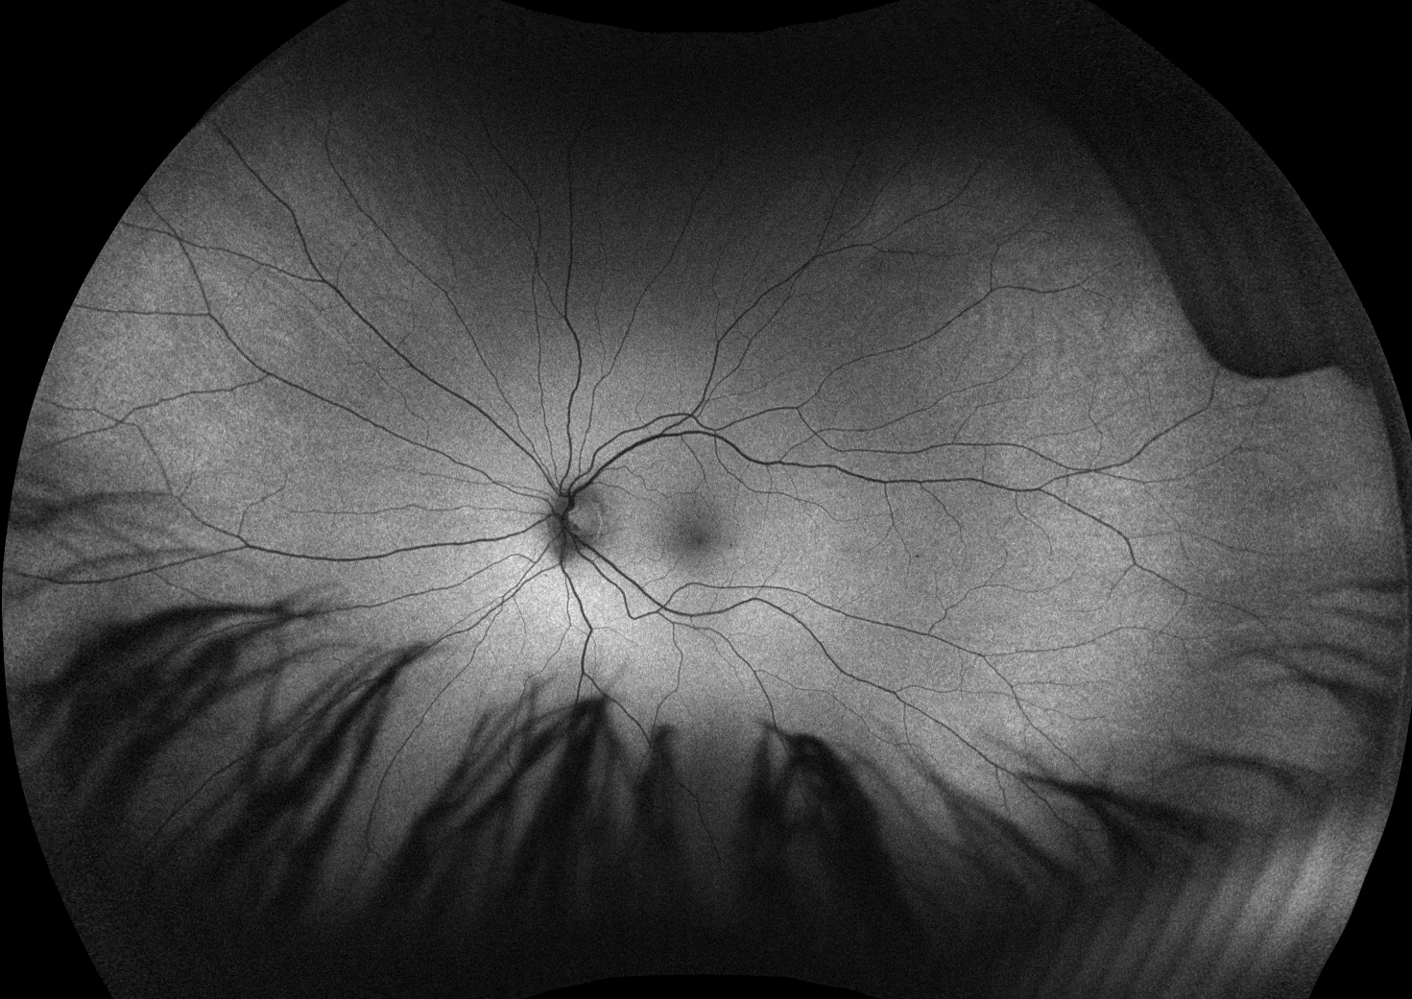
Case 1 FAF

Slide 13
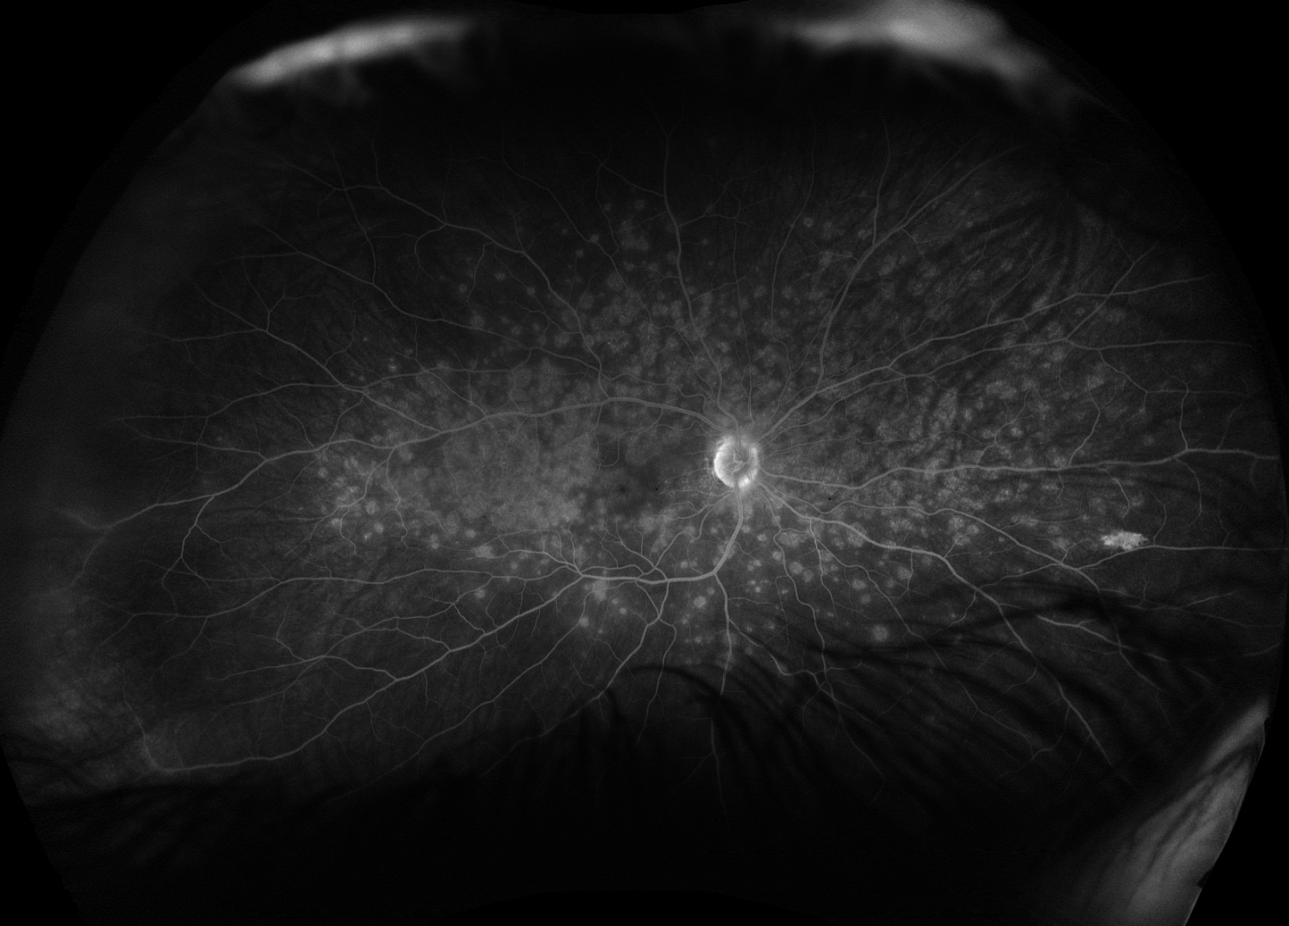
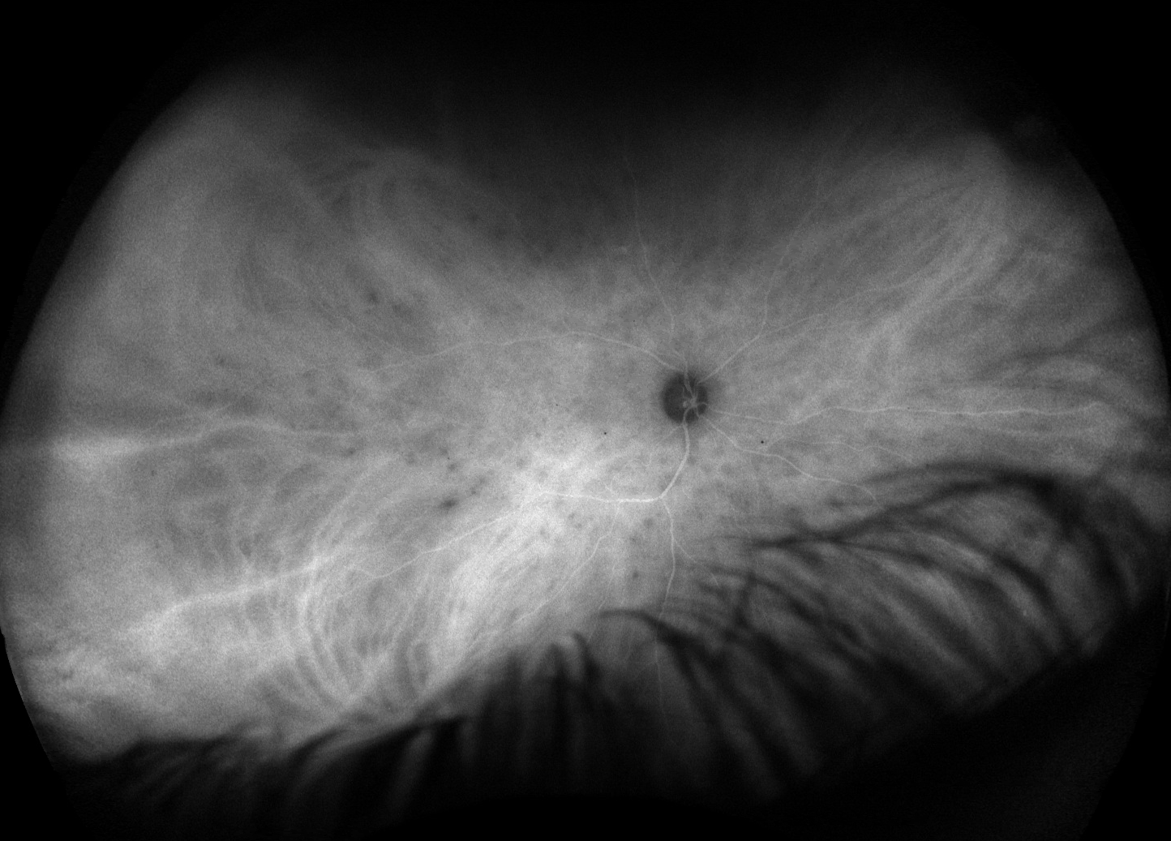
Case 1 FA and ICGA

Slide 14
Multiple evanescent white dot syndrome (MEWDS)
Acute onset, multiple small gray-white dots in deep retina and RPE
80% of cases are unilateral and there is a F > M predominance
Foveal granularity on exam and loss of EZ integrity are characteristic
Most cases are self-limited and vision recovers well
Steroids can hasten recovery
From the neurology literature: AKA idiopathic enlargement of blind spot syndrome

Slide 15
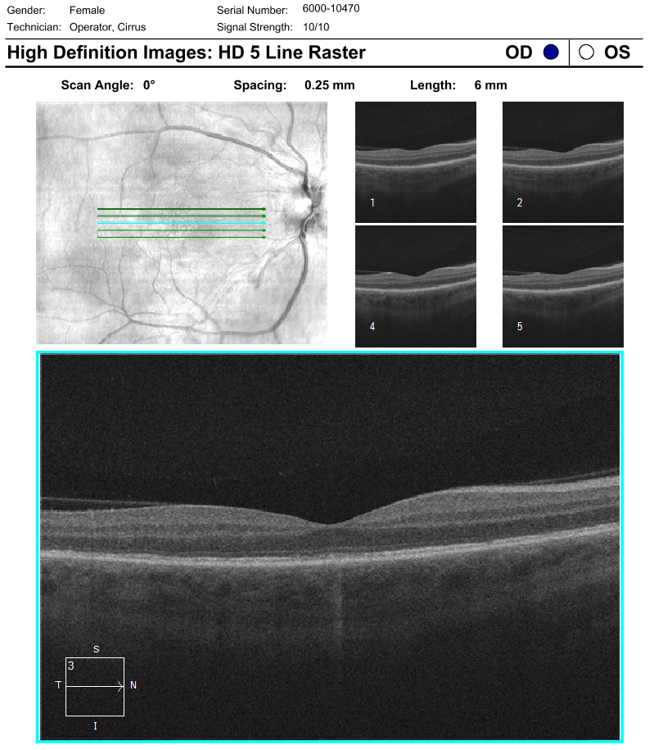
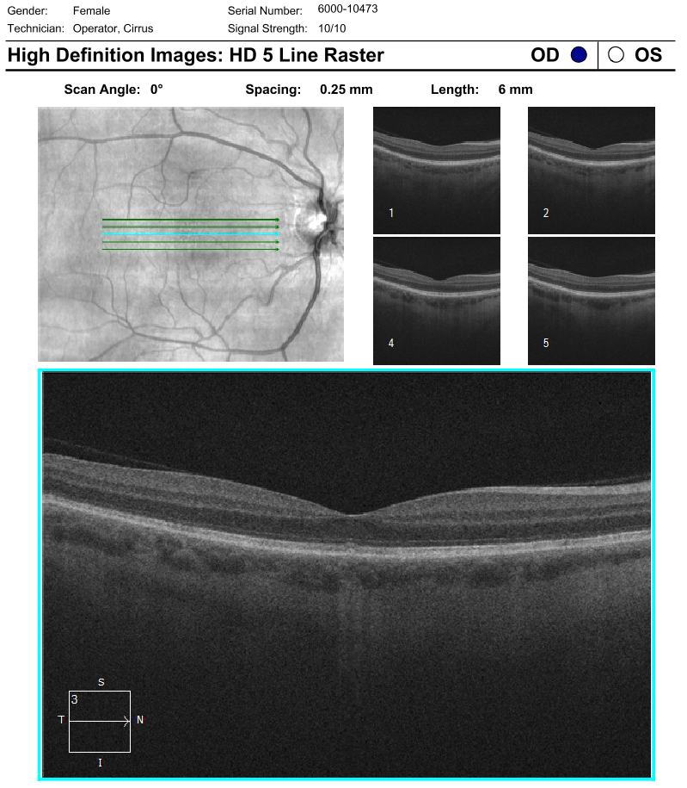
Case 1 Follow-up
Presentation
VA 20/60
2 weeks
VA 20/40
6 weeks
VA 20/20

Slide 16
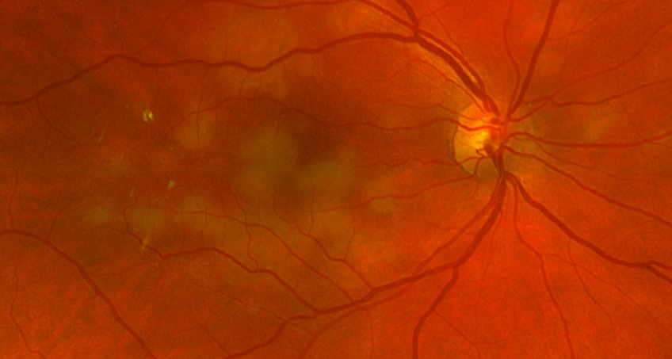
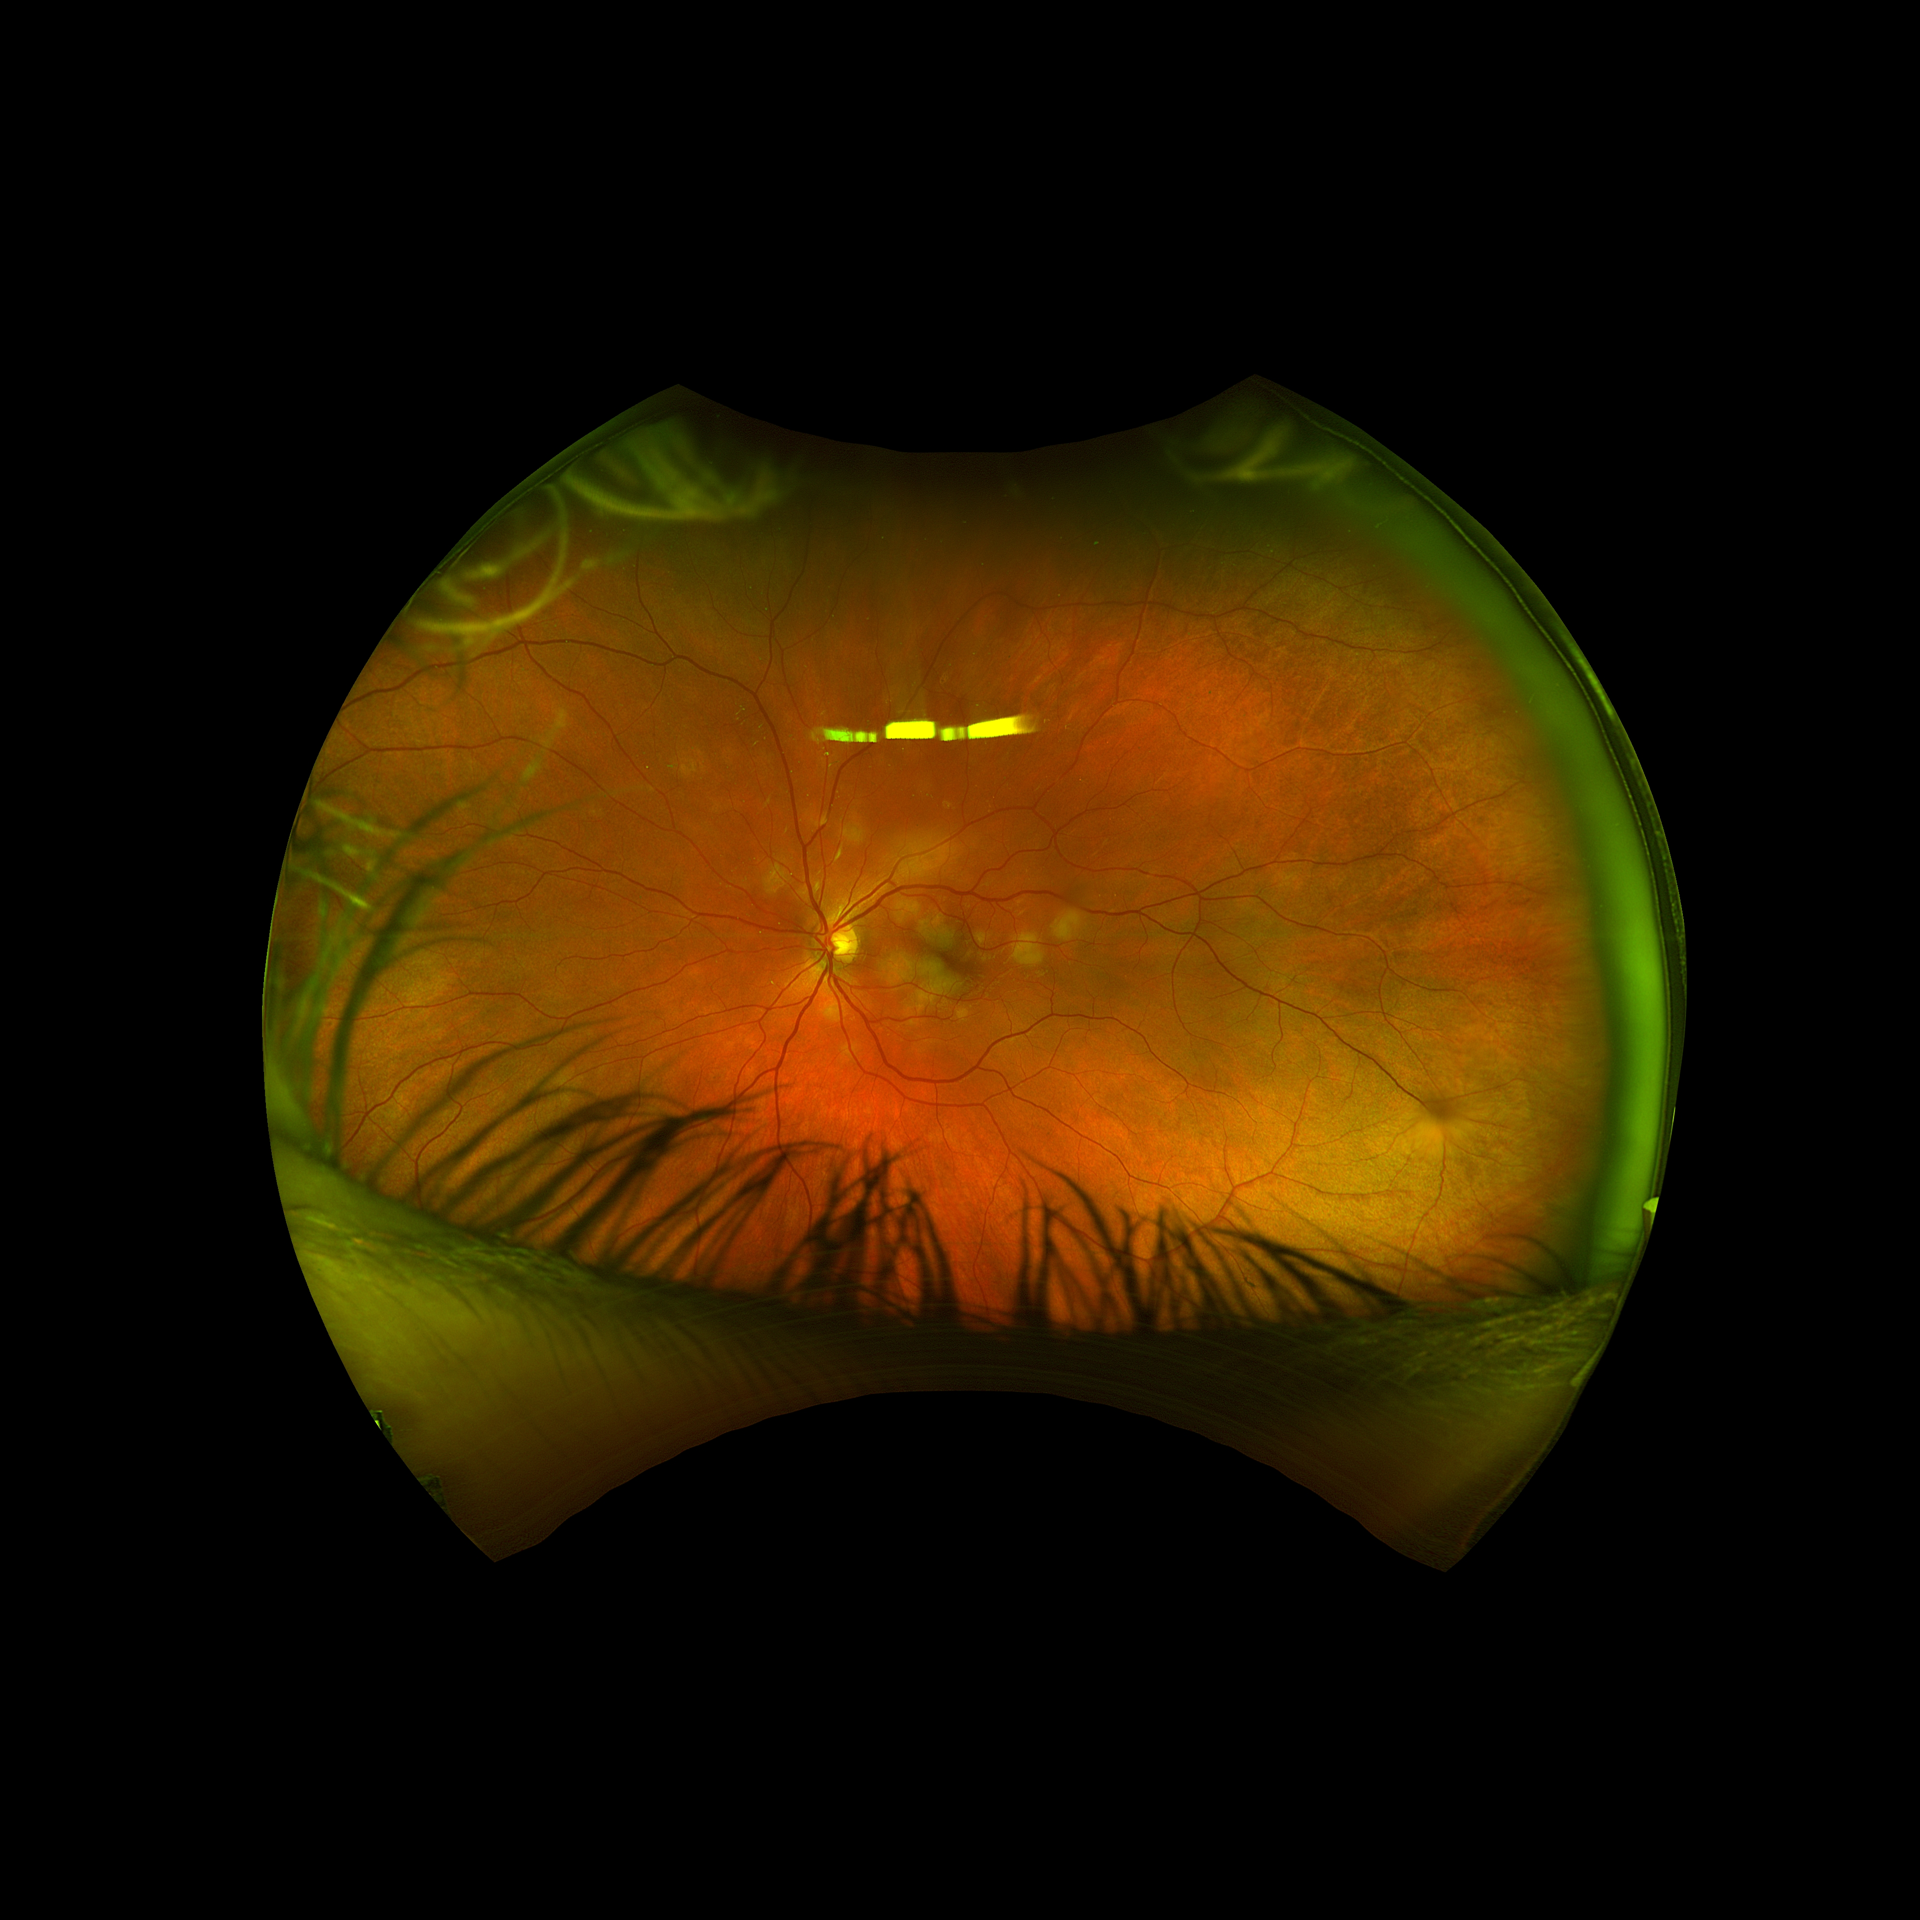
Case 2
24M w/ headaches and new vision changes OU
20/30
IOP 9
20/25
IOP 9

Slide 17
Case 2 OCT

Slide 18
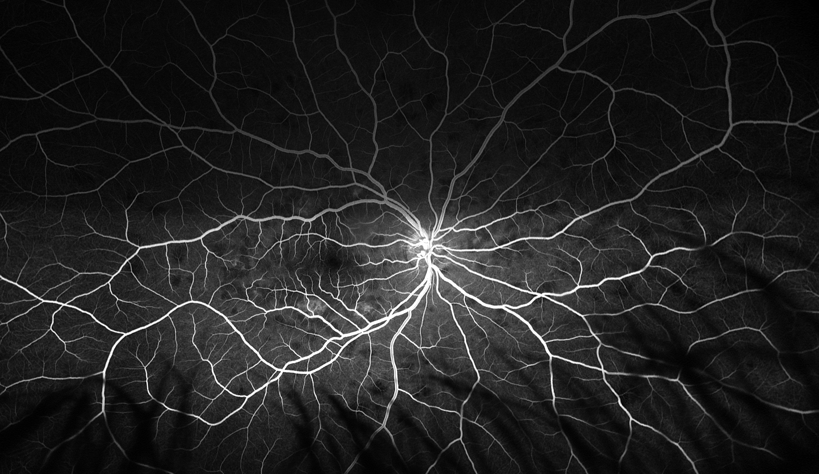
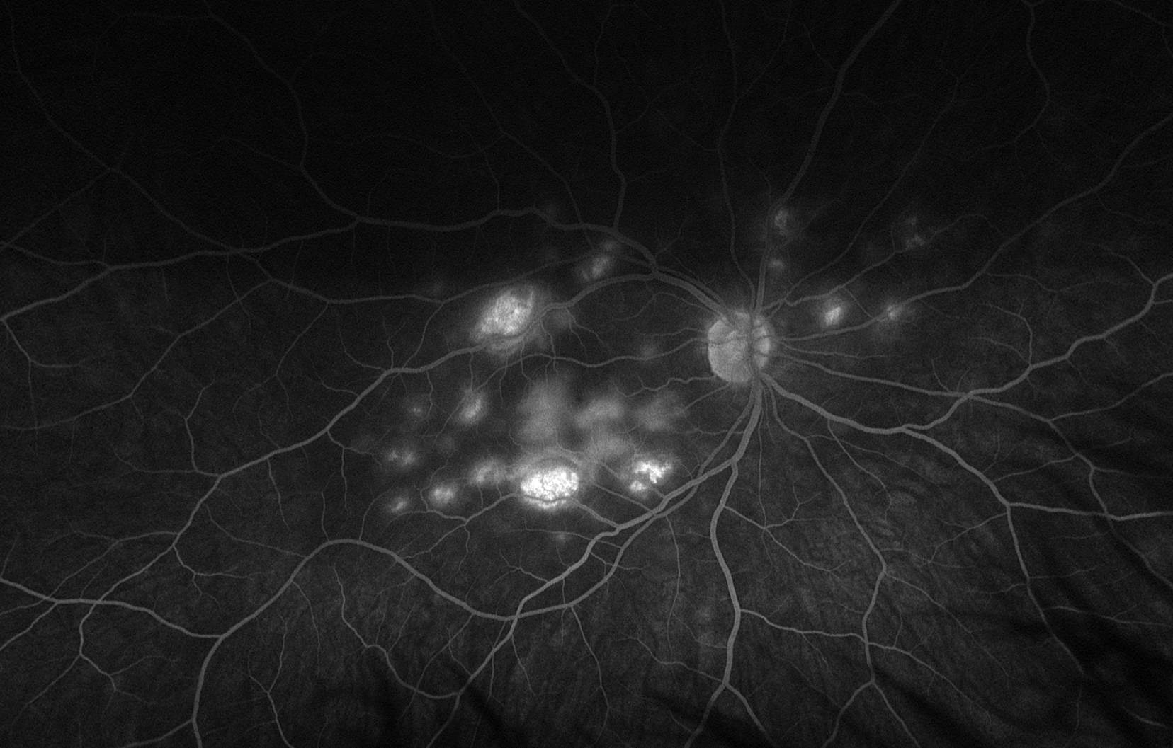
Case 2 FA
Late phase
Early phase

Slide 19
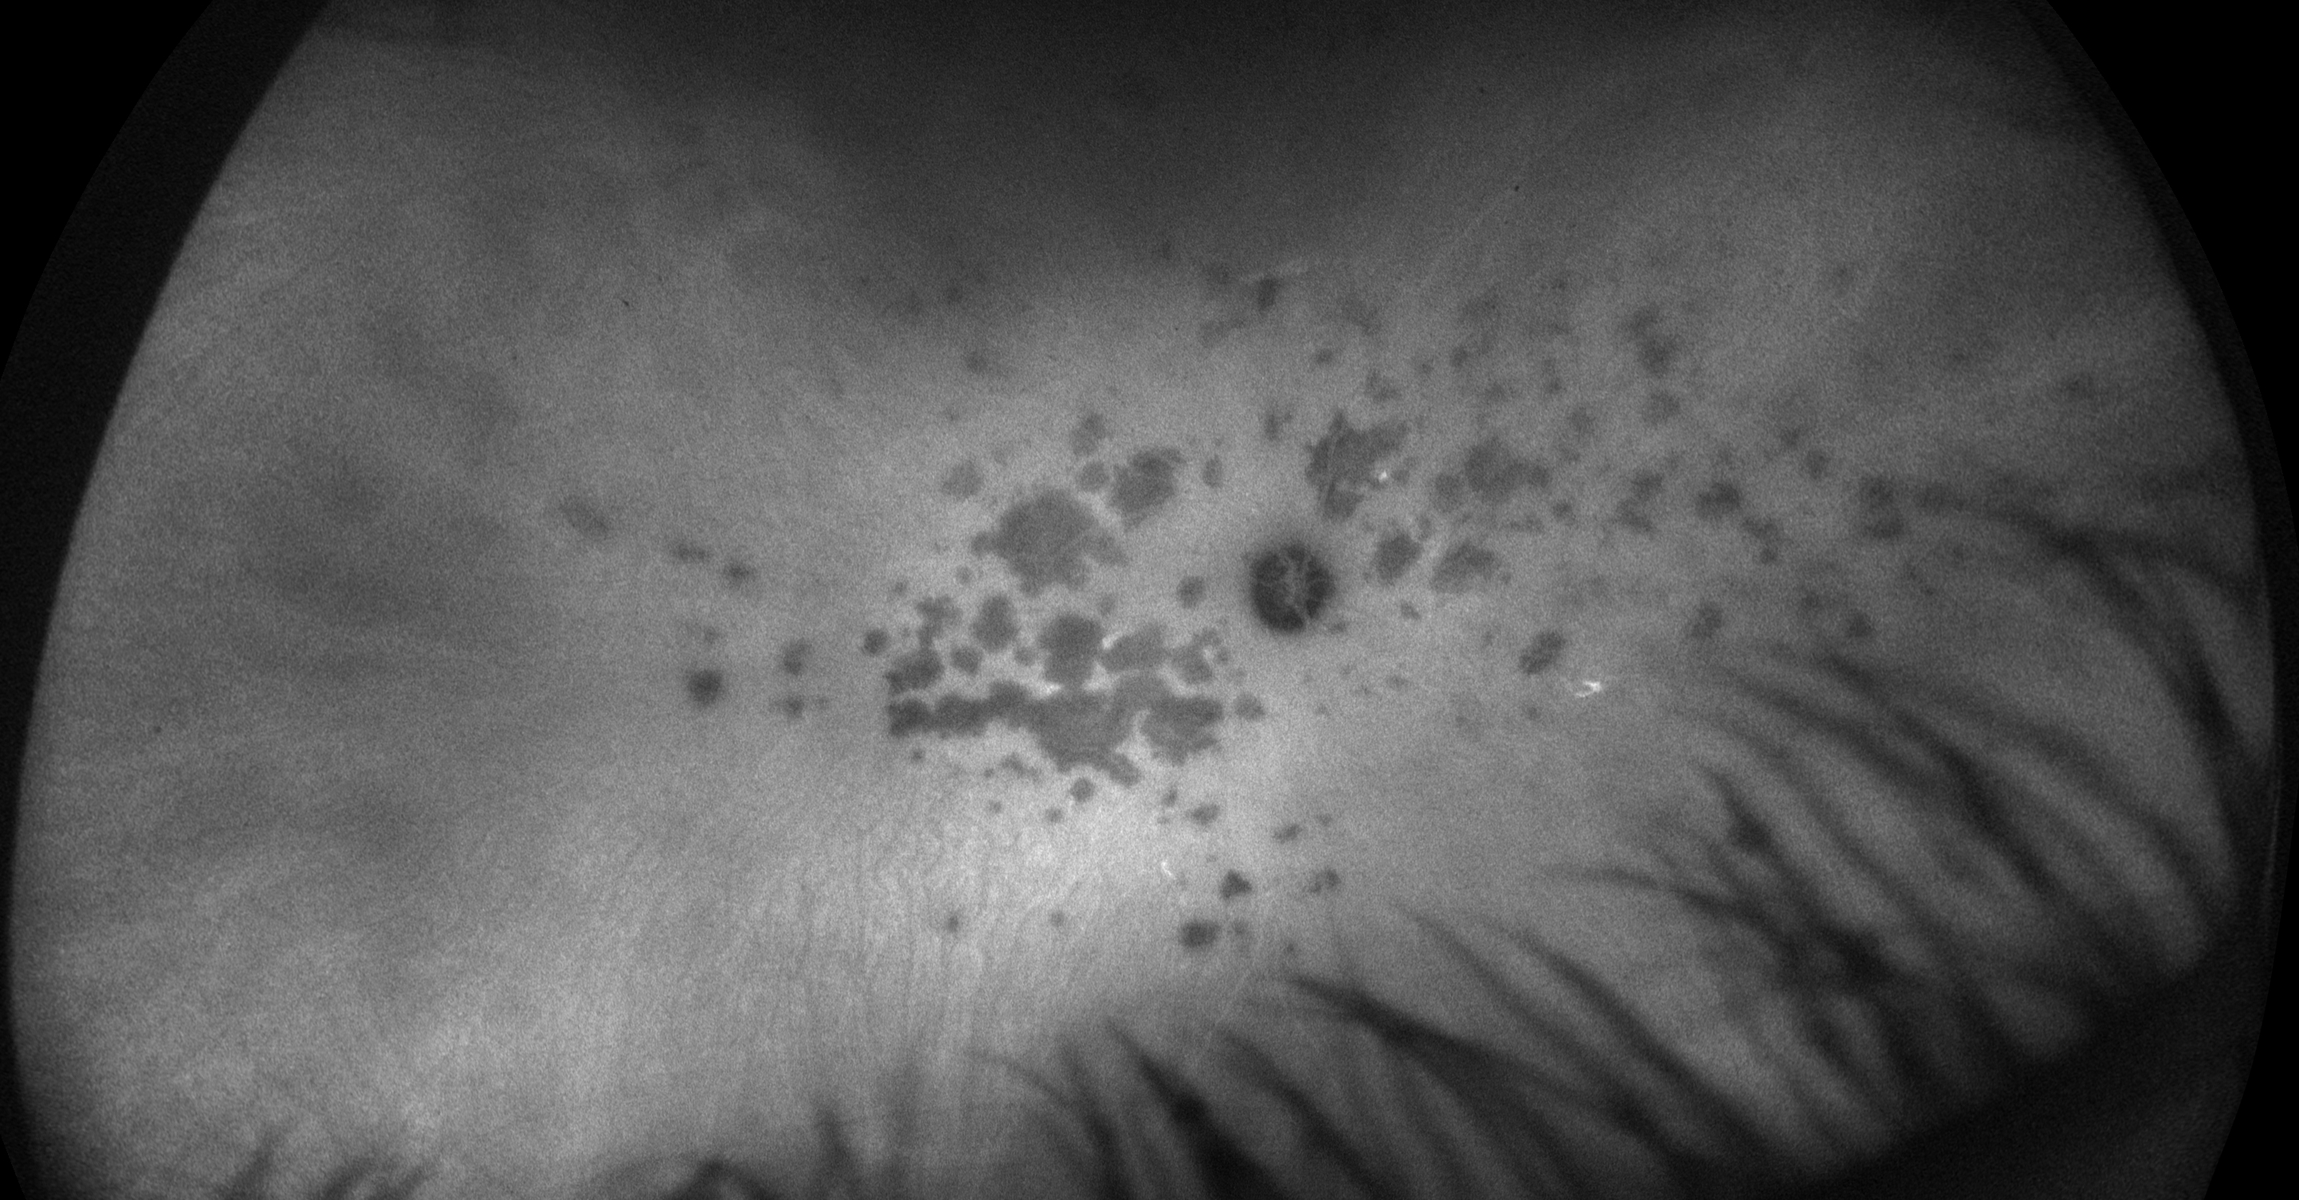
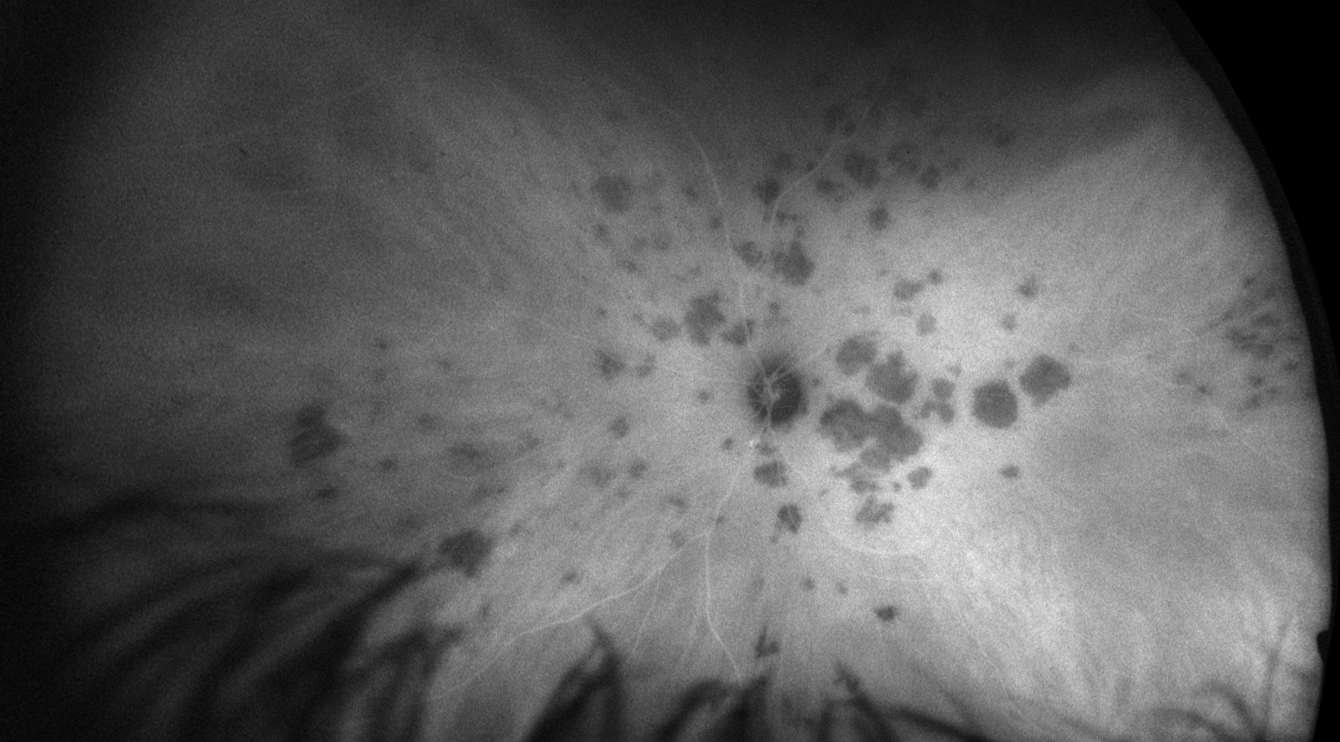
Case 2 ICGA

Slide 20
Acute posterior multifocal placoid pigment epitheliopathy (APMPPE)
Sequential, bilateral onset in young patients (2nd – 3rd decade)
Male predominance
Characteristic lesions on FA; “blocks early, hyperfluoresces late”
However this is not specific
Treatment is steroids or observation
DDx to consider: serpiginous, “ampiginous” (relentless APMPPE)
Watch for neurologic signs (headaches)
Can develop strokes in very rare cases within days to weeks of eye diagnosis
Most commonly occur as steroids are being tapered or IMT is being changed

Slide 21
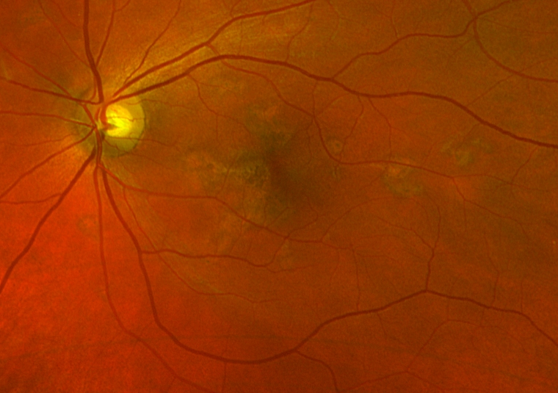
Case 2 Follow-up (2 weeks later)
20/30
20/25

Slide 22
Case 2 Follow-up (2 weeks later)

Slide 23
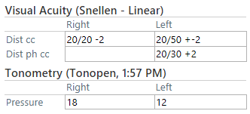
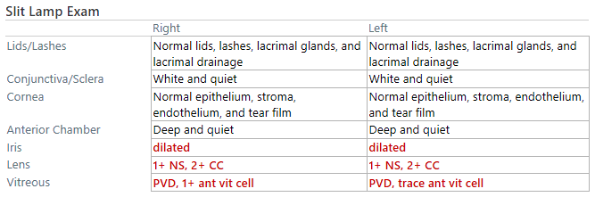
Case 3
67F with new onset flashes and floaters OU

Slide 24
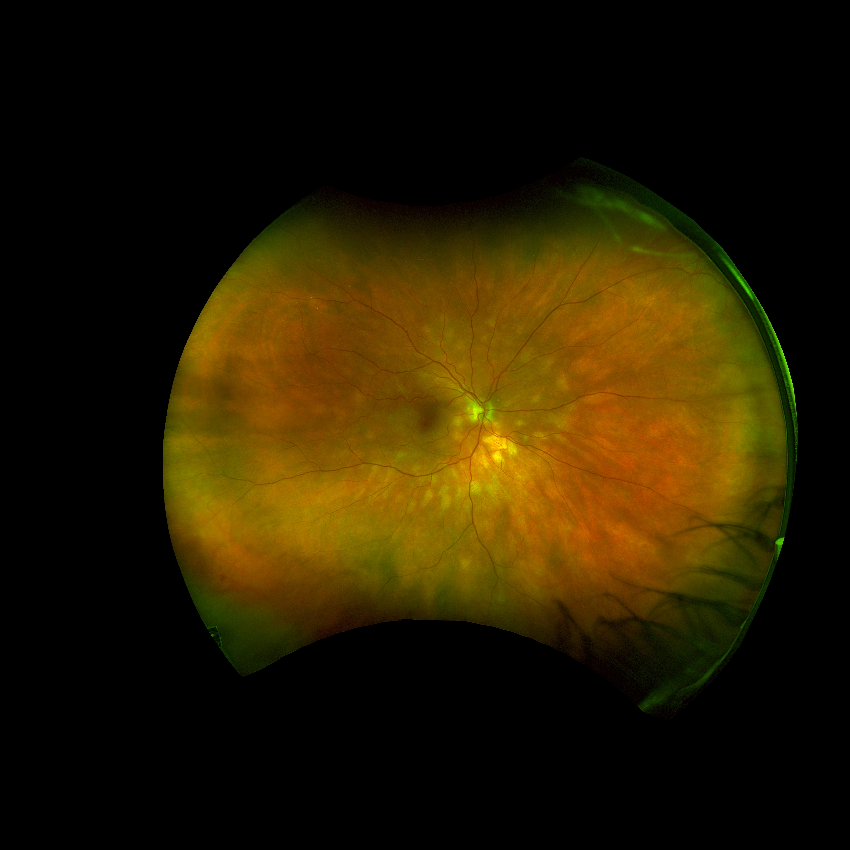
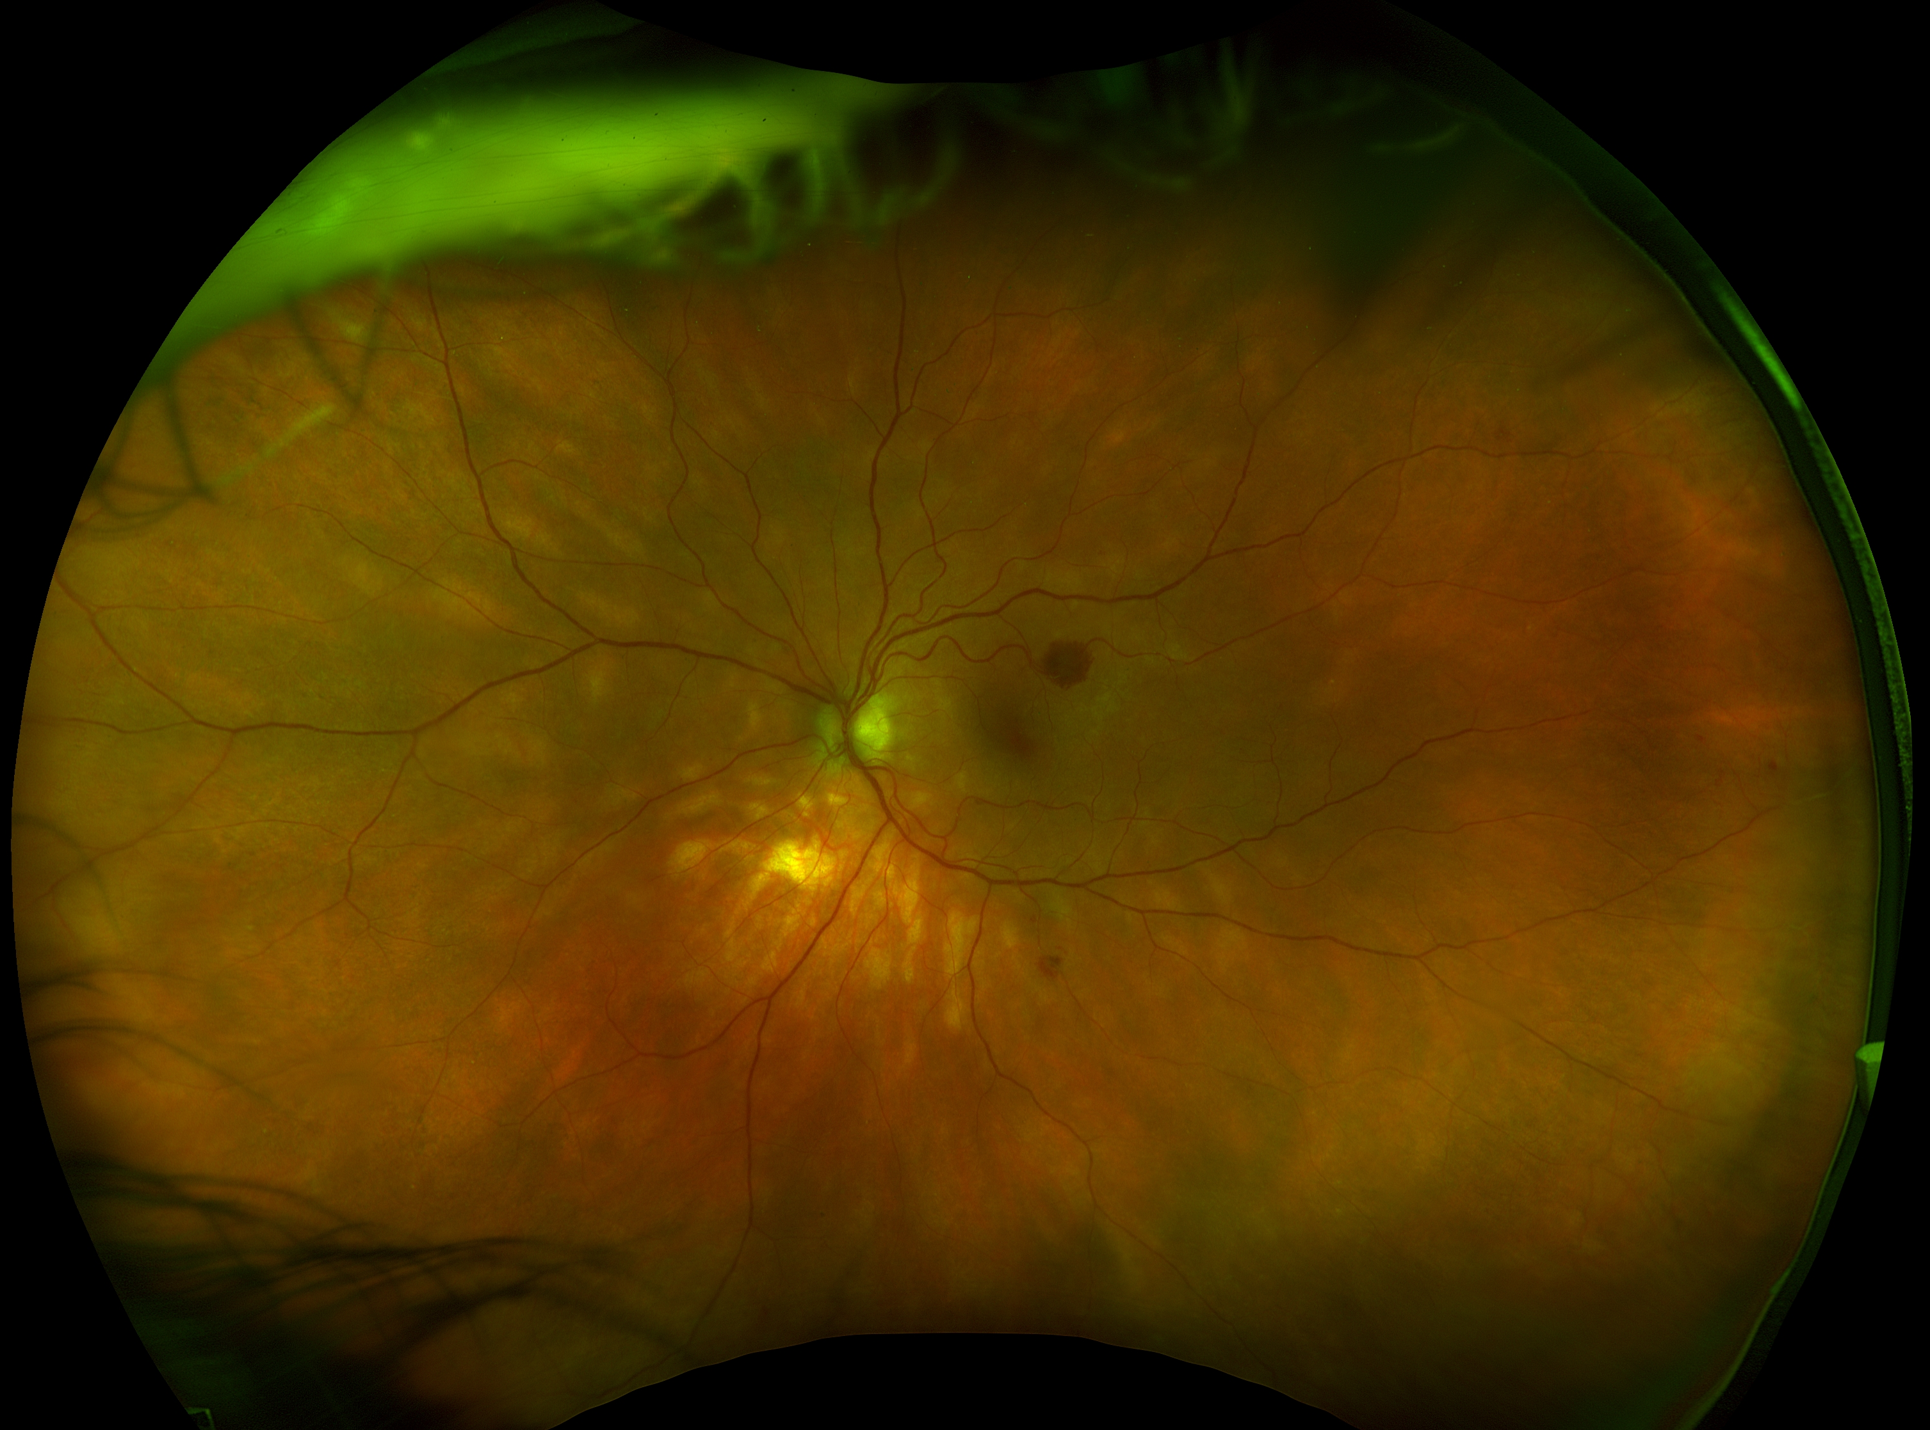
Case 3 Photos

Slide 25
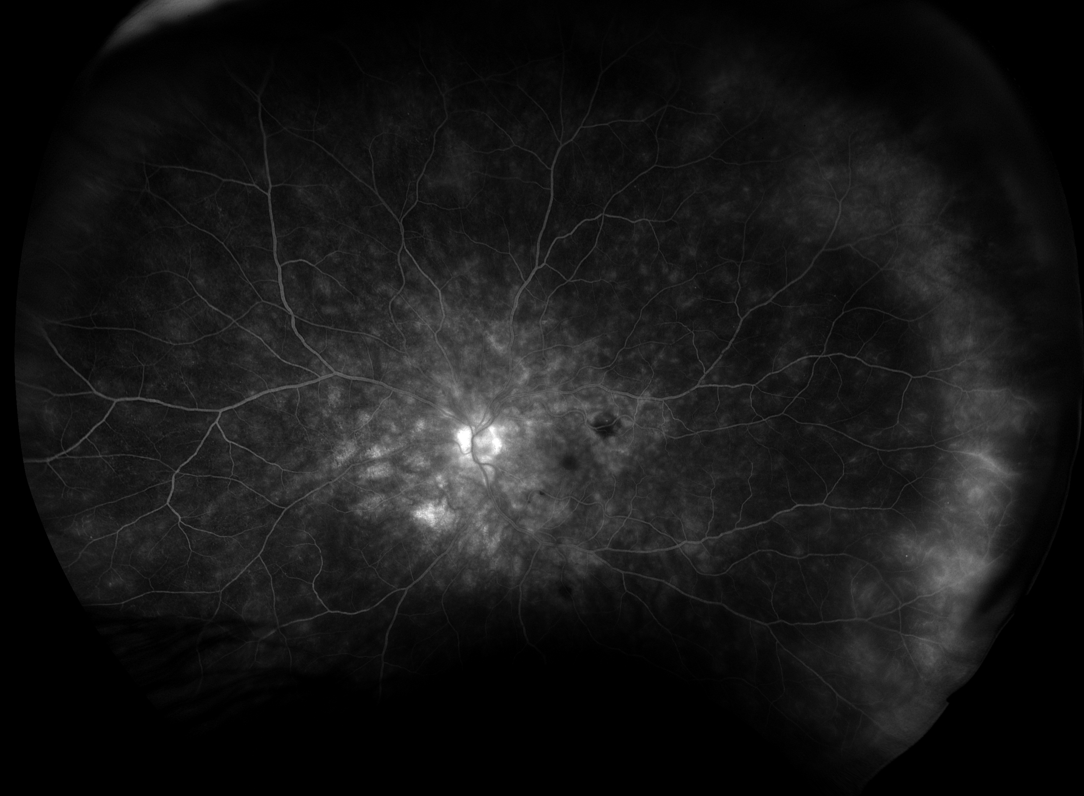
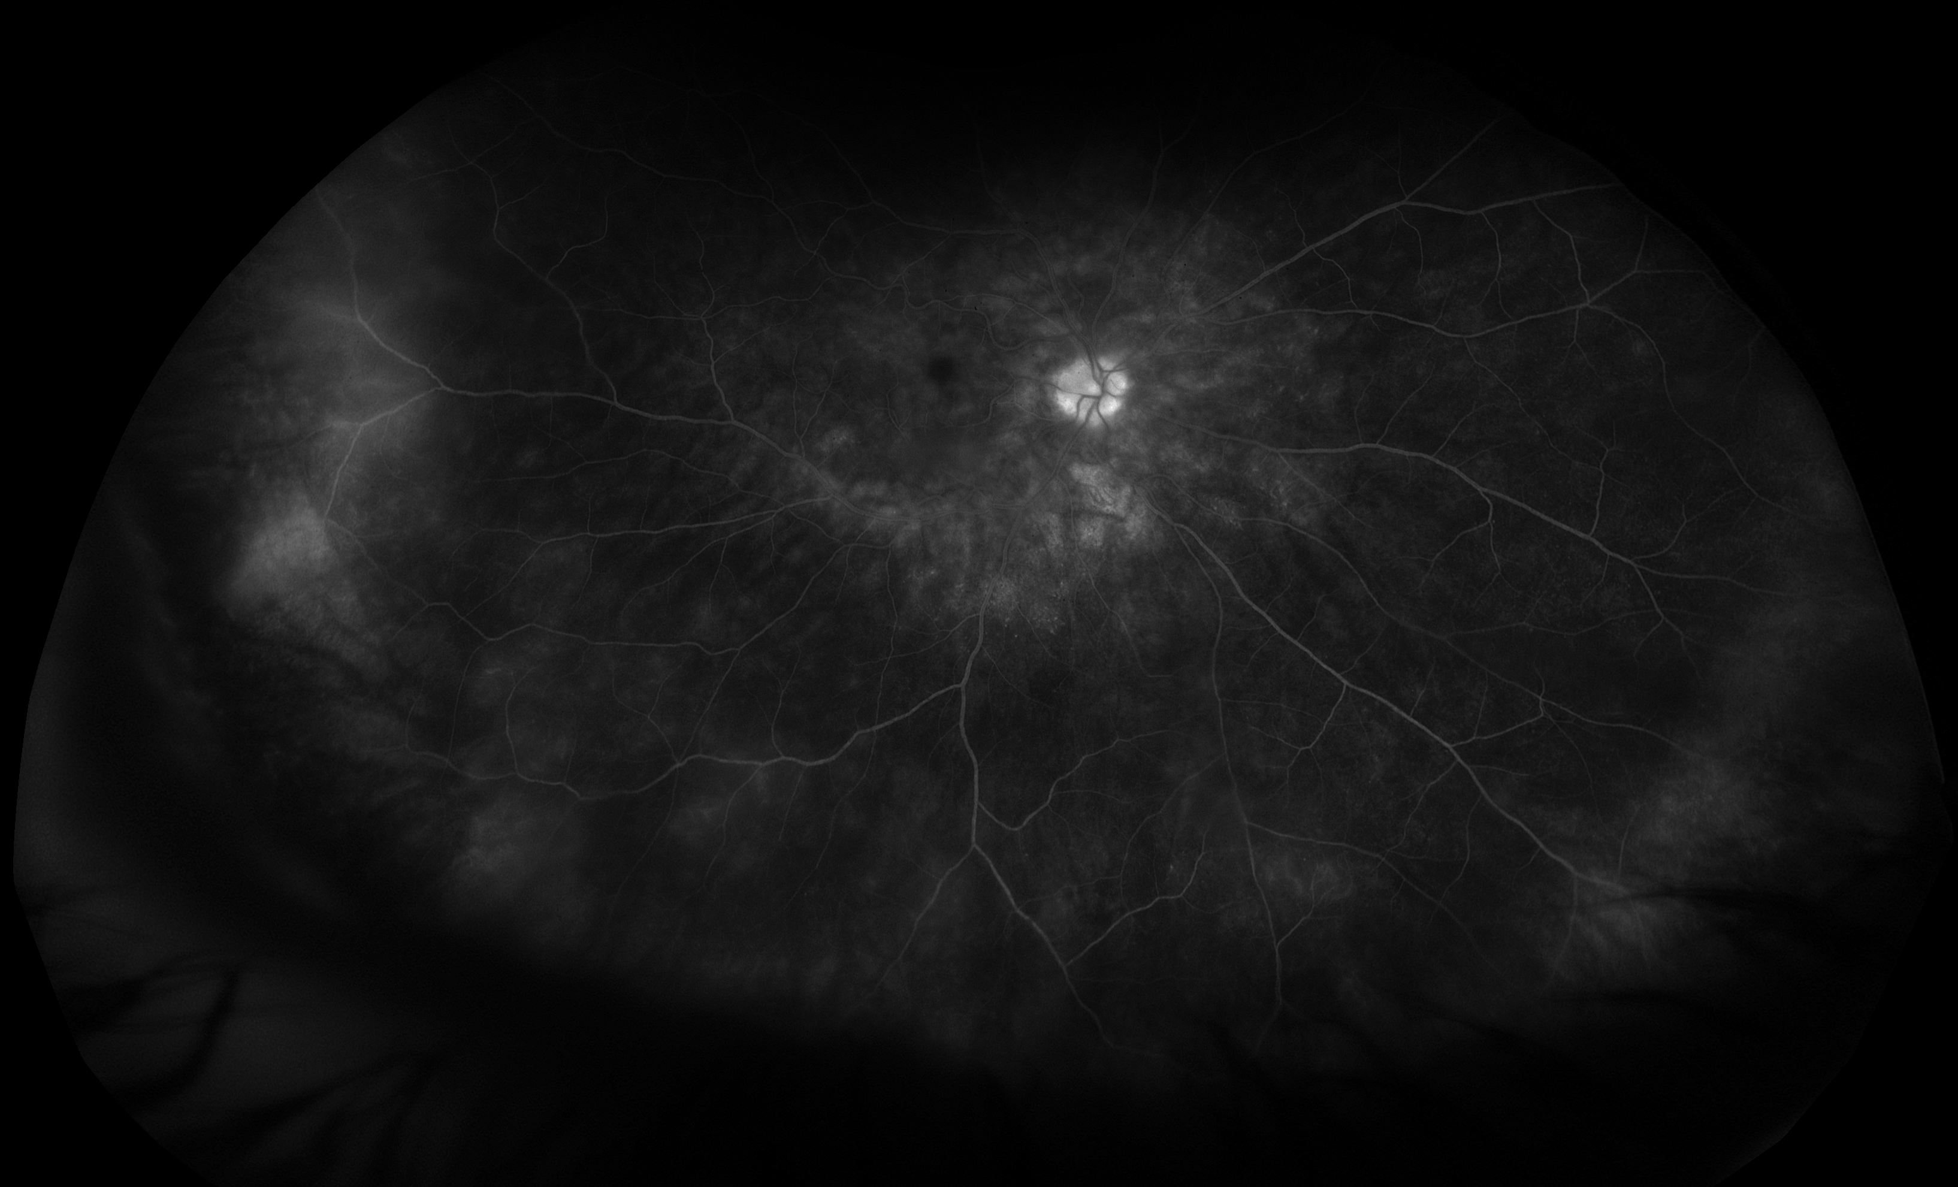
Case 3 FA

Slide 26
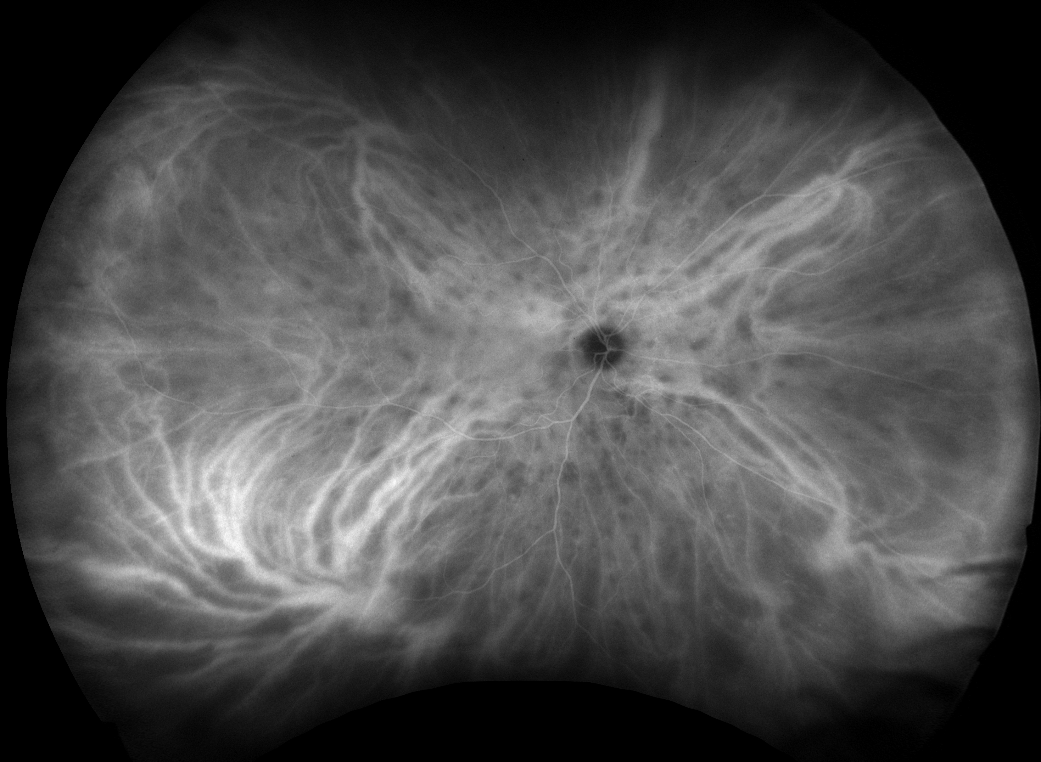
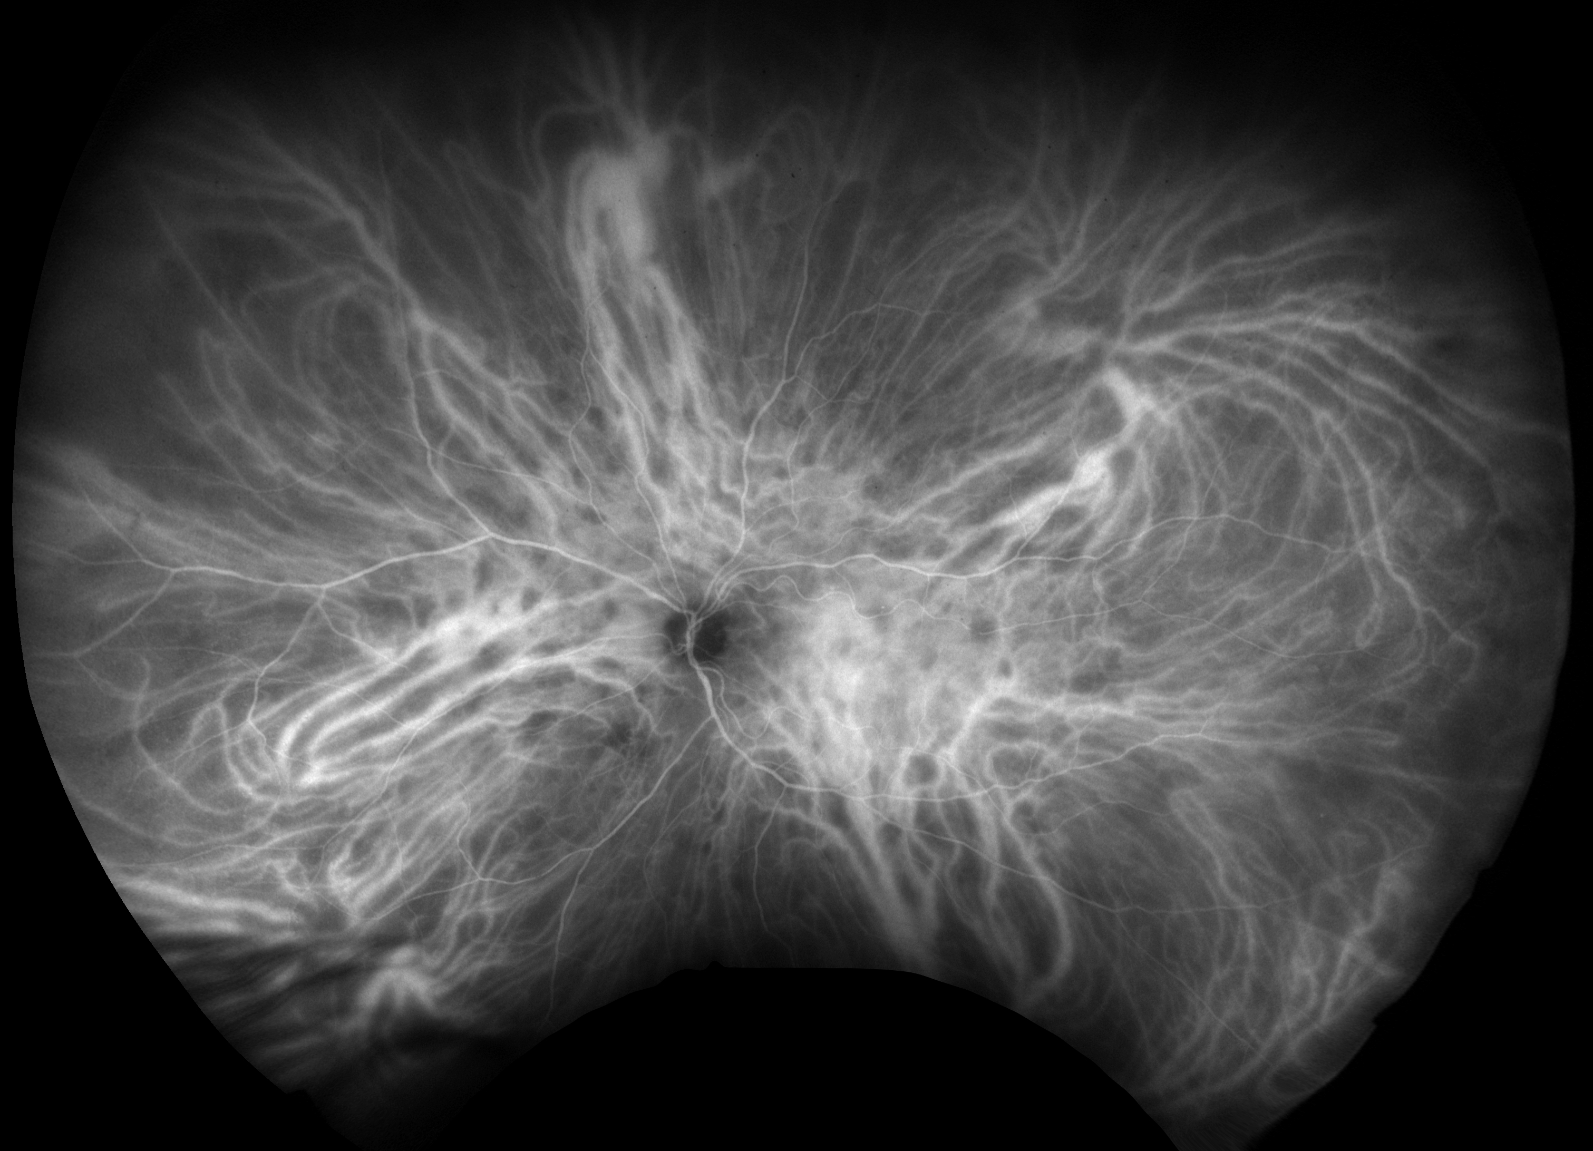
Case 3 ICGA

Slide 27
Birdshot retinochoroidopathy
Characteristic deep, ovoid, creamy lesions best seen on ICGA
Chronic, bilateral, and often recurrent if untreated
Not generally associated with systemic disease (ocular inflammation only)
Female > male predominance
Average age at diagnosis in 5 – 6th decade of life
Photopsias, nyctalopia, color vision loss
Inflammation (vitritis, disc leakage, vasculitis) → immunosuppression

Slide 28
Birdshot retinochoroidopathy
HLA-A29 is highly sensitive but not specific for birdshot
About 8 – 10% of the population is HLA-A29 (+)
Only 1 in 10 000 HLA-A29 (+) patients have birdshot
Also has a retinal degeneration-like component that is often chronic and progressive → follow with exam, imaging, HVF, ERG

Slide 29
HLA-A29 testing in birdshot retinochoroidopathy
If you are HLA-A29 positive, does this mean you have birdshot?
90% of US population is HLA-A29 negative
(297 million people)
10% A29(+) 33 mil people
3000 birdshot cases in US
(1 in 10 000 A29+ people)
.

Slide 30
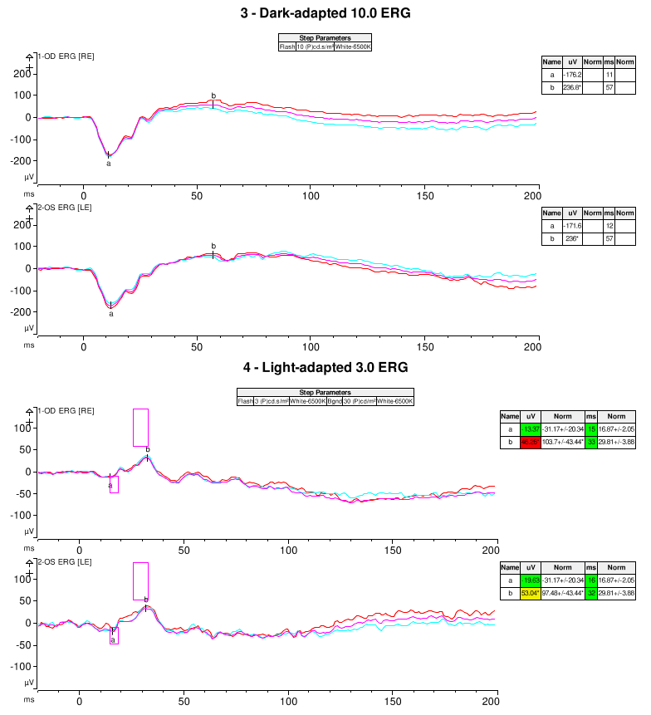
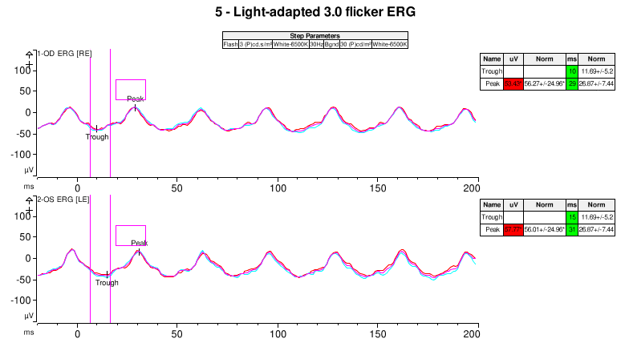
Case 3 ERG

Slide 31
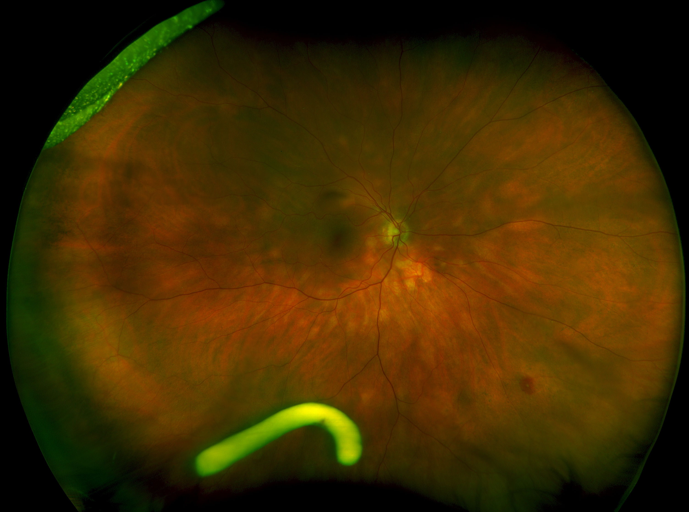
Case 3 Follow-up
Presentation
20/20
Month 2
20/20

Slide 32
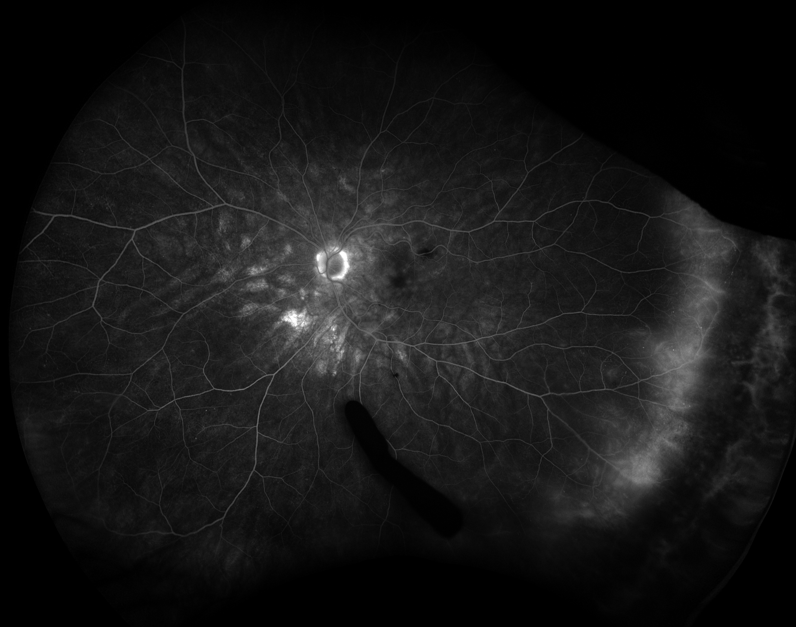
Case 3 ERG
Presentation
20/30
Month 2
20/20

Slide 33
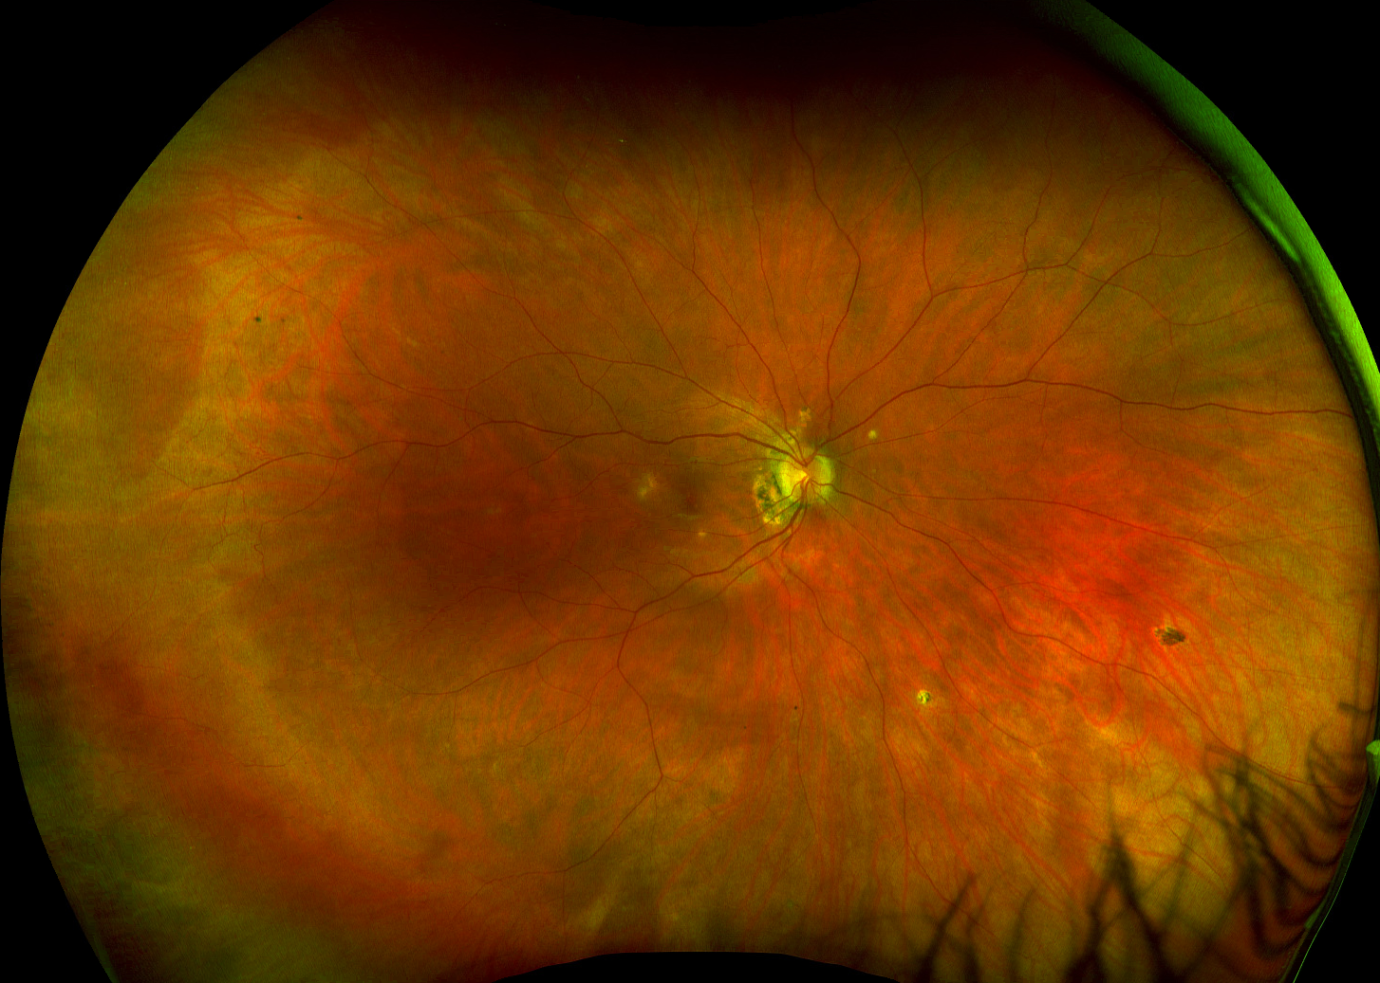
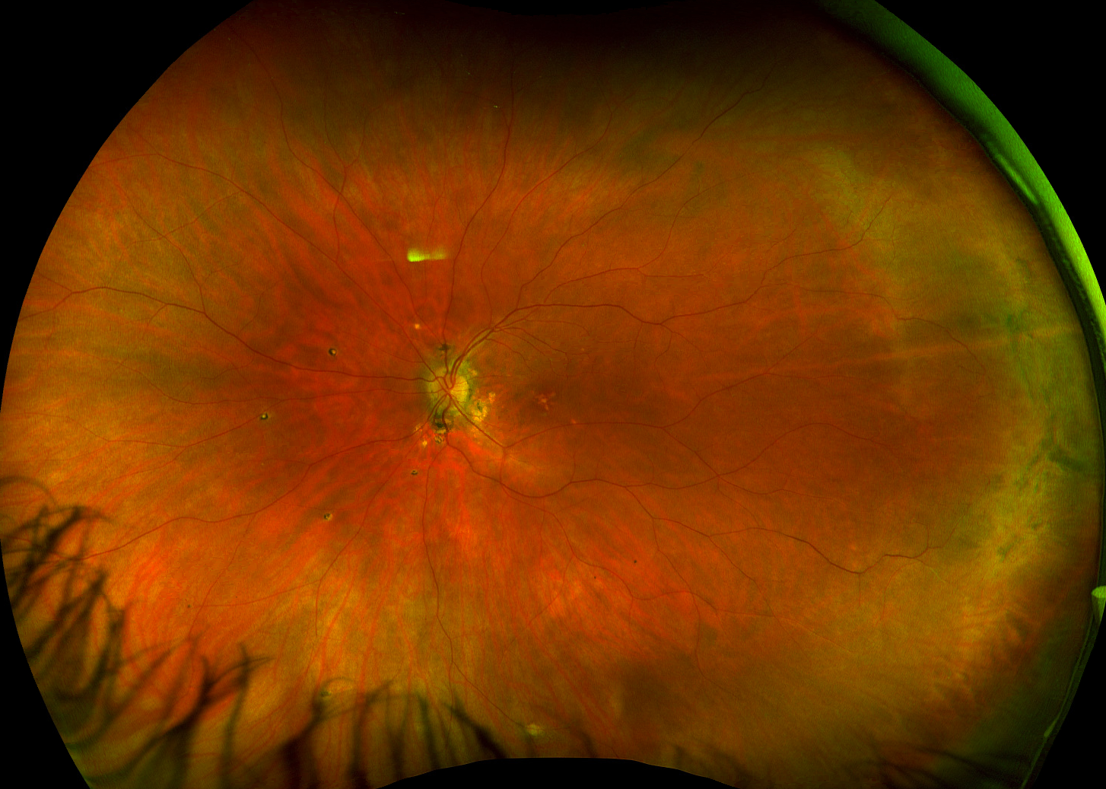
Case 4
32F with h/o uveitis presents with increased photopsias OD
20/20
IOP 15
20/20
IOP 16

Slide 34
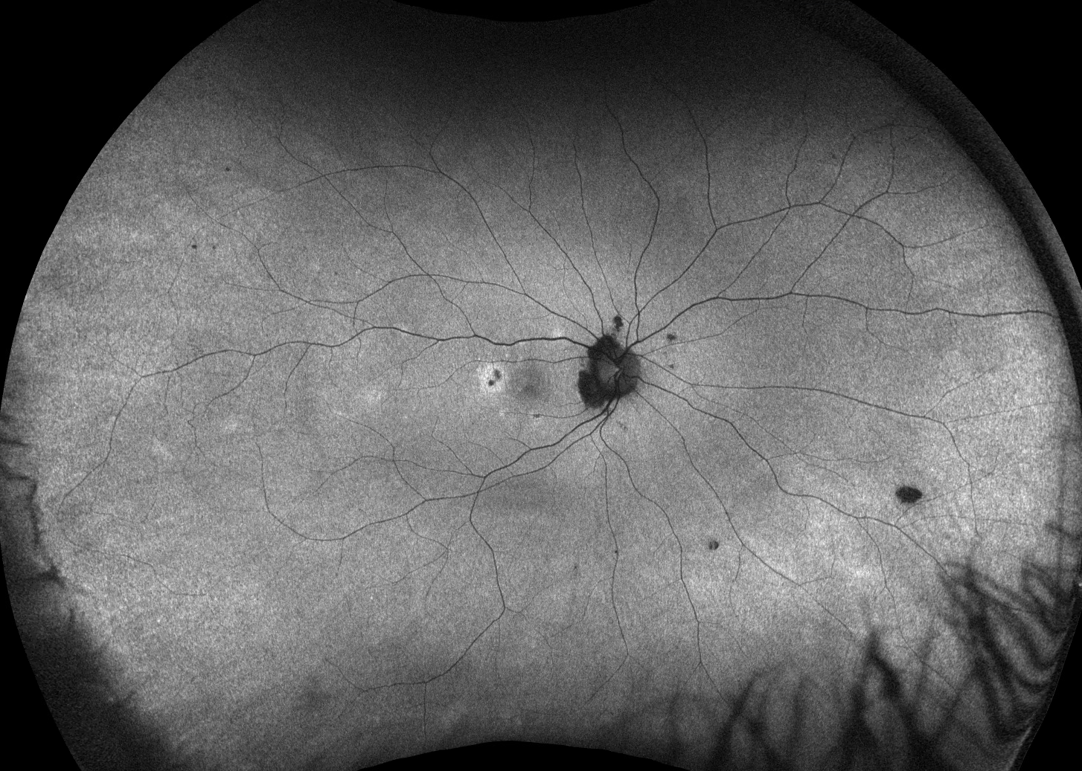
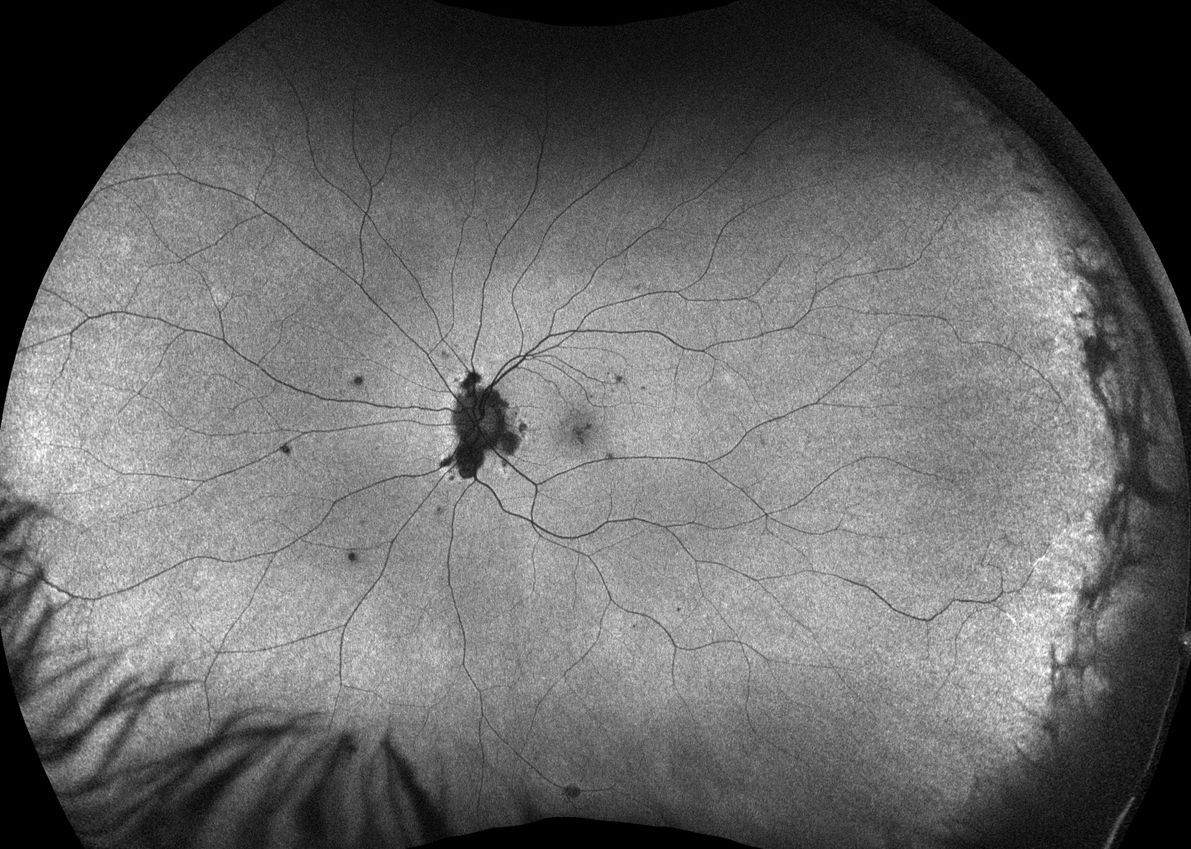
Case 4 FAF

Slide 35
Punctate inner choroidopathy (PIC)
Young, myopic women in 3rd – 4th decade of life
Characteristic photopsias
Acute/recurrent inflammatory lesions (but no vitritis)
PO steroids, intravitreal steroids, IMT, implants (Yutiq, Retisert)
CNVM sequelae
Anti-VEGF

Slide 36
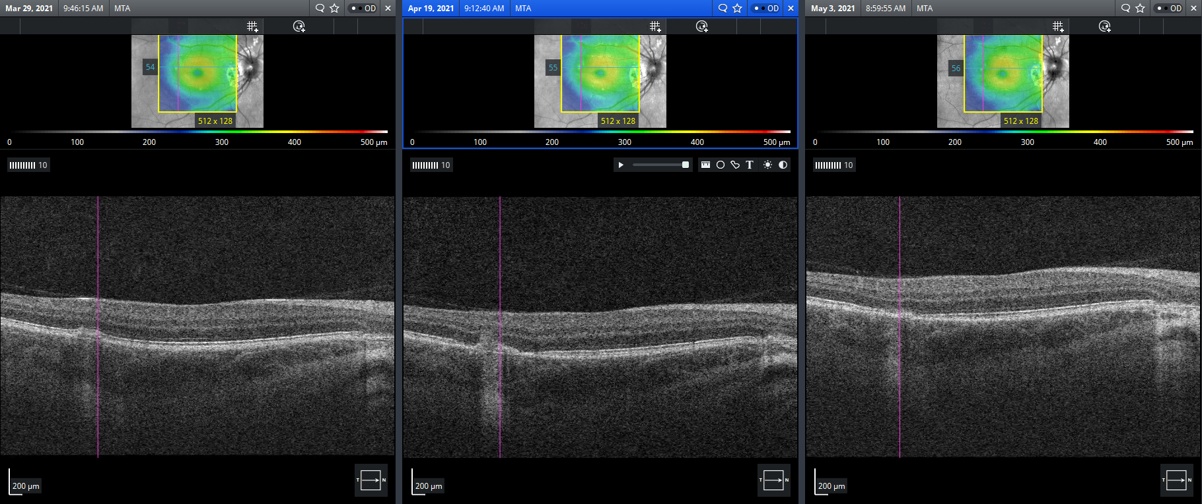
Case 4 Follow-up

Slide 37
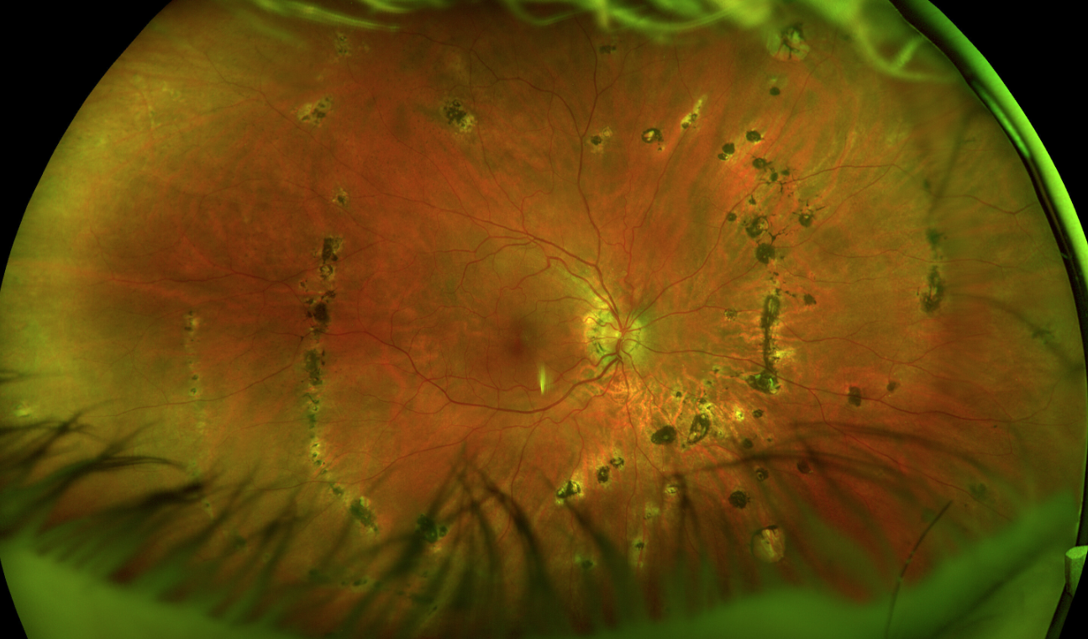
Case 5
43M with blurry VA, floaters, and photopsias OD
Schlaegal line
20/30
IOP 20
Pigment vit cell
and debris

Slide 38
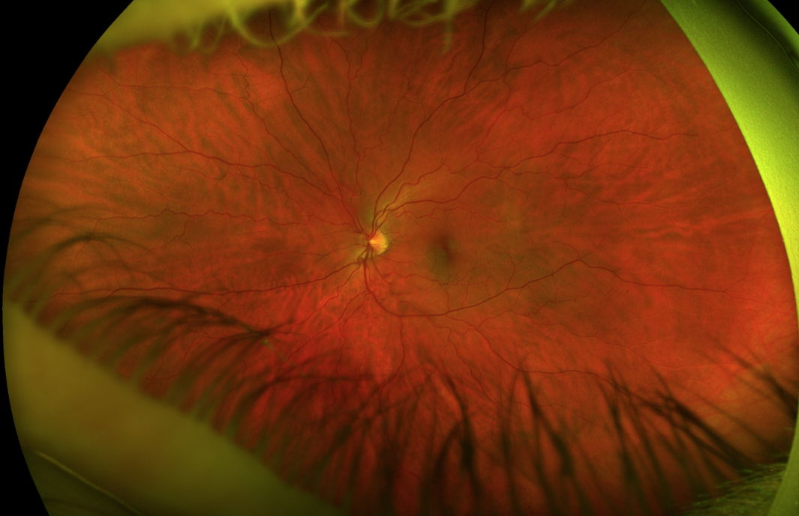
Case 5 Photo of normal left eye

Slide 39
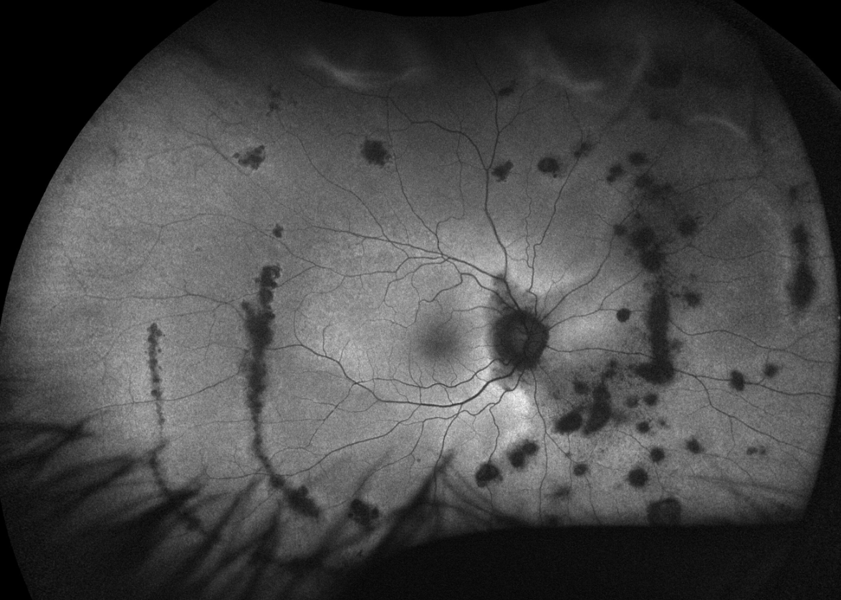
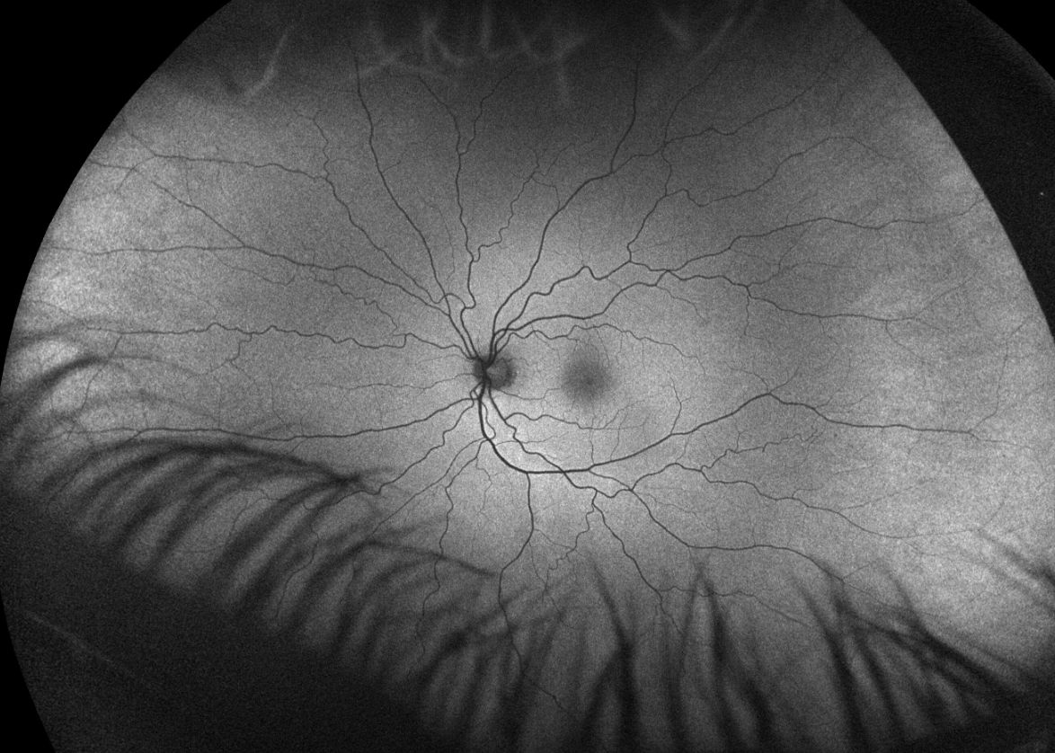
Case 5 FAF

Slide 40
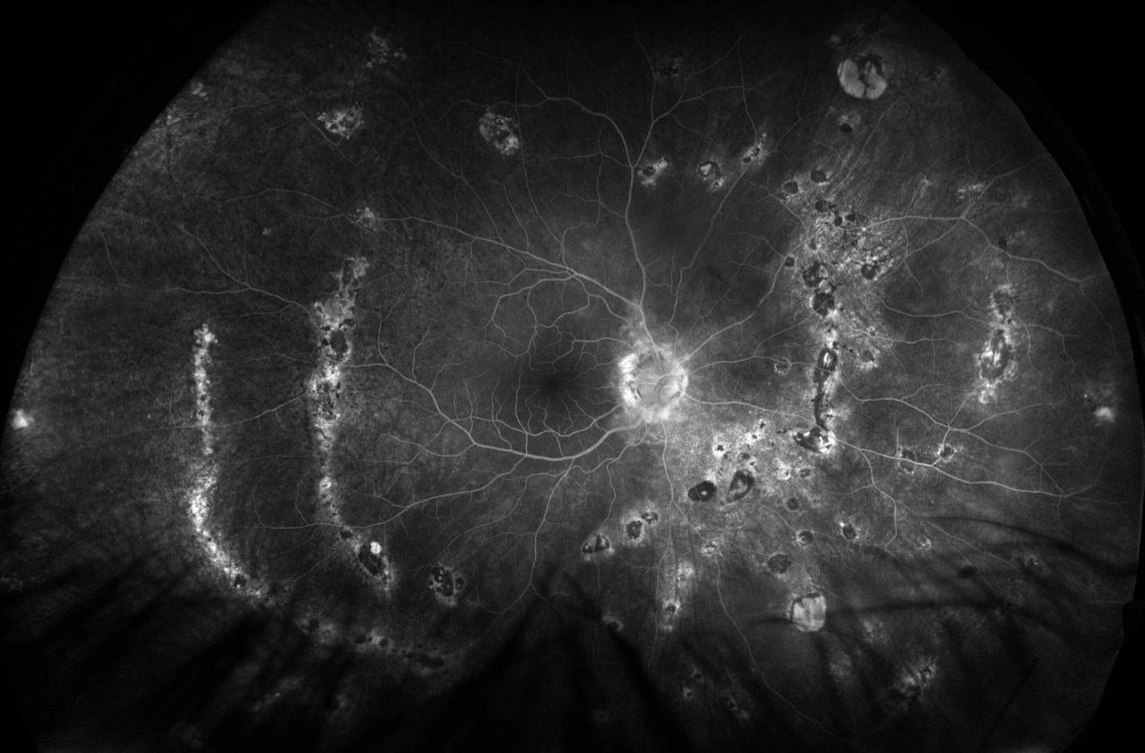
Case 5 FA

Slide 41
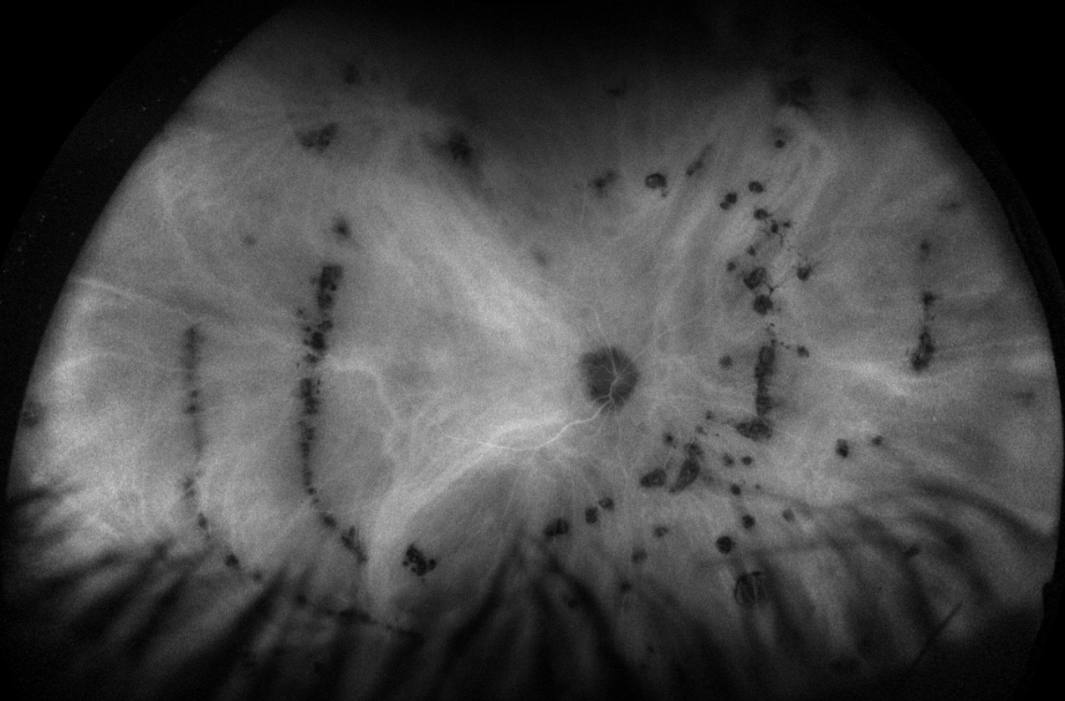
Case 5 ICGA

Slide 42
Multifocal choroiditis with panuveitis (MCP)
Creamy active choroidal lesions that progress to pigmented and punched out chorioretinal scars
Lesions may be slightly bigger, more numerous, and more confluent than those seen in PIC
Can have anterior and/or vitreous inflammation (MCP) but may not
Like PIC, can have macular CNVM complications that cause VA loss
Schlaegal line- equatorial curvilinear streaks of CR lesions

Slide 43
Pattern recognition is important…
Birdshot
APMPPE
PIC
MEWDS
MFC/MCP

Slide 44
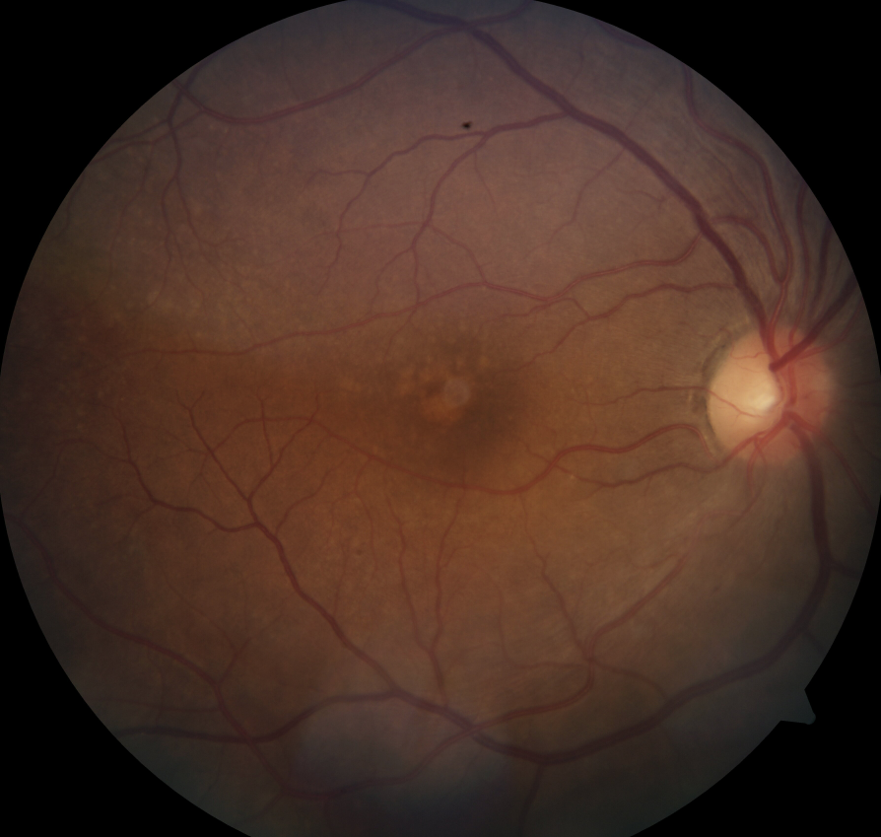
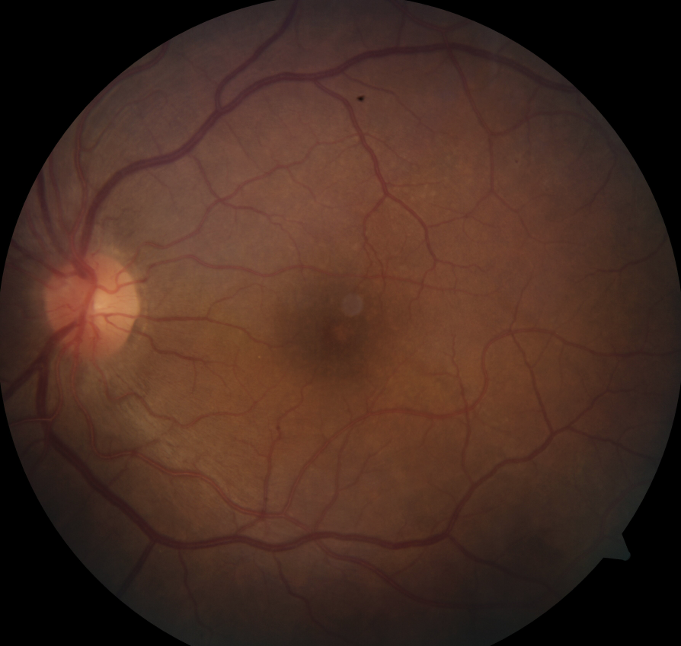
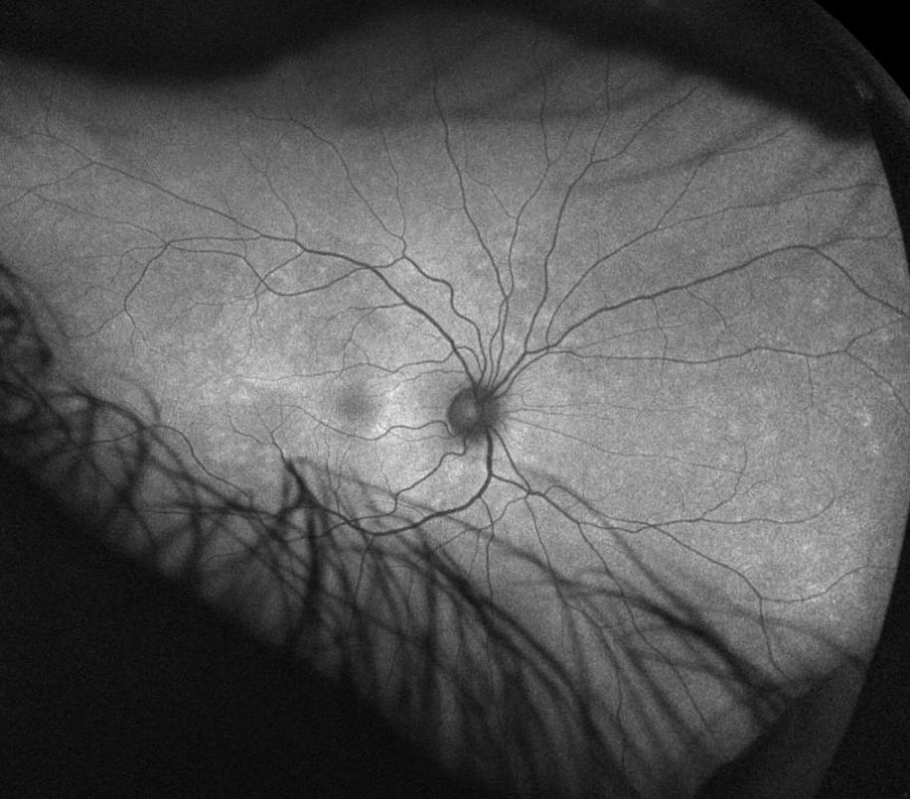
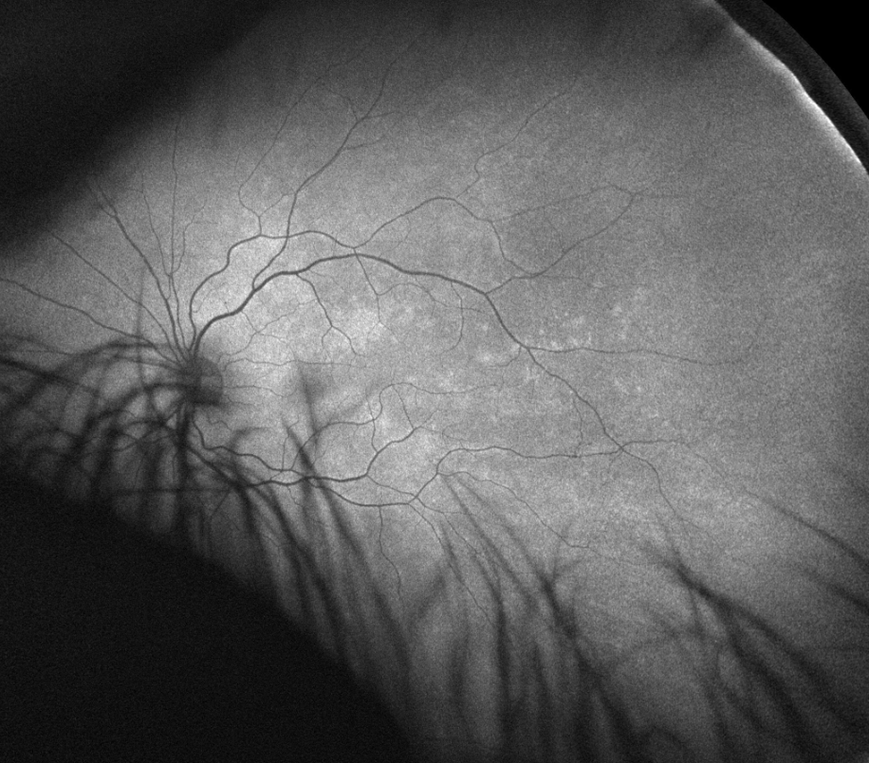
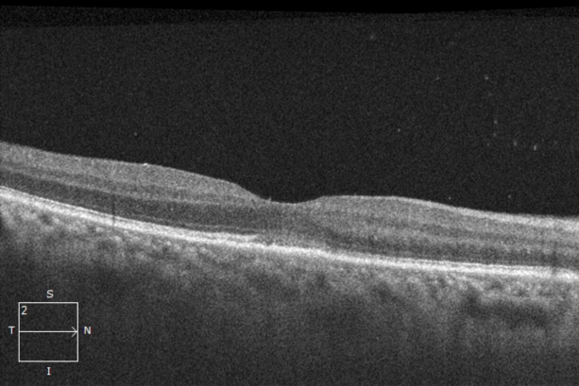
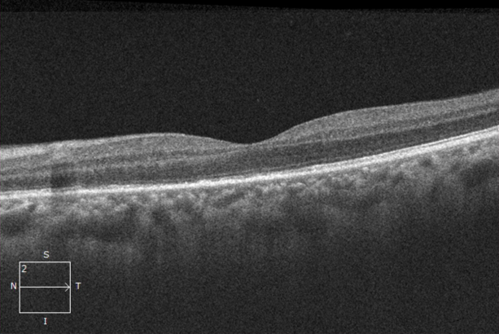
…but watch for masquerades!
SYPHILIS

Slide 45
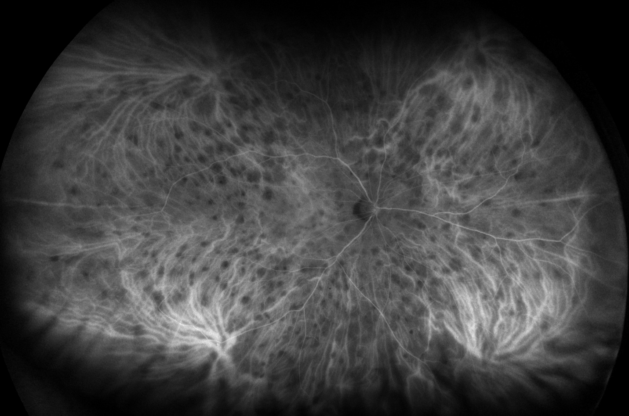


Systemic disease can mimic white dot syndromes
…and should be identified and treated
Sarcoidosis
Uveal lymphoma
Syphilis

Slide 46
TREATMENT MODALITIES

Slide 47
Acute phase treatments
Initial treatments to rapidly control disease at onset
Oral prednisone
High dose 1 mg/kg up to 60mg daily
Taper weekly
Extensive long-term side effects affecting nearly every organ system
Safe in pregnancy
Generally highly effective at controlling inflammation
Topical steroid drops are less effective as disease is mostly posterior

Slide 48


Acute phase treatments
Intravitreal injection options
Ozurdex (dexamethasone implant)
Xipere (triamcinolone suprachoroidal)
Anti-VEGF intravitreal injections
Only for CNVM in PIC or MCP

Slide 49



Long-term treatments
Systemic immunosuppression and long-term steroid options
Iluvien (fluocinolone implant)
Lasts for 3 years
Retisert (surgical implant)
Lasts for 5+ years
…but being discontinued
Systemic immunosuppression
Methotrexate (once a week pills)
Mycophenolate (daily pills)
Adalimumab (biweekly injections)
Infliximab, tocilizumab (monthly or bimonthly infusion)

Slide 50
Treatments for pregnant patients
Many white dot syndromes affect women of child-bearing age
Many but not all treatment options are safe in pregnancy
Oral and injection steroids are generally always safe
Adalimumab and infliximab and azathioprine (less used) also safe to use
Anti-VEGF injections generally avoided in pregnancy
Methotrexate and mycophenolate contraindicated in pregnancy

Slide 51
Conclusions and summary
The various white dot syndromes differ in the size and distribution of lesions, patient demographics, and prognosis/outcomes
Multimodal imaging (OCT, FAF, FA, ICGA) is essential in fully characterizing the different presentations of the white dot syndromes
Oral steroids are a mainstay of treatment; chronic conditions such as birdshot may require long-term immunosuppression; PIC and MCP can cause secondary CNVM which may require anti-VEGF injections
Patients w/ white dot syndromes require a full uveitis work-up to rule out masquerade conditions which may require a different treatment approach

Slide 52
Thank you for your attention!
Andrew Zheng, MD
azheng@retinacolorado.com

