Slide 1
Eye to Eye with Melton and Thomas
Ron Melton, OD, FAAO
Randall Thomas, OD, MPH, FAAO
www.eyeupdate.com

Slide 2
Financial Disclosure
Drs Ron Melton and Randall Thomas are consultants to, on the speakers bureau of, on the advisory committee of, or involved in research for the following companies: ICARE and B+L

Slide 3
EyeMedsNow.com

Slide 5
*Why People Should Not Search the Internet
Alrex (Loteprednol Etabonate Ophthalmic Suspension) - RxList
Search for: Can you get Alrex over the counter?
What is a substitute for Alrex?
Alrex Alternatives Compared
Alrex (loteprednol) Lotemax (loteprednol) Sulfacetamide sodium ophthalmic
Encourage your patients to contact you if they have any questions. Further, try to dissuade them from seeking any advice from the internet!!!

Slide 7
*A Study on Nanodropper Performance
“Some patients run out of drops too soon, have trouble affording drops, or experience excessive side effects.”
The Nanodropper adaptor delivered 2.6 times the total number of drops for all medications.”
“Drop volume greater than 20 microliters provided no real additional benefit which may explain why drops almost always roll down the cheek, no matter how accurately they are placed.”
“The Nanodropper may theoretically reduce medical waste by more than 50%.”
EyeNet Magazine, July 2023
Notes:
Eyedrop Bottle Adaptor May Make Drops Last Longer. EyeNet Magazine, July 2023,

Slide 8
Ryzumvi™ for Dilation Reversal
Last was Rev-Eyes™ (0.5% dapiprazole) 1990’s
Phentolamine ophthalmic solution 0.75% by Ocuphire/Viatris
Blocks alpha-1 receptors on iris radial muscles
Approved down to age 3: One to two drops post-exam for adults; only one drop <12 years
Comes in preservative-free individual unit dose: 5 per foil pack - 6 foil packs per carton (0.31 mL per unit)
Store under refrigeration, but once foil is opened, can stay at room temperature for 2 weeks
Consult drugs.com/Ryzumvi or ryzumvi.com

Slide 9
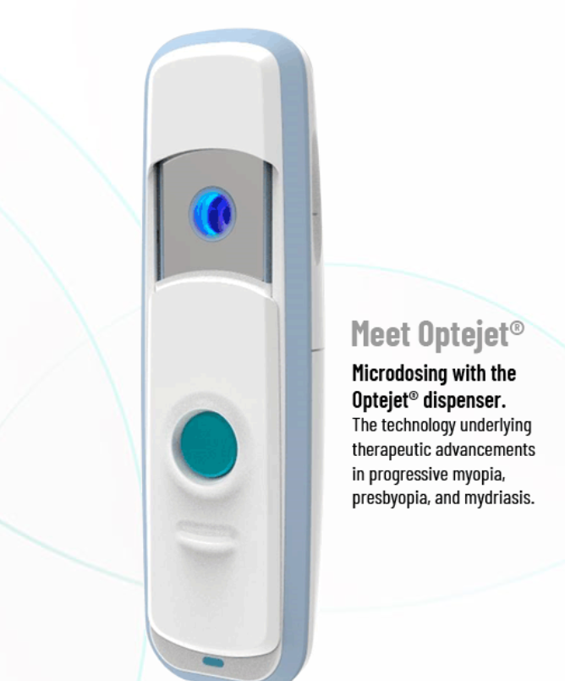
*

Slide 10
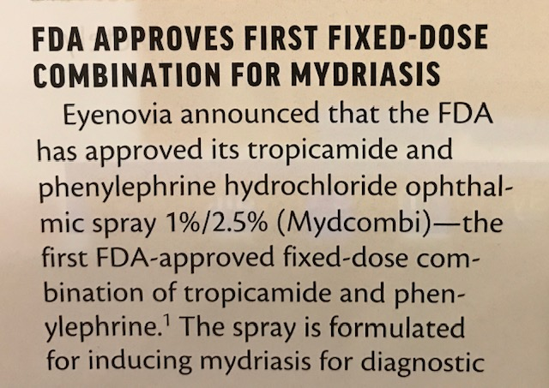

Slide 11
Presbyopia Drugs – Current and Pipeline

Slide 12
Vuity (Pilocarpine 1.25%)
First of a new wave of drugs to enhance near vision in presbyopia
Induced miosis increases depth of focus
About 30% of patients gained about 3 lines of near vision with slight compromise of distance vision
Urge caution when regarding compromised night driving
Dosage: 1 drop OU daily, PRN – onset in about 20 minutes
Effect duration: 2 to 6 hours – can dose another drop if needed
Side effect potential: HA, conjunctival hyperemia, retinal detachment – use with caution in patients with anterior uveitis
Marketed by Allergan in a 5 ml bottle containing 2.5 ml of drug. It is preserved with 0.0075% BAK (Xalatan has 0.02% BAK)

Slide 13
The Finer Points Regarding Vuity™
Vuity “may also include hydrochloric acid and/or sodium hydroxide for pH adjustment to between 3.5 and 5.5, if necessary.”
“Patients should be advised to exercise caution in night driving and other hazardous occupations in poor illumination. In addition, miotics may cause accommodative spasm.”
Regarding the very slight risk of retinal detachment, “Patients should be advised to seek immediate medical care with sudden onset of vision loss.
On the good side, there could be “increased lacrimation.”
Vuity also contracts the ciliary muscles and may shift the eye to a more myopic state.”
Vuity™ [package insert] Allergan 2021

Slide 14
Another Entry for Presbyopia Amelioration
Pilocarpine first FDA-approved in 1974 for QID use
Pilocarpine is pregnancy category C
0.4% pilocarpine (QLOSI™): BID administration
One drop in the morning, and a second drop can be instilled about 2-3 hours later if desired
Store under refrigeration until the foil pouch containing 5 single-patient-use vials is opened
Comes in boxes of:
10 single-patient-use vials (2 pouches containing 5 vials)
20 single-patient-use vials (4 pouches containing 5 vials)
30 single-patient-use vials (6 pouches containing 5 vials)
60 single-patient-use vials (12 pouches containing 5 vials)
Marketed as QLOSI ophthalmic eye drop by Orasis Pharmaceuticals

Slide 15
*Retinal Detachment and Pilocarpine
“Prior to prescribing pilocarpine for presbyopia, physicians should inform patients of potential adverse events and consider that patients undergo a screening dilated examination, particularly if they are myopic, to determine if they are at higher risk for retinal detachment. Findings on history and examination that could indicate an increased risk of detachment may include lattice retinal degeneration, a personal or family history of retinal detachment, higher degrees of myopia, and prior retinal tears. Before the initiation of therapy, patients should be appropriately informed regarding symptoms of retinal tears or detachment, which includes flashes, floaters, and visual field loss.”
Am J Ophthalmol. October, 2022
Notes:
Al-khersan H, Flynn HW Jr., Townsend JH. Retinal Detachments Associated With Topical Pilocarpine Use for Presbyopia. Am J Ophthalmol. 2022;242:52-55. https://doi.org/10.1016/j.ajo.2022.05.011

Slide 16
Regarding Pupillary Abnormalities
If there is:
- No ptosis
- No EOM dysfunction
Then it’s nothing “bad” and a scan is not indicated
Consider:
Adies, pharmacologic causation, or “discovered” physiologic anisocoria as probabilities

Slide 17
Management of 3rd Nerve Palsy
Pain vs no pain, pupil involvement, or not
Does not matter!
All patients need emergent CTA or MRA
Send straight to ED; not to an ophthalmologist
However, about 95% of 3rd N. palsies are simply “microvascular,” and not aneurysmal in nature
Foster PJ, et al. JAMA Ophthalmol 2017;135(3):203-4.

Slide 18
Diagnostic Error of Neuro-ophthalmic Conditions
“Neuro-ophthalmologists commonly encounter high rates (50%) of diagnostic erroring the patients referred to their practices.”
Why? Inadequate physical exam, Hx, and inadequate consideration of differential Dx.
“There are tremendous pressures on ophthalmologists to maximize patient volume because of declining reimbursements for office visits and common procedures like cataract surgery.”
M+T: Well-trained doctors of optometry may be better suited to care for these types of patients!
Ophthalmology. September, 2021
Notes:
Stunkel L, Sharma RA, Mackay DD, Wilson B, Van Stavern GP, Newman NJ, Biousse V. Patient Harm Due to Diagnostic Error of Neuro-Ophthalmologic Conditions. Ophthalmology. 2021 Sep;128(9):1356-1362

Slide 19
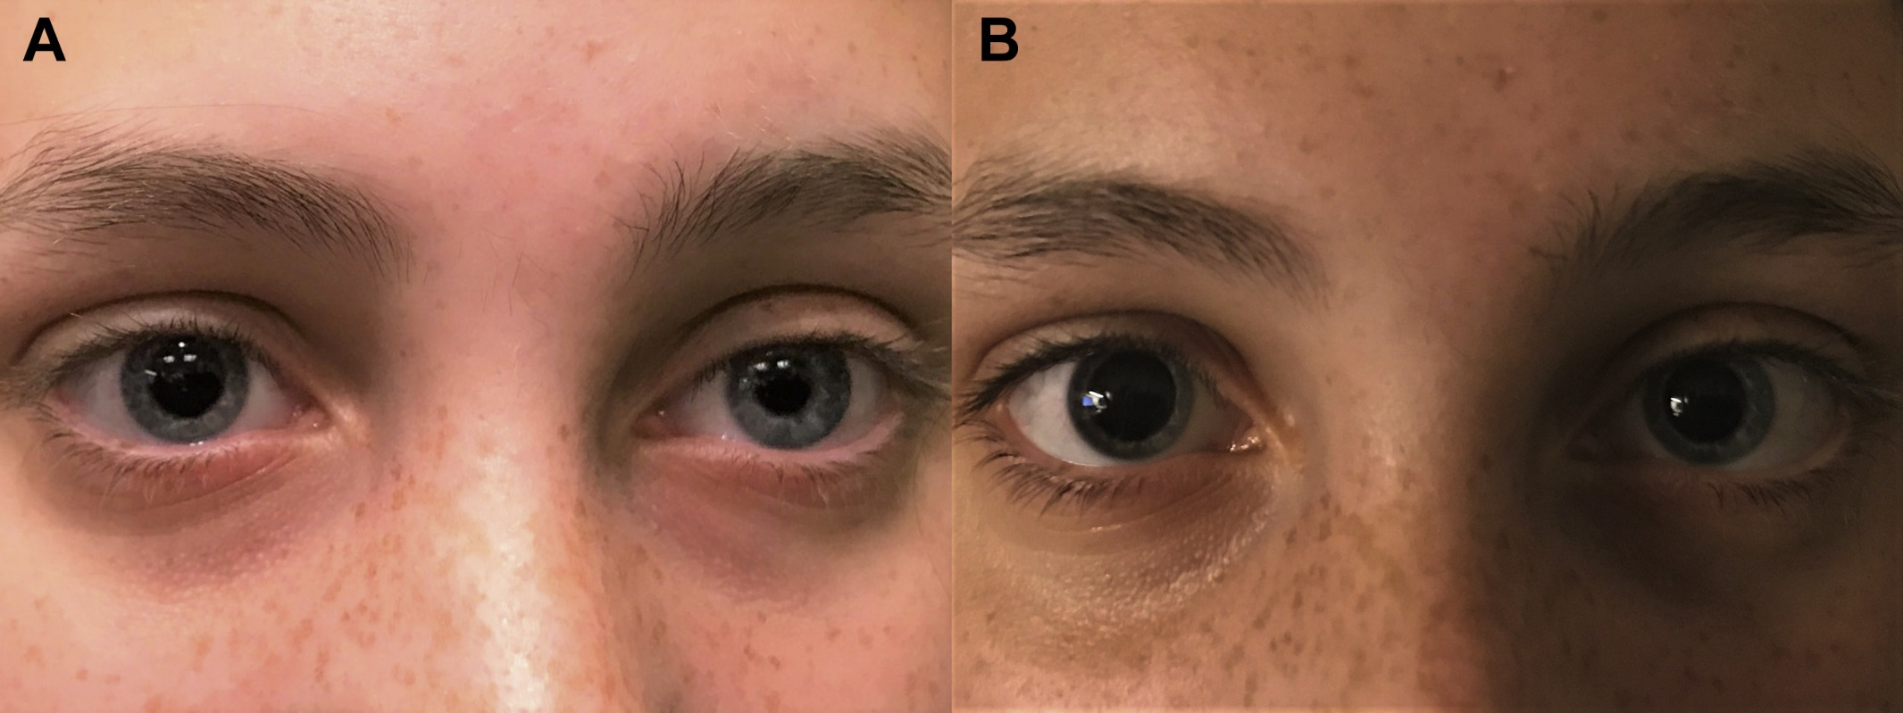
The Importance of History!
Teenage female presented with anisocoria greater in bright light and had neuroimaging, which was negative.
Ophthalmology, Oct, 2020
Notes:
Al-Holou SN, Lipsky SN, Wasserman BN. Don't Sweat the Blown Pupil: Anisocoria in Patients Using Qbrexza. Ophthalmology 2020;127(10):1381

Slide 20
Qbrexza: The Importance of History!
The mydriasis was “eventually” attributed to Qbrexza! (Think! Take a good Hx!)
“Inadvertent contact with the ocular structures can cause mydriasis and blurred vision. A thorough history asking specifically about cloth wipes such as Qbrexza for patients presenting with unilateral mydriasis in the absence of extraocular motor deficits may prevent unnecessary medical costs, neuroimaging, and risk, as well as avoid considerable fear and anxiety for our patients.”

Slide 21
Qbrexza™ (glycopyrronium tosylate)
In a class of anticholinergics – therefore can affect accomodation
Indication: Primary Axillary Hyperhidrosis (excessive underarm sweating)
Approved in 2018 as a medicated towelette applied directly to skin
Prescription drug approved down to age 9.
Potential ocular side-effects:
Dilated pupils
Dry eyes
Blurred vision
Angle closure (in anatomically narrow angles)
Manufacturer: Demira, Inc. Menlo Park, CA

Slide 22
Oxymetazoline 0.1% and Ptosis
Afrin nasal spray = 0.05% oxymetazoline
To help with acquired ptosis
Alpha agonist to stimulate muller muscle
Used once daily as needed
Provides about .5mm - .7mm of lid rise
Approved down to age 13
Duration of effect is not yet known
Marked as Upneeq (single use vial) by RVL Pharmaceuticals
Only available via RVL Pharmacy (Upneeq.com)
JAMA Ophthalmol. Nov 2020
Notes:
Bradley EA, Bradley DJ. Oxymetazoline for Ptosis. JAMA Ophthalmol 2020;138(11):1176-1177.

Slide 23
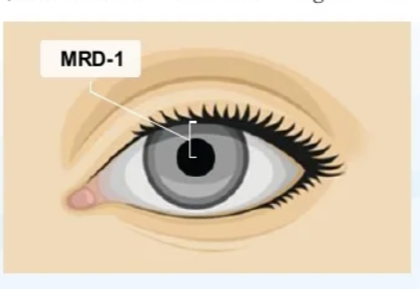

Slide 24
*Impact of Blepharodermatologic Microblading
In this semi-permanent technique, tattoo pigment is deposited into the epidermis via cuts shaped to mimic eyebrow hair to give a more natural appearance.
The effects of microblading fade as the epidermis sheds and regenerates.
Tattoo ink can cause delayed hypersensitivity reactions in the eyelid tissue.
Survey Ophthalmol. Nov/Dec, 2022

Slide 25
Graves’ Disease and the Eye
GD is an immune system disorder expressed as hyperthyroidism
Common constitutional symptoms:
Nervousness
Hand microtremor
Increased sensitivity to heat
Unintentional weight loss
Onset of symptoms: Several weeks or months
About a third of GD patients develop secondary ocular disease (TED)
Most patients are females 30 – 50 years of age
Smoking is a major complicating risk factor

Slide 26
Eye Findings in Graves’ Disease
Usually mild – can be highly variable
Upper lid retraction (often with temporal flare)
Gritty, irritated eyes, dry eyes
Periorbital edema – puffiness
Proptosis – generally relatively symmetric
Exposure keratopathy (± secondary pain)
EOM restriction, occasional diplopia
Conjunctival injection
Early detection enables better outcomes!

Slide 27
*Overview of Thyroid Eye Disease (TED)
Inflammatory autoimmune condition most often presenting with Graves disease
TED begins with orbital and periocular inflammation
Patients often suffer from psychosocial distress such as anxiety and depression
There can be substantial quality of life burden confronting patient with TED, and this newer study finds such QOL impact “is probably a lot poorer than we might have thought.”
JAMA Ophthalmol. Feb, 2023
Notes:
Smith TJ, Cockerham K, Lelli G, et al. Utility Assessment of Moderate to Severe Thyroid Eye Disease Health States. JAMA Ophthalmol. 2023;141(2):159–166. doi:10.1001/jamaophthalmol.2022.3225

Slide 28
Thyroid Eye Disease and Graves’ Disease
General Observations:
Women predominately express orbital involvement
Men predominately express late optic nerve compression
Diplopia often results from EOM enlargement and fibrosis
The “active phase” lasts 12-18 months, then spontaneous remission may occur
TED can occur at any time along the Graves’ disease continuum
Vision compromise is rare, and can occur from exposure keratopathy or optic neuropathy
EOM “belly” enlargement mainly involves the inferior and medial recti

Slide 29
Treatment for Thyroid-related Proptosis
New breakthrough drug to reduce proptosis
Tepezza™ (teprotumumab) - Amgen
75% achieved ~2.5mm reduction in proptosis
I.V. infusion every 3 weeks for 8 sessions
Mild to moderate side effects:
Cost is about $800,000.00 for 6 month treatment
Muscle spasm | Nausea
Alopecia | Diarrhea
Fatigue | Hyperglycemia
Hearing loss | Dry skin
Dysgeusia | Headache
NEJM January 23, 2020
Notes:
Douglas RS, Kahaly GJ, Patel A, et al. Teprotumumab for the treatment of active thyroid eye disease. N Engl J Med 2020;382:341-352.

Slide 30
Update on Teprotumumab (Tepezza®)
Thyroid eye disease (TED) is a secondary expression of Graves’ disease
Many patients with TED will improve without treatment
Cost varies: 500K per 150 lb. patient; 800K for obese patients
Relapse rate after cessation is 40% at 72 weeks
Main side effects: muscle spasms and nausea in 20%
In 2020, 463 reports of side effects; 78 were serious
Other optional approaches: thyroidectomy, a course of IV methylprednisolone for 12 weeks, or radiotherapy
Ophthalmology, August 2021
Notes:
Allen RC, Bradley EA, Fante RG, Lucarelli MJ. A Perspective on the Current Role of Teprotumumab in Treatment of Thyroid Eye Disease. Ophthalmology. 2021 Aug;128(8):1125-1128.

