Slide 1
Billing and Coding The Basics and Beyond
Mile Brujic, OD, FAAO
Bowling Green, OH

Slide 2
The Key to Billing and Coding….
It is simply translating what we do in the exam room to appropriate diagnosis and office visit and procedure codes
Diagnosis codes should always be the most specific to the patients condition
Office visit and procedure codes should best represent what was performed at that visit
All office visits and procedure codes have certain documentation requirements

Slide 3
ICD and CPT
ICD-10-CM: International classification of diseases, 10th revision, clinical modification
CPT: Current procedural terminology

Slide 4
Office Visits
New versus established
A new patient is one who has not received any professional services from the physician or other qualified health care professional or another physician or other qualified health care professional of the exact same specialty and subspecialty who belongs to the same group practice, within the past three years
An established patient is one who has received professional services from the physician or other qualified health care professional or another physician or other qualified health care professional of the exact same specialty and subspecialty who belongs to the same group practice, within the past three years.
https://aoa.codingtoday.com/restricted/cpt/category/500/

Slide 5
Office Visits
Level of office visit is based on three factors:
1) Number and Complexity of Problems Addressed
2) Amount and/or Complexity of Data to be Reviewed and Analyzed
3) Risk of Complications and/or Morbidity or Mortality of Patient Management
Based on meeting the requirements for two of the three elements
Additionally, you can utilize the time of the visit as a criteria for justifying a certain level

Slide 6
Office Visits
99202 (15 min)
99212 (10 min)
1) Minimal; 1 self-limited or minor problem
2) Minimal or none
3) Minimal risk of morbidity from additional diagnostic testing or treatment

Slide 7
Office Visits
99203 (30 min)
99213 (20 min)
1) Low; 2 or more self-limited or minor problems; or 1 stable, chronic illness; or 1 acute, uncomplicated illness or injury; or 1 stable, acute illness; or 1 acute, uncomplicated illness or injury requiring hospital inpatient or observation level of care

Slide 8
Office Visits
2) Limited; (Must meet the requirements of at least 1 out of 2 categories)
Category 1: Test and documents
Any combination of 2 from the following:
Review of prior external note(s) from each unique source;
Review of the result(s) of each unique test;
Ordering of each unique test; or
Category 2: Assessment requiring an independent historian(s) (For the categories of independent interpretation of tests and discussion of management or test interpretation, see moderate or high)
3) Low risk of morbidity from additional diagnostic testing or treatment

Slide 9
Office Visits
99204 (45 min)
99214 (30 min)
1) Moderate
1 or more chronic illnesses with exacerbation, progression, or side effects of treatment; or
2 or more stable, chronic illnesses; or
1 undiagnosed new problem with uncertain prognosis; or
1 acute illness with systemic symptoms; or
1 acute, complicated injury

Slide 10
Office Visits
2) Moderate
(Must meet the requirements of at least 1 out of 3 categories)
Category 1: Tests, documents, or independent historian(s)
Any combination of 3 from the following:
Review of prior external note(s) from each unique source*;
Review of the result(s) of each unique test*;
Ordering of each unique test*;
Assessment requiring an independent historian(s); or
Category 2: Assessment requiring an independent interpretation of tests
Independent interpretation of a test performed by another physician/other qualified health care professional (not separately reported); or
Category 3: Discussion of management or test interpretation
Discussion of management or test interpretation with external physician/other qualified health care professional/appropriate source (not separately reported

Slide 11
Office Visits
3) Moderate risk of morbidity from additional diagnostic testing or treatment
Examples only:
Prescription drug management
Decision regarding minor surgery with identified patient or procedure risk factors
Decision regarding elective major surgery without identified patient or procedure risk factors
Diagnosis or treatment significantly limited by social determinants of health

Slide 12
Office Visits
99205 (60 min)
99215 (45 min)
1) High
1 or more chronic illnesses with severe exacerbation, progression, or side effects of treatment; or
1 acute or chronic illness or injury that poses a threat to life or bodily function

Slide 13
Office Visits
2) Extensive
(Must meet the requirements of at least 2 out of 3 categories)
Category 1: Tests, documents, or independent historian(s)
Any combination of 3 from the following:
Review of prior external note(s) from each unique source*;
Review of the result(s) of each unique test*;
Ordering of each unique test*;
Assessment requiring an independent historian(s); or
Category 2: Assessment requiring an independent interpretation of tests
Independent interpretation of a test performed by another physician/other qualified health care professional (not separately reported); or
Category 3: Discussion of management or test interpretation
Discussion of management or test interpretation with external physician/other qualified health care professional/appropriate source (not separately reported)

Slide 14
Office Visits
3) High risk of morbidity from additional diagnostic testing or treatment
Examples only:
Drug therapy requiring intensive monitoring for toxicity
Decision regarding elective major surgery with identified patient or procedure risk factors
Decision regarding emergency major surgery
Decision regarding hospitalization or escalation of hospital-level care
Decision not to resuscitate or to de-escalate care because of poor prognosis
Decision regarding parenteral controlled substances

Slide 15
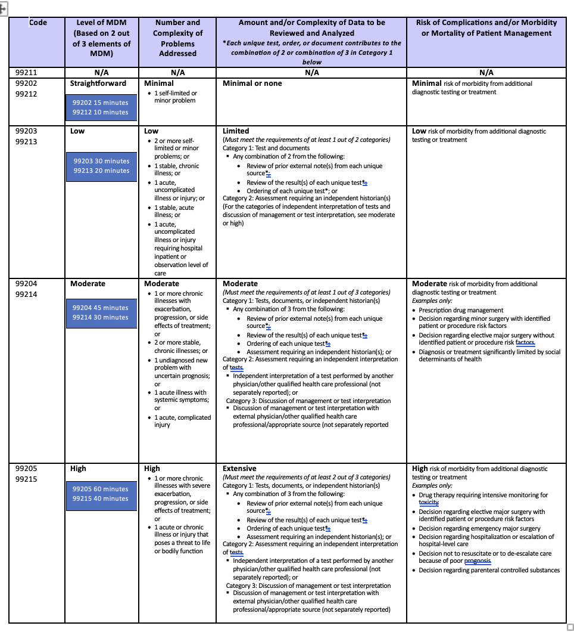
Office Visits Summary Table

Slide 16
Office Visits
www.aoa.org
Practice
Practice Success Resources
Coding and Reimbursement
AOACodingToday.com

Slide 17
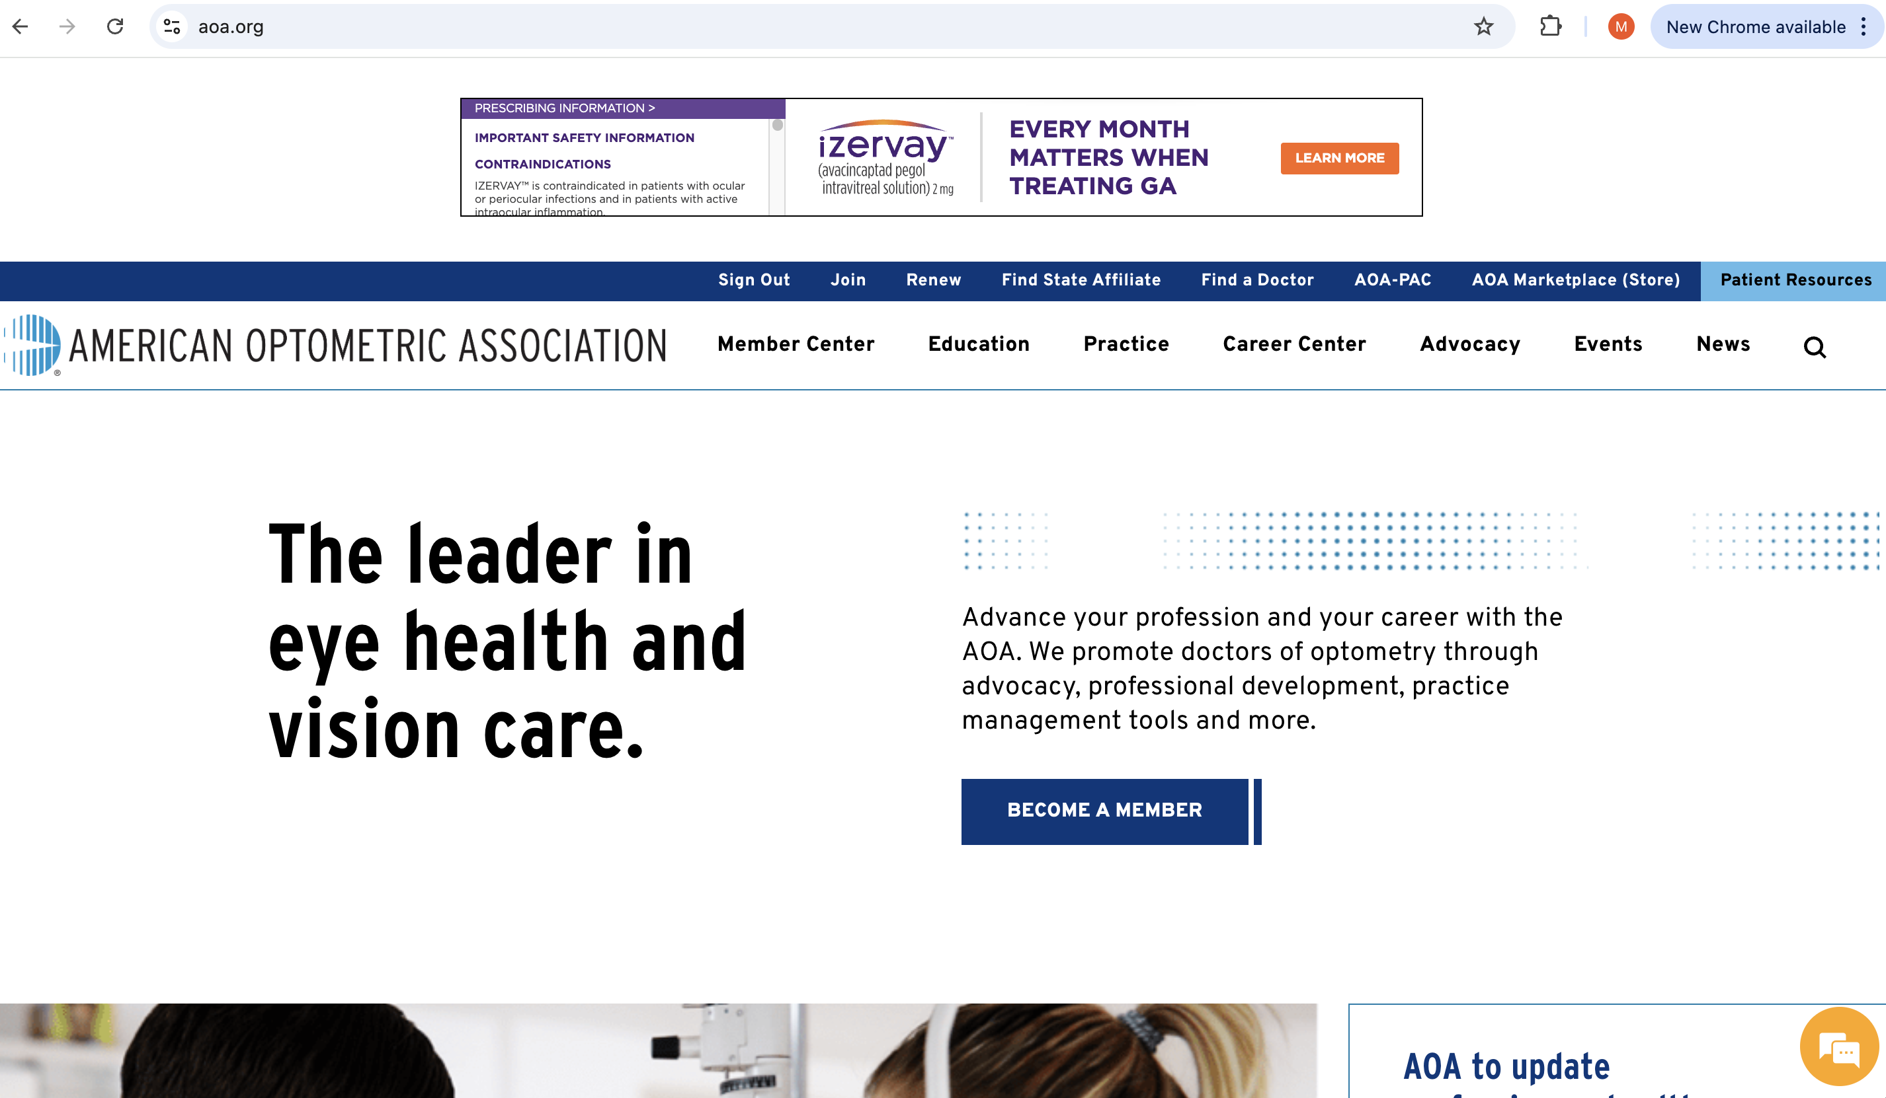
Office Visits

Slide 18
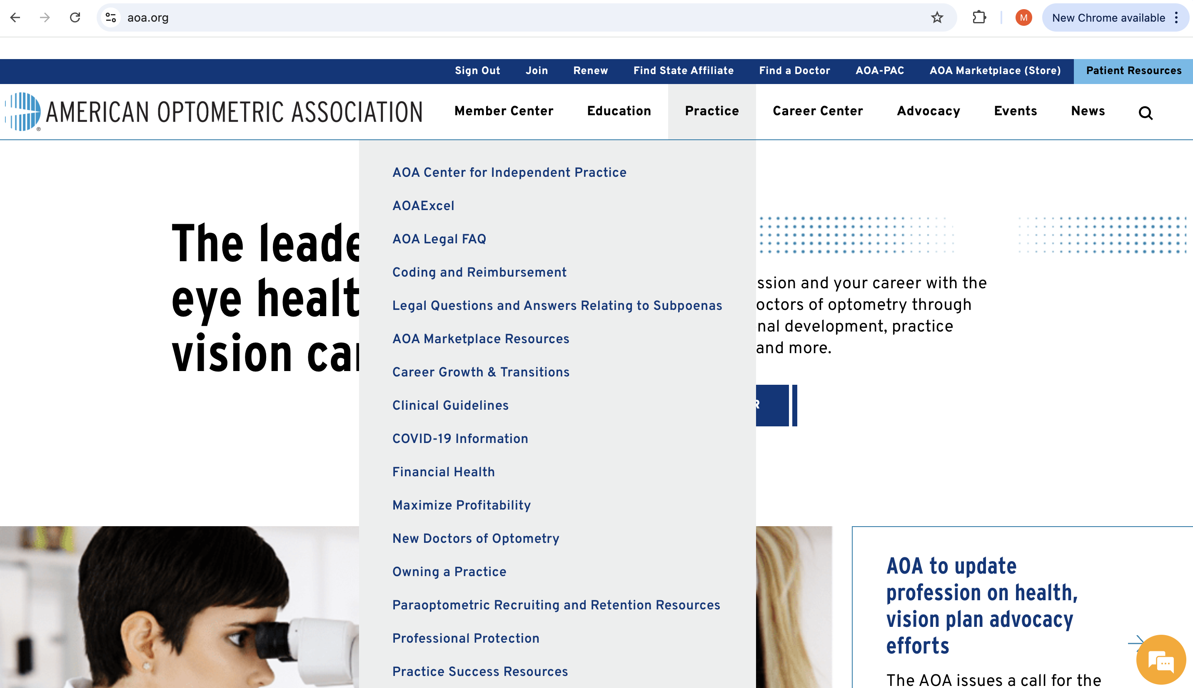
Office Visits

Slide 19
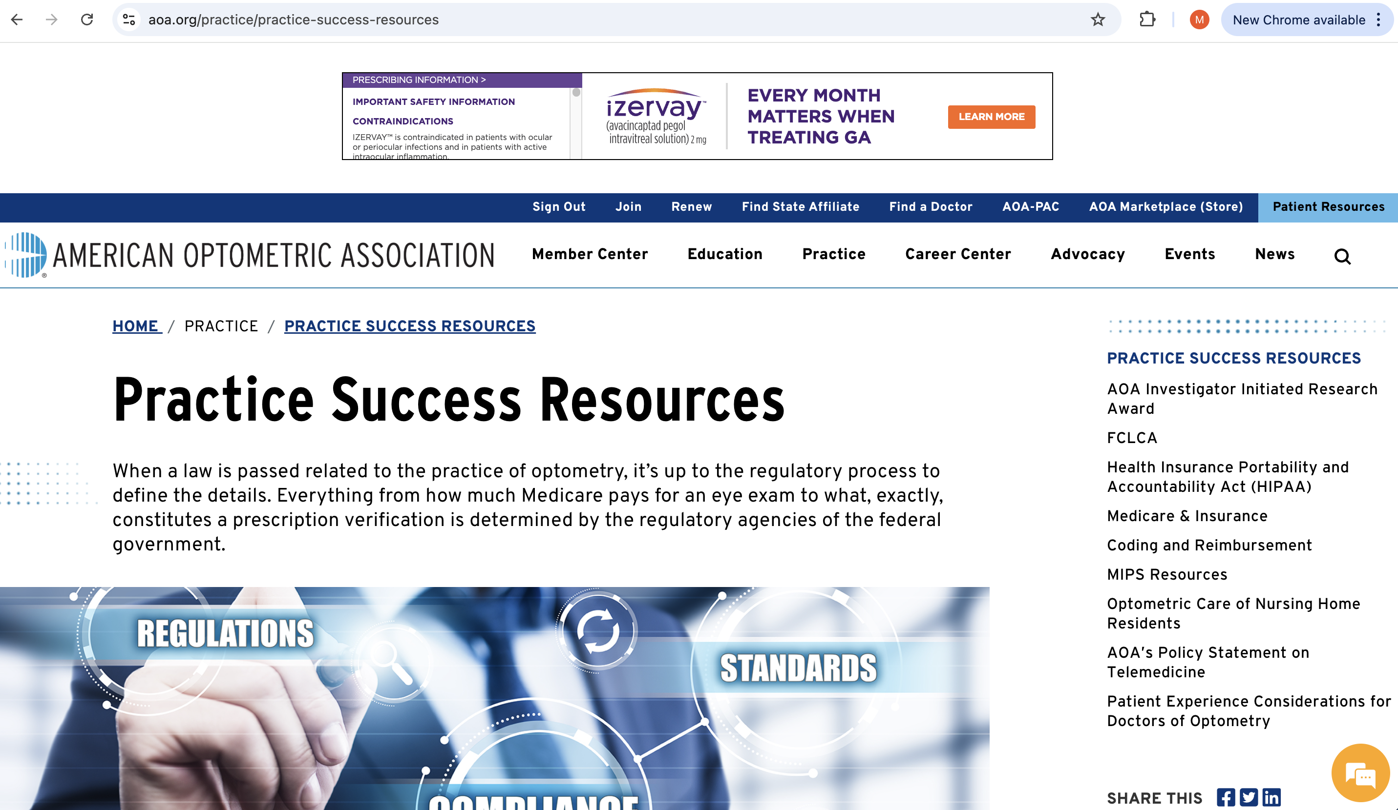
Office Visits

Slide 20
Office Visits

Slide 21
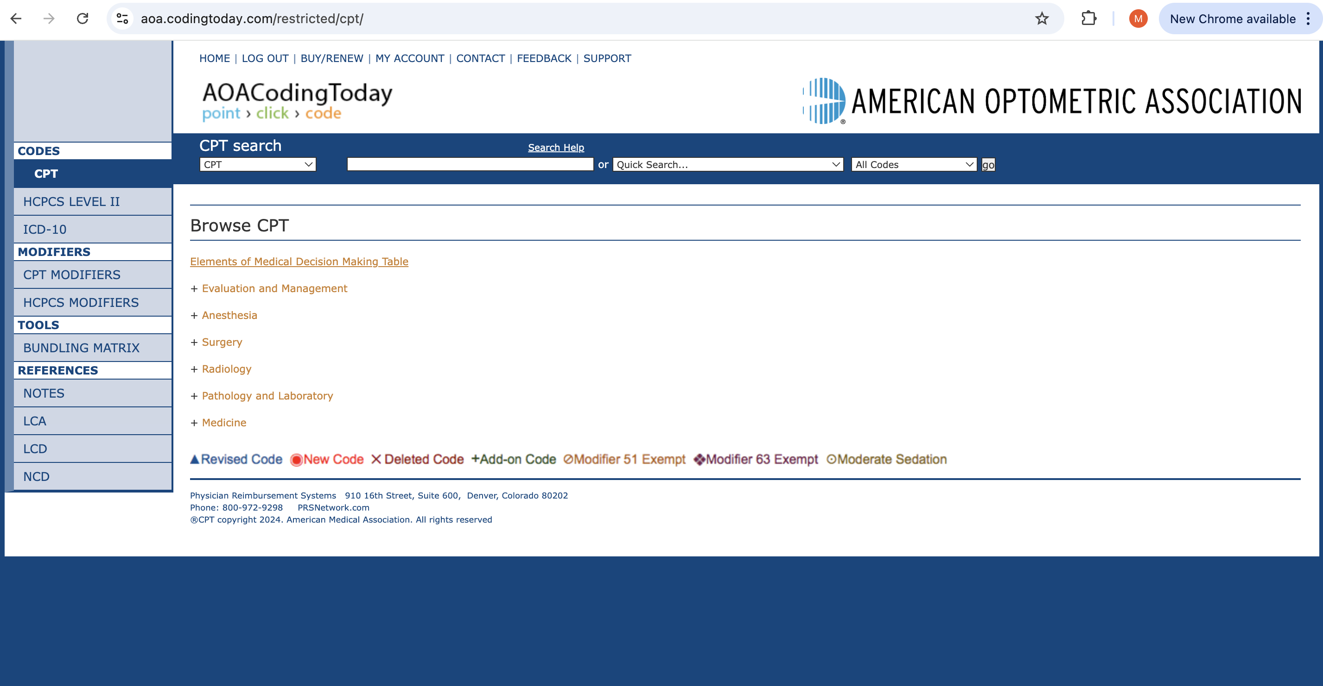
Office Visits

Slide 22
https://aoa.codingtoday.com/

Slide 23
Billing and coding ICD look up
https://www.cms.gov/medicare-coverage-database/search.aspx#

Slide 27
CPT 92004
Ophthalmological services: medical examination and evaluation with initiation of diagnostic and treatment program; comprehensive, new patient, 1 or more visits
Comprehensive ophthalmological services describes a general evaluation of the complete visual system. The comprehensive services constitute a single service entity but need not be performed at one session. The service includes history, general medical observation, external and ophthalmoscopic examinations, gross visual fields and basic sensorimotor examination. It often includes, as indicated: biomicroscopy, examination with cycloplegia or mydriasis and tonometry. It always includes initiation of diagnostic and treatment programs.

Slide 28
CPT 92004
Intermediate and comprehensive ophthalmological services constitute integrated services in which medical decision making cannot be separated from the examining techniques used. Itemization of service components, such as slit lamp examination, keratometry, routine ophthalmoscopy, retinoscopy, tonometry, or motor evaluation is not applicable.

Slide 29
CPT 92014
Ophthalmological services: medical examination and evaluation, with initiation or continuation of diagnostic and treatment program; comprehensive, established patient, 1 or more visits

Slide 30
CPT 92002
Ophthalmological services: medical examination and evaluation with initiation of diagnostic and treatment program; intermediate, new patient
Intermediate ophthalmological services describes an evaluation of a new or existing condition complicated with a new diagnostic or management problem not necessarily relating to the primary diagnosis, including history, general medical observation, external ocular and adnexal examination and other diagnostic procedures as indicated; may include the use of mydriasis for ophthalmoscopy.

Slide 31
Important to know…
Ophthalmological services: medical examination and evaluation, with initiation or continuation of diagnostic and treatment program; intermediate, established patient
Special ophthalmological services describes services in which a special evaluation of part of the visual system is made, which goes beyond the services included under general ophthalmological services, or in which special treatment is given. Special ophthalmological services may be reported in addition to the general ophthalmological services or evaluation and management services. Fluorescein angioscopy, quantitative visual field examination, refraction or extended color vision examination (such as Nagel's anomaloscope) should be separately reported.

Slide 32
CPT 92015
Determination of refractive state

Slide 33
CPT 76514
Ophthalmic ultrasound, diagnostic; corneal pachymetry, unilateral or bilateral (determination of corneal thickness)

Slide 34
CPT 92020
Gonioscopic exam to diagnose injury or disease in the anterior chamber of the eye, performed under local anesthetic due to necessity of placing specialized lens directly on the eye to obtain a clear image.

Slide 35
CPT 92132
Scanning computerized ophthalmic diagnostic imaging, anterior segment, with interpretation and report, unilateral or bilateral

Slide 36
CPT 92133
Scanning computerized ophthalmic diagnostic imaging, posterior segment, with interpretation and report, unilateral or bilateral; optic nerve

Slide 37
CPT 92134
Scanning computerized ophthalmic diagnostic imaging, posterior segment, with interpretation and report, unilateral or bilateral; retina

Slide 38
92137
Computerized ophthalmic diagnostic imaging (eg, optical coherence tomography [OCT]), posterior segment, with interpretation and report, unilateral or bilateral; retina, including OCT angiography

Slide 39
CPT 92250
Fundus photography with interpretation and report

Slide 40
CPT 92285
External ocular photography with interpretation and report for documentation of medical progress (eg, close-up photography, slit lamp photography, goniophotography, stereo-photography)

Slide 41
CPT 92081
Visual field examination, unilateral or bilateral, with interpretation and report; limited examination (eg, tangent screen, Autoplot, arc perimeter, or single stimulus level automated test, such as Octopus 3 or 7 equivalent)

Slide 42
CPT 92082
Visual field examination, unilateral or bilateral, with interpretation and report; intermediate examination (eg, at least 2 isopters on Goldmann perimeter, or semiquantitative, automated suprathreshold screening program, Humphrey suprathreshold automatic diagnostic test, Octopus program 33)

Slide 43
CPT 92083
Visual field examination, unilateral or bilateral, with interpretation and report; extended examination (eg, Goldmann visual fields with at least 3 isopters plotted and static determination within the central 30 deg, or quantitative, automated threshold perimetry, Octopus program G-1, 32 or 42, Humphrey visual field analyzer full threshold programs 30-2, 24-2, or 30/60-2)

Slide 44
CPT 67820
Correction of trichiasis; epilation, by forceps only
The physician removes an ingrown eyelash with forceps

Slide 45
CPT 68801
Dilation of lacrimal punctum, with or without irrigation

Slide 46
CPT 65222
Removal of foreign body, external eye; corneal, with slit lamp
65220 - Removal of foreign body, external eye; corneal, without slit lamp

Slide 47
CPT 65205
Removal of foreign body, external eye; conjunctival superficial
65210 - Removal of foreign body, external eye; conjunctival embedded (includes concretions), subconjunctival, or scleral nonperforating

Slide 48
CPT 68761
Closure of the lacrimal punctum; by plug, each
Considered minor procedure
10 day global period

Slide 49
CPT 92071
Fitting of contact lens for treatment of ocular surface disease

Slide 50
CPT 92072
Fitting of contact lens for management of keratoconus, initial fitting

Slide 51
CPT 65778 - amniotic membrane
Placement of amniotic membrane on the ocular surface; without sutures

Slide 52
Thank You! mile.brujic75@gmail.com

