Slide 1
Clinical Topics in Primary Eye Care
Randall Thomas, OD, MPH, FAAO

Slide 2
Financial Disclosure
Dr. Randall Thomas is a consultant to, on the speaker's bureau of, on the advisory committee of, or involved in research for the following companies: iCare and B+L.

Slide 5
An Updated Report by the US Surgeon General
“Alcohol consumption is the third leading preventable cause of cancer in the United States, after tobacco and obesity, increasing risk for at least seven types of cancer. While scientific evidence for this connection has been growing over the past four decades, less than half of Americans recognize it as a risk factor for cancer.”
US Surgeon General’s Advisory, Alcohol and Cancer Risk. January 3, 2025
Notes:
DHHS, Surgeon General of the US, Alcohol and Cancer Risk January 3, 2025. https://www.hhs.gov/sites/default/files/oash-alcohol-cancer-risk.pdf

Slide 6
Newer Science on Alcohol Consumption
“Too many Americans are living with an outdated assumption that some amount of alcohol is not only harmless, but also good for you.”
US Surgeon General’s Advisory, Alcohol and Cancer Risk. January 3, 2025

Slide 8
Health Impact Potential of Semaglutide
Ozempic (December 2017 for type 2 diabetes)
Wegovy (December 2022 for obesity)
These glucagon-like peptide 1 receptor agonists have revolutionized the care of patients with T2D and obesity.
These regulate insulin secretion, reduction of appetite and delay gastric emptying.
Rapid reduction in hyperglycemia can worsen DR initially, but long term decreased HA₁C is very beneficial.
Patients with DR should be monitored more closely during the initiation of any GLP-1 receptor agonist!!
Ophthalmology, September 2024
Notes:
Niazi, Siar et al. Association between Glucagon-like Peptide-1 Receptor Agonists and the Risk of Glaucoma in Individuals with Type 2 Diabetes
Ophthalmology, 2024;131(9):1056-1063.

Slide 9
Semaglutide (Ozempic, Wegovy) and AION
Ozempic® approved December 2017 for T2D
Wegovy ® approved December 2022 for obesity
There is the potential (yet to be substantiated) for these drugs, or their effects, to be a risk factor for AION.
Overall, these drugs are safe and effective for their approved purposes.
If a causal relationship were to be determined, it is still thought to be a rare occurrence.
JAMA Ophthalmology, August 2024
Notes:
Hathaway JT, Shah MP, Hathaway DB, et al. Risk of Nonarteritic Anterior Ischemic Optic Neuropathy in Patients Prescribed Semaglutide. JAMA Ophthalmology 2024;142(8):732-739.

Slide 11
Key Risk Factors for NA-AION
More common in white men
Only common risk factors: A normal or small optic disc with a low C/D ratio, DM or both
“Although numerous participants harbored cardiovascular risk factors classically associated with NA-AION, including hypertension, smoking, diabetes and obesity, other than a small C/D ratio and obesity, no other risk factor was present in most participants.”
“The cardiovascular risk factors presumed to be associated with NA-AION were present in 90% of participants across the 7 countries, however it was found that having a small C/D ratio clearly is a very important predisposing factor.”
Ophthalmology, July 2024
Notes:
Kupersmith MJ, Fraser CL, Morgenstern R, et al. Ophthalmic and Systemic Factors of Acute Nonarteritic Anterior Ischemic Optic Neuropathy in the Quark207 Treatment Trial. Ophthalmology 2024;131(7):790-802.

Slide 12
GLP-1RA Use: Impact on Glaucoma
Two main findings:
“The use of glucagon-like peptide - 1 receptor agonists (GLP-1RA) was associated with a 19% decrease in the risk of glaucoma.”
“Increased exposure to GLP-1RA, especially over extended durations, accentuated this protective association by 29% risk reduction when looking at 3 or more years exposure to GLP-1RA.”
More studies need to be done to corroborate these findings.
Ophthalmology, September 2024
Notes:
Niazi, Siar et al. Association between Glucagon-like Peptide-1 Receptor Agonists and the Risk of Glaucoma in Individuals with Type 2 Diabetes
Ophthalmology, 2024;131(9):1056-1063.

Slide 13
Idiopathic Orbital Inflammatory Disease (Orbital Pseudotumor)
Usually acute onset, unilateral, red eye
Chemosis, lid edema and erythema
Proptosis, EOM dysfunction - diplopia +
Systemic association rare if unilateral
VA, exophthalmometry, IOP, CT or MRI
Treatment is oral prednisone, high dose (1mg/kg/d initially) with taper

Slide 14
Idiopathic Orbital Inflammation
Presents as dacryoadenitis in up to 50% of cases
Risk factors for development of “idiopathic orbital inflammation” include high body mass index, lower socioeconomic status, and bisphosphonate use (Fosamax®, Boniva®, Actonel®, ReClast®)
Mean age at onset: About 50 (Range 11-86)
Fluctuating periorbital swelling, most often noticed upon awakening
CT or MRI is essential for work-up
Lacrimal gland biopsy is further definitive
Initial Tx: Approximately 60-80 mg P.O. prednisone per day with long slow taper
Am J Ophthalmol, Mar, 2016
Notes:
Andrew NH, Kearney D, Sladden N, et al. Idiopathic Dacryoadenitis: Clinical Features, Histopathology, and Treatment Outcomes. Am J Ophthalmol 2016;163:148-153.e1.

Slide 15
Idiopathic Orbital Inflammation
Bisphosphonate generic drugs typically end in “ronate”
Common brand/generic names are:
Fosamax® - alendronate sodium
Boniva® - ibandronate sodium
Actonel® - risedronate sodium
Reclast® - zoledronic acid

Slide 16
Myopia and Low-Dose Atropine (LDA)
Low-dose atropine is neither commercially available nor FDA approved
Ocular compounding pharmacies can make such
0.01% and 0.05% concentrations are commonly used
Dosage is at bedtime for many years
Combining LDA with multifocal lenses is being studied.
“Pediatricians and optometrists are referring patients specifically for LDA treatment.”
This intervention is evolving, and exact protocols are yet to be established.
EyeNet Magazine, August, 2021
Notes:
McKenzie K. Low-dose atropine to slow myopia: Evidence and adoption are growing. EyeNet Magazine, August 2021.

Slide 17
Myopia Control: Onset and Progression
“Daily disposable soft bifocal and multifocal contact lenses require less professional expertise and oversight than are required for orthokeratology lens treatment, and they possess similar efficacy in slowing myopia progression.”
Low dose atropine (0.01%) is the “most reasonable approach to myopia control.”
“Increasing outdoor time seems central to mitigating the risk of myopia onset.” However, such outdoor activity is less effective regarding progression.
Early screening and early diagnosis of children with myopia is essential to maximize the benefit of myopia control interventions.
Ophthalmology, June 2021
Notes:
Modjtahedi BS, Abbott RL, Fong DS, Lum F, Tan D. Reducing the Global Burden of Myopia by Delaying the Onset of Myopia and Reducing Myopic Progression in Children The Academy’s Task Force on Myopia. Ophthalmology 2021;128(6):816-826.

Slide 18
2024 Atropine for Myopia Update
“Long-term F/U of a minority of participants who received 0.01% atropine for 3 to 4 years during childhood did not affect final refractive errors or incidence of ocular complications in adulthood.”
“There is uncertainty if low-dose atropine concentrations in common clinical use today, such as 0.01% or 0.05%, have long-term benefit.”
JAMA Ophthalmology, January 2024
Notes:
Li Y, Yip M, Ning Y, et al. Topical Atropine for Childhood Myopia Control: The Atropine Treatment Long-Term Assessment Study. JAMA Ophthalmology. 2024:142(1):15-23.

Slide 19
Primary HSV Infection
Vesicular eruptions on the eyelid skin and/or eyelid margin
Can be limited to the skin or can also result in follicular conjunctivitis and/or corneal epithelial disease
Treatment: - PO ACV 400 mg 5 x D x 1W - PO Valtrex 500 mg tid x 1W
Vesicles resolve without scarring
Notes:
19

Slide 20
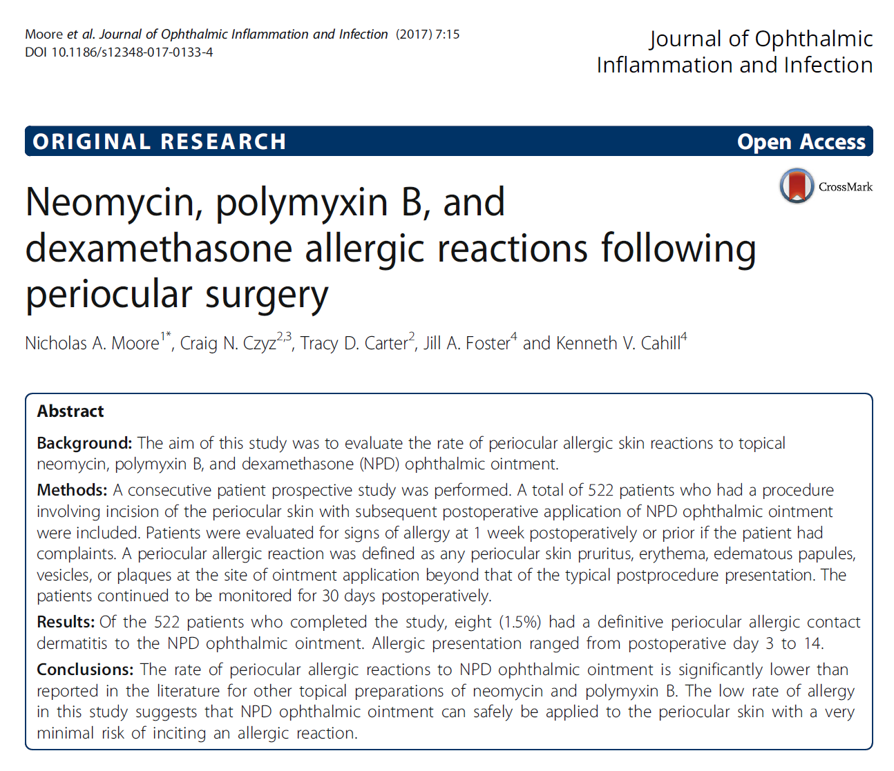

Slide 21
Itch Girl Dx
Based on this information, your assessment is:
1. Medicamentosa reaction to topical steroid
2. Allergic conjunctivitis that is non- responsive to steroid
3. Phthiriasis Palpebrarum
4. Chlamydial conjunctivitis

Slide 22
Dural Arteriovenous Malformations of the Cavernous Sinus
Us. women ages 50 or older; often with HTN
Classic syndrome:
mild to moderate proptosis
dilation of conjunctival vessels
mild to moderate conjunctival chemosis
abducens nerve paresis
venous stasis retinopathy
DDx: Conjunctivitis, dysthyroid orbitopathy, orbital pseudotumor, true orbital mass

Slide 23
Dural AVM of the Cavernous Sinus
Almost always spontaneous (not trauma assoc.)
Work-up: comprehensive eye exam, MRI, TSH
Natural history
rarely affect mortality rates
rarely bleed
rarely have extraocular signs and symptoms
often close spontaneously
Patient at risk for infrequent CRVO; rarely glaucoma

Slide 24
Lotilaner (Xdemvy®): Literature Update
“Four RCTs were included in the meta-analysis of mite eradication incidence.”
“In terms of efficacy, our study demonstrated statistically significant and better outcomes in patients treated with lotilaner compared to those who received a placebo.”
“Lotilaner administration and cost effectiveness should now be contemplated for the study population as these constituents have a vital impact on treatment success.”
Notes:
Talha M, Ali MH, Fatima E, et al. Efficacy and Safety of Lotilaner Ophthalmic Solution (0.25%) for the Treatment of Demodex Blepharitis: A GRADE Assessed Systematic Review and Meta-Analysis of Observational & Experimental Studies. Am J Ophthalmnol 2024;264:8-16.

Slide 25
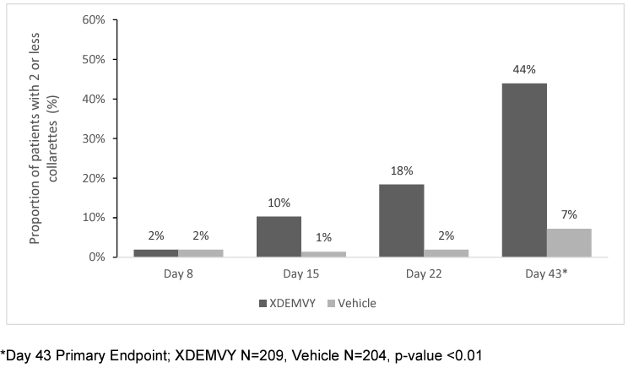
XDEMVY. Prescribing Information, Tarsus Pharmaceuticals, Inc. 2023

Slide 26
The American Academy of Ophthalmology on FEMTO
“Compared with PHACO, FEMTO has been shown to produce a precisely circular, centered capsulotomy and to reduce the amount of ultrasound energy delivered within the eye during PHACO. However, in several meta-analysis, these benefits have not translated into improved refractive outcomes or reduced complications. In addition, additional costs are associated with FEMTO as compared with PHACO.”
“Patients achieve excellent visual acuity and refractive accuracy with both FEMTO and PHACO, but one technique is not superior to the other.”
“This study, even with sensitivity analyses, showed that FEMTO was not superior to PHACO, but more expensive.”
Ophthalmology, Aug 2022
Notes:
Lin CC, Rose-Nussbaumer JR, Al-Mohtaseb ZN, et al. Femtosecond Laser-Assisted Cataract Surgery: A Report by the American Academy of Ophthalmology. Ophthalmology 2022;129(8):946-954. doi:10.1016/j.ophtha.2022.04.003

Slide 27
Impact of Blepharodermatologic Microblading
In this semi-permanent technique, tattoo pigment is deposited into the epidermis via cuts shaped to mimic eyebrow hair to give a more natural appearance.
The effects of microblading fade as the epidermis sheds and regenerates.
Tattoo ink can cause delayed hypersensitivity reactions in the eyelid tissue.
Survey Ophthalmol. Nov/Dec, 2022

Slide 28
From the 2019 American Academy of Ophthalmology
“Optometrists were portrayed as greedy opportunists reaching beyond their skill set to recklessly expand their scope of practice, endangering the populace as a result. Most of the major sessions ended with the speaker imploring the attendees to donate to the Academy of Ophthalmology’s political action committee for the express purpose of fighting the progress of optometry legislatively.
This wasn’t just an occasional cheap shot here and there: it was built into the meeting’s program to close the talks with an anti-optometry diatribe and a passing of the collection plate.”
Persico J. “A Tale of Two Academies.” Review of Optometry, Nov 15, 2019.

Slide 29
Qbrexza: The Importance of History!
The mydriasis was “eventually” attributed to Qbrexza! (Think! Take a good Hx!)
“Inadvertent contact with the ocular structures can cause mydriasis and blurred vision. A thorough history asking specifically about cloth wipes such as Qbrexza for patients presenting with unilateral mydriasis in the absence of extraocular motor deficits may prevent unnecessary medical costs, neuroimaging, and risk, as well as avoid considerable fear and anxiety for our patients.”

Slide 30
Superior Limbic Keratoconjunctivitis
Both sexes affected, women more
Main symptoms: distressingly irritated eyes
Dry eyes common companion finding
Symptoms disproportionate to clinical findings
Spontaneous exacerbations and remissions
25-40% have some thyroid dysfunction
Tx: difficult- .5% AgNO3, optimum lubrication, pressure patching, therapeutic soft lenses, surgical resection, cryotherapy

Slide 31
SLK: A Comprehensive Review
No familial or ethnic relationships; F>M
Pathology: mechanical/friction with DED leading to keratinization of conjunctival tissues.
Prognosis: Good Duration: 1-10 years
“A high rate of associated autoimmune thyroid disease” is not well understood. All patients should be evaluated for thyroid disease.
Tx: Punctal plugs, lipid ATs, large diameter SCLs, 0.5% silver nitrate and others.
Surgical conjunctival resection “may be considered when patients are not responsive to medical therapy.”
Survey Ophthalmol. Mar/Apr, 2022
Notes:
Lahoti S, Weiss M, Johnson DA, Kheirkhah A. Superior limbic keratoconjunctivitis: a comprehensive review. Surv Ophthalmol. 2022 Mar-Apr;67(2):331-341.

