Slide 1
CONTEMPORARY GLAUCOMA CARE
Ron Melton, OD, FAAO
Randall Thomas, OD, MPH, FAAO

Slide 2
Financial Disclosure
Dr. Ron Melton and Dr. Randall Thomas are consultants to, on the speakers bureau of, on the advisory committee of, or involved in research for the following companies: ICARE, B+L

Slide 3
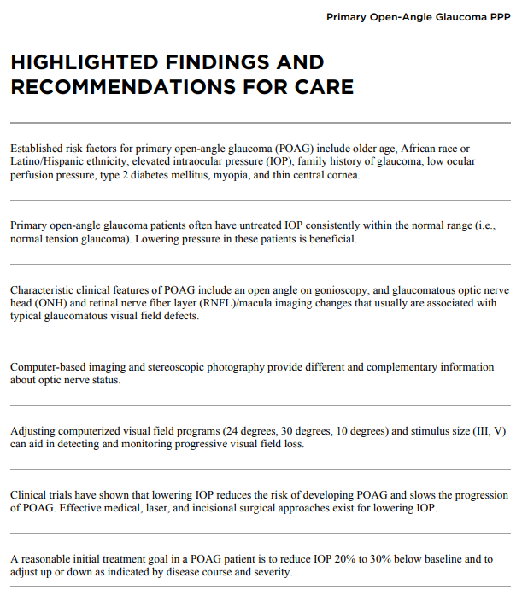

Slide 4
Perspective on Ocular Hypertension Treatment Study
About 5% of Americans over age 40 have OHT
Screening tests are RNFL assessment and VF testing
“Median time to develop POAG was 6.0 years in the observation group and 8.7 years in the medication group.”
“There is little absolute benefit of early treatment in low-risk OHT patients. Most OHT patients fall into this group and probably can be followed less frequently without treatment.”
5 Key Factors: Age, IOP, CCT, C/D ratio, and VF’s
Am J Ophthalmol, May, 2018
Notes:
Gordon MO, Kass MA. What We Have Learned From the Ocular Hypertension Treatment Study. Am J Ophthalmol. 2018;189:24-27.

Slide 5
Guidance On If Or When to Treat
“Treatment for glaucoma is never benign and may cause more disability than the disease itself.”
“Accurately assessing the stage of a person’s glaucoma is essential. If there is no detectible existing visual loss, then the development of a small amount of loss should be of no immediate concern, as it will not cause the person to have either a decreased quality of life or a decreased ability to perform the activities of daily living. In such a situation one wonders why any treatment is advised. Knowing that early changes are possibly reversible decreases even further the need to initiate treatment.”
Survey Ophthalmol, 66(4) 2021
Notes:
Ahmed OM, Waisbourd M, Spaeth GL, Katz LJ. Improvement in structure and visual function in patients with glaucoma: the possible key to better treatment? Survey Ophthalmol. 2021;66(4):644-652.

Slide 6
Optic Nerve Head Evaluation
Cup depth is critical - Stereopsis!
Are cup walls steep or sloping?
Note rim translucency and vertical elongation of the cup
Is the cup concentric with the disc, or is the cup displaced?
Is the neuroretinal rim thinned more at certain clock hours than others? Especially look for any accentuated erosion of the inferotemporal or superotemporal regions.
Is the disc generally pink, yellowish, or pale?

Slide 7
ISN’T
Helpful diagnostic observation in ONH evaluation
Normal neuroretinal rim anatomy follows the ISN’T rule
  - Inferior rim should be thickest
  - Superior rim is slightly less thick
  - Nasal rim is slightly less thick
  - Temporal rim should be the thinnest
Most ONH’s are round or slightly vertically oval
ISN’T rule may not hold if ONH horizontally oval

Slide 8
Hard to Judge ONH’s
70 yocm followed by OD “nephew” for 5 yrs. Old records show .1 cups OU
Family Hx unknown
Meds: Lipitor, ASA, NKDA’s
BVA’s: 20/30, 20/30
SLE: 2+NS cataracts
Gonio: Angles grade 2+ open OU
IOP: 19 OU
CCT: 595, 585
DFE: ONH’s OD .8; OS.85
VF (24-2 SF): OD normal; OS ? Infer
NFL: OD normal; OS normal
Plan:
Notes:
Walker, Joseph

Slide 9
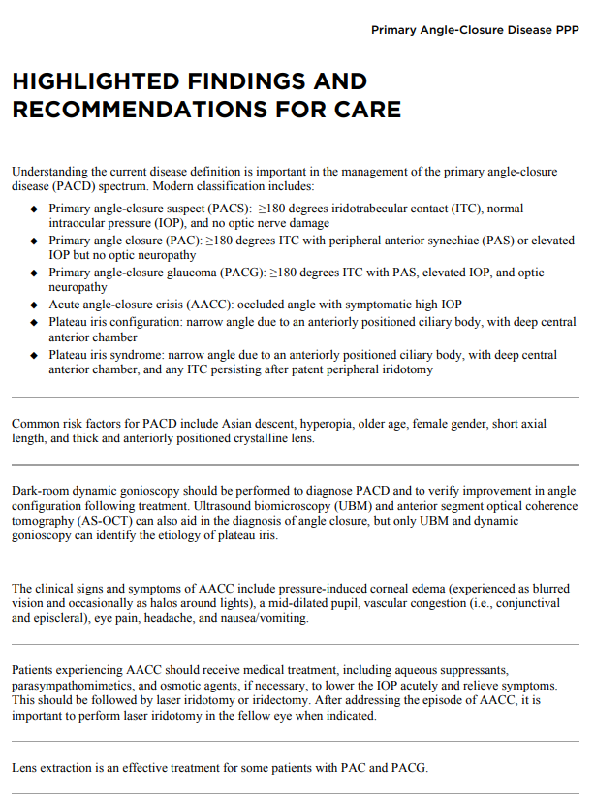

Slide 10
*Pupillary Dilation and Angle Closure
Exceedingly rare in Western populations
Asian people (especially Chinese) are more at risk
LPI had no significant effect on post dilation IOP in eyes characterized as primary angle closure suspects
Acute angle closure “is extremely low even in primary angle closure suspects.”
“Routine LPI before dilation is not recommended.”
Am J Ophthalmol. March, 2022
Notes:
Wang L, Huang W, Han X, Liao C, Jin L, He M. The Impact of Pharmacological Dilation on Intraocular Pressure in Primary Angle Closure Suspects. Am J Ophthalmol. 2022;235:120-130.

Slide 11
*Is Laser Photoiridotomy (LPI) the ”Fix” for Narrow Angles?
No! but prevents angle closure in most patients
“Primary angle closure suspect eyes with persistent angle narrowing by anterior-segment OCT or cumulative gonioscopy score 2 weeks after LPI were at higher risk of primary angle closure and acute angle closure.”
Quantify (and document) angle anatomy pre-LPI, then again 2 week after LPI. You should see opening and deepening of the angle. If not, follow the patient more closely!
There is recent trending moving away from LPI toward earlier lens extraction.
JAMA Ophthalmol, June 2023
Notes:
Augusto Azuara-Blanco. Use of Biometric Data After Laser Peripheral Iridotomy—Individualized Monitoring Strategy for Angle Closure Progression. JAMA Ophthalmol. 2023;141(6):524. doi:10.1001/jamaophthalmol.2023.1119

Slide 12
Impact of LPI on Primary Angle Closure Disease
Some eyes exhibited angle widening after LPI but showed narrowing over time
Mechanisms of angle closure: Pupillary block, plateau iris, thick peripheral iris, and exaggerated lens vaulting
“Continuous monitoring of these patients by AS-OCT should be considered mandatory.”
Am J Ophthalmol. January 2024
Notes:
Jiehoon Kwak,Kilhwan Shon,Yunhan Lee,Kyung Rim Sung. Progressive Changes in the Anterior Segment and Their Impact on the Anterior Chamber Angle in Primary Angle Closure Disease. Am J Ophthalmol 2024;257:57-65.

Slide 13
How Often Do Narrow Angles Close?
Occlusion is much more common in elderly women
Higher IOP and shallow central and limbal anterior chamber depth are risk factors for progression to occlusion.
AS-OCT very helpful at detection and in follow-up (but was no better at detection than Van Herrick!)
25% of “occludable” angles actually occluded over 14 years
Risk factors: old age, female, hyperopia, Asian race, + family history
Avoid use of sympathomimetic medications
Use smartphone flashlight if an attack occurs as first aid.
JAMA Ophthalmol. March 2024
Notes:
Yuan Y, Xiong R, Wang W, et al. Long-Term Risk and Prediction of Progression in Primary Angle Closure Suspect. JAMA Ophthalmol. 2024;142(3):216–223. doi:10.1001/jamaophthalmol.2023.5286

Slide 14
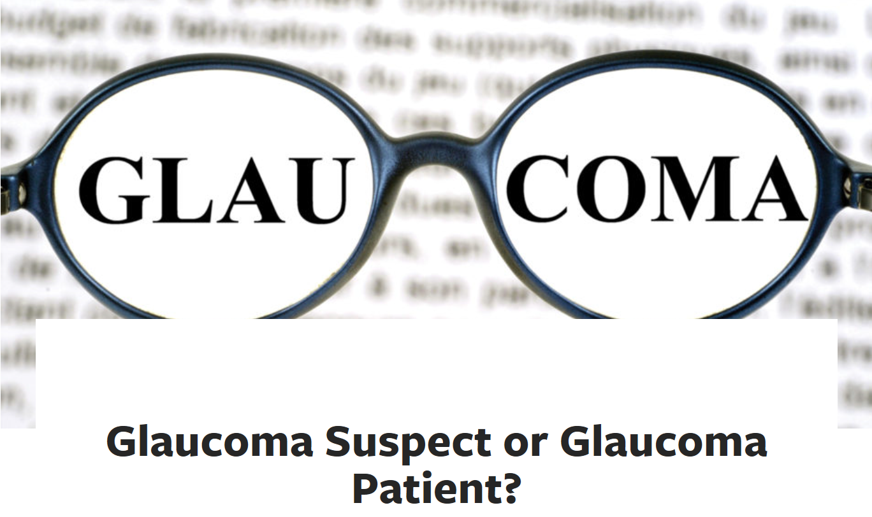

The Pressure on Glaucoma Clinics
“Glaucoma clinics are currently under colossal strain, partly due to aging populations, but mainly because they’re increasingly being sent people who have been referred ‘just in case’, but who in truth have healthy eyes and don’t need to be there.”
The Ophthalmologist, June, 2019

Slide 15
Stop Referring Glaucoma Suspects!
“Opportunistic screening by optometrists may result in earlier detection of glaucoma but also an increased burden on ophthalmologists because of larger numbers of referred patients.”
The optometric profession, in our opinion, needs to become mostly autonomous care givers for most all patients with glaucoma (or glaucoma suspects).
Am J Ophthalmol, August 1, 2021
Notes:
Aspberg J, Heijl A, Bengtsson B. Screening for Open-Angle Glaucoma and Its Effect on Blindness. Am J Ophthalmol 2021;228:106-116.

Slide 16
Systemic Medicines and Their Associations with Advanced Glaucoma
SSRI’s (selective serotonin reuptake inhibitors) and
  Prozac®, Zoloft®, Paxil® and Lexapro®
SNRI’s (serotonin-norepinephrine reuptake inhibitors)
  Effexor®, Cymbalta®
showed a 30% protective effect
Beta-blockers (mainly metoprolol); 20% protection
CCB (calcium channel blockers) (mainly amlodipine) (Norvasc®) have a strong harmful association with glaucoma.
Eye physicians need to be aware of these positive and negative influences on their patients with advancing, and advanced glaucoma.
Ophthalmology, July, 2018
Notes:
Zheng W, Dryja TP, Wei Z, et al. Systemic Medication Associations with Presumed Advanced or Uncontrolled Primary Open-Angle Glaucoma. Ophthalmology 2018;125(7):984-993.

Slide 17

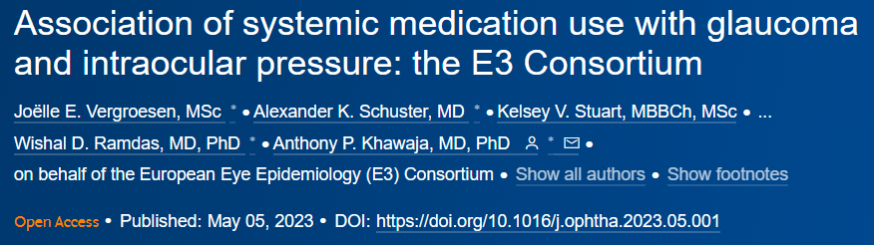
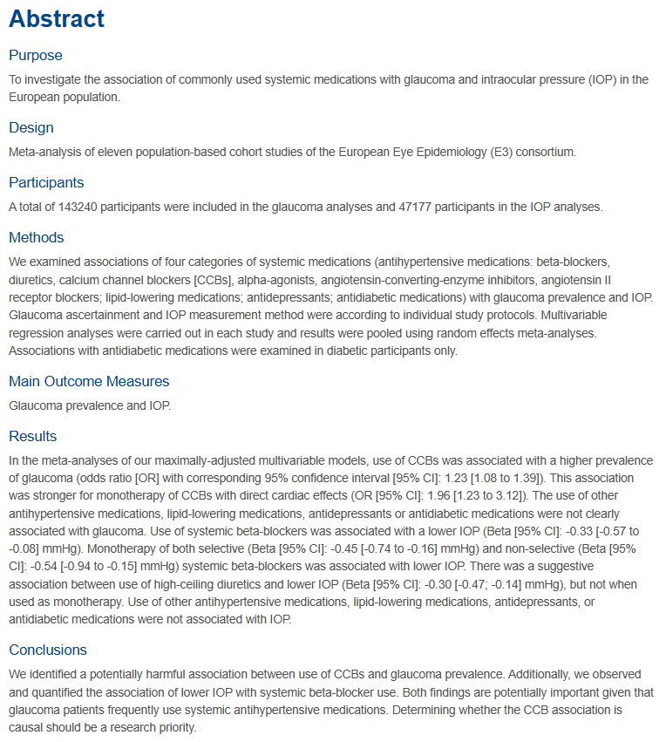
*

Slide 18
Systemic Antihypertensive Medicines and Glaucoma
This AJO article of November, 2023 further underscores the previous knowledge of the impact of systemic antihypertensive medicines can have on glaucoma risk.
Low systemic blood pressure is a risk factor for glaucoma, especially LTG.
Use of systemic BB may delay the onset of the need for ocular treatment.
Calcium Channel Blockers (amlodipine, esp.), by reducing “ocular perfusion pressure,” can put the ONH at increased risk of glaucoma.
Am J Ophthalmol. Nov, 2023
Notes:
Leung G, Grant A, Garas AN, Li G, Freeman EE. A Systematic Review and Meta-analysis of Systemic Antihypertensive Medications With Intraocular Pressure and Glaucoma. Am J Ophthalmol 2023;255:7-17.

Slide 19
Sleeping Relationship on IOP
IOP is highest while we sleep
In Supine posture there is a hydrostatic increase in the pressure of the episcleral and orbital veins.
“The reason that nocturnal IOP elevation is so important is because: the increase is greater for glaucoma patients and the increase coincides with the time when our systemic blood pressure is the lowest. If IOP increases and BP decreases, the ocular perfusion pressure will decrease, leaving it at greater risk for glaucomatous damage.”
Doug Rett, OD, FAAO.
Primary Care Optometry News. March 28, 2018.

Slide 20
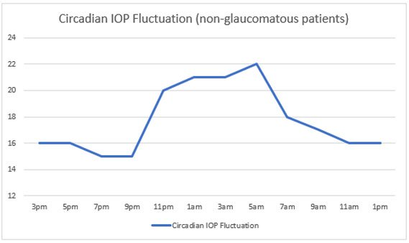
IOP (shown here in mm Hg) changes during the day, reaching its highest points at night. Source: Doug Rett, OD, FAAO. Primary Care Optometry News. March 28, 2018.

Slide 21
Expert Perspective on Rebound Tonometry
“The iCare rebound tonometer demonstrated significantly lower test-retest variability than Goldman tonometry with good inter-operator and inter-device reproducibility, supporting it’s value in monitoring IOP changes over time aiding clinicians in assessing the effectiveness of glaucoma therapy and consistency of IOP control.” “Rebound tonometry can
characterize IOP changes over time more robustly than
Goldman tonometry.”
Notes:
Realini T, McMillan B, Gross RL, Devience E, Balasubramani GK. Assessing the Reliability of Intraocular Pressure Measurements Using Rebound Tonometry. J Glaucoma. 2021 Aug;30(8):629-633.

Slide 22
Handheld vs Slit lamp Mounted iCare Tonometer: Is There a Difference?
Both rebound devices were also compared to GAT
Study of 64 men and 93 women
“Measurements with the 3 tonometers were not statistically different from each other.”
“Conclusions: The ST500 (slit lamp mounted) shows good agreement with GAT over a large range of IOP and significantly higher repeatability compared to the IC200 (handheld) and GAT, suggesting it may be advantageous in clinical settings where topical anesthesia or skilled staff are unavailable.”
Ophthalmology Glaucoma, March/April 2025
Notes:
Tomita, Ryo et al. A Comparative Study of the Handheld IC200 and Slit Lamp-mounted ST500 Rebound Tonometers with Goldmann Applanation Tonometry
Ophthalmology Glaucoma, Volume 8, Issue 2, 152 - 156

Slide 23
Virtue of Non-Office Hours IOP Measurements
“Two-thirds of patients experienced peak IOP outside of regular clinic hours, with peak IOP most frequently occurring at night.”
“We recommend obtaining multiple IOP pressure measurements outside of office hours.”
The Icare HOME device allows for self-measurement of IOP and your contact lens technician can easily teach most patients how to perform this technique.
Survey Ophthalmol, March/April 2020
Notes:
Mansouri K, Tanna AP, De Moraes CG, Camp AS, Weinreb RN. Review of the measurement and management of 24-hour intraocular pressure in patients with glaucoma. Survey Ophthalmol 2020;65(2):171–186.

Slide 24
Expert Perspective on Self-Tonometry
“Currently iCare Home is the best option for self-tonometry because it does not require anesthesia and has a system that allows the patient to know when the device is aligned and will get the best possible values.”
“The iCare Home can be used for self-measurement by most trained individuals and IOP measurements obtained using iCare Home tonometry by self- and third-party assessment showed a slight underestimation compared to GAT.”
Survey Ophthalmol. Sept-Oct, 2022

Slide 25
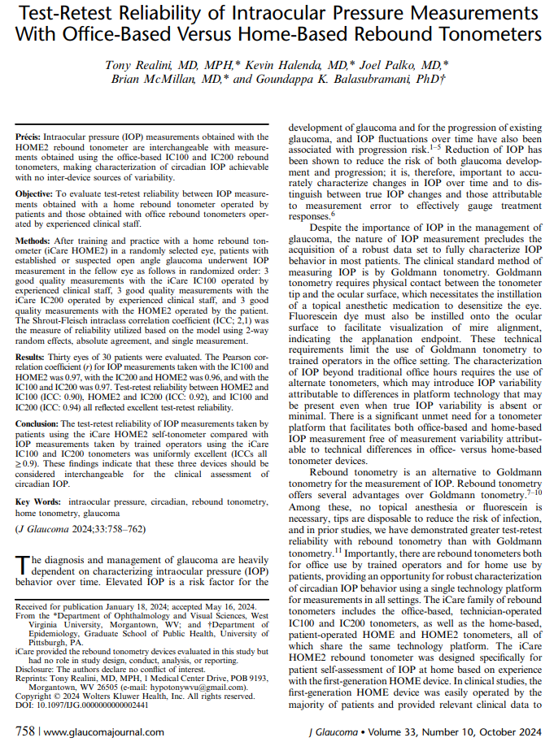
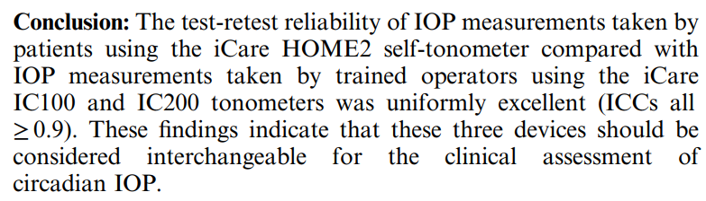

Slide 26
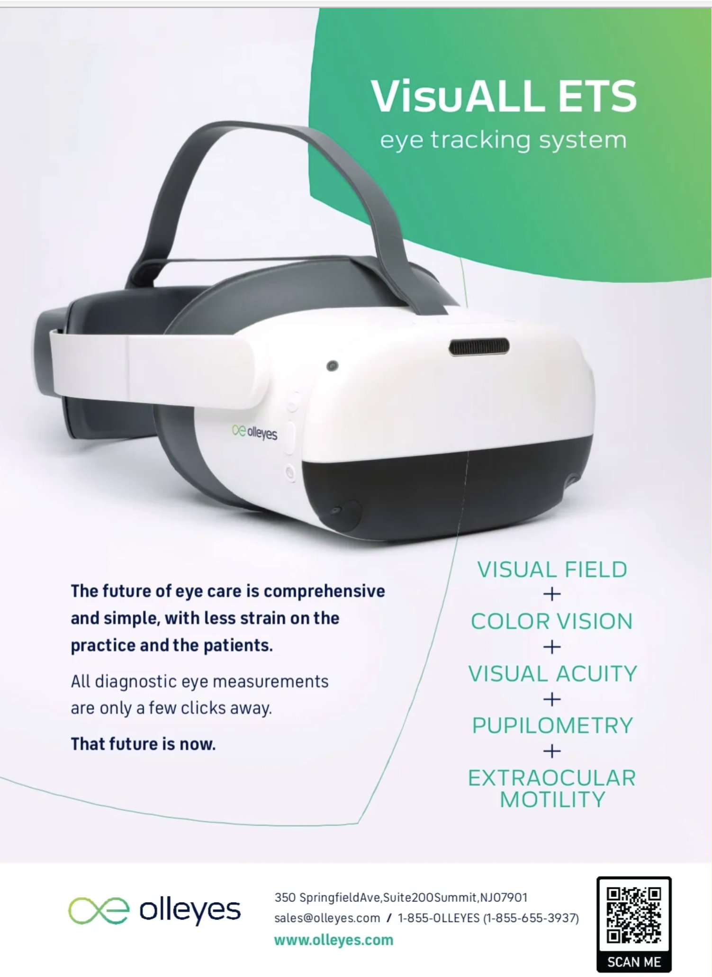

Slide 27
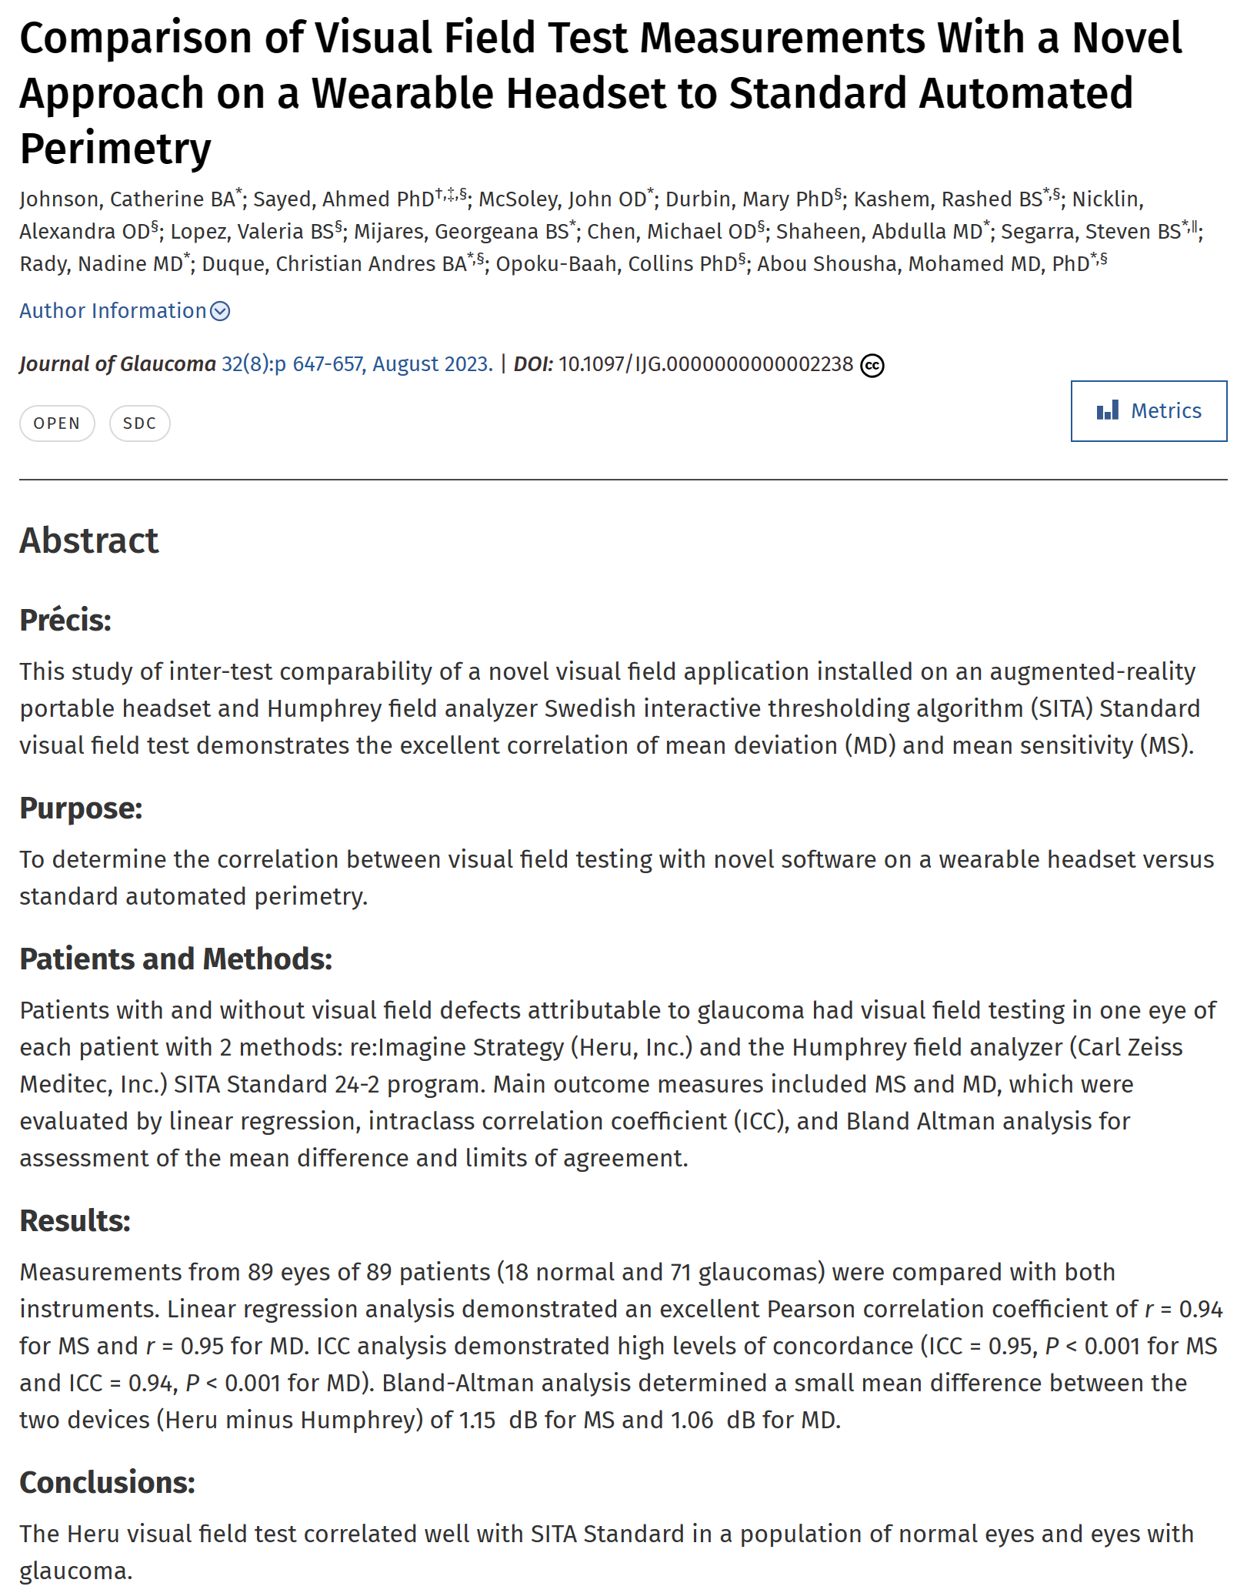

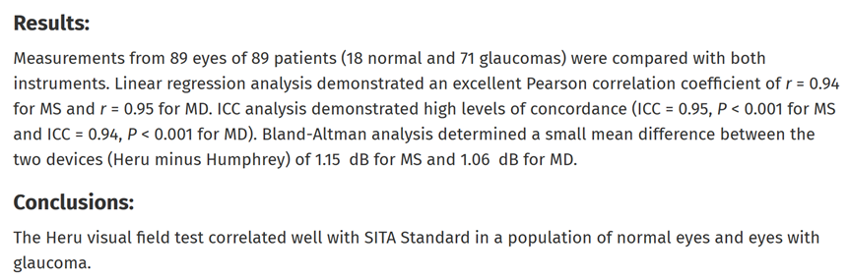

Slide 28

New SITA-FASTER
Judging “rate of progression” is a critical step in managing glaucoma
New proposal protocol:
  3 fields per year for the first 2 years
  Then revert to annual testing
Known for over 2 decades: Overall SITA-Fast is just as good as SITA-Standard
SITA-Faster shaves about 2 minutes per eye off testing time, making more frequent testing more practical.
“Given the importance of not missing the conversion to glaucoma, the frequency of testing used in OHTS (6 mo) was optimal for the detection of progression in high-risk patients. Low-risk patients could be potentially be tested every 12 months to optimize resource utilization.”
-J of Glaucoma 8-23
Notes:
Heijl A, Patella VM, Chong LX, et al. A new SITA perimetric threshold testing algorithm: Construction and multicenter clinical study. Am J Ophthalmol. 2019;198:154-165.

Slide 29
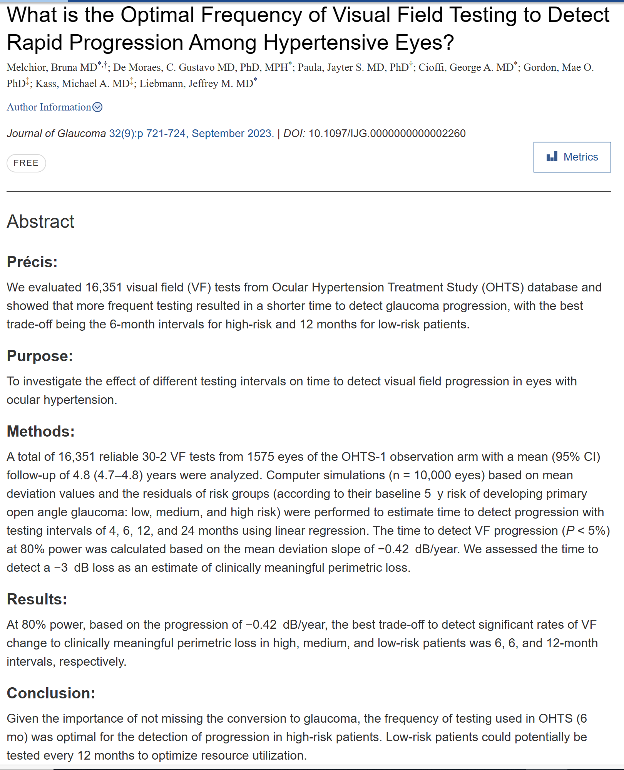

Slide 30
Breakthrough on Gonioscopic Training
A most wonderful website exists to help teach superb gonioscopic anatomy and technique
Please seek and study:
www.gonioscopy.org

Slide 31
Preventing Angle Closure Through Gonioscopy
Risk factors for angle closure:
  Positive family Hx of angle closure
  Older age
  Female sex
  Asian descent
  Hyperopia
Gonioscopy is absolutely essential, yet rarely done, even among patients with glaucoma.
Even when gonioscopy was done, over half of the patients did not receive a Dx of narrow angles!
There is a need for “increased attention to education on proper gonioscopy technique among ophthalmology residents and optometry students to ensure accurate characterization of angle morphology.”
www.gonioscopy.org
JAMA Ophthalmol. June, 2022
Notes:
Wu AM, Stein JD, Shah M. Potentially Missed Opportunities in Prevention of Acute Angle-Closure Crisis. JAMA Ophthalmol. 2022;140(6):598–603. doi:10.1001/jamaophthalmol.2022.1231.

Slide 32
Role of Cataract Extraction on IOP
“The role of cataract extraction in the alogorithm of glaucoma treatment is undeniable.”
“The latest studies to include washout in the context of MIGS show surprisingly large effects of phacoemulsification alone and relatively small incremental benefit of MIGS.”
(M+T: Don’t be “oversold” on hyped MIGS!)
Results of cataract extraction
  For angle closure, reduction averaged 6.4 mm Hg
  For open angle glaucoma, about 2.7 mm Hg reduction
Survey Ophthalmol. September - October, 2018
Notes:
Masis M, Mineault PJ, Phan E, Lin SC. The role of phacoemulsification in glaucoma therapy: A systematic review and meta-analysis. Survey Ophthalmol 2018;63(6):700-710.

Slide 33
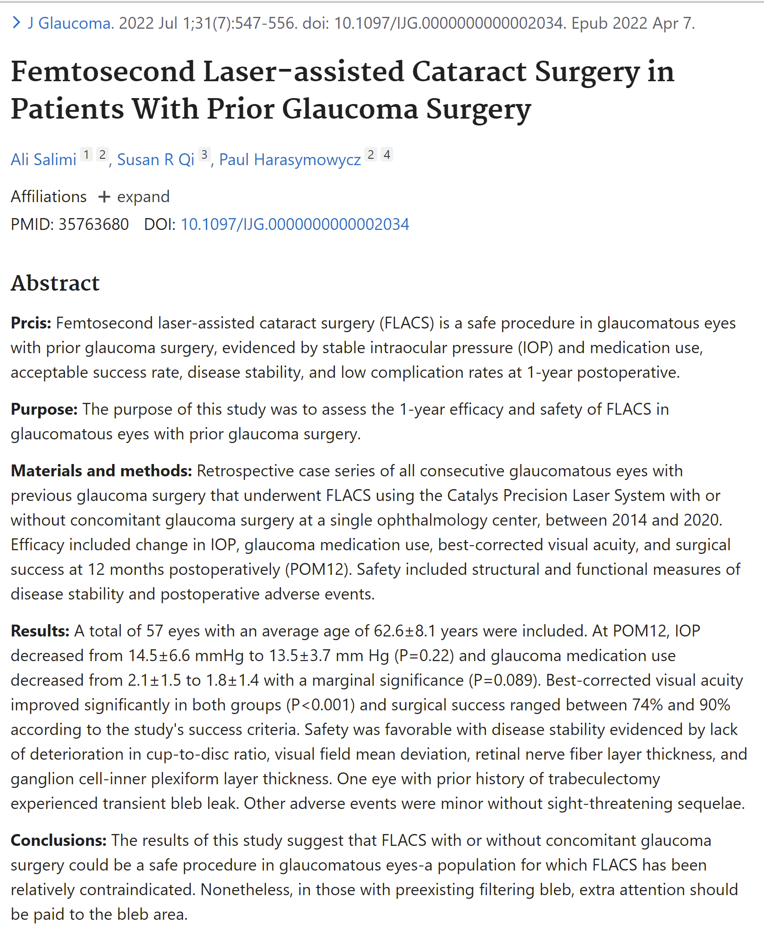

Slide 34
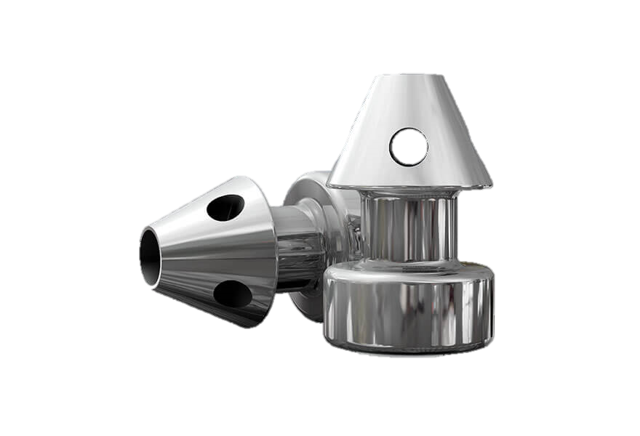
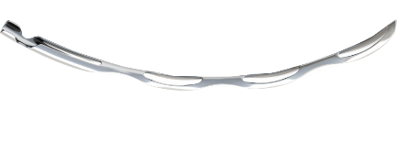
MIGS in Perspective
“Some MIGS may afford patients with glaucoma greater drop-free disease control than cataract surgery alone.”
“Study data associate the Hydrus® with greater drop-free glaucoma control and IOP lowering than the iStent®; however, these effect sizes were small.”
Hydrus Microstent
iStent inject
JAMA Ophthalmology. September 2021
Notes:
Bicket AK, Le JT, Azuara-Blanco A, et al. Minimally Invasive Glaucoma Surgical Techniques for Open-Angle GlaucomaAn Overview of Cochrane Systematic Reviews and Network Meta-analysis. JAMA Ophthalmol. 2021;139(9):983-989. doi:10.1001/jamaophthalmol.2021.2351

Slide 35
The Impact of MIGS in Reducing IOP
“There is some evidence to support the role of MIGS devices in the current treatment armamentarium for glaucoma with a goal of modest IOP and topical medication reduction.”
“Many previous articles included studies which suffered from limitations including bias, conflicts of interest, industry sponsorship, and a lack of standardized reporting.”
“Hydrus was superior to iStent in terms of both IOP and topical medication reductions postoperatively.”
Further trials are necessary to elucidate the role of MIGS in the glaucoma treatment paradigm.
Survey Ophthalmol, Sept-Oct 2021
Notes:
Nichani P, Popovic MM, Schlenker MB, Park J, Ahmed IIK. Microinvasive glaucoma surgery: A review of 3476 eyes. Surv Ophthalmol 2021;66(5):714-742.

Slide 36
Do MIGS Matter?
“The long-term efficacy and safety of MIGS procedures remains to be determined.”
Am J Ophthalmol. Oct. 2024
Notes:
Hays, Ron D.Nguyen, Don et al. A Health-Related Quality of Life Measure for Patients Who Undergo Minimally Invasive Glaucoma Surgery. American Journal of Ophthalmology, 2024;266:313-320.

Slide 37
Special Report on MIGS
New metric: Minimal Clinically Important Difference (MICD) (Much more relevant than “statistical significance”)
Generally, a 20% reduction in IOP
For MIGS, 50% at 2 years
  For cataract surgery alone, 50-60% at 2 years
  For cataract surgery plus MIGS, 65% at 2 years
“Long-term studies assessing the safety and efficacy of MIGS are needed to better define it’s role in the surgical treatment of glaucoma.”
Ophthalmology, February, 2025
Notes:
Gedde, Steven J. et al. Special Commentary: Reporting Clinical Endpoints in Studies of Minimally Invasive Glaucoma Surgery. Ophthalmology, Volume 132, Issue 2, 141 - 153

Slide 38
Perspectives on MIGS
“The majority of patients who underwent laser trabeculoplasty or iStent implantation saw no tangible reduction in their health care burden.”
“In terms of medication burden, 60.6% of patients who underwent laser trabeculoplasty saw no change in their number of medications, while 18.4% saw an increase. Patients who received an iStent fared similarly, with 57.4% seeing no change in medications and 12.3% seeing an increase in medications.”
“There was no reduction in the average medication burden post-procedure.”
Ocular Surgery News, Dec 25, 2021
Notes:
Martin E. Laser trabeculoplasty, iStent may not reduce patients’ medication burden. Ocular Surgery News Dec 25, 2021.

Slide 39
Study in Brief
A retrospective literature review found that traditional glaucoma surgeries such as selective laser trabeculoplasty and trabeculectomy were significantly more cost-effective for IOP reduction than other surgical procedures, including MIGS.
WHY IT MATTERS
Approximately 2.7 million people in the United States had primary open-angle glaucoma in 2013. This number is expected to reach approximately 7.3 million by 2050 owing to increased life expectancy. As more people develop glaucoma and associated costs increase, it becomes increasingly important to identify which treatment modalities are the most effective and the most cost-efficient.
Glaucoma Today January/February 2022
Notes:
Elhusseiny AM, Yannuzzi NA, Khodeiry MM, Lee RK, Smiddy W. Cost analysis of surgical intraocular pressure management in glaucoma. Glaucoma Today January/February 2022.

Slide 40
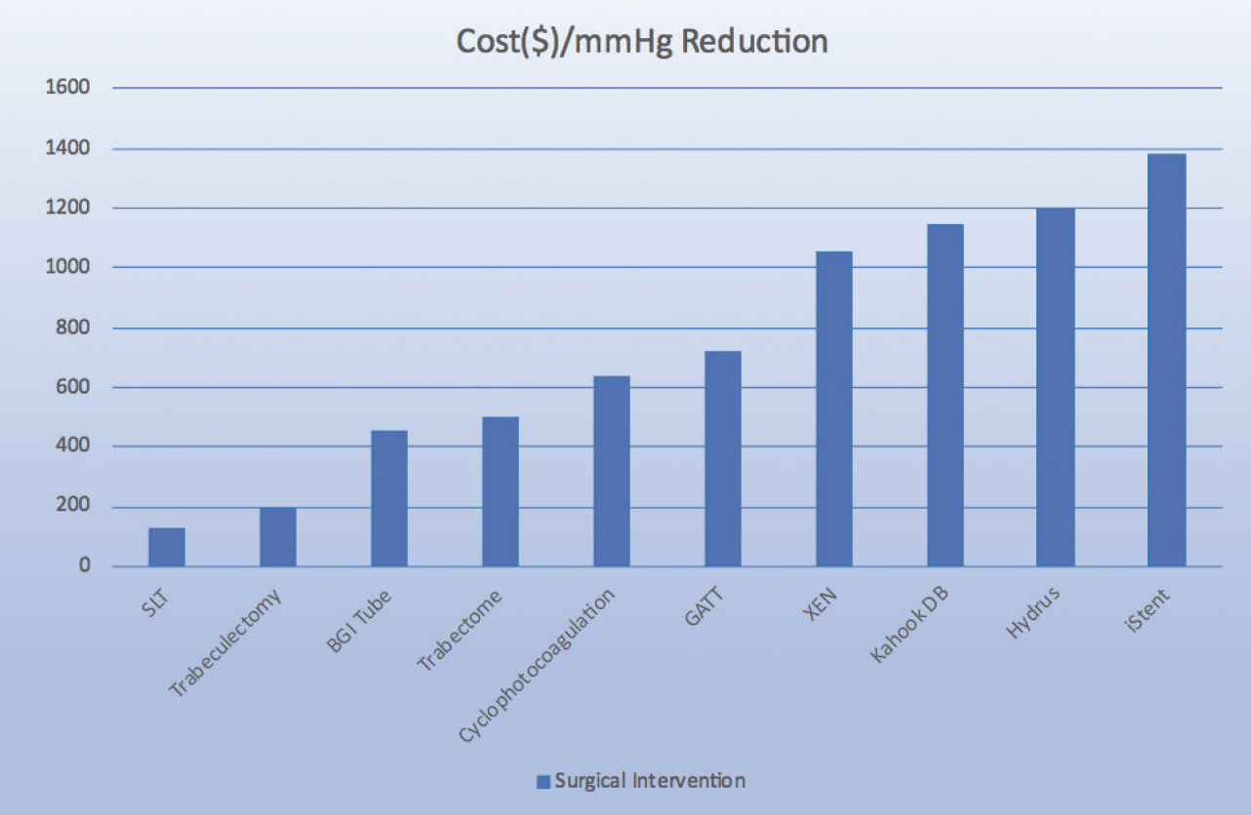
Figure. Bar graph illustrating the cost per each 1 mm Hg IOP reduction ($/mm Hg) at 1 year postoperatively for various glaucoma interventions. Abbreviations: SLT, selective laser trabeculoplasty; BGI tube, Baerveldt glaucoma implant tube; GATT, gonioscopy-assisted transluminal trabeculotomy; Kahook DB, Kahook Dual Blade. Manufacturing information: Baerveldt glaucoma implant (Johnson & Johnson Vision), Trabectome (MicroSurgical Technology), Xen Gel Stent (Allergan), Kahook Dual Blade (New World Medical), Hydrus Microstent (Alcon), iStent (Glaukos). Reprinted with permission from Elhusseiny et al.⁵
Glaucoma Today January/February 2022
Notes:
Elhusseiny AM, Yannuzzi NA, Khodeiry MM, Lee RK, Smiddy W. Cost analysis of surgical intraocular pressure management in glaucoma. Glaucoma Today January/February 2022.

Slide 41

Preventing / Delaying Glaucoma Through Exercise
Recommended: 150 minutes of moderate intensity aerobic exercise and 2 days of resistance exercise each week
Such exercise may reduce glaucoma risk by about 40-50%
“The magnitude of a 40-50% reduced risk of developing glaucoma by being active and fit is surprising, and may be one of the strongest factors in glaucoma prevention besides aging.”
Medical Science & Sports Exercise, August, 2018
“Our study found that physical activity was associated with less visual field progression in patients with glaucoma.”’
“Increased steps per day, minutes of non-sedentary activity, and minutes of moderate-to-vigorous physical activity were associated with slower rates of decline.”
^{Ophthalmology, July, 2019}

Slide 42
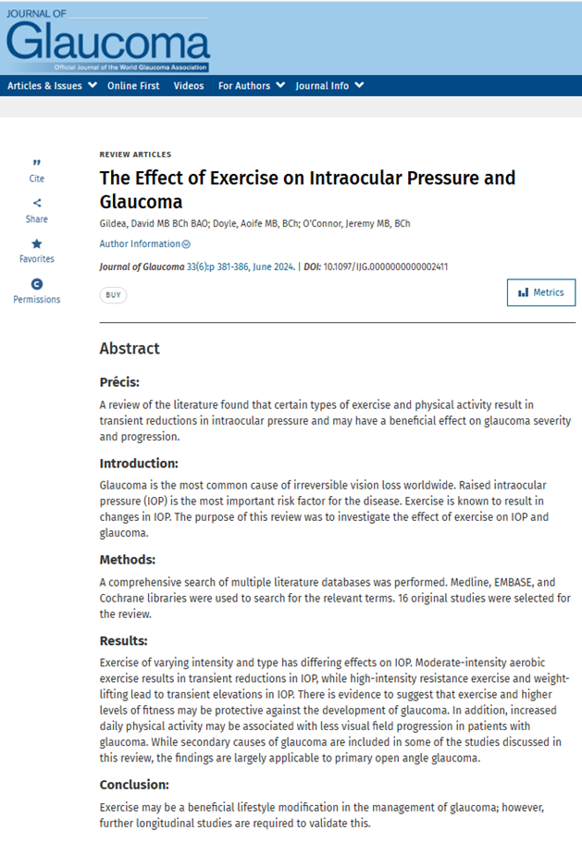

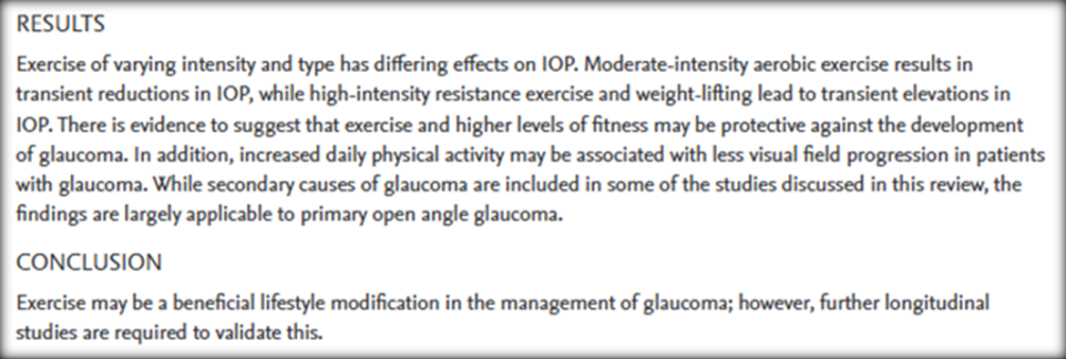

Slide 43
WALKING 10,000 Steps A Day -
Do I really need to hit that goal?
Walking 4,000 steps a day (3,867 to be precise, or roughly 2 miles) can reduce your risk of dying from any cause
The risk of dying decreases the more you walk
Increase of 1,000 steps a day (about 10 minutes of walking) – 15% reduction from dying from any cause
An increase in 500 steps – 7% reduction in dying from cardiovascular disease
Average walking pace is 20 minutes/mile (close to 4,000 steps)
European Journal of Preventive Cardiology - 2023
Notes:
Smith TJ, Cockerham K, Lelli G, et al. Utility Assessment of Moderate to Severe Thyroid Eye Disease Health States. JAMA Ophthalmol. 2023;141(2):159–166. doi:10.1001/jamaophthalmol.2022.3225

Slide 44
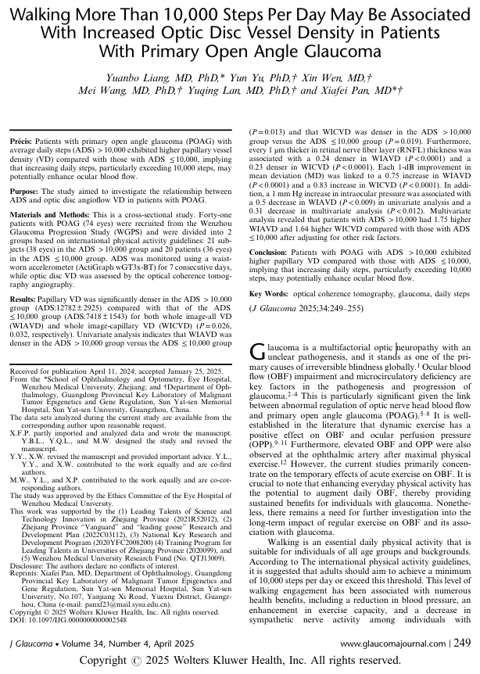
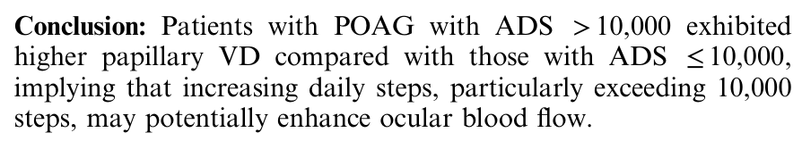

Slide 45
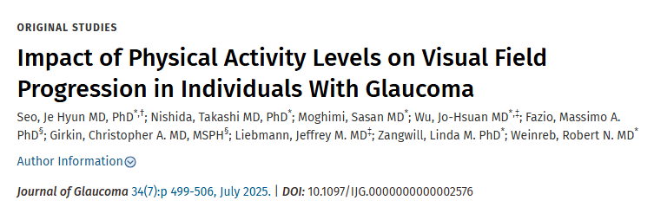
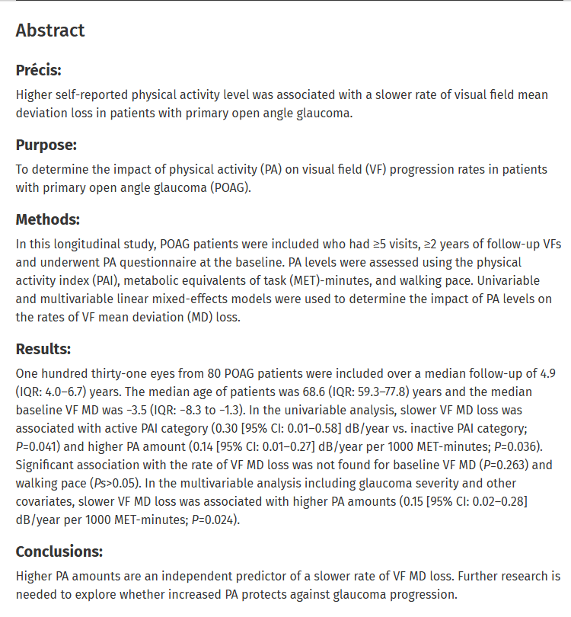


Slide 46
Caffeine and the Eye
Caffeine is an adenosine receptor antagonist
Used to treat acute migraine headache; analgesic adjuvant
CNS stimulant, peripheral vasoconstrictor, diuretic, respiratory stimulant and bronchodilator, and promoter of gastrointestinal reflux
No association with cataract formation
“Patients at risk of glaucoma should be cautious of high caffeine intake”, and “it would be reasonable to advise patients to avoid excessive caffeine intake if IOP control is critical because even a small reduction in IOP has been shown to reduce the risk of glaucoma progression.”
Survey Ophthalmol. May/June, 2019

Slide 47
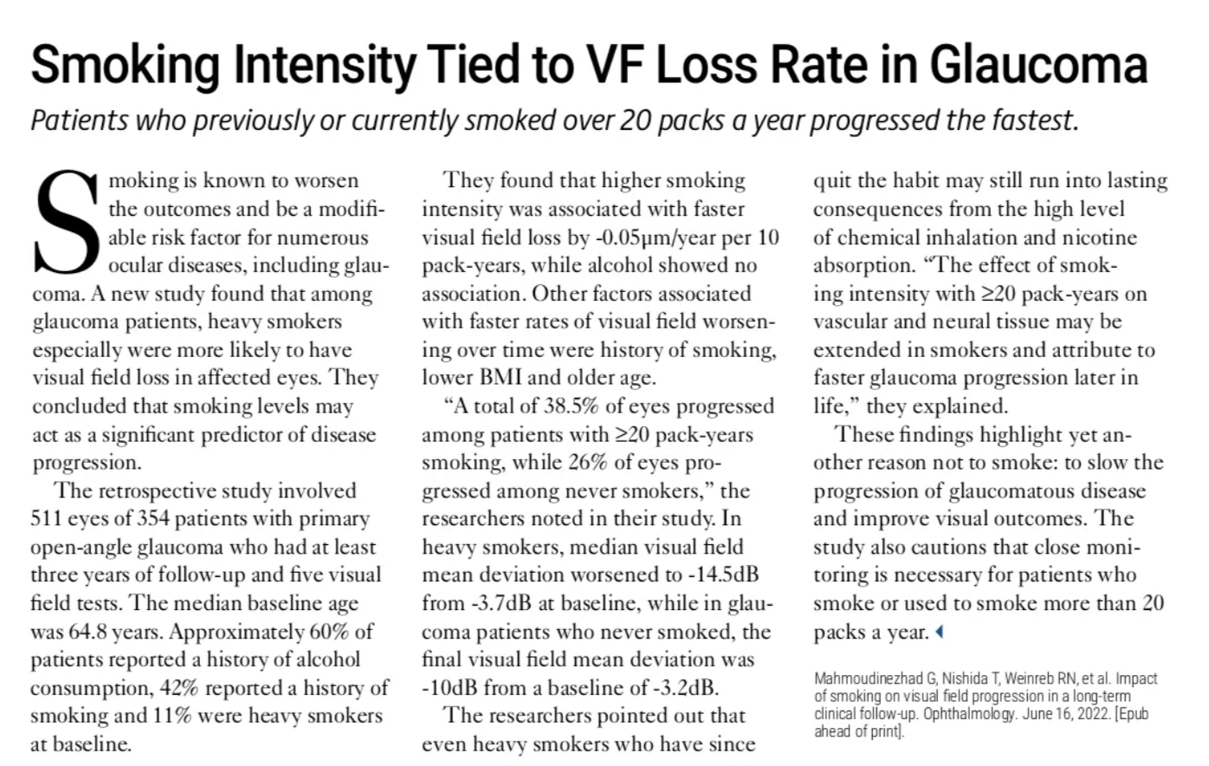

Slide 48
Perspective on Central Corneal Thickness (CCT)
CCT has become “standard-of-care” in the POAG (or suspect) work-up
Thinner corneas are a strong risk factor for POAG because true IOP is actually higher than the measured IOP.
Some patients with measured ocular hypertension may simply have a thicker CCT, thus reducing POAG risk because the true IOP is actually less than the measured IOP
“CCT is the most heritable aspect of ocular structure (more than refraction, axial length, or optic disc size), suggesting that it is under exquisite genetic control.” (Ophthalmology, Nov. 2007)
“Stop adjusting IOP measurements” JAMA, May 2017

Slide 49
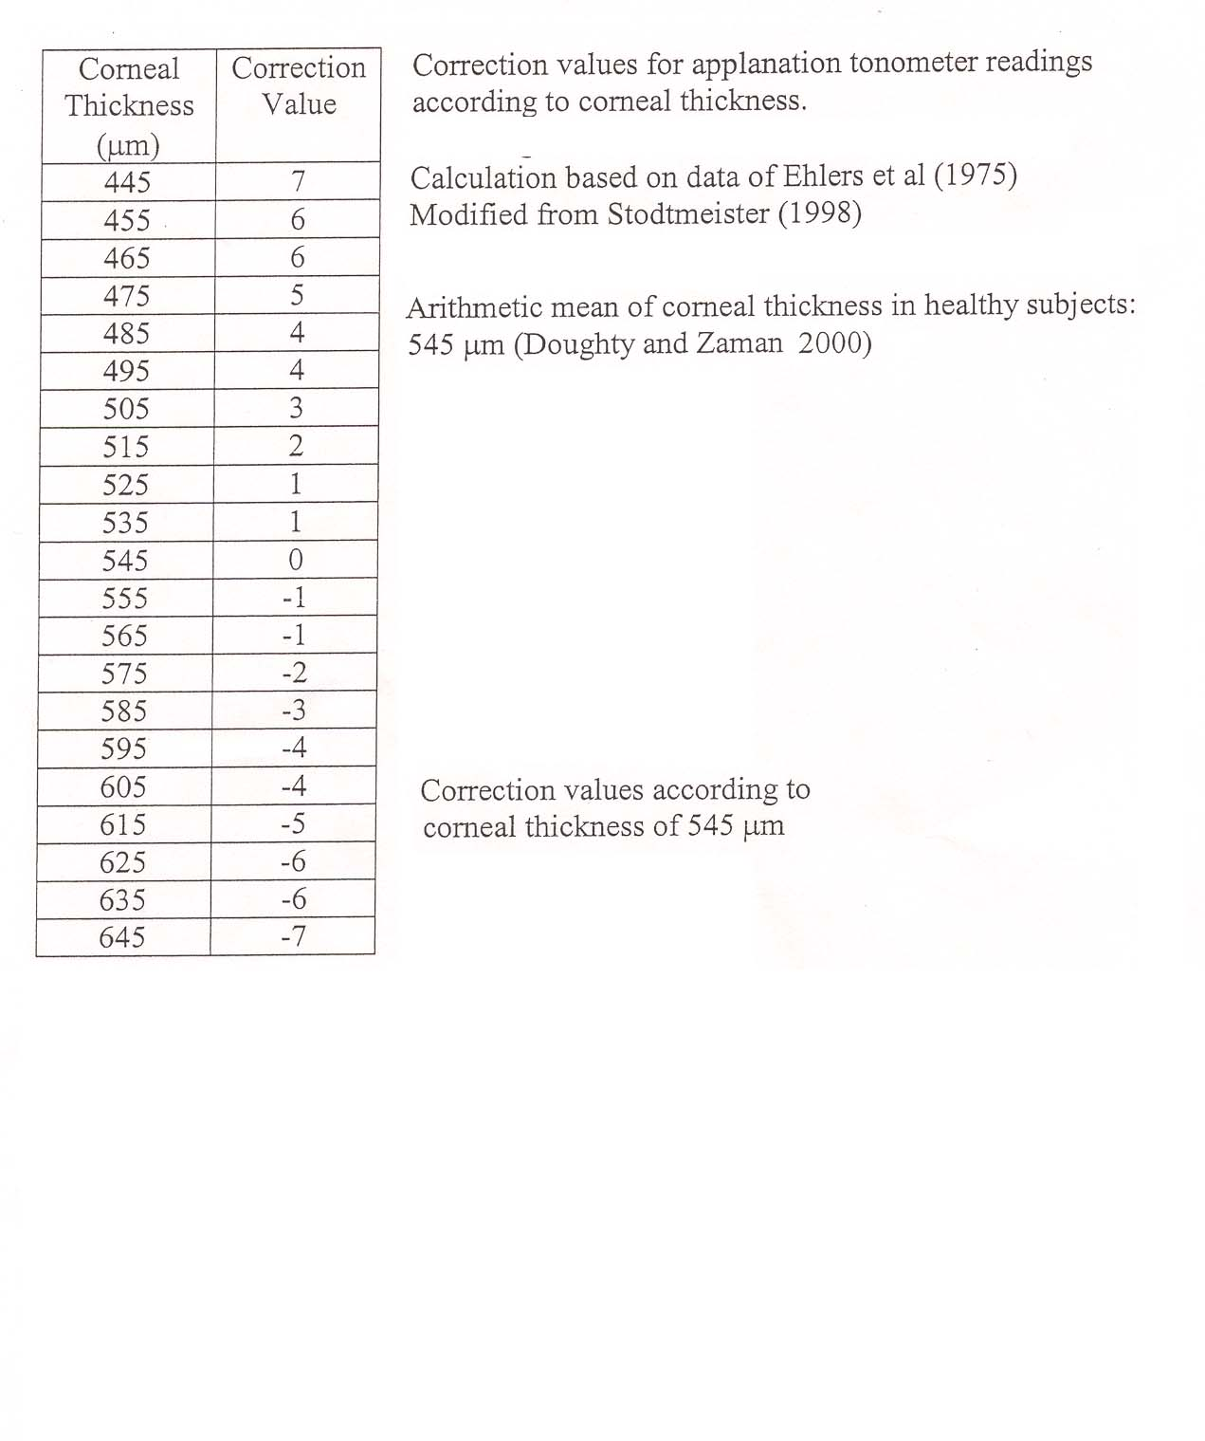
Correction values for applanation tonometer readings according to corneal thickness
Calculation based on data of Ehlers et al (1975)
Modified from Stodtmeister (1998)
Arithmetic mean of corneal thickness in healthy subjects: 545 µm (Doughty and Zaman 2000)
Correction values according to corneal thickness of 545 µm

Slide 50
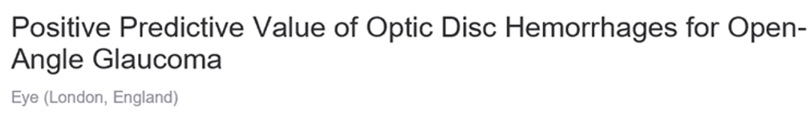
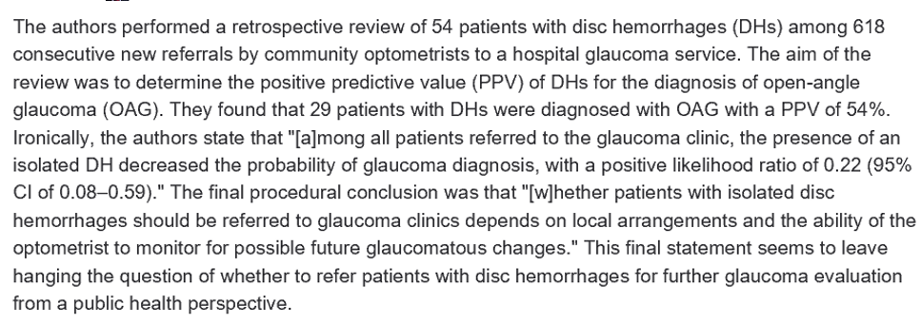
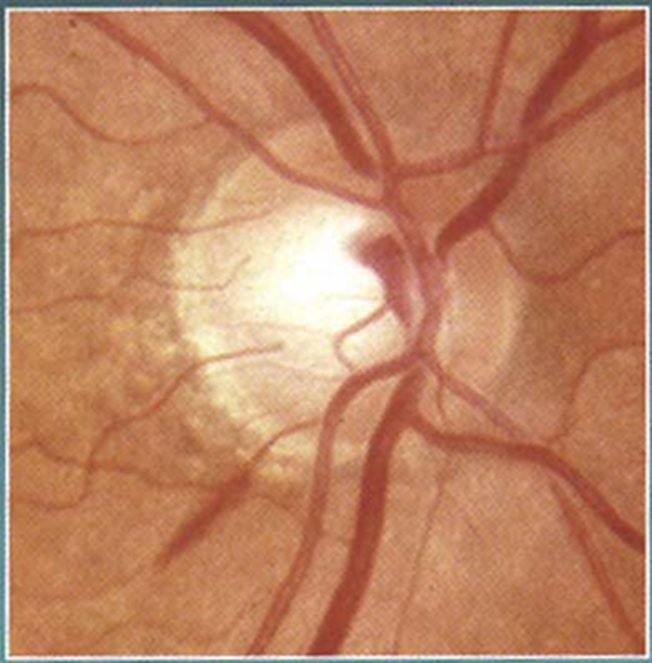
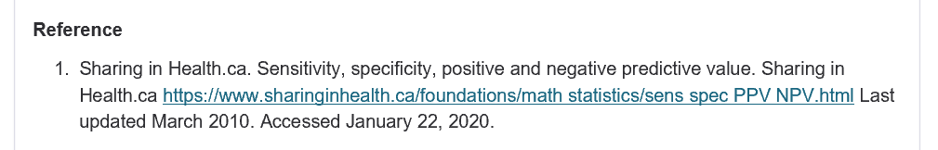
1-2020

Slide 51
Glaucoma: Nocturnal Dip in Blood Pressure
Role of BP in glaucoma pathogenesis is critical
Extreme dipper (~20% of people) portend higher risk for glaucoma, esp. in normotensive patients
Antihypertensive meds need morning administration!
Relationship between IOP and POAG is weak with lower levels of IOP
Ophthalmology, June, 2018
Notes:
Melgarejo JD, Lee JH, Petitto M, et al. Glaucomatous Optic Neuropathy Associated with Nocturnal Dip in Blood Pressure: Findings from the Maracaibo Aging Study. Ophthalmology 2018;125(6):807-814.

Slide 52
Blood Pressure and Glaucoma
Low blood pressure is associated with incidence and progression of glaucoma
“Calcium channel blockers can cause sudden and extreme reduction in blood flow.”
“Nocturnal diastolic blood pressure dip may have a greater impact on VF progression in NTG eyes than nocturnal systolic blood pressure dip. Spontaneous or drug-induced excessive nocturnal DBP dip should be avoided.”
Ophthalmology, July 2019
Notes:
Kwon J, Jo Yh, Jeong D, et al. Baseline Systolic versus Diastolic Blood Pressure Dip and Subsequent Visual Field Progression in Normal-Tension Glaucoma. Ophthalmology 2019;26(7):967-979.

Slide 53
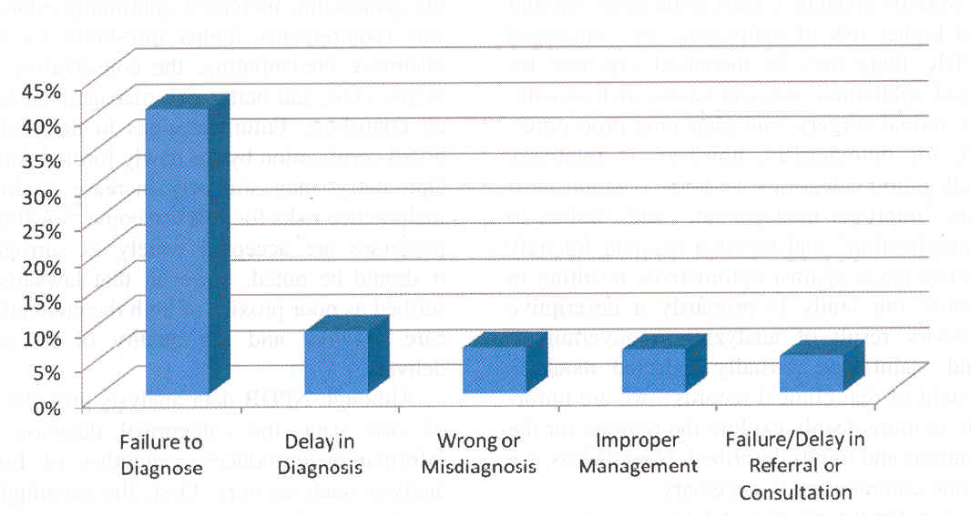

Causes of Optometric Medicolegal Misadventures

Slide 54
Glaucoma and Medical Malpractice
“Overall the rate of plaintiff verdicts was similar in glaucoma and in ophthalmology as a whole; However, the magnitude of plaintiff awards was higher in glaucoma than in ophthalmology overall.” “Common scenarios leading to litigation included failure to diagnose or mismanagement of glaucomatous disease, as well as adverse drug effects, and surgical complications. Many cases could have been avoided with careful examinations, thorough documentation in the patients’ chart, and detailed conversations with patients.”
Ophthalmology Glaucoma, October 2020

Slide 55
Don’t Get Sued: Key Points
Study the optic nerve – Don’t let a normal or low IOP fake you out!
Always document your discussions with your patients, especially for follow-up evaluations.
Truly care, and be clinically attentive
These 3 basic fundamentals can prevent a lot of law suits.

