Slide 1
THERAPEUTIC UPDATE – CLINICAL APPLICATIONS
Ron Melton, OD, FAAO
Randall Thomas, OD, MPH, FAAO

Slide 2
Financial Disclosure
Drs Ron Melton and Randall Thomas are consultants to, on the speakers bureau of, on the advisory committee of, or involved in research for the following companies: ICARE and B+L

Slide 3
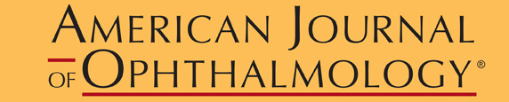
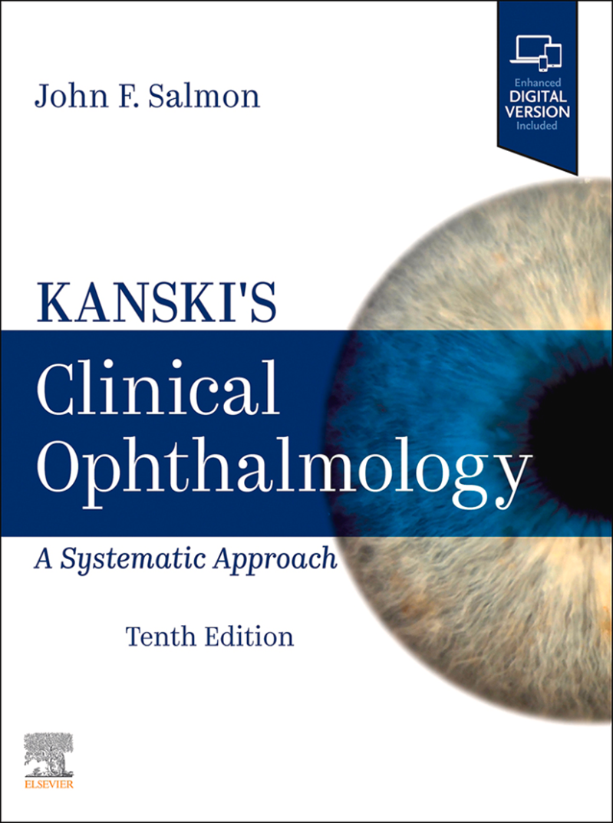
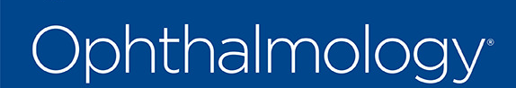



Slide 4
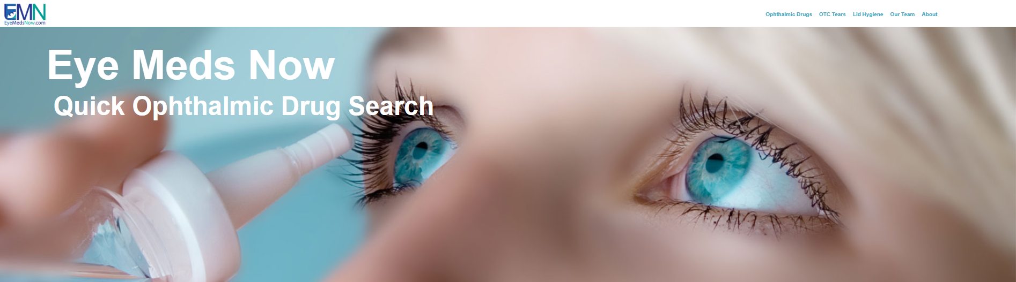
EyeMedsNow.com

Slide 5
The Future of Optometric Practice
From 2020 to 2030, medical eye care is expected to increase 28% while routine eye care is expected to grow by 2%!
Optometry needs to fill the void of chronic medical eye care that ophthalmology will simply not be able to deliver.
Review of Optometry, January 15, 2025
Notes:
Leanne Spiegle. How Scope Expansion is Shaping Optometry’s Future. Review of Optometry. January 2025.

Slide 6
Egregious Over-referral of Glaucoma Suspects
“Only 8% of those under 40 referred for glaucoma evaluation were diagnosed with glaucoma within 2 years.”
Worse, about half of all referred patients did not follow-up with the referral!
(M+T): Take home message: Optometrists-please provide glaucoma care services to your patients.
JAMA Open Network, February 2025
Notes:
Frediani T, Yoo K, Cho A, et al. Outcomes of Glaucoma Referrals in Adults Aged 18 to 40 Years. JAMA Netw Open. 2025;8(2):e2457843. doi:10.1001/jamanetworkopen.2024.57843

Slide 7
Compassion in Patient Health Care
“Compassion in society has substantially decreased over recent decades.”
“The recent increase in documentation requirements and widespread adoption of electronic medical records further impairs the ability of physicians to connect with patients and may perceive a lack of caring and emotional connection.”
“Numerous surveys have confirmed that choosing physicians, patients value compassion, kindness, connection and caring over considerations such as education, experience, wait time and cost.”
Am J Ophthalmol. March 2024
Notes:
Lains, Ines et al. Compassionomics: The Science and Practice of Caring. American Journal of Ophthalmology, Volume 259, 15 - 24

Slide 8

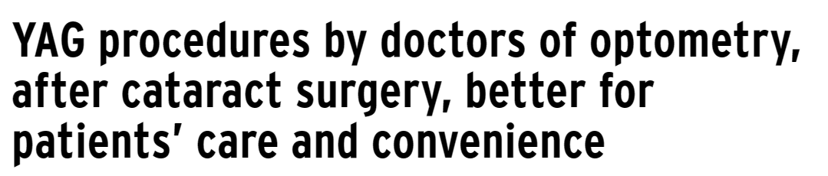
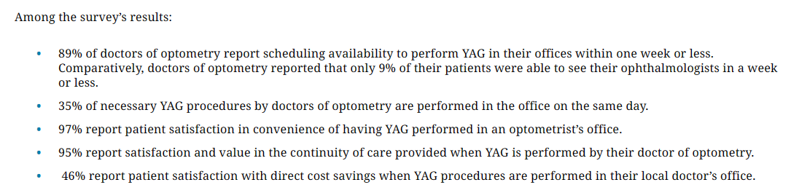
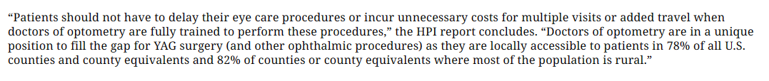

Slide 9
Ryzumvi™ for Dilation Reversal
Last was Rev-Eyes™ (0.5% dapiprazole) 1990’s
Phentolamine ophthalmic solution 0.75% by Ocuphire/Viatris
Blocks alpha-1 receptors on iris radial muscles
Approved down to age 3: One to two drops post-exam for adults; only one drop <12 years
Comes in preservative-free individual unit dose: 5 per foil pack - 6 foil packs per carton (0.31 mL per unit)
Store under refrigeration, but once foil is opened, can stay at room temperature for 2 weeks
Consult drugs.com/Ryzumvi or ryzumvi.com

Slide 10
Update on Ryzumvi™
100 million dilated eye examinations in US per year.
Accelerating mydriasis reversal could reduce a barrier to dilation
Phentolamine 0.75% is a non-selective alpha-adrenergic antagonist - relaxes radial muscles
Effective at 1 hour; peak reduction at 3 hours
Half of patients returned to baseline in 90 minutes
“The reduction in recovery time was achieved across all mydriatic agents and for participants with either light or dark irides.” (Note: dilation was done with single agents not 1% + 2.5% combination)
“This study was funded by the sponsor who organized and participated in the design of the study; conducted the study; data collection, data management, data analysis, interpretation of the data; preparation of the data, and review of the manuscript”
Ophthalmology, January 2025
Notes:
Pepose, Jay S. et al. Reversal of Pharmacologically Induced Mydriasis with Phentolamine Ophthalmic Solution Ophthalmology, 2025;132(1):79 – 91.

Slide 11
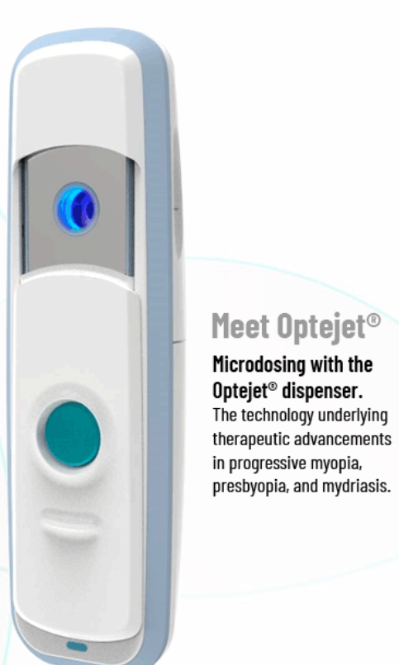
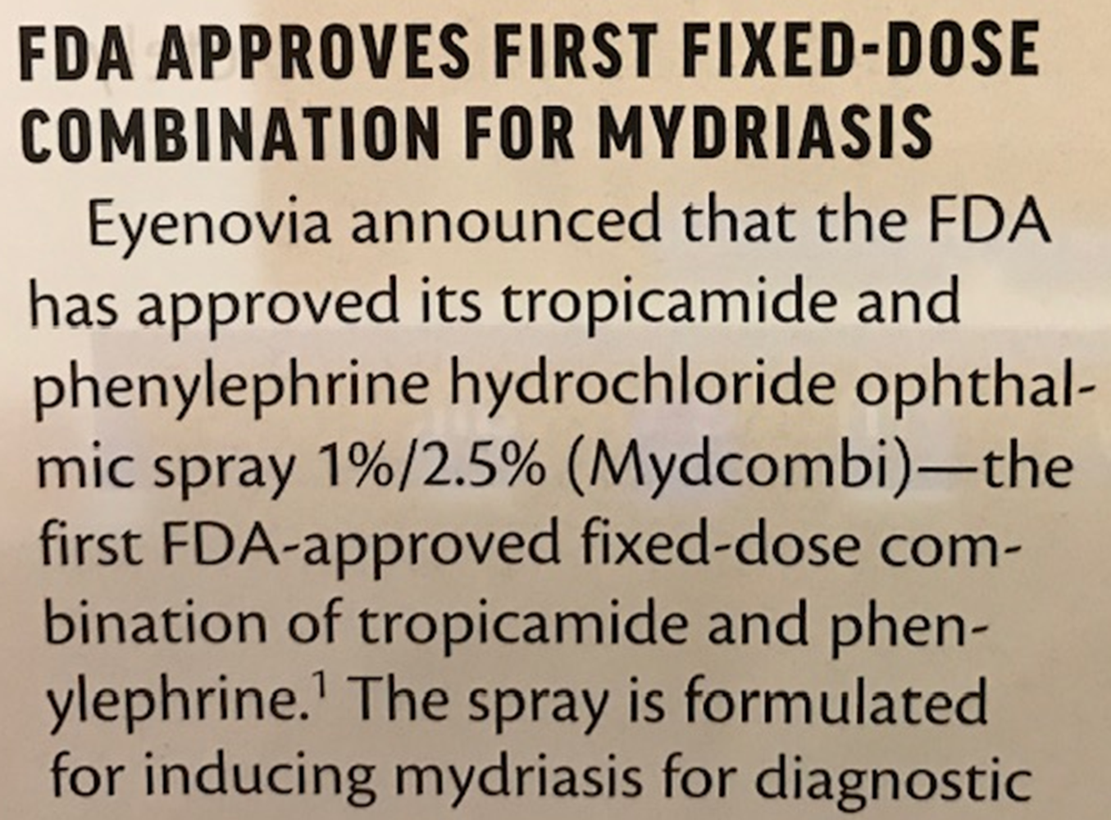

Slide 12
Forget Cyclopentolate - Maybe
“Automated refraction has comparable results to manual retinoscopy.”
“Cyclopentolate produces a clinically insignificant mean refractive change of 0.175 D more plus than tropicamide.”
“Our study showed tropicamide to be effective in brown-colored irides, which are not as efficiently responding to cycloplegic agents as lighter colored ones.”
“Tropicamide might be an effective and safe replacement for cyclopentolate in refracting the non-strabismic pediatric population between the ages of 3 and 16 years regardless of their refractive error status.”
Am J Ophthalmol, January 2024
Notes:
Al-Thawabieh W, Al-Omari R, Abu-Hassan DW, Abuawwad MT, Al-Awadhi A, Serhan HA. Tropicamide Versus Cyclopentolate for Cycloplegic Refraction in Pediatric Patients With Brown Irides: A Randomized Clinical Trial. Am J Ophthalmol 2024;257:218-226.

Slide 13
Repeated Low-Level Red Light Therapy
Pre-myopic children: SE decreased .41D at 1 year
RLRL may be more effective in established myopia
Tx daily for 3 minutes twice a day (5/7 days/week)
“AL shortening and SE regression may be related to retinal and choroidal thickening.”
“Numerous studies have indicated that choroidal thickening cannot fully explain AL shortening.”
The ultimate effectiveness of RLRL may not be known for years.
Am J Ophthalmol. February 2025
Notes:
Axial Shortening Effects of Repeated Low-level Red-light Therapy in Children With High Myopia: A Multicenter Randomized Controlled Trial
Liu, Guihua et al.
American Journal of Ophthalmology, Volume 270, 203 – 215.

Slide 14
Vuity (Pilocarpine 1.25%)
First of a new wave of drugs to enhance near vision in presbyopia
Induced miosis increases depth of focus
About 30% of patients gained about 3 lines of near vision with slight compromise of distance vision
Urge caution when regarding compromised night driving
Dosage: 1 drop OU daily, PRN – onset in about 20 minutes
Effect duration: 2 to 6 hours – can dose another drop if needed
Side effect potential: HA, conjunctival hyperemia, retinal detachment – use with caution in patients with anterior uveitis
Marketed by Allergan in a 5 ml bottle containing 2.5 ml of drug. It is preserved with 0.0075% BAK (Xalatan has 0.02% BAK)

Slide 15
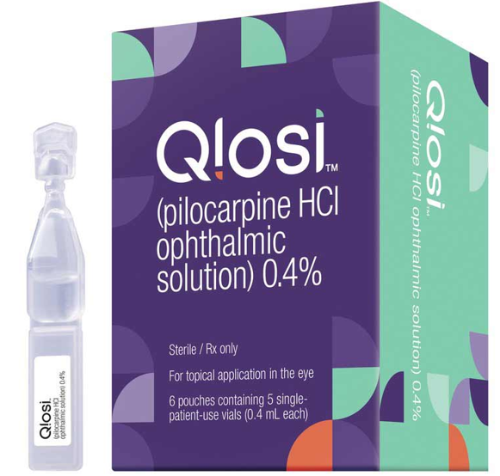
Qlosi (Pilocarpine 0.4%)
Pilocarpine first FDA-approved in 1974 for QID use
Pilocarpine is pregnancy category C
0.4% pilocarpine (QLOSI™): BID administration
One drop in the morning, and a second drop can be instilled about 2-3 hours later if desired
Store under refrigeration until the foil pouch containing 5 single-patient-use vials is opened
Comes in boxes of:
10 single-patient-use vials (2 pouches containing 5 vials)
20 single-patient-use vials (4 pouches containing 5 vials)
30 single-patient-use vials (6 pouches containing 5 vials)
60 single-patient-use vials (12 pouches containing 5 vials)
Marketed as QLOSI ophthalmic eye drop by Orasis Pharmaceuticals

Slide 16
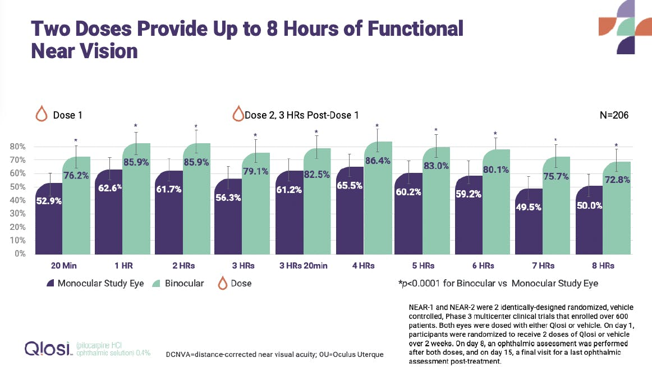
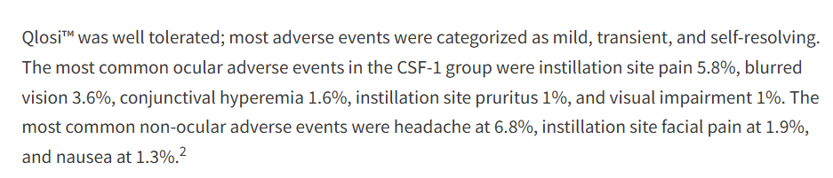

Slide 17
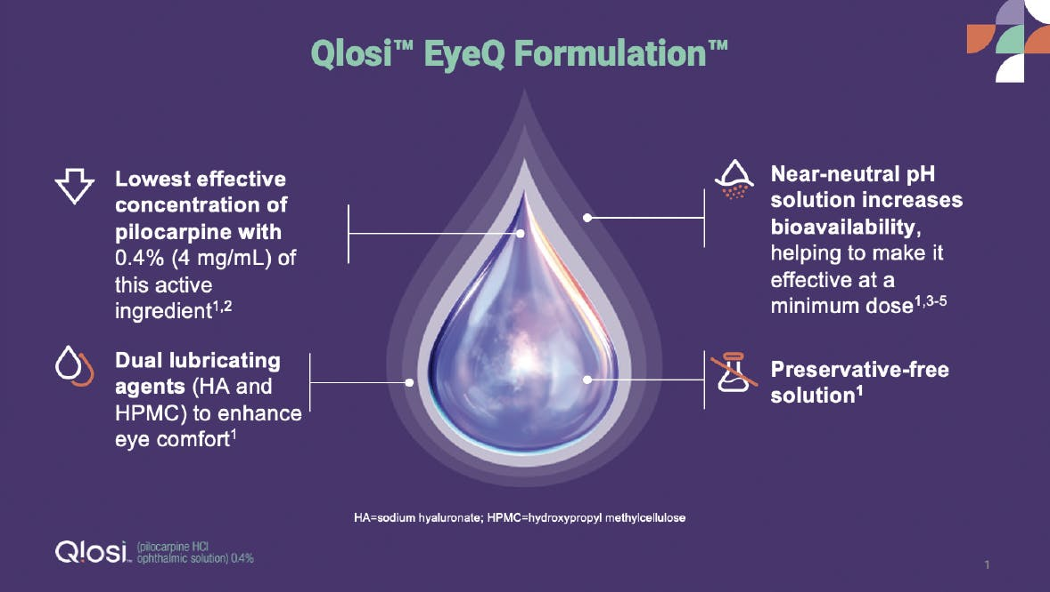

Slide 18
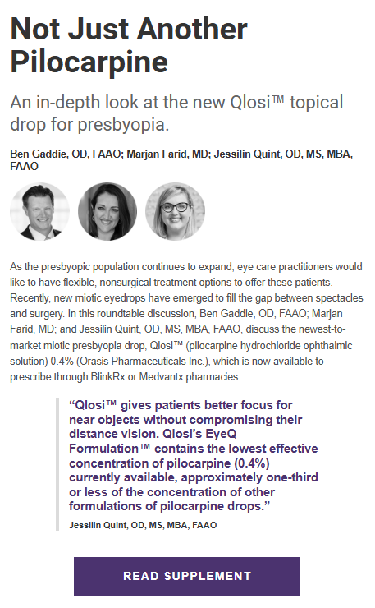

Slide 19
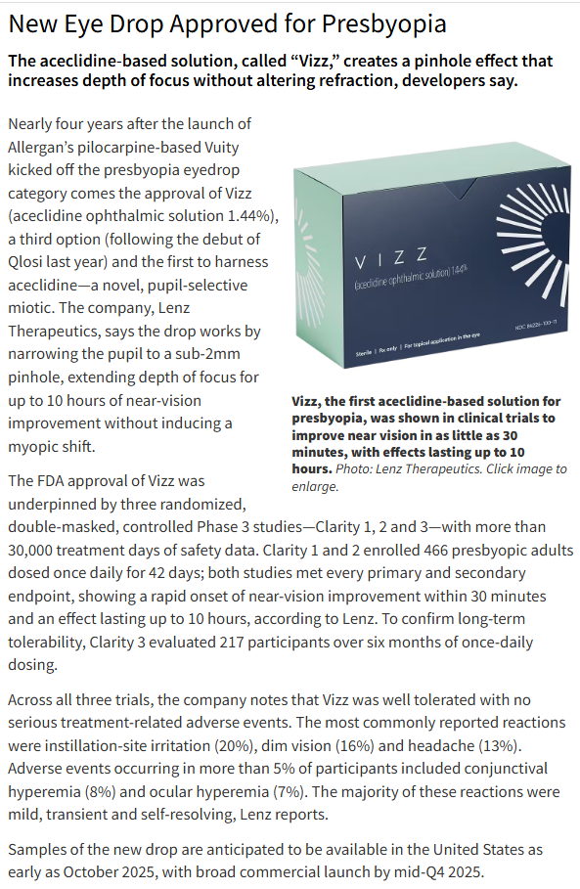
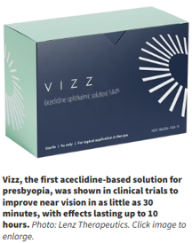
Review of Optometry – 8/1/2025

Slide 20
Retinal Detachment and Pilocarpine
“Prior to prescribing pilocarpine for presbyopia, physicians should inform patients of potential adverse events and consider that patients undergo a screening dilated examination, particularly if they are myopic, to determine if they are at higher risk for retinal detachment. Findings on history and examination that could indicate an increased risk of detachment may include lattice retinal degeneration, a personal or family history of retinal detachment, higher degrees of myopia, and prior retinal tears. Before the initiation of therapy, patients should be appropriately informed regarding symptoms of retinal tears or detachment, which includes flashes, floaters, and visual field loss.”
Am J Ophthalmol. October, 2022
Notes:
Al-khersan H, Flynn HW Jr., Townsend JH. Retinal Detachments Associated With Topical Pilocarpine Use for Presbyopia. Am J Ophthalmol. 2022;242:52-55. https://doi.org/10.1016/j.ajo.2022.05.011

Slide 21
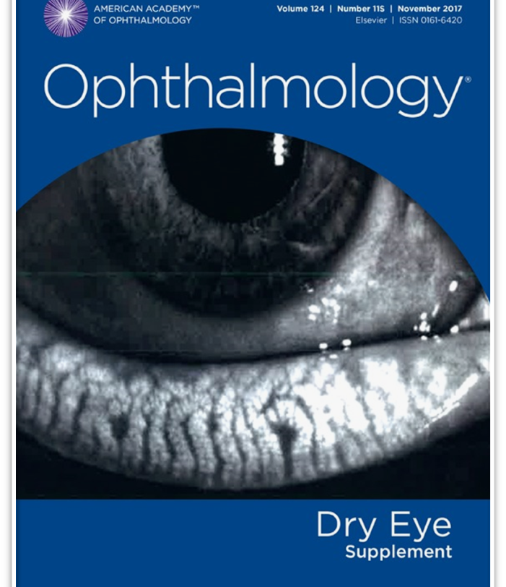

Dry Eye Disease
“Dry eye disease is a heterogeneous disorder of the ocular surface in which the common denominator is inflammation.”
“Topical corticosteroids also play an important role in breaking the inflammatory cycle.” “Repeated short-term pulse therapy has produced a disease-free state for more than 1 year in a study of patients with Sjögren’s syndrome.”
“Inflammation is one of the major targets in treating DED, and breaking the cycle of inflammation is crucial in improving symptoms. All patients DED deserve a trial of anti-inflammatory therapy at some point during their treatment.” “Corticosteroids are one of the most effective and rapid therapies available for suppressing inflammation on the ocular surface.”
“Treatment of DED is based on minimizing inflammation and optimizing various components of the tear film.”

Slide 22
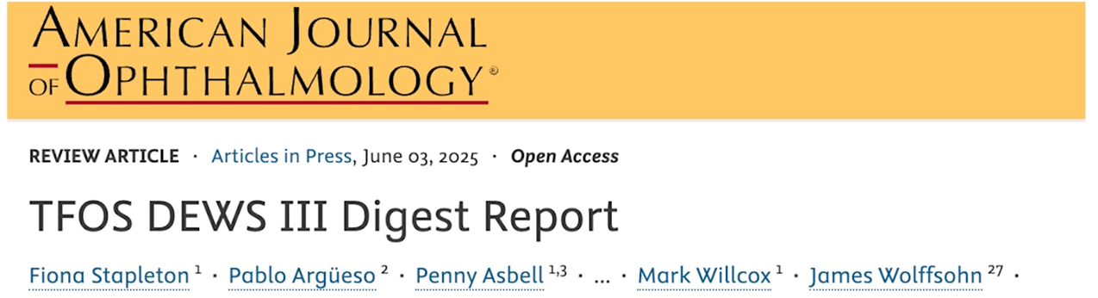
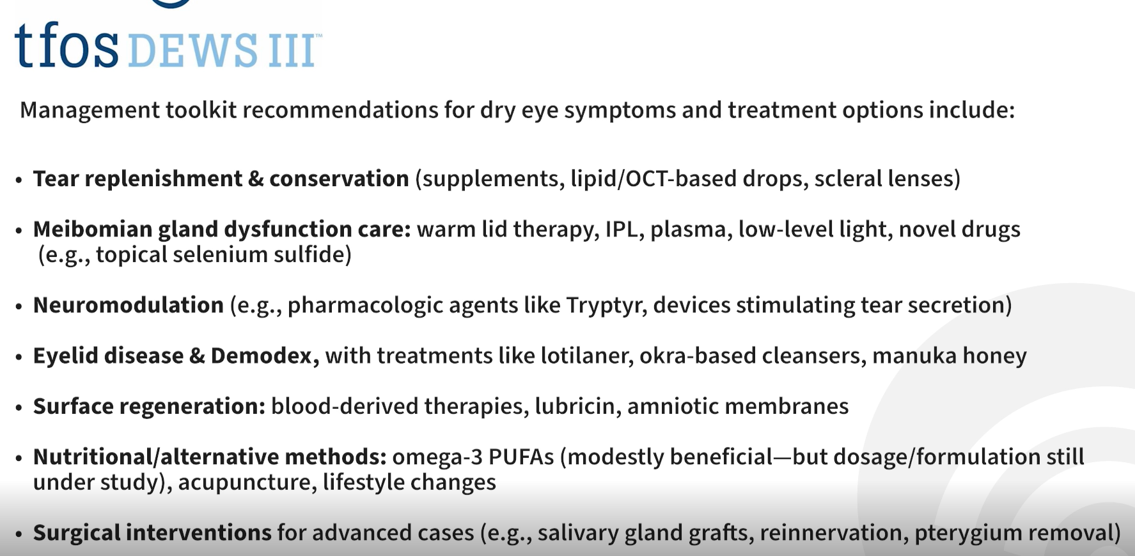

Slide 23
“Consensus Report Simplifies Dry Eye Diagnosis”
“No new equipment is required”
“All that’s needed to diagnose dry eyes are a history, slit lamp, and a fluorescein strip.”
“An unstable tear film, when accompanied by ocular discomfort or impaired vision is sufficient to diagnose DED.”
“Inflammation can perpetuate the vicious cycle of chronic DED.”
“Controlling inflammation, whether over the long-term or during disease flare-ups, is a must to prevent ocular damage and to rein in symptoms.”
EyeNet Magazine, November, 2022

Slide 24
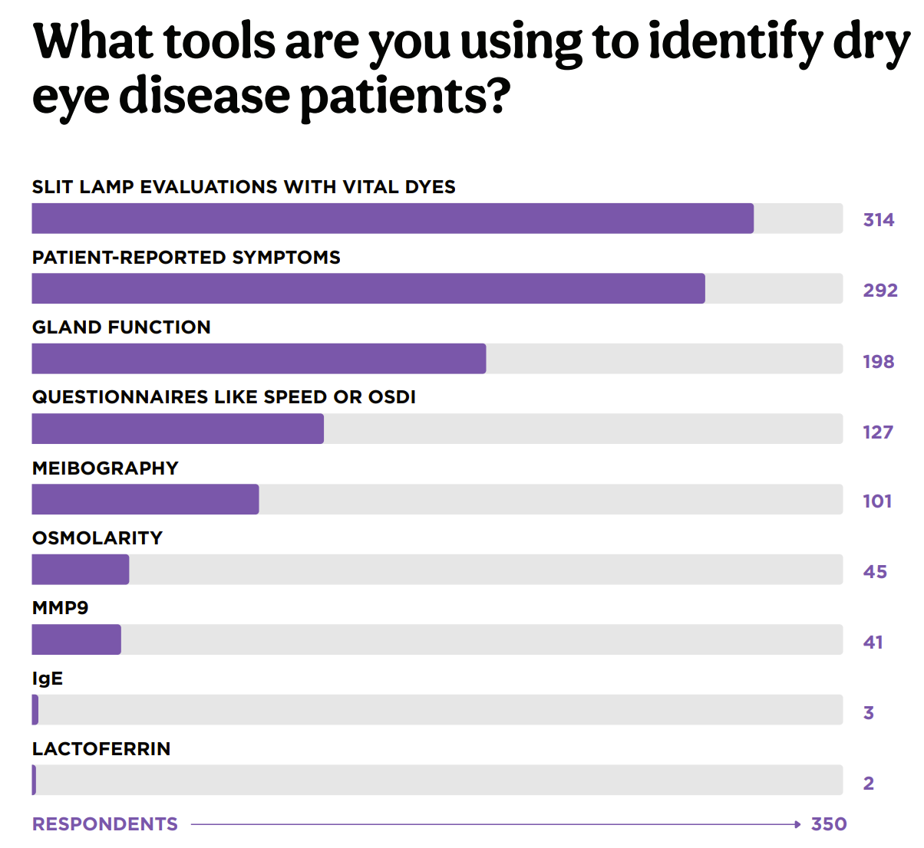

Slide 25
Effect on DED on the Pre-surgical Evaluation
“Results in the current study suggest dry eye does not materially affect surgical planning, with the exception that in some dry eye patients, reflective-based keratometry seemed slightly less reliable.”
“The main finding was that the variability was not influenced by osmolarity.”
“There is uncertainty whether the osmolarity we measure in the tear meniscus is actually representative of the central corneal surface.”
Clinical Ophthalmology, January 2024
Notes:
Nilsen C, Gundersen M, Jensen PG, et al. The Significance of Dry Eye Signs on Preoperative Keratometry Measurements in Patients Scheduled for Cataract Surgery. Clinical Ophthalmology 2024;18:151-161.

Slide 26
No Clinical Advantage to Femto Cataract Surgery
“Study finds no differences in vision, adverse postoperative events or patient perceptions of quality between FLACS and conventional phaco at 12 months.”
“The authors concluded that FLACS was not superior to conventional phaco, as it did not provide any benefits in outcomes and it incurred higher costs.”
Br J Ophthalmol, May 2021
Notes:
Stanojcic N, Roberts HW, Wagh VK, et al. A randomised controlled trial comparing femtosecond laser-assisted cataract surgery versus conventional phacoemulsification surgery: 12-month results. Br J Ophthalmol. Epub ahead of print.

Slide 27
American Academy of Ophthalmology on FEMTO
“Compared with PHACO, FEMTO has been shown to produce a precisely circular, centered capsulotomy and to reduce the amount of ultrasound energy delivered within the eye during PHACO. However, in several meta-analysis, these benefits have not translated into improved refractive outcomes or reduced complications. In addition, additional costs are associated with FEMTO as compared with PHACO.”
“Patients achieve excellent visual acuity and refractive accuracy with both FEMTO and PHACO, but one technique is not superior to the other.”
“This study, even with sensitivity analyses, showed that FEMTO was not superior to PHACO, but more expensive.”
Ophthalmology, Aug 2022
Notes:
Lin CC, Rose-Nussbaumer JR, Al-Mohtaseb ZN, et al. Femtosecond Laser-Assisted Cataract Surgery: A Report by the American Academy of Ophthalmology. Ophthalmology 2022;129(8):946-954. doi:10.1016/j.ophtha.2022.04.003

Slide 28
BYQLOVI (clobetasol propionate 0.05%)
A newer “very high potency” corticosteroid ophthalmic suspension approved Mar 2024
Uniue nanoparticle formulation minimizes particle settling allowing consistent dosing; There is no “shake well” in the PI or on the bottle.
Used only bid for 2 weeks “for the relief of pain and inflammation following ocular surgery.”
About 85% of patients were pain-free in a week
Marketed as BYQLOVI by Harrow Health, Inc.
Reference: Package Insert, and Drug Facts and Comparisons
Notes:
Chan, Jian S.Lee, Matthew K.Tweedie, Peter J.Tiong, Claudia J.Tsoi, Amy T.Borchert, Grace A.Gunasegaram, James R.Waldie, Anna M. et al.
Observations on the association between obstructive sleep apnea and floppy eyelid syndrome: A systematic review and meta-analysis
Survey of Ophthalmology, Volume 69, Issue 2, 291 - 292

Slide 29
Steroids for DED
“Treat any inflammation on the ocular surface, of course. Start with a topical steroid in “pulse” mode, attempting to quell both the visible inflammation and symptoms quickly without ongoing prescription therapy.”
Ocular Surgery News, July 25, 2023
Notes:
White DE. Time to talk about evaporative dry eye disease. Ocular Surgery News, July 25, 2023.

Slide 30
Our Dry Eye Management Algorithm
All therapy – dry eye included – should be individualized to the patient.
Here is our usual approach to dry eye management.
Two Weeks
Two Weeks
Indefinitely
Lipid-Based Artificial Tear
Four to six times a day as needed
Lipid-Based Artificial Tear
Three to four times a day as needed
Lipid-Based Artificial Tear
Two to four times a day as needed
Loteprednol*
Four times a day
Loteprednol Two times a day
(Consider punctal plugs if needed)
Discontinue Loteprednol
If symptoms break through or continue, then pulse dose loteprednol four times a day for one week or consider loteprednol once daily as needed.
The risk of increased IOP with loteprednol is uncommon at high dosage and rare at low dosage.
Our experience has been that if an increase in IOP is going to occur, it will do so at the initial one-month follow-up, and not later.
Omega-3 essential fatty acids (derived from fish and/or flaxseed oil) can be initiated at any stage, based on clinical judgment.
*Alternatively, instill loteprednol ointment daily at bed-time for two weeks, then M-W-F for two weeks.

Slide 31
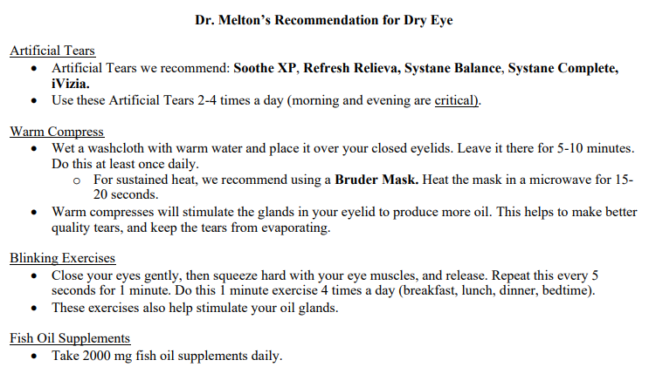
Blink triple care

Slide 32
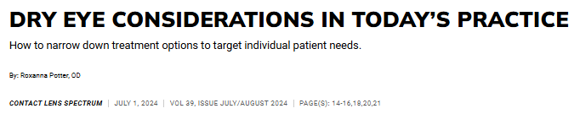
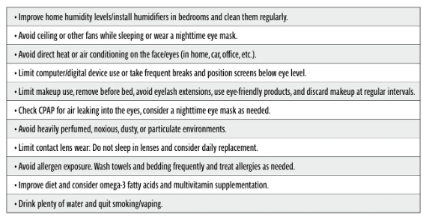

Slide 33
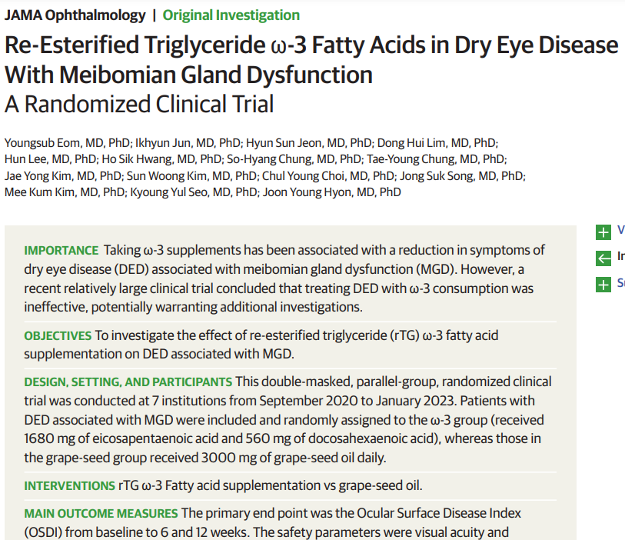
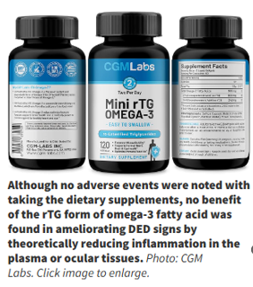
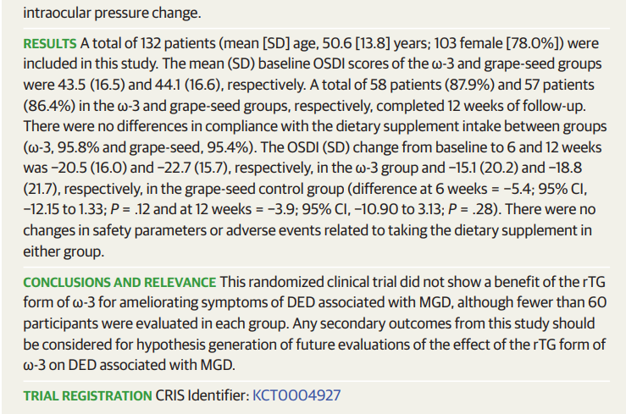
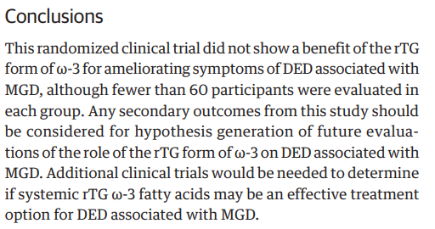

Slide 35
Fish Oil Fails Yet Again
First was the DREAM study
Now, a new study states: “This randomized clinical trial did not show a benefit of the re-esterified triglyceride form of omega-3 for ameliorating symptoms of DED associated with MGD.”
M+T conclusion: If fish oil supplementation is beneficial; the impact is certainly not robust.
JAMA Ophthalmol, July 2024
Notes:
Eom Y, Jun I, Jeon HS, et al. Re-Esterified Triglyceride ω-3 Fatty Acids in Dry Eye Disease With Meibomian Gland Dysfunction: A Randomized Clinical Trial. JAMA Ophthalmol. 2024;142(7):617–624.

Slide 36
Another Blow to Fish Oil Intervention
“This RCT did not show a benefit of the re-esterified form of omega-3 fatty acids for ameliorating symptoms of DED associated with MGD.”
“In summary, more work may need to be done before the field makes a firm conclusion and fully closes the chapter on omega-3 fatty acid supplements for patients with evaporative dry eye.”
JAMA Ophthalmology, July 2024
Notes:
Eom Y, Jun I, Jeon HS, et al. Re-Esterified Triglyceride ω-3 Fatty Acids in Dry Eye Disease With Meibomian Gland DysfunctionA Randomized Clinical Trial. JAMA Ophthalmology 2024;142(7):617-624.

Slide 37
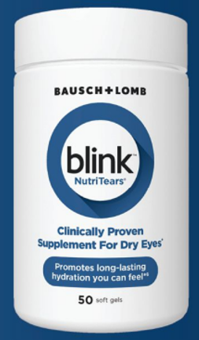
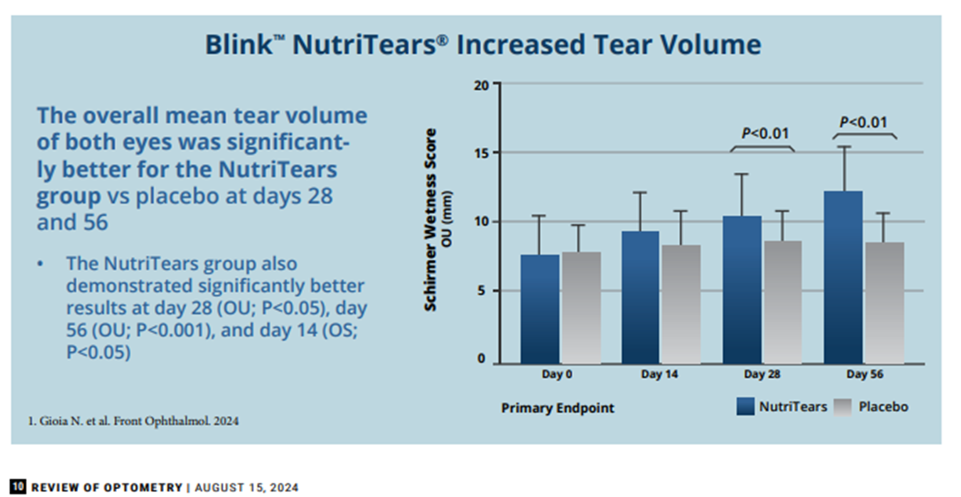
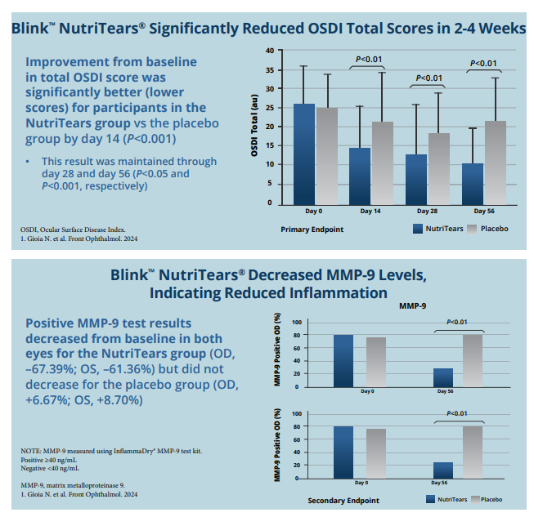
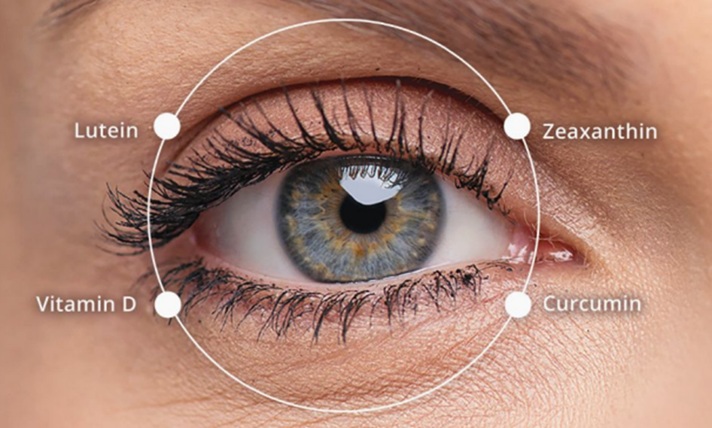

Slide 38
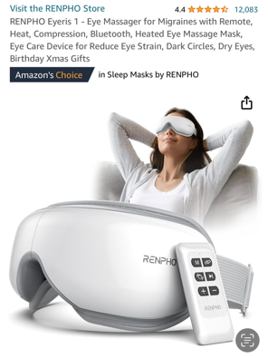
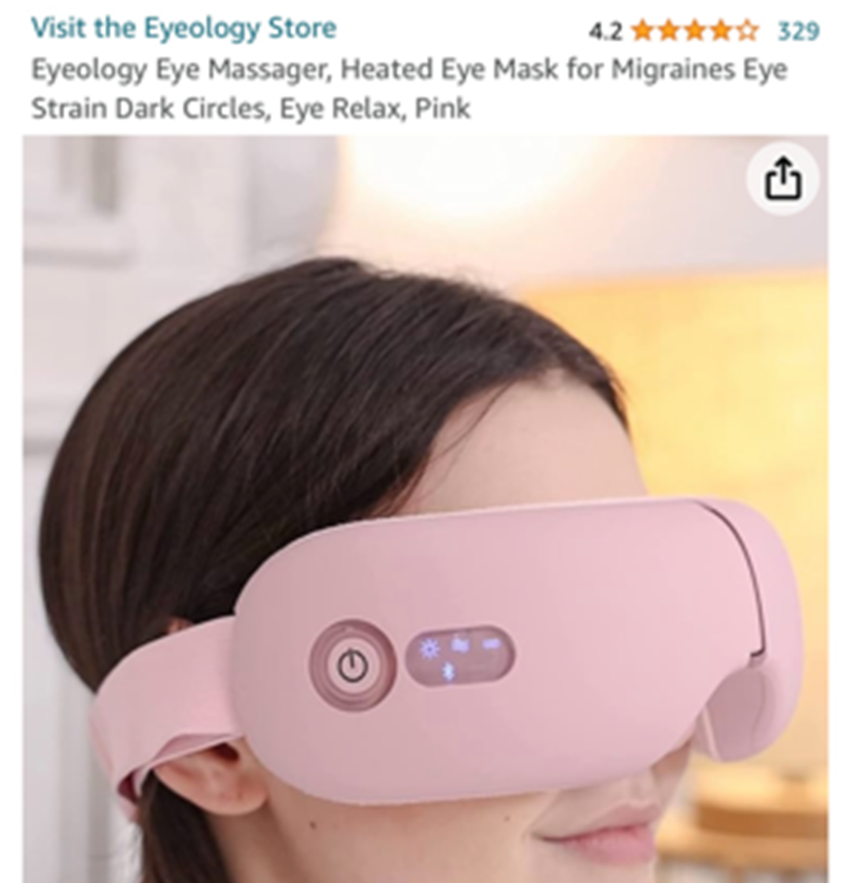

Slide 39
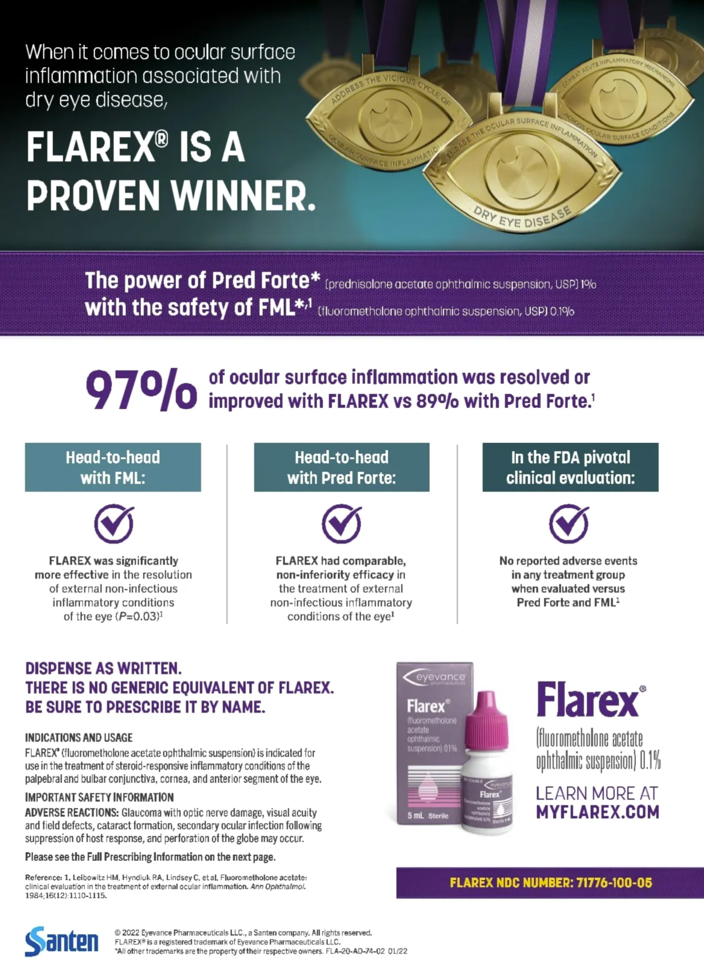

Slide 40
Literature Perspective on Steroids and Elevated IOP
“IOP elevation is much more common with older steroids such as dexamethasone, prednisolone and fluorometholone, compared to newer steroids such as loteprednol, difluprednate or rimexolone.”
A note about difluprednate: “Though the occurrence of increased IOP is about 3%, the IOP elevation may be significantly higher compared to the other newer steroids.” Only about 2% of patients experience “a clinically significant IOP increase” with loteprednol.
“Post-operatively, loteprednol did not induce a significant IOP elevation and when used as a replacement for older steroids led to a significant IOP reduction in known steroid responders.”
Survey Ophthalmol. March/April 2020
Notes:
Roberti G, Oddone F, Agnifili L, et al. Steroid-induced glaucoma: Epidemiology, pathophysiology, and clinical management. Surv Ophthalmol. 2020;65(4):458-472.

Slide 41
Vevye™ (Cyclosporine Solution 0.1%)
Cyclosporine is insoluble in water, however this newer formulation is soluble in water-free, preservative-free “inactive” perfluorobutylpentane (PFBP)
PFBP by itself is beneficial in treating DED
Since no water, there is no pH or osmolarity
“Medical treatment for dry eye has become extraordinarily expensive for patients. Water-free cyclosporine, 0.1% may represent a marginal improvement over Restasis emulsion.”
M+T: We just don’t see another cyclosporine bringing anything new to the table.
JAMA Ophthalmol. May, 2023

Slide 42
A Nose for Dry Eye
Tyrvaya™ (varenicline 0.03%) nasal spray (Varenicline is the same drug as Chantix)
A cholinergic agonist (parasympathomimetic)
Used bid, with effectiveness in 4-6 weeks
Main side effect: sneezing (over 80%)
Do not shake the bottle
Store at room temperature
Two bottles; each good for 15 days 60 sprays/bottle
Consult tyrvaya.com for more information
Marketed as Tyrvaya nasal spray by Viatris

Slide 43
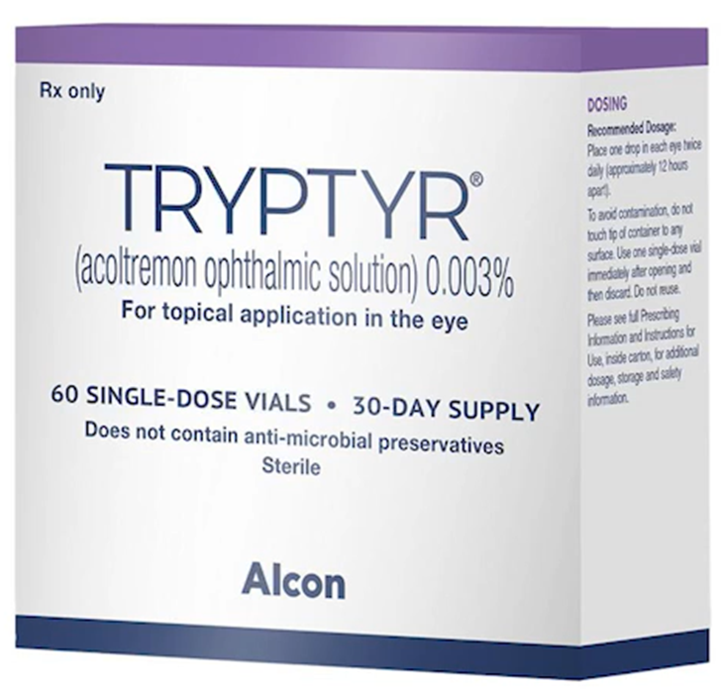
Tryptyr (acoltremon ophthalmic solution 0.003%)
Transient Receptor Potential Melastatin 8 receptor
“TRPM8” is neuromodulator agonist receptor which senses “coolness”
Activation of these unique receptors causes tear production
This activation can affect multiple body tissues, but increasing “basal tear production” is it’s MOA
Since MGD is the weak link in the DED chain, drugs whose primary expression is increasing tear production such as Restasis, Xiidra, and Tryptyr may be most effective when combined with a lipid layer stabilizing artificial tear
Tryptyr is manufactured in single dose vials by Alcon (also makers of Eysuvis for DED); BID recommended dosing
Br J Ophthalmol. October 2023
Notes:
Congdon N, Azuara-Blanco A, Solberg Y On behalf of GLAUrious study group, et al
Direct selective laser trabeculoplasty in open angle glaucoma study design: a multicentre, randomised, controlled, investigator-masked trial (GLAUrious)
British Journal of Ophthalmology 2023;107:62-65.

Slide 44
Regener-Eyes for DED
First in class eye drop
Contains numerous anti-inflammatory cytokines and growth factors from placental-derived tissue
Hyaluronic acid for lubrication
Enhances the lipid layer
Helps the body to regenerate itself
Available as Regener-Eyes and Regener-Eyes Lite in a 3 ml sterile bottle
See regenereyes.com

Slide 45
Perfluorohexyloctane = Meibo
A new and unique treatment for DED
Specifically designed to target MGs
“Meibo demonstrated statistically and clinically meaningful improvements in the signs and symptoms of DED associated with MGD.”
“Meibo is thought to spread over the ocular surface to form a long-lasting anti-evaporative barrier.”
Dosage is QID for at least 8 weeks
Meibo contains no water or preservative
Marketed as Miebo by B+L
Ophthalmology, May, 2023
Notes:
Tauber J, Berdy GJ, Wirta DL, Krösser S, Vittitow JL, GOBI Study Group. NOV03 for dry eye disease associated with meibomian gland dysfunction: Results of the randomized Phase 3 GOBI Study. Ophthalmology. 2023;130(5):516-524. https://doi.org/10.1016/j.ophtha.2022.12.021

Slide 46
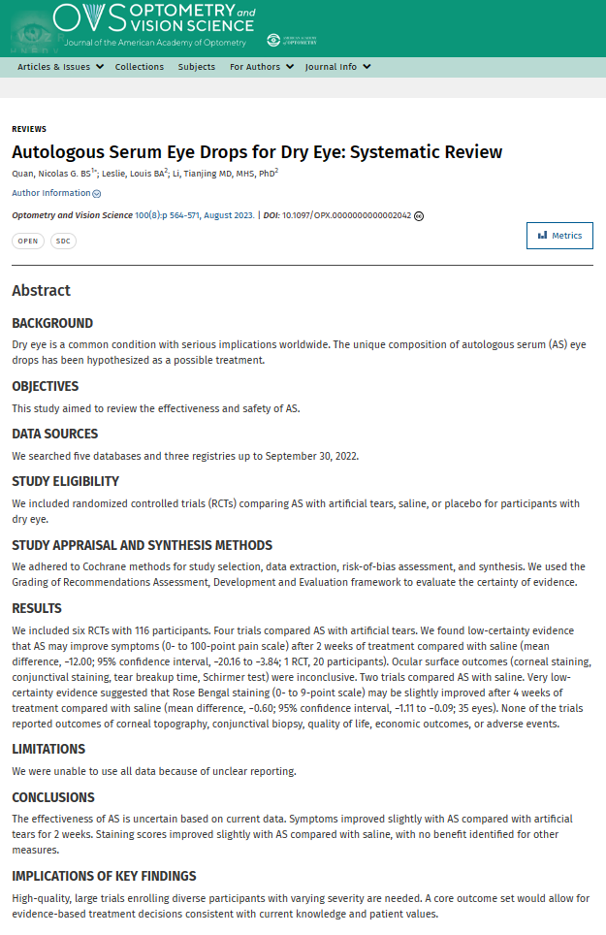
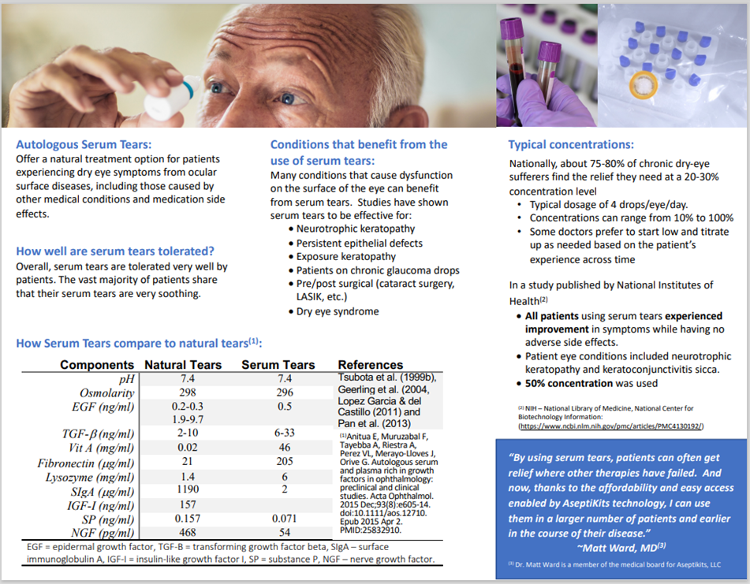
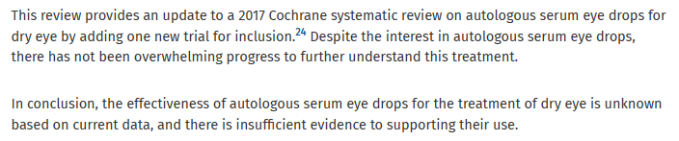

Slide 47
*Oral Azithromycin vs Oral Doxycycline in Treating MGD
Doxycycline 100 mg twice a day for 6 weeks or oral azithromycin 1g once a week for 3 weeks
With equivalent efficacy, fewer frequent side effects and a less frequent dosing regimen, azithromycin could be an attractive alternative to doxycycline in patients with MGD. “However, long-term follow-up in each group would be needed to determine if these outcomes persist for this chronic condition.”
OSN, July 23, 2023

Slide 48
Lumify (brimonidine 0.025%) Ophthalmic Solution
FDA approved in December 2017 – OTC product
Major upgrade to help the chronic red eye
Venular constriction is the mechanism of action, therefore …
No rebound hyperemia
Used once or twice a day PRN
Marketed as Lumify OTC by Bausch & Lomb
Notes:
To drug lecture

Slide 49
Chronic Redness
60 yobm, hx chronic blepharitis
Meds: Was on Zylet BID OU but stopped 2 wks ago. PF Artificial Tears
BVA: 20/20, 20/20
Pupils: Normal OU
SLE: 1+ scruff lashes, 2+ conjunctival injection, cornea clear OU, 1+NS OU
IOP: 12,14 @ 9:00am
DFE: .3 / .3, fundus normal OU
Notes:
Van wagenen, walter

Slide 50
Chronic Redness – Med List
Fish oil
PRN
PF Refresh
Freshkote
Electrolysis Lashes
Punctal Plugs
Commercial lid scrubs
Cliradex
Polytrim
DCN
Restasis
LE Gel
Systane B
Tetracycline
Steroid dose pack
Minocycline
Tobradex ointment
Tobradex
Tobradex ST
Lotemax ung
Zylet
Oracea
Notes:
Van wagenen, walter

Slide 51
Brimonidine Dermatologic Gel
Used to address the erythema and flushing commonly expressed in facial and eyelid rosacea
Causes microvascular vasoconstriction
Comes in a 30 gram tube – applied once daily
Provides a “somewhat effective” clinical response
Available as a .33% gel (Mirvaso) by Gladerma
Reference: The Medical Letter, October 2013

Slide 52
Oxervate (cenegermin) 0.002% solution for Neurotrophic Keratitis
FDA-approved in August 2018
Eye drop delivery of human nerve growth factor
Dosage: 6 x D (2 hour intervals) for 8 weeks
Do Not Shake – Very complex administration protocol
70% “complete healing” in 8 weeks
“Orphan Drug” – marketed by Dompe U.S., Boston

Slide 53
Overview of Neurotrophic Keratopathy
Epithelial turnover occurs every 7-10 days
Corneal hypoesthesia or anesthesia is the hallmark of NK
Main Causes: Post HSK and Post VZV
Signs outweigh (neurotrophic) symptoms
Testing corneal sensitivity is critical
BCL, PF-ATs, doxycycline, vitamin C, cenegermin (Oxervate)
Topical insulin appears to be effective as well
Effect of varenicline (Tryvaya) also being studied.
Survey Ophthalmol. Sept/Oct 2024
Notes:
Vera-Duarte, Guillermo Raul et al. Neurotrophic keratopathy: General features and new therapies. Survey of Ophthalmology, 2024;69(5)789-804

Slide 54

Neuropathic (DED) Eye Pain
The best article we have found on this topic is available from:
https://www.ncbi.nlm.nih.gov/books/NBK542282/
Moshirfar M, Benstead EE, Sorrentino PM, et al. Ocular Neuropathic Pain. [Updated 2023 Feb 22]. In: StatPearls [Internet]. Treasure Island (FL): StatPearls Publishing; 2023 Jan.

Slide 55
Neuropathic Corneal Pain
“NCP is characterized by dysfunctional corneal nerves and ocular symptoms including pain, discomfort, burning, stinging, allodynia and photophobia, which are typically not relieved by conventional dry eye treatment because of its neurobiological nature.”
Two most common symptoms: Burning and photophobia.
In vivo confocal microscopy (IVCM) is 100% able to differentiate NCP from DED.
Most of these patients have “severe” symptoms which impact quality of life.
Am J Ophthalmol. September 2024
Notes:
Liu C, Lin M T-U, Lee IXY, et al. Neuropathic Corneal Pain: Tear Proteomic and Neuromediator Profiles, Imaging Features, and Clinical Manifestations. Am J Ophthalmology. 2024;265:6-20.

Slide 56
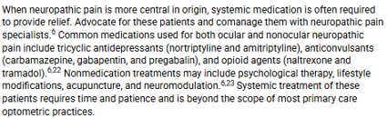

Slide 57
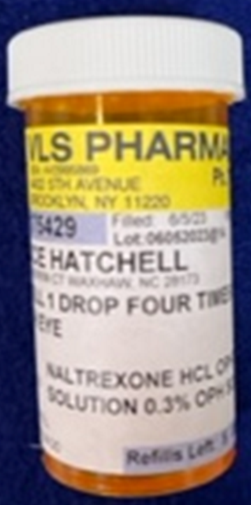
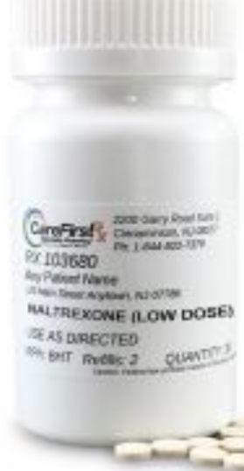
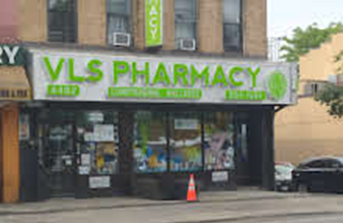
Low Dose Naltrexone (LDN) for Treating Pain Associated with Neuropathic DED
Neuropathic corneal pain (NCP) is caused by damage or disease of the central somatosensory nervous system
If corneal pain is not suppressed by proparacaine, then the diagnosis points to NCP
NCP patients tend to also have anxiety and depression
LDN causes transient blockade of opioid receptors
Most common SE: vivid dreams and headaches
Dosage at bedtime: 1.5 mg x 2 weeks, then 3.0 mg x 2 weeks, then 4.5 mg x 2 weeks (to several months, if relief is obtained).
LDN works for about 50% of patients
Ocular Surface, April 2021
Notes:
Dieckmann G, Ozmen MC, Cox SM, Engert RC, Hamrah P. Low-dose naltrexone is effective and well-tolerated for modulating symptoms in patients with neuropathic corneal pain. Ocular Surface. 2021;20:33-38.

Slide 58
Low Dose Naltrexone for NK
Standard dosage 50 mg used to treat opioid disorders
LDN starts at 1.5 mg, and can be increased to 3.0 and 4.5 mg.
Provides modest improvement of corneal pain
LDN well-tolerated in most all patients
Most common SEs: Vivid dreams and headaches
Pain, photoallodynia most common symptoms in NK
Should be considered as an option for refractory NCP
Reference: The Ocular Surface 2021; 20:33 - 38
Notes:
Gabriela Dieckmann, M. Cuneyt Ozmen, Stephanie M. Cox, Ryan C. Engert, Pedram Hamrah. Low-dose naltrexone is effective and well-tolerated for modulating symptoms in patients with neuropathic corneal pain. The Ocular Surface 2021;20:33-38.

Slide 59
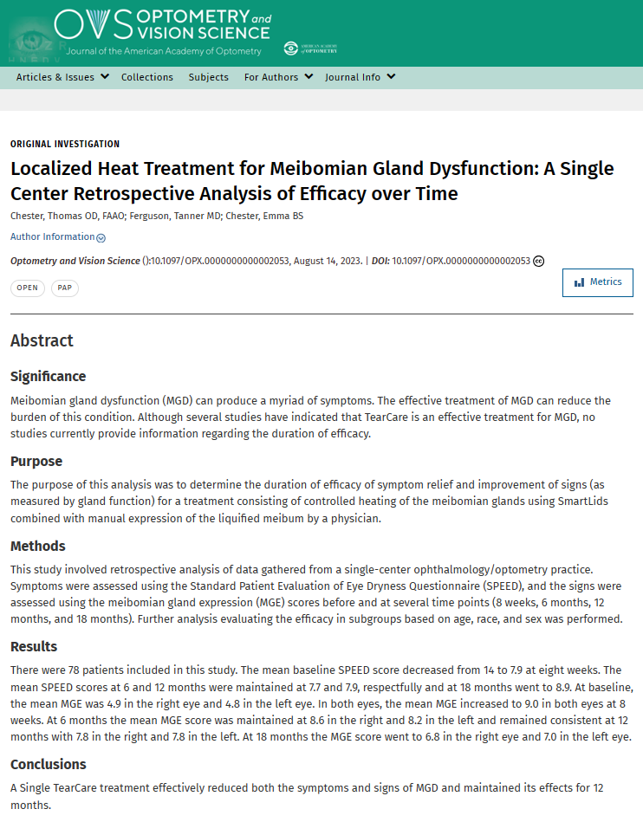
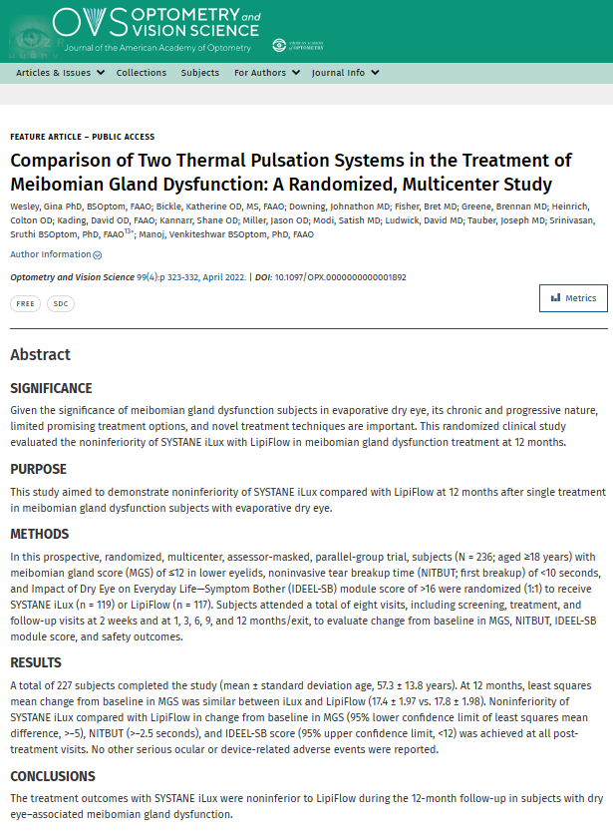

Slide 60
Thermal Systems to Treat DED
Lipiflow®, Ilux®, TearCare®, and home self treatments were evaluated.
All treatments were safe, effective and relatively similar.
Most in-office treatments provided 6-12 months of improvement.
“There are currently no conclusive results on which baseline characteristics may predict patient response to in-office thermal treatment.”
Costs (to doctor and patient) are high. Like life in general, decisions are based on a balance of cost vs. convenience.
Survey Ophthalmol, Sep-Oct, 2022
Notes:
Beining MW, Magnø MS, Moschowits E, et al. In-office thermal systems for the treatment of dry eye disease. Surv Ophthalmol. 2022;67(5):1405-1418.

Slide 61
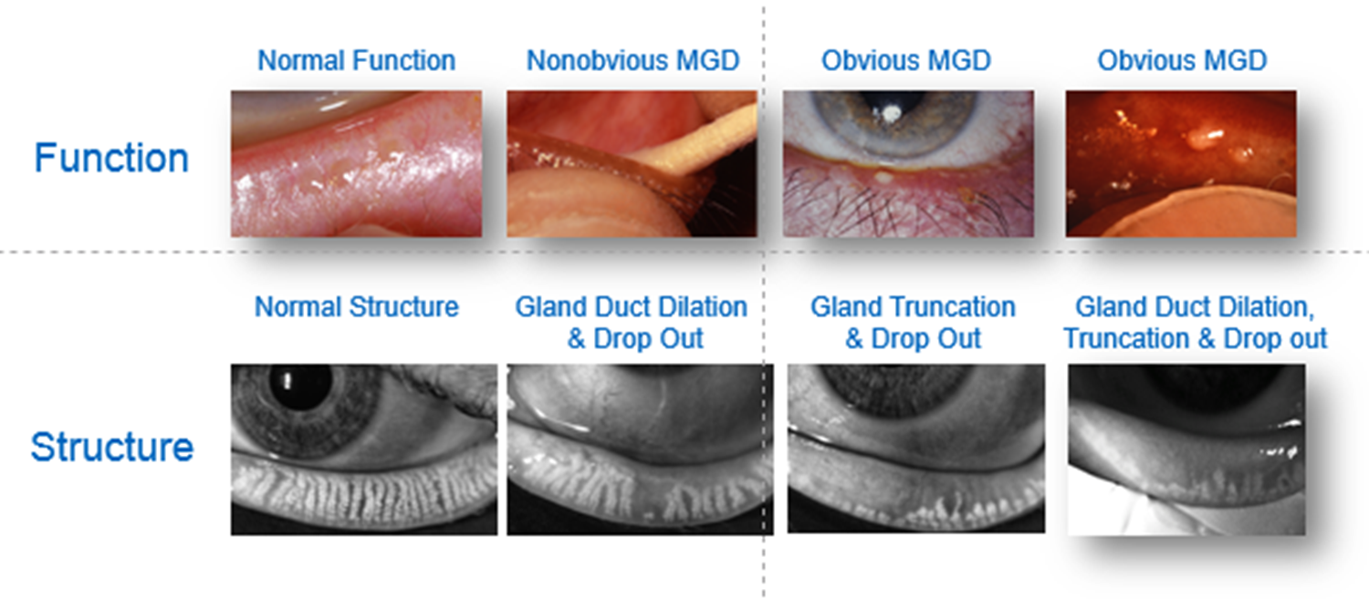
*
“As we move up the “sexy” scale, in-office direct-to-gland heating treatments are a full order of magnitude more effective than any at home thermal therapy.”

Slide 62
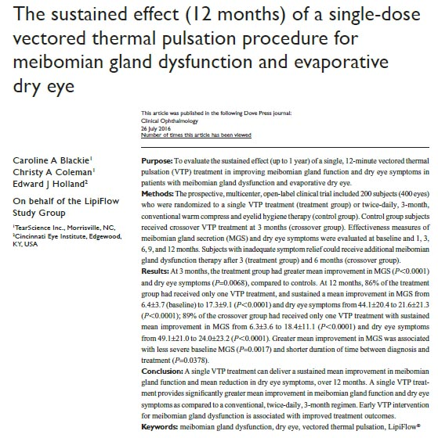
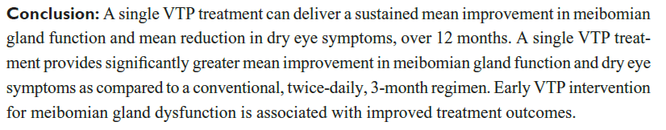

Slide 63
Thermal Pulsation Treatment Increases CL Wearing Time
“Conclusion: In SCL wearers with MGD, a single VTP treatment significantly improved mean meibomian gland function and significantly reduced dry eye signs and symptoms compared to an untreated control. The treatment increased mean comfortable lens wearing time by 4 hours (approximately doubling the pretreatment findings). This was sustained for up to 3 months post-treatment on average.”
Clinical Ophthalmology, Jan, 2018

Slide 64
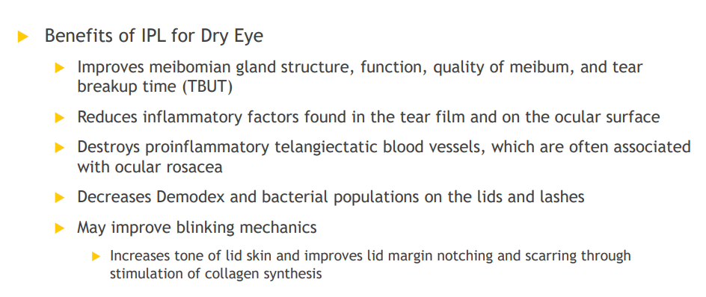
IPL and Dry Eye

Slide 65
MG Scraping in Treating DES
“In the future, the health and maintenance of the MCJ and keratinized lid margin may be considered integral to routine eye care. This shift in our culture will involve improvements in our observation skills and also the willingness to incorporate novel techniques such as debridement-scaling of the MCJ and keratinized lid margin in our clinical practice.”
Korb/Blackie. Cornea. December 2013

Slide 66
In-office Procedure for Meibomian Gland Dysfunction
Focused heat application followed by doctor-delivered meibomian gland expression is a critical intervention for moderate to advanced dry eye disease
TearCare® (SightSciences) is an in-office procedure where heat strips are strategically placed over the eyelids to achieve optimum liquefaction of meibum
Once liquefaction is quickly achieved, the doctor then properly expresses the meibum contents, thus allowing more physiological meibum to be produced.

Slide 67
Inflammation and Eyelid Scraping
“For years, we have understood that inflammation is the underlying pathophysiology responsible for the signs and symptoms of dry eye disease (DED).”
“A supermajority of people in the developed world spend almost all their work time looking at screens. Most people who spend their days in front of a computer blink neither frequently nor completely enough to release the oil sequestered in the glands, producing chronic obstruction at the mouth of the gland.”
Ocular Surgery News, July 25, 2023
Notes:
White DE. Time to talk about evaporative dry eye disease. Ocular Surgery News, July 25, 2023.

Slide 68
Pediatric DED and Risk Factors: Things to Ponder
“Multi-screen” lifestyle – major risk factor
Vegetarian and vegan lifestyle – insufficient consumption of Omega 3 EFA’s
Meibography revealed that about 10% of grade school children had compromised meibomian glands.
This compromise was directly correlated to the amount of time looking at screens
“Evaporative DED associated with smartphone use is a lifestyle disease.”
Reference: OSN, January 25, 2016

Slide 69
Anti-infective/Anti-inflammatory Combinations
Prednisolone Dexamethasone Blephamide Maxitrol Pred-G TobraDex(ST)
Loteprednol Hydrocortisone
Zylet Cortisporin

Slide 70
Eyelid Cleansing Treatments for Blepharitis
Study compared “dedicated eyelid cleanser to diluted baby shampoo”
Cleaning was done bid for four weeks
Conclusion: improvements occurred with both treatments. “However only the dedicated eyelid cleanser proved effective in reducing inflammation and was the preferred therapy.”
The Ocular Surface, October, 2017

Slide 71
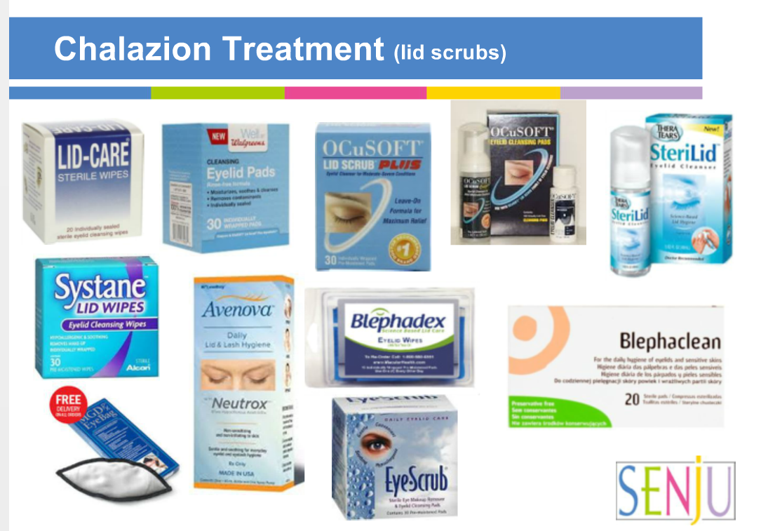

Slide 72
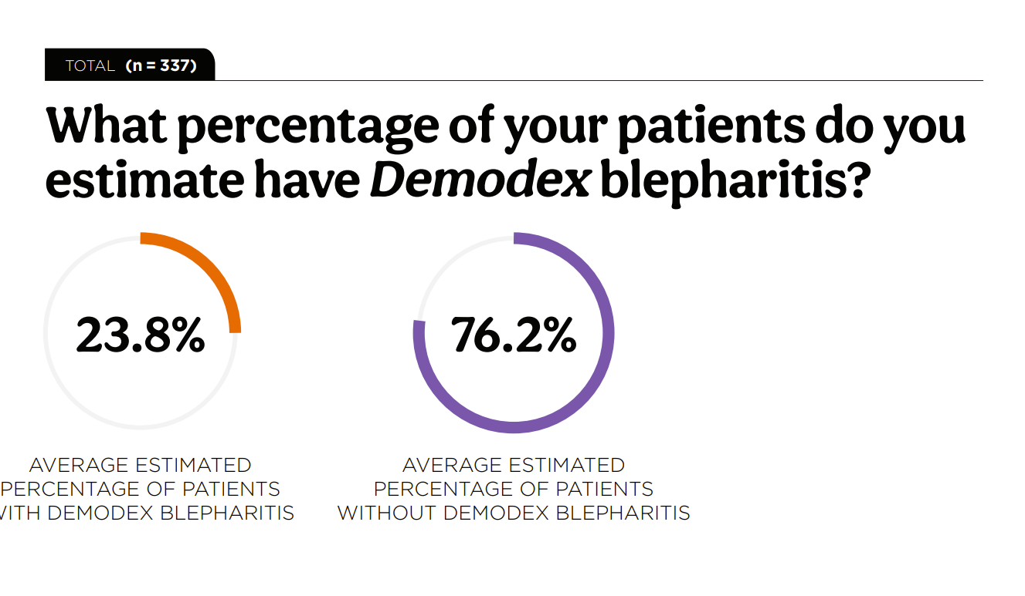


Slide 73
Demodex Blepharitis
Caused by an infestation of the eyelashes and eyelash follicles by Demodex mites, the most common ectoparasite found in humans
Reasonably common, accounting for 45% of blepharitis cases overall, and 84% in people aged 60 and older
Symptoms: eyelid margin inflammation, redness, and ocular irritation
Commonly occurs with rosacea or conditions such as diabetes

Slide 74
Lotilaner Ophthalmic Solution 0.25%
FDA-approved July 25, 2023
Lotilaner 0.25% is an anti-parasitic ophthalmic solution to treat demodex blepharitis
Mechanism of action: inhibits the gamma-aminobutyrid acid (GABA)-gated chloride channels in the Demodex mites to cause paralysis in the mite and its death
Administered BID for 6 weeks
Side Effects: instillation site stinging and burning (10%); chalazions and punctate keratitis (<2%)
Marketed as Xdemvy by Tarsus Pharmaceuticals

Slide 75






Slide 76



Slide 77


Slide 78
Itch Girl
19 y/o wf nursing student 3+ itch OS
Referred by internist
Tx topical antihistamine and steroids
Slight improvement
No previous ocular hx
BC pills; NKDAs

Slide 79
Itch Girl Dx
Based on this information, your assessment is:
1. Medicamentosa reaction to topical steroid
2. Allergic conjunctivitis that is non- responsive to steroid
3. Phthiriasis Palpebrarum
4. Chlamydial conjunctivitis

Slide 80
Itch Girl Tx
Your tx plan includes:
1. Artificial tears ung tid left lids
2. Ciprofloxacin drops qid OS
3. Zithromax 250 mg q d x 5 days
4. Tobramycin drops qid OS

Slide 81
Phthiriasis Palpebrarum
Phthirus Pubis (crab louse) eyelid infestation
Uncommon form of blepharitis
Symptoms: intense itching (pruritus)
Signs: nits (louse egg cases) and reddish sanguinofecal debris at base of eyelashes classic slit lamp findings
Treatment
Forceps to remove lice at slit lamp
Standard lid scrubs and aggressive ointment to lid margins bid x 7 days
Consult with primary care physician

