Slide 1
OCULAR THERAPEUTICS
UPDATE
Ron Melton, OD, FAAO
Randall Thomas, OD, MPH, FAAO

Slide 2
Financial Disclosure
Drs Ron Melton and Randall Thomas are consultants to, on the speakers bureau of, on the advisory committee of, or involved in research for the following companies: ICARE and B+L

Slide 3
Regarding Pupillary Abnormalities
If there is:
- No ptosis
- No EOM dysfunction
Then it’s nothing “bad” and a scan is not indicated
Consider:
Adies, pharmacologic causation, or “discovered” physiologic anisocoria as probabilities

Slide 4
Management of 3rd Nerve Palsy
Pain vs no pain, pupil involvement, or not
    Does not matter!
All patients need emergent CTA or MRA
Send straight to ED; not to an ophthalmologist
However, about 95% of 3rd N. palsies are simply “microvascular,” and not aneurysmal in nature
Foster PJ, et al. JAMA Ophthalmol 2017;135(3):203-4.

Slide 5
Oxymetazoline 0.1% and Ptosis
Afrin nasal spray = 0.05% oxymetazoline
To help with acquired ptosis
Alpha agonist to stimulate muller muscle
Used once daily as needed
Provides about .5mm - .7mm of lid rise
Approved down to age 13
Duration of effect is not yet known
Marked as Upneeq (single use vial) by RVL Pharmaceuticals
Only available via RVL Pharmacy (Upneeq.com)
JAMA Ophthalmol. Nov 2020
Notes:
Bradley EA, Bradley DJ. Oxymetazoline for Ptosis. JAMA Ophthalmol 2020;138(11):1176-1177.

Slide 6
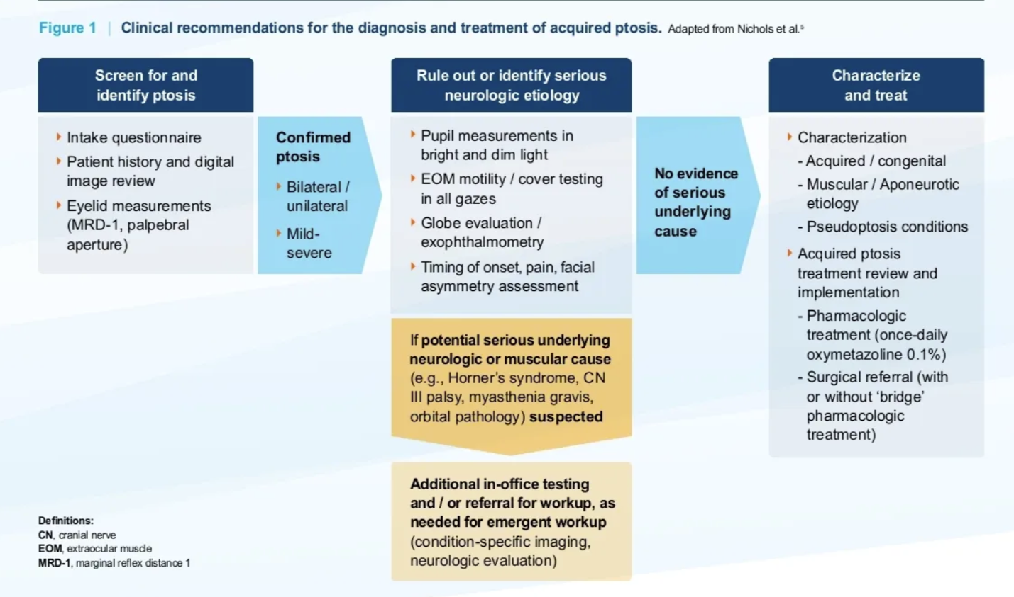
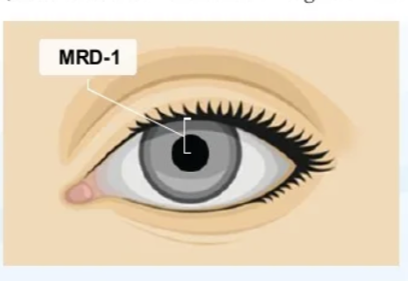

Slide 7
Thyroid Eye Disease and Graves’ Disease
General Observations:
  Women predominately express orbital involvement
  Men predominately express late optic nerve compression
  Diplopia often results from EOM enlargement and fibrosis
  The “active phase” lasts 12-18 months, then spontaneous remission may occur
  TED can occur at any time along the Graves’ disease continuum
  Vision compromise is rare, and can occur from exposure keratopathy or optic neuropathy
  EOM “belly” enlargement mainly involves the inferior and medial recti

Slide 8
Updated Perspective on Thyroid Eye Disease
Smoking is a major risk factor
Type I diabetes joins smoking as a risk factor
TED highest in Black>White>Asian/Hispanic
Peak incidence age: 50-59 per both sexes
Younger age of onset (30’s-40’s) in Asians/Hispanics
Serious disease more common in older, black, female smoker (or previous smoker) with Type I Diabetes
Older patients tend to have more diplopia and expression of optic neuropathy
Am J Ophthalmol, Sept, 2023
Notes:
Ramesh S, Zhang Q, Sharpe J, et al. Thyroid Eye Disease and its Vision-Threatening Manifestations in the Academy IRIS Registry: 2014-2018.
Am J Ophthalmol 2023;253:74-85.

Slide 9
Overview of Thyroid Eye Disease (TED)
Inflammatory autoimmune condition most often presenting with Graves disease
TED begins with orbital and periocular inflammation
Patients often suffer from psychosocial distress such as anxiety and depression
There can be substantial quality of life burden confronting patient with TED, and this newer study finds such QOL impact “is probably a lot poorer than we might have thought.”
JAMA Ophthalmol. Feb, 2023
Notes:
Smith TJ, Cockerham K, Lelli G, et al. Utility Assessment of Moderate to Severe Thyroid Eye Disease Health States. JAMA Ophthalmol. 2023;141(2):159–166. doi:10.1001/jamaophthalmol.2022.3225

Slide 10
Treatment for Thyroid-related Proptosis
New breakthrough drug to reduce proptosis
Tepezza™ (teprotumumab) - Amgen
75% achieved ~2.5mm reduction in proptosis
I.V. infusion every 3 weeks for 8 sessions
Mild to moderate side effects:
Median Commercial Cost- $823,000 ($431,000 - $981,000 range)
Amgen/Horizon co-pay programs and Patient Assistance Programs help
Muscle spasm | Nausea
Alopecia | Diarrhea
Fatigue | Hyperglycemia
Hearing loss | Dry skin
Dysgeusia | Headache
NEJM January 23, 2020
Notes:
Douglas RS, Kahaly GJ, Patel A, et al. Teprotumumab for the treatment of active thyroid eye disease. N Engl J Med 2020;382:341-352.

Slide 11
Thoughts on Teprotumumab (Tepezza®)
“Teprotumumab makes the extraocular muscles and intraconal fat behind the globe shrink back to a more normal volume in a way that nothing else does.”
“Tepezza turns off the inflammatory process, but it also reverses proptosis and reduces strabismus.”
“Tepezza has a place in reversing the disease in the acute setting, the chronic setting and even down the road after the disease has seemingly burned out.”
Monoclonal antibodies (-mab) are now used in TED, and tocilizumab (Actemra) for giant cell arteritis.
Ocular Surgery News, July 25, 2023
Notes:
Goldstein SM. Teprotumumab has been game changer in management of thyroid eye disease. Ocular Surgery News July 25, 2023.

Slide 12
Update on Teprotumumab (Tepezza®)
Thyroid eye disease (TED) is a secondary expression of Graves’ disease
Many patients with TED will improve without treatment
Cost varies: 500K per 150 lb. patient; 800K for obese patients
Relapse rate after cessation is 40% at 72 weeks
Main side effects: muscle spasms and nausea in 20%
In 2020, 463 reports of side effects; 78 were serious
Other optional approaches: thyroidectomy, a course of IV methylprednisolone for 12 weeks, or radiotherapy
Ophthalmology, August 2021
Notes:
Allen RC, Bradley EA, Fante RG, Lucarelli MJ. A Perspective on the Current Role of Teprotumumab in Treatment of Thyroid Eye Disease.
Ophthalmology. 2021 Aug;128(8):1125-1128.

Slide 13
Tepezza® Impact on Quality of Life
“Is a modern-day miracle of the innovation cycle”
Follow patients for potential hearing loss
Downgaze may make subtle eyelid retraction more evident
OSD is a common finding, but not exclusive in the 30-50 year old
Transient morning diplopia is noteworthy
Tepezza seems to work independent of
duration or severity of disease
Ocular Surgery News, December 10, 2023

Slide 14
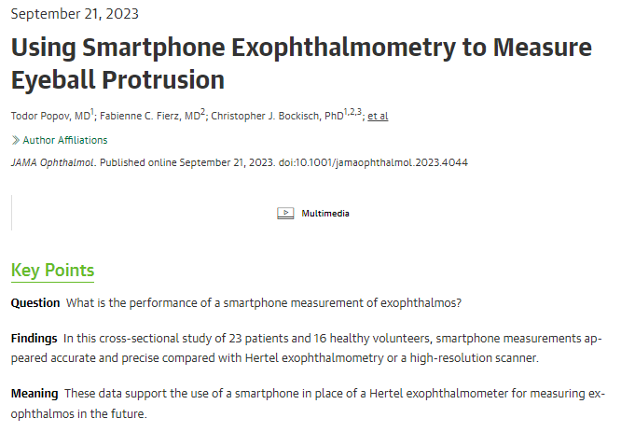

JAMA Ophthal 9-21-23

Slide 15
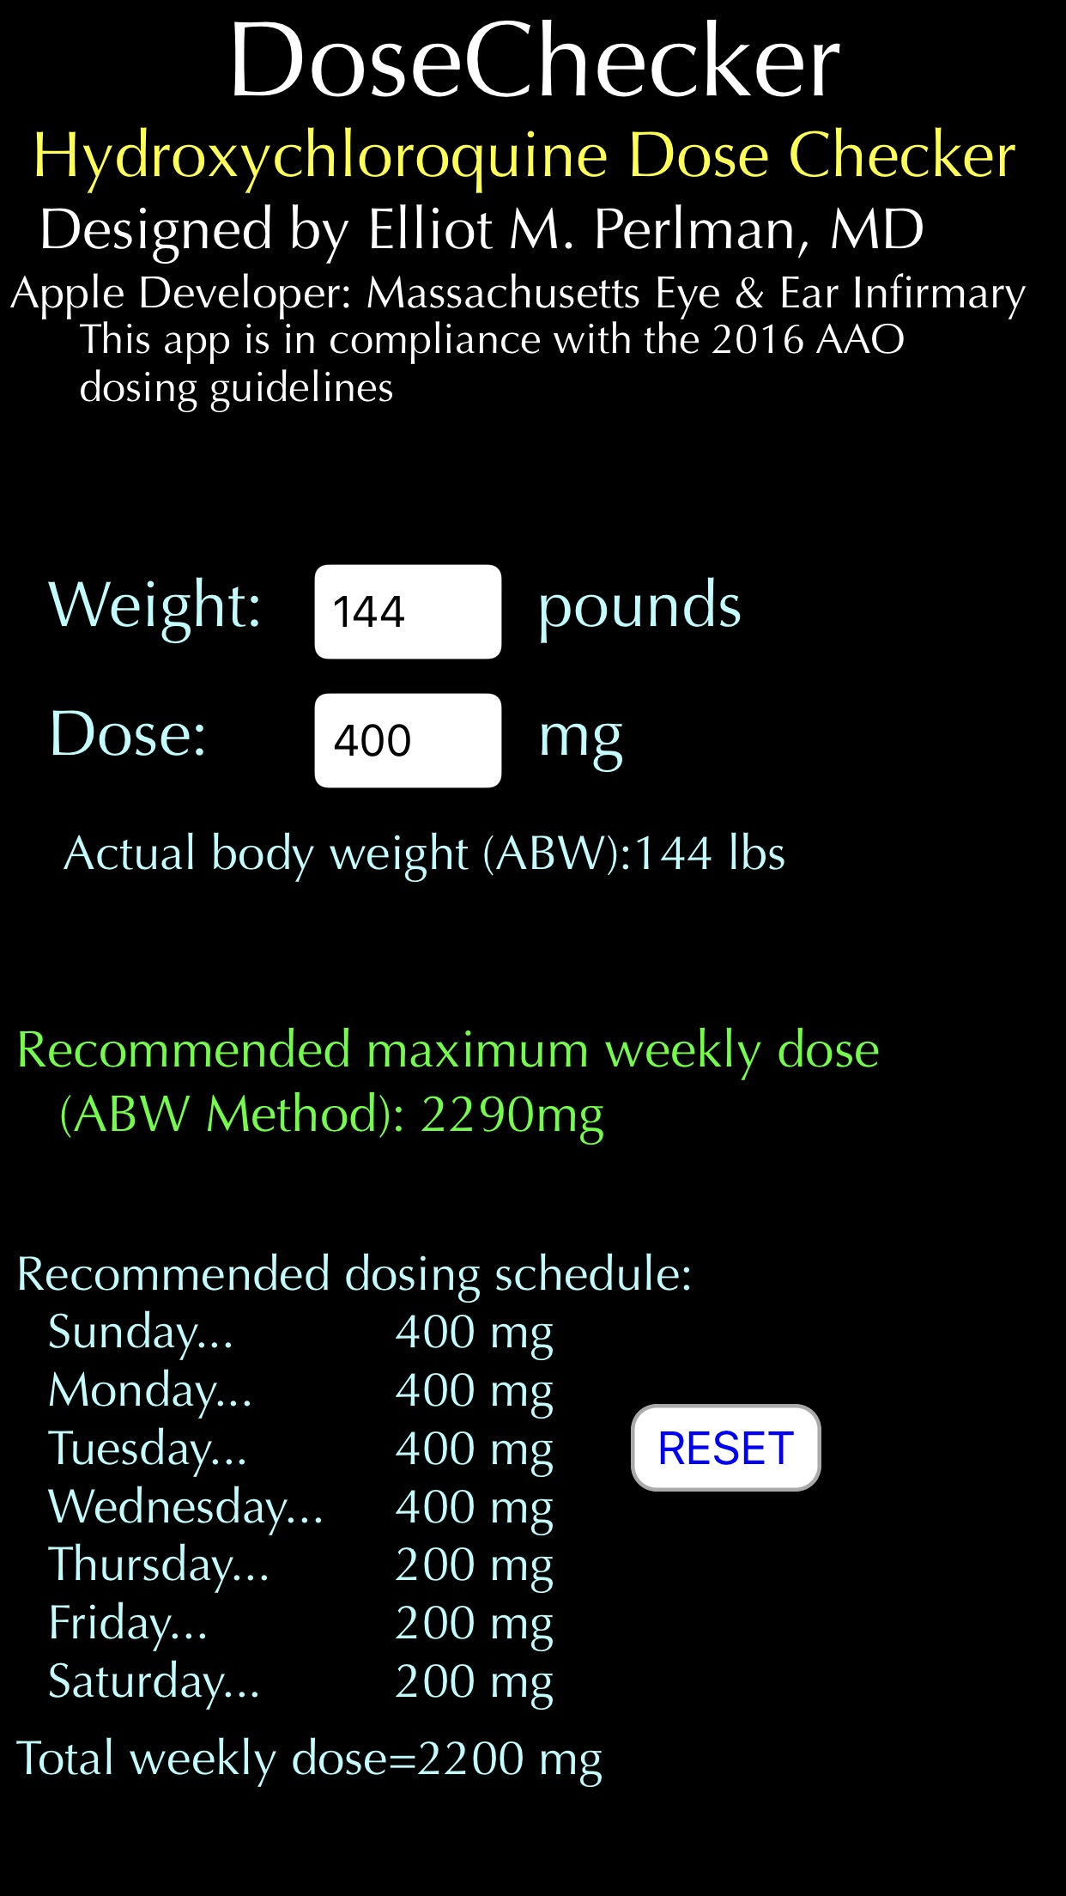

Slide 16
Retinal Risks with Hydroxychloroquine
Risk is greatly reduced when dosage stays below 5 mg/kg/day. (Roughly 105 lbs. compared to 135 lbs. at 6.5 mg/kg/day).
Use a dosage of 300 mg/day to greatly reduce toxicity potential.
“The greatest risk factors for HCQ damage are over-dosage and prolonged dosage (> 5-10 years), along with cofactors such as renal disease or tamoxifen. Unfortunately, compliance with these recommendations is still poor among both ophthalmologists and rheumatologists.”
Survey Ophthalmol. Sept/Oct 2024
Notes:
Cheng, Tiantian et al. Clinical features of ocular damage in systemic lupus erythematosus and risk factors for hydroxychloroquine-related complications. Survey of Ophthalmology, 2024;69(5):733-742.

Slide 17
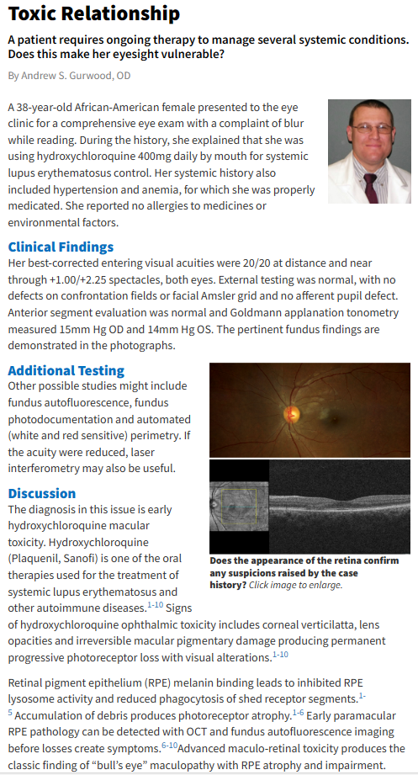
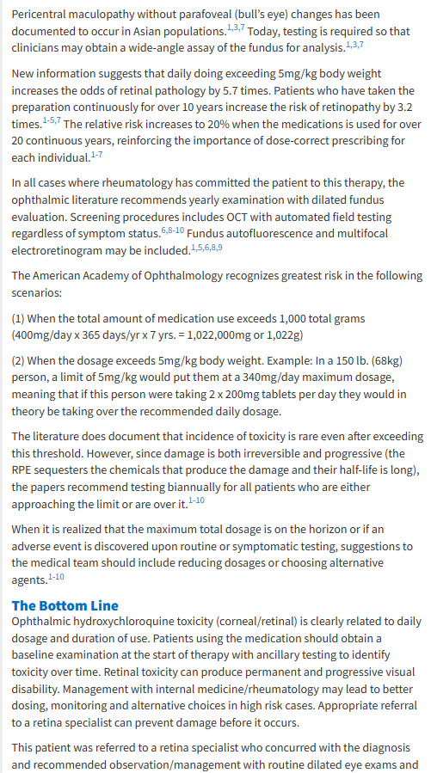

Slide 18
Pentosan Polysulfate Sodium (Elmiron) Maculopathy
Only FDA-approved drug to treat interstitial cystitis (painful inflammation of the bladder)
FDA-approved in 1996 (same as Xalatan) 100 mg TID
Like Plaquenil, extended use (about 4 years) can cause a toxic (geographic) maculopathy in approximately 20% of patients.
Like Plaquenil, visual acuity is initially preserved even with visible maculopathy
Evaluate annually with OCT and fundus photographs
Bottom line: in patients taking Pentosan, educate the patient and communicate with their urologist.
Ophthalmology June 2020
Notes:
Vora RA, Patel AP, Melles R. Prevalence of Maculopathy Associated with Long-Term Pentosan Polysulfate Therapy. Ophthalmology 2020;127(6):835-836.

Slide 19
Further Insights Regarding Pentosan Maculopathy
Patients with high cumulative doses are at greatest risk (>3000 grams)
Symptoms:
  Blurry vision
  Adjusting to light
  Difficulty reading
Even after cessation, symptoms progressed during the 2-year follow-up
Early detection is critical to diminishing risk of permanent visual compromise
FAF, OCT, OCT-A are key to diagnostic detection and quantification.
Am J Ophthalmol. Nov, 2023
Notes:
Somisetty S, Santina A, Au A, Romero-Morales V, Bousquet E, Sarraf D. Progression of Pentosan Polysulfate Sodium Maculopathy in a Prospective Cohort. Am J Ophthalmol. 2023;255:57-67.

Slide 20
Further Insights Regarding Pentosan Maculopathy
Patients with high cumulative doses are at greatest risk (>3000 grams)
Symptoms:
  Blurry vision
  Adjusting to light
  Difficulty reading
Even after cessation, symptoms progressed during the 2-year follow-up
Early detection is critical to diminishing risk of permanent visual compromise
FAF, OCT, OCT-A are key to diagnostic detection and quantification.
  **
Am J Ophthalmol. Nov, 2023
Notes:
Somisetty S, Santina A, Au A, Romero-Morales V, Bousquet E, Sarraf D. Progression of Pentosan Polysulfate Sodium Maculopathy in a Prospective Cohort. Am J Ophthalmol. 2023;255:57-67.

Slide 21
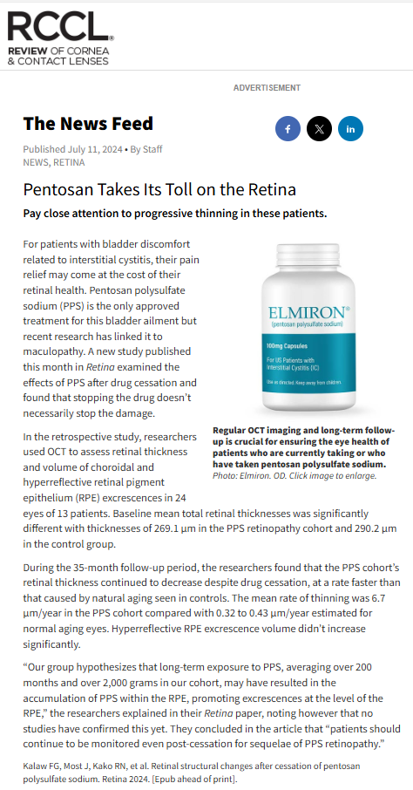
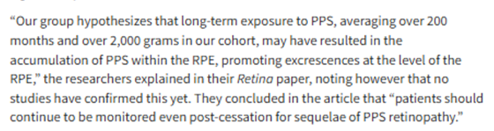

Slide 22
Thoughts on Geographic Atrophy
AMD is on a continuum – prevention is key
Don’t smoke, eat healthy (esp. fish), take AREDS 2
Multiple pathways to GA: Complement (a part of our innate immune response), oxidative stress, and/or mitochondrial dysfunction.
Two new intravitreal drugs are compliment inhibitors: Pegcetacoplan (Syfovre®) and avacincaptad (Izervay™) require monthly (or QOM) injections. They slow lesion growth about 20%, and take 18-24 months to show results.
OCT is the best diagnostic instrument
Because lesions are often extramacular, VA is not sensitive at diagnosing geographic atrophy.
EyeNet, February, 2023
Notes:
Taylor R. Novel Therapies and New Biomarkers for Geographic Atrophy. EyeNet February, 2023

Slide 23
Limited Data on Complement Inhibitors (C3 + C5)
Prevalence of GA is about 0.7%
At 12 months and 24 months; both inhibitors were equal in their histopathologic effects.
Effects were the same at QM or EOM Tx intervals
These inhibitors did cause an increase in neoAMD
Most lesions are extrafoveal, therefore VA is unaffected
Microperimetry and “patient-reported” outcomes are key!
Tx for GA is rapidly evolving, thus all data to date require a “living systematic review”.
Survey of Ophthalmology May/June 2024
Notes:
Garg A, Nanji K, Tai F, et al. The effect of complement C3 or C5 inhibition on geographic atrophy secondary to age-related macular degeneration: A living systematic review and meta-analysis. Survey Ophthalmol 2024;69(3):349-361

Slide 24
Critical Pearls Regarding Tx of GA
These compliment inhibitors ONLY slow the rate of progression (by about 20%)
Their effectiveness enhances over the course of several months of treatments
Getting patients to consent to “preventive” therapy when their vision is still good is a major management challenge as compared to Anti-VEGF injections when vision is already compromised.
Many GA lesions are PARA-foveal; We want to slow the expansion of the lesion to try to prevent foveal incursion.
In like manner, we use AREDS 2 to try to slow (by about 25%) the process of dry ARMD.

Slide 25
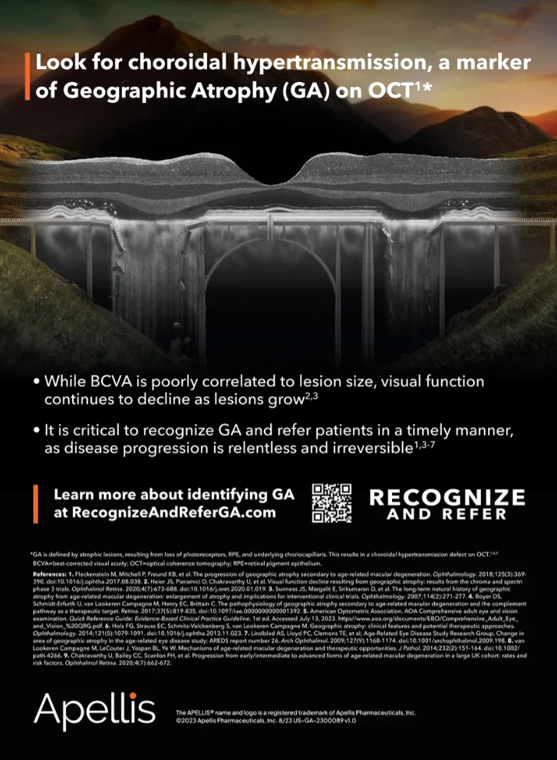
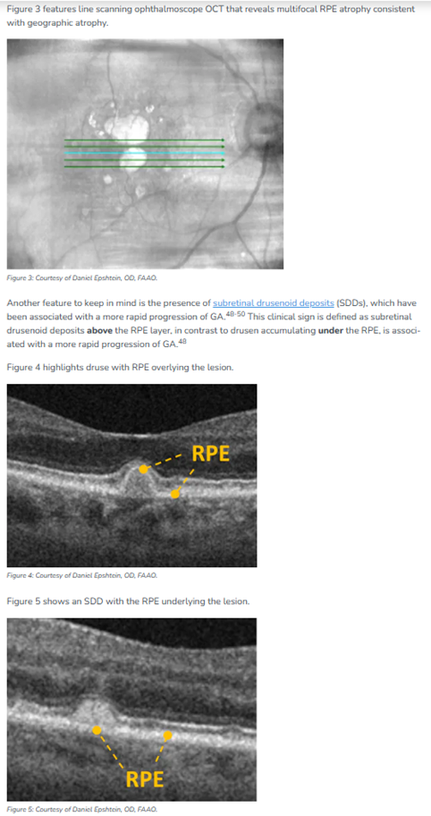
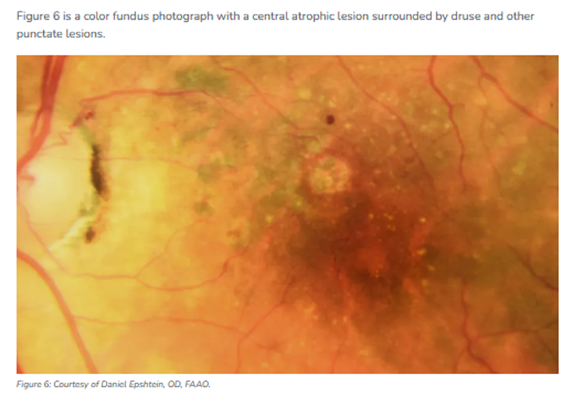
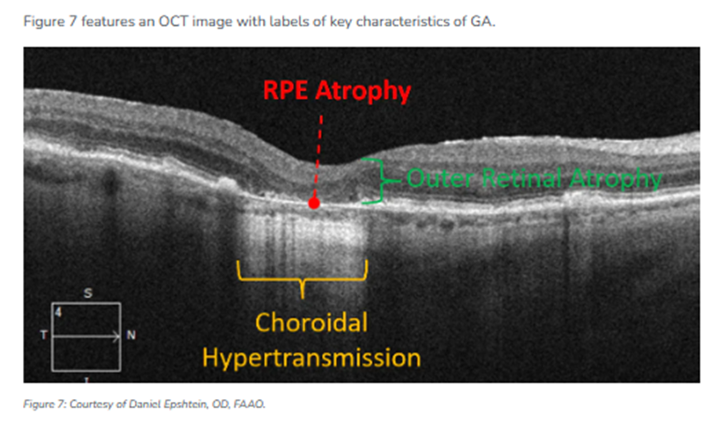

Slide 26
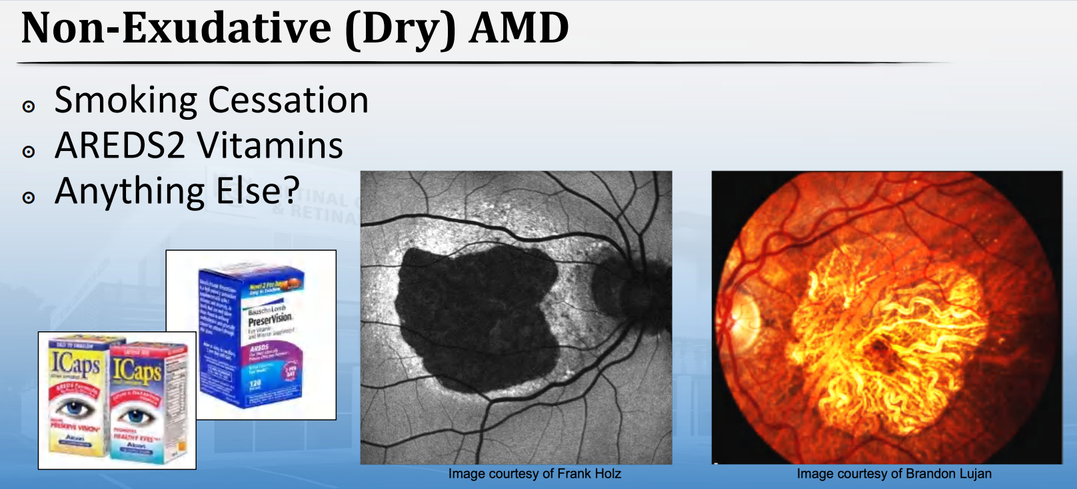

Slide 27
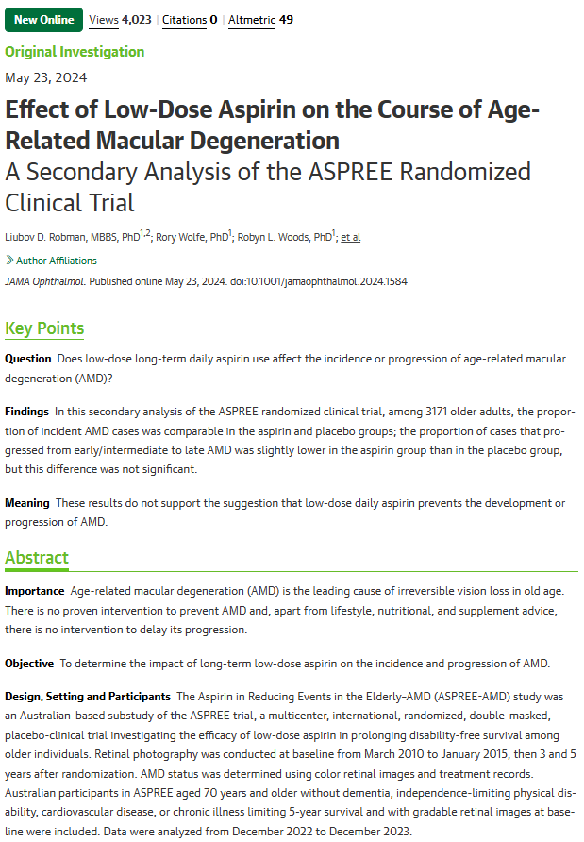
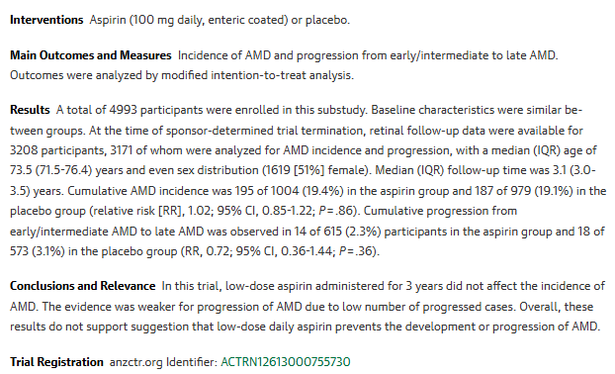
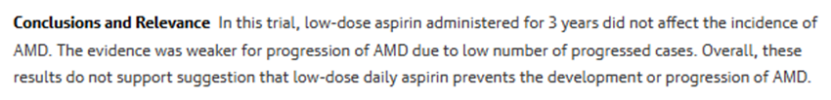

Slide 28
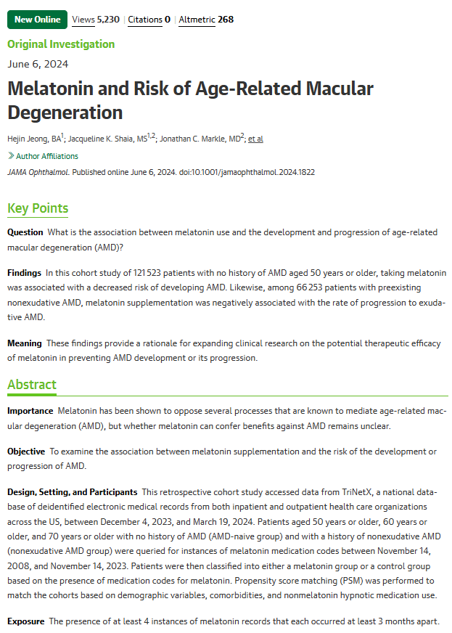
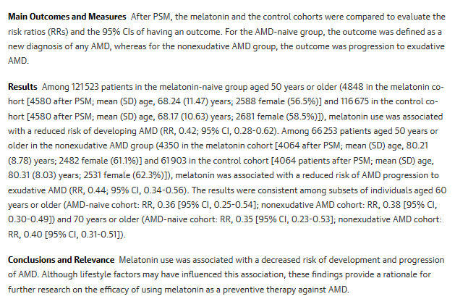


Slide 29
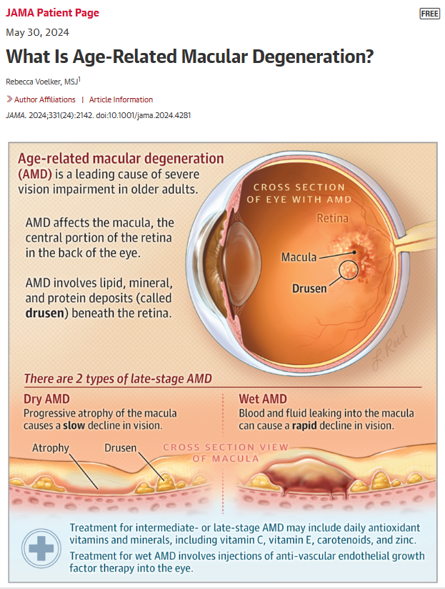
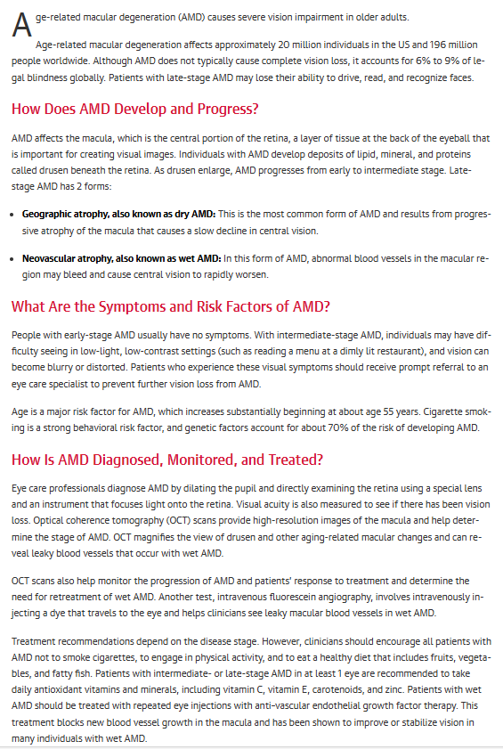

Slide 30

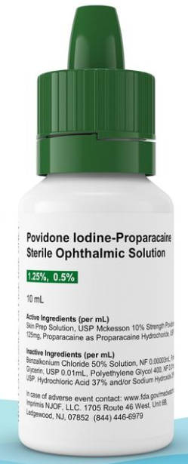

Slide 31
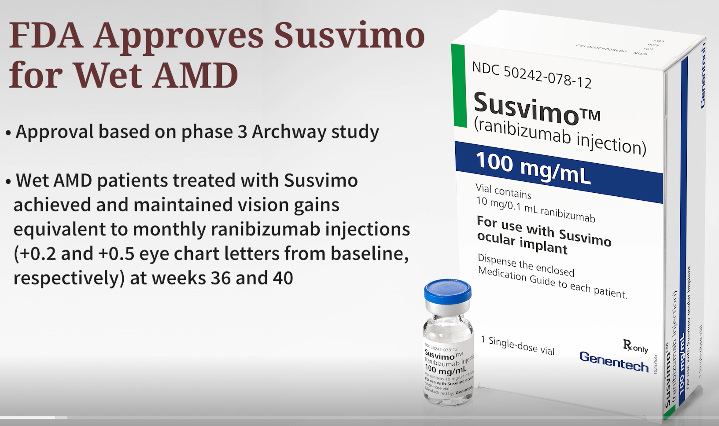
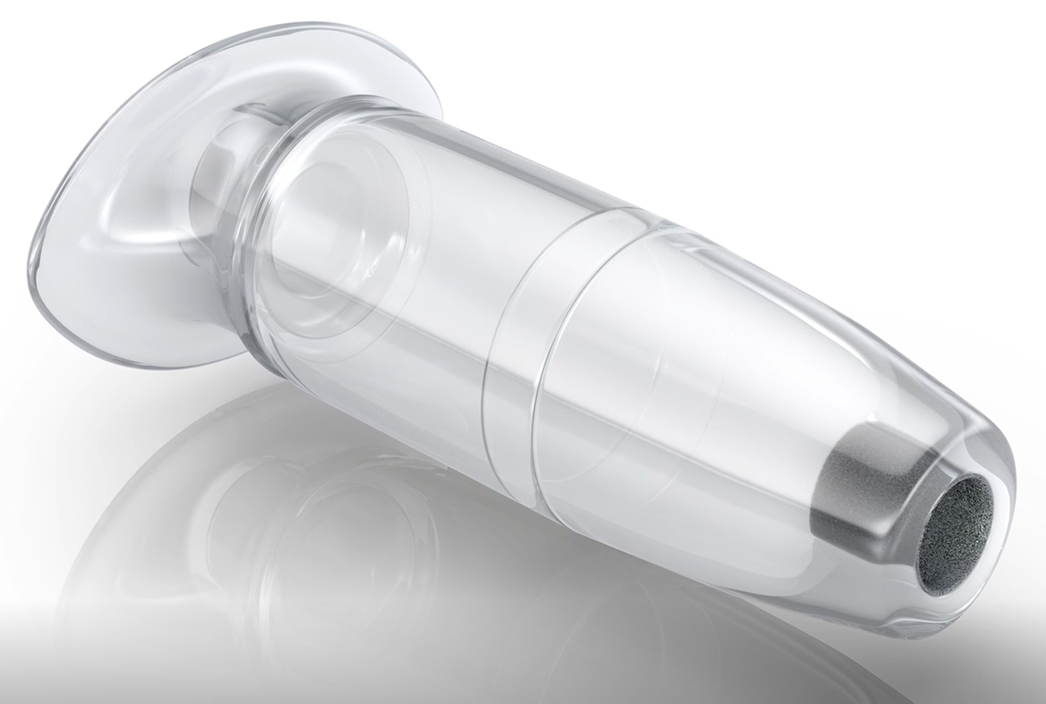
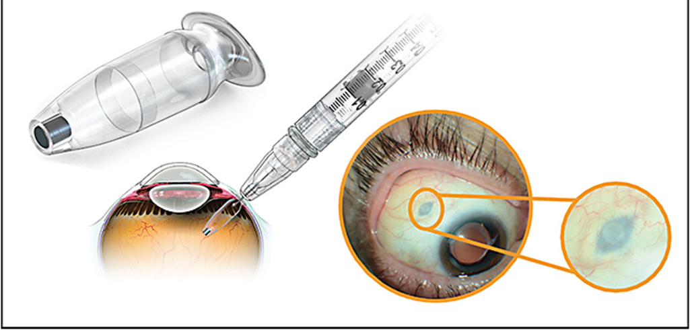

Slide 32
Home-Monitoring for WET AMD
“We found no robust diagnostic accuracy of any home-monitoring test.” “Virtually all of the studies included authors who had either involvement in the development of the test or a financial/patent interest.”
In this study; “The Foresee Home Device (Notal Vision), was considered, but the owners declined an offer to take part.”
“None of the tests evaluated (KeepSight Journal, MyVisionTrack or MultiBit) are ready for implementation in a clinical situation.”
JAMA Ophthalmol. June, 2024
Notes:
Hogg RE, Sivaprasad S, Wickens R, et al. Home-Monitoring Vision Tests to Detect Active Neovascular Age-Related Macular Degeneration. JAMA Ophthalmol. 2024;142(6):512-520.

Slide 33


Blue-Light Blocking Glasses Likely Don’t Help to Reduce Eye Strain Or Improve Sleep, Meta-Analysis Shows
NBC News (8/17/2023, Sullivan) reports, “Despite their popularity, blue-light blocking glasses probably don’t do much to reduce eye strain, help keep people alert or improve sleep, according to a new meta-analysis looking at 17 studies published Thursday.”
The findings were published in the Cochrane Database of Systematic Reviews

Slide 34
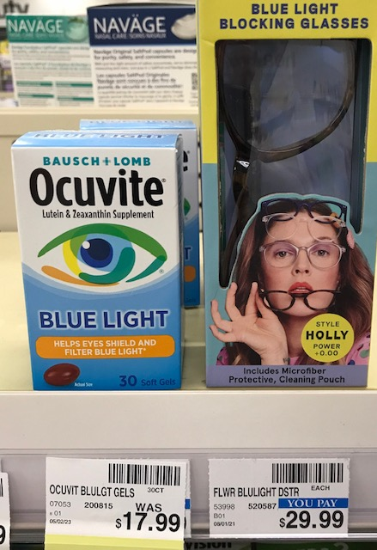
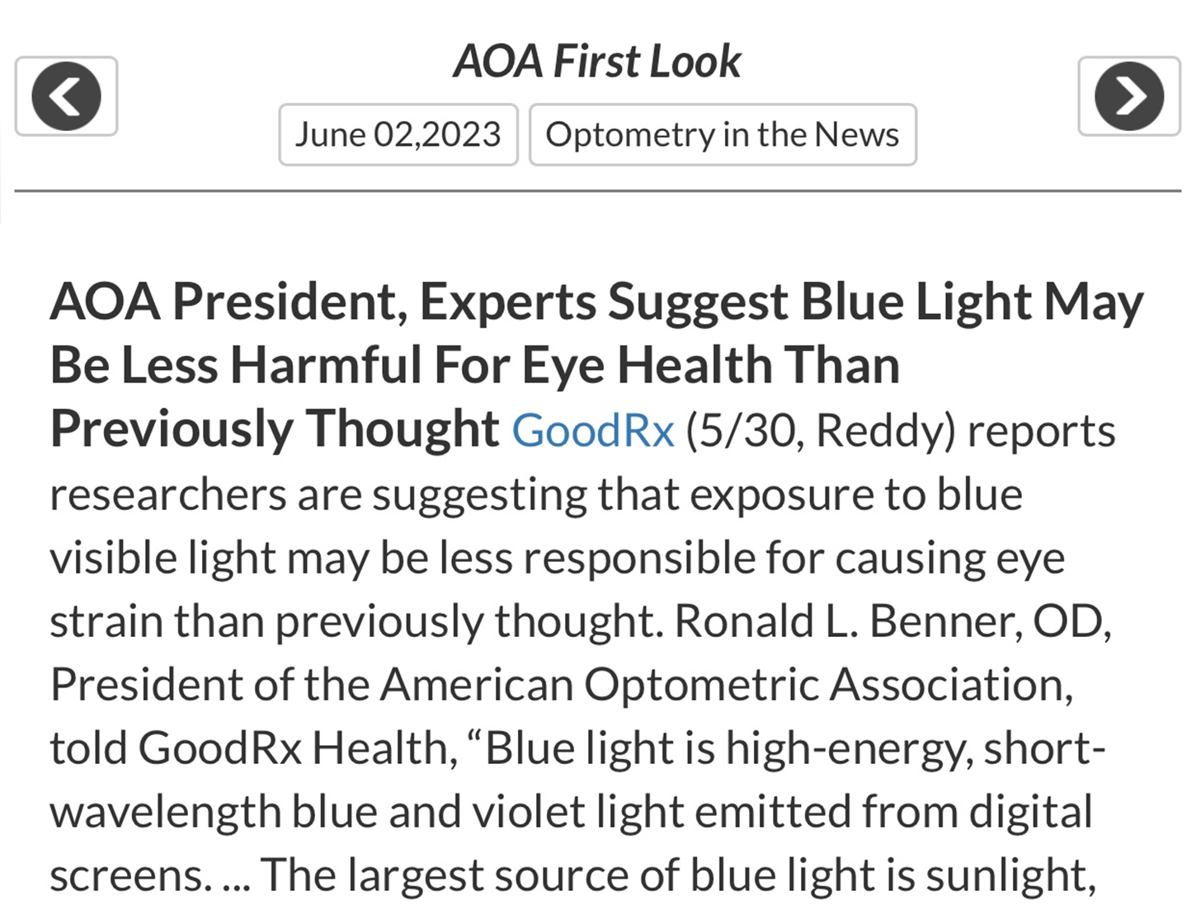

Slide 35
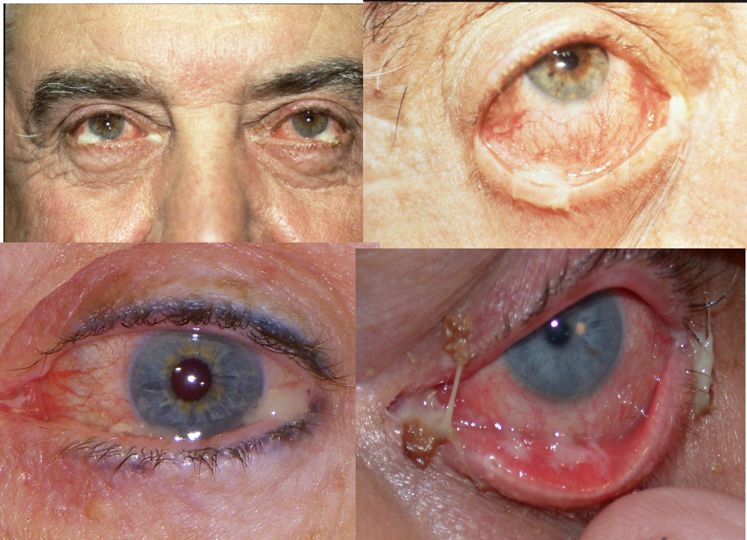
Antibacterial
Medications
Sulfa Preparations
Erythromycin
Bacitracin
Bacitracin / Polymyxin B
Bacitracin / Polymyxin B / Neomycin
Chloramphenicol
Gentamicin
Tobramycin
Trimethoprim / Polymyxin B
Fluoroquinolones
Azithromycin
Oral antibiotics

Slide 36
Antibiotics for Acute Bacterial Conjunctivitis
“Patients who see optometrists, urgent care doctors, pediatricians, internists, or family practitioners for conjunctivitis have a much higher odds of antibiotic script than do patients who saw ophthalmologists.”
“65% of patients, conjunctivitis resolves without antibiotic treatment within 2-5 days of symptom onset.”
“Our review provided evidence of moderate certainty to support the use of antibiotics over placebo in clinical resolution.”
Am J Ophthalmol. January 2024
Notes:
Su-Hsun Liu, Yu-Yen Chen, Ulugbek Nurmatov, Onno C.P. van Schayck, Irene C. Kuo. Antibiotics Versus Placebo for Acute Bacterial Conjunctivitis: Findings From a Cochrane Systematic Review
Am J Ophthalmol 2024;257:143-153.

Slide 37
Differential Diagnosis of Corneal Ulcers vs. Infiltrates
Ulcer (Infection) | Infiltrate (Inflammation)
Rare | Common
Usually painful | Mild pain
Tend to be central | Tend to be peripheral
1 to 1 staining defect to lesion ratio | Staining defect size relatively small
Cells in anterior chamber | Rare cells in anterior chamber
Generalized conjunctival injection | Sector skewed injection pattern
Usually solitary lesion | Can be multiple lesions
Possible tear lake debris | Clear tear lake
Notes:
37

Slide 38
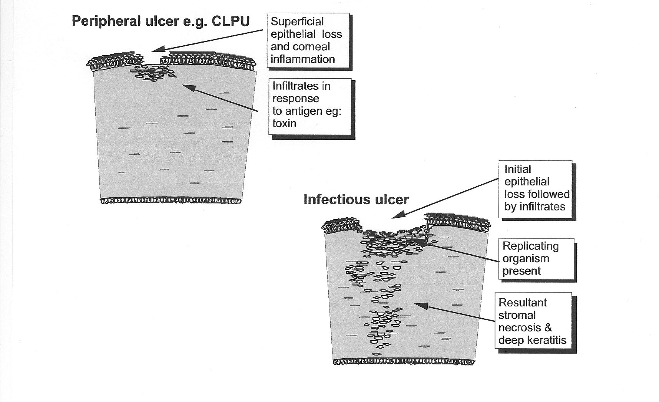

Slide 39
An Updated Perspective on Treating Pseudomal Infection
“Multiple studies have shown high minimal inhibitory concentrations for moxifloxacin in P. aeruginosa as well as a sharp increase in the percentage of P. aeruginosa isolates that are resistant to moxifloxacin.”
It seems likely that Fortisite is superior to moxifloxacin but no comparative studies have been done.
JAMA Ophthalmol, June, 2023

Slide 40
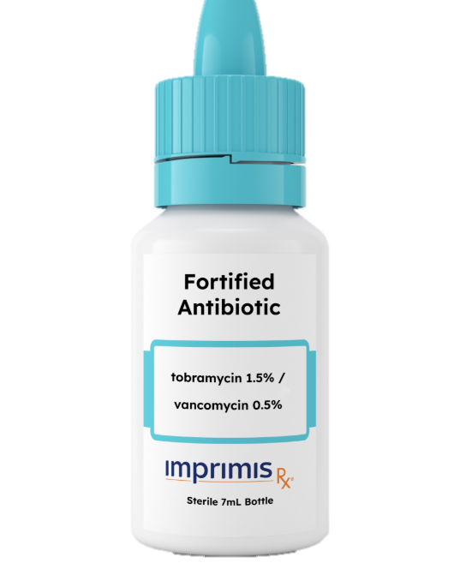
New Combination for Corneal Ulcers
Dual therapy for bacterial corneal ulcers has been the standard for decades.
Tobramycin for gram negative coverage
Vancomycin for gram positive coverage
New combination is pre-fortified!
Tobramycin is 1.5% (standard is 0.3%)
Vancomycin is 5% (there is no standard)
Marketed as Fortisite™ ophthalmic solution by ImprimisRx (owned by Harrow Health)
Must be ordered directly (503A) via Imprimisrx.com or 844-446-6979

Slide 41
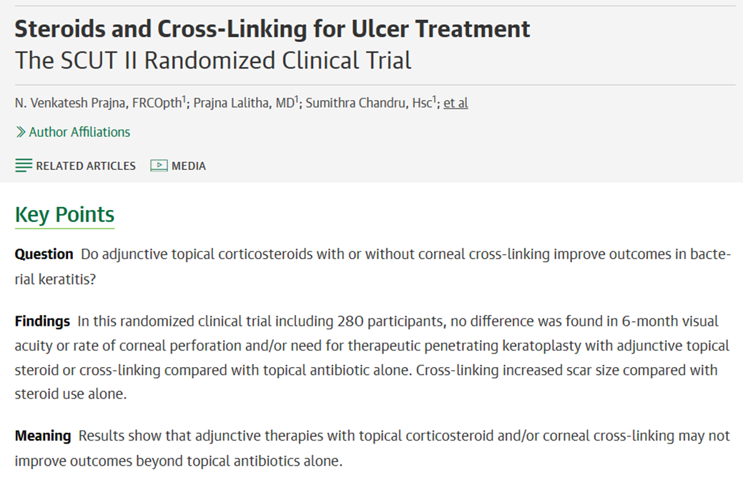
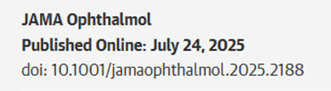

Slide 42
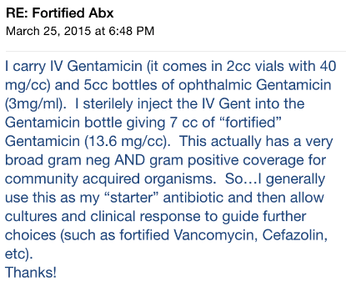

Slide 43
“Culturing” is Being Eclipsed
PCR is eclipsing traditional culturing
Test results by next morning
Targets most relevant micro-organisms
There is only one universal collection device
Provides a personalized antibiotic summary of effectiveness
See www.healthtrackrx.com for details

Slide 44
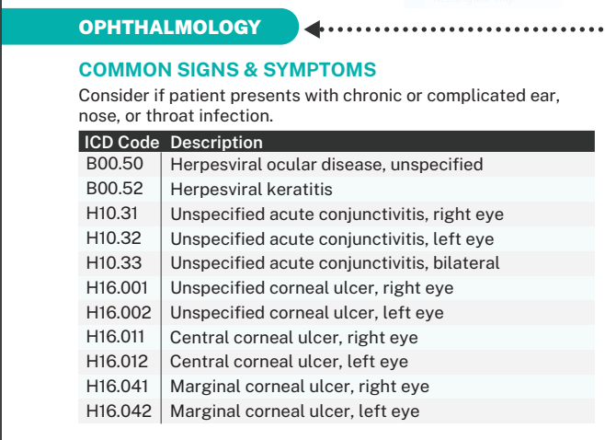
Notes:
https://www.healthtrackrx.com/wp-content/uploads/2023/10/MenuPers-v1118-v7-092723.pdf

Slide 45
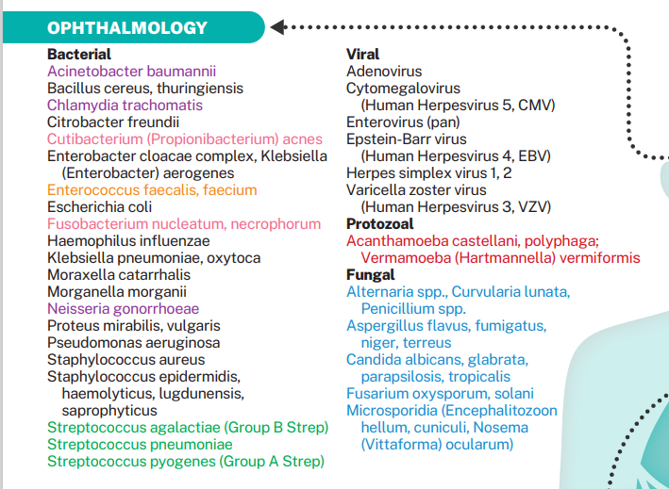

Slide 46
Antibiotics - Systemic
Penicillins
Cephalosporins
Tetracyclines
Macrolides
Fluoroquinolones

Slide 47
Keflex® (Cephalexin)
Children > 2 months
For skin and soft tissue infections, may be given every 12 hours
Weight (LBs) | Dose (250 mg/5ml)
11 | ¼ tsp
22 | ½ tsp
33 | ¾ tsp
44 | 1 tsp (250 mg cap)
66 | 1 ½ tsp
88+ | 2 tsp (500 mg cap)

Slide 48
Statement by the American College of Physicians: Key Recommendations
For non-purulent cellulitis (skin infections)
“Recommended antimicrobials: Cephalosporin (e.g. Cephalexin)”
“Recommended duration: 5 days”
Journal Watch-General Medicine May, 2021

Slide 49
Ester vs Ketone Corticosteroids
Ester
Loteprednol
Ketone
Prednisolone
Fluorometholone
Dexamethasone
Medrysone
Rimexolone
Difluoroprednisolone
Notes:
Key discussion point: Loteprednol etabonate is the first and only ester corticosteroid available for ophthalmic use^{1,2} [LOTEMAX PI][Zylet PI]
Prior to the development of loteprednol etabonate, the only ocular corticosteroids were ketone steroids
Prednisolone
Fluorometholone
Dexamethasone
Medrysone
Rimexolone
LOTEMAX [package insert]. Tampa, Fla: Bausch & Lomb Incorporated; 2006.
Zylet® (loteprednol etabonate 0.5% and tobramycin 0.3% ophthalmic suspension) [package insert]. Tampa, Fla: Bausch & Lomb Incorporated; 2006.

Slide 50
Literature Perspective on Steroids and Elevated IOP
“IOP elevation is much more common with older steroids such as dexamethasone, prednisolone and fluorometholone, compared to newer steroids such as loteprednol, difluprednate or rimexolone.”
A note about difluprednate: “Though the occurrence of increased IOP is about 3%, the IOP elevation may be significantly higher compared to the other newer steroids.” Only about 2% of patients experience “a clinically significant IOP increase” with loteprednol.
“Post-operatively, loteprednol did not induce a significant IOP elevation and when used as a replacement for older steroids led to a significant IOP reduction in known steroid responders.”
Survey Ophthalmol. March/April 2020
Notes:
Roberti G, Oddone F, Agnifili L, et al. Steroid-induced glaucoma: Epidemiology, pathophysiology, and clinical management. Surv Ophthalmol. 2020;65(4):458-472.

Slide 51
Loteprednol Etabonate
Only ester-based, site-specific steroid
Works at target tissues, and then is quickly metabolized into inert compounds
LE has high intrinsic activity when applied locally
0.5% loteprednol similar in therapeutic equivalence to 1% prednisolone acetate, yet causes little, if any, incree in IOP
Availability:
  B+L- 0.2% (Alrex) suspension, 0.5% Lotemax ointment, 0.5% Lotemax Gel, and 0.38% Lotemax SM
  Alcon- 0.25% (Eysuvis) suspension, 1.0% (Inveltys) suspension
  Generic- 0.5% loteprednol suspension

Slide 52
Difluprednate 0.05% (Durezol)
“There is increased bioavailability and dose uniformity resulting from the formulation of difluprednate as an emulsion, rather than a suspension.”
Steroid-induced hypertension seen in 8% of the normal population, and is more common in patients with glaucoma.
Steroid-induced hypertension is “generally not seen until 3 to 6 weeks of corticosteroid use.”
“Difluprednate was shown to provide better results compared with prednisolone acetate…”
“We believe the effects seen are the result of the greater anti-inflammatory potency of difluprednate.”
AJO, October, 2011

Slide 53
Difluprednate (Durezol) and IOP
About a third of uveitis patients sustain IOP increase.
Such increase occurs in 2 to 6 weeks and returns to baseline in 2 to 4 weeks after use.
Durezol 0.05% can be dosed about half the frequency of PA with similar results.
Children are at 8 times greater risk than adults
Risk of IOP increase is higher if a patient is also taking oral steroids.
Cessation of Tx (with or without anti-glaucoma eye drops) results in restoration to baseline IOP.
Am J Ophthalmol. Aug 2022
Notes:
Yakin M, Kumar A, Kodati S, Jones L, Sen HN. Risk of Elevated Intraocular Pressure With Difluprednate in Patients With Non-Infectious Uveitis. Am J Ophthalmol. 2022;240:232-238.

Slide 54
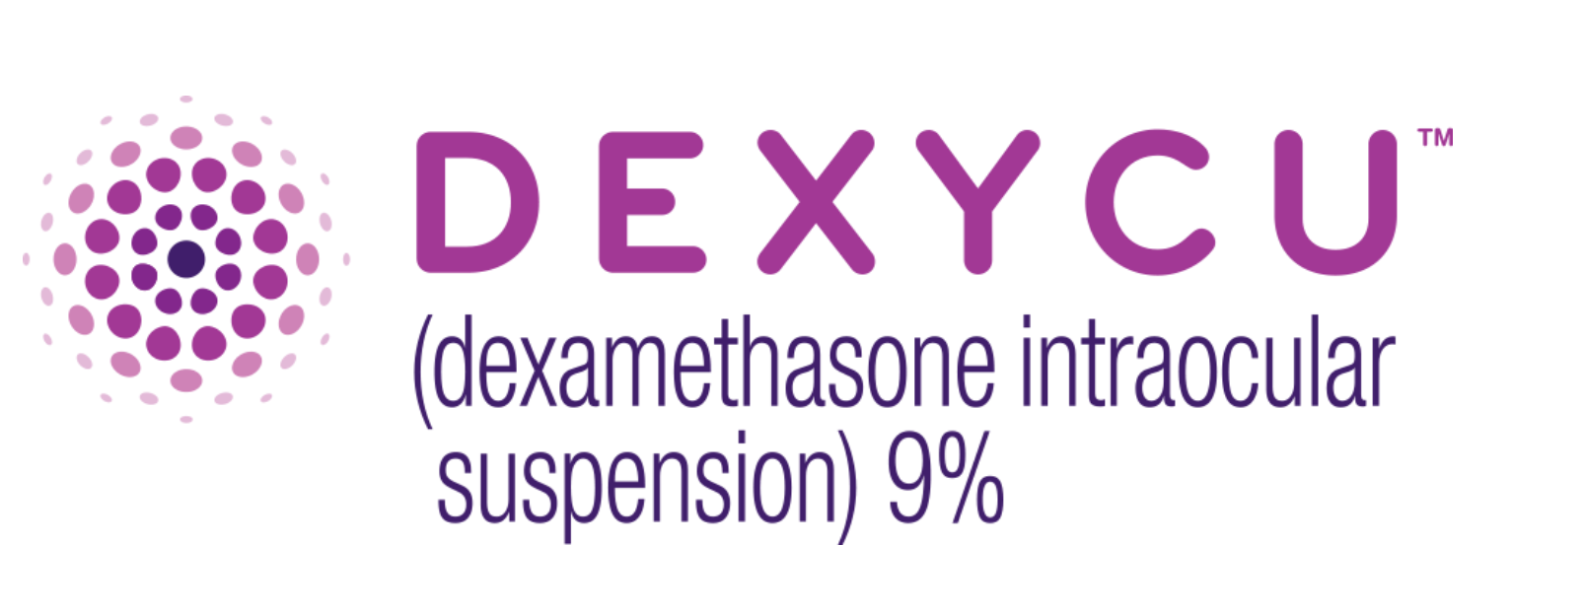
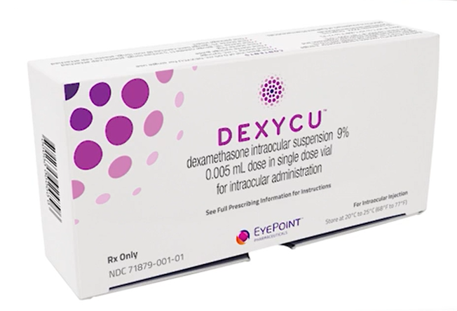

s

Slide 55
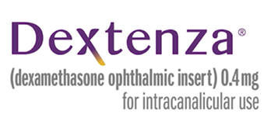
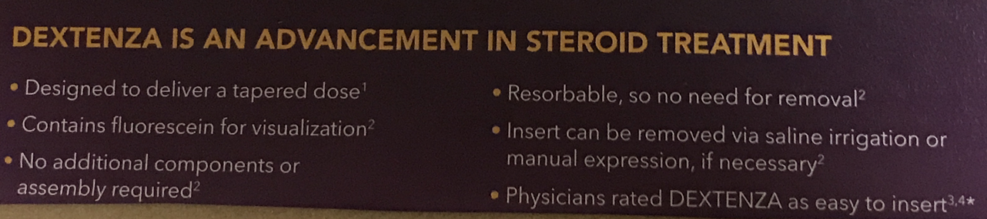
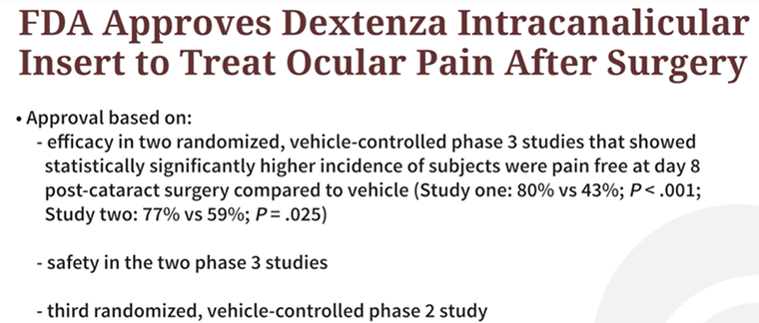
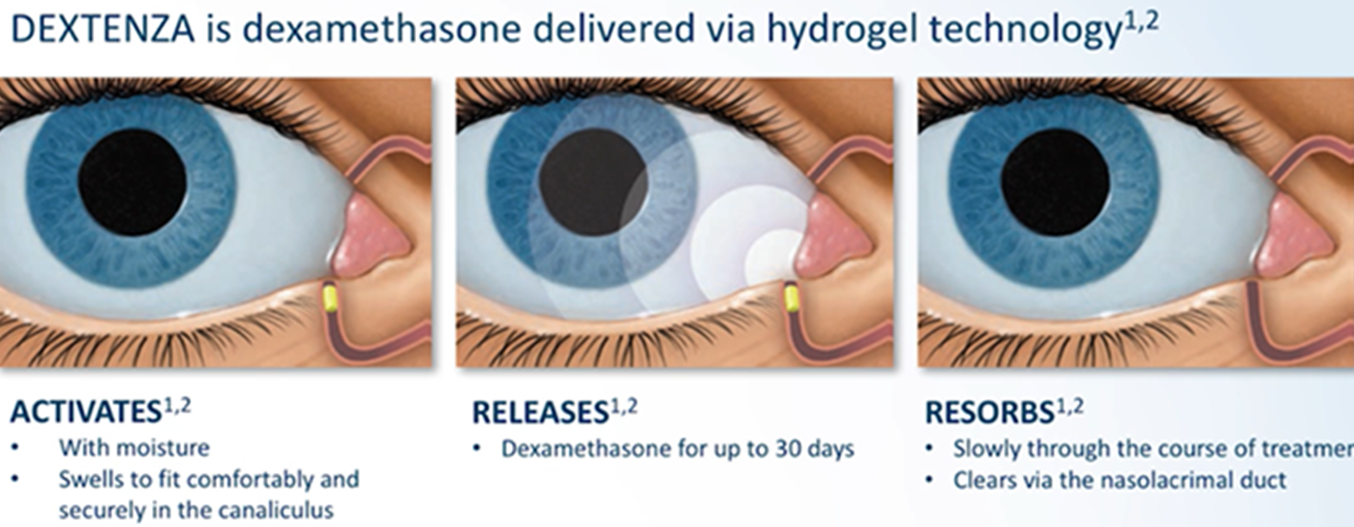

Slide 56
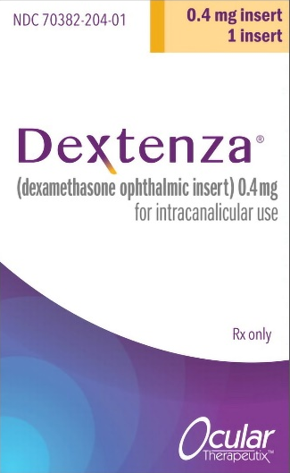
Dexamethasone Intraocular Insert to treat DED
Alternate approach to eye drops
Releases dexamethasone for up to 30 days
Was initially approved by the FDA, Nov, 2018
About 10% of patients experienced transient hypertension
Fly in ointment: About $1,200 for two devices
Novel approach, but too expensive
to be practical
Manufactured as Dextenza® by
Ocular Therapeutix.
Ophthalmology, September 2024
Notes:
Lin, Michael X. et al. Dexamethasone Intracanalicular Insert for Clinically Significant Aqueous-Deficient Dry Eye
Ophthalmology, 2024;131(9):1033-1044.

Slide 57
Non-ophthalmic steroid: ointment/cream/lotion
Triamcinolone - moderate potency steroid
Available in cream, ointment and lotion (0.5%, 0.1%, 0.025%)
Our favorite: the 0.1% cream
Reference: drugs.com

Slide 58
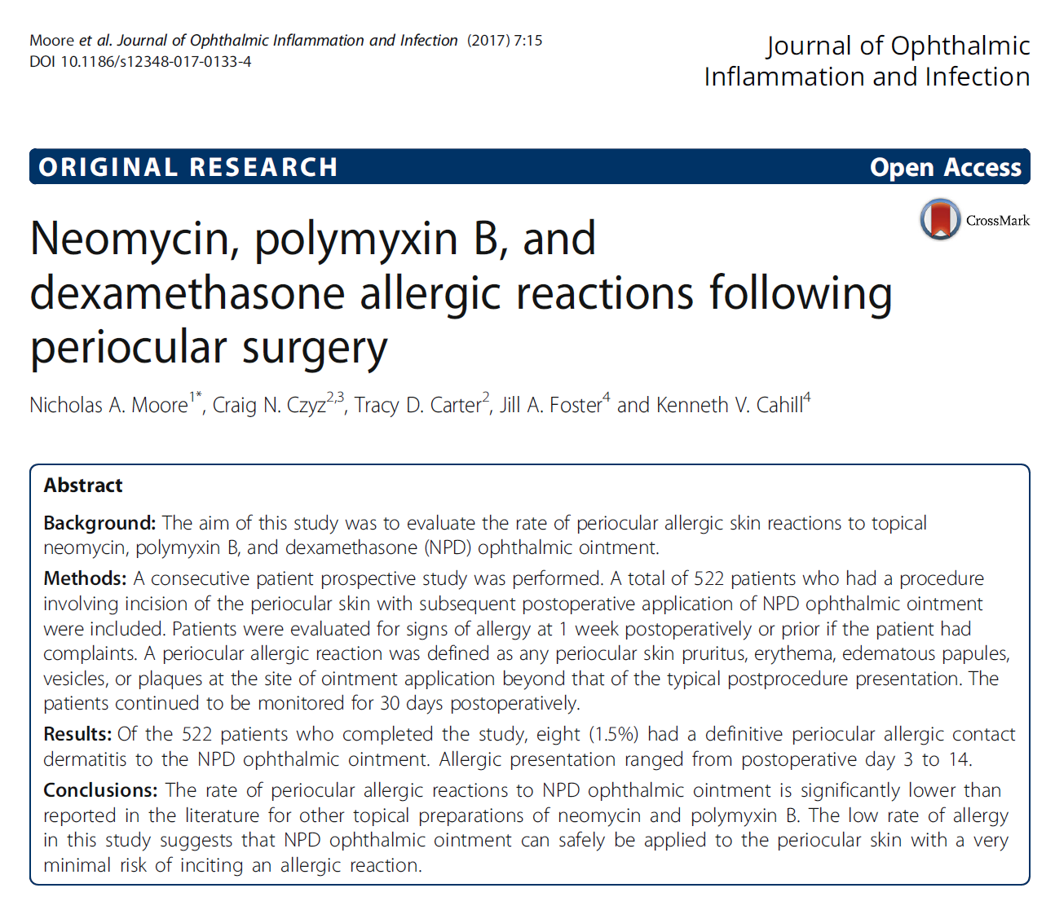

Slide 59
Rethinking Neomycin Hypersensitivity
Large study done in 2017
This study was done by non-ophthalmic plastic surgeons
Study population was 522 patients
All used neomycin, polymyxin B and dexamethasone ophthalmic ointment post eyelid surgery
Between days 3-14, eight (1.5%) developed a neomycin reaction!
Traditional teaching of 10-15% reaction rate appears to be outdated.
J Ophthalm Inflamm Infect. 2017
Notes:
Moore, N.A., Czyz, C.N., Carter, T.D. et al. Neomycin, polymyxin B, and dexamethasone allergic reactions following periocular surgery. J Ophthal Inflamm Infect 7, 15 (2017). https://doi.org/10.1186/s12348-017-0133-4

Slide 60
Anti-inflammatory Effects of 0.1% Tacrolimus
The topical calcineurin inhibitor, tacrolimus, has good anti-inflammatory properties.
0.1% tacrolimus eye drops can be highly effective in treating severe allergic conjunctival diseases.
Tacrolimus eye drops often cause a stinging sensation or conjunctival redness, especially in the beginning of treatment of severely inflamed eyes. This can be avoided by topical steroid pretreatment.
Tacrolimus eye drops did not have an immediate effect and required 1-2 weeks to be effective.
In contrast, topical steroids are fast acting and can immediately relieve allergic symptoms. Although treatments eventually can be conducted without topical steroids, prompt relief of symptoms merits topical steroids.
Ophthalmology, March 2017
Notes:
Miyazaki D, Fukushima A, Ohashi Y, et al. Steroid-sparing effect of 0.1% tacrolimus eye drop for treatment of shield ulcer and corneal epitheliopathy in refractory allergic ocular diseases. Ophthalmology 2017;124(3):287-294.

Slide 61
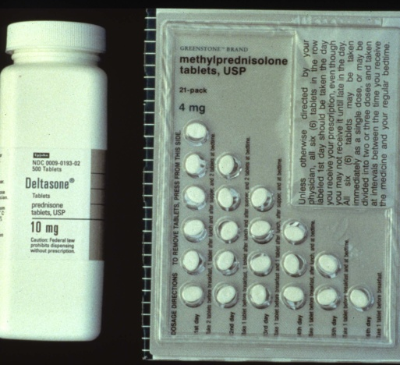
Systemic Prednisone
Most common Rx’d systemic corticosteroid
Common initial dosage 40-60 mg
Available generically in both tablets and DosePaks (5 or 10 mg at 6 or 12 day course)
Questions to ask before prescribing?
  Diabetic?
  Peptic Ulcer Disease?
  Tuberculosis?
  Pregnant?

Slide 62
Systemic Prednisone
Most common Rx’d systemic corticosteroid
Common initial dosage 40-60 mg
Available generically in both tablets and DosePaks (5 or 10 mg at 6 or 12 day course)
Questions to ask before prescribing?
  Diabetic?
  Peptic Ulcer Disease?
  Tuberculosis
  Pregnant?

Slide 63
Perspective on Oral Prednisolone
Using oral prednisolone at 1,250 mg/day is equivalent to 1,000 mg of I.V. methylprednisolone sodium succinate (Solu-Medrol®) for 3 days in treating acute optic neuritis.
“There was no significant difference in adverse events between the groups.”
And,… we are concerned about using 40 – 60 mg/day!?!
JAMA Neurology, June, 2018
Notes:
Morrow SA, Fraser A, Day C, et al. Effect of Treating Acute Optic Neuritis With Bioequivalent Oral vs Intravenous Corticosteroids. A Randomized Clinical Trial. JAMA Neurol. 2018;75(6):690-696.

Slide 64
Oral Prednisone Short-Term Use
“Nowadays, use of corticosteroid bursts are considered harmless, an assumption supported by years of clinical data linking exposure duration with toxic effects. Clinicians currently prescribe short courses of oral corticosteroids to 21% of the general adult population in the US and up to 17% of the general adult population in France. Corticosteroid bursts are typically prescribed for treating non–life-threatening conditions, such as upper respiratory tract infections, bronchitis, rashes, and low-back pain.”
JAMA Pediatrics, April 19, 2021
Notes:
Yao T-C, Wang J-Y, Chang S-M, et al. Association of Oral Corticosteroid Bursts With Severe Adverse Events in Children. JAMA Pediatrics. Published online April 19, 2021. doi:10.1001/jamapediatrics.2021.0433

Slide 65
Bilateral Periorbital Impetigo - Dermatitis
Impetigo is a Staph aureus infection, often seen in patients with eczema
Usually seen in children and young adults
Can cause a secondary inflammatory dermatitis
Can create cicatricial ectropion
Tx with oral antibiotic and topical antibiotic/steroid or steroid ointment
Ophthalmology, June, 2018
Notes:
Homer N, Habib L, Lee NG. Bilateral Periorbital Impetigo Inducing Significant Dermatitis and Cicatricial Eyelid Changes in an Adult. Ophthalmology 2018;125(6):798.

