Slide 1
KEY ISSUES
IN
OCULAR DISEASE MANAGEMENT
Ron Melton, OD, FAAO
Randall Thomas, OD, MPH, FAAO

Slide 2
Financial Disclosure
Drs Ron Melton is a consultant to, on the speakers bureau of, on the advisory committee of, or involved in research for the following companies: ICARE and B+L.
“All relevant relationships have been mitigated.”

Slide 3
Antihistamine/Mast Cell Stabilizer
Highly selective H1 receptor blockers with prolonged receptor binding
Good mast cell stabilization
All bid dosing, except Pataday and Lastacaft (qd)
Olopatadine 0.1% (Patanol) (5 ml)
0.2% (Pataday) qd (2.5 ml)
0.7% (Pazeo) qd (2.5ml)
Bepotastine 1.5% (Bepreve) (5, 10 ml)
Epinastine 0.05% (Elestat and generic) 5 ml
Alcaftadine 0.25% (Lastacaft) qd (3 ml)
Azelastine 0.05% (Optivar and generic) (6 ml)
Ketotifen 0.025% (generic and OTC)
(Claritin Eye) (5 ml)
(Zyrtec Itchy Eye) (5 ml)
(Zaditor) (5 ml)
(Alaway) (10 ml)
(Refresh) (5ml)
(TheraTears) (5 ml)

Slide 4
Cetirizine 0.24% ophthalmic solution
Now Indicated for ocular itching associated with allergic conjunctivitis
Instill 1 drop in each affected eye BID (8 hr apart)
Adverse Effects:
  Hyperemia (1-7%)
  Instillation site pain (1-7%)
  Reduced visual acuity (1-7%)
Marketed by Eyevance as Zerviate ophthalmic solution

Slide 5
Cyclosporin 0.1% Emulsion
For perspective, Restasis is a 0.05% emulsion
Marked as Verkazia® by Harrow
Approved to treat vernal keratoconjunctivitis
Dosage is QID for 1 to 4 months
Eye pain was 12% in clinical trials
“Gently shake the vial several times” prior to instillation
A topical steroid is the class of choice for vernal disease
Verkazia® [package insert]. Emeryville, CA. Santen Inc. 2021.

Slide 6
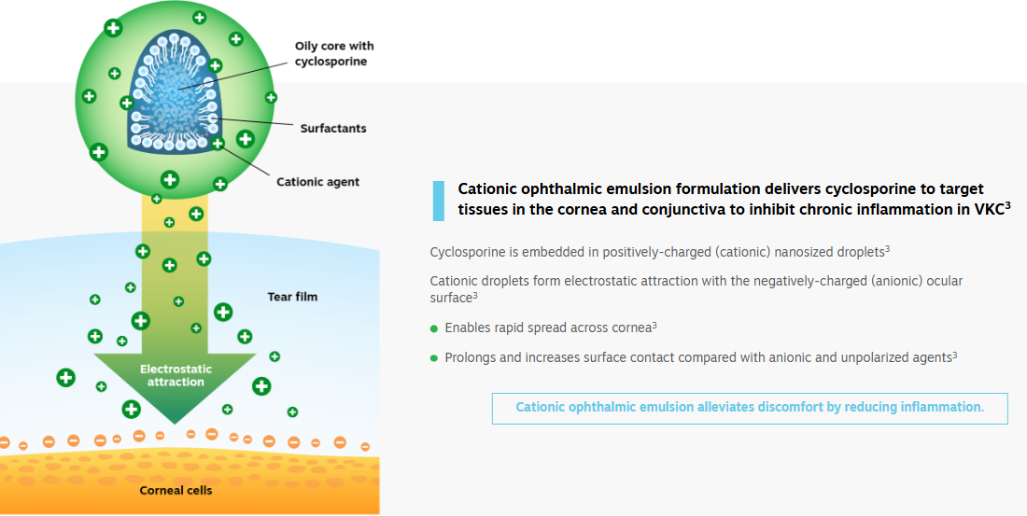

Slide 7
Vernal Conjunctivitis
Two forms:
  Tarsal conjunctival
  Limbal
Children and young adults (limbal-Blacks)
Symptoms: itch, blepharospasm, photophobia, mucus discharge
Responds well to topical steroids (pulse dose)
Antihistamine/Mast cell stabilizers helpful in overall maintenance

Slide 8
No Clinical Advantage to Femto Cataract Surgery
“Study finds no differences in vision, adverse postoperative events or patient perceptions of quality between FLACS and conventional phaco at 12 months.”
“The authors concluded that FLACS was not superior to conventional phaco, as it did not provide any benefits in outcomes and it incurred higher costs.”
Br J Ophthalmol, May 2021
Notes:
Stanojcic N, Roberts HW, Wagh VK, et al. A randomised controlled trial comparing femtosecond laser-assisted cataract surgery versus conventional phacoemulsification surgery: 12-month results. Br J Ophthalmol. Epub ahead of print.

Slide 9
American Academy of Ophthalmology on FEMTO
“Compared with PHACO, FEMTO has been shown to produce a precisely circular, centered capsulotomy and to reduce the amount of ultrasound energy delivered within the eye during PHACO. However, in several meta-analysis, these benefits have not translated into improved refractive outcomes or reduced complications. In addition, additional costs are associated with FEMTO as compared with PHACO.”
“Patients achieve excellent visual acuity and refractive accuracy with both FEMTO and PHACO, but one technique is not superior to the other.”
“This study, even with sensitivity analyses, showed that FEMTO was not superior to PHACO, but more expensive.”
Ophthalmology, Aug 2022
Notes:
Lin CC, Rose-Nussbaumer JR, Al-Mohtaseb ZN, et al. Femtosecond Laser-Assisted Cataract Surgery: A Report by the American Academy of Ophthalmology. Ophthalmology 2022;129(8):946-954. doi:10.1016/j.ophtha.2022.04.003

Slide 10
Non-traditional Compounded Eye Drops
Customized Medications Include:
Pred+Moxi+Brom | 5 & 8mL | $40/60 | Dex+Moxi | 1mL | $25
Pred+Moxi | 5mL | $40 | Tim+Bim | 5mL | $50
Pred+Brom | 4mL | $40 | Tim+Brim+Dor | 5mL | $55
Moxi+Brom | 5mL | $40 | Tim+Brim+Dor+Bim | 5mL | $60
Pred+Moxi+Ketor | 5 & 8mL | $40/60 | Atropine+0.01% | 3.5mL | $45
Pred+Ketor | 4mL | $40 | Atropine+0.025% | 3.5mL | $45
Brim+Dor | 2mL | $11 | Atropine+0.05 | 3.5mL | $45
Trop+Phen | 2mL | $15 | *Shipping is included
Manufactured by OSRX, Inc., Missoula, MT.
www.osrxpharmaceuticals.com 855-466-1076

Slide 11
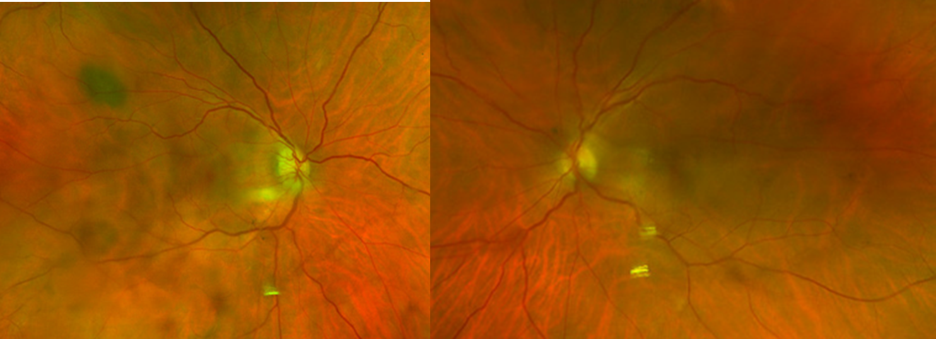
62 yowm P/O PCIOL OD (2 wks) with vision loss
-Post-Op cataract surgery OU with OD decreased vision noticed over last several days; OD VA 6/20 ABC visit 20/25 and today 20/80-2; IOP OD 40, OS 21 probable steroid responder OD; APD present OD; ONH OD has disc edema with no hemorrhages; Presented findings to COR with recommendation remain on post-op drops and in-office combigan and dorzolamide and consult with in retina service; presented findings to RET with probable dx of AION - recommendation for consult with neuro-ophthalmologist. Telephone consult with NOM with findings - plan to see NOM ASAP- his staff will contact patient with appointment. Recommend patient obtain ESR, CRP, CBC with platelet ct- patient will get this done at his PCP's office (DVD); Continue post-op Pred-Moxi-Brom ("combo drop") - 1 gtt in operative eye 3x/day OU per COR. Rx Combigan bid OD and Dorzolamide 2% along with Diamox 2 250mg tabs bid PO x 1 wk; F/U per NOM or COR.

Slide 12
F/U 4 days
Patient feels vision OD worse; Currently taking Combigan bid, Diamox PO 250 mg tid
Lab Results: CRP <0.5 normal, ESR- 6 normal, Platelet Count- 188 normal;
BVA: OD 20/400 (plano), OS 20/20 (+0.50-0.75x120)
APD OD
IOP: OD 11, OS 12
ONH edema remains OD
Plan: Continue Diamox 250 tid PO, Combigan bid OU until patient returns on 7/8/24. After 7/8 visit will stop p/o meds as well as consider stopping glaucoma meds and will check iops again 7/11/24 to make sure iops remain normal.

Slide 13
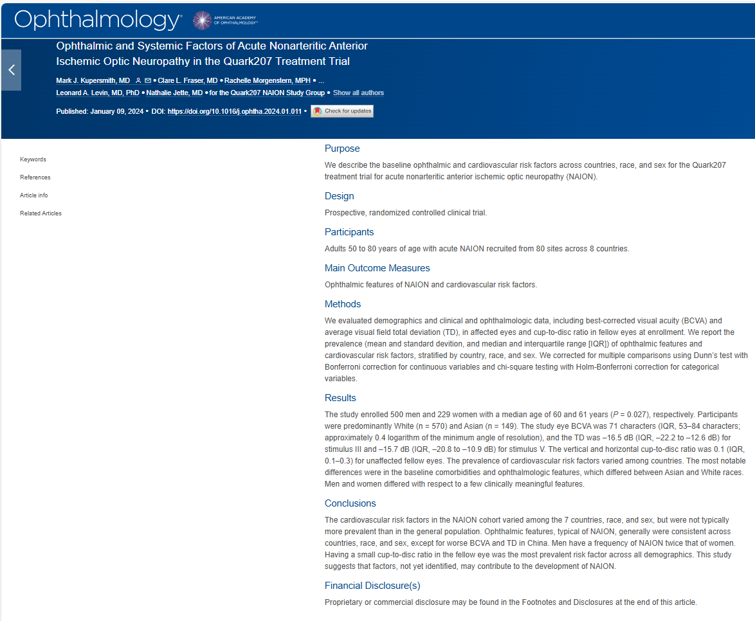
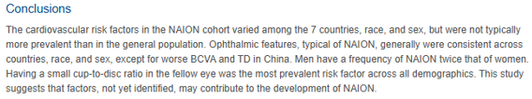

Slide 14
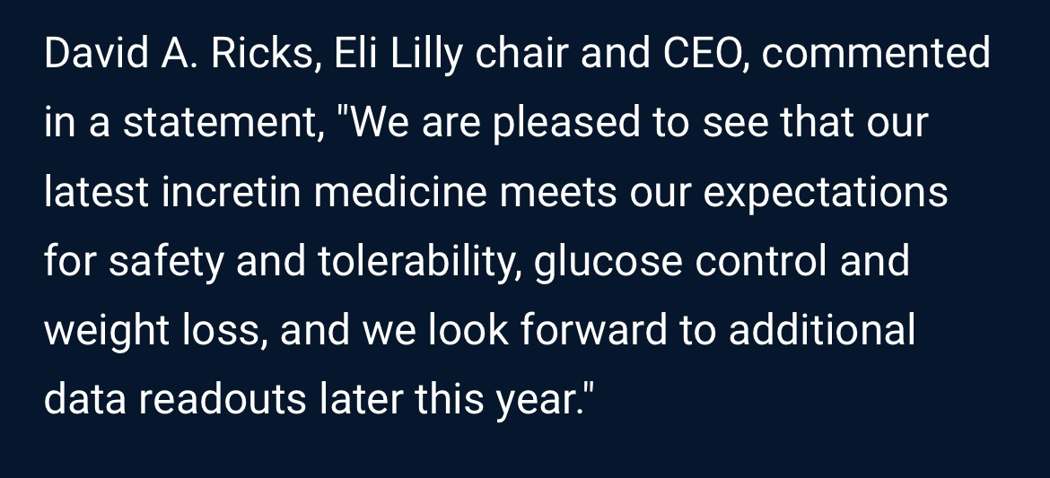

Slide 15
Two Primary Incretins
Glucose-dependent insulinotropics
  Polypeptide (GLP), or gastric inhibitory polypepide
  Tirzepatide (Monjaro® and Zepbound®)
Glucagon-like peptide-1 (GLP-1)
  Semaglutide (Ozempic®, Rybelsus®, Wygovy®)
  Dulaglutide (Trulicity®)
  Exenatide (Byetta®)
  Liraglutide (Victoza®, Saxenda®)
These are gut secreted hormones that enhance insulin secretion by the pancreas
OpenEvidence, April 3, 2025

Slide 16
GLP-1 + GIP Receptor Agonists
GLP-1: Glucagon-like peptide
GIP: Glucose-dependent Insulinotropic Polypeptide
These hormones regulate the incretin system
They suppress appetite, provide satiety, and slow gastric emptying, yielding weight loss of 10 to 20%.
For DM, these are second-line after metformin
Slight worsening of DR can occur with initiation of treatment, but ultimately reduce HA₁C
Retinal microvascular evaluation should be done at baseline and perhaps every 2-3 months during the first year of treatment.
Review Optometry, March 15, 2025

Slide 17
Key Risk Factors for NA-AION
More common in white men
Only common risk factors: A normal or small optic disc with a low C/D ratio, DM or both
“Although numerous participants harbored cardiovascular risk factors classically associated with NA-AION, including hypertension, smoking, diabetes and obesity, other than a small C/D ratio and obesity, no other risk factor was present in most participants.”
“The cardiovascular risk factors presumed to be associated with NA-AION were present in 90% of participants across the 7 countries, however it was found that having a small C/D ratio clearly is a very important predisposing factor.”
Ophthalmology, July 2024
Notes:
Kupersmith MJ, Fraser CL, Morgenstern R, et al. Ophthalmic and Systemic Factors of Acute Nonarteritic Anterior Ischemic Optic Neuropathy in the Quark207 Treatment Trial. Ophthalmology 2024;131(7):790-802.

Slide 18
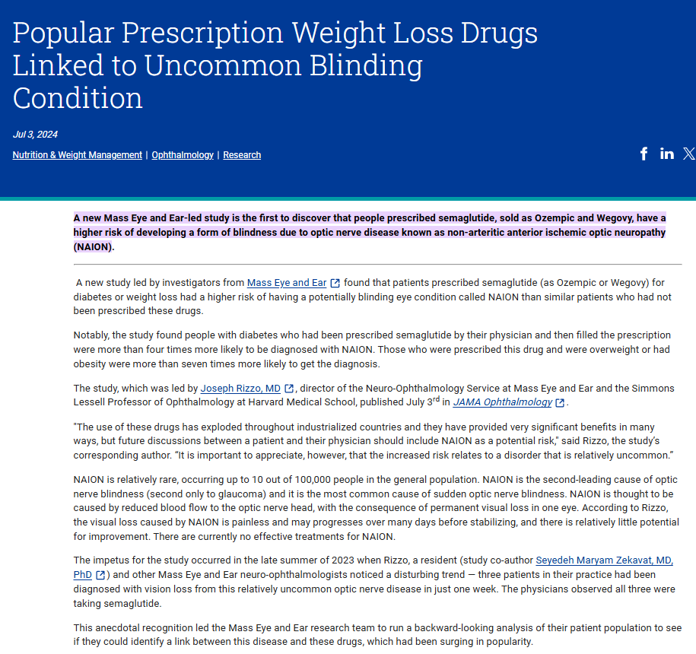
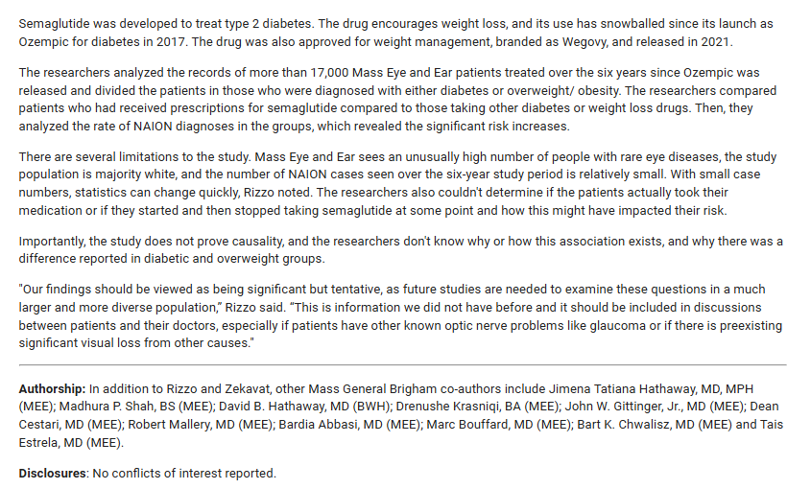


Slide 19
Semaglutide (Ozempic, Wegovy) and AION
Ozempic® approved December 2017 for T2D
Wegovy ® approved December 2022 for obesity
There is the potential (yet to be substantiated) for these drugs, or their effects, to be a risk factor for AION.
Overall, these drugs are safe and effective for their approved purposes.
If a causal relationship were to be determined, it is still thought to be a rare occurrence.
JAMA Ophthalmology, August 2024
Notes:
Hathaway JT, Shah MP, Hathaway DB, et al. Risk of Nonarteritic Anterior Ischemic Optic Neuropathy in Patients Prescribed Semaglutide. JAMA Ophthalmology 2024;142(8):732-739.

Slide 20
Effect of Semaglutide/GLP-1’s on NAION
“GLP-1 receptor agonists have demonstrated potential benefits in addressing many of the conditions associated with NAION including hypertension, hyperlipidemia, and obstructive sleep apnea.”
GLP-1’s have been shown to impact multiple pathways involved in plaque formation, exhibiting atheroprotective effects.”
“There was no significant increase in risk of NAION in patients taking GLP-1’s compared to T2DM or high BMI controls.”
Am J Ophthalmol, June 2025
Notes:
Abbass NJ, Nahlawi R, Shaia JK. The Effect of Semaglutide and GLP-1 RAs on Risk of Nonarteritic Anterior Ischemic Optic Neuropathy. Am J Ophthalmol. 2025;274:24-31.

Slide 21
Semaglutide and Risk for NAION
Only GLP-1RA also available in an oral form
The question: Is there such a risk?
“There are now nearly as many different conclusions as there are studies.”
Two different studies using the same database “drew opposite conclusions”!
Further; “drastically different conclusions can be drawn using the same database by altering any component of the study design choices.”
M+T: We have always held that when a firm answer can’t be definitely established, then if such a risk exists, it can’t be a big deal!
JAMA Ophthalmol, May 2025
Notes:
Hsu AY, Kuo H, Wang Y, et al. Semaglutide and Nonarteritic Anterior Ischemic Optic Neuropathy Risk Among Patients With Diabetes. JAMA Ophthalmol. 2025;143(5):400–407. doi:10.1001/jamaophthalmol.2025.0349

Slide 22
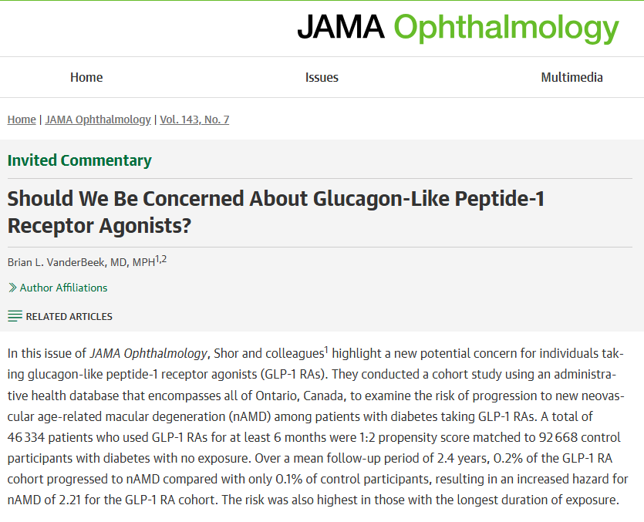

Slide 23
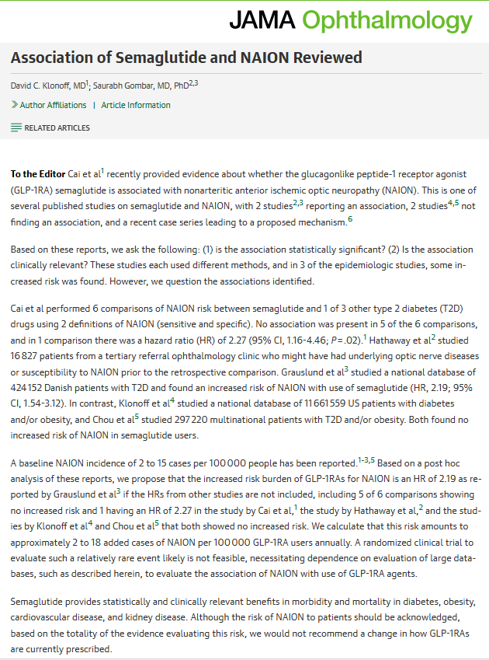


Slide 24
GLP-1RA Use: Impact on Glaucoma
Two main findings:
  “The use of glucagon-like peptide - 1 receptor agonists (GLP-1RA) was associated with a 19% decrease in the risk of glaucoma.”
  “Increased exposure to GLP-1RA, especially over extended durations, accentuated this protective association by 29% risk reduction when looking at 3 or more years exposure to GLP-1RA.”
More studies need to be done to corroborate these findings.
Ophthalmology, September 2024
Notes:
Niazi, Siar et al. Association between Glucagon-like Peptide-1 Receptor Agonists and the Risk of Glaucoma in Individuals with Type 2 Diabetes
Ophthalmology, 2024;131(9):1056-1063.

Slide 25
What Are SGLT-2 Inhibitors?
Sodium-glucose cotransporter-2 inhibitors for treating type 2 diabetes
Common brand names are:
  Jardiance® (empagliflozin)
  Farxiga® (dapagliflozin)
  Invokana® (canagliflozin)
They prevent kidneys from reabsorbing glucose causing removal of excess glucose through the urine.
M+T: We need to be keenly attentive of our patients with DR who are placed on these newer medicines, especially GLP-1 receptor agonists.
Am J Ophthalmol. September 2024
Notes:
Impact of GLP-1 Agonists and SGLT-2 Inhibitors on Diabetic Retinopathy Progression: An Aggregated Electronic Health Record Data Study
Wai, Karen M. et al.
American Journal of Ophthalmology, Volume 265, 39 - 47

Slide 26
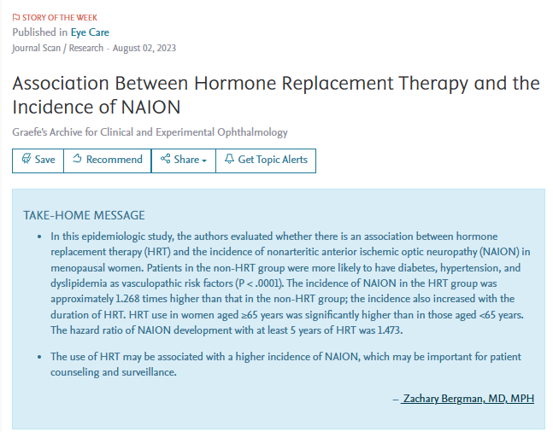
*

Slide 27
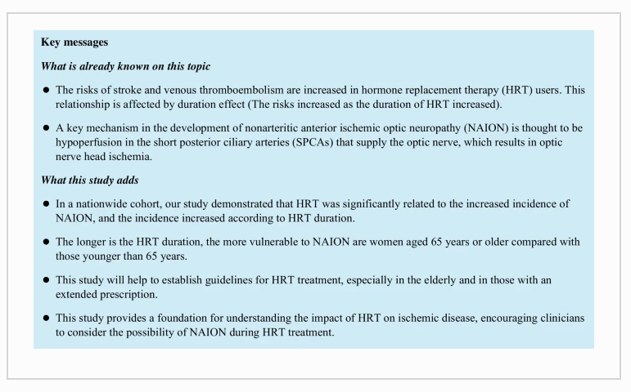
*

Slide 28
Being “On-Call” is a Practice Builder
“Every clinic I have worked in since my residency has offered on-call services – which has been a huge practice builder, not to mention it affords the best eye care to patients”
“Patients deserve on-call services from their doctors who provide specialty care (like eye doctors), with a prompt and courteous response.”
“We shouldn’t rely on the ED simply because it is easier than caring for our patients ourselves.”
Chris Wroten, OD. Optometry Times, March 2022

Slide 29
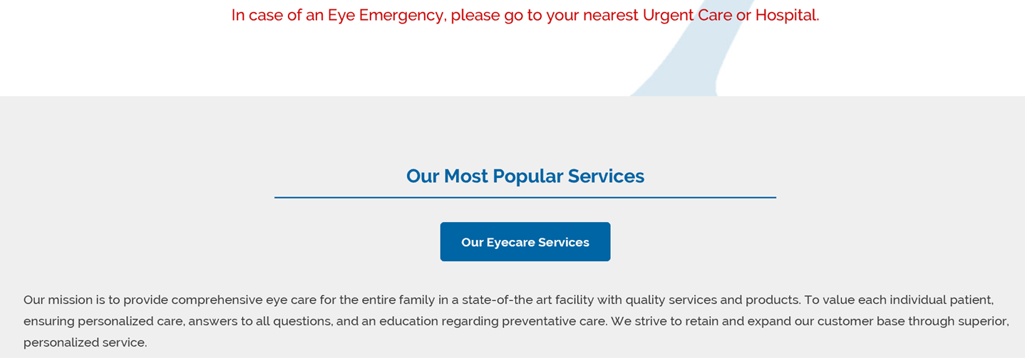
Patient “Care”, or No Care
“In case of an Eye Emergency,
please go to your nearest
Urgent Care or Hospital.”
Directly from an O.D. Practice Website

Slide 30
Thoughts About Taking Call
ED care is compromised if no eye doctor is available
With the advent of ASC’s, fewer ophthalmologists are taking call
“Every ophthalmologist should be comfortable with taking call and realize it’s an obligation that we have both to our patients and the profession.”
“Covering call is a way to get to know other doctors in the community, and obtaining referrals from them has been vital to building my practice.”
“With fewer and fewer ophthalmologists willing to take call, this is leading to a crisis of ED coverage.”

Slide 31
Imaging in the Emergency Department
MRI – Optic disc edema, diplopia, cranial nerve palsy, decreased vision.
  Expensive – much less needed than CT
CT – Non-neuro-ophthalmological conditions
Most common conditions: ”conjunctivitis, corneal abrasion, dry eye syndrome, corneal foreign body, PVD, and blepharitis.”
“Eye problems account for approximately 2 million ED visits every year, with 44% of these visits being for nonemergent problems.”
Am J Ophthalmol. March 2020
Notes:
Zafar S, Sebestyen K, Qureshi Z, et al. National trends in imaging rates for eye-related emergency department visits in the United States. Am J Ophthalmol. 2020;211:114-122.

Slide 32
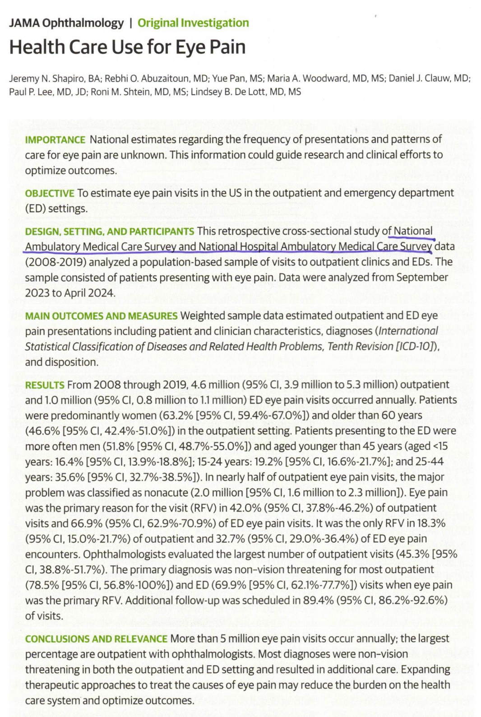
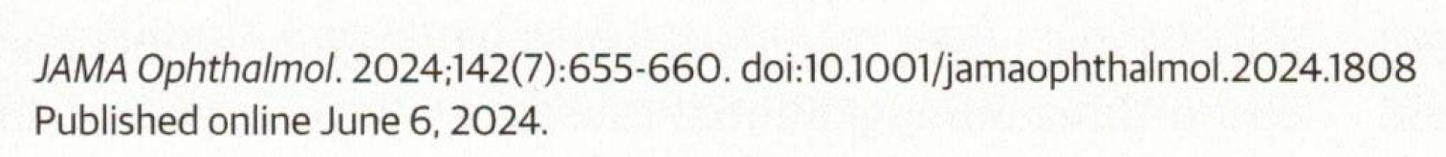

Slide 33
“Health Care Use for Eye Pain”
Overview: “There are about 4.6 million outpatient and 1 million ED visits annually.” (for whatever inexplicable reason, optometrists were not surveyed!)
Reasons outpatient: red eye(s) diminished vision, discharge, itching
Reasons ED: red eyes, eye swelling, HA, diminished vision, discharge
Rarely were any of these presentations sight-threatening.
A key recommendation (to decrease ED visits) was to increase availability of outpatient ophthalmology and optometry services.
Clearly, this is a grand opportunity for optometric practices to aggressively embrace medical eye care services and availability.
JAMA Ophthalmol. July, 2024
Notes:
Shapiro JN, Abuzaitoun RO, Pan Y, et al. Health Care Use for Eye Pain. JAMA Ophthalmol. 2024;142(7):655-660.

Slide 34
Post PRK Pain Control Interventions
Pain Peak is day 1 or 2 post procedure
Re-epithelialization occurs by day 4
APAP/codeine outperformed APAP/oxycodone
“Topical NSAIDs and BCLs offered significant reduction in pain with limited side effects.”
“Adding a topical NSAID to an oral one did not offer additional pain control benefits.”
“There is no evidence to support the efficacy of one NSAID over another.”
Toxicity was not observed with the use of topical anesthetics.
Ophthalmology, January 2023
Notes:
Steigleman, Walter Allan et al. Management of Pain after Photorefractive Keratectomy. Ophthalmology, 2023;130(1):87-98.

Slide 35
Pickleball Injury Perspective
Size of a tennis ball – half the weight
Speed varies, but can be 20-25 mph
Can fit into the orbital socket and impact the globe
Obviously, protective lenses should be worn
Participants are skewed to an older demographic
If an eye injury, ask about use of a blood thinner
EyeNet Magazine. March 2024
Notes:
Welch A. More Than a Pickle: Fastest-Growing U.S. Sport May Pose Ocular Injury Risks. EyeNet Magazine. March 2024.

Slide 36
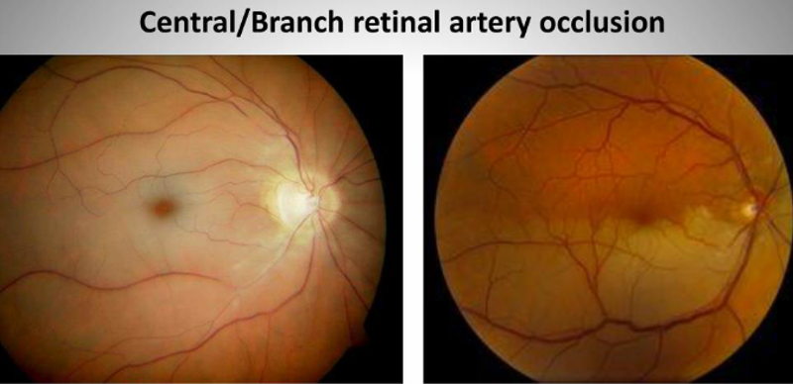
Retinal Artery Occlusion (RAO)
“RAO is analogous to and shares almost the same risk factors as cerebral infarction - in fact acute symptomatic RAO embolic etiologies necessitates immediate referral for stroke evaluation.”
Since RAO can be associated with GCA, be sure to rule out GCA, however most cases of RAO are non-arteritic in origin.
Transient RAO is defined as “an acute onset of major visual loss affecting 1 eye, together with rapid and complete reversibility of symptoms and no residual signs ischemic damage.”
“Migraine with aura is associated with increased risk of RAO compared with migraine without aura.”
Am J Ophthalmol. May, 2021
Notes:
Al-Moujahed A, Tran EM, Azad A, et al. Risk of Retinal Artery Occlusion in Patients with Migraine. Am J Ophthalmol, 2021;225:157-165.

Slide 37
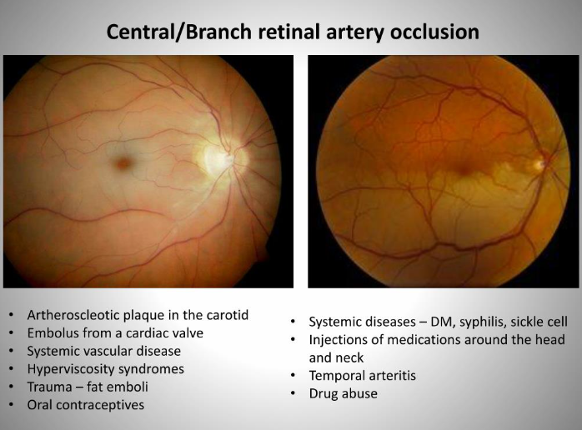

Slide 38
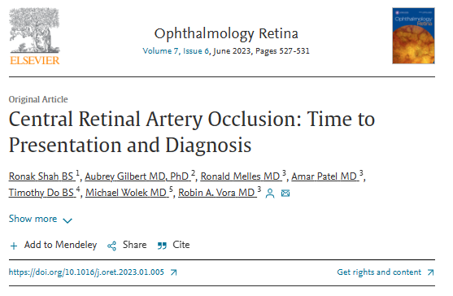
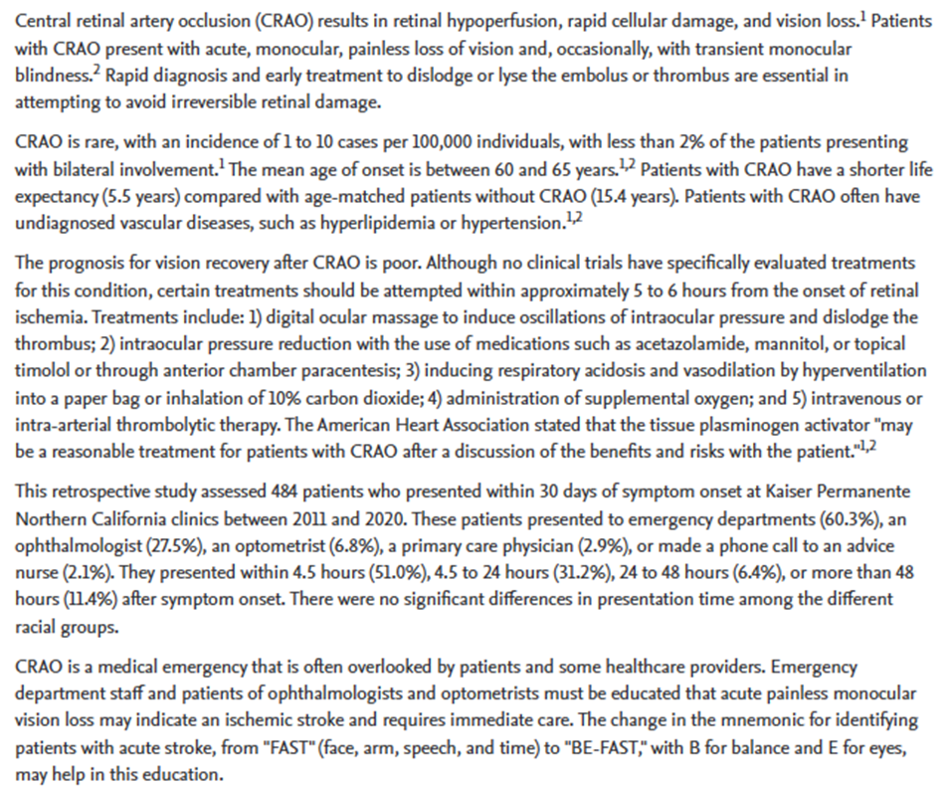
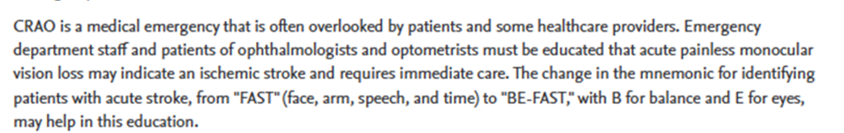

Slide 39
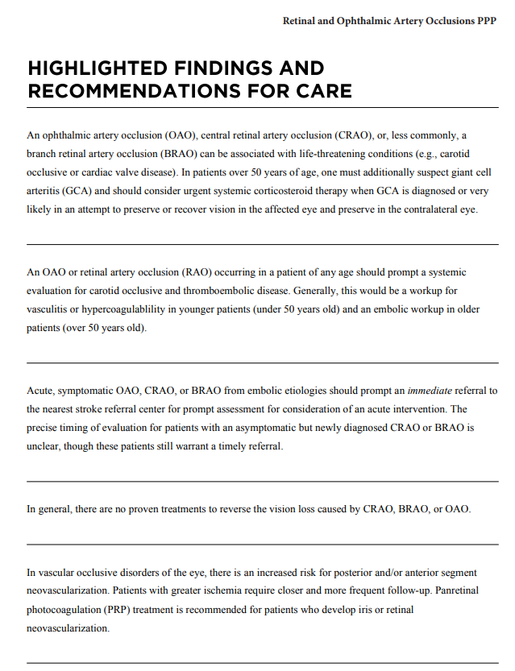

Slide 40
Risk Factors for Retinal Emboli
Age: 0.1% under 40; 1.4% over age 70
Risk Factors: Older age, hypertension, smoking
Novel Risk Factors: Low household income and nutritional status (underweight BMI)
Education level, DM, and hypercholesterolemia were not risk factors
Am J Ophthalmol. January, 2024
Notes:
Teebagy S, Jastrzembski BG, Oke I. Factors Associated With Incidental Retinal Emboli in the U.S. Adult Population. Am J Ophthalmol. 2024;257:34-37.

Slide 41
Transient Monocular Vision Loss in Young Patients
TMVL occurs as a result of retinal ischemia
Most of these are considered “retinal migraines”
No cause found in 80% of patients
CTA of head and neck, MRI and MRA of brain and orbits, along with Holter monitor for 2 weeks and echocardiography is comprehensive work-up
Significant findings found in 15-20% of patients
Am J Ophthalmol. January 2024
Notes:
Irina Sverdlichenko, Laura Donaldson, Edward Margolin. Yield of Investigations in Young Patients Presenting With Transient Monocular Vision Loss: A Prospective Study. Am J Ophthalmol. 2024;257:137-142.

Slide 42
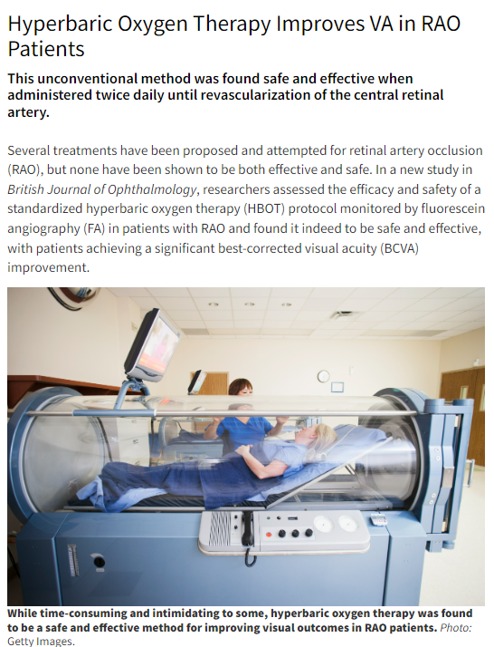
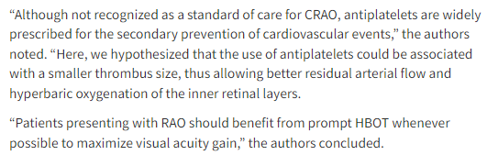


Slide 43
Adenoviral Infections
Common cause of “red eyes”
Assume adenovirus until proven otherwise
Often have pre-auricular node
Non-purulent watery discharge
Usually starts in one eye and spreads to fellow eye in a few days
Always evert lids to survey tarsal conjunctiva
With EKC, spotty sub-epithelial infiltration in 50 to 75% of untreated cases

Slide 44
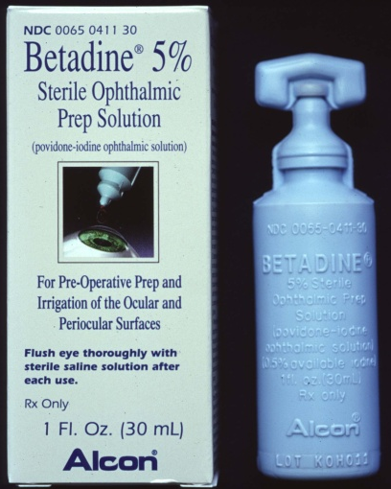
Povidone - Iodine 5% ophthalmic solution
Broad spectrum microbicide
Indicated for “irrigation of the ocular surface”
“Off label” use: Tx adenoviral keratoconjunctivitis
- Anesthetize with proparacaine
- Instill 1 or 2 drops of NSAID
- Instill several drops Betadine 5% in eye(s), close eye(s)
- Swab or rub excess over eyelid margin
- After 1 minute, irrigate with sterile saline
- Instill 1 or 2 drops of NSAID
- Rx steroid qid x 4 days
No reports in clinical trials of adverse reactions.
Marketed as Betadine 5% ophthalmic prep solution (30 ml opaque bottle) by Alcon surgical
CPT 99070 supply code

Slide 45
Dupixent® and Inflammatory Conjunctivitis
Dupixent (dupilumab) is a subcutaneous-administered biologic drug to treat asthma and eczema.
About 10% of patients develop
conjunctivitis as a side effect
Asthma and eczematoid dermatitis are common conditions, so encountering Dupixent associated conjunctivitis may be seen in the office.
We anticipate treatment with Lotemax® SM or FML qid x 1 week, then bid for 2 more weeks to be effective
Dupixent. Package Insert. Regeneron Pharmaceuticals, Inc. 2017
Reuters, Nov 29, 2022

Slide 46
Dupilumab (Dupixent®) and the Eye
Duoduo Wu,
Benjamin S. Daniel,
Andre J.X. Lai
First-in-class biologic (interleukin inhibitor) with unprecedented effectiveness.
Tx: atopic dermatitis (eczema) the most common use.
Administered by IV infusion
Baseline eye examination is highly recommended to rule-out pre-Tx eye diseases and conditions.
Main ocular consequences: conjunctivitis, DED, blepharitis (including demodex), and keratitis (SPK), along with typical symptoms of these disorders.
Tx: Artificial tears and/or topical antihistamines, and/or loteprednol.
Survey Ophthalmol. Sept/Oct 2022
Notes:
Wu D, Daniel BS, Lai AJX. Dupilumab-associated ocular manifestations: A review of clinical presentations and management. Survey Ophthalmol 2022;67(5):1419-1442.

Slide 47
Best Treatments for Psoriasis
Infliximab (Remicade®) TNF blocker
Bimekizumab (Bimzelx®) IL-17 blocker
Ixekizumab (Taltz®) IL-17 blocker
Risankizumab (Skyrizi®) IL-23 blocker
Guselkumab (Tremfya®) IL-23 blocker
  Has the longest durability of efficacy
JAMA Dermatology, 2024

Slide 48
Perspective on Posterior Vitreous Detachment
Occurs mostly between ages 50 and 70 (peak incidence 62)
No association with refractive error, except patients with -3.00D or more go to P.V.D. 5-10 years earlier
80-90% of breaks associated with P.V.D. are in the superior quadrants
Ophthalmology, January 2018

Slide 49
Acute PVD and Retinal Tears
The rate of an acute retinal tear associated with an acute symptomatic PVD is about 8% at the initial visit, and 1.5% of eyes without a tear on the initial visit are found to have a tear on follow-up examination.
Ophthalmology, January 2018
Notes:
Yannuzzix NA, Chang JS, Brown GC, Smiddy WE. Cost-Utility of Evaluation for Posterior Vitreous Detachment and Prophylaxis of Retinal Detachment. Ophthalmology 2018;125(1):43-50.

Slide 50
AAO-PPP on PVD Patient Care
“Patients presenting with an acute PVD and no retinal breaks have a small chance (~2%) of developing retinal breaks in the weeks that follow. Selected patients, particularly those with any degree of vitreous pigment, vitreous or retinal hemorrhage, or visible vitreoretinal traction, should be asked to return for a second examination promptly if they have new symptoms or within 6 weeks following the onset of PVD symptoms.”
Preferred Practice Guidelines, AAO, Oct, 2019
Notes:
AAO PPP Retina/Vitreous Committee, Hoskins Center for Quality Eye Care. Posterior Vitreous Detachment, Retinal Breaks, and Lattice Degeneration PPP 2019

Slide 51
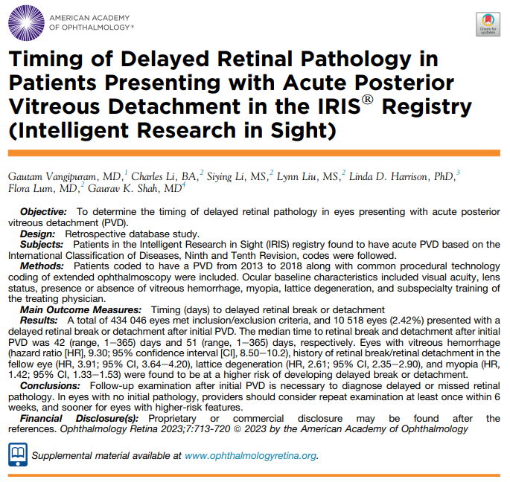

Slide 52
Follow-up After Initial PVD Event
About 2% of patients with normal findings will develop a subsequent retinal tear.
In this study, 45% of these retinal breaks “were found more than 6 weeks after presentation.”
At the Wills Eye Hospital Retina Service; “60% of patients in our study had at least a 4-6 week follow-up. Most physicians in our practice do not routinely follow up patients beyond this timeframe.”
Only about half of these subsequent events were symptomatic, therefore there may be a need to re-evaluate acute PVD patients more frequently than is currently common practice.
Ophthalmology, April 2020
Notes:
Uhr JH, Obeid A, Wibbelsman TD, et al. Delayed Retinal Breaks and Detachments after Acute Posterior Vitreous Detachment. Ophthalmology 2020;127(4):516-522. https://doi.org/10.1016/j.ophtha.2019.10.020

Slide 53
ED Protocol for Flashes-Floaters
If patients did not have any of the following, deferent of definitive care for 48 hours resulted in no harm.
  No personal history of RD
  No trauma in the past month
  No ocular surgery in the past month
  No VF defects on confrontation
  No significant difference in VA
This makes sense but depends upon the competence of the ED staff and the anxiety of the patient and/or the doctor.
Am J Ophthalmol., October, 2022
Notes:
Shen BY, Salman AR, Shah SM, et al. Clinical Outcomes Following Implementation of a Formalized “Flashes and Floaters” Emergency Department Triage Protocol. Am J Ophthalmol 2022;242:125-130.

Slide 54
What About Scleral Depression
“An examination using a 28 diopter lens with scleral depression did not provide any additional benefit to an examination without depression during indirect ophthalmoscopy.”
“In many areas around the world ophthalmologists have progressively shifted from indirect ophthalmoscopy with 28 diopter-type lenses to new fundus lenses at the slit lamp to improve the comfort of the patient without scleral depression.”
Am J Ophthalmol. November 2018
Notes:
Tran KD, Schwartz SG, Smiddy WE, Flynn HW, Jr. The Role of Scleral Depression in Modern Clinical Practice. Am J Ophthalmol. 2018;195:xviii-xix.

Slide 55
Treatment of Vitreous Floaters
Treatment options:
  Live with them
  Vitrectomy
  Vitreolysis
YAG laser – angle of focus can be changed to reach floaters; special vitreous lenses allow the laser beam to focus on floater
Advantages: simple, noninvasive, no pain or discomfort
Disadvantages: healthy eyes getting elective surgery, risk of retinal detachment, possibly worsening of symptoms
Clear visualization of floaters key to successful treatment
Treatment may require more than one laser session; symptomatic vitreous opacifications (SVO); only SVO’s > 4mm from retina treated
Patient decision on benefits vs risks CRST, May 2016 (Stonecipher)

Slide 56
Vitreolysis for Symptomatic Floaters
Two options: YAG laser or vitrectomy
Newer “Reflex Technology” enhances YAG success
Floater material is both fractionated and vaporized
Multiple sessions may be required
Weiss ring easier to treat than amorphous clouds
About half of patients obtain symptomatic relief
Complications are few, but can be serious
Survey Ophthalmol, March 2020
Notes:
Singh IP. Modern vitreolysis—YAG laser treatment now a real solution for the treatment of symptomatic floaters. Survey Ophthalmol 2020;65(5):581-588.

Slide 57
Timing and RD Repair: Is there a hurry?
Preoperative VA is the strongest predictor of postoperative VA
When central vision is affected, about 30% of patients ultimately achieve 20/40 or better
“There is no difference in VA outcomes among patients who underwent repair within the first week of onset.”
VA can improve for months to years after surgical repair
There was no association between duration of macular detachment and postoperative VA
“Clinical evidence suggests that the duration of macular detachment has a minor, if any, effect on visual outcome when repair is performed within about one week. Similarly, many fovea-sparing RD’s can likely be deferred for a short period without affecting visual outcomes.”
JAMA Oph. November 2013

Slide 58
Bullous Retinal Detachment – Macula?
69 yowm with CC of blurred vision and curtain over OD inferiorly x 1 D; No flashes of light; LEE local eye doctor 6 months ago; no dilation but paid extra for photo – told eyes healthy
No family hx eye problems; Meds: ASA 81 mg, atorvastatin, pantoprazole, ipratropium nasal spray; NKDAsBVA: OD 20/50, OS 20/30
Pupils: 3 mm OU, no APD
CF: significant inferior constriction OD
SLE: 2 NS OU
DFE: OD .4, OS .4; Superior bullous retinal detachment with 2 large retinal tears, borders macula; OS pigmented lattice w/o holes
OCT macula: OD C-362, Vol 8.86 with superior cut macula off; OS C-269, Vol 8.60 normal
Plan:

Slide 59
Malpractice Risks Regarding
Retinal Detachments
Uptick in legal claims for diagnostic errors
  Especially retinal detachments
“And by far the most frequently missed diagnosis in our entire study was RD– nothing else came close.”
85% or these missed RD’s presented with risk factors specific to RD
“The primary pathogenic mechanism– and the biggest risk factor– for RD is PVD.”
Comprehensive ophthalmologists (and optometrists) should have a low threshold for referral to a retinal subspecialist.”
    Reference: EyeNet, April, 2018

Slide 60
Limitations of Ultra-Widefield Fundus Photography
These devices can capture more than 80% and up to 200º of the retinal surface area.
However, “visualization of the inferior and superior sectors is often limited.”
In fact: Nearly half of horseshoe tears were missed by UWF imaging; the majority in the superior quadrant.
“UWF imaging should not be relied upon as a substitute for funduscopic examination in the evaluation of PVD or symptoms indicative of a retinal tear. This cautionary note is essential, as a negative UWF image can provide false reassurance, potentially leading to delayed diagnosis and management of a critical retinal condition.
Am J Ophthalmol. Nov, 2023
Notes:
Lin AC, Kalaw FGP, Schönbach EM, et al. The Sensitivity of Ultra-Widefield Fundus Photography Versus Scleral Depressed Examination for Detection of Retinal Horseshoe Tears. Am J Ophthalmol, 2023;255:155-160.

Slide 61
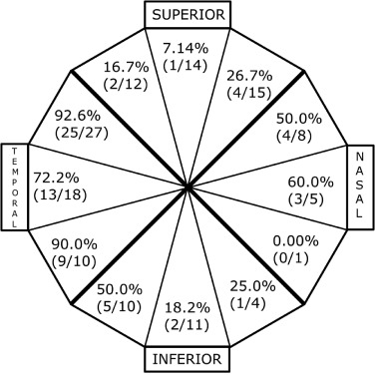
FIGURE 3. Sensitivity of ultra-widefield (UWF) imaging for detection of horseshoe tears (HSTs). Sensitivities of HSTs detected on foveal-centered UWF imaging per clock-hour and grouped into superior, nasal, inferior and temporal quadrants with respect to the orientation of the right eye.**
Am J Ophthalmol. July 17, 2023
Notes:
Lin AC, Kalaw FGP, Schönbach EM, et al. The Sensitivity of Ultra-Widefield Fundus Photography Versus Scleral Depressed Examination for Detection of Retinal Horseshoe Tears. Am J Ophthalmol, 2023;255:155-160.

Slide 62
The “Good” of Ultra-Wide Field Photography
“Severity of DR is most rigorously defined using retinal photography.”
Initial Early Treatment Diabetic Retinopathy Study (ETDRS) only captured 7 field images of the central 30 degrees.
Several studies show “equivalent or more” data with ultra-wide photography
UWF imaging covers much more retinal tissues and “allows for the identification of additional pathology and a more robust ability to predict retinopathy progression.”
JAMA Ophthalmol. September 2024
Notes:
Aiello LP, Blodi B, Gao X, et al. Ultra-Widefield and Early Treatment Diabetic Retinopathy Study 7-Field Grading of Diabetic Retinopathy. JAMA Ophthalmol. 2024;142(9):856–863.

