Slide 1
MYSTERY SOLVED –
CONQUERING THERAPEUTIC DILEMMAS
Ron Melton, OD, FAAO
Randall Thomas, OD, MPH, FAAO

Slide 2
Financial Disclosure
Drs Ron Melton is a consultant to, on the speakers bureau of, on the advisory committee of, or involved in research for the following companies: ICARE and B+L.
“All relevant relationships have been mitigated.”

Slide 3
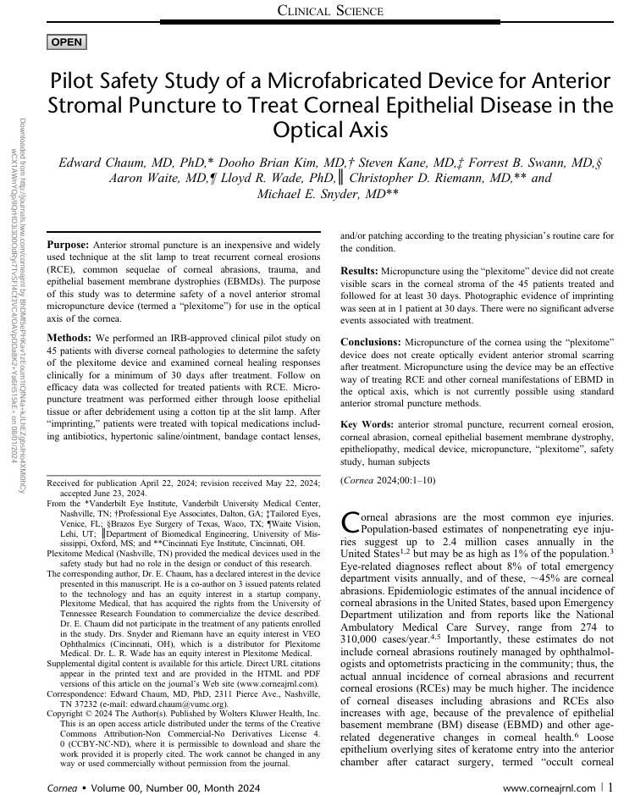
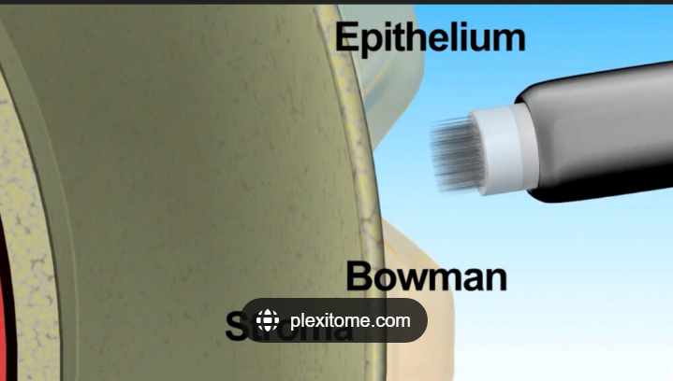


Slide 4
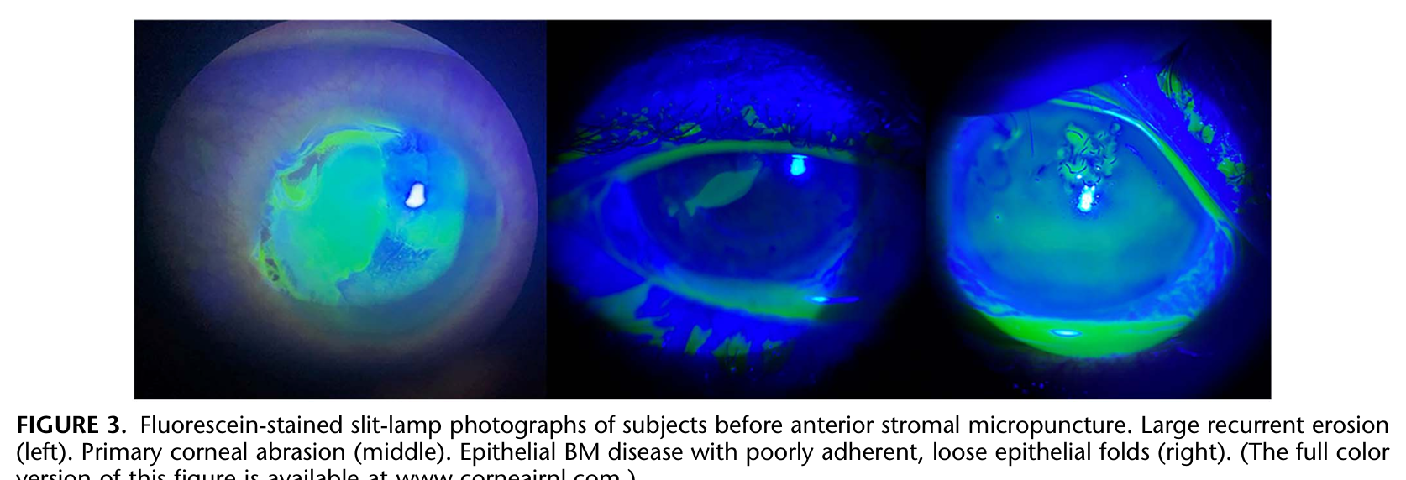
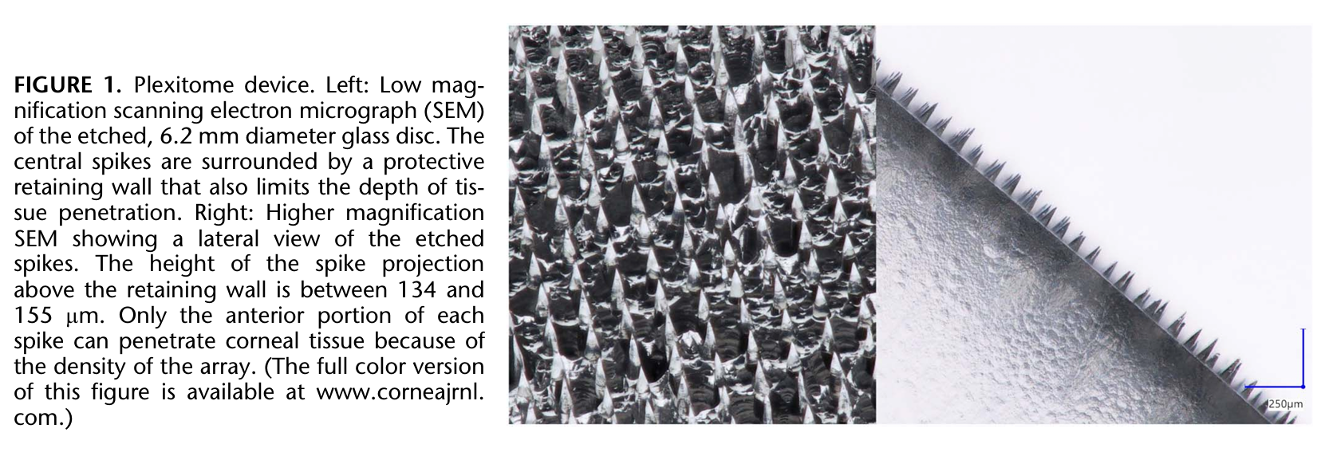

Slide 5
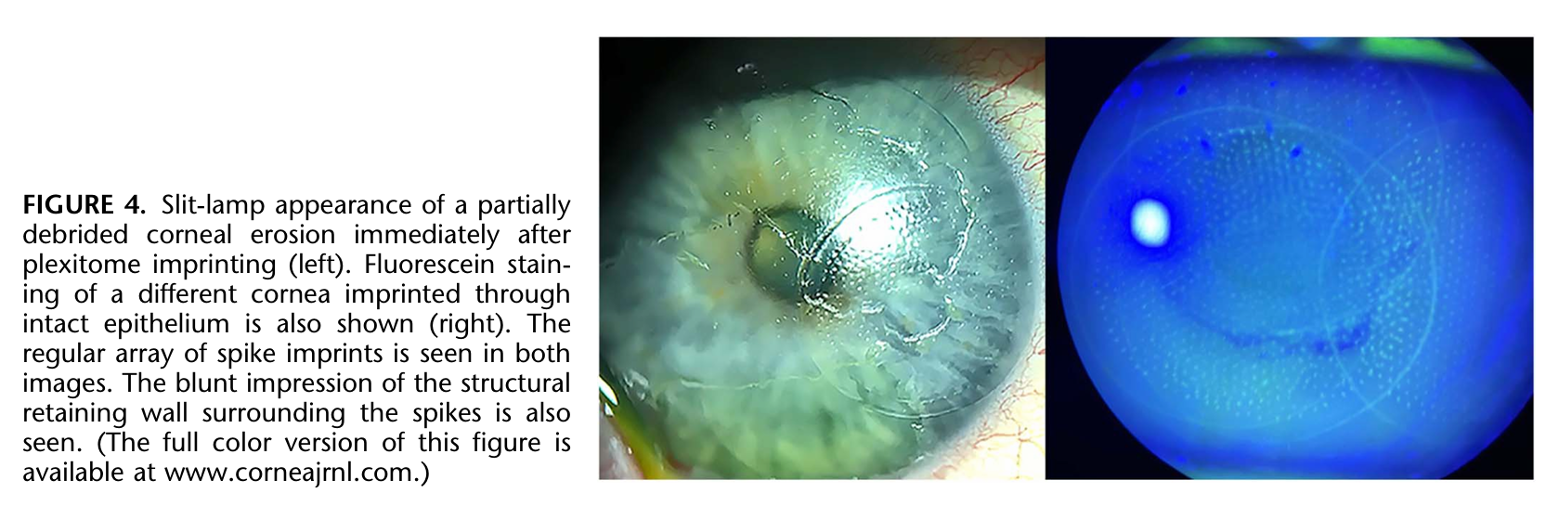
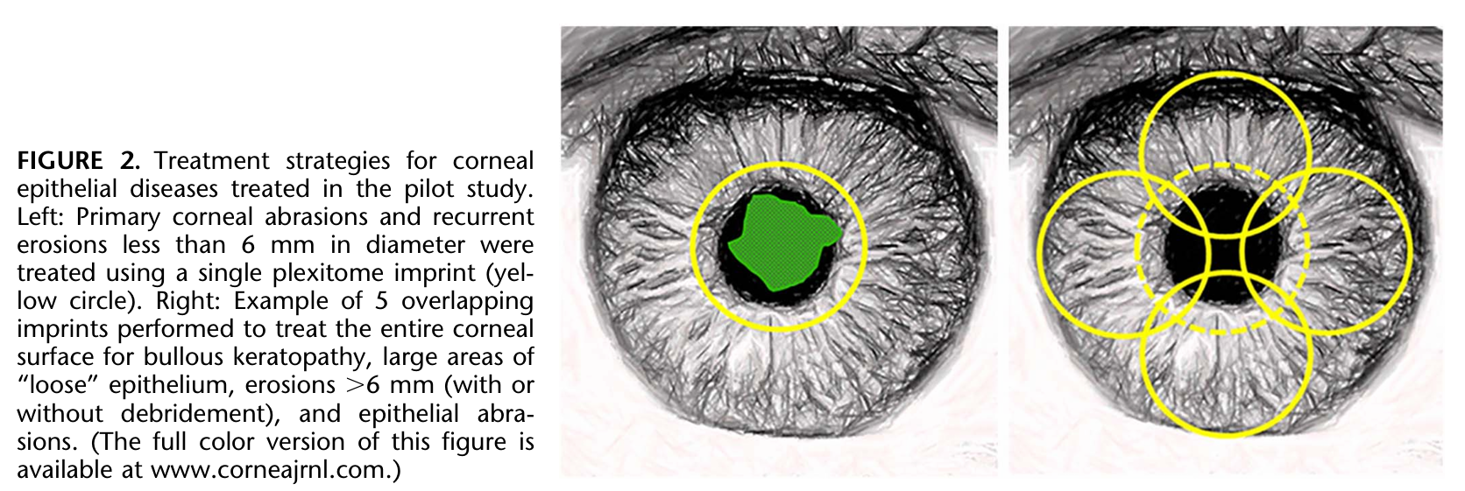

Slide 6
Myths in Eye Care
“The common teaching about Hutchinson’s sign is misleading; all patients with V1 zoster should be evaluated fully for ocular involvement.”
In 2004, the primary ingredient in baby shampoo was named the “contact allergen of the year.” “Baby shampoo should not be recommended as a preferred treatment.”
“Only a small percentage of patients with TED demonstrate SLK.”
“There is little to no data supporting the therapeutic value of artificial tears for any condition.” “We have been unable to find evidence to support the commonly taught dictum that if prescribing AT’s more than 4 times daily, prescribe N-P AT’s, which increases costs for the patient.”
Tapering topical steroids to prevent rebound inflammation is not a concern. However, reducing dosing to find the least intervention to maintain inflammation control is appropriate.
Ophthalmology, August, 2023
Notes:
Margolis TP, Galor A. Six Myths of the Anterior Segment: Misunderstandings and Critical Thinking in Ophthalmology. Ophthalmology 2023;130(8):783-785.

Slide 7
Anti-Viral Medicines
Topical
Trifluridine Viroptic
Ganciclovir Zirgan
Oral
Acyclovir Zovirax
Valacyclovir Valtrex
Famciclovir Famvir
- These are anti-herpetic drugs and are ineffective against the various adenoviral serotypes -

Slide 8
Topical Antiviral Options
Trifluridine
Old drug
Indiscriminate expression
Potentially toxic
More frequent dosing
Refrigerate until opened
Thimerisol preserved
Solution (7.5 ml bottle)
Viroptic and generic
Ganciclovir
New drug
Infected cell-specific
Minimally toxic
Less frequent dosing
No refrigeration needed
BAK preserved
Gel (5 gram tube)
Zirgan by B+L

Slide 9
 | Acylovir | Valacyclovir | Famciclovir
Zoster Dosage | 800 mg 5x a day for 7-10 days | 1000 mg TID for 7-10 days | 500 mg TID for 7-10 days
Simplex Dosage | 400 mg 5x a day for 7-10 days | 500 mg TID for 7-10 days | 250 mg TID for 7-10 days

Slide 10
Herpes Simplex Keratitis
90% of adults harbor the Herpes Virus
Strain-specific expression of the disease
Unilateral red eye with serous discharge
Affected cornea has decreased sensitivity
Males more commonly affected; recur more often
40% chance of recurrence within 5 years
Fellow eye not at risk of involvement (1’ and 2’)
Cause of recurrence: trauma, stress, adrenergic and prostaglandin eyedrops, fever, menstruation, climate, UV light
Treatment: topical or systemic anti-viral

Slide 11
Valacyclovir vs. Acyclovir for Recurrent HSV
“One-year suppression therapy with oral valacyclovir (500-mg tablet daily) was shown to be as effective and as well-tolerated as acyclovir (400-mg tablet twice daily) in reducing the rate of recurrent ocular HSV disease.”
SOURCE: Miserocchi E, Modorati G, Galli L, Rama P. Efficacy of valacyclovir vs. acyclovir for the prevention of recurrent herpes simplex virus eye disease: A pilot study. Am J Ophthalmol, Oct. 2007

Slide 12
Herpes Zoster Vaccination (Shingrix)
Shingrix is the 2nd vaccine to be FDA approved to help prevent shingles.
Approved for people aged 50 and older
A non-live vaccine (Zostavax is live, attenuated)
Administered in 2 - I.M. doses (initially then 2-6 months later)
About 90% effective and maintained over four years
If the last Zostavax vaccine was at least 5 years ago, can have Shingrix
Marketed by GlaxoSmithKline

Slide 13
Shingles Vaccine Update
Shingrix vaccine was 76% effective for the 4 years of the study
A single dose was only 64% effective
Still effective if second dose is beyond 6 months
45,000 cases: 90% were unvaccinated
All healthcare providers need to continue to encourage patients to receive the shingles vaccination.
Annals Intern Med. January 2024

Slide 14
Facts on Shingles
Incidence is on the rise, and at increasingly earlier ages
Mean age of event: 52
Patients who have had HZO should be examined “within several weeks before and after vaccination against herpes zoster” because they may be at risk for recurrent eye disease.
We should “recommend strongly” that patients over 50 get Shingrix.
Our advocacy could “play an important role in increasing vaccination rates.”
About 10% of people have a reaction to Shingrix, more after the second doseIncidence is on the rise, and at increasingly earlier ages
Postherpetic neuralgia occurs in about 30% of patients with HZO, mostly in older people
Shingrix is about 90% effective
“Although eye doctors often view recommending vaccinations as the job of the PCP, given the incredible toll that HZ can take on the eye, we must take responsibility for protecting our patients and recommending this preventive measure.” Reference: Ophthalmology, Nov 2018
Reference: Ophthalmology, Nov 2018

Slide 15
Herpes Zoster Ophthalmicus
Acute vesicular eruption of ophthalmic division of 5th cranial nerve
Etiology: varicella-zoster virus; more common after 50 or in the immuno-compromised
Symptoms: skin pain most common
Ocular involvement in 50%
  more common - zoster epithelial lesions, anterior uveitis, stromal keratitis, episcleritis
  Tx: valacyclovir 1000mg tid for 1 wk; famciclovir 500 mg tid for 1 wk; acyclovir 800mg 5x d for 1 wk
  If ocular involvement, treat with topical steroids

Slide 16
Zoster Eye Disease Study
“Evidence supports suppressive valacyclovir treatment 1000 mg daily for 12 months to reduce new or worsening keratitis or iritis in immunocompetent, non-pregnant adults with good renal function.”
Purpose: To reduce multiple episodes of keratitis or iritis.
There was a mild trend to ameliorate post-herpetic neuralgia, especially in patients over age 60.
JAMA Ophthalmol, December, 2023

Slide 17
Zoster Vaccine and HZO
Patients with HZO develop ocular complications 50-70% of the time.
Of these 20% develop chronic or recurrent episodes of keratitis or uveitis
Corneal complications are most common, and can occur concurrently, weeks, months or years later; Some as neurotrophic keratitis
Shingrix is 90-95% effective; decreased risk of shingles 200 fold!
“Doctors should continue to educate patients about the importance of vaccination.”
Am J Ophthalmol. January 2025
Notes:
Lobo-Chan, Ann-Marie et al. Risk Factors for the Development of Ocular Complications in Herpes Zoster Ophthalmicus and Zoster Vaccine Utilization in a Large, Urban Health System. American Journal of Ophthalmology, Volume 269, 435 – 449.

Slide 18
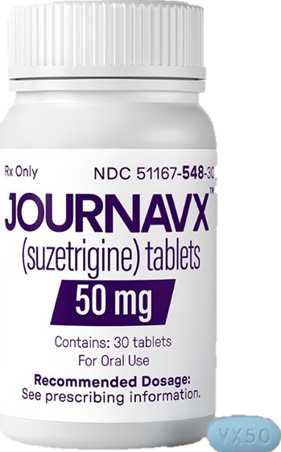
Finally – New Medicine for Pain
Journavx (Suzetrigine) 25 years since Celebrex
A sodium channel blocker (works at pain site)
Avoid if patients are taking CYP3A -
metabolized drugs such as statins, amlodipine or
a benzodiazepine (Xanax, Ativan, Valium, etc.)
Not tested in pregnancy or in people under age 18; main side effects: itching, muscle spasms, and rash
Roughly equivalent to opioid analgesia (just safer)
Onset 1-4 hours; dosage 50 mg every 12 hours
See www.Journavx.com for more information
Manufactured by Vertex Pharmaceuticals Inc.
Journavx.com

Slide 19
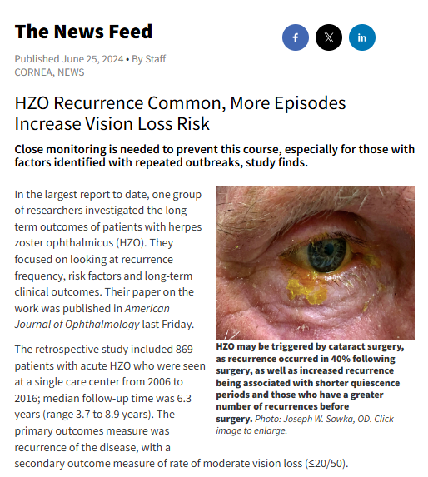
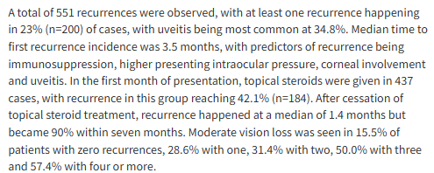


Slide 20
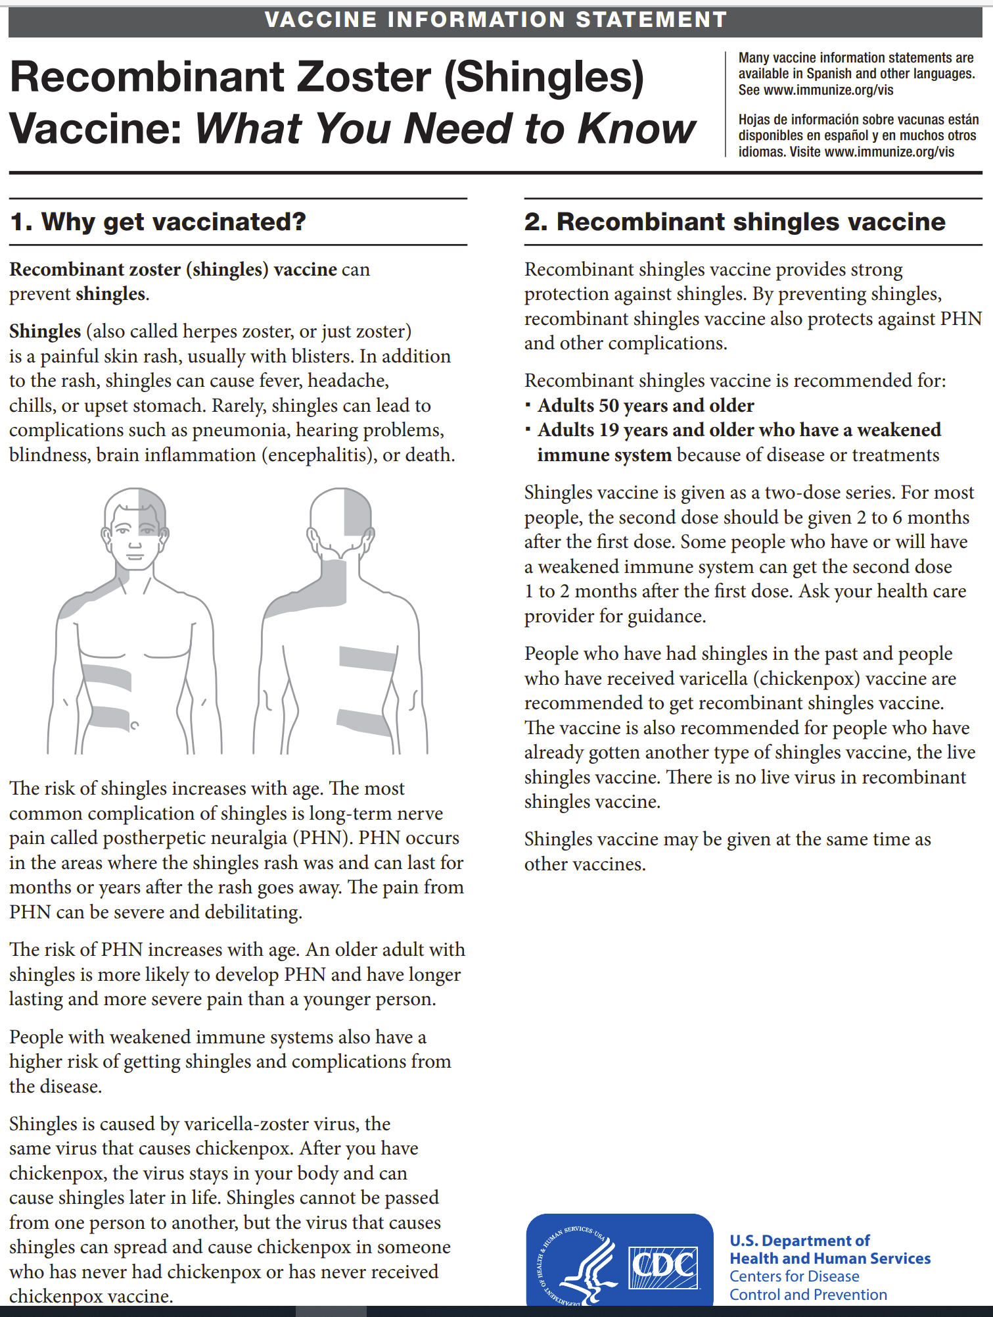
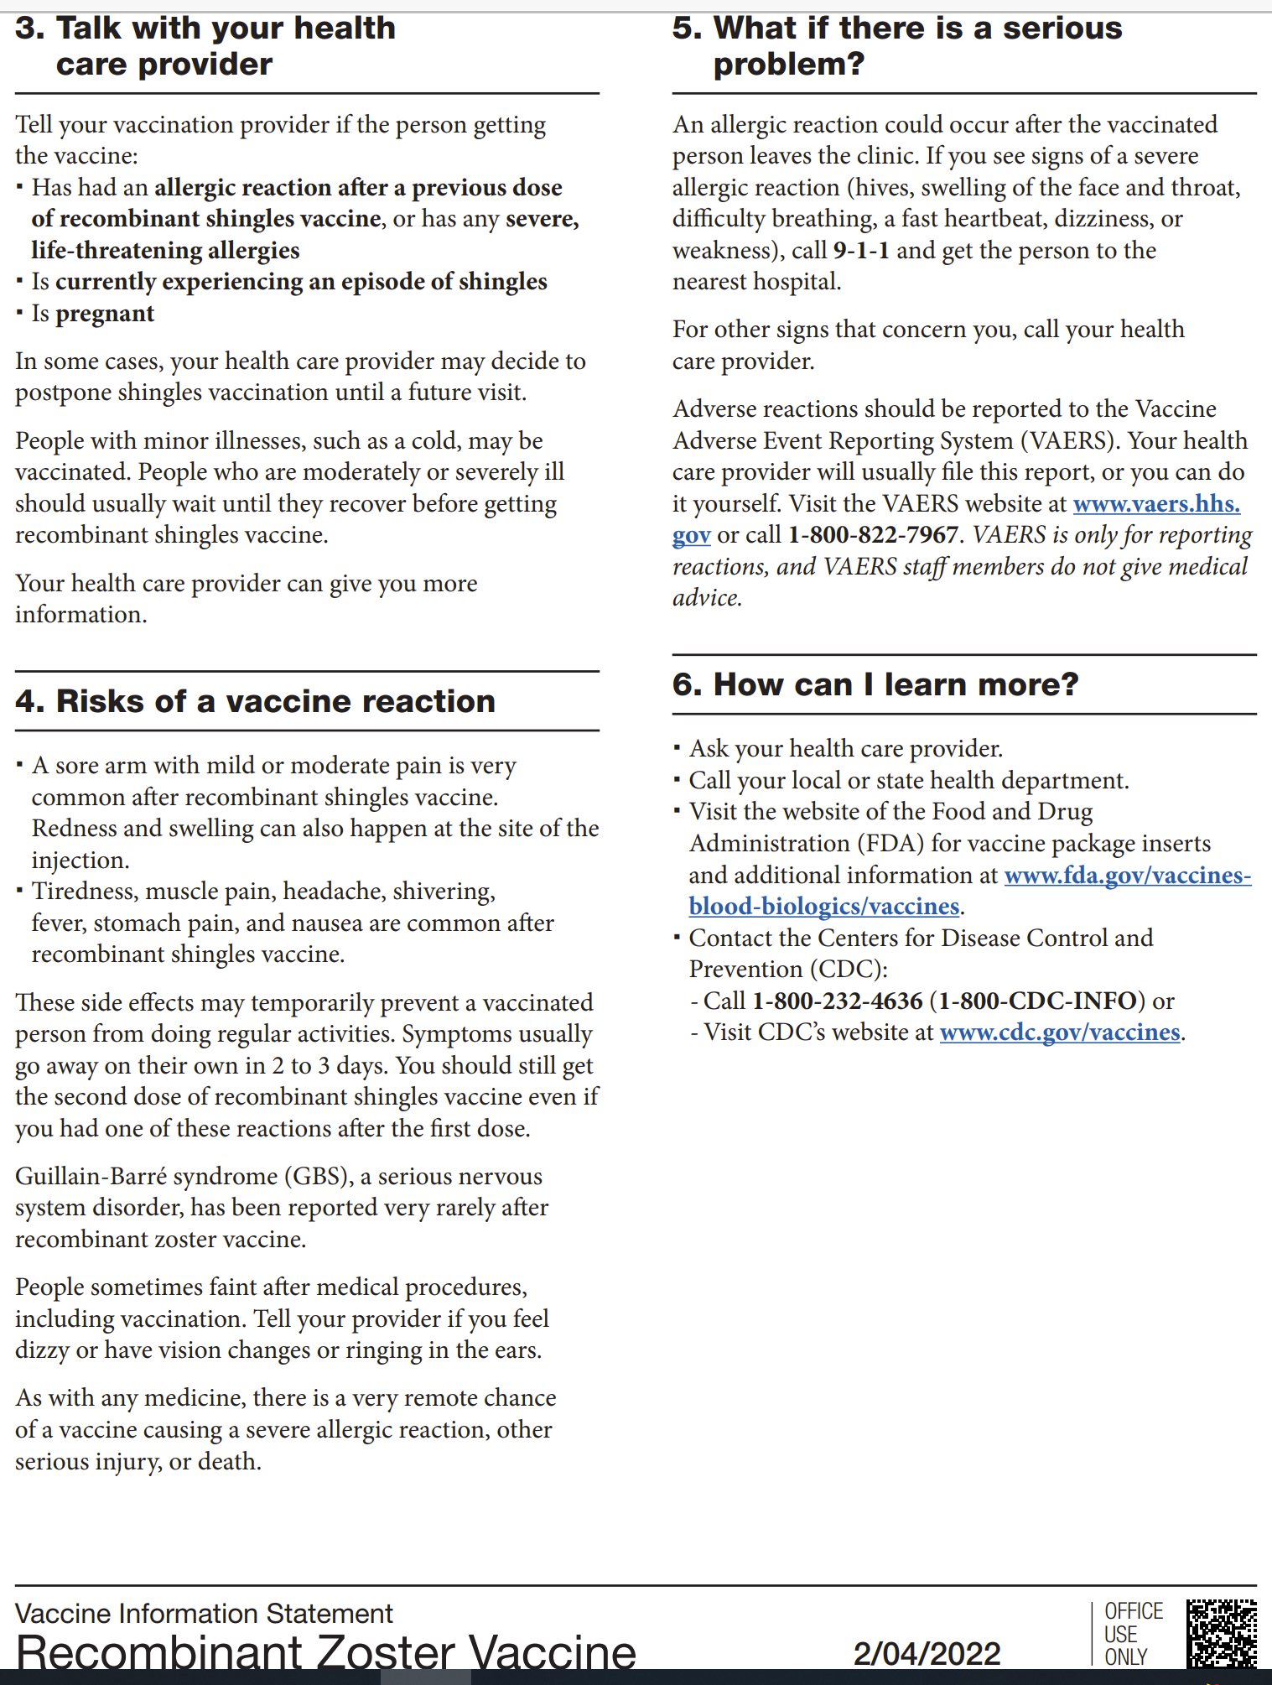

Slide 21
Primary HSV Infection
Vesicular eruptions on the eyelid skin and/or eyelid margin
Can be limited to the skin or can also result in follicular conjunctivitis and/or corneal epithelial disease
Treatment: - PO ACV 400 mg 5 x D x 1W - PO Valtrex 500 mg tid x 1W
Vesicles resolve without scarring
Notes:
21

Slide 22
Race and Giant Cell Arteritis
Most studies have found GCA to be pretty much a disease of Caucasians
A newer study has shown that patients of African descent are roughly at EQUAL risk of developing GCA!
Therefore, “race” should no longer be a risk factor when evaluating patients with suspected GCA.
Women are still at higher risk
All most all patients are aged 50 or older.
JAMA Ophthalmol, October, 2019

Slide 23
Black Patients and NAION
Black patients comprise about 5% of NAION
(Optic disc drusen in Black patients is rare as well as hypothyroidism; kidney disease much more common)
There is no difference in systemic risk factors among the two groups
Rarity in Black patients is thought to be linked to their prevalence of small C/D ratios.
Am J Ophthalmol. February 2025
Notes:
Banc A, et al. Nonarteritic Anterior Ischemic Optic Neuropathy in Black Patients. American Journal of Ophthalmology, Volume 270, 192 - 202

Slide 24
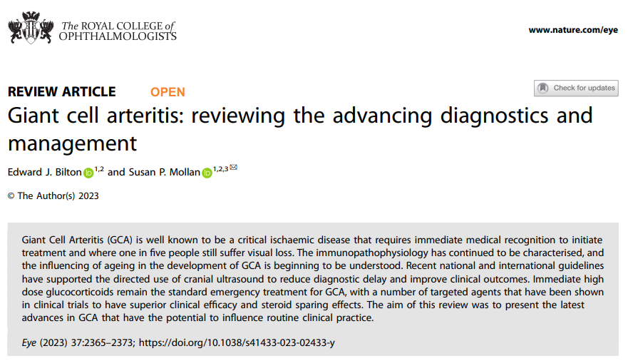
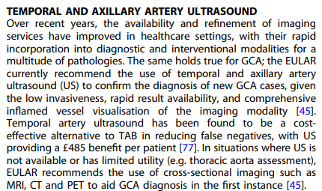

Slide 25
Clinical presentation
“The majority of people with cranial GCA will have symptoms of new onset headache, jaw claudication and cutaneous allodynia. Nearly half of people with GCA have symptoms of PMR while up to one-fifth of people with PMR will be diagnosed with GCA. There may be large vessel involvement in cranial GCA, which may be asymptomatic and revealed by diagnostic imaging alone. Up to 50% of people with GCA will experience constitutional symptoms such as fever, weight loss, night sweats, loss of appetite, malaise, depression. These may help narrow the differential diagnosis from an ocular cause or pain syndrome (such as migraine or cluster headache) to a systemic cause, however many systemic conditions have the potential to exhibit these symptoms.”
Notes:
Bilton, E.J., Mollan, S.P. Giant cell arteritis: reviewing the advancing diagnostics and management. Eye 37, 2365–2373 (2023). https://doi.org/10.1038/s41433-023-02433-y

Slide 26
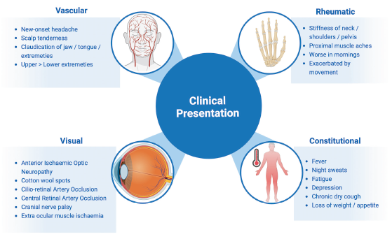
Notes:
Bilton, E.J., Mollan, S.P. Giant cell arteritis: reviewing the advancing diagnostics and management. Eye 37, 2365–2373 (2023). https://doi.org/10.1038/s41433-023-02433-y

Slide 27
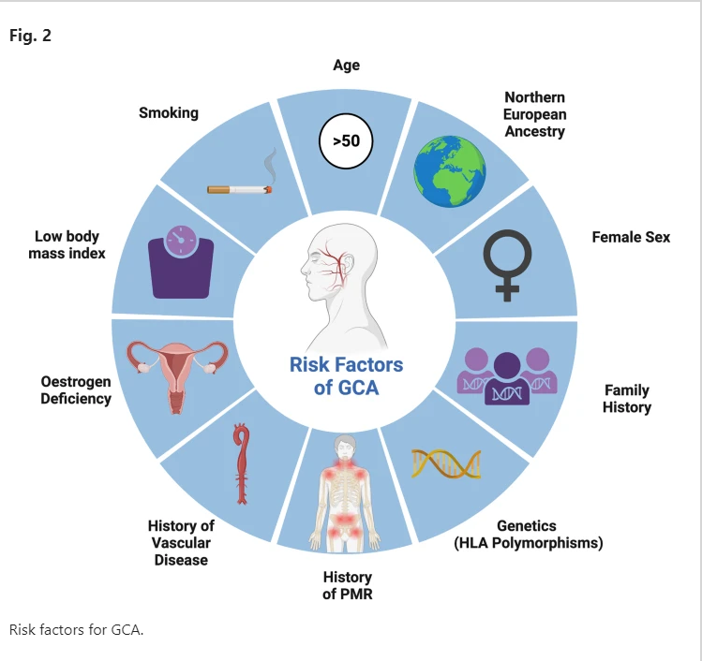
Notes:
Bilton, E.J., Mollan, S.P. Giant cell arteritis: reviewing the advancing diagnostics and management. Eye 37, 2365–2373 (2023). https://doi.org/10.1038/s41433-023-02433-y

Slide 28
IV Methylprednisolone in GCA
NEWS: “The use of IVMP showed limited to no advantage over treatment with oral prednisolone only.”
Typical initiating oral dose: 60-80 mg/day
“Surprisingly, the evidence supporting the use of IVMP in GCA is low.”
Medication tapering can take weeks to months and often steroid-sparing drugs such as the anti-interleukin-6 drug tocilizumab (Actrema) are employed after initial control with oral steroid.
After initial acute treatment, on-going care is generally done by rheumatology.
Rheumatology. August 2024
Notes:
Hampus Henningson, Björn Hammar, Aladdin J Mohammad, The use of intravenous methylprednisolone in giant cell arteritis: a population-based study, Rheumatology, 2024;, keae459, https://doi.org/10.1093/rheumatology/keae459

Slide 29
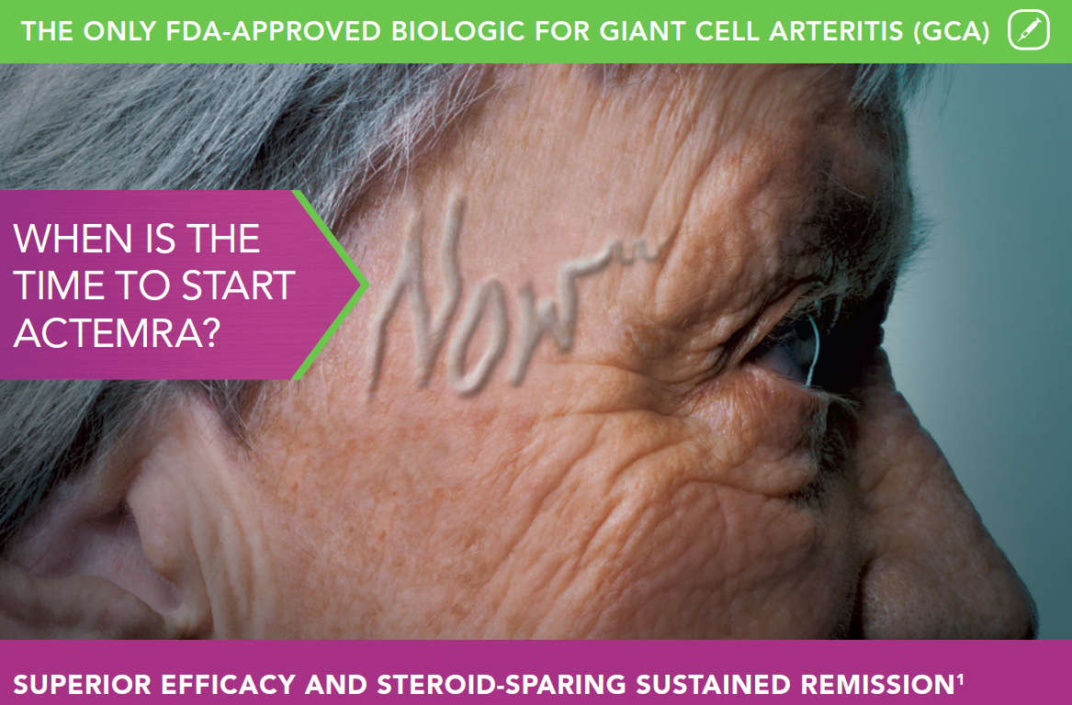

Slide 30
Tapering Oral Steroids in GCA
The inflammation associated with GCA often requires many months of suppression therapy
Oral steroids are initially required to aggressively suppress this idiopathic vasculitis
Enhancing steroid tapering with a non-steroidal medicine should diminish steroid exposure
Tocilizumab (Actemra) subcutaneously every two weeks significantly diminishes the need for enduring steroid therapy.
This may be a “game changer” in the overall care and long-term management of GCA
Stone JH, et al. N Engl J Med 2017;377:317-28
Notes:
Stone JH, Tuckwell K, Dimonaco S, et al. Trial of tocilizumab in giant-cell arteritis. N Engl J Med 2017;377:317-328.

Slide 31
Verbatim Transcript of GCA Case (2024) –Deposing a Rheumatologist
Q: “Doctor, how many times in your (40 year) career have you worked up a patient that you suspected temporal arteritis or included temporal arteritis in your differential diagnosis?”
A: “Several hundred times”
Q: “And how many times was that diagnosis actually made after you suspected?”
A: “Perhaps five to ten times.” Of which “none of them became blind.”

Slide 32
R/O Giant Cell Arteritis
78 yobf referred by ENT colleagues for “possible bad infection to OD after TA biopsy 1 week ago; hx of HA and right eye pain and photophobia for last month; PCP referred to ENT for TA biopsy 1 month ago even though ESR was negative
Meds: see chart. Allergies: Ibuprofen
Med Hx: Diabetes since 2007, TIA 2000, hypertension, anxiety, acid reflux, cataract surgery 2013
BVA: 20/25 OU
Pupils: normal, neg for APD
IOP: 9, 9 ICARE 3:10 pm
A/S Exam:
Conj: 3+ subconj heme OD, 1+ subconj heme OS
Cornea: Clear OD; Clear OS
A/C: 3+ -4 C/F; mild fibrin OD, clear OS
Lens: PC IOL OU clear
DFE: .3 OU, normal
P:

Slide 33
Ocular Lymphangiectasis
History: patient notices blister on conjunctiva; may be associated with irritation
Clear, fluid-filled dilation of conjunctival lymphatic vessels
Single or multiple small, transparent pearl-like blebs or cysts
Surrounding bulbar conjunctiva quiet
ICD-9 code 372.89
Treatment:
  Patient reassurance
  Drainage of blebs/destruction

Slide 34
Corneal Foreign Body
Take good Hx to help rule out penetration
Remove foreign body and corneal rust deposits
Cycloplege to prevent or treat secondary iritis
Do thorough intraocular exam with BIO
Cycloplege if any secondary iritis
Prophylactic antibiotic drops +/- NSAID drops
F/U until epithelial integrity re-established

Slide 35
Bacterial Conjunctivitis
Unilateral or bilateral red eye(s) with purulent or mucopurulent discharge of varying degree
In subtle cases, carefully examine the lacrimal lake under high magnification and look for microparticulate debris which can be evidence of bacterial infection.
Preauricular lymphadenopathy is uncommon, but can be present in hyperacute cases
Chemosis may be present in more severe cases
SPK can be present, especially if staphylococcal etiology. This is usually the result of staph exotoxin chemotoxicity, and tends to be seen mostly inferionasally because of tear film dynamics
Common etiology: Adults: Staph aureus, Staph epidermidis, Strep pneumoniae
Children: Strep pneumoniae, Haemophilus
Therapy: Adults: Tobramycin, Polytrim, or Fluoroquinolone
Children: Polytrim or Polysporin ung
Treat for five to seven days as a rule

Slide 36
Acute Conjunctivitis and Antibiotic Use
“Conjunctivitis is the most common cause of red or pink eye, but most (up to 80%) are viral.”
“Topical antibiotics (for bacterial infection) provide only a very modest beneficial effect on clinical remission.”
    Antibiotic Rx Combo Rx
  - OD’s – 44% OD’s – 30%
  - MD’s – 36% MD’s – 23%
  - Non-Eye Dr’s – 60% Non-Eye Dr’s – 8%
One-fifth of all Rx’s were for a combination antibiotic-steroid “which are contra-indicated in acute cases of conjunctivitis.” (Not True!)
Use of AdenoPlus may reduce diagnostic uncertainty and increase comfort with deferring antibiotic therapy.
Ophthalmology, August, 2017
Notes:
Miyazaki D, Fukushima A, Ohashi Y, et al. Steroid-sparing effect of 0.1% tacrolimus eye drop for treatment of shield ulcer and corneal epitheliopathy in refractory allergic ocular diseases. Ophthalmology 2017;124(3):287-294.

Slide 37
Corneal Abrasion
Common ocular injury associated with pain, foreign body sensation, tearing, photophobia, and blurred vision
Use antibiotic qid or antibiotic ophthalmic ointment tid for 1-3 days as needed
Trauma
  Fingernail, paper cut, tree branch - increased risk of recurrent corneal erosion
  Rule out foreign body
  Cycloplege if indicated for pain
Treatment
  Small abrasions - topical antibiotic drops or ointments alone
  Extensive abrasions – topical antibiotics, cycloplegics, nsaid’s, and pressure patching or bandage soft contact lens
If caused by organic material requires closer follow-up
NEVER PATCH corneal abrasion caused by contact lens wear

Slide 38
INR: International Normalized Ratio
A universally accepted measure of “coagulability”(clotting) behavior of blood in patients taking Coumadin® (warfarin).
An INR of 1 is a normal, physiological clotting behavior.
Target anticoaguable profile is an INR generally between 2 and 3.
The higher the INR > 3, the thinner the blood thus increasing the risk of bleeding and hemorrhagic stroke.

Slide 39
Alternative Oral Anticoagulants to Coumadin
Direct thrombin inhibitor
  Pradaxa (dabigatran)
Oral factor Xa inhibitor
  Xarelto (rivaroxaban)
  Eliquis (apixaban)
  Savaysa (edoxaban)

Slide 40
Rivaroxaban (Xarelto®) vs. Apixaban (Eliquis®)
Xarelto – once daily
Eliquis – twice daily
“Increasingly, observational studies suggest that bleeding risk is lower
with apixaban than with rivaroxaban.”
“Apixaban is more effective in preventing short-term venous thromboembolism (VTE) recurrence.”
Lancet Haematol. (as reported in NEJM Journal Watch – Gen Med. January, 2019
Notes:
Dawwas GK, Brown J, Dietrich E, Park H. Effectiveness and safety of apixaban versus rivaroxaban for prevention of recurrent venous thromboembolism and adverse bleeding events in patients with venous thromboembolism: a retrospective population-based cohort analysis.
Lancet Haematol. 2019;6(1):e20-e28.

Slide 41
Reversal Agents for Anticoagulants
Vitamin K quickly reverses warfarin, a vitamin K antagonist
Newer anticoagulants: Pradaxa, Xarelto, Eliquis, and Savaysa
Praxbind reverses Pradaxa
The Xa-inhibitors; Xarelto, Eliquis, and Savaysa are inhibited by Andexanet within minutes
Andexanet is a major enhancement to the clinical usefulness of these newer anticoagulants!
Reference: NEJM. November 2015

Slide 42
Intraocular Bleeding with Novel Anticoagulants
Dabigatran (Pradaxa®), rivaroxaban (Xarelto®), apixaban (Eliquis®), edoxaban (Lixiana®)
Reduce the risk of intraocular bleeding by ~1/5 compared with warfarin (Coumadin®)
Consider for patients at risk for proliferative diabetic retinopathy, the wet forms of ARMD, etc.
Sun MT, et al. JAMA Ophthalmol, 2017;135(8):864-70
Notes:
Sun MT, Wood MK, Chan W, et al. Risk of intraocular bleeding with novel oral anticoagulants compared with warfarin. A systematic review and meta-analysis. JAMA Ophthalmol. 2017;135(8):864-70.

Slide 43
Efficacy of New Oral Anticoagulants Compared to Warfarin
50% fewer hemorrhagic strokes
25% more GI bleeds
10% lower all cause mortality
Lancet, December, 2013

Slide 44
INR: International Normalized Ratio
A universally accepted measure of “coagulability”(clotting) behavior of blood in patients taking Coumadin® (warfarin).
An INR of 1 is a normal, physiological clotting behavior.
Target anticoaguable profile is an INR generally between 2 and 3.
The higher the INR > 3, the thinner the blood thus increasing the risk of bleeding and hemorrhagic stroke.

Slide 45
Iris Vascular Tufts
AKA capillary hemangioma or microhemangioma
Single or multiple – usually bilateral
Most always at pupillary border
Most patients are over age 50
Can lead to spontaneous hyphema
Natural course is benign (self-limited)
Recurrence is unusual (can Tx with argon ablation)
Tx with cycloplegia and steroids (similar to traumatic hyphema)

Slide 46
Solar and Laser Retinopathy
Similar pathophysiology: DDx- good Hx
Central scotoma with mild to moderate reduction in BVA
Small, focal yellowish macular lesion
OCT: Compromise to RPE and outer layers
  Inner layer involvement in severe damage
Light energy is absorbed by RPE resulting in heat damage to the tissue
Some recovery of vision may occur over several months

Slide 47
Acute Zonal Occult Outer Retinopathy
(AZOOR)
Rare condition characterized by acute onset of loss of one or more zones of visual field (often temporal); field loss may progress; in 50% stabilization within 6 months but recovery infrequent
Occurs in one or both eyes
More common in young or middle-aged females; often with antecedent viral-like illness
Photopsia and mild vitritis frequent; subtle vasculitis sometimes present
Mechanism undefined
Minimal fundoscopic signs early in disease course
Late findings: RPE clumping and vascular attenuaton in involved area and peripapillary region
ERG shows a-wave and b-wave amplitude reduction and delayed 30 HZ flicker (cones affected more than rods); EOG shows absence/severe reduction light rise

