Slide 1
Glaucoma’s Next Move:
Deep Dive 2006
Ron Melton, OD, FAAO
HAWAIIAN OPHTHALMIC SUMMIT 2026
TARR TREK ELEVATED EYE EDUCATION
Oahu, Hawaii
October 17-20, 2026

Slide 2
Financial Disclosure
Drs. Ron Melton is a consultant to, on the speakers bureau of, on the advisory committee of, or involved in research for the following companies: ICARE and B+L.
“All relevant relationships have been mitigated.”

Slide 3
Is Glaucoma Over or Under Diagnosed?
“It is important to understand risk factors for diagnostic changes in glaucoma in order to prevent undertreatment of disease and overtreatment of suspects.”
In a 900-subject study of POAG and POAG-suspect, 14% were found to be erroneously diagnosed.”
Of this 14%, 78% were up-staged from suspect to POAG, and 22% were down-staged from POAG to suspect.
“Performing VF’s or OCT reduced the odds of misdiagnosis.”
Note: Medical diagnosis is an art, not an exact science, but we do the best we can.
Ophthalmology Glaucoma, 2025
Notes:
Lillian K. To, Nicole V. Carrabba, Chaitanya G. Kalathuru, Alice Z. Chuang, Logan Smith, Robert M. Feldman. Risk Factors for Diagnostic Change from Glaucoma Suspect to Primary Open-Angle Glaucoma and Vice Versa Over 2 Years
Ophthalmology Glaucoma Vol. 8Issue 3p257–265. Published online: December 20, 2024

Slide 4
The Pressure on Glaucoma Clinics
“Glaucoma clinics are currently under colossal strain, partly due to aging populations, but mainly because they’re increasingly being sent people who have been referred ‘just in case’, but who in truth have healthy eyes and don’t need to be there.”
If there is uncertainty, and you would like a second opinion, seek out an optometric colleague in your area to offer their perspective. But remember, the patient is yours; if you would like to continue his/her care, just let the other consultant know this, just like the situation with any other specialist
Workforce projections show total number of ophthalmologists (including glaucoma specialists) is expected to decline by 12% by 2035, while demand for care is projected to increase by 24% over the same period. Result- 30% workforce inadequacy in ophthalmology overall.
The Ophthalmologist, June, 2019
American Academy of Ophthalmology, 2026

Slide 5
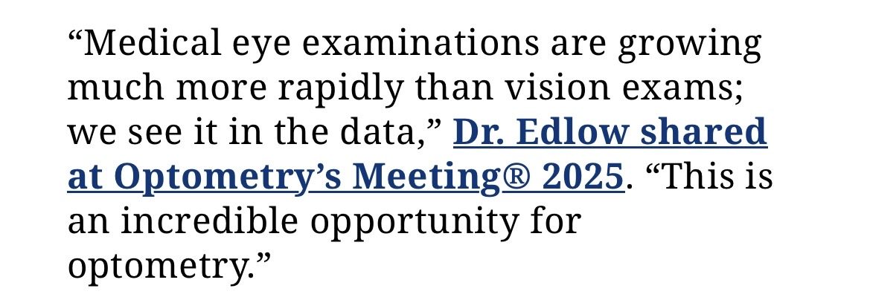
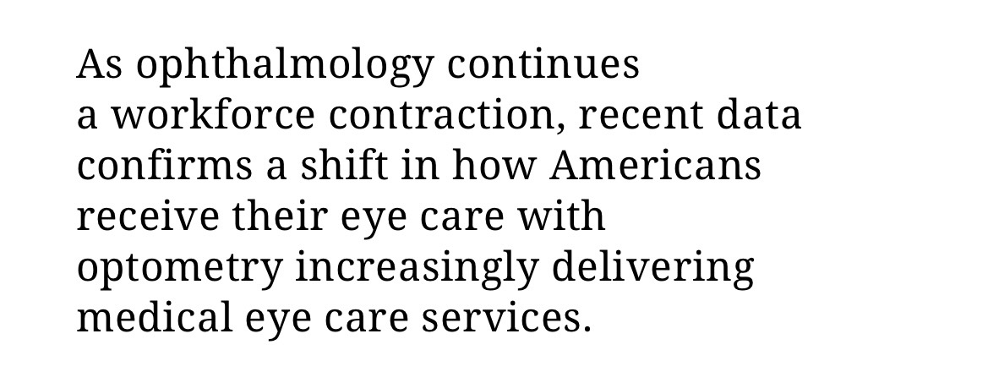
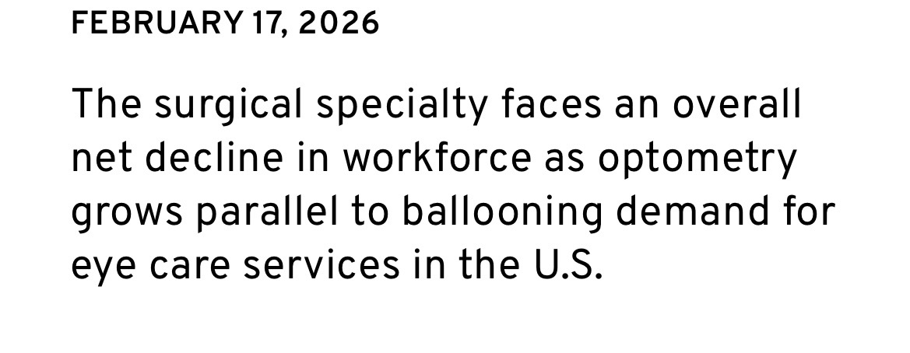
Optometry Increasingly Shoulders Medical Eye Care as Ophthalmology Shrinks

Slide 6
Thoughts and Perspectives on Glaucoma
“The overall glaucoma burden in absolute numbers is rising because of a growing and ageing global population.”
“Diagnosing and managing glaucoma is a marathon, not a sprint. The condition plays out over decades.”
“Elevated intraocular pressure does not define glaucoma as it once did.”
The characterization of glaucoma is more complex than thought looking at risk factors such as poor blood flow, abnormal biomechanics of the optic nerve head, and cerebrospinal fluid pressure.
Am J Ophthalmol, February 2026
Notes:
Foster, Paul J. et al. Glaucoma: Are We Getting the Wrong Answers, or Asking the Wrong Questions? American Journal of Ophthalmology, Volume 282, 489 - 491

Slide 7
Is 22 mm Hg Still a Valid Benchmark?
“These findings suggest that the historical IOP cutoff of 22 mm Hg may still influence clinical decision-making in glaucoma management.”
“Most patients with IOPs of 22 mm Hg or higher never go on to develop glaucoma, and over half of patients with glaucoma, have IOPs consistently below 22 mm Hg. In other words, there is a nonclinical basis to support a true IOP cutoff of 22 mm Hg in glaucoma decision-making,”
M+T: Thinking and critical analysis is part of being a doctor.
JAMA Ophthalmology, February 2026
Notes:
Polski A, Brintz BJ, Hess R, et al. Influence of Intraocular Pressure on Clinical Decision-Making in Glaucoma Management. JAMA Ophthalmol. 2026;144(2):167–173. doi:10.1001/jamaophthalmol.2025.5593

Slide 8
Egregious Over-referral of Glaucoma Suspects
“Only 8% of those under 40 referred for glaucoma evaluation were diagnosed with glaucoma within 2 years.”
Worse, about half of all referred patients did not follow-up with the referral!
(M+T): Take home message: Optometrists-please provide glaucoma care services to your patients.
JAMA Open Network, February 2025
Notes:
Frediani T, Yoo K, Cho A, et al. Outcomes of Glaucoma Referrals in Adults Aged 18 to 40 Years. JAMA Netw Open. 2025;8(2):e2457843. doi:10.1001/jamanetworkopen.2024.57843

Slide 9
Progression from OHT to POAG
Approximately 25-30% of ocular hypertensive patients progress to POAG over 20 years.
Key factors to assess risk of progression in OHTs were:
  Age
  IOP
  CCT
  Vertical C/D Ratio
  Visual field status (PSD)
Now we would also include OCT NFL thickness
Attentive follow-up monitoring is required to enable timely therapeutic intervention.
JAMA Ophthalmol. April 2021
Notes:
Kass MA, Heuer DK, Higginbotham EJ, et al. Assessment of Cumulative Incidence and Severity of Primary Open-Angle Glaucoma Among Participants in the Ocular Hypertension Treatment Study After 20 Years of Follow-up. JAMA Ophthalmol. 2021 Apr 15;e210341. doi: 10.1001/jamaophthalmol.2021.0341.

Slide 10
Glaucoma “Suspect” Conversion Rate to Glaucoma
“We found a conversion rate of 13.6% from glaucoma suspect to POAG cases over a median follow-up of 6.7 years.”
“Clinicians should consider more aggressive IOP-lowering interventions in suspects with elevated IOP.”
“Lower baseline mean arterial pressure and systolic BP were associated with faster rates of glaucomatous VF damage.”
“The association between the absence of hypertension and conversion risk highlights the complex relationship between systemic BP and glaucoma progression.”
M+T: Check BP on your glaucoma suspects.
Am J Ophthalmol, December 2025
Notes:
Zhao, Aaron T. et al. Predictors of Glaucoma Conversion in an African Ancestry Cohort: A Longitudinal Study. American Journal of Ophthalmology, 2025 Volume 280, 120 - 129

Slide 11
Expert Perspective on Rebound Tonometry
“The rebound tonometer demonstrated significantly lower test-retest variability than Goldman tonometry with good inter-operator and inter-device reproducibility, supporting it’s value in monitoring IOP changes over time aiding clinicians in assessing the effectiveness of glaucoma therapy and consistency of IOP control.”
“Rebound tonometry can
characterize IOP changes over
time more robustly than
Goldman tonometry.”
J Glaucoma, August, 2021
Notes:
Realini T, McMillan B, Gross RL, Devience E, Balasubramani GK. Assessing the Reliability of Intraocular Pressure Measurements Using Rebound Tonometry. J Glaucoma. 2021 Aug;30(8):629-633.

Slide 12
Rebound Tonometry More Stable Than Goldmann
IOP measurements are shown to be stable and consistent with in-office tonometry and patient self-tonometry
“Rebound tonometry is significantly more reproducible than Goldmann tonometry.”
“With RT, we can be more confident that changes in measurements between visits represent true IOP changes than we can with GT.”
“IOP measurements obtained with the office-based tonometer and patient-operated HOME2 tonometer are highly interchangeable.”
J Glaucoma, October 2024
Notes:
Realini T, Halenda K, Palko J, McMillan B, Balasubramani GK. Test-Retest Reliability of Intraocular Pressure Measurements With Office-Based Versus Home-Based Rebound Tonometers. Journal of Glaucoma. 2024;33(10):758-762. DOI: 10.1097/IJG.0000000000002441

Slide 13

IOP Can Be Misleading and Unimportant???
“Many individuals, despite having elevated IOP, never progress to glaucoma.”
“While IOP has some ability to discriminate between glaucomatous and healthy eyes, this ability is limited.”
“The importance of evaluating both the visual field and the optic nerve has been noted by others, particularly when evaluating patients with ocular hypertension. Moreover, using both functional and structural metrics is consistent with clinical practice.”
M+T: Even if there is no increased IOP, attentively study the optic nerve, and if suspicious, get a NFL scan and a visual field. It’s all about the optic nerve!
J Ophthalmol, October, 2018

Slide 14
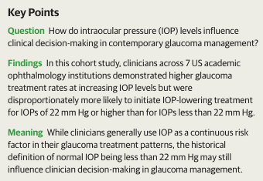
Influence of IOP on Clinical Decision-Making in Glaucoma Management
“Most patients with IOPs of 22 mm Hg or higher never go on develop glaucoma, and over half of patients with glaucoma have IOPs consistently below 22 mm Hg.”
“There is no clinical basis to support a true IOP cutoff of 22 mm Hg in glaucoma decision-making.”
JAMA Ophthalmol, Jan 2026

Slide 15
Rapid Progression in Glaucoma
Approximately 12.5% (1 in 8) of glaucoma patients exhibit fast progression (<-1dB/year MD) under routine care
Fast progressors are clinically significant due to risk of functional disability and need for intensified monitoring/therapy
Intensive testing improves detection of rapid progression
Risk factors include pseudoexfoliation, disc hemorrhages, thinner CCT, older age, and other factors
Ophthalmology. 2023; 130(2);
AAO Journal. 2024, Medeiros
Notes:
Heijl A, Patella VM, Chong LX, et al. A new SITA perimetric threshold testing algorithm: Construction and multicenter clinical study. Am J Ophthalmol. 2019;198:154-165.

Slide 16
Virtual Visual Field Testing
Advantages:
Portability – devices are smaller and can be placed in any exam space or taken to outreach clinics.
Patient experience – more comfortable and less intimidating than dome perimeters
Speed – shorter test times reduce fatigue and improve reliability
Workflow flexibility – can test outside traditional eye clinics, including home monitoring
Limitations & Cautions:
Not yet universally accepted as standard of care - (awaiting larger validation datasets)
Comparative evidence varies – large, multicenter, prospective trials needed for definitive equivalence to SAP
User training & calibration – performance can depend on patient familiarity with technology and quality of eye/head tracking
Reimbursement & coding – standardization for billing continues evolving and varies by practice and payer
Ophthalmic & Physiological Optics, 2024; Ophthalmology Science, 2025; Vision, 2025.
Notes:
Realini T, Halenda K, Palko J, McMillan B, Balasubramani GK. Test-Retest Reliability of Intraocular Pressure Measurements With Office-Based Versus Home-Based Rebound Tonometers. Journal of Glaucoma. 2024;33(10):758-762. DOI: 10.1097/IJG.0000000000002441

Slide 17
Gonioscopy: How Pitiful We All Are
Gonioscopy is the clinical standard for detecting patients at risk for angle closure, and plays a key role in the glaucoma evaluation.
Both AAO and the WGA recommend all patients receive gonioscopy at the initial evaluation for glaucoma and every 5 years thereafter
About 30% of such visits include gonioscopy!
“The Van Herick technique is a poor substitute for gonioscopy.”
AS-OCT can be a reasonable substitution
Website: www.gonioscopy.org
Am J Ophthalmol. August, 2024
Notes:
Lee JH, Yoo K, Lung K, et al. Patterns and Disparities in Recorded Gonioscopy During Initial Glaucoma Evaluations in the United States. Am J Ophthalmol 2024;264:90-98.

Slide 18
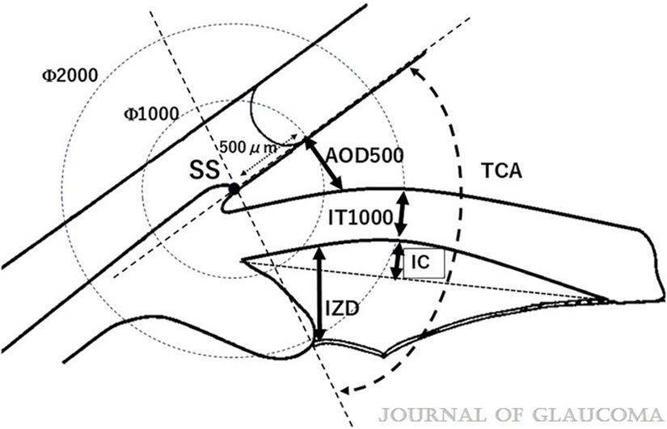
Gonioscopy vs UBM in Occludable Angles
Study: Disagreement between gonioscopy and UBM in occludable angles
93 eyes (Van Herick ≤ grade 2), no PAS, evaluated in dark
Gonioscopy, UBM, and AS-OCT used for angle assessment
UBM identified more occludable angles than gonioscopy
Only moderate agreement between modalities
UBM overdiagnosis linked to longer axial length, deeper chambers
UBM underdiagnosis associated with smaller angle-opening distance
Posterior chamber anatomy significantly affects classification
Key point: modalities are not interchangeable
Clinical takeaway: multimodal imaging improves risk assessment
Mataki et al. J Glaucoma. 2026;35(4):218–225

Slide 19
Is Laser Photoiridotomy (LPI) the ”Fix” for Narrow Angles?
No! but prevents angle closure in most patients
“Primary angle closure suspect eyes with persistent angle narrowing by anterior-segment OCT or cumulative gonioscopy score 2 weeks after LPI were at higher risk of primary angle closure and acute angle closure.”
Quantify (and document) angle anatomy pre-LPI, then again 2 week after LPI. You should see opening and deepening of the angle. If not, follow the patient more closely!
There is recent trending moving away from LPI toward earlier lens extraction.
JAMA Ophthalmol, June 2023
Notes:
Augusto Azuara-Blanco. Use of Biometric Data After Laser Peripheral Iridotomy—Individualized Monitoring Strategy for Angle Closure Progression. JAMA Ophthalmol. 2023;141(6):524. doi:10.1001/jamaophthalmol.2023.1119

Slide 20
How Often Do Narrow Angles Close?
Occlusion is much more common in elderly women
Higher IOP and shallow central and limbal anterior chamber depth are risk factors for progression to occlusion.
AS-OCT very helpful at detection and in follow-up (but was no better at detection than Van Herrick!)
25% of “occludable” angles actually occluded over 14 years
Risk factors: old age, female, hyperopia, Asian race, + family history
Avoid use of sympathomimetic medications
Use smartphone flashlight if an attack occurs as first aid.
JAMA Ophthalmol. March 2024
Notes:
Yuan Y, Xiong R, Wang W, et al. Long-Term Risk and Prediction of Progression in Primary Angle Closure Suspect. JAMA Ophthalmol. 2024;142(3):216–223. doi:10.1001/jamaophthalmol.2023.5286

Slide 21
Role of Cataract Extraction on IOP
“The role of cataract extraction in the alogorithm of glaucoma treatment is undeniable.”
“The latest studies to include washout in the context of MIGS show surprisingly large effects of phacoemulsification alone and relatively small incremental benefit of MIGS.”
(M+T: Don’t be “oversold” on hyped MIGS!)
Results of cataract extraction
  For angle closure, reduction averaged 6.4 mm Hg
  For open angle glaucoma, about 2.7 mm Hg reduction
Survey Ophthalmol. September - October, 2018
Notes:
Masis M, Mineault PJ, Phan E, Lin SC. The role of phacoemulsification in glaucoma therapy: A systematic review and meta-analysis. Survey Ophthalmol 2018;63(6):700-710.

Slide 22
High Pillow Sleeping & IOP in Glaucoma
Head elevation (20–35°) associated with increased intraocular pressure (IOP)
High pillow position may alter episcleral venous pressure dynamics
Compression of jugular veins can impair venous outflow from the eye
Result: increased IOP and greater nocturnal IOP fluctuations
Flat position may allow more stable venous drainage
Reduced ocular perfusion possible with venous congestion
Nocturnal IOP spikes may contribute to glaucoma progression
Position-dependent IOP variation is clinically relevant
Counsel glaucoma patients on sleep positioning habits
Br J Ophthalmol. 2026 (Epub Jan 27)

Slide 23
Micromanagement in Glaucoma
DO NOT micromange these tests:
Visual fields
Nerve fiber analyses
Corneal thickness
Family History
IOP
ABSOLUTELY DO micromanage:
Optic Nerve

Slide 24
When to Treat?
“Patients with normal optic disc and visual field could tolerate an IOP of 30 mmHg for many years without need of treatment.”
“What it comes down to is . . . treat young patients who are in the high-risk group, and it is worth watching the elderly in a low-risk group. The problem remains what to do for those in the middle.”
“AAO PPP states the goal is to “maintain the IOP in a range at which visual field loss is unlikely to significantly reduce a patient’s health-related quality of life.” Intervention is recommended because untreated IOP is significantly above target.
Melton-Thomas: All glaucoma doctors struggle with the decision of whom to treat, and when. Remember: medical care is an art, and equally well-trained doctors commonly differ in clinical decision-making.
Reference: A Sommer / Johns Hopkins U., Ophthalmology Times, January 2011
American Academy of Ophthalmology – Preferred Practice Patterns 2026

Slide 25
Glaucoma Treatment Options
Prostaglandin Analogs (including nitric oxide moiety)
Timolol
Brimonidine
Carbonic Anhydrase Inhibitors (CAI’s)
Rho-Kinase Inhibitors
Timolol/brimonidine
Dorzolamide/timolol
Brinzolamide/brimonidine
Latanoprost/Rhopressa
Pilocarpine derivatives
Sustained-released implants
Laser Trabeculoplasty
Surgical Options (trabeculectomy, tube shunts, cyclo-destruction, filtering MIGS, angle surgery)

Slide 26
Key Advancements in Glaucoma Treatment
New Meds:
  Shift from traditional eye drops to sustained-release drug delivery systems. These include tiny implants that release medication over several months, reducing the need for daily eye drops and improving adherence to treatment.
  Injectable therapies are also being explored, with clinical trials showing promising results in reducing intraocular pressure (IOP) for extended periods, up to six months.
Minimally Invasive Glaucoma Surgery (MIGS):
  MIGS has emerged as a revolutionary approach, offering less invasive options with quicker recovery times compared to traditional surgeries. Devices like the iStent and Hydrus Microstent are enhancing fluid drainage within the eye, effectively lowering IOP without extensive surgical intervention.
  Procedures such as canaloplasty are also gaining traction, which dilates the eye's natural drainage system to maintain long-term pressure reduction.
Glaucoma Today – 2025-2026
Notes:
Lillian K. To, Nicole V. Carrabba, Chaitanya G. Kalathuru, Alice Z. Chuang, Logan Smith, Robert M. Feldman. Risk Factors for Diagnostic Change from Glaucoma Suspect to Primary Open-Angle Glaucoma and Vice Versa Over 2 Years
Ophthalmology Glaucoma Vol. 8Issue 3p257–265. Published online: December 20, 2024

Slide 27
Key Advancements in Glaucoma Treatment
Laser Innovations:
  Advances in selective laser trabeculoplasty (SLT) are making it a first-line treatment option in many clinics. New variations, such as micropulse laser trabeculoplasty, are being developed to minimize tissue damage while effectively managing IOP.
Technological Integration:
  The use of AI-powered diagnostic tools and wearable monitoring devices is enhancing the precision of glaucoma detection and treatment. These technologies allow for continuous monitoring of eye pressure, enabling proactive management of the condition.
Neuroprotective Treatments:
  Research is ongoing into medications that not only lower IOP but also protect the optic nerve from degeneration, which is crucial for preserving vision in glaucoma patients.
Conclusion: The landscape of glaucoma management in 2026 is marked by innovative treatments and technologies that promise to improve patient care significantly. With ongoing research and development, the outlook for individuals affected by glaucoma is becoming increasingly optimistic, offering more effective options for preserving vision and enhancing quality of life.
Glaucoma Today – 2025-2026
Notes:
Lillian K. To, Nicole V. Carrabba, Chaitanya G. Kalathuru, Alice Z. Chuang, Logan Smith, Robert M. Feldman. Risk Factors for Diagnostic Change from Glaucoma Suspect to Primary Open-Angle Glaucoma and Vice Versa Over 2 Years
Ophthalmology Glaucoma Vol. 8Issue 3p257–265. Published online: December 20, 2024

Slide 28
Interventional Glaucoma Therapy (IGT)
“IGT with laser and/or incisional procedures in combination with implants will play an increasing role in treating our patients with glaucoma.”
Ophthalmologists point to patient non-adherence to eye drops as a reason to progressively move to laser, etc., procedures. It is our opinion that if optometrists were the glaucoma doctors, we would take much better care of such patients by spending more time with them!
“Still, we have excellent eye drops available, which in generic form cost less than $15.00 per month with strong IOP lowering efficacy and safety.”
Ocular Surgery News, July 10, 2025
Notes:
Lindstrom RL. Interventional glaucoma therapy will continue to gain traction. Ocular Surgery News. July 10, 2025

Slide 29
IGT – (contined)
Because of alleged laser outcomes,…“That really gave ophthalmologists confidence that laser first is indeed the best initial treatment.”
“As lasers becomes more common as a first-line treatment, it is changing patient expectations.”
“The biggest risk of prescribing drops is that patients don’t use them.”
“If you wanted to help patients adhere better, it would be good to spend a little more time explaining to patients how to use their drops and what their disease is.” (Think optometry!!)
Ocular Surgery News, July 10, 2025
Notes:
Young A. Interventional glaucoma mindset goes beyond traditional management strategies. Ocular Surgery News July 10, 2025.

Slide 30
SLT and Medical Therapy in Reducing IOP
SLT and medical therapy are roughly equal in all regards
Both decreased IOP about 27%
“The authors found no evidence of a difference in overall quality of life scores between the 2 groups.”
“SLT does not provide an IOP advantage over topical medications as an initial treatment, although it may have a modest quality of life advantage.”
Ophthalmology, January 2024
Notes:
Takusagawa, Hana L. et al. Selective Laser Trabeculoplasty for the Treatment of Glaucoma
Ophthalmology, 2024;131(1):37 – 47.

Slide 31
Factors Affecting Laser Trabeculoplasty
80% respond to LTP; 20% do not
Of responders, 80% remain controlled after 2 years
“Medication cost is also a major barrier in therapy adherence.” (M+T: Think timolol!)
“Higher pretreatment IOP correlates with higher treatment success.”
“This analysis of 380,951 eyes revealed a modest overall LTP response rate.”
Am J Ophthalmol, March, 2021
Notes:
Chang TC, Parrish RK, Fujino D, Kelly SP, Vanner EA. Factors Associated With Favorable Laser Trabeculoplasty Response: IRIS Registry Analysis. Am J Ophthalmol. 2021;223:149-158.

Slide 32
SLT Success Assessment
“There is often a continued need for adjunctive eye drop medication as the effect of SLT wears off.”
“The data show that a substantial proportion of persons who have either 1 or 2 SLT treatments will still need to take drops within 2 years.”
“1/3 of patients failed to achieve short-term target IOP either immediately following or within 2 years of initial SLT.”
“Participants who were older, female, had lower baseline IOP, or had moderate or severe visual field loss experienced worse outcomes.”
JAMA Ophthalmol. October 2024.
Notes:
Kanter JA, Quigley HA. Repeat Selective Laser Trabeculoplasty and Open-Angle Glaucoma. JAMA Ophthalmol. 2024;142(10):924–925. doi:10.1001/jamaophthalmol.2024.3279

Slide 33
Direct SLT: The Voyager
“A non-touch, faster and easier technique, with fewer side effects and more comfort for the patient.”
“Drop therapy should no longer be considered first line.”
“DSLT as first-line therapy is a revenue generator for the practice.”
“Voyager DLT democratizes glaucoma care in allowing non-glaucoma specialists to take care of the broad base of glaucoma patients who we diagnose at the early stages in our practices.”
Procedure takes 2.3 seconds to apply over 360◦
Alcon has purchased this technology from Belkin Eagle (developed in Israel)
Ocular Surgery News, March 5, 2025
Notes:
Desai NR. DSLT democratizes access to first-line laser for glaucoma, ocular hypertension. Ocular Surgery News March 25,2025.

Slide 34
A Perspective on Why SLT Matters
“SLT and topical drops are both recommended for the treatment of glaucoma and reduction of IOP. The 6-year LIGHT trial results, however, provide compelling evidence that SLT rather than IOP-lowering eye drops should be the initial treatment for eligible patients newly diagnosed with ocular hypertension or open-angle glaucoma.”
M+T: The profession of optometry needs to gain competency in this straight-forward procedure or be left behind. It’s our duty to be proactive in our ability to fully meet our patient’s needs.
Glaucoma Today. Sept/Oct, 2023
Notes:
Do JL, Alam N. Lessons in Nonsurgical Glaucoma Management. Should SLT be performed as the initial treatment for glaucoma and ocular hypertension? Glaucoma Today September/October 2023.

Slide 35
Just How Good is Laser Trabeculoplasty?
IOP reduction is about 4 mm Hg
Repeat LT helps further reduce IOP about 1.0 to 1.5 mm Hg
Risk factors for non-responsiveness are older age, Female sex, and lower baseline IOP
“The data show that a substantial proportion of persons who have either 1 or 2 SLT treatments will still need to take drops within 2 years.”
“36% failed to achieve short-term target IOP either immediately following or within 2 years of initial SLT.”
JAMA Ophthalmol, October 2024
Notes:
Kanter JA, Quigley HA. Repeat Selective Laser Trabeculoplasty and Open-Angle Glaucoma. JAMA Ophthalmol. 2024;142(10):924–925. doi:10.1001/jamaophthalmol.2024.3279

Slide 36
MINIMALLY INVASIVE GLAUCOMA SURGERY
While cataract surgery alone will often achieve a degree of IOP reduction for glaucoma patients, combining planned cataract surgery with a MIGS device achieves greater reductions in IOP.
Additionally, there is a greater likelihood of the patient achieving post-operative drop-independence compared to cataract surgery alone.
Fan Gaskin et al. reported that 57% of eyes with mild to moderate glaucoma undergoing cataract surgery with MIGS achieved drop independence versus 36% for patients undergoing cataract surgery alone.
Readers will be familiar with the current array of MIGS devices, the most common of which are Glaukos’ iStent trabecular microbypass system in its various generations, and Alcon’s Hydrus microstent. Initially developed to be used in combination with cataract surgery, these MIGS devices lower IOP by enhancing conventional aqueous outflow.
MIVISION–The Ophthalmic Journal (9/2025) P Moore, MD

Slide 37
Special Report on MIGS
New metric: Minimal Clinically Important Difference (MICD) (Much more relevant than “statistical significance”)
Generally, a 20% reduction in IOP
For MIGS, 50% at 2 years
  For cataract surgery alone, 50-60% at 2 years
  For cataract surgery plus MIGS, 65% at 2 years
“Long-term studies assessing the safety and efficacy of MIGS are needed to better define it’s role in the surgical treatment of glaucoma.”
Ophthalmology, February, 2025
Notes:
Gedde, Steven J. et al. Special Commentary: Reporting Clinical Endpoints in Studies of Minimally Invasive Glaucoma Surgery. Ophthalmology, Volume 132, Issue 2, 141 - 153

Slide 38
Latanoprost Cup Runneth Over
First was Xalatan® 1996
Then a bunch of generics after patent expiration
Then Xelpros® preserved with potassium sorbate
Then Iyuzeh™ by Thea has it’s PF product
Imprimis has its PF product line as well
A sort of hybrid, Vyzulta® (latanoprostene bunod) contains latanoprost with a fixed nitric oxide moiety.

Slide 39
The Efficacy and Safety of Once-Daily Versus Once-Weekly Latanoprost Treatment for Increased Intraocular Pressure
“Latanoprost treatment for ocular hypertension or early glaucoma once-weekly was as effective as once-daily after 3 months of follow-up, and there were fewer, and only minor, side effects with this protocol.”
Reference: S. Kurtz, MD and G. Shemesh, MD. Journal of Ocular Pharmacology and Therapeutics, November 2004

Slide 40
(Bimatoprost Implant) 10 mcg
First FDA-approved biodegradable, intracameral implant
Indicated to reduce IOP in patients with open angle glaucoma or ocular hypertension via a sustained-release drug delivery system
Reduces IOP approximately 5-8 mmHg and engineered to release bimatoprost 3-4 months
Currently FDA approval limited to one implant per eye (no re-retreatment)
Most common adverse reaction was conjunctival hyperemia (27%); nonocular was headache (5%)
Durysta is manufactured by Allergan

Slide 41
Travoprost Intracameral Device
For about 2 decades, Travatan-Z® has been available
Intracameral device approved December 2023
iDose® TR (travoprost intracameral implant) uses a metallic (titanium) delivery device
The implant is MRI-Conditional, not fully “MRI-safe” universally
Engineered to control iop for 3 months
IOP change from baseline 6.6-8.4 mmHg, and for timolol 6.5-7.7 mmHg
iDose TR is marketed by Glaukos
FDA recently approved repeat dosing
Ophthalmology, September 2024

Slide 42
Topical Beta-Blockers
Decrease aqueous production
Reduces IOP .25%; no response 15%
R/O asthma
Recommend monocular trial with lowest concentration once daily
Possible diminished effect if used with systemic beta-blockers
No advantage to gel-forming solution
Available preservative-free in unit doses as .25% and .5% in .2mL individual units of solution from B+L (Timoptic in Ocudose)

Slide 43
Do Systemic Beta-Blockers Preclude use of Topical Beta-Blockers?
Tradition teaching says they do
Newer research says not
“Patients taking a systemic beta blocker still achieve more than a 75% lowering (about 5 mmHg), on average, when using a topical beta blocker. Therefore, withholding a topical beta blocker from these patients seems unwarranted.”
“The present data suggests that the use of a systemic beta blocker does not meaningfully affect the IOP-lowering effectiveness of glaucoma eyedrop regimens as prescribed and used in a real-world scenario.”
In summary, being on a systemic beta blocker may ever so slightly dampen the effectiveness of a topical beta blocker, but in no way precludes the beneficial use of topical beta blocker treatment.
Ophthalmology, February 2021
Notes:
Johnson TV, Jampel HD. Systemic β-Blockers do not Affect Glaucoma Eye Drop Effectiveness. Ophthalmology 2021;128(2):326-328.

Slide 44
β-Blockers Are Helpful In Patients with COPD!
“Conclusion: Treatment with β-blockers may reduce the risk of exacerbations and improve survival in patients with COPD, possibly as a result of dual cardiopulmonary protective properties.”¹
“Patients with COPD often do not receive β-blockers because of concerns that they might exacerbate respiratory symptoms.”
“Beta-blocker users who subsequently received diagnosis of COPD didn’t have worse outcomes; indeed, outcomes were better in the beta-blocker cohort.”²
References:
Rutten F, et al. Arch Int Med. 2010;170(10)
E-Clin Med, January, 2019 (as reported in Journal Watch , April 1, 2019.

Slide 45
Timolol Eyedrops to Treat Migrane Headache
Oral timolol or propranolol are effective in helping prevent migraine HAs, but are ineffective for treating acute HA.
Oral beta blockers have to be metabolized in the liver which is why they are not effective for acute treatment.
However, “the use of eyedrops has the advantage of attaining peak plasma levels quickly at levels high enough to abort the acute migraine attacks effectively.”
Instill 1-2 drops at the onset of the attack; 80% were significantly helped in 20 min.
JAMA Ophthalmol. Nov 2020
Notes:
Kurian A, Rerghunadhan I, Thilak P. Short-term efficacy and safety of topical ß–blockers (Timolol Maleate Ophthalmic Solution, 0.5%) in acute migraine; A randomized crossover trial. JAMA Ophthalmol. 2020;138(11):1160-1166.

Slide 46
Topical Ophthalmic Timolol in Dermatology
Timolol is used to treat congenital capillary hemangiomas, and to stop early onset migraine HA.
Now it has been found to cure a rare, post traumatic vasculodermatopathy.
Reactive angioendotheliomatosis is a benign vasculoproliferation disease often occurring at the site of traumatic scars.
Treatment was 0.5% timolol eye drops (two drops three times a day for six weeks)
It appears that beta adrenergic receptor blockade has a role in some forms of vascular lesions.
JAMA Dermatology, July 2021
Notes:
Bhatia R, Hazarika N, Chandrasekaran D, et al. Treatment of Posttraumatic Reactive Angioendotheliomatosis With Topical Timolol Maleate. JAMA Dermatol. Published online June 9, 2021. doi:10.1001/jamadermatol.2021.1770

Slide 47
Adrenergic
Receptor Agonists
Brimonidine
Apraclonidine

Slide 48
Brimonidine Tartrate
Alpha-2 adrenergic agonist; tid FDA approval
Acts by reducing aqueous production with some enhancement of uveoscleral outflow
Reduces IOP similar to timolol 0.5% bid
Side effects: fatigue and dry mouth most common side effects; uveitis reported; may reduce systolic BP 10 mmHg
Less tachyphylaxis or allergy development than the other alpha-2 agonists
Neuro-protective potential unknown (as of late 2025, there is still no FDA approved “neuroprotective glaucoma drop”)
Alphagan (0.2%) by Allergan, and generic Alphagan P (0.15%) by Allergan and generic Alphagan P (0.1%) by Allergan and recently generic

Slide 49
Topical CAI’s
Dorzolamide 2% sol. and Brinzolamide 1% susp.
Mechanism: decreases aqueous humor secretion
Reduces IOP approximately 15%
FDA dosage: tid, practical dosage bid
Contraindications: Allergy to sulfa and/or history of blood dyscrasias
Side effects: minimal; some burning, bitter taste, rare allergic reaction
Most all patients controlled with oral acetazolamide were successfully controlled with a topical CAI
Brinzolamide 1.0% (Azopt susp-Alcon); Dorzolamide 2.0% (Trusopt sol-Merck)

Slide 50
Efficacy of Glaucoma Drugs at Night
“Alpha agonists and beta-blockers have reduced, or even lack, IOP lowering during the nocturnal period.”
All prostaglandins reduce nocturnal IOP, but with a “reduced magnitude” as compared to diurnal efficacy.
CAI’s might reduce IOP about 15% around the clock, but BID dorzolamide “failed to reduce IOP versus baseline at any of the nighttime measurements.”
Survey Ophthalmol. 2020
Notes:
Mansouri K, Tanna AP, De Moraes CG, Camp AS, Weinreb RN. Review of the measurement and management of 24-hour intraocular pressure in patients with glaucoma. Survey Ophthalmol. 2020;65(2):171-186. https://doi.org/10.1016/j.survophthal.2019.09.004

Slide 51
Netarsudil 0.02%
FDA approved in December 2017
First rho-kinase inhibitor
MOA purported to be enhancement of conventional trabecular outflow
Use once daily in the evening
Reduces IOP about 4-5 mm Hg
Preserved with 0.015% BAK
Comes in a 2.5 ml bottle
Potential Side Effects:
  In phase III, 53% experienced red eyes;
  Can cause subconjunctival hemorrhages
  Can cause an amiodarone-like vortex keratopathy
Marketed as Rhopressa by Alcon

Slide 52
Netarsudil 0.02% + Latanoprost 0.005%
A combination of netarsudil 0.02% (Rhopressa) and latanoprost 0.005%
First combination drug of a prostaglandin and a rho-kinase inhibitor
Both ingredient drugs are “once daily” administration
As with new drugs, coupons may be essential to achieve cost-effectiveness
Conjunctival hyperemia (59%) may be a limiting factor
Marketed by Alcon

Slide 53
Brimonidine 0.2% + Timolol 0.5%
Combination of 0.2% brimonidine and 0.5% timolol
Reduces IOP 4.4 – 7.6 mmHg (27-35%)
With ANY combination drug, always try one of the component drugs as monotherapy, and only use the combination product if or when the monotherapy drug comes close, but does not achieve target IOP
Remember, most all drugs have a non-response rate of about 10%, so there is a 20% chance that one of the components of any combination drug is not performing
Marketed as Combigan by Allergan and generic, preserved with BAK .005%

Slide 54
Dorzolamide 2.0% –Timolol 0.5%
Both components decrease IOP by reducing aqueous humor secretion
Reduces IOP by 5-9 mmHg (25-30%)
Because of the CAI, must be used bid, which results in excessive beta-blocker therapy
Contraindications: patients with asthma, heart disease, or allergy to sulfa drugs
Ocular side effects: burning/stinging
and perversion in taste
Marketed as Cosopt by Merck bottle, PF and generic

Slide 55
Brinzolamide 1.0%-Brimonidine 0.2%
Combination drug without a beta blocker where both ingredient drugs are dosed the same (b.i.d.)
Combines 1% brinzolamide (Azopt ophthalmic suspension) with 0.2% brimonidine
Offers a wide range of treatment possibilities due to its strong efficacy and ability to decrease elevated IOP by 5-9 mmHg (21- 35%)
Marketed as Simbrinza by Alcon

Slide 56
Contemporary Glaucoma Medication Flow
1st Tier: Latanoprostene bunod , prostaglandin, or timolol
2nd Tier: Topical CAI, brimonidine, or netarsudil
3rd Tier: Fixed Combinations
Brimonidine 0.2% + Timolol 0.5%
Dorzolamide 2.0% + Timolol 0.5%, Brinzolamide 1.0% + Brmonidine 0.2%, Latanoprost 0.005% + Netarsudil 0.02%
4th Tier: Pilocarpine
Oral CAI (preferably methazolamide)

Slide 57
Contemporary Glaucoma Medication Flow
1st Tier: Prostaglandin or timolol
2nd Tier: Latanoprostene bunod, topical CAI, brimonidine, or netarsudil
3rd Tier: Fixed Combinations
Brimonidine 0.2% + Timolol 0.5%
Dorzolamide 2.0% + Timolol 0.5%
Brinzolamide 1.0% + Brimonidine 0.2%
Latanoprost 0.005% + Netarsudil 0.02%
4th Tier: Pilocarpine
Oral CAI (preferably methazolamide)

Slide 58
After a Prostaglandin; What to Add
Meta-analysis of studies regarding what drug to add to a prostaglandin
Is it brimonidine, a beta-blocker, or a CAI?
Conclusions: “All 3 classes are similarly effective in lowering mean diurnal IOP when used in combination with PGAs. Brimonidine is statistically less effective in reducing IOP at trough compared with the beta-blockers and CAI’s.”
Additional lowering of IOP was, on average, 2.5 to 3 mmHg for all three
  Arch. Oph. July 2010
Modern alternative add-ons include netarsudil (1-3 mmHg additional) 2025-2026 Data
If a patient does not respond well to prostaglandin medication A, it is of little value to switch to another prostaglandin medication B or to add another prostaglandin medication.
Arch. Oph. July 2010

Slide 59
After Prostaglandin First-Line Therapy
1st - First-Line
  Prostaglandin analog (QHS) or SLT ( reduce IOP 25-30 %)
2nd - Most Common Add-On
  Beta-blocker (Timolol qAM) or SLT
    Best daytime control
    Avoid in asthma/bradycardia
3rd - If More Reduction Needed or BB Contraindicated
  Bromonidine or Carbonic Anhydrase Inhibitor (CAI)
  Rho-kinase Inhibitor
4th - Fixed Combinations (preferred over multiple)
5th - Escalation Beyond Drops
  SLT (often earlier than a 3rd-4th drop)
  MIGS/incisional surgery if progression continues
Notes:
Popovic MM, Schlenker MB, Thiruchelvam D. Serious Adverse Events of Oral and Topical Carbonic Anhydrase Inhibitors. JAMA Ophthalmology 2022;140(3):235-242.

Slide 60
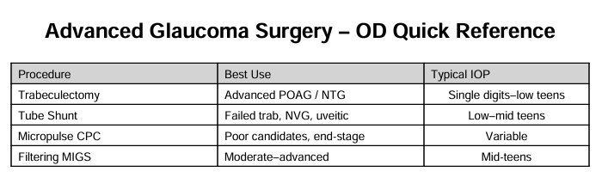
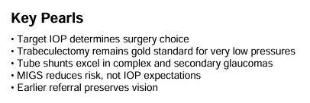

Slide 61
Preventing / Delaying Glaucoma Through Exercise
Recommended: 150 minutes of moderate intensity aerobic exercise and 2 days of resistance exercise each week
Such exercise may reduce glaucoma risk by about 40-50%
“The magnitude of a 40-50% reduced risk of developing glaucoma by being active and fit is surprising, and may be one of the strongest factors in glaucoma prevention besides aging.”
Medical Science & Sports Exercise, August, 2018
“Our study found that physical activity was associated with less visual field progression in patients with glaucoma.”’
“Increased steps per day, minutes of non-sedentary activity, and minutes of moderate-to-vigorous physical activity were associated with slower rates of decline.”
^{Ophthalmology, July, 2019}

Slide 62
Angle Closure Management Options
500 mg of acetazolamide in tablet form
Brimonidine q 15 min x 2 doses
A beta-blocker, q 15 min x 2 doses
Pilocarpine 2% once above steps completed
Potent steroid q 1h if there is much associated inflammation
YAG photoiridotomy once control is achieved

Slide 63
Don’t Forget Oral CAI’s When Needed
Topical CAI’s reduce IOP about 20%, whereas systemic CAI’s reduce IOP about 30%
The risk of a “severe complicated adverse reaction” is about 3 per 1,000 patients for systemic, and about 2 per 1,000 patients for topical CAI. Such events are not necessarily seen right after initiation, but can occur over time.
Dosages of acetazolamide are safe and tolerable up to 4 gm per day. Only dysgeusia and paresthesia side effects are dose dependent.
Sulfa allergy does not contraindicate CAI use.
We should not be reluctant to prescribe an oral CAI given the low risk of severe adverse events.
JAMA Ophthalmol, March, 2022
Notes:
Popovic MM, Schlenker MB, Thiruchelvam D. Serious Adverse Events of Oral and Topical Carbonic Anhydrase Inhibitors. JAMA Ophthalmology 2022;140(3):235-242.

Slide 64
Key Developments in the
Glaucoma Pipeline
Innovative Surgical Techniques:
  A novel class of glaucoma surgery is being explored that targets the supraciliary space, which may help modulate aqueous flow and minimize complications. This includes the development of a new drainage device designed to enhance glaucoma treatment.
  The Eagle system, which performs direct selective laser trabeculoplasty (DSLT), received FDA clearance in December 2023. This automated system allows for efficient laser delivery without the need for contact with the eye, potentially improving patient comfort and compliance.
Emerging Therapies:
  DelveInsight's report highlights over 20 pipeline drugs for open-angle glaucoma, including promising candidates like NCX 470, a nitric oxide-donating prostaglandin analog currently in Phase 3 trials, and DE-126, a once-daily eye drop from Santen Pharmaceuticals.
  Other notable therapies include XEN45, a glaucoma gel stent, and BTQ-1902, an EyeSol-based formulation of timolol, both of which are in various stages of clinical trials.
Glaucoma Today 2025 - 2026

Slide 65
Key Developments in the
Glaucoma Pipeline (continued)
Technological Innovations:
  The integration of minimally invasive glaucoma surgery (MIGS) is becoming more prevalent, with techniques that allow for better intraocular pressure control and reduced reliance on daily medications. This includes devices that can be implanted during cataract surgery to enhance treatment outcomes.
  Remote monitoring technologies are also being explored to improve patient management and adherence to treatment protocols, which is crucial for effective glaucoma care.
Conclusion: The glaucoma pipeline is evolving rapidly, with numerous innovative treatments and technologies on the horizon. These advancements aim to enhance the efficacy of glaucoma management, reduce patient burden, and improve overall outcomes. Keeping abreast of these developments is essential for healthcare providers and patients alike as they navigate the complexities of glaucoma treatment.
Glaucoma Today 2025 - 2026

