Slide 1
The Ophthalmic Pipeline:
Riding the New Wave of Ophthalmic Therapeutics
Ron Melton, OD, FAAO
HAWAIIAN OPHTHALMIC SUMMIT 2026
TARR TREK ELEVATED EYE EDUCATION
Oahu, Hawaii
October 17-20, 2026

Slide 2
Financial Disclosure
Drs Ron Melton is a consultant to, on the speakers bureau of, on the advisory committee of, or involved in research for the following companies: ICARE and B+L.
“All relevant relationships have been mitigated.”

Slide 3
Learning Objectives
Review recently approved ophthalmic therapies.
Interpret key clinical trial outcomes.
Identify clinical indications for new treatments.
Recognize safety considerations and contraindications.
Counsel patients realistically
Encourage continued literature review.

Slide 4
Why the Ophthalmic Pipeline Matters
Rapid growth of ophthalmic therapeutics is reshaping eye care.
Late‑phase drugs are targeting both anterior and posterior segment disease.
New delivery systems aim to reduce treatment burden.
Optometrists play a key role in identifying candidates for new therapies.
Pipeline awareness improves patient counseling.
Understanding pivotal trials helps guide co‑management.
Many therapies aim to modify disease rather than just treat symptoms.

Slide 5
Substandard Generic Drugs:
Patient Safety & National Security Risks
Generic drugs = >90% of U.S. prescriptions; assumed therapeutically equivalent
Hatch–Waxman Act enabled rapid approval → $2.2T savings (2009–2019)
Manufacturing shifted offshore → reduced FDA oversight
61% of foreign plants not inspected within 5 years (GAO)
Document falsification & contamination reported in overseas plants
>60% of drug shortages linked to quality failures
Nitrosamine contamination → recalls (metformin, ARBs, ranitidine)
Higher adverse event signals with some foreign-manufactured generics
2008 contaminated heparin → 238 U.S. deaths
FDA may prioritize shortage mitigation over strict quality enforcement
FDA does NOT routinely test finished generic drug products
Solutions: independent testing, quality scoring, transparency, U.S. manufacturing (NEJM-4/29/26)

Slide 6
Phentolamine 0.75% for Dilation Reversal
Last was Rev-Eyes™ (0.5% dapiprazole) 1990’s
Phentolamine ophthalmic solution 0.75% by Ocuphire/Viatris
Blocks alpha-1 receptors on iris radial muscles
Approved down to age 3: One to two drops post-exam for adults; only one drop <12 years
Comes in preservative-free individual unit dose: 5 per foil pack - 6 foil packs per carton (0.31 mL per unit)
Store under refrigeration, but once foil is opened, can stay at room temperature for 2 weeks
Consult drugs.com/Ryzumvi or ryzumvi.com

Slide 7
FDA‑Approved Presbyopia Eye Drops: Comparison (Label‑Based)
Drug | Active Ingredient(s) | FDA‑Approved Indication | Dosing (Label) | Best Candidate / Common Complaints | Class
Yuvezzi® | Carbachol 2.75% + Brimonidine tartrate 0.01% | Presbyopia in adults | Once daily | Patients desiring longer duration; avoid if miotic intolerance | Combination
Vuity® | Pilocarpine HCl 1.25% | Presbyopia in adults | Once daily | Younger presbyopes; night vision complaints possible | Single‑agent
Qlosi® | Pilocarpine HCl 0.4% | Presbyopia in adults | Twice daily | Lower‑dose option; shorter duration | Single‑agent
Vizz™ | Pilocarpine‑based (low‑dose) | Presbyopia in adults | Once daily | Patients seeking improved tolerability | Single‑agent

Slide 8
Non-Pilo for Presby - (Aceclidine 1.44%)
Approved July 2025
A new, non-pilocarpine, presbyopia enhancer
As a selective cholinergic agonist, affects primarily the iris sphincter with minimal ciliary body effect
Near vision improvement in as little as 30 minutes, with effects lasting up to 10 hours
Pinhole effect with trace myopic shift
Instill 2 drops, once daily with up to 10 hour effect
Marketed as VIZZ by LENZ Therapeutics Inc., in unit-dose vials

Slide 9
First Dual-Agent Presbyopia Eye Drop (Carbachol 2.75% + Brimonidine 0.1%)
Yuvezzi® is the first FDA-approved fixed-combination eye drop for presbyopia in adults (TenPoint)
Combines carbachol 2.75% (cholinergic miotic) with brimonidine tartrate 0.1% (alpha-2 adrenergic agonist).
Mechanism creates a pinhole effect, increasing depth of focus and improving near vision.
Brimonidine sustains miosis and may improve tolerability versus miotic monotherapy.
Once-daily dosing provides near-vision improvement lasting up to 8–10 hours.

Slide 10
(Carbachol 2.75% + Brimonidine 0.1%) Phase 3 Trials: Key Results Supporting FDA Approval
Approval supported by two pivotal Phase 3 trials (BRIO-I and BRIO-II) with over 800 participants.
BRIO-I showed superior near-vision improvement versus individual components.
BRIO-II demonstrated statistically significant ≥3-line improvement in binocular uncorrected near visual acuity.
Near-vision gains occurred without clinically meaningful loss of distance acuity.
Adverse events were generally mild and transient, including headache and temporary visual disturbance.

Slide 11
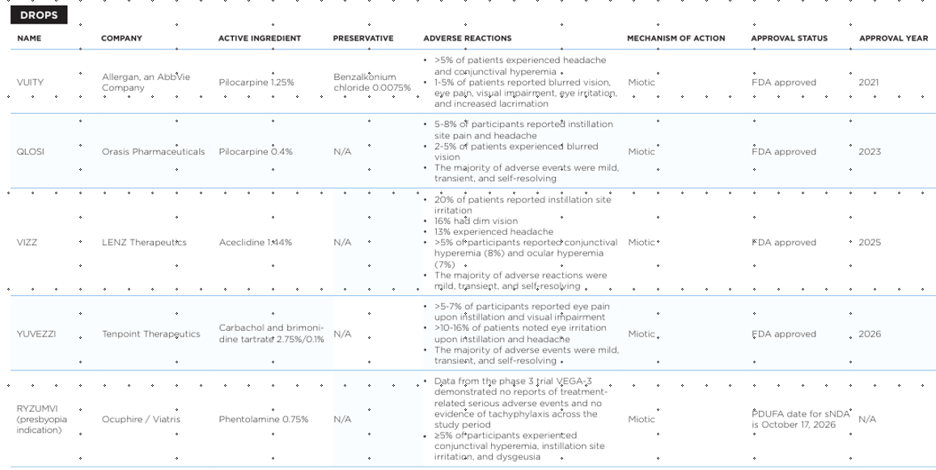
Approved and Emerging Presbyopia Drops

Slide 12
Clinical Takeaways for Presbyopia Drops
Presbyopia drops may offer a non-surgical alternative to reading glasses.
Best suited for motivated patients with early to moderate presbyopia.
Patients should be counseled on duration of effect and visual side effects.
Caution advised for patients who require optimal night vision.Ongoing research will refine patient selection and dosing strategies.

Slide 13
Anterior Segment: Unmet Needs
Persistent dry eye symptoms
Evaporative disease under-treatment
Chronic blepharitis
Steroid dependence

Slide 14
Dry Eye Pipeline Themes
Rapid symptom relief is a key development goal.
New anti‑inflammatory mechanisms are emerging.
Improved drug delivery systems increase tolerability.
Neuromodulation therapies stimulate tear production.
Lipid layer stabilization targets evaporative dry eye.
Combination therapies address multiple disease pathways.
Personalized treatment strategies are emerging.

Slide 15
Loteprednol Approved for Dry Eye
October, 2020 marks the first FDA-approved steroid treatment for DED
A 0.25% ophthalmic suspension formulation, however, only 2 or 3 shakes is necessary
Unique “Mucus Penetrating” nanoparticle formulation enhances tear film residency time
Approved for up to 2 weeks of QID therapy
Can be “re-pulsed” as needed over time
“Adverse events and IOP increases were comparable to those seen with vehicle.”
Marketed by Alcon as Eysuvis Ophthalmic Suspension

Slide 16
Clobetasol propionate 0.05%
A newer “very high potency” corticosteroid ophthalmic suspension approved Mar 2024
Uniue nanoparticle formulation minimizes particle settling allowing consistent dosing; There is no “shake well” in the PI or on the bottle.
Used only bid for 2 weeks “for the relief of pain and inflammation following ocular surgery.”
About 85% of patients were pain-free in a week
Marketed as BYQLOVI by Harrow Health, Inc.

Slide 17
Perfluorohexyloctane
Perfluorohexyloctane is a semifluorinated alkane indicated for evaporative dry eye disease.
It targets tear film instability by stabilizing the lipid layer of the tear film.
The molecule spreads rapidly across the ocular surface due to extremely low surface tension.
Creates a thin anti‑evaporative barrier that reduces tear film evaporation.
Particularly beneficial in patients with meibomian gland dysfunction (MGD).
Formulation contains no water and no preservatives, improving tolerability.
Clinical trials demonstrated improvements in both dry eye symptoms and corneal staining.
Marketed as Miebo by B+L and approved for qid dosing.
Represents a novel mechanism focused on evaporation rather than inflammation.

Slide 18
Cyclosporine Solution 0.1%
Cyclosporine reduces T‑cell mediated inflammation.
Contains a water‑free formulation, in perfluorobutylpentane (PFBP), a semifluorinated alkane.
Improves drug tolerability.
Reduces ocular surface inflammation.
Used for chronic dry eye disease.
Preservative‑free design enhances comfort.
Represents improved formulation of existing therapy.
Available as Vevye by Harrow in a 2ml solution.

Slide 19
Acoltremon ophthalmic solution 0.003%
Approved May 28, 2025
Transient Receptor Potential Melastatin 8 receptor
“TRPM8” is neuromodulator agonist receptor which senses “coolness”
Activation of these unique receptors causes tear production
This activation can affect multiple body tissues, but increasing “basal tear production” is it’s MOA
Since MGD is the weak link in the DED chain, drugs whose primary expression is increasing tear production such as Restasis, Xiidra, and Tryptyr may be most effective when combined with a lipid layer stabilizing artificial tear
Tryptyr is manufactured in single dose vials by Alcon (also makers of Eysuvis for DED); BID recommended dosing
Br J Ophthalmol. October 2023
Notes:
Congdon N, Azuara-Blanco A, Solberg Y On behalf of GLAUrious study group, et al
Direct selective laser trabeculoplasty in open angle glaucoma study design: a multicentre, randomised, controlled, investigator-masked trial (GLAUrious)
British Journal of Ophthalmology 2023;107:62-65.

Slide 20
Oral Azithromycin vs Oral Doxycycline in Treating MGD
Doxycycline 100 mg twice a day for 6 weeks or oral azithromycin 1g once a week for 3 weeks
With equivalent efficacy, fewer frequent side effects and a less frequent dosing regimen, azithromycin could be an attractive alternative to doxycycline in patients with MGD. “However, long-term follow-up in each group would be needed to determine if these outcomes persist for this chronic condition.”
OSN, July 23, 2023

Slide 21
Re‑Esterified Omega‑3 Fatty Acids in Dry Eye Disease (JAMA Ophthalmology 2024)
A randomized, double‑masked clinical trial evaluated re‑esterified triglyceride (rTG) omega‑3 supplementation for dry eye disease associated with meibomian gland dysfunction (MGD).
132 patients with DED and MGD were enrolled across 7 institutions and randomized to rTG omega‑3 fatty acids or grape‑seed oil placebo.
Omega‑3 dosing: 1680 mg EPA + 560 mg DHA daily; control group received 3000 mg grape‑seed oil.
Primary outcome: change in Ocular Surface Disease Index (OSDI) scores at 6 and 12 weeks.
Results showed no statistically significant improvement in symptoms with rTG omega‑3 compared with placebo.
Mean OSDI score changes were similar between groups, indicating no clinically meaningful benefit.
Compliance was high and no significant safety concerns or adverse events were reported.
Authors concluded rTG omega‑3 supplementation did not improve symptoms of DED associated with MGD.
Clinical Pearl: Current evidence does not support routine omega‑3 supplementation for MGD‑related dry eye.

Slide 22
Omega-3 Evidence in Dry Eye
Study | Result
DREAM Trial — NEJM 2018 | No significant benefit
JAMA Ophthalmology rTG Trial — JAMA Ophthalmology 2024 | No benefit
Oleñik et al. — Clin Interv Aging 2013 | Improvement in TBUT and symptoms
Kangari et al. — Ophthalmology 2013 | Improved tear stability and symptoms
Key Evidence Points
DREAM Trial (NEJM 2018): Large multicenter randomized trial found omega‑3 supplementation was no better than placebo for improving dry eye symptoms or signs.
JAMA Ophthalmology rTG Trial (2024): Re‑esterified triglyceride omega‑3 fatty acids showed no significant improvement in dry eye disease associated with meibomian gland dysfunction.
Earlier small trials (2013) reported improvements in tear breakup time and symptoms, contributing to mixed literature prior to larger randomized trials.

Slide 23
Omega-3 Fatty Acids…?
19 related Randomized Clinical Trials assessed by Cochrane Risk of Bias tool (Total n= 4246 DED pts)
Pts given Omega-3 treatment demonstrated more significant improvements in:
  Symptoms (Hedges' g = -1.047; p < 0.001)
  TBUT [standardized mean difference (SMD) = -0.939; p < 0.001]
  Schirmer Scores (SMD = -0.372; p < 0.001)
  Corneal Fluorescein Staining (SMD = -0.299; p = 0.037)
  Osmolarity (SMD = -0.721; p < 0.001) vs placebo
Wang WX, Ko ML. Efficacy of Omega-3 Intake in Managing Dry Eye Disease: A Systematic Review and Meta-Analysis of Randomized Controlled Trials. J Clin Med. 2023 Nov 10;12(22):7026. doi: 10.3390/jcm12227026. PMID: 38002640; PMCID: PMC10672334.

Slide 24
Omega-3 Fatty Acids…?
In the meta-regression analysis of DED symptoms, signif. positive correlation with reduction in DED symptoms were assoc. with:
  Daily dose of omega-3 (coefficient = -0.0005, p = 0.002).
  Duration of omega-3 intake (coefficient = -0.1399, p = 0.021)
  % of eicosapentaenoic acid (EPA) (coefficient = -0.0154, p < 0.001)
“Based on the evidence, omega-3 FAs effectively reduce DED symptoms, especially in high doses, for a long duration, and with increased EPA levels. However, given the heterogeneity in study results and diverse patient characteristics, caution is needed in generalizing these findings. In conclusion, omega-3 FA supplementation is still recommended for DED management in clinical settings.”
Wang WX, Ko ML. Efficacy of Omega-3 Intake in Managing Dry Eye Disease: A Systematic Review and Meta-Analysis of Randomized Controlled Trials. J Clin Med. 2023 Nov 10;12(22):7026. doi: 10.3390/jcm12227026. PMID: 38002640; PMCID: PMC10672334.

Slide 25
Blink NutriTears - Nutritional Therapy for DES
NutriTears is not an omega-3 formulation; instead it combines carotenoids (lutein 20mg/zeaxanthin 4mg), anti-inflammatory curcumin 200mg, and vitamin D 600 IU to target tear film stability and ocular surface inflammation from a nutritional pathway.
These compounds may reduce ocular inflammation.
Studies show increased tear production.
OSDI symptom scores improved in trials.
MMP‑9 levels decreased suggesting reduced inflammation.
May serve as adjunctive therapy.
Larger trials are needed.

Slide 26
Brimonidine 0.025%) Ophthalmic Solution
FDA approved in December 2017 - OTC product
Major upgrade to help the chronic red eye
Venular constriction is the mechanism of action, therefore …
No rebound hyperemia
Used 1-4 times daily PRN
Marketed as Lumify and Lumify PF in May 2025; OTC by B+L

Slide 27
Varenicline (Tyrvaya®) and Neurotrophic Keratitis (Investigational)
Tyrvaya® (varenicline nasal spray) is FDA-approved for dry eye disease, not for neurotrophic keratitis (NK).
Neurotrophic keratitis results from impaired trigeminal corneal innervation leading to epithelial breakdown.
Intranasal varenicline activates nicotinic acetylcholine receptors in the nasal mucosa.
This stimulation triggers the trigeminal– parasympathetic reflex, relevant to corneal trophic support.
The Phase 2 OLYMPIA trial evaluated intranasal varenicline in patients with neurotrophic keratitis.
Use in NK remains investigational pending larger confirmatory clinical trials.

Slide 28
Clinical Trial Context: Neurotrophic Keratitis
The Phase 2 OLYMPIA trial evaluated intranasal varenicline in patients with neurotrophic keratitis.
Primary endpoints included corneal epithelial healing and improvement in corneal staining.
The therapeutic concept targets restoration of corneal surface health rather than pain control.
Early trial results support biologic plausibility for trigeminal neuro- stimulation in NK.
Varenicline is not FDA-approved for neurotrophic keratitis.

Slide 29
Management Algorithm: Stain ≫ Pain vs Pain ≫ Stain
If corneal staining is severe with minimal pain → suspect neurotrophic keratitis.
  Assess corneal sensation and history of HSV, diabetes, surgery, or chronic contact lens wear.
  Prioritize trophic and protective therapy (e.g., serum tears, bandage/scleral lenses, Oxervate).
If pain is severe with minimal staining → suspect neuropathic ocular pain.
  Shift management toward neuromodulation and pain-directed therapy rather than surface-only treatment.

Slide 30
Low Dose Naltrexone (LDN) for Treating Pain Associated with Neuropathic DED
Neuropathic corneal pain (NCP) is caused by damage or disease of the central somatosensory nervous system
If corneal pain is not suppressed by proparacaine, then the diagnosis points to NCP
NCP patients tend to also have anxiety and depression
LDN causes transient blockade of opioid receptors
Most common SE: vivid dreams and headaches
Dosage at bedtime: 1.5 mg x 2 weeks, then 3.0 mg x 2 weeks, then 4.5 mg x 2 weeks (to several months, if relief is obtained).
Ocular Surface, April 2021; Eye, 2024

Slide 31
Reproxalap - Regulatory Pipeline Highlight
Reproxalap is a reactive aldehyde species (RASP) modulator for inflammatory dry eye disease
Targets toxic aldehydes, a downstream driver of chronic ocular surface inflammation
Distinct, non-immunosuppressive mechanism compared with cyclosporine and lifitegrast
Currently under FDA review
PDUFA date: March 16, 2026 — near-term regulatory catalyst
Potential to expand options for patients refractory to existing therapies

Slide 32
Prescription Dry Eye Products
Drug | Mechanism | Target | Onset | Dosing | Key Role | Common Side Effects
Cyclosporine | Calcineurin inhibitor → ↓ IL-2 | T-cell suppression | 6–12 wks | BID | Long-term control | Burning, stinging
Lifitegrast | LFA-1 antagonist | T-cell activation block | 2–4 wks | BID | Faster symptom relief | Dysgeusia, irritation
Perfluorohexyloctane | Lipid layer replacement | Tear evaporation | Days–weeks | QID | MGD / evaporative DED | Blurred vision
Varenicline (nasal) | Nicotinic receptor agonist | Trigeminal → tear reflex | Rapid | BID nasal | Tear stimulation | Sneezing, cough
Acoltremon | Neurostimulation pathway | Lacrimal reflex | Rapid | BID | Reflex tear production | Mild irritation
Loteprednol | Corticosteroid | Inflammation | Days | QID short-term | Flare control | IOP rise (short-term risk)

Slide 33
Dry Eye Disease: Late-Stage & Near-Term Catalysts
Therapy (Company) | Indication | Mechanism of Action | Stage / Key Date | Clinical Angle
Reproxalap (Aldeyra) | Dry eye disease | Reactive aldehyde species (RASP) modulator; reduces upstream inflammatory signaling | NDA under FDA review; PDUFA Mar 16, 2026 | Potential rapid symptom/sign modulation pending final FDA label
AZR‑MD‑001 (Azura) | Meibomian gland dysfunction | Topical selenium sulfide analog; normalizes gland keratinization | Phase 3 (NCT06329791) | First potential medical (non‑device) MGD therapy
Perfluorohexyloctane (Miebo) (B+L) | DED associated with MGD | Semifluorinated alkane; stabilizes lipid layer and reduces evaporation | Phase 3 evidence base; post‑hoc analyses ongoing | Evaporative phenotype support; set symptom expectations

Slide 34
Blepharitis Pipeline
Blepharitis remains one of the most common ocular conditions.
Lid hygiene alone often insufficient.
Demodex mites are a major cause of chronic blepharitis.
Targeted therapies now exist.
Short course therapy improves compliance.
Combination therapies address inflammation and infection.
New drugs may significantly improve outcomes.

Slide 35
Lotilaner Ophthalmic Solution 0.25%
FDA-approved July 25, 2023
Lotilaner 0.25% is an anti-parasitic ophthalmic solution to treat demodex blepharitis
Mechanism of action: inhibits the gamma-aminobutyrid acid (GABA)-gated chloride channels in the Demodex mites to cause paralysis in the mite and its death
Administered BID for 6 weeks
Side Effects: instillation site stinging and burning (10%); chalazions and punctate keratitis (<2%)
Marketed as Xdemvy by Tarsus Pharmaceuticals

Slide 36
Compounded Therapies for Blepharitis / Demodex Management
Compounded eyelid therapies are emerging options for managing chronic blepharitis and Demodex-related lid disease.
Triune™ Spray is a medicated eyelid cleanser containing azithromycin dihydrate 1% and diclofenac sodium 0.1%.
This combination provides both antimicrobial and anti-inflammatory activity directly at the eyelid margin.
Topical spray formulations may improve patient compliance compared with ointments or lid scrubs.
Demovectin™ kit combines ivermectin 1%, metronidazole 0.5%, and tea tree oil 0.3% for Demodex-associated lid disease.
Ivermectin targets Demodex mites, while metronidazole and tea tree oil provide anti-inflammatory and anti-parasitic effects.
The kit also includes supportive lid hygiene products such as lid scrub formulations and warming masks.
These therapies are typically compounded and prescribed through specialty pharmacies rather than standard retail pharmacies.
Clinical Pearl: Successful blepharitis management often requires combination therapy addressing mites, inflammation, and lid hygiene.

Slide 37
Dupixent® and Inflammatory Conjunctivitis
Dupixent (dupilumab) is a subcutaneous- administered biologic drug to treat asthma and eczema.
About 10% of patients develop conjunctivitis as a side effect
Tx: atopic dermatitis (eczema); asthma
Administered by IV infusion
Baseline eye examination is highly recommended to rule-out pre-Tx eye diseases and conditions.
Main ocular consequences: conjunctivitis, DED, blepharitis (including demodex), and keratitis (SPK), along with typical symptoms of these disorders.
Tx: Artificial tears and/or topical antihistamines, and/or loteprednol.
Dupixent. Package Insert. Regeneron Pharmaceuticals, Inc. 2026

Slide 38
Best Treatments for Psoriasis
Infliximab (Remicade®) TNF blocker
Bimekizumab (Bimzelx®) IL-17 blocker
Ixekizumab (Taltz®) IL-17 blocker
Risankizumab (Skyrizi®) IL-23 blocker
Guselkumab (Tremfya®) IL-23 blocker
  Has the longest durability of efficacy
JAMA Dermatology, 2024

Slide 39
Biologic Psoriasis Therapy and Ocular Surface Disease Risk
Psoriasis is a systemic inflammatory autoimmune disease that has been associated with several ocular conditions, including blepharitis, dry eye disease, and other ocular surface disorders.
Chronic systemic inflammation in psoriasis may contribute to ocular surface disease through immune-mediated mechanisms.
A large propensity score–matched cohort study evaluated the relationship between biologic therapy for psoriasis and risk of ocular surface disease.
The investigators used the TriNetX global medical database to analyze patient outcomes and hazard ratios for ocular disease development.
Patients with psoriasis receiving biologic immunosuppressive therapy were compared with those not receiving biologic treatment.
Results showed a significantly lower risk of developing ocular surface disease among patients treated with biologic therapy.
The protective effect was consistent across multiple follow-up intervals, including long-term observation periods up to 10 years.
These findings suggest systemic control of inflammatory pathways may reduce ocular surface complications in psoriasis.
Clinical Pearl: When managing patients with psoriasis, systemic biologic therapy may provide secondary ocular benefits by reducing inflammatory ocular surface disease risk.

Slide 40
Upadacitinib (Rinvoq)
Is a JAK (Janus kinase) inhibitor
  JAK proteins are intracellular mediators of inflammation
FDA-approved for use in:
  Eczema
  Rheumatoid & Psoriatic & Juvenile Arthritis
  Atopic Dermatitis
  Ulcerative Colitis
  Crohn’s Disease
  Ankylosing Spondylitis
FDA-approved 2025 as first line therapy for Giant Cell Arteritis
Once daily pill
Notes:
RINVOQ is indicated for the treatment of adults with moderately to
severely active rheumatoid arthritis who have had an inadequate response
or intolerance to one or more TNF blockers. (1.1)
• RINVOQ/RINVOQ LQ is indicated for the treatment of adults and
pediatric patients 2 years of age and older with active psoriatic arthritis
who have had an inadequate response or intolerance to one or more TNF
blockers. (1.2)
• RINVOQ is indicated for the treatment of adults and pediatric patients 12
years of age and older with refractory, moderate to severe atopic dermatitis
whose disease is not adequately controlled with other systemic drug
products, including biologics, or when use of those therapies are
inadvisable. (1.3)
• RINVOQ is indicated for the treatment of adults with moderately to
severely active ulcerative colitis who have had an inadequate respo
• RINVOQ is indicated for the treatment of adults with Crohn’s Ds.

Slide 41
Fortified Combination for Corneal Ulcers
Dual therapy for bacterial corneal ulcers has been the standard for decades
Tobramycin for gram negative coverage
Vancomycin for gram positive coverage
New combination is pre-fortified!
Tobramycin is 1.5% (standard is 0.3%)
Vancomycin is 5% (there is no standard)
Marketed as Fortisite™ ophthalmic solution by ImprimisRx (Harrow Health)

Slide 42
“Culturing” is Being Eclipsed
PCR is eclipsing traditional culturing
Test results by next morning
Targets most relevant micro-organisms
There is only one universal collection device
Provides a personalized antibiotic summary of effectiveness
www.healthtrackrx.com

Slide 43
Cetirizine 0.24% ophthalmic solution
Indicated for ocular itching associated with allergic conjunctivitis
Rapid onset of relief starting at 3 minutes that last up to 8 hours
Statistically significant and rapid reduction in ocular itch in moderate and severe patients
Available in single-unit containers for dosing convenience
Instill 1 drop in each affected eye BID (8 hr apart)
Adverse reactions in 1-7%: hyperemia, instillation site pain, and visual acuity reduced
Marketed by Harrow as Zerviate ophthalmic solution

Slide 44
Cyclosporin 0.1% Emulsion
For perspective, Restasis is a 0.05% emulsion
Marked as Verkazia® by Harrow
Approved to treat vernal keratoconjunctivitis
Dosage is QID for 1 to 4 months
Eye pain was 12% in clinical trials
“Gently shake the vial several times” prior to instillation
A topical steroid is the class of choice for vernal disease
Harrow acquired this product from Santen

Slide 45
Anterior Segment Pipeline: Late-Stage & Near-Term Catalysts
Category | Therapy / Program | Mechanism of Action | Stage / Timing | Clinical Angle for OD
Antibiotic | Besifloxacin XR (Bausch + Lomb) | Fluoroquinolone with extended ocular surface residence | Late-stage development | Simplified dosing; improved adherence for bacterial conjunctivitis
Antibiotic | Novartis Topical Antibiotic Program | Next-generation fluoroquinolone derivatives | Phase 2–3 | Potential resistance coverage improvement
Steroid | Loteprednol Gel 0.5% (PF) (Bausch + Lomb) | Soft steroid with reduced IOP elevation risk | Late-stage / lifecycle management | Short-term control of ocular surface inflammation
Steroid | EYSUVIS follow-on formulations (Kala) | Loteprednol etabonate optimized pulse dosing | Near-term lifecycle expansion | Designed for flare-based DED management
Dry Eye | Reproxalap (Aldeyra) | Reactive aldehyde species modulator | NDA under FDA review; PDUFA Mar 16, 2026 | Potential new class for rapid symptom/sign relief
Dry Eye | AZR-MD-001 (Azura Ophthalmics) | Selenium sulfide analog; meibomian gland normalization | Phase 3 | First potential medical therapy for MGD
Allergy | AR-15512 nasal–ocular TRPM8 agonist (Alcon/Aerie) | Cold-sensing ion channel modulation | Phase 2–3 programs | Rapid itch relief with novel mechanism
Allergy | Next-gen dual-action antihistamine/mast cell stabilizers | Histamine H1 blockade + mast cell stabilization | Late-stage formulation optimization | Improved onset and comfort
Antiviral | Brincidofovir ophthalmic | DNA polymerase inhibition | Phase 2 | Potential adenoviral keratoconjunctivitis option
Antiviral | Pritelivir topical (HSV programs) | Helicase–primase inhibition | Phase 2–3 systemic/topical exploration | Non-nucleoside HSV strategy
Other (Pain/Neuro) | Intranasal neurostimulation programs | Trigeminal–parasympathetic activation | Late-stage / approved (DED) + pipeline | Adjunctive tear production without surface drops
Other (MGD) | Next-gen thermal + pharmacologic combo systems | Mechanical expression + anti-inflammatory modulation | Near-term device–drug convergence | More durable evaporative DED control

Slide 46

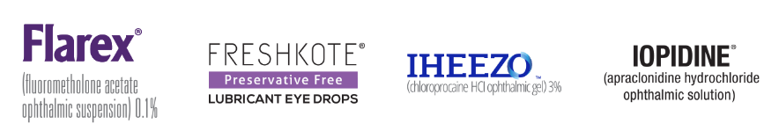
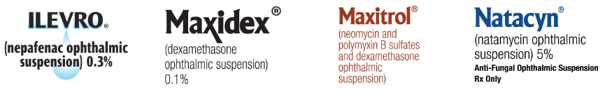
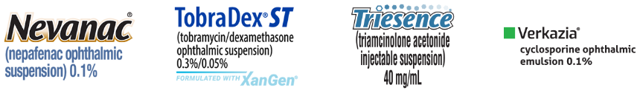



Slide 47



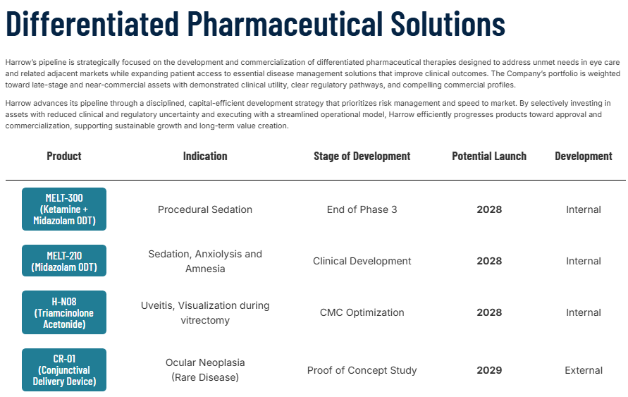

Slide 48
Posterior Segment Pipeline
Retinal disease remains leading cause of blindness.
New drugs aim to extend treatment intervals.
Early treatment improves outcomes.
Optometrists identify candidates early.
Sustained delivery technologies emerging.
Biologic therapies expanding.
Pipeline innovations will reshape retinal care.

Slide 49
Wet AMD Treatment Goals
Anti‑VEGF therapy revolutionized wet AMD care.
Frequent injections remain a burden.
Durability strategies aim to extend intervals.
New drugs reduce treatment frequency.
Sustained delivery platforms emerging.
Combination mechanisms under study.
Goal is vision preservation.

Slide 50
Susvimo Port Delivery System
Susvimo continuously delivers ranibizumab.
Implant placed in the pars plana.
Drug reservoir refillable in clinic.
ARCHWAY trial showed comparable vision outcomes.
Equivalent to monthly ranibizumab injections.
Significantly reduces injection burden.
Represents major durability innovation.

Slide 51
Geographic Atrophy Therapies
Geographic atrophy previously lacked treatment.
Complement pathway inhibitors now available.
Syfovre targets complement C3.
Izervay targets complement C5.
Both slow lesion progression.
Goal is delay of central vision loss.
Treatment requires careful counseling.

Slide 52
Valeda Light Therapy
Photobiomodulation therapy for AMD.
Stimulates mitochondrial function.
Improves cellular metabolism.
Used for early‑intermediate AMD.
Multiple treatment sessions required.
Clinical trials show functional improvement.
Represents non‑drug therapy.

Slide 53
Diabetic Retinopathy Pipeline
Earlier intervention is a major research focus.
Anti‑VEGF therapy remains central.
New therapies target inflammation pathways.
Durability strategies reduce treatment burden.
Disease modification is a major goal.
Early treatment may prevent vision loss.
Pipeline research continues.

Slide 54
Posterior Segment: Late-Stage & Near-Term Catalysts
Disease Area | Therapy / Program | Mechanism of Action | Stage / Timing | Clinical Theme
Wet AMD | EYP-1901 (EyePoint) | Sustained-release tyrosine kinase inhibitor; inhibits VEGF signaling | Phase 3 | Reduced injection burden
Wet AMD | OTX-TKI (Ocular Therapeutix) | Intraocular implant delivering axitinib (VEGF receptor TKI) | Late Ph2 → Ph3 | Implant-based durability
Wet AMD | KSI-501 / DAYBREAK (Kodiak) | Dual mechanism antibody (anti-VEGF + anti-IL-6) | Phase 3 | Durability + inflammation
Geographic Atrophy | Tinlarebant (Belite Bio) | Visual cycle modulator; reduces toxic retinoid byproducts | Phase 3 | Non-complement GA
Geographic Atrophy | ANX007 (Annexon) | C1q complement inhibition | Late Ph2 / Ph3-ready | Selective complement
Diabetic Eye Disease | Susvimo (Genentech/Roche) | Continuous intravitreal delivery of anti-VEGF | FDA approved | Reduced treatment burden

Slide 55
Future Outlook
Multiple ophthalmic drugs nearing approval.
Durability technologies expanding.
Complement inhibitors expanding.
MGD therapies evolving.
Pipeline research continues rapidly.
Clinicians must remain current.
Future therapies may modify disease.

Slide 56
Key Clinical Takeaways
Pipeline knowledge improves patient counseling.
Earlier diagnosis enables earlier therapy.
Optometrists influence referral timing.
New drugs expand treatment options.
Durability strategies reduce burden.
Combination therapy increasing.
Continuous education remains essential.

Slide 57
References
Aldeyra Therapeutics. PDUFA extension for reproxalap NDA (PDUFA Mar 16, 2026). (Dec 15–16, 2025).
Ophthalmology Times. Pipeline watch / PDUFA dates Q1 2026. (Jan 15, 2026).ClinicalTrials.gov. NCT06329791 (AZR‑MD‑001 Phase 3 MGD study).
Retina Today. Trials and Innovations in Geographic Atrophy Therapy. (Nov/Dec 2025).
Retinal Physician. Clinical Trial Update: EYP‑1901 Phase 3 trials (LUCIA/LUGANO) and other retina updates. (Jul/Aug 2025).
Roche press release. FDA approval of Susvimo for diabetic retinopathy. (May 22, 2025).AAO EyeNet. New Geographic Atrophy Drugs overview. (May 1, 2024).

