Slide 1
Headache Hacks: Neuro-Ophthalmic Disorders & Visual Pathway Disease
Ron Melton, OD, FAAO
HAWAIIAN OPHTHALMIC SUMMIT 2026
TARR TREK ELEVATED EYE EDUCATION
Oahu, Hawaii
October 17-20, 2026

Slide 2
Financial Disclosure
Dr. Ron Melton is a consultant to, on the speakers bureau of, on the advisory committee of, or involved in research for the following companies: ICARE and B+L.
“All relevant relationships have been mitigated.”

Slide 3
Learning Objectives
Recognize neuro‑ophthalmic red flags in headache patients
Differentiate primary vs secondary headache disorders
Interpret visual field patterns associated with neurologic disease
Understand OCT findings linked to optic nerve pathology
Identify when neuroimaging is indicated
Recognize vision‑ or life‑threatening etiologies
Apply triage and referral strategies in eye care practice

Slide 4
Why Headaches Matter in Eye Care
Headache commonly presents with visual complaints
Eye care clinicians are often first‑contact providers
Visual pathway disease may present with headache
Optic nerve edema can signal intracranial pathology
Visual fields and OCT provide critical diagnostic clues
Early recognition prevents permanent vision loss
Efficient triage improves patient outcomes

Slide 5
Headache Epidemiology
~90% lifetime prevalence
~50% of adults report active headaches annually
Primary headaches represent ~90–95% of cases
Migraine affects ~40 million Americans
Leading neurologic cause of disability under age 50
Common cause of emergency visits
Major socioeconomic burden

Slide 6
Headache Classification
Primary: migraine, tension‑type, TACs (Trigeminal Autonomic Cephalalgias)
Have normal eye exams
Primary headaches = diagnosis
Secondary: vascular, neoplastic, infectious, ICP disorders
Pearl- Headache + fever + neck stiffness or mental status change = assume secondary until proven otherwise.
GCA, tumor, bacterial or viral meningitis, IIH, etc.
“Primary headaches hurt a lot but look well; Secondary headaches often look sick.”

Slide 7
The General Neuro-ophthalmic Evaluation
History - History- History!
Onset, duration, frequency, severity
Location and character of pain
Associated visual and neurologic symptoms
Medication and trigger review
Best Visual Acuity
Pupillary Function
Ocular alignment and EOM function

Slide 8
Headache Red Flags – SNOOP (identifies danger)
S – Systemic symptoms or disease (fever, weight loss, cancer, HIV)
N – Neurologic signs (focal deficit, confusion, altered consciousness)
O – Onset sudden (thunderclap headache → r/o SAH)
O – Older age at onset (>50 years)
P – Pattern change or progressive headache
*SNOOP identifies danger

Slide 9
Additional Testing Options
Radiologic imaging
Systemic blood pressure
Electrophysiology
Fluorescein angiogram
Color vision assessment
Amsler grid testing
Carotid auscultation
Temporal artery palpation when indicated

Slide 10
Headache Triage: When to Image or Refer
Immediate imaging / ED referral: thunderclap headache, acute vision loss, new focal neurologic deficit
Urgent referral: papilledema, suspected GCA, CN III palsy with pupil involvement
MRI brain/orbits indicated: atypical headache, progressive pattern, abnormal neuro exam
Order ESR/CRP immediately: if age >50 with new headache or visual symptoms
Routine management: typical migraine or tension headache with normal exam
Always document: VA, pupils, VF, optic nerve appearance

Slide 11
Choosing the Right Imaging
No routine imaging for classic, stable migraine with normal exam
Image immediately if red flags (SNOOP criteria) present
MRI brain w/ contrast preferred for most secondary headache concerns
MRI orbits if optic neuropathy, disc edema, or visual decline
MRV indicated when IIH or venous sinus thrombosis suspected
CTA / MRA for suspected aneurysm, dissection, or vascular etiology
CT head for acute thunderclap headache or trauma
Avoid unnecessary imaging in low-risk primary headache
Abnormal visual fields or papilledema → urgent neuroimaging

Slide 12
Visual Fields in Headache Patients
Baseline automated perimetry recommended in new or atypical headache
Enlarged blind spot suggests papilledema / elevated ICP
Arcuate or nerve fiber defects raise concern for optic neuropathy
Altitudinal defect → consider ischemic optic neuropathy
Homonymous defects → urgent neuroimaging
Transient defects may accompany migraine with aura
Serial fields critical for IIH monitoring
Progressive loss mandates urgent neurologic referral
Normal fields do not exclude secondary headache pathology

Slide 13
OCT in Headache Evaluation
Normal RNFL thickness in primary headaches (migraine without optic pathology)
RNFL thickening suggests papilledema from elevated intracranial pressure
Peripapillary subretinal hyporeflective space supports true disc edema
Stable RNFL favors pseudopapilledema (optic disc drusen)
Enhanced depth imaging identifies buried optic nerve head drusen
Chronic papilledema may progress to RNFL thinning (secondary optic atrophy)
Macular ganglion cell layer thinning indicates prior optic nerve injury
Serial OCT essential for monitoring IIH treatment response
OCT helps exclude secondary optic neuropathy but does not diagnose migraine

Slide 14
Migraine — Primary Headache
History: episodic or chronic; unilateral > bilateral; pulsatile; duration 4–72 hours; worsened by activity
Associated symptoms: nausea, photophobia, phonophobia; ± aura
Etiology: trigeminovascular activation with CGRP release; cortical spreading depression in aura
Key diagnostic features: typical pattern, triggers, family history; normal neuro exam
Labs/Imaging: none routinely; MRI if red flags or atypical aura
Treatment (acute): NSAIDs, triptans, gepants, ditans
Treatment (preventive): CGRP mAbs, beta-blockers, topiramate, TCAs, onabotulinumtoxinA
Red flags: thunderclap onset, focal deficit, fever, immunosuppression, new/worsening pattern

Slide 15
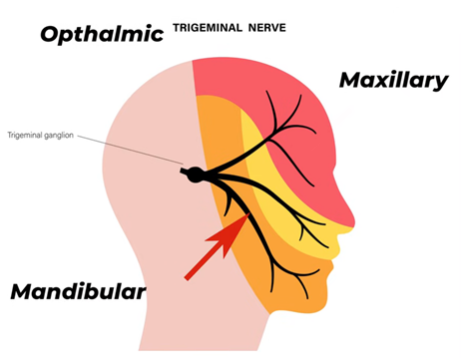
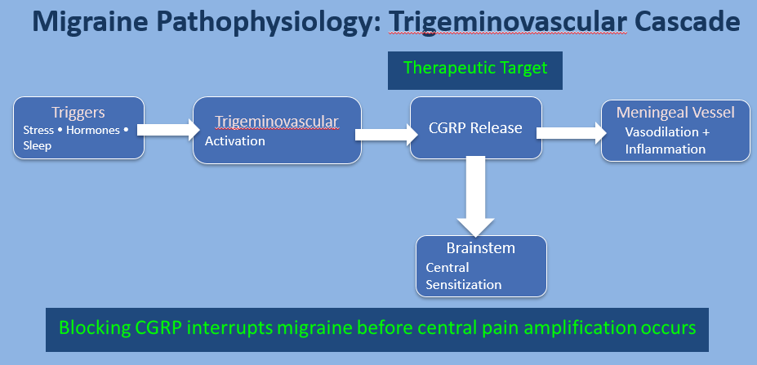
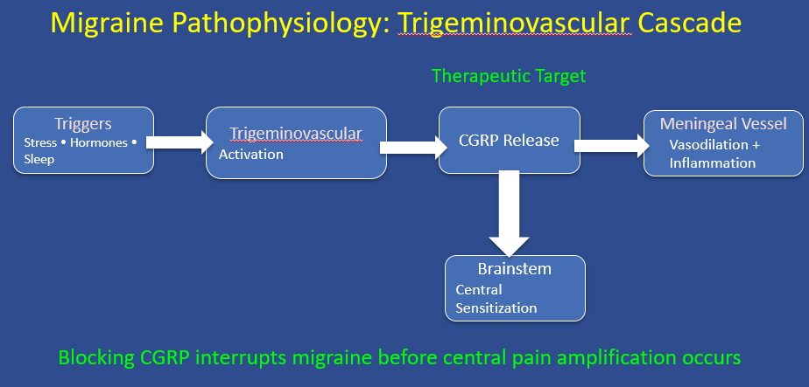
Pathophysiology
Cortical spreading depression produces aura
Trigeminovascular activation releases CGRP
CGRP causes vasodilation and neurogenic inflammation
Central sensitization leads to photophobia and nausea
Target for newer therapies

Slide 16
Migraine — Key Eye-Related Findings
Photophobia common
Visual aura (scintillations, scotoma)
Transient visual field defects
Normal fundus exam
Dry eye symptoms during attacks
Triggers include light and screens
No persistent visual loss
Red flag: atypical aura >60 min

Slide 17
Tension-Type Headache — Primary
History: bilateral band-like pressure or tightness; duration hours–days
Intensity: mild–moderate; not worsened by activity
Etiology: central pain sensitization; pericranial muscle involvement
Key diagnostic features: absence of nausea, aura, or autonomic symptoms
Labs/Imaging: none; image only if secondary concern
Treatment (acute): NSAIDs, acetaminophen
Treatment (preventive): amitriptyline, SNRIs, stress reduction, PT
Red flags: neurologic deficits, systemic symptoms, new headache in older patient

Slide 18
Tension-Type Headache — Key Eye-Related Findings
Periocular pressure sensation
Asthenopia with near work
Normal ocular exam
No photophobia or aura
Often associated with uncorrected refractive error
Dry eye overlap common
Symptoms improve with rest
Red flag: focal vision changes

Slide 19
Cluster Headache — Primary
History: severe unilateral orbital/ temporal pain; duration 15–180 minutes
Pattern: occurs in clusters over weeks- months; circadian periodicity
Etiology: hypothalamic dysfunction with trigeminal–autonomic reflex activation
Key diagnostic features: ipsilateral lacrimation, ptosis, rhinorrhea; restlessness
Labs/Imaging: MRI brain at diagnosis (pituitary/hypothalamus)
Treatment (acute): 100% oxygen; SC or intranasal triptans
Treatment (preventive): verapamil (1st-line), lithium, topiramate, CGRP mAbs
Red flags: atypical features, abnormal neuro exam, poor response to therapy

Slide 20
Cluster Headache - Key Eye-Related Findings
Ipsilateral tearing and redness
Ptosis and miosis (Horner syndrome)
Conjunctival injection
Orbital pain localization
Normal vision between attacks
Autonomic ocular signs
No fundus pathology
Red flag: atypical laterality

Slide 21
Visual Symptoms That Change the Game
• Transient vision loss
• Diplopia
• Visual field defects
• Papilledema
Notes:
Any visual symptom with headache = slow down and think.

Slide 22
Role of Eye Care Providers
First‑contact providers
Identify red flags
Visual symptoms change urgency
Coordinate referral when needed
Notes:
Timing guide: ~2.7 minutes | Cumulative: ~50.7 min
ODs as frontline screeners.

Slide 23
Transient Visual Events - Classication
Retiring “Ocular Migraine”
Retinal Migraine
Migraine with Aura
Amaurosis Fugax
Occipital TIA
GCA

Slide 24
NANOS Recommendations:
Classification of Transient Visual Loss (TVL)
1. Localize First
• Monocular → Pre-chiasmal (retina / optic nerve)
• Binocular homonymous → Post-chiasmal (occipital cortex)
2. Characterize Phenomenology
• Positive phenomena (scintillation, fortification spectra) → Cortical
• Negative phenomena (blackout, curtain, gray-out) → Ischemic until proven otherwise
3. Assess Temporal Profile
• Seconds → Embolic or hypoperfusion
• 5–60 minutes → Migraine spectrum
• Persistent or progressive → Structural/inflammatory cause
4. Stratify Vascular & Systemic Risk
• Age >50, vascular risk factors → Evaluate for TIA
• Jaw claudication, scalp tenderness → Immediate GCA work-up

Slide 25
Retiring the Term “Ocular Migraine”
“Ocular migraine” is non-specific and outdated
Use retinal migraine for true monocular events
Use migraine with aura for cortical visual phenomena
Retinal ≠ cortical origin
Terminology affects triage decisions
Prevents missing vascular transient vision loss
Aligns with ICHD-3 and stroke protocols
Improves documentation clarity

Slide 26
Retinal Migraine
Monocular visual disturbance
Positive or negative phenomena (gray, black, shimmering scotoma; patchy dimming or central dark spot
Duration 5–60 minutes
Fully reversible
May or may not be followed by headache
Rare; frequency variable and unpredictable
DDx: amaurosis fugas, retinal vasospasm, TIA, migraine with aura (often misinterpreted as one eye)
Teaching Pearl:
  - Rare, monocular, short, infrequent
  - Ask: If you cover one eye, is it still there?
Notes:
Retinal migraine represents a strictly monocular transient visual event.
It is believed to result from retinal vasospasm rather than cortical spreading depression.
Patients describe a gray, black, or shimmering scotoma confined to one eye.
The key clinical maneuver is confirming monocularity by asking the patient
to cover one eye during the episode. If the disturbance persists with either eye covered,
it is cortical—not retinal.
Duration is typically 5–60 minutes and vision returns completely.
Importantly, retinal migraine is a diagnosis of exclusion.
In patients over 50 or with vascular risk factors, retinal TIA must be ruled out first.

Slide 27
Migraine With Aura
Reversible neurologic symptoms (usually visual) preceding migraine
Gradual onset over 5-20 minutes; duration <60 minutes
Typically binocular (homonymous)
Positive symptoms (zig-zag lines, shimmering, flashing lights)
Negative symptoms (scotoma, blind spots)
Fortification spectra classic
Cortical spreading depression
May occur without headache
Normal eye exam between episodes
Pearl: “Expanding, moving visual disturbance”

Slide 28
Amaurosis Fugax
'Curtain coming down'
Monocular
Sudden onset
Seconds to minutes
Often embolic from carotid disease
“Retinal TIA” until proven otherwise
Emergency Work-Up:
- Carotid imaging + stroke risk evaluation

Slide 29
Occipital TIA (Posterior Circulation Ischemia)
Posterior circulation ischemia
Homonymous hemianopia (same side both eyes)
Often sudden
Patient may not recognize binocular involvement
Usually negative phenomenon (black/blank area)
Distinguishing Feature:
- Binocular + identical side field loss

Slide 30
Giant Cell Arteritis (AAION)
Sudden profound vision loss
Often altitudinal defect
May be permanent
Associated systemic symptoms
- (jaw claudication, scalp tenderness)
This is a steroid-now diagnosis

Slide 31
Transient Visual Events – Clinical Comparison
Condition | Laterality | Duration | Risk Level | Action | In‑Office Testing (OD)
Retinal Migraine | Monocular | 5–60 min | Low | Exclude vascular first | BP, pupils, confrontation VF, OCT mac/RNFL
Migraine w/ Aura | Binocular | 5–60 min | Low | Neuro if atypical | BP, VF, neuro screen; OCT if concern
Amaurosis Fugax | Monocular | Seconds | High | Stroke protocol | BP, pupils, VF-?; DO NOT delay ER referral
Occipital TIA | Binocular | Minutes | High | Stroke protocol | BP, VF-?; urgent referral without delay
GCA | Monocular | Variable | Very High | ESR/CRP urgent | BP, CV, VF, OCT RNFL; order ESR/CRP if >50 yrs
*Color vision (CV) useful if optic neuropathy suspected (GCA, AION, ON(; not decessive for vascular TMVL.

Slide 32
Transient Vision Loss – Differential Framework
First question: monocular or binocular?
Monocular → retinal or vascular cause
Binocular → cortical or occipital cause
Positive phenomena → migraine more likely
Negative blackout → vascular until proven otherwise
Age >50 raises ischemic concern
Acute vision loss in elderly-think GIANT CELL ARTERITIS

Slide 33
Migraine Treatment Ladder
Step 1: Simple analgesics (acetaminophen, NSAIDs)
Step 2: Combination analgesics
Step 3: Triptans (inhibit trigeminal signaling)
Step 4: Gepants (block CGRP receptor) or ditans (inhibit trigeminal pain transmission)
Preventive therapies include CGRP antibodies (prevent pathway activation) and Botox (blocks neuropeptide release from sensory neurons)

Slide 34
Key Takeaways for Primary Headache Evaluation
Most headaches are benign — some are vision-threatening
Red flags + visual findings guide urgency
Check visual acuity, pupils, and visual fields
Papilledema requires urgent neuro-imaging
Positive visual phenomena suggest migraine aura
Monocular curtain vision suggests retinal ischemia
New headache after age 50 - evaluate for giant cell arteritis
Clinical Pearls:
  Headache + vision = think neuro
  Image early when unsure
  Trust your instincts

Slide 35
Secondary Headache Disorders: Clinical Comparison
Secondary: vascular, neoplastic, infectious, ICP disorders
  Pearl: Headache + fever + neck stiffness or mental status change = Assume secondary until proven otherwise.
  GCA, tumor, bacterial or viral meningitis, IIH, etc.
History patterns differentiate secondary from primary headache
Etiology varies: vascular, infectious, inflammatory, neoplastic
Diagnostic features include systemic or focal neurologic signs
Labs/imaging guided by clinical suspicion
Treatment targets underlying cause
Red flags: thunderclap onset, fever, neurologic deficit, cancer, immunosuppression

Slide 36
Idiopathic Intracranial Hypertension
Predominantly obese females of child-bearing age (~90%)
Headache = most common symptom; papilledema = hallmark sign
Vision loss risk from chronic papilledema (optic neuropathy)
Black patients may demonstrate more aggressive disease
Weight loss (5–10%) is disease-modifying and essential long-term
LP: diagnostic + may transiently improve symptoms
Monitor with BCVA + VFs (NOT scanning devices)
OCT = adjunct only; does not replace functional testing
Associated: OSA, tetracyclines, vitamin A derivatives
Pathophysiology likely multifactorial (CSF dynamics, vitamin A)
Central fat distribution may be more relevant than BMI alone
Tx: weight loss + acetazolamide; surgery if refractory
Red Flags: vision loss, worsening papilledema

Slide 37
Giant Cell Arteritis (GCA)
Age >50 with new-onset headache; temporal pain classic
Key symptoms: jaw claudication, scalp tenderness, vision loss
Vision loss mechanism: ischemic optic neuropathy (AAION)
Etiology: granulomatous vasculitis of medium/large arteries
Exam: abnormal temporal artery (tender, nodular, ↓ pulse)
Labs: markedly elevated ESR/CRP (CRP often more sensitive)
Diagnosis: clinical + temporal artery biopsy (do not delay tx)
Imaging adjuncts: ultrasound (halo sign), MRI/PET for large-vessel disease
Treatment: immediate high-dose systemic steroids (prevent blindness)
Start treatment BEFORE biopsy if suspected (vision-saving)
Adjuncts: tocilizumab or MTX for steroid-sparing when appropriate
Red flag: ANY visual symptoms = ophthalmic emergency

Slide 38
Pituitary / Sellar Lesions
History: progressive headache; visual field loss; endocrine symptoms
Etiology: pituitary adenoma, apoplexy, other sellar masses
Key diagnostic features: bitemporal hemianopia; hormonal abnormalities
Labs/Imaging: MRI sella with contrast; pituitary labs
Treatment: neurosurgical, medical, or radiation depending on lesion
Acute management: pituitary apoplexy requires urgent steroids
Red flags: acute vision loss, ophthalmoplegia, altered mental status

Slide 39
Infectious Headache
History: diffuse or focal headache with fever
Associated symptoms: neck stiffness, photophobia, AMS
Etiology: meningitis, encephalitis, sinusitis
Key diagnostic features: systemic illness; abnormal neuro exam
Labs/Imaging: LP, blood cultures; imaging prior to LP if indicated
Treatment: urgent empiric antimicrobials
Red flags: rapid progression, altered mental status, seizures

Slide 40
Headaches - Infectious Associations
Infection | Eye Finding | VF Pattern | OCT Findings
Bacterial meningitis | Papilledema | Enlarged blind spot | RNFL thickening from disc edema
Tuberculous meningitis | Papilledema / optic neuropathy | Peripheral constriction | RNFL edema → later thinning
Brain abscess | Cortical lesion | Homonymous hemianopia | Usually normal OCT structure
Cryptococcal meningitis | Optic nerve involvement | Central or peripheral defects | RNFL edema or optic nerve thinning

Slide 41
Painful Cranial Neuropathies
History: sharp, electric, stabbing facial pain (paroxysmal attacks)
Distribution: follows cranial nerve territory (CN V most common)
Classic entity: trigeminal neuralgia (trigger zones; normal exam between attacks)
Etiologies: vascular compression (most common), demyelination (MS), tumor, infection
Pain may be triggered by light touch, chewing, talking, or cold air
Motor involvement → consider additional CN involvement (III, IV, VI) → diplopia
Examination often normal between episodes in primary neuralgia
Atypical features (constant pain, neuro deficit) → suspect secondary cause
Imaging: MRI brain/orbits with attention to cranial nerves ± MRA
First-line treatment: carbamazepine or oxcarbazepine
Alternatives: gabapentin, pregabalin; refractory → surgical decompression
RED FLAGS: sensory loss, bilateral symptoms, progressive deficits, age <50, or abnormal neuro exam

Slide 42
Oculomotor Nerve (CN III) Palsy
Isolated CN III palsy: compressive vs microvascular etiologies
Pupil involvement → typically mid-dilated, poorly reactive
Pupil-involving palsy → high suspicion for compressive lesion (PCA aneurysm)
Pupil-sparing palsy → often microvascular (DM/HTN), but NOT reliably benign
Pain can occur in both, but more concerning with pupillary involvement
Aneurysms may initially spare the pupil → exam alone is insufficient
Classic exam: ‘down & out’ eye with ptosis; diplopia in multiple gazes
Older vasculopathic patients may be observed ONLY if truly isolated and stable
Modern shift: many experts recommend imaging ALL acute CN III palsies
Management: occlusion or Fresnel prism for diplopia symptom control
Follow closely for recovery (expected 8–12 weeks if microvascular)
RED FLAG: Any acute CN III palsy → treat as aneurysm until proven otherwise → send for urgent neuroimaging
Reference: AAO EyeNet (2024)

Slide 43
Fourth Nerve (CN IV) Palsy
Vertical diplopia; worse with reading/down gaze (stairs) — classic complaint
Hypertropia increases with ipsilateral head tilt (Bielschowsky head tilt test)
Compensatory head tilt AWAY from affected side to reduce diplopia
Congenital CN IV: long-standing head tilt, large vertical fusional amplitudes, intermittent headaches
Microvascular CN IV (DM/HTN): acute onset; may have mild periocular pain
Trauma is a common cause (long intracranial course makes CN IV vulnerable)
Differentiate from skew deviation (brainstem lesion) in acute headache/neuro cases
Imaging: indicated if atypical, acute with neuro signs, or suspected central cause
Headache + CN IV palsy → consider intracranial pathology (tumor, stroke, increased ICP)
Treatment: prism or observation; most microvascular cases resolve in 6–12 weeks
RED FLAGS: additional neuro deficits, bilateral palsy, papilledema, or acute severe headache

Slide 44
Sixth Nerve (CN VI) Palsy
Horizontal diplopia; worse at distance (driving) – classic complaint
Key exam: impaired abduction → esotropia in primary gaze
Common etiologies: microvascular (DM/HTN) and ↑ intracranial pressure (ICP)
CN VI highly sensitive to ↑ ICP due to long intracranial course
Headache + CN VI palsy → think increased ICP (IIH, mass, hydrocephalus)
Bilateral CN VI palsy strongly suggests ↑ ICP until proven otherwise
Associated findings: papilledema, transient visual obscurations, pulsatile tinnitus (IIH)
Acute painful CN VI palsy → consider cavernous sinus, meningitis, or aneurysm
Imaging: MRI brain/orbits ± MRV if IIH suspected
Microvascular cases: typically resolve in 6–12 weeks; monitor closely
Treatment: manage underlying cause; prism/occlusion for diplopia
RED FLAGS: papilledema, bilateral palsy, severe headache, or additional neuro deficits

Slide 45
Secondary Headache Disorders: Clinical Comparison
Feature | IIH | GCA | Pituitary / Sellar | Infectious | Painful Cranial Neuropathies
Typical History | Daily pressure headache; worse supine | New headache >50; temporal pain | Progressive headache ± endocrine symptoms | Headache with fever or systemic illness | Sharp, electric facial pain
Etiology | Elevated intracranial pressure | Granulomatous vasculitis | Pituitary adenoma/apoplexy | Meningitis, encephalitis, sinusitis | Vascular compression, demyelination
Key Diagnostic Features | Papilledema, TVOs | Jaw claudication, vision loss | Bitemporal hemianopia | Neck stiffness, AMS | Trigger zones
Labs / Imaging | MRI/MRV; LP ↑ OP | ESR/CRP; biopsy | MRI sella; pit labs | LP, cultures | MRI brain/cranial nerves
Treatment | Weight loss, acetazolamide | High-dose steroids | Surgery / medical therapy | Urgent antimicrobials | Anticonvulsants
Red Flags / Secondary Headache | Vision loss, worsening papilledema | Any visual symptoms | Acute vision loss, ophthalmoplegia | Rapid progression, seizures | Sensory loss, bilateral symptoms

Slide 46
Clinical Pearls for Evaluating Headache Patients in Eye Care
Always assess visual acuity, pupils, and visual fields in patients presenting with headache
Relative afferent pupillary defect (RAPD) strongly suggests optic neuropathy
Papilledema should always prompt urgent neuro‑imaging to evaluate for elevated intracranial pressure
Transient visual obscurations (seconds of dimming) are highly suggestive of increased intracranial pressure
Bitemporal visual field defects localize to optic chiasmal compression
Positive visual phenomena (zig‑zags, scintillations) are more typical of migraine aura
Curtain‑like transient vision loss suggests retinal ischemia / amaurosis fugax
New headache after age 50 requires evaluation for Giant Cell Arteritis
Color vision loss disproportionate to visual acuity loss suggests optic nerve disease
A normal ocular examination does not exclude neurologic causes of headache

Slide 47
References
Robbins MS. JAMA. 2021. Diagnosis and Management of Headache.
Viera AJ. Am Fam Physician. 2022.
Ashina M. NEJM. 2020.
GBD Headache Collaborators. Lancet Neurol. 2025.
AAO Preferred Practice Patterns.
FDA Orange Book – Migraine Therapies.
Notes:
Timing guide: ~2.7 minutes | Cumulative: ~72.0 min

