Slide 1
From Drusen to Decisions: Modern AMD Management for the Busy Optometrist
Anna Parlin, MD, MPH
Hawaiian Ophthalmic Summit
October 18th, 2026

Slide 2
Disclosures
No relevant financial disclosures

Slide 3
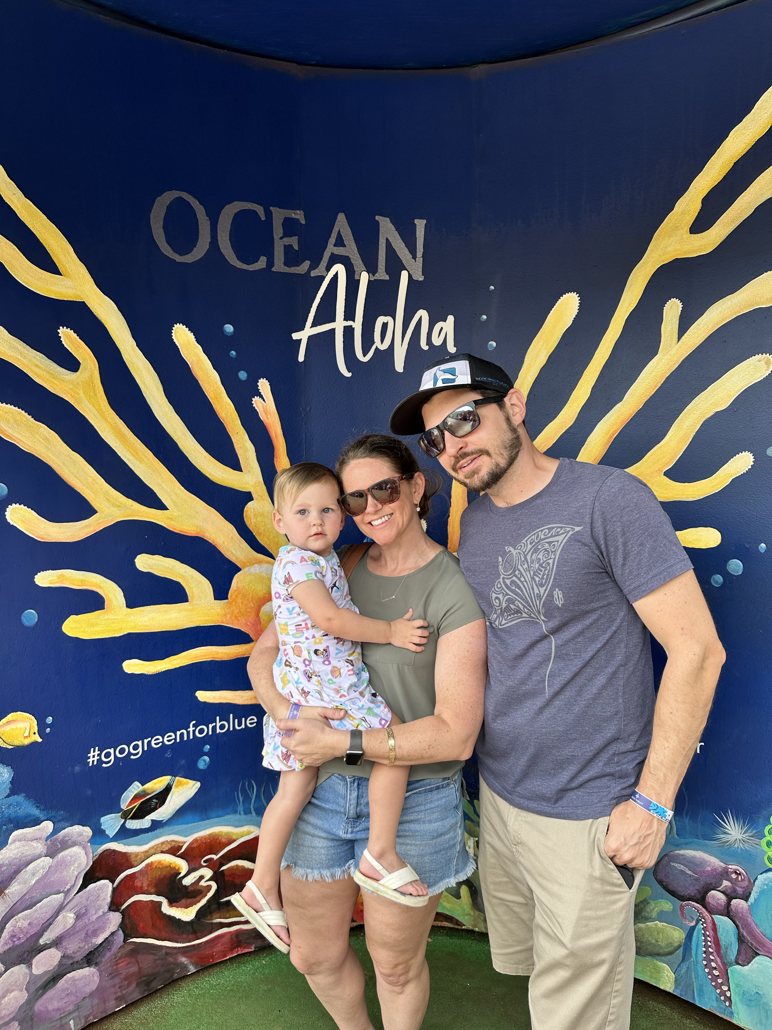
Retina Associates of Hawaii, Inc
POB2 1329 Lusitania St
Suite 502, Honolulu
(808) 521-8483
https://www.hawaiiretina.com/
Notes:
From NC
Med School/School of Public Health UNC Chapel Hill (2007-2012)
Internship at Tulane which is where I met Drew (2012-2013)
Residency KU Eye in Kansas City Kansas (2013-2016)
Vitreoretinal Surgical Fellowship at LSU NOLA (2016-2018)
Retinal Associates of Hawaii 2018-current

Slide 4
Age Related Macular Degeneration (ARMD)
Hallmark: Drusen, Macular Pigmentary Changes
Risks
  Age
  Cigarette Smoking
  Genetics (Complement H Factor)
  Other: CVD, HTN, Female, White, Hypercholesterolemia, Obesity, Hyperopia, Light Irides
Signs: Drusen, RPE changes, Subretinal fluid or hemorrhage, atrophy, subretinal fibrosis
Symptoms: decreased or blurred vision, distortion, scotoma, decreased contrast sensitive, decreased reading speed
Notes:
This evening we will be discussing ARMD with focus on advanced dry ARMD known as geographic atrophy.
As I'm sure you are aware, the clinical hallmarks of ARMD are drusen and pigmentary changes in the macula.
ARMD risk increases with age. It is not typically seen before mid 50s. At age 60 there is a 10% risk which increases almost 10% per decade of life, ie 20% at 70, 30% at 80 and 40% at 90yo. Smoking is a major modifiable risk factor for both the development of ARMD and the progression to the severe forms (wet ARMD and GA). There is also a genetic risk with Complement Factor H being an important gene in the pathogenesis of ARMD. Although, genetic screening for ARMD is not a current recommendation but may play a part in the future for both risk and treatment response predictions. Other risks are cardiovascular disease, hypertension, female gender, white race, hypercholesterolemia, obesity, hyperopia, and light irides.
On exam you can see mild small drusen with pigmentary changes to subretinal hemorrhage, subretinal fibrosis, and large patches of atrophy
Wide range of visual complaints dependent upon severity of clinical findings. Patients can complain of decreased or blurred vision, distortion, central scotoma, difficulty reading or with visual activities in dim lighting. Symptoms can be very vague.

Slide 5
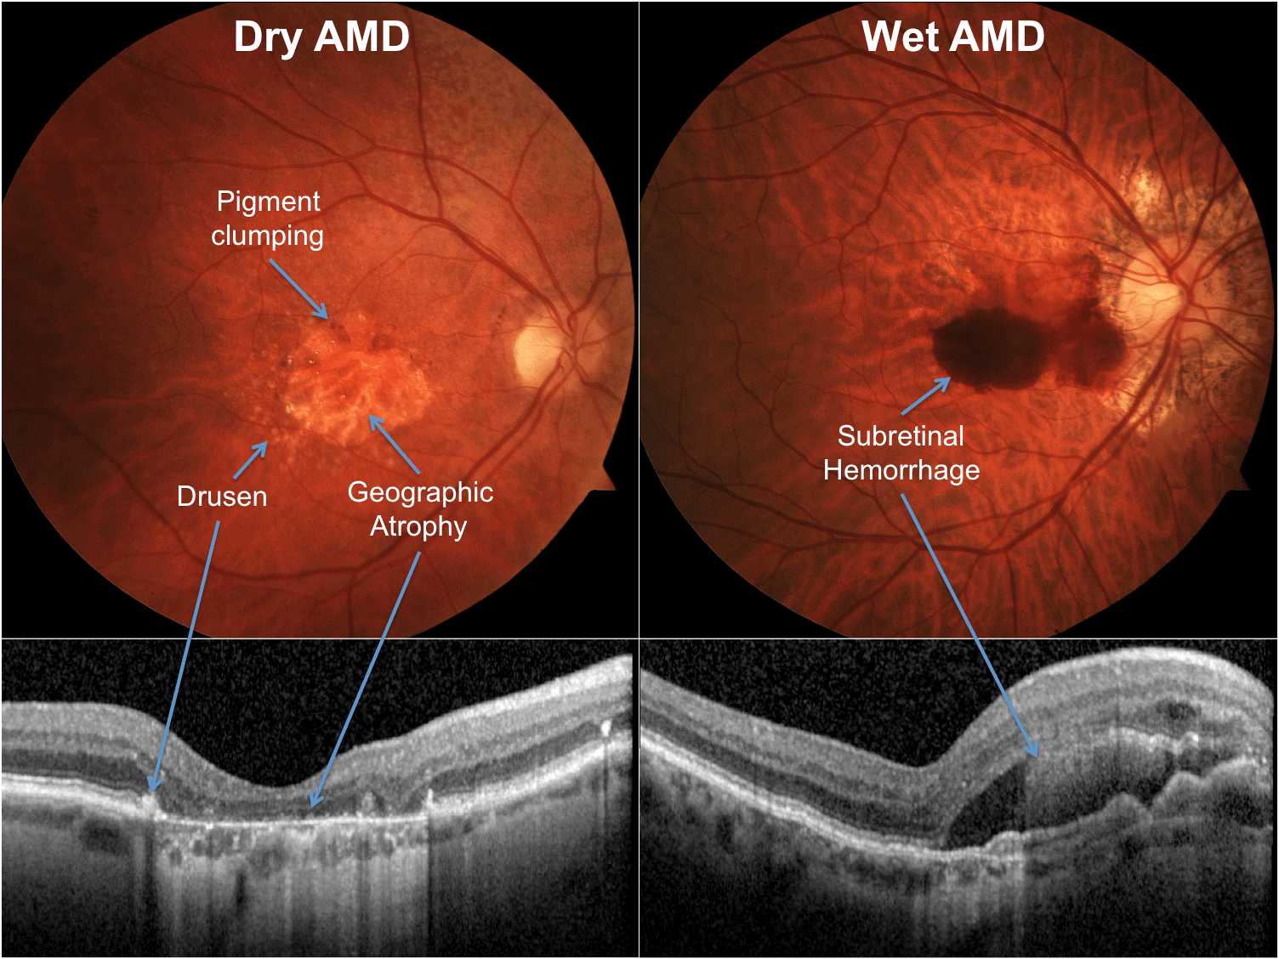
Wet ARMD
10-15% of cases
Primary cause of vision loss due to ARMD
Treatment:
  anti-VEGF intravitreal therapy: Avastin, Lucentis, Eylea, Eylea HD, Vabysmo, Beovu, Biosimilars
  Photodynamic therapy
  Port Delivery System
Notes:
anti-VEGF: Avastin, Lucentis, Eylea, Eylea HD, Beovu, Vabysmo, Port Delivery System (Susvimo), Biosimilars
Mainly treated with treat and extend protocol with monthly injection x 3 (4 for Vabysmo) and then extend interval if dry

Slide 6
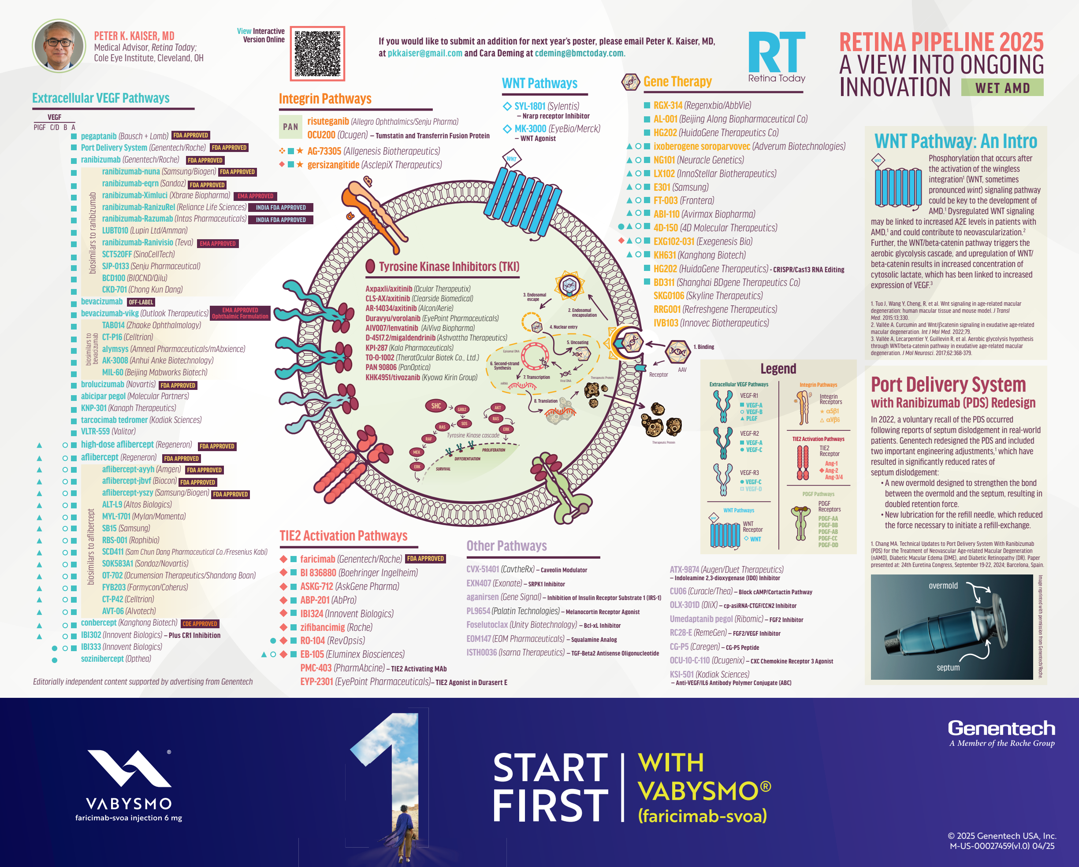
What’s Next?
Extracellular VEGF Pathways
TIE2 Activation Pathways
Integrin Pathways
WNT Pathways
Gene Therapy
Other Approaches

Slide 7
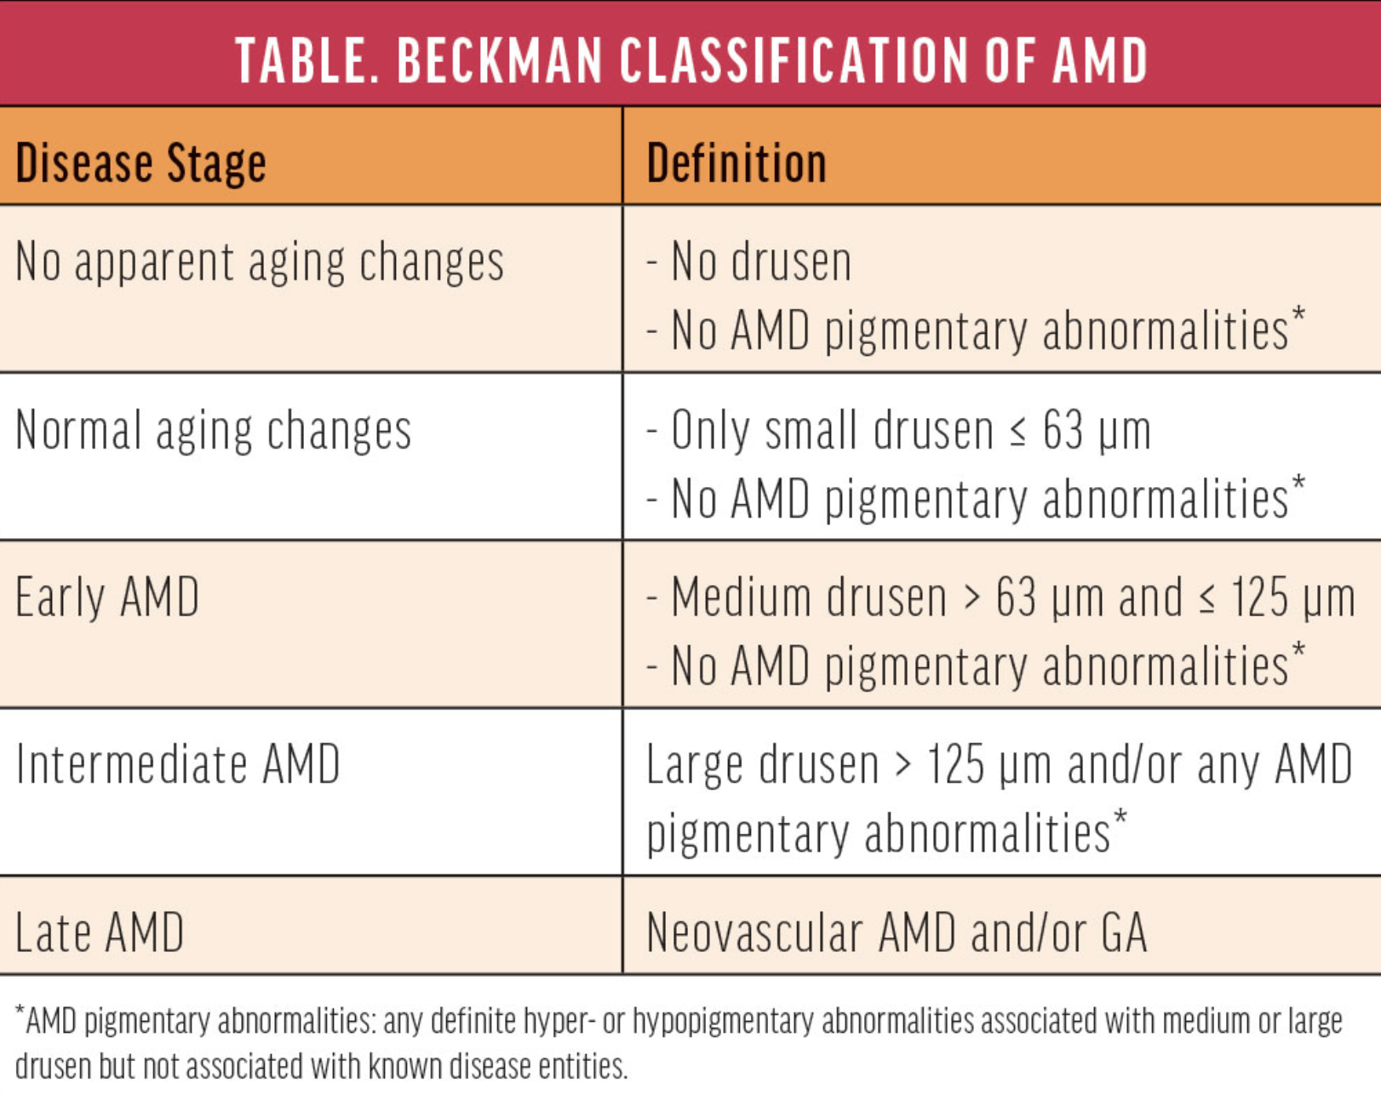
Dry ARMD
85% of AMD cases
Early->Intermediate->Advanced (GA)
Notes:
Can range from asymptomatic (early, intermediate) to legally blind (GA)
Dry ARMD comprises 85-90% of patients with ARMD diagnosis and ranges from early to intermediate to geographic atrophy. It is common for early and intermediate to have no to mild symptoms. While those with geographic atrophy can progress to legally blind.

Slide 8
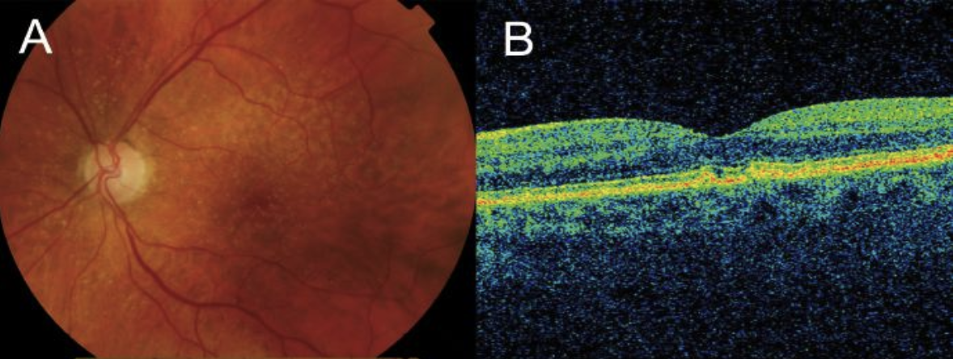
Early Dry ARMD
Presence of small (<63 um, “hard”) or intermediate (<63um but >125um, “soft”) druse
Treatment: address systemic factors such as CVD, obesity, smoking
Monitoring
  Amsler Grid
  Q9-12 month dilated macular evaluation with macular OCT
Notes:
Early ARMD: Defined by the presence of numerous small (<63 microns, “hard”) or intermediate (≥63 microns but <125 microns, “soft”) drusen. Note: Small drusen are frequently seen in those 50 and older, and can represent an epiphenomenon of aging (therefore, intermediate drusen are more specific for ARMD).
AREDS/2 not found to be beneficial at this level. I personally focus more on diet (mediterranean & goji berries)
Typically asymptomatic

Slide 9
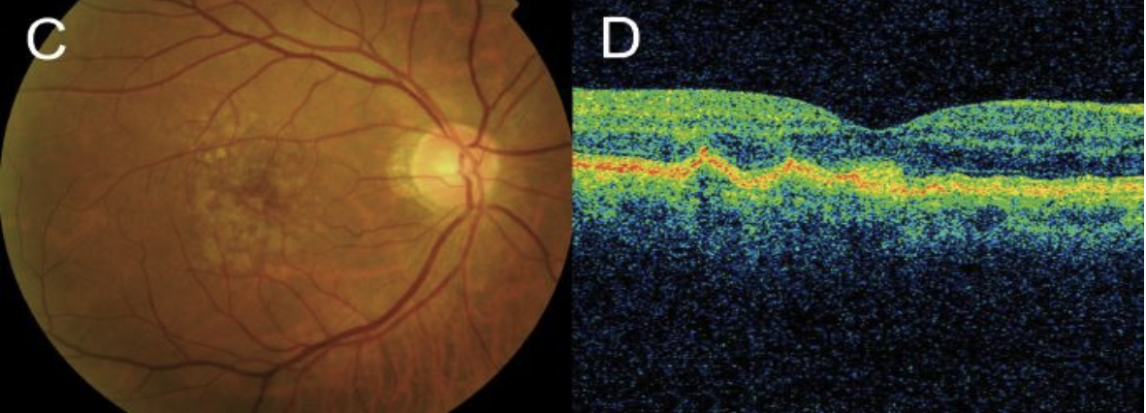

Intermediate Dry ARMD
Presence of extensive small or intermediate drusen or any large (>125um) drusen
Treatment
  Address systemic factors
  AREDS/2 Vitamin supplementation
  Photobiomodulation
Monitoring
  Amsler Grid or ForeSeeHome Monitoring Device
  Q6 month dilated macular exam with Macular OCT
Notes:
Defined as the presence of extensive small, intermediate or any large drusen.
You can determine the size of the drusen by comparing it to the retinal vein as it exits the optic nerve which is approximately 124um in size. These patients are often asymptomatic but can notice blurred or distorted vision, especially if there is a subfoveal drus or PED. This is the point at which the AREDS/AREDS2 trial found supplementation to be beneficial. I still discuss lifestyle modification with focus on diet and smoking cessation. I see these patients every 6 months with instructions for home monitoring with Amsler Grid or Foreseehome Monitoring Device. The Foresee Device is indicated for intermediate dry ARMD with vision at least 20/60. It has been shown to increase the chance of maintaining driving vision (20/40 or better) compared to Amsler Grid (81% vs 34%). This is, of course, in conjunction with regular retinal examinations. This is a medical device that requires a prescription. The device is shipped to the patient and the company trains the patient in it’s use. The ideal patient is comfortable with a computer and mouse set up. There is no out of pocket cost for patients with Medicare and a secondary. Typically $15/m if no secondary insurance and $75/m if not covered by insurance. The test results go directly to the monitoring company (Notal Vision). If the test varies from baseline an alert is sent to the prescribing physician so the patient can be contacted for evaluation.

Slide 10
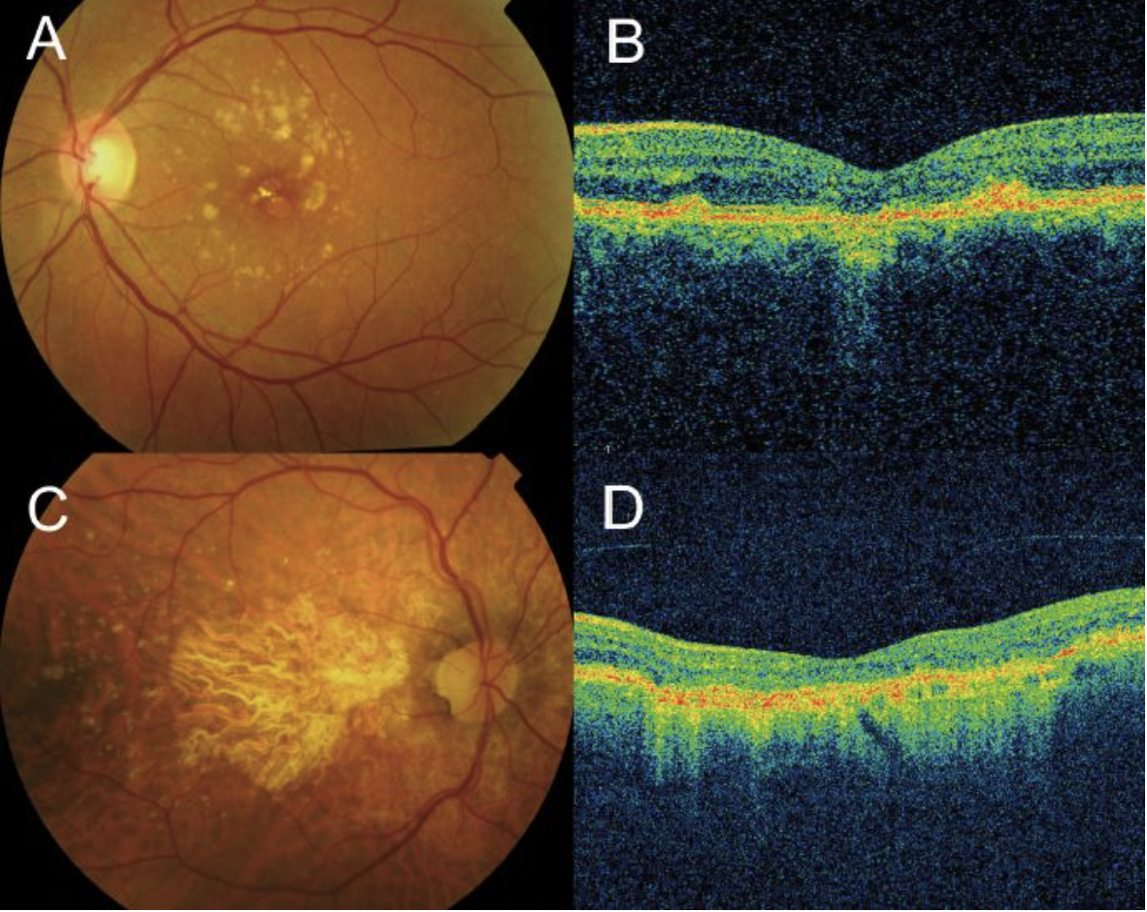
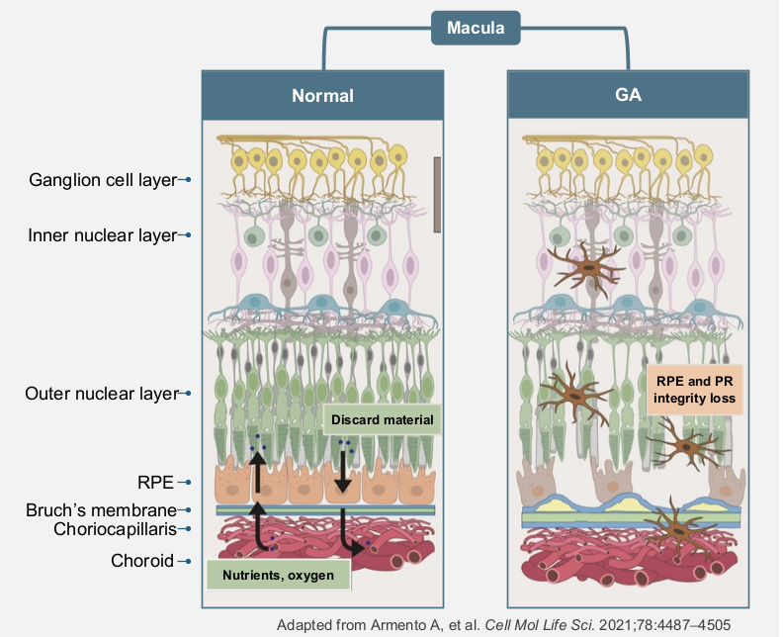
Advanced Dry ARMD: Geographic Atrophy
Progressive atrophy of photoreceptors, RPE, and choriocapillaris. Typically begins in perifoveal region and expands to involve fovea
  Mean Growth rate of 1.78mm2/y with average of 2.5 years from time of diagnosis to foveal involvement
Incidence: ~1million with GA in US with GA in at least 1 eye. ~160,000 new cases/year
  Up to 29% of eyes with GA will develop nAMD
  Up to 37% of eyes with nAMD will develop GA
Treatment: Lifestyle modification, Complement Inhibitor Intravitreal Injections
Monitoring
  Amsler Grid
  Q4 month dilated macular exam with macular OCT and fundus autofluorescence (FAF)
Notes:
nGA (nascent) defined as (1) subsidence of inner nuclear layer (INL) & outer plexiform layer (OPL) and/or (2) hyporeflective wedge-shaped band within Henle’s nerve fiber layer
This brings us to advanced dry ARMD, known as Geographic Atrophy, or GA for short. There are approximately 1million patients in the US with GA in at least 1 eye (5million world wide) with approximately 160,000 new cases/year
There is nascent GA (nGA) which is defined as
1) subsidence (sinking/caving in) of inner nuclear layer (INL) & outer plexiform layer (OPL) and/or
(2) hyporeflective wedge-shaped band within Henle’s nerve fiber layer
There was recently a consensus classification for GA (CAM- classification of atrophy meeting) as incomplete ( RPE and Outer Retinal Atrophy - iRORA) or complete (RPE and Outer Retinal Atrophy - cRORA). Complete is defined as
1) minimum size of >250um of apparent absence of RPE characterized by hypertransmisson,
2) >250um zone of RPE attenuation or disruption,
3) evidence of overlying photoreceptor degeneration (any outer nuclear layer thinning, external limiting membrane loss, or ellipsoid zone/interdigitation zone loss), and
4) no evidence of RPE tear.
For subjects with intermediate AMD the 15-year cumulative incidence of neovascular AMD is approximately 2.0% and for progression to pure GA it is approximately 1.3%
Prior to 2023 the only treatment was observation with lifestyle modification. Beginning in February of 2023 we have been able to offer patients intravitreal injection of complement inhibitor which slows the disease progression.
I now monitor these patients approximately every 4 months with a dilated exam and macular OCT. I obtain a FAF every other visit.

Slide 11
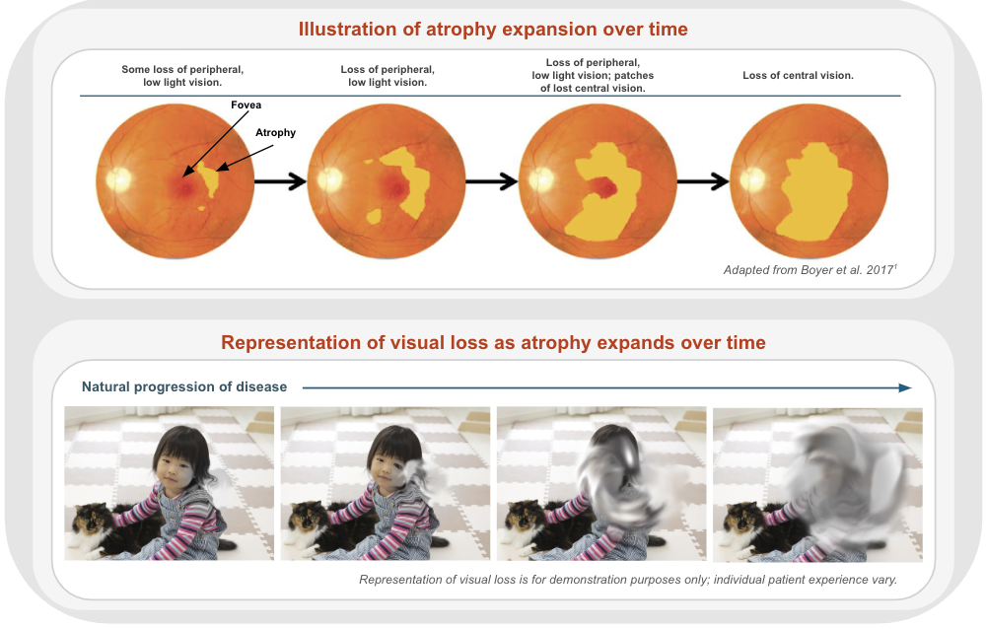
Notes:
The mean time from early GA to center involved lesion is 2.5 years. The mean growth rate is 1.78mm2/year however that is quite variable. We know that extrafoveal lesions grow more rapidly than subfoveal lesions but there are also patterns seen on ancillary testing that are predictive of growth rate.
Imaging
Fundoscopy/Color Fundus Photo (CFP) in GA typically shows a well-circumscribed oval or round area of pigment epithelium atrophy with sharply demarcated borders and increased visibility of choroidal vessels, usually sparing the fovea until late stages
OCT scan shows thinning of hyperreflective external band, corresponding to attenuation of RPE/Bruch’s complex, and deeper hyperreflectivity because of loss of outer layers including photoreceptors. Recently, changes in OCT that precede the development of GA have been identified (nGA). These changes include the presence of hyperreflective foci in the retina overlying drusen, a subsidence of the inner nuclear layer (INL) and outer plexiform layer (OPL) with the development of hyporeflective, wedge-shaped bands, and increased signal transmission below the level of the RPE. PR degeneration precedes and exceeds the loss of the RPE. Where the area of PR loss exceeds that of RPE loss, the RPE lesion will consistently expand to cover the concomitant PR loss area. A low PR/RPE ratio (indicating that PR and RPE lesion sizes are closely matched, and the disease is considered inactive) or a high PR/RPE ratio (indicating that the PR lesion is significantly larger than the RPE lesion, and the latter is expected to grow). The software that measures this is not yet available in clinical practice.
Fundus Autofluorescence (FAF) is the current standard of care for monitoring, measuring GA. FAF reflects the level of lipofuscin which is accumulated in the RPE cells. The decreased autofluorescence represents a decrease or lack of RPE cells. FAF is increased in the junctional zone around areas of atrophy, and intensity seems to correlate with extension of the atrophic area and also with reduction of retinal sensitivity detected by fundus perimetry. The FAM-Study Group developed the classification of abnormal FAF according to distinct patterns in the junctional zone of the GA area and identified the following five primary phenotypes based on the presence of increased hyper-autofluorescence: None, Focal, Banded, Patchy and Diffuse(62).
These hyperfluorescent areas in the junctional zone are believed to represent regions of cells that are stressed and more likely to become atrophic(8).
OCTA can identify nonexudative neovascular ARMD associated with GA (helpful in determining risk of exudation with complement inhibition treatment). Also has 20% risk of developing exudation in general
IVFA/ICG not necessary unless diagnosis is unclear

Slide 12
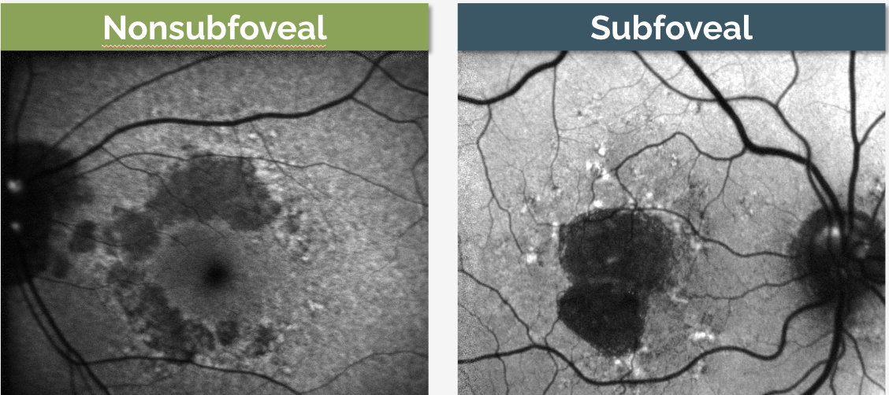
Nonsubfoveal lesions grow faster than subfoveal lesions
Notes:
The lesion here on the left is an example of extrafoveal and on the right is a subfoveal lesion seen on FAF

Slide 13
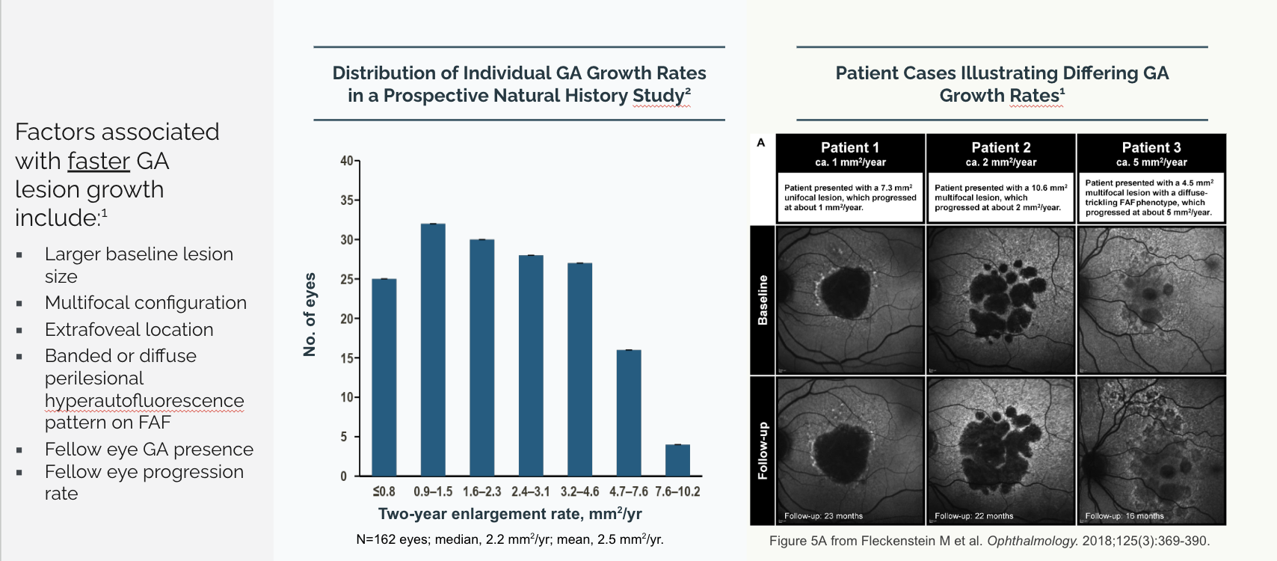
Notes:
The graph on the left shows the distribution of growth rate. The photos on the right depict patient examples of different growth rates. The far left photo shows a subfoveal lesion that grew 1mm/y. The central photo shows a multifocal lesion which grew 2mm/year. The photo on the far right shows a multifocal lesion with diffuse trickling pattern on FAF which grew 5mm/year. This highlights the importance of early monitoring with FAF in order to determine which patients will benefit most from the newly FDA approved treatments

Slide 14
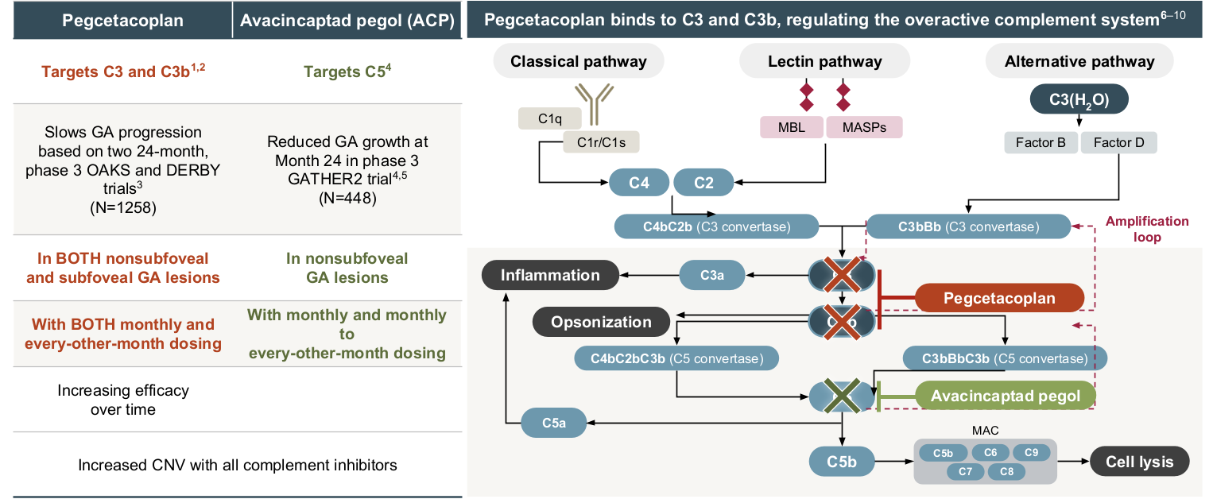
Complement Inhibitors
Notes:
Numerous mechanisms have been implicated in the development of GA including oxidative damage, chronic inflammation, excessive accumulation of lipofuscin, and malfunctioning of the complement system which is thought to be overactive in GA. Complement Factor H, which is highly expressed in the RPE and choroid, keeps the complement system inactive in the normal healthy state.The complement system is the primary target for research and treatment for GA. Three pathways (classical, lectin, and alternative) converge at C3 to activate the complement system. C3 then activates C5 which initiates the inflammatory response through chemotaxis, neutrophil migration, and formation of MAC (macrophage attack complex) which poke holes in cells leading to cell death. C3, C5 and their biproducts accumulate in the sub RPE space leading to inflammation and a breakdown of the blood retinal barrier
Current treatments target C3, C5 with the goal of therapy to SLOW progression. Does not stop or reverse it. Functional benefit will not be perceived by patient which is vastly different from treatment effect of nAMD. Although current therapies offer hope to patients that recently had none, ideal patient selection for treatment is an evolving discussion as the retinal community better learns who would benefit from the treatment most. It is also important to note that treatment is an intravitreal injection of 0.1mL of complement inhibitor (current anti-VEGF is 0.05mL while Eylea HD is 0.07mL)

Slide 15
Syfovre (pegcetacoplan)
Compliment 3 Inhibitor FDA approved for the treatment of GA February 17,2023
Approved for subfoveal and extrafoveal lesions
25% decreased lesion growth with monthly dosing and 24% decreased growth with EOM dosing at 1 year
Notes:
Pegcetacoplan (peg-ceta-coplan) was approved for the treatment of GA by the FDA on February 17, 2023.
The complement factor 3 inhibitor (meaning that it prevents C3 cleavage) has been assessed for the treatment of the geographic atrophy in the phase 3 DERBY and OAKS trials. Primary endpoint was change in lesion size. In the DERBY trial, monthly dosing of pegcetacoplan led to a 36% decrease in lesion growth, while every other month dosing of pegcetacolplan led to a 29% decrease in lesion growth at 24 months. The OAKS trial showed a 24% decrease in GA growth with every month dosing, and a 25% decrease in lesion growth with every other month dosing. No clinically meaningful differences were noted on functional outcomes. However, patients with extrafoveal lesions had a mean of 5.6 letter preservation and 4.1 point better on quality of life score compared to sham.
3 year data. The effect continues to increase year by year. There is a larger difference in treatment efficacy at 3 years (35%M vs 24% EOM) than at 2 years (23%M vs 22% EOM). I explain to patients that this is an investment for the future self
Post hoc analysis showed decreased rate of progression from iRORA to cRORA in treatment group compared to sham

Slide 16
Izervay (avacincaptad pegol)
Compliment 5 inhibitor FDA approved for treatment of FA on August 6, 2023
Approved for extrafoveal lesions only
35% decreased lesion growth at 1 year
Notes:
Avacincaptad pegol was approved for the treatment of GA buy the FDA on August 6, 2023.
Inhibition of C5 ought to downregulate MAC complexes, decreasing inflammation and cellular death.The complement factor 5 inhibitor avacincaptad pegol (prevents C5 cleavage) has also been assessed for the treatment of geographic atrophy in the phase 2/3 GATHER1 and phase 3 GATHER2 trials for extrafoveal lesions only. GATHER2 evaluated 2 mg avacincaptad monthly versus EOM vs sham, again with primary endpoint of mean rate of growth of GA at 12 months and with secondary endpoints at 18 months related to GA growth and visual function. The inclusion criteria is notable for requiring non-subfoveal GA, thus these patients did not have subfoveal GA in contrast to the OAKS and DERBY trials. At 12 months, GATHER1 showed a 35% decrease in GA growth, while GATHER 2 showed a 17.7% decrease in GA growth. No statistically significant effects were found in BCVA between treated and SHAM groups. Post hoc analysis of year a data showed 56% risk reduction of >15 letter loss
Treatment regimen in monthly for first year then EOM. most retinal specialist do a 3-6m loading series of monthly then switch to EOM. There is no data or consensus on this.

Slide 17
Risks of Treatment
Endophthalmitis – common to all intravitreal injections
 | Syfovre (pegcetacoplan) | Izervay (avacincaptad pegol)
IOI | 3.8% monthly / 2.1% EOM | 1.5%
NAION | 1.7% monthly / 0.2% EOM | 1.5%
CNV | 12.2% monthly / 6.7% EOM / 3.1% sham | 11.9% / 2.7% sham
Notes:
Risks of treatment: CNV, IOI, NAION, endophthalmitis (all invasive procedures)
Syfovre (pegcetacoplan)
IOI: 3.8% monthly, 2.1% EOM; to date 14 cases of retinal vasculitis (0.01%) and all have been only after the 1st injection
NAION: 1.7% monthly, 0.2% EOM, all were “disc at risk”
CNV: 12.2% monthly, 6.7% EOM, 3.1% Sham
Izervay (Avacincaptad pegol - ACP)
IOI: 1.5% (single case) in GATHER ½, study underpowered to identify rare event
NAION: 1.5% (single case)
CNV: 11.9%, 2.7% Sham
Difficult to compare the two drugs as the studies were very different. Syfovre include subfoveal lesions (grow slower) while Izervay did not. Izervay also excluded eyes with CNV in the contralateral eye (increased risk of CNV if has CNV in contralateral eye) while Syfovre did not. However, a study comparing the efficacy for nonsubfoveal lesions using the anchored matching-adjusted indirect comparison found greater treatment effect with Syfovre.

Slide 18
Who Are We Treating?
Who to treat?
  Symptomatic patients with lesions already affecting vision
Who to consider?
  Nascent GA on macular OCT. Will likely need to consider treatment within a year
Who to watch closely?
  Macular lesions at risk for progression - early hypertransmission on macular OCT
Notes:
1. Symptomatic patients who have lesions that already affecting vision - ℅ difficulty seeing at night, contrast sensitivity, missing letters in words. These would be ideal candidates for immediate treatment
2. Nascent GA - wedge defect in Henle layer on OCT. These would likely need treatment within a year. f/u every 4m
3. Macular lesions at risk for progression - early hypertransmission on OCT. Should be referred to retinal specialist for baseline evaluation and close monitoring to initiate therapy. f/u every 6m
Ideal treatment patient: Symptomatic. parafoveal GA with good vision.Bilateral: start with eye with faster progression 1st. After 3-4 treatments start treatment in 2nd eye
Most physicians choose EOM dose. For Izervay, a loading series of 3-6 months followed by EOM dosing is common. When selecting patients for treatment, it’s important to keep several key factors in mind such as considering their age and any other underlying medical conditions and recognize the importance of treating the whole person, not just their eye condition. Also physicians should assess whether patients can easily reach the clinic for frequent injections, and take into account the health of their fellow eye, as well as the characteristics and progression of the GA lesions. Important understanding that the goal of therapy is SLOWING the damage. It will not stop or reverse it

Slide 19
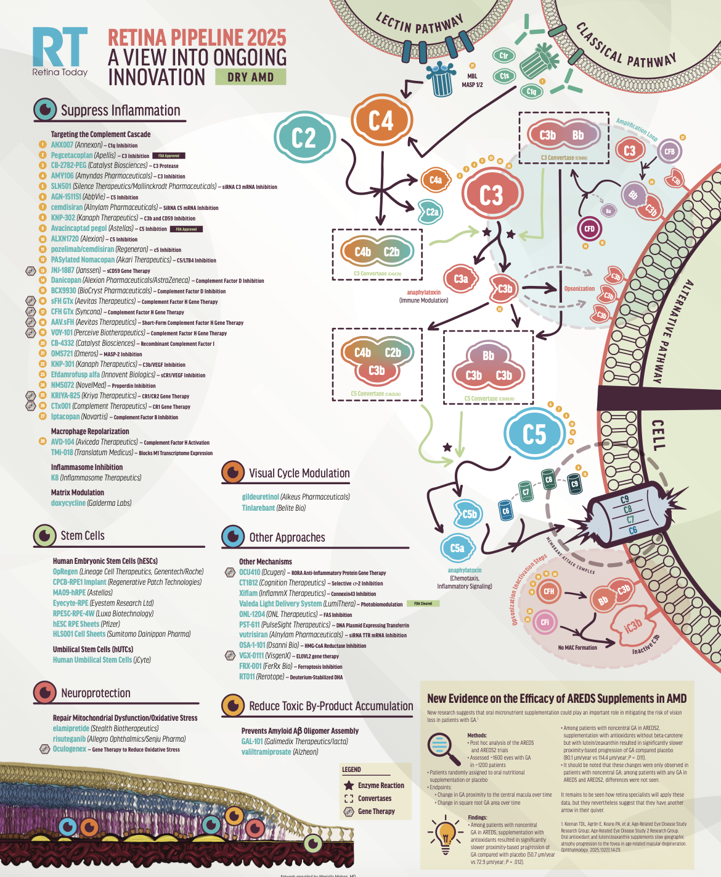
What’s Next?
Suppress Inflammation
Stem Cells
Neuroprotection
Visual Cycle Modulation
Reduce Toxic By-Product
Other Approaches

Slide 20
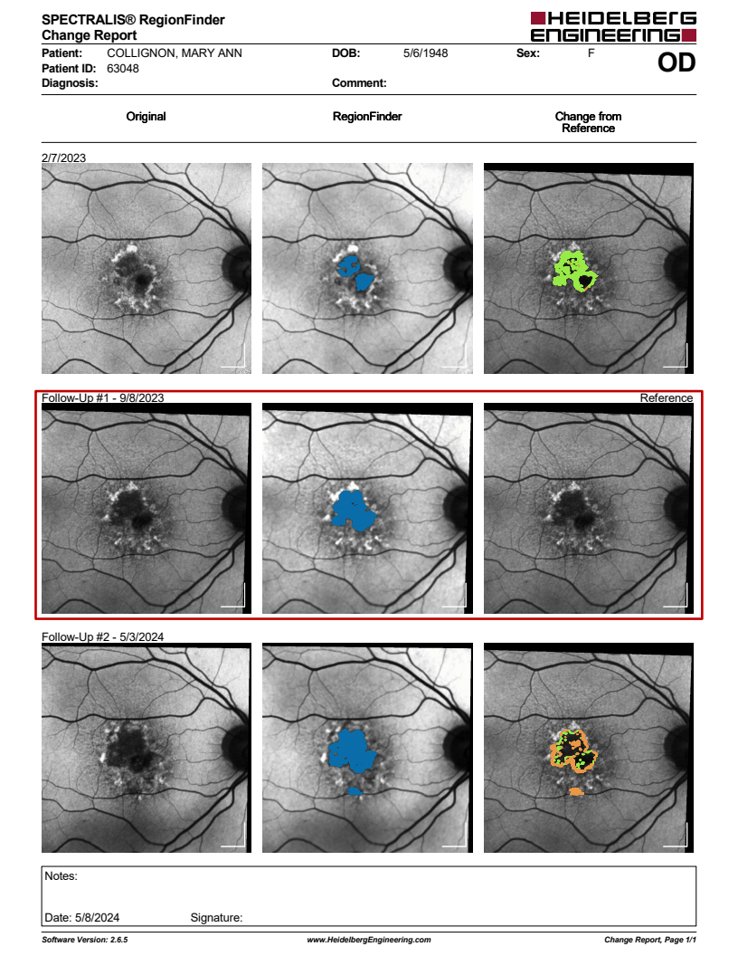
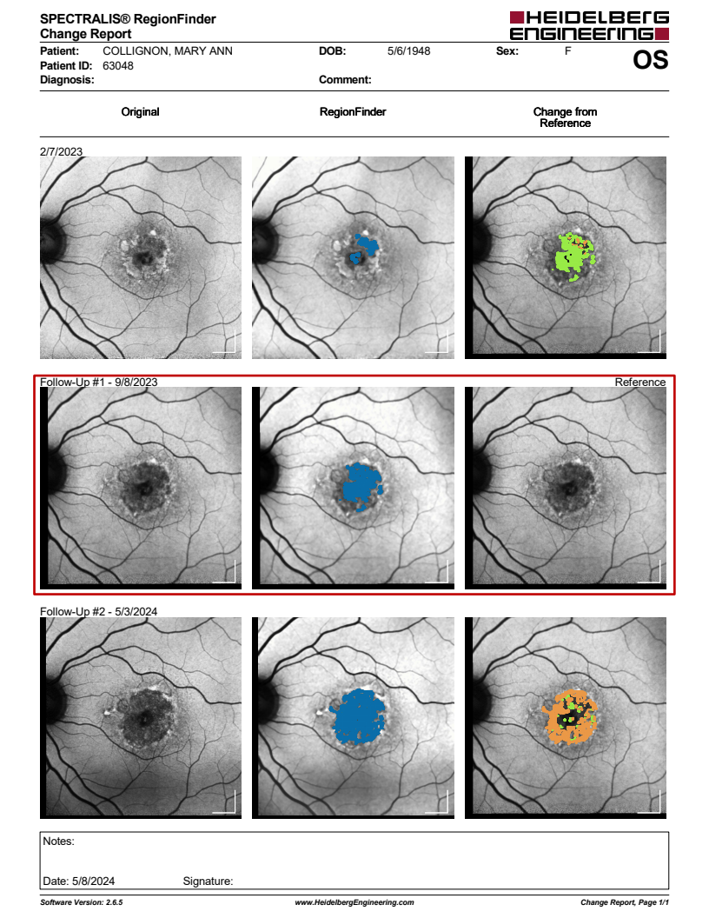
76yoF with bilateral complaints of worsening quality of vision. Began bilateral treatment with pegcetacoplan May, 2023

Slide 21
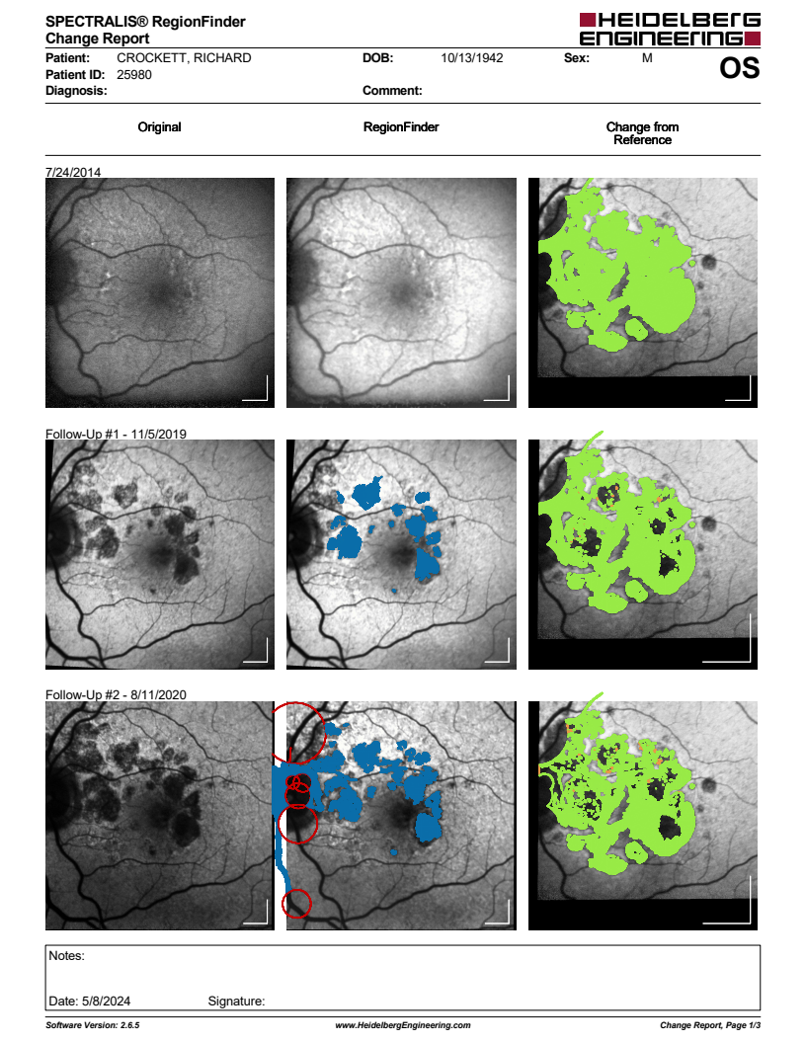
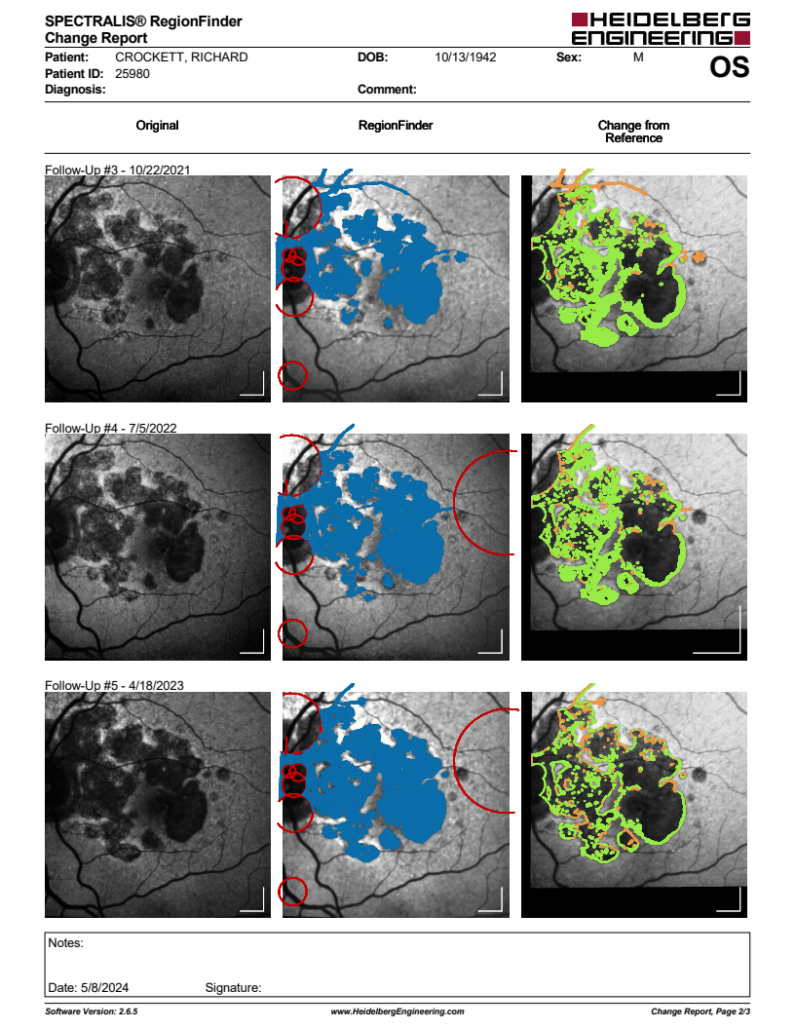
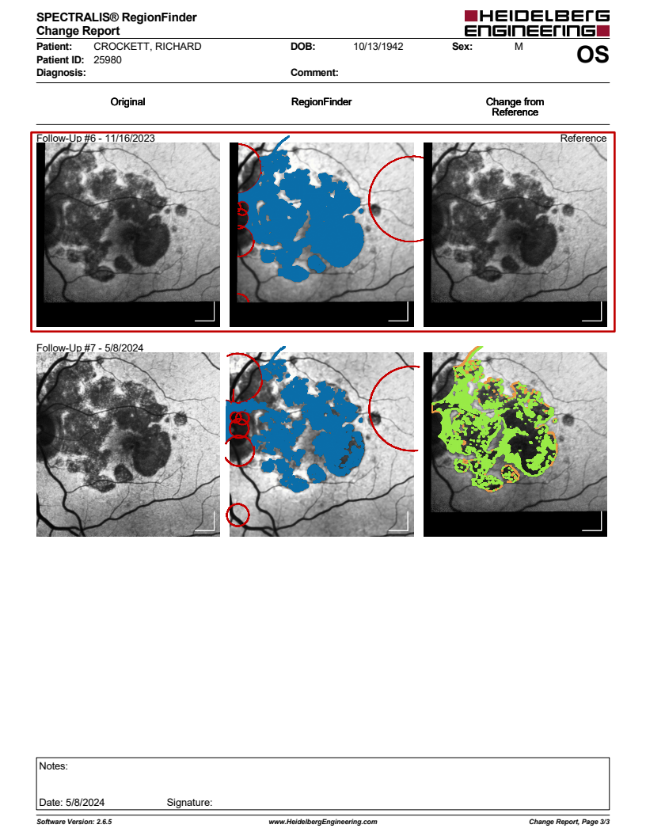
81yoM who started treatment for nAMD in 2018

Slide 22
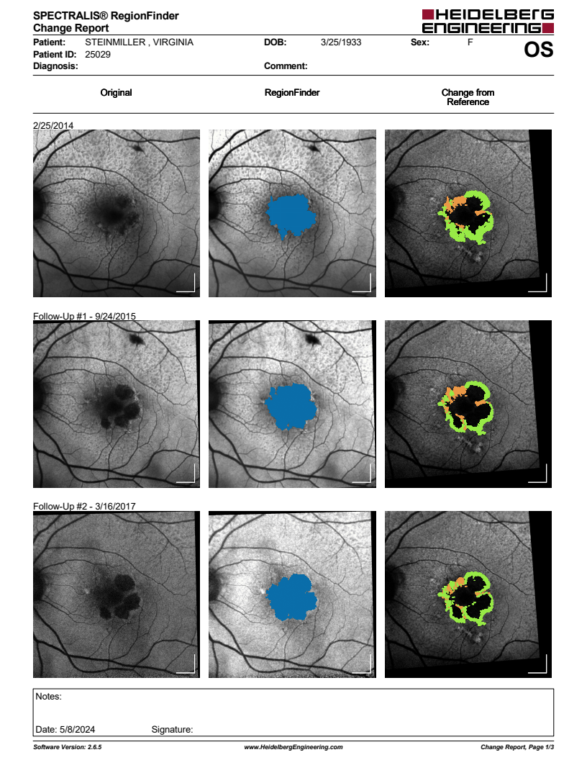
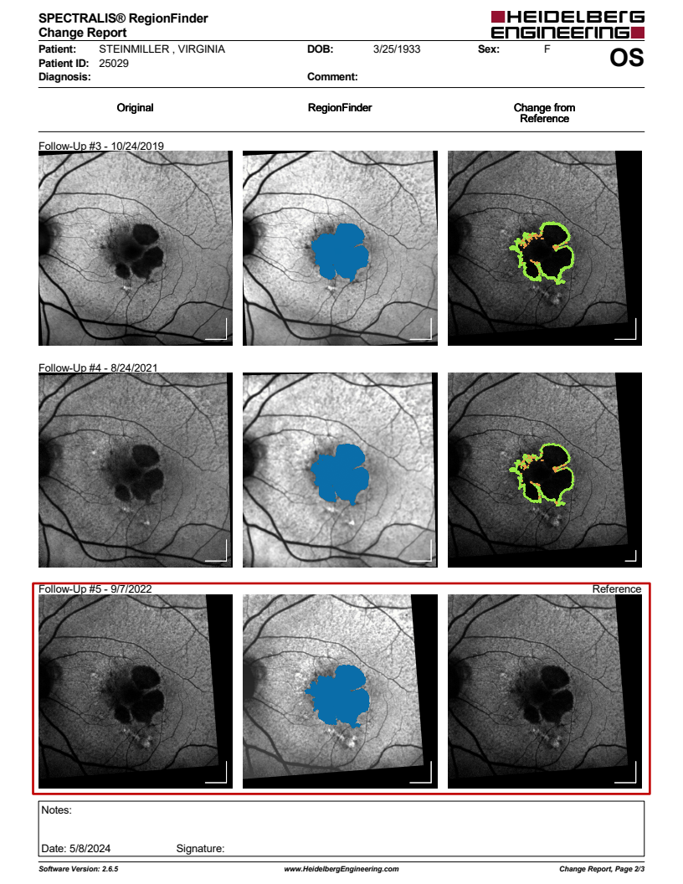
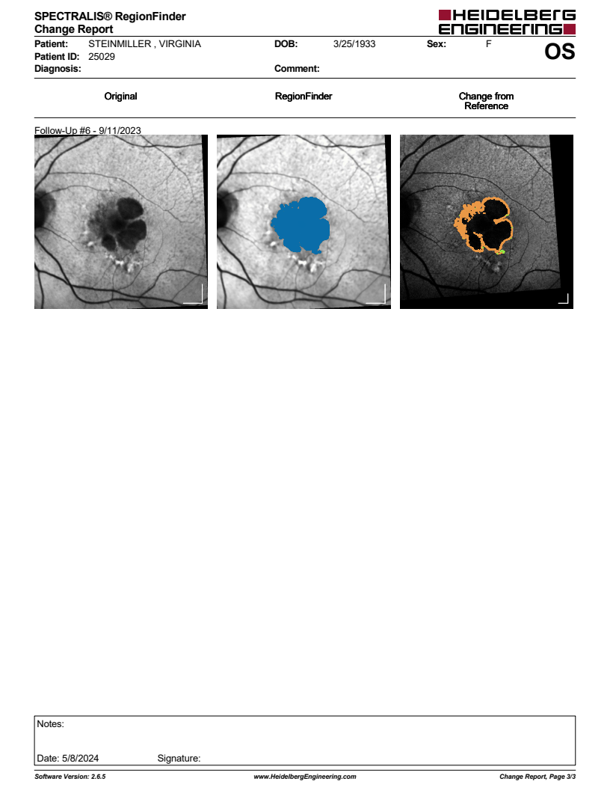
91yoF who started treatment for nAMD in 2017

Slide 23
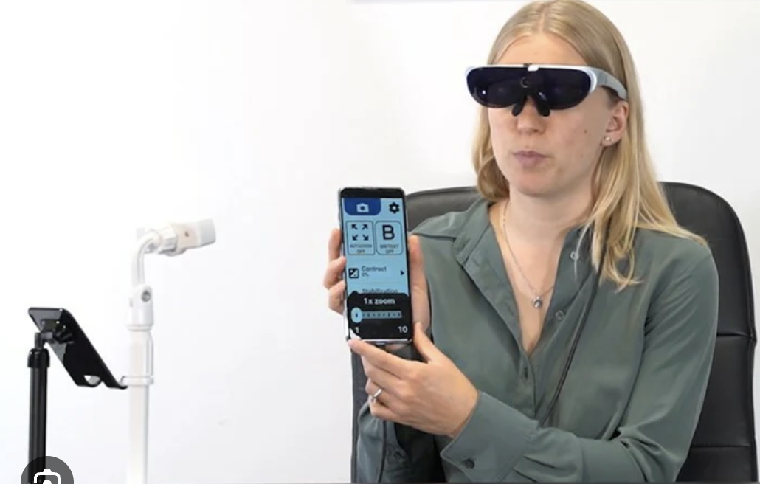
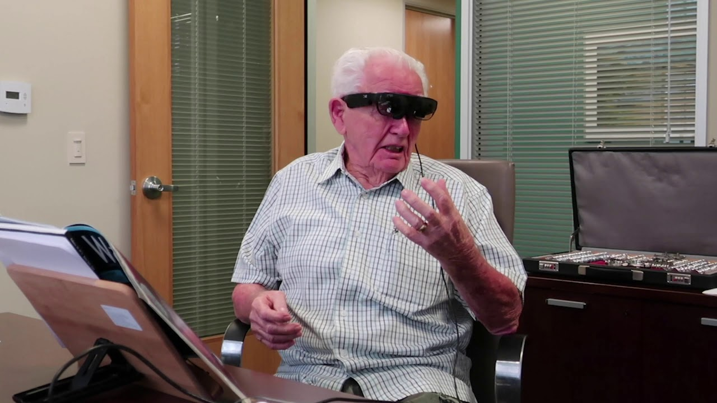
Low Vision Aids
Ho’Opono
  https://humanservices.hawaii.gov/vr/hoopono/about/
  Stand Magnifier
  Closed Circuit TV
Wearable Devices: Eyedaptic, eSight
  https://eyedaptic.com/
Smartphone apps/virtual assistants (Siri)
Online resources
https://hadleyhelps.org/
  https://www.youtube.com/c/theblindlife
Notes:
So what are our options once vision is lost.
The state department runs Ho’Opono whose mission is to enable visually impaired adults to attain maximum vocational and functional independence. It’s located at 1901 Bachelot St, Honolulu, HI 96817, which I believe is Kalihi.
Can obtain vocational training, and assistive devices such as closed circuit tv and stand magnifiers.
Wearable devices. My office has partnered with Eyedaptic to bring the newest version of the wearable device to Hawaii. The device uses augmented reality to overcome the central scotoma and allow wearers to “see”. It is best for patients with central vision loss, such as ARMD, DR, Stargardts with vision 20/60-20/400 in the better eye.
Play the video
We’ve received a lot of good feedback from patients who have tried it. It ranges from patients who are trying to continue working to retired individuals who just want to watch sports
The most moving story I’ve heard regarding the glasses is a young woman who’s vision declined during pregnancy due to Stargardts. The first time she ever truly saw her baby’s face was when she tried on the glasses.
Unfortunately cost is a significant barrier for most low vision devices as they are not covered by insurance
There are also some online resources for the more internet savvy low vision patient.

Slide 24
References
Klein R, Klein BE, Knudtson MD, et al. Fifteen-year cumulative incidence of age-related macular degeneration: the Beaver Dam Eye Study. Ophthalmology. 2007;114:253-262.
Buch H, Vinding T, Nielsen NV, et al. 14-year incidence progression and visual morbidity of age-related maculopaty: The Copenhagen City Eye Study. Ophthalmology. 2005;112:787-798.
Klein R, Klein BE, Linton KL. Prevalence of age-related maculopathy. The Beaver Dam Eye Study. Ophthalmology. 1992;99:933-943.
Smith W, Assink J, Klein R, et al. Risk factors for age-related macular degeneration: Pooled findings from three continents. Ophthalmology. 2001;108:697-704.
Pauleikhoff D, Spital G, Bird AC. A Fluorescein and Indocyanine Green Angiographic Study of Choriocapillaris in Age-related Macular Disease. Arch Ophthalmol. 1999;117:1353-1358.
Srinivas S, Chakravarthy U, et al. Clinical endpoints for the study of geographic atrophy secondary to age-related macular degeneration. Retina. 2016;36:1806–1822.
Frangieh GT, Green WR, Fine SL. A histopathological Study of Best’s Macular Dystrophy. Arch Ophthalmol. 1982;100:1115-1121.
Sparrow JR, Boulton M. Lipofuscin and its role in retinal pathobiology. Exp Eye Res. 2005;80:595-606
Von Ruckmann A, Fitzke FW, Bird AC. Fundus Autofluorescence in Age-Related Macular Disease Imaged with Laser scanning Ophthalmoscope. Invest Ophthalmol Vis Sci. 1997;38:478-86
Holz FG, Bellman C, Staudt S, et al. Fundus Autofluorescence and Development of Geographic Atrophy in Age-Related Macular Degeneration. Invest Ophthalmol Vis Sci. 2001;42:1051-1056.
Schmitz-Valkenberg S, Bültmann S, Dreyhaupy J, et al. Fundus autofluorescence and fundus perimetry in the junctional zone of geographic atrophy in patients with age-related macular degeneration. Invest Ophthalmol Vis Sci. 2004;45:4470-4476.
Schmitz-Valckenberg S, Bindewald-Wittich A, Dolar-Szczasny J, et al. Fundus Autofluorescence and Fundus Perimetry in the Junctional Zone of Geographic Atrophy in Patients with Age-Related Macular Degeneration. Invest Ophthalmol Vis Sci. 2006;47:2648-2654.
Bindewald A, Schmitz-Valckenberg S, Jorzik JJ et al. Classification of abnormal fundus autofluorescence patterns in the junctional zone of geographic atrophy in patients with age related macular degeneration. Br J Ophthalmol. 2005;89(7):874-8.
Holz FG, Bindewald-Wittich A, Fleckenstein M et al. Progression of geographic atrophy and impact of fundus autofluorescence patterns in age-related macular degeneration. Am J Ophthalmol. 2007;143(3):463-72.
Suness JS, Gonzalez-Baron J, Bressler NM, et al. The Development of Choroidal Neovascularization in Eyes with Geographic Atrophy Form of Age-Related Macular Degeneration. Ophthalmology. 1999;106:910-919.
Suness JS, Margalit E, Bressler NM, et al. The Long-term Natural History of Geographic Atrophy from Age-Related Macular Degeneration: Enlargement of Atrophy and Implications for Interventional Clinical Trials. Ophthalmology. 2007;114:271-277.
Ambati, J., Atkinson, J. P., & Gelfand, B. D. (2013). Immunology of age-related macular degeneration. Nature reviews. Immunology, 13(6), 438–451.
Fleckenstein, M., Keenan, T. D., Guymer, R. H., Chakravarthy, U., Schmitz-Valckenberg, S., Klaver, C. C., ... & Chew, E. Y. (2021). Age-related macular degeneration. Nature reviews Disease primers, 7(1), 31.

Slide 25

Questions?

