Slide 1
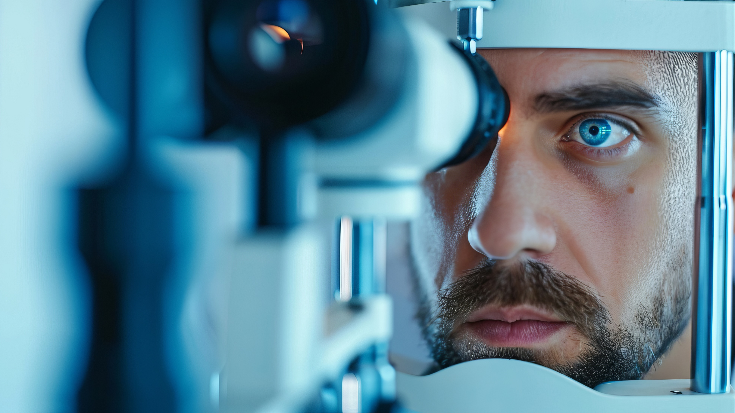


Modern LASIK -
Debunking Myths
Neda Nikpoor, MD
October 28, 2025

Slide 2

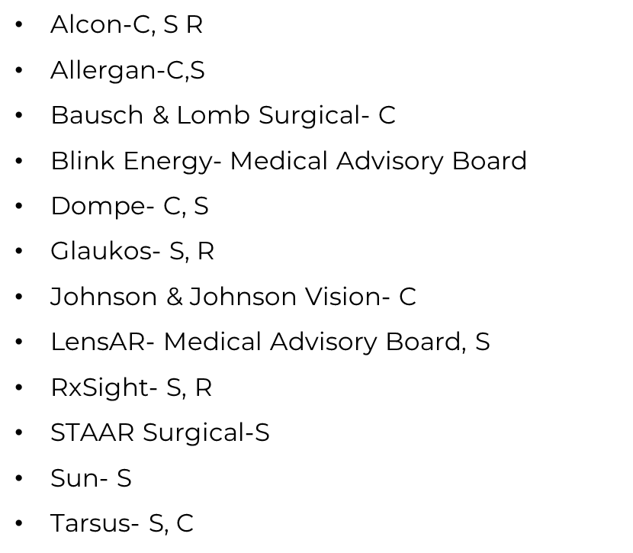
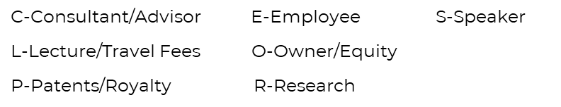
Financial Disclosures
All financial relationships have been mitigated

Slide 3
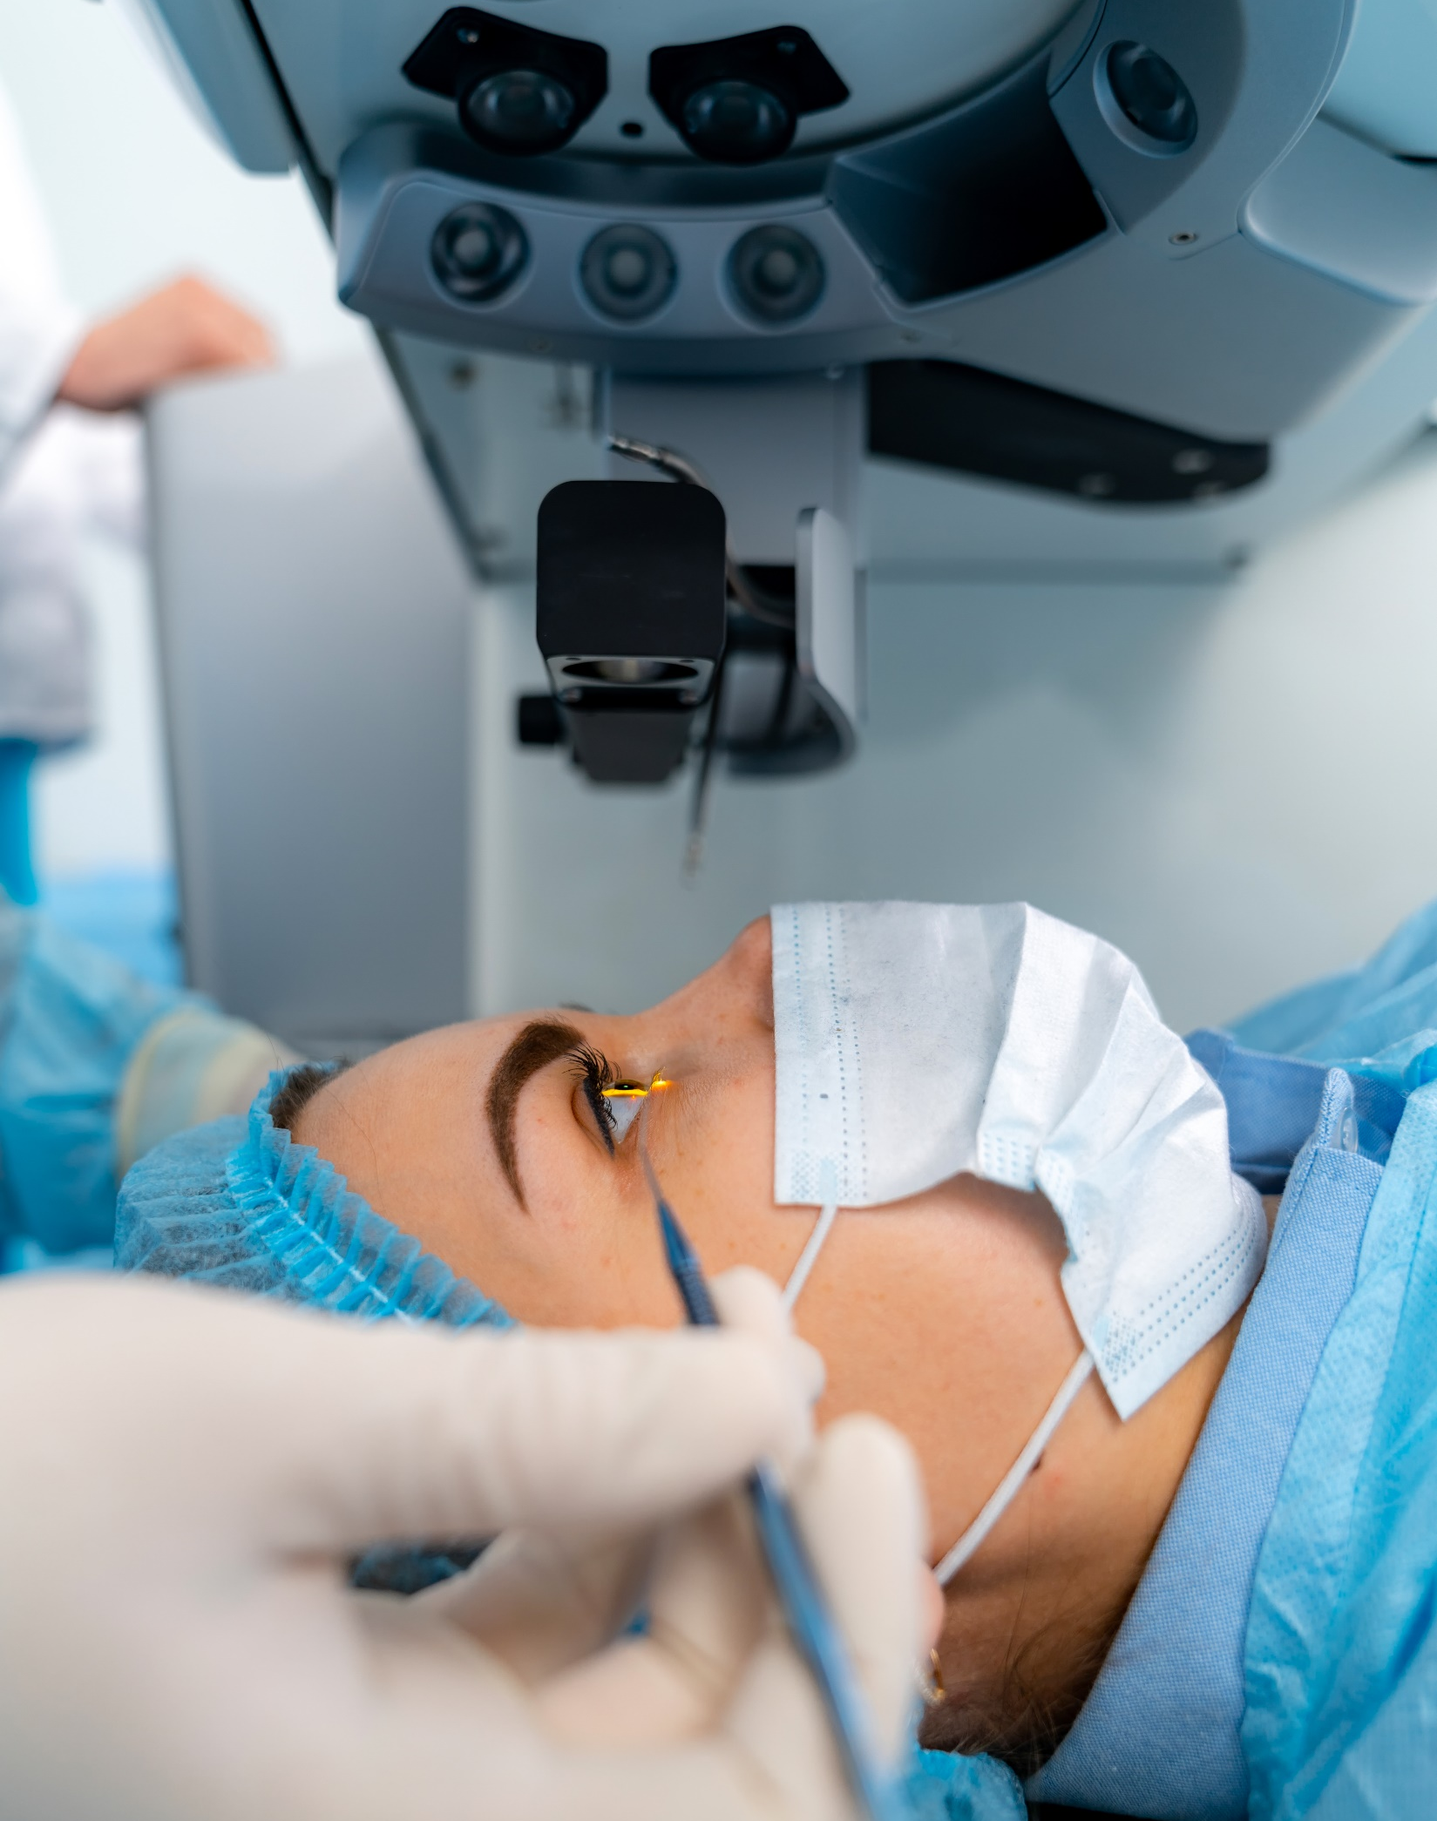




Why This Matters
Patients are influenced by outdated info, anecdotes, and online myths.
Your guidance is crucial in helping them understand today’s LASIK.
We'll walk through common myths and the data behind the truth.

Slide 4
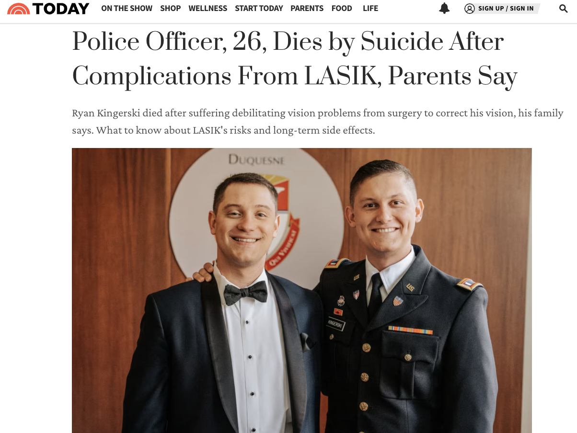
Notes:
- Before we dive in, I want to take a moment to address something serious that’s been in the news recently (may 28) — a tragic case of LASIK-associated suicide, which has brought attention to the rare but very real issue of neuropathic ocular pain.
- As someone who’s had one patient with suspected neuropathic symptoms, I can say it was challenging — but ultimately my patient had a good outcome.
My goals: 1) not to scare anyone, 2) honesty and transparency, 3) awareness so you recognize and refer these patients right away so our community never suffers a tragic loss like this.
I’m sharing this upfront not to scare anyone, but because I believe in being honest and transparent. It’s important that we, as eye care providers, are aware of these rare outcomes, know how to talk about them, and continue working together to give patients the safest, most supportive care possible.”

Slide 5
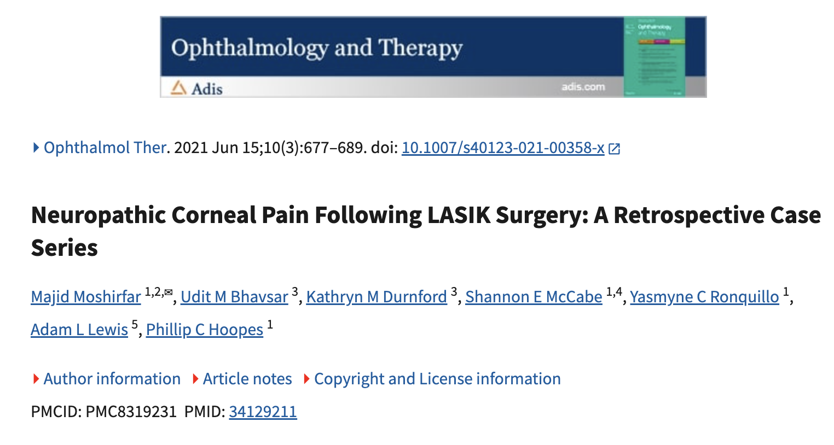
What Is The Incidence Of Nerve Pain After LASIK?
This study is a retrospective medical record review of a case series of 18 patients who developed NCP post-LASIK over the years 1996–2021.
The 26-year prevalence of NCP post-LASIK in this study was roughly 1 in 900 cases, or 0.0011%.
Neuropathic corneal pain (NCP) after LASIK surgery is a chronic pain condition that can occur after refractive surgery.

Slide 6

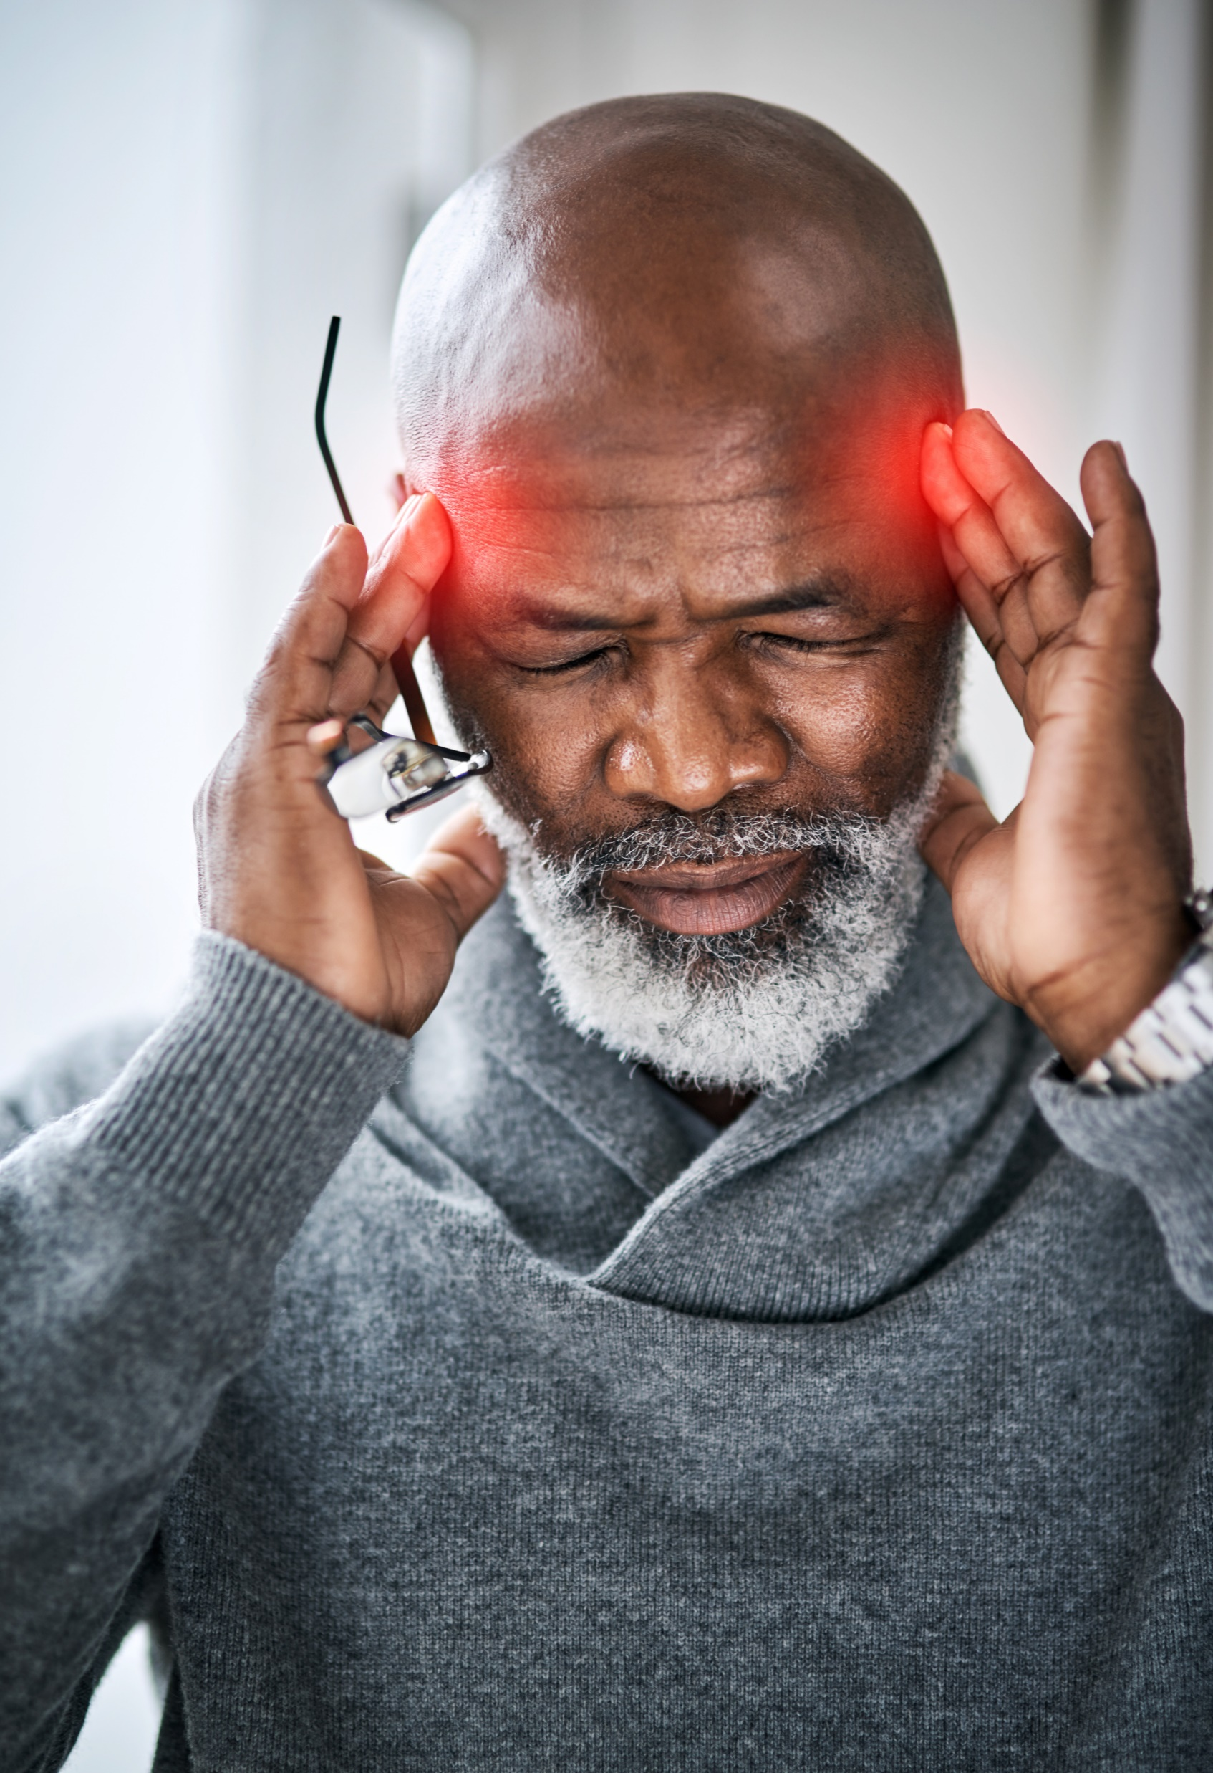
What Factors Were Associated
With Neuropathic Corneal Pain After LASIK?
The majority of patients were female (72.2%) and of Caucasian ancestry (83.3%).
Patients had past medical histories significant for neuropsychiatric conditions (50%), functional pain syndromes (22.2%), autoimmune diseases (33.3%), and hypothyroidism (27.8%)
Symptoms include severe pain (not relieved by topical anesthetic), normal ocular surface exam, and often photophobia.

Slide 7
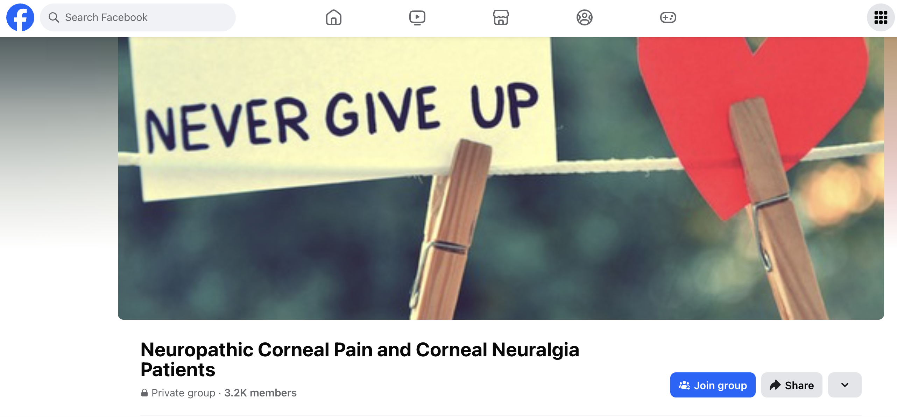
My Own Experience
Young Caucasian female with fibromyalgia, depression, and anxiety.
PRK performed and patient developed severe pain (not relieved by proparacaine) and photophobia
Social history: later learned the patient was unhappy in her marriage and divorced about 6 months after surgery
PSHx relevant for tummy tuck and breast implants (later revealed that she had “complications” after those surgeries)
Treatments included steroids, serum tears, Cequa/Xiidra, AMT/BCL, oxervate, oral gabapentin, oral duloxetine, and ultimately Botox
IMPORTANT TAKEAWAY: SHE NEVER FELT DISMISSED OR ABANDONED
Treatments were successful, and patient resumed underwater photography and normal life activities.

Slide 8

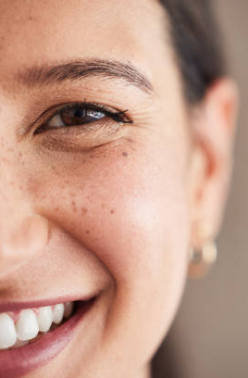

Context Is Important
Neuropathic pain is real but very rare and is manageable with early recognition and compassionate, competent care
LASIK is one of the most commonly performed elective procedures in the world with one of the highest satisfaction rates of any procedure.
FACT: 30 years and 40 million procedures worldwide with the highest patient satisfaction rate of any elective procedure (more than 96%)

Slide 9

PROWL Studies
The Patient-Reported Outcomes with LASIK (PROWL) study is a clinical trial of over 500 people who had LASIK eye surgery 2011-2014.
GOAL of the study was to validate a pre-surgery and post-surgery patient reported outcome surveys.
PROWL-1 was conducted at a military center with 262 active-duty Navy personnel (ages 21-52 years of age).
PROWL-2 had 312 civilian participants (ages 21-57 years of age) located at five private practice and academic centers around the country.
Overall, patients’ satisfaction was extremely high, with 96% of patients in PROWL-1 and 98.7% in PROWL-2 expressing satisfaction with their vision at month 3.

Slide 10
Now With That Said…
Let’s dive into some common misconceptions about LASIK

Slide 11
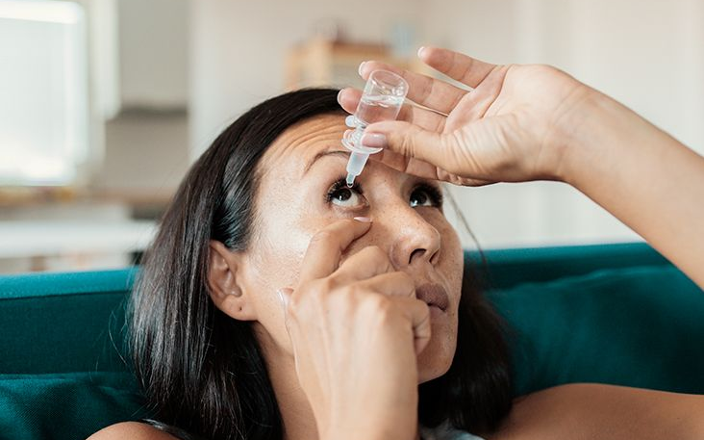



Myth #1: "LASIK Causes Dry Eye"
Data
PROWL-1 & 2: 59% of patients with pre-op dry eye had resolution of their symptoms at 3mo
PROWL-1: 65% of patients with pre-op dry eye had resolution of their symptoms at 6mo
Reality: Temporary dryness is common; long-term issues are rare.
PROWL-2: 19.5% developed dry eye symptoms at 6mo, most of which were mild.
5.1% and 0.08% developed moderate or severe symptoms

Slide 12
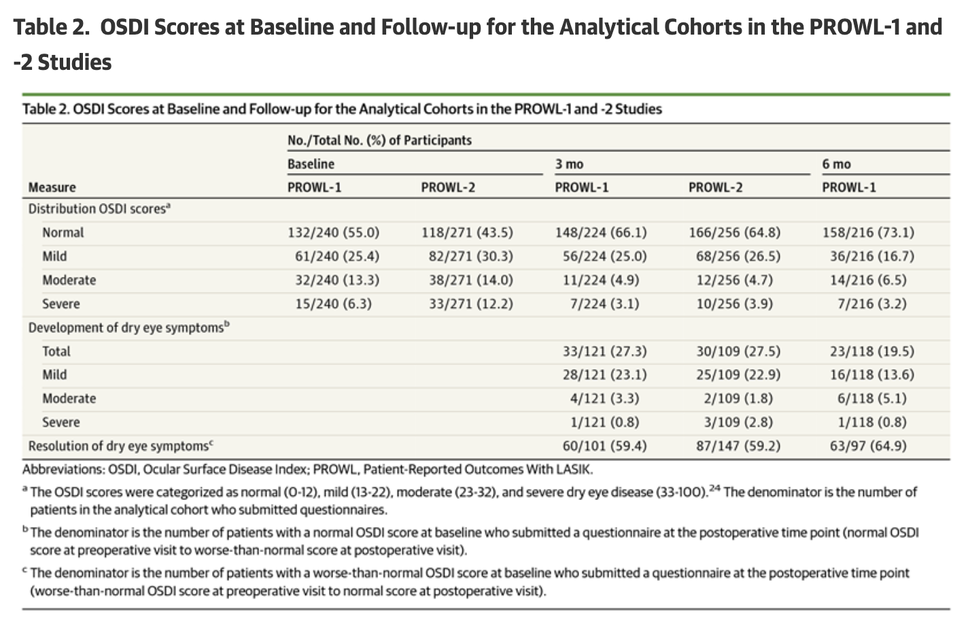
Table 2
OSDI Scores At Baseline And Follow-up For The Analytical Cohorts In The PROWL-I And -2 Studies

Slide 13

Myth #2: "LASIK Is Unsafe"
Data
PROWL-1: 99.5% achieved 20/20 or better; no loss >1 line of BCVA.
The incidence of corneal ectasia after LASIK surgery is estimated to be around 0.04% to 0.2%
Over 7,000 peer-reviewed clinical studies on LASIK
NOTE: Ectasia stats from early 2000s. Incidence is likely lower now
FUN FACT: the lifetime odds of being struck by lightning in the U.S. are 1 in 15,300. that’s 0.006% (which is one sixth of 0.04%)
Reality: Modern LASIK is one of the safest elective procedures.

Slide 14
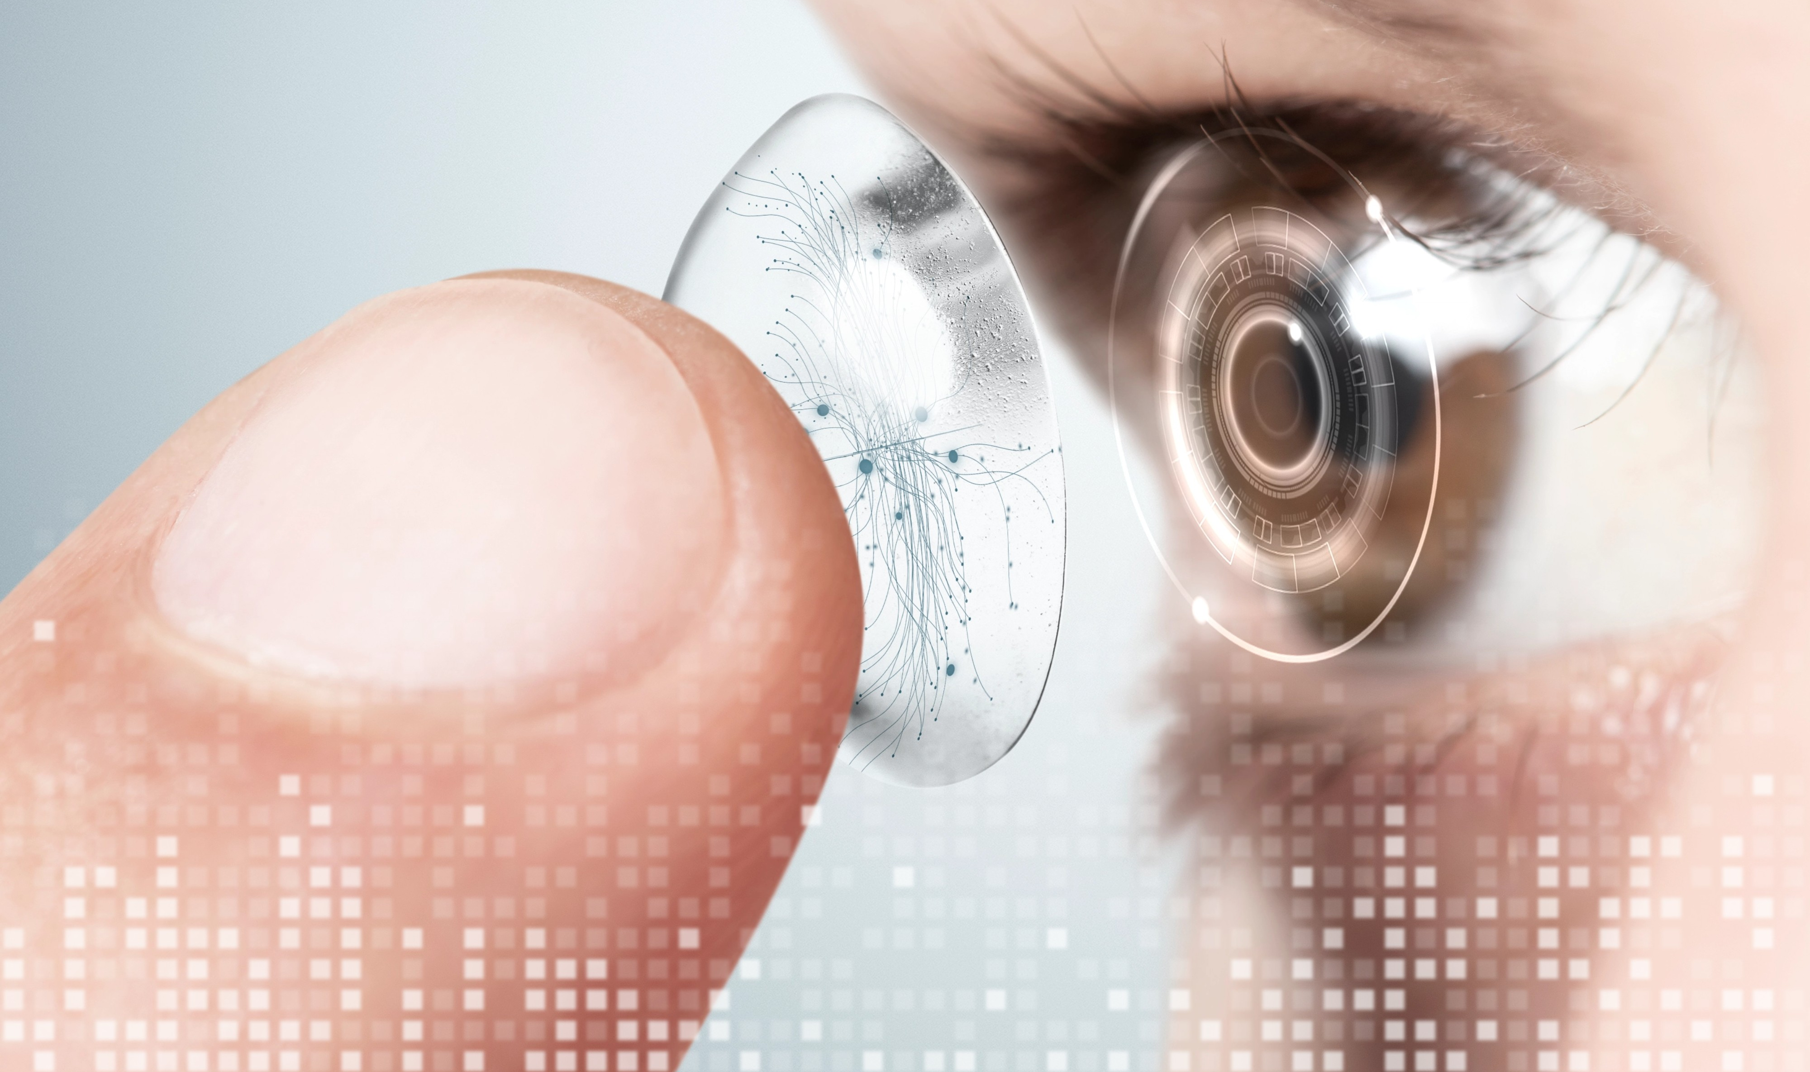
Myth #3: “Contacts Are Safer Than LASIK”
Data
2009 study by McGee and Mathers compared LASIK with
long-term contact lens wear.
The risk of vision loss with LASIK and with daily-wear contact lenses was about the same.
Risk of infection was higher with daily CLs (3x for 5 years of daily soft CL use) than LASIK (1 time risk). (P < 0.0001)
Conclusion: LASIK and long-term contact lens wear carried risks of vision loss that were closer to each other than is generally assumed.
Reality: LASIK is safer than extended wear contact lenses and equal in safety to daily contact lenses
NOTE:
- Familiarity does not mean safety
- Both LASIK and contact lenses are better now.
- A new comparison study should be done, but this is the best data we have.
Notes:
Masters J, Kocak M, Waite A. Risk for microbial keratitis: Comparative metaanalysis of contact lens wearers and post-laser in situ keratomileusis patients. J Cataract Refract Surg. 2017 Jan;43(1):67-73. doi: 10.1016/j.jcrs.2016.10.022. PMID: 28317680.

Slide 15
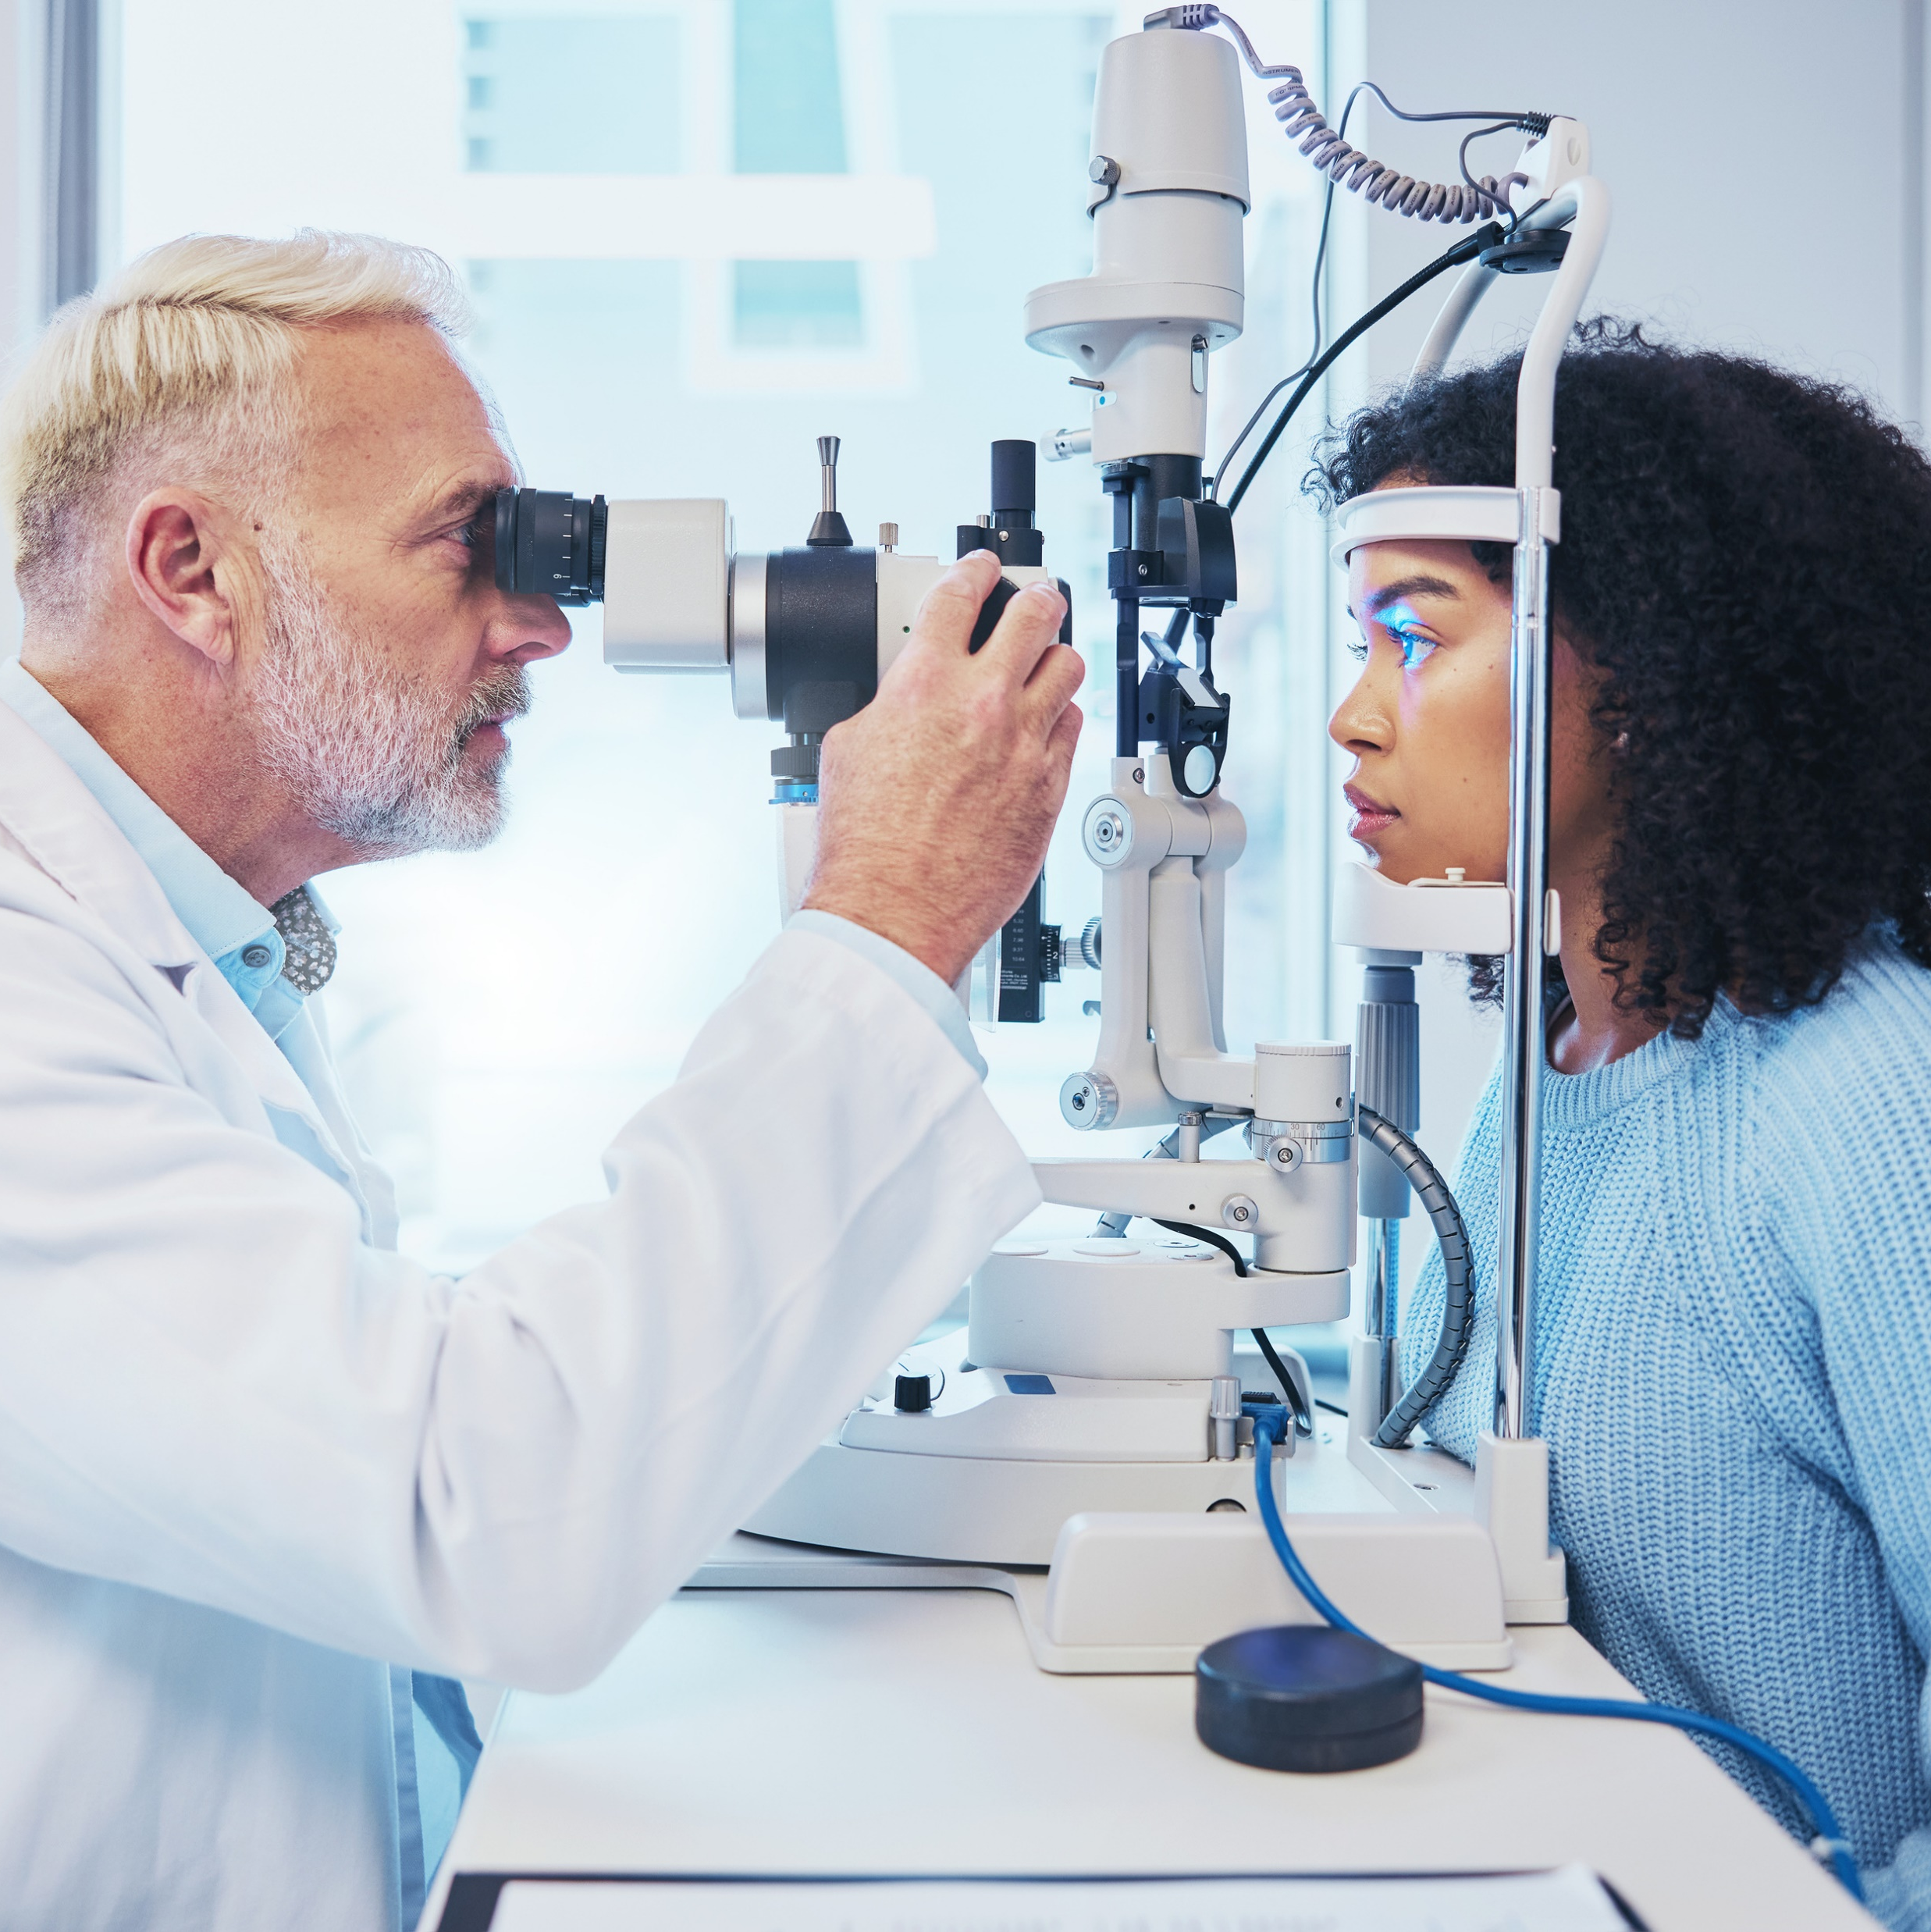

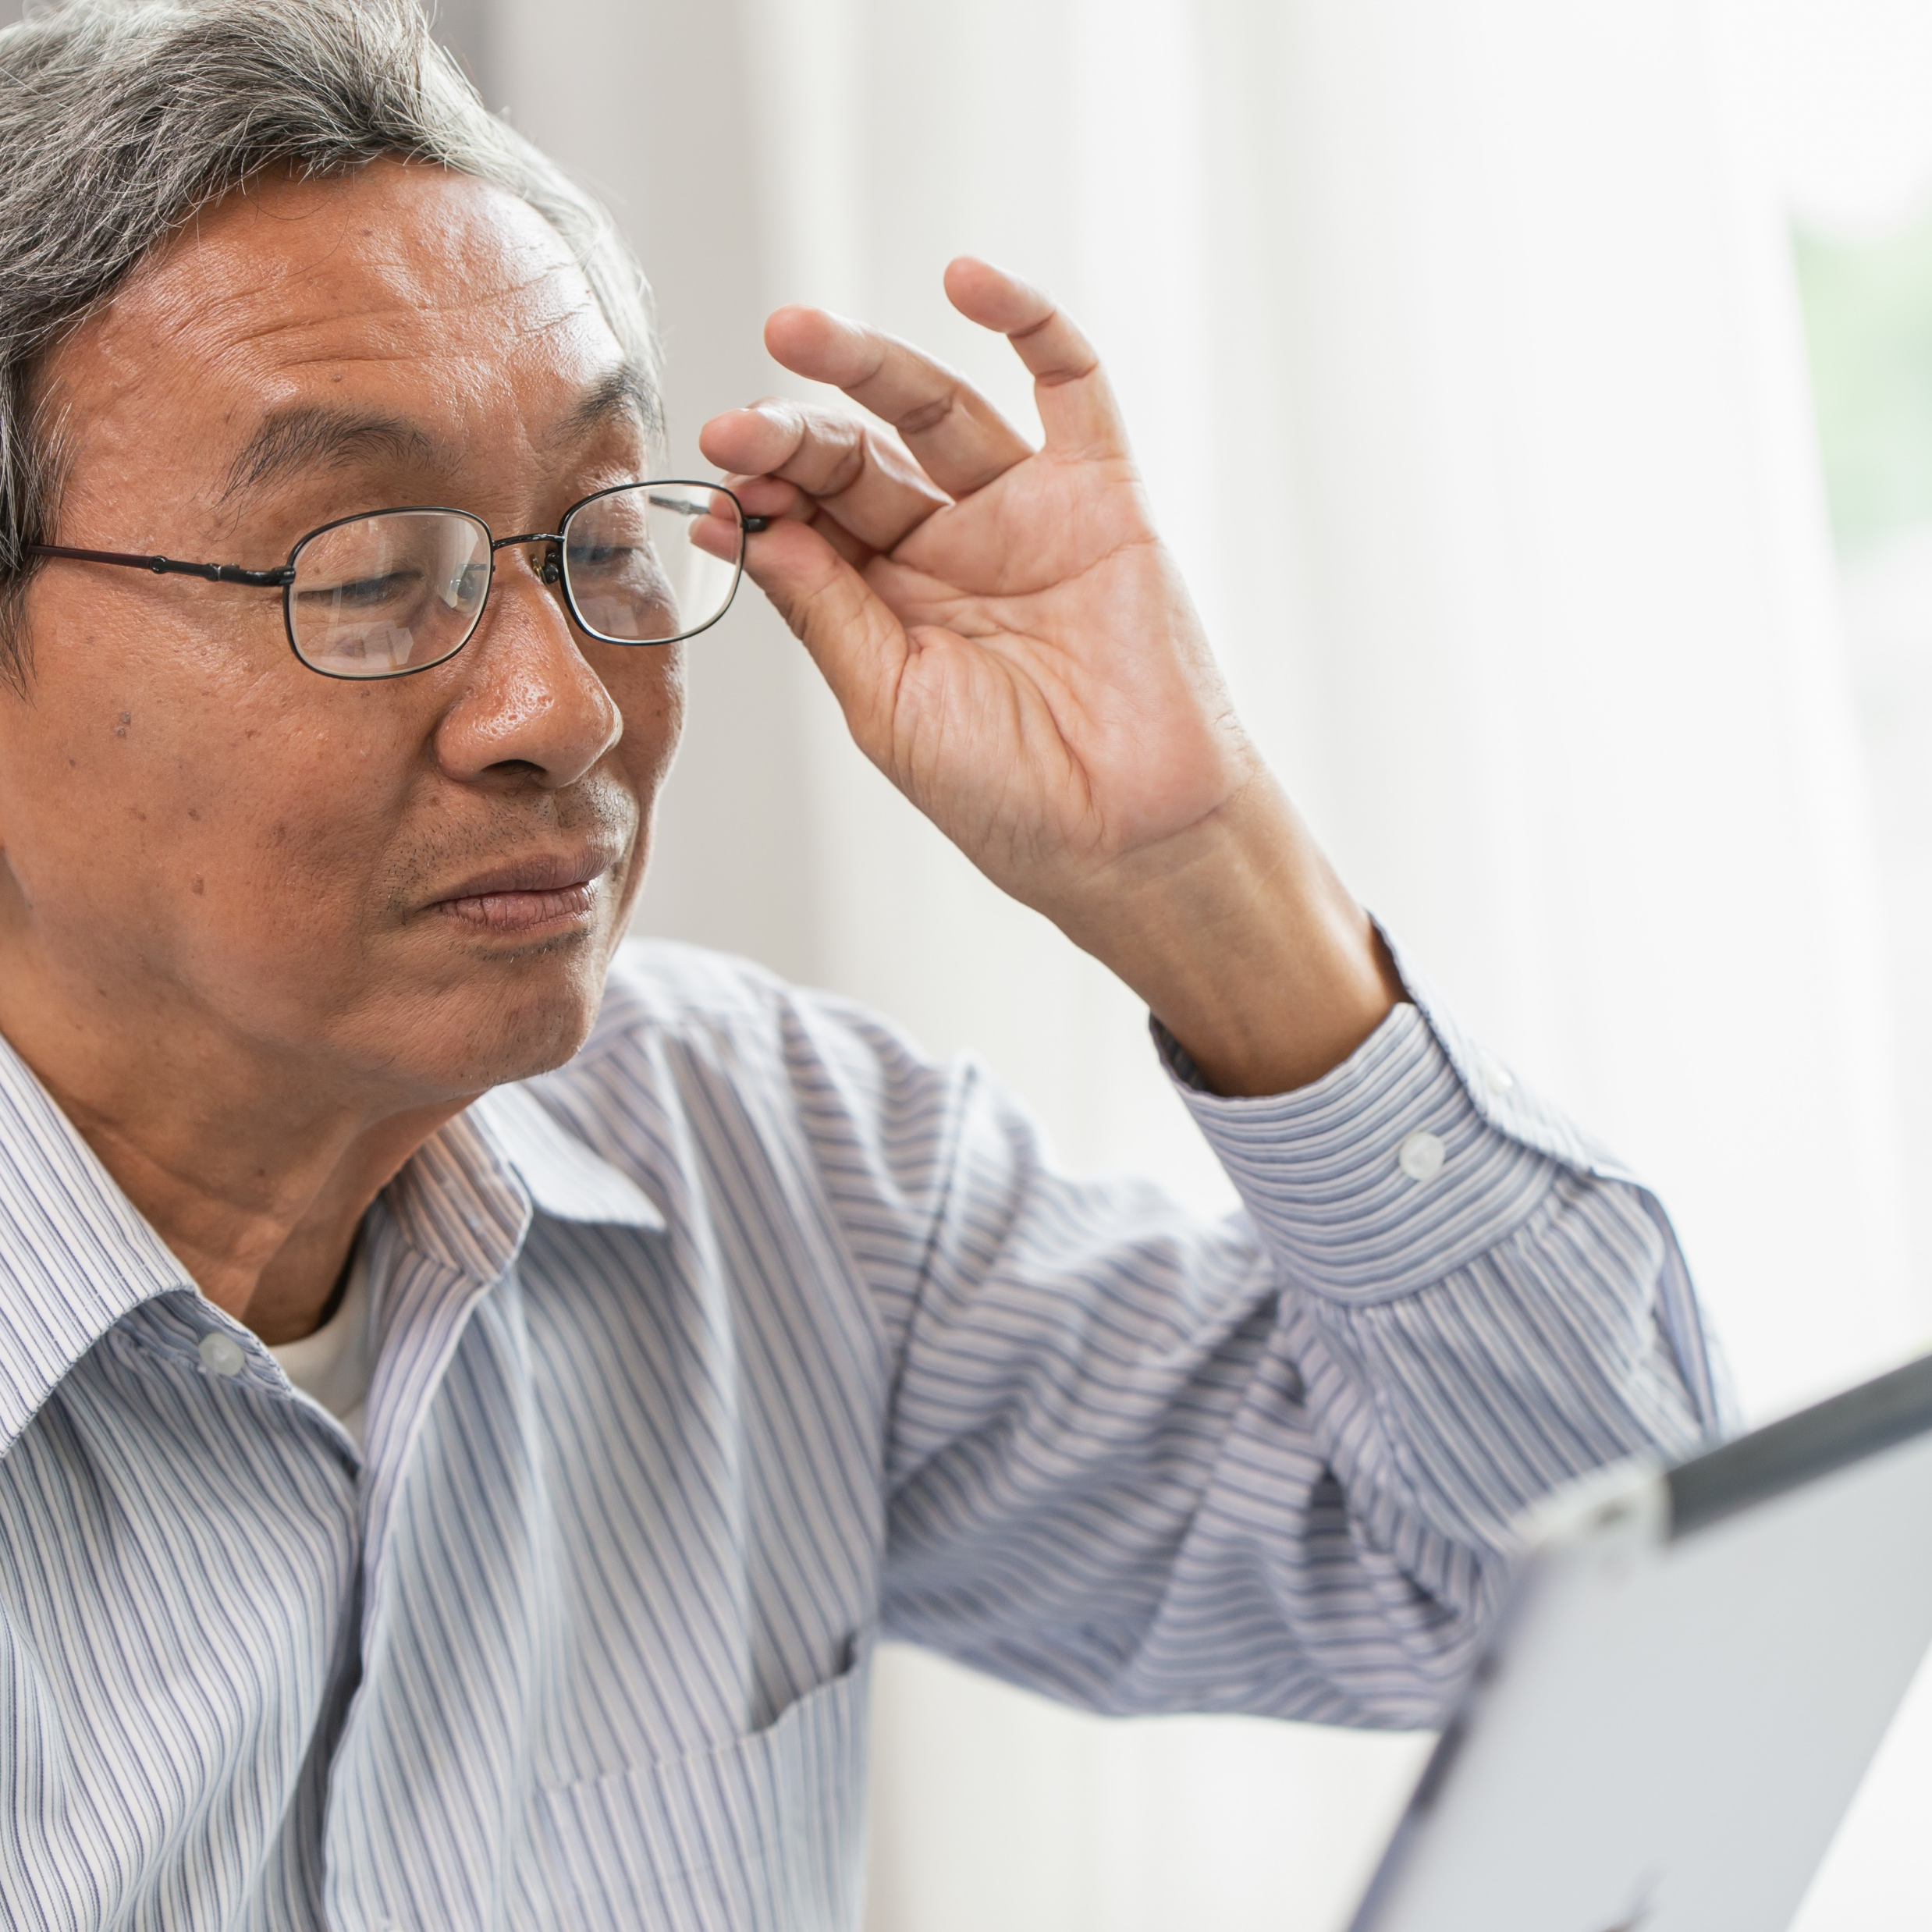
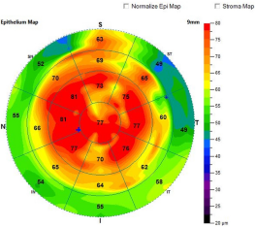
Myth #4: "LASIK Results Don’t Last / LASIK Wears Off"
Reality: Long-term studies show refractive stability.
Regression and progression are not the same thing.
Patients routinely mistake presbyopia for their LASIK “wearing off” and should be pre-educated about presbyopia

Slide 16
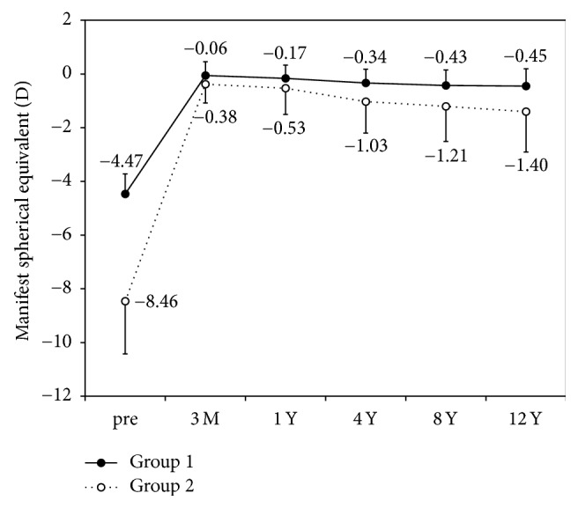
Time Frame | Stability Achieved | Notes | Avg Myopia (SE) | Study / Source
7 years | Excellent | ≤±0.50 D maintained in ~90% | –4.59 D (?) | Li et al, JRS 2008
10 years | Shows regression | - Regression –0.25 D/year in high myopia 42% within +/-1.00 D 61% within +/-2.00 D 5% lost 2 lines of BCVA and 1% ectasia Same data set LOW myopia -0.12D/year | –13.95 D | Alió et al., JCRS 2008 (high myopia)
12 years | Acceptable | Stable under -6D (group 1), regression over -6D (group 2) | –6.70 D | Kamiya et al, Biomed Res Int 2017
Low myopia
High myopia
Notes:
Alió J. L., Muftuoglu O., Ortiz D., et al. Ten-year follow-up of laser in situ keratomileusis for myopia of up to -10 diopters. American Journal of Ophthalmology. 2008;145(1):46–54.e1. doi: 10.1016/j.ajo.2007.09.010.
12 year study https://pmc.ncbi.nlm.nih.gov/articles/PMC5449750/?utm_source=chatgpt.com

Slide 17




Myth #5: "LASIK Causes Night Vision Problems"
Reality: With Contoura/Wavelight Plus, night vision issues typically improve.
PROWL 1 And 2 Data: Visual Complaints (Glare And Halo) Decreased Postoperatively. (2011-2014)
Contoura FDA Trial:
The data is confusing because 43% and 46% developed symptoms at 3mo, but also 46% and 34% had resolution of symptoms at 3mo.
Difficulty performing usual activities due to symptoms was reported by less than 1% of participants
Very or extremely bothersome symptoms were reported by a smaller percentage of participants at 3 months postoperatively than at baseline
Postop - statistically significant decrease in light sensitivity, difficulty driving at night, glare, halos, and starbursts
A study by Tanzer et al : 88% of pilots who land on aircraft carriers at night found their night vision to be better after LASIK with no glasses than they did with their glasses before surgery.
Notes:
Can talk about monofocal patients thinking they have haloes bc we talk about it so much preoperatively.

Slide 18


Myth #6: "LASIK Is Painful"
Reality: LASIK is virtually painless. Numbing drops used. Mild pressure at worst during femto. Flap is created in 6 seconds.
Data: PROWL-1 study: 98% satisfaction at 6 months; discomfort was minimal.

Slide 19
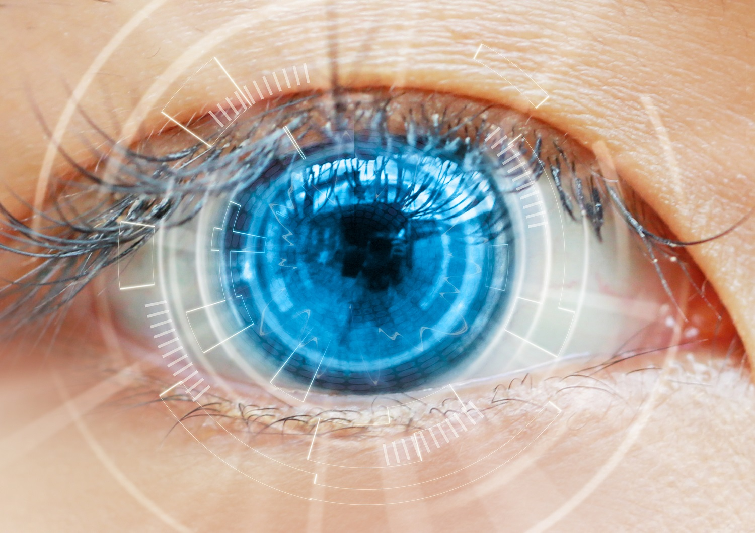
Myth #7: "LASIK Just Matches Glasses Or Contacts"
Reality: Many patients see better after LASIK than they ever did with glasses/contacts.
Data:
CONTOURA: (Topo-Guided LASIK)
31.6% saw better than spectacle BCVA. Treats HOAs.
WAVELIGHT Plus: (Ray Tracing LASIK)
Enhances contrast and visual clarity.
Overwhelming majority see better than 20/20

Slide 20
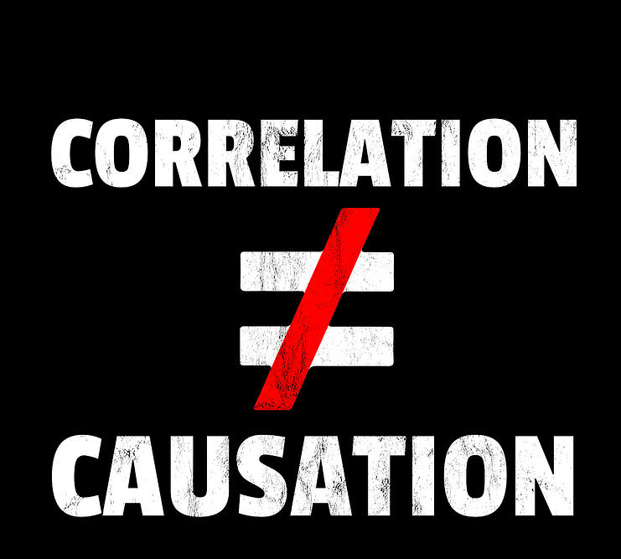
Myth #8: LASIK Causes Retinal Detachments
Reality: It’s more likely association (due to high myopia) but not causation. Data is mixed, but strongest evidence is that LASIK does not cause retinal detachments.
Data
The largest study illustrated a 0.02% yearly incidence in patients who had an average refractive error of -6.00 D, a finding that indicates a lack of association between LASIK and RRD.
Smaller studies however, reported a higher incidence of RRDs in patients who had undergone prior LASIK than would be predicted from myopia alone. (Yearly incidence of 0.02% - 0.30%)
FLAW: different degrees of myopia, highly variable follow-up times, and the retrospective nature of most of the studies.
No large, long-term, case-controlled, prospective study has ever been undertaken to properly evaluate the issue.
Note: FS200 femto mean IOP increase over baseline of ~32-38 mmHg

Slide 21
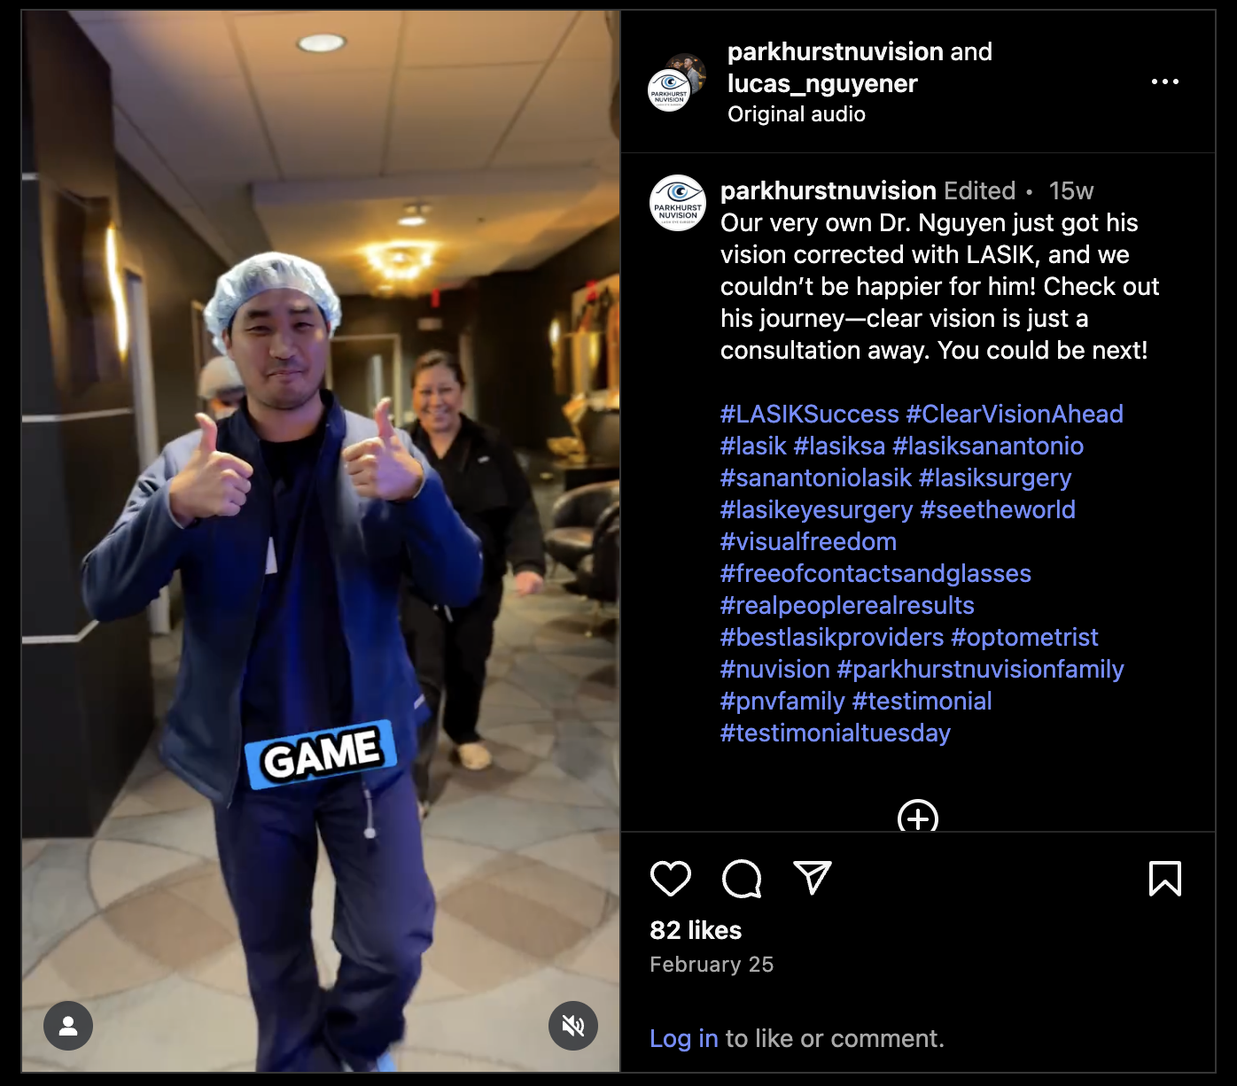
Myth #9: Physicians Would Not Have LASIK On Their Own Eyes
Reality: Ophthalmic surgeons routinely have laser surgery themselves and recommend refractive surgery to family members
Data
Kezirian et al study - refractive surgeons are more than 4x more likely to have had refractive surgery than the general population.
Online survey emailed to 250 randomly selected practicing refractive surgeons
107 respondents who were candidates for laser vision correction. Of these, 67 reported that they had undergone laser vision correction (LASIK, 65.7%; PRK, 34.3%) on their own eyes. (63%)
91% of all respondents said that
they recommend refractive surgery to their immediate family members.

Slide 22
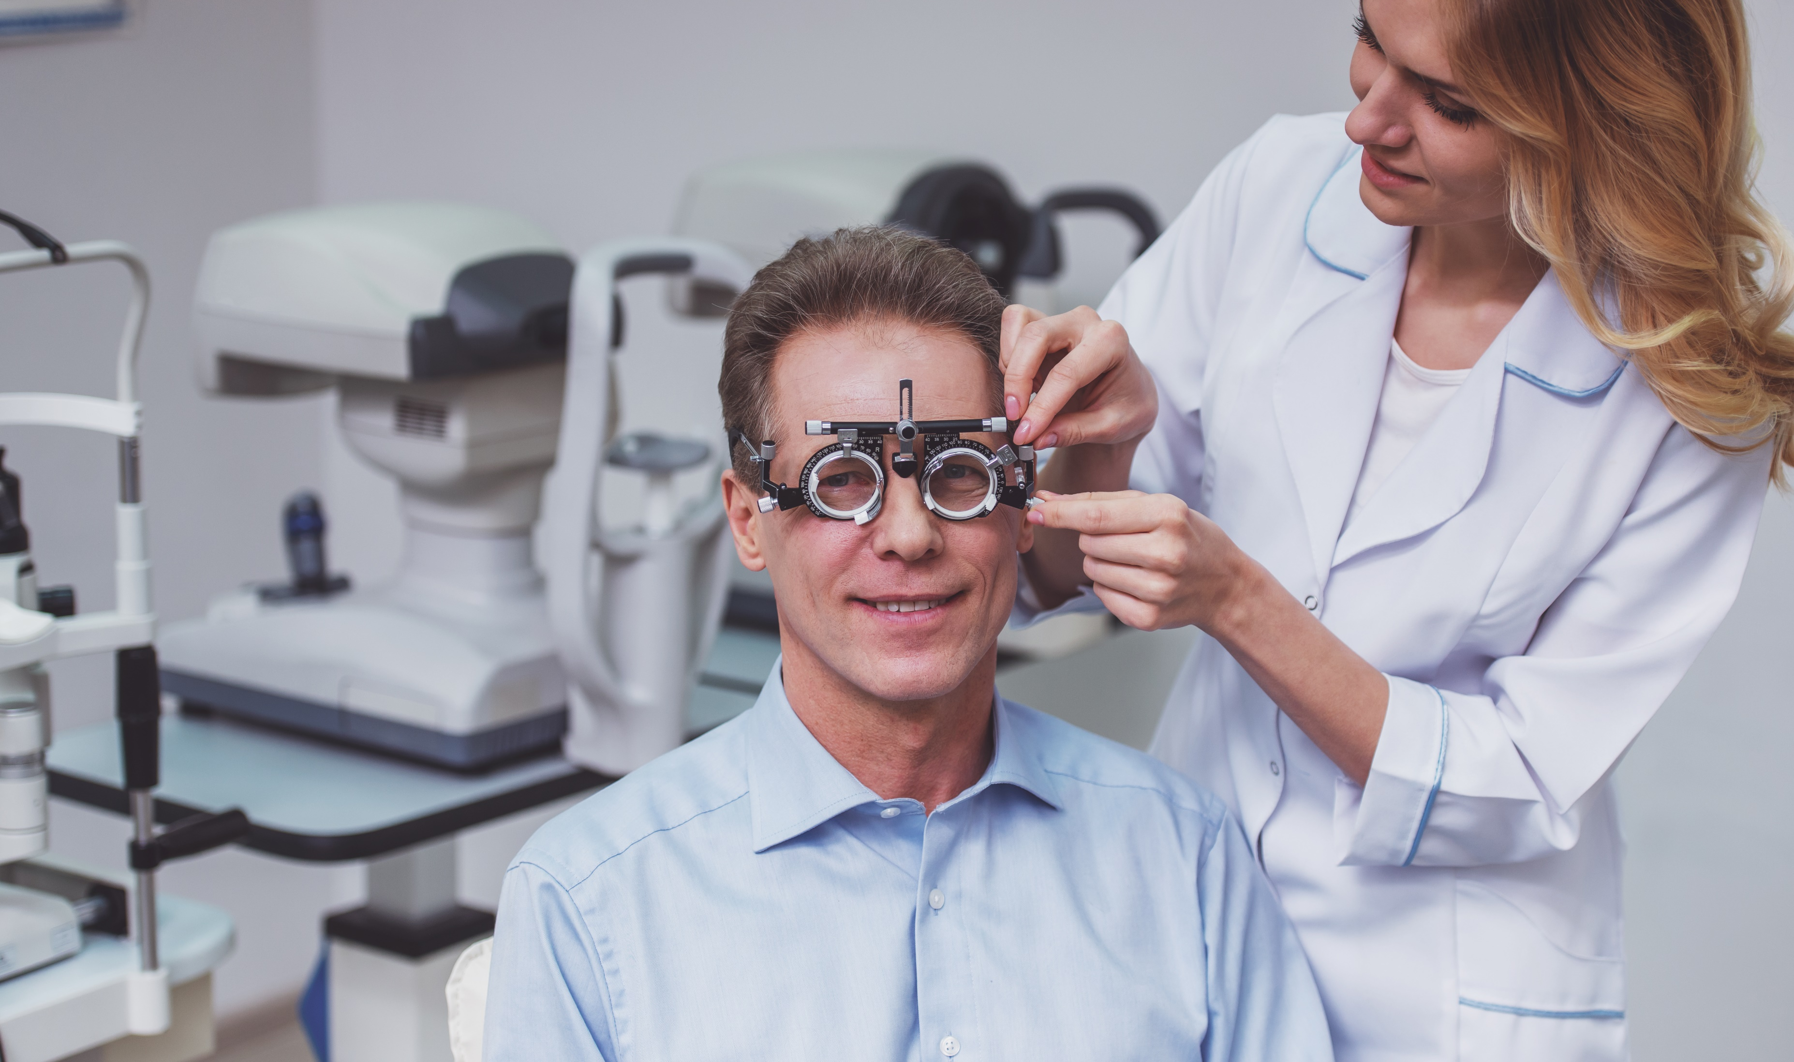
Myth #9: Physicians Would Not Have LASIK On Their Own Eyes
Data
Kezirian et al study - refractive surgeons are more than four times more likely to have had refractive surgery than the general population.
Online survey emailed to 250 randomly selected practicing refractive surgeons
107 respondents who were candidates for laser vision correction. Of these, 67 reported that they had undergone laser vision correction (LASIK, 65.7%; PRK, 34.3%) on their own eyes. (63%)
Reality: Ophthalmic surgeons routinely have laser surgery themselves and recommend refractive surgery to family members
91% of all respondents said that
they recommend refractive surgery to their immediate family members.

Slide 23
Myth #9 Continued
In a separate survey of physicians who underwent laser vision correction at one institution, patients’ satisfaction among 132 respondents was 95.3%.
In this physician population, 84.8% of participants who answered a 12-question survey on their unique experiences with refractive surgery noted an improved quality of vision postoperatively compared with their preoperative vision with glasses.

Slide 24
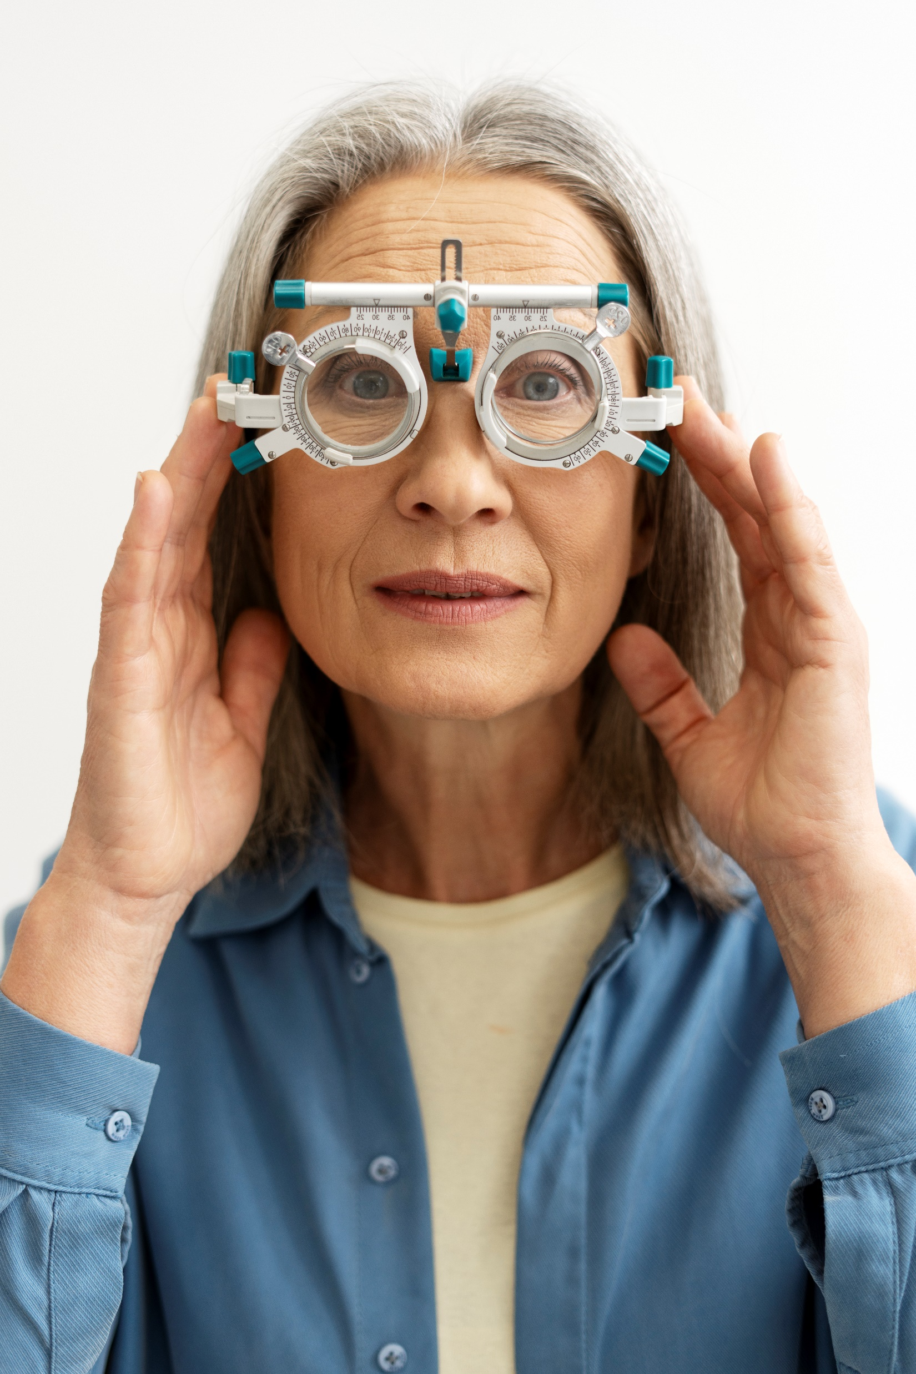
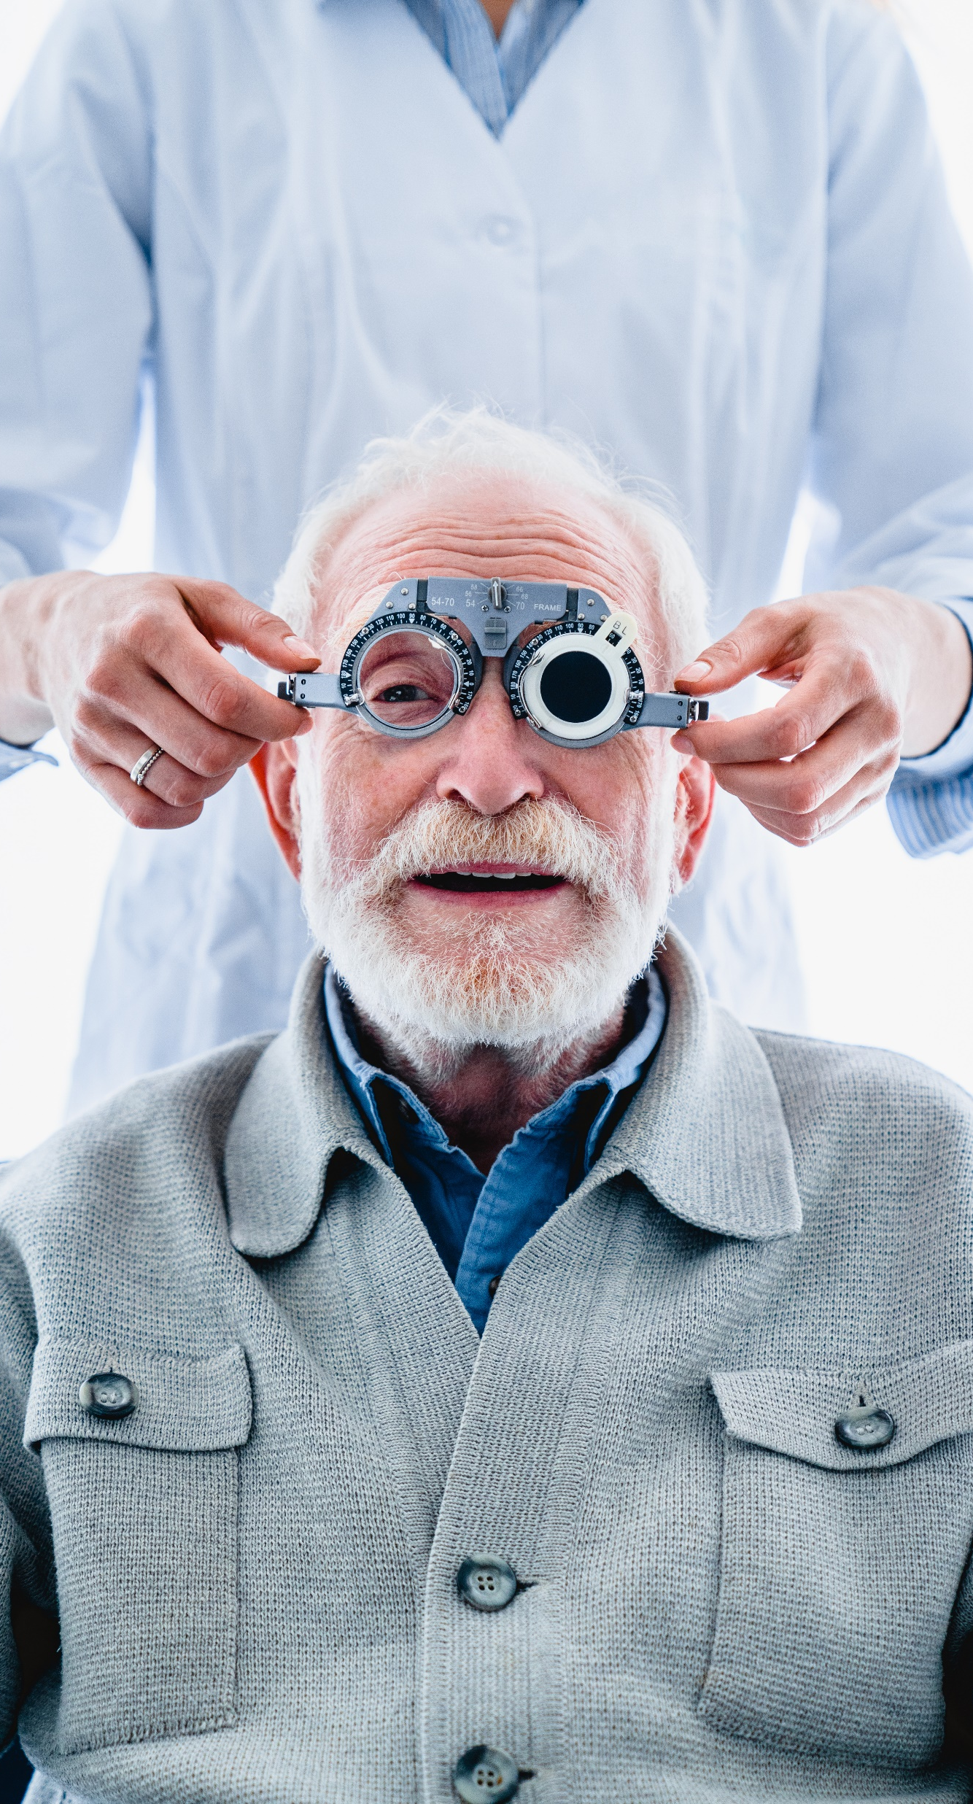

Myth #10: I’m Too Old For LASIK
True that LASIK is more satisfying for patients under 40 who can enjoy the freedom of complete independence from glasses, but…
Reality: We routinely do LASIK with monovision for patients over 40!
This is where your expertise comes in – help us set the patient up for success by choosing the target in contact lenses!
Over 45 we may be more likely to recommend EVO (myopes) or RLE (hyperopes)

Slide 25

Summary Of Myths Debunked
Causes permanent dry eye
Contact lenses are safer
Causes poor night vision
Unsafe
Doesn’t last
Can’t beat glasses
Causes retinal detachments
Physicians don’t get LASIK
Painful
I’m too old
Modern LASIK Offers High Safety, Satisfaction, And Visual Quality

Slide 26
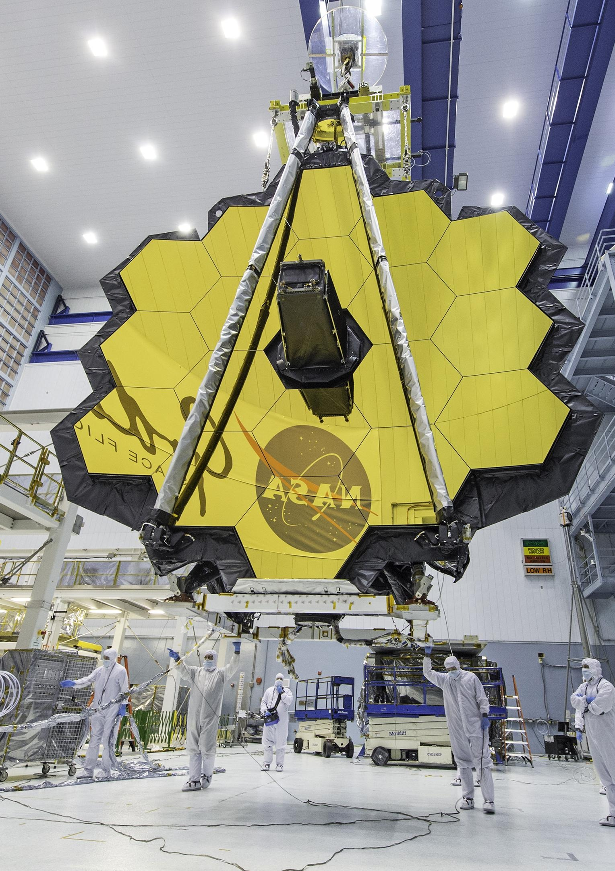
Other Fun LASIK Facts
It is Space Age science. One of the key LASIK technologies – the eye-tracking system – was originally developed for the NASA Space Shuttle’s autonomous satellite docking capabilities. In fact, the optical system of the James Webb Space Telescope was optimized using the same wavefront technology used in today’s LASIK eye surgery.
Speaking of the space program, today’s astronaut candidates can have LASIK to ensure their visual acuity meets NASA’s qualifications. When you think about the rigors of space travel, you can be assured NASA put LASIK to the test to make sure it has the right stuff for its astronauts.
It has been around for a long time. 30 years and 40 million procedures worldwide with the highest patient satisfaction rate of any elective procedure ( more than 96 percent) – this simply wouldn’t be the case if LASIK were anything other than safe.
It backed by an enormous amount of research. There are more than 7,000 peer-reviewed clinical studies on LASIK performance, safety, and outcomes published in reputable scientific journals around the world. It is this robust body of scientific evidence that supports the laser vision correction procedure’s tremendous popularity.

Slide 27
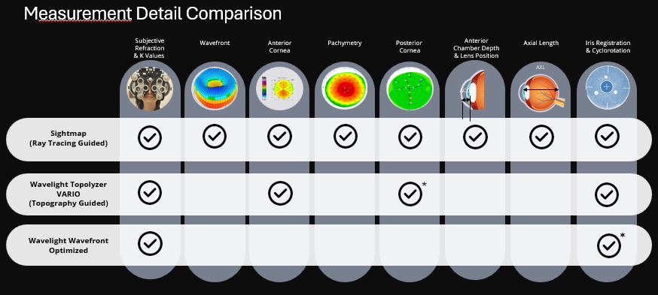
Measurement Detail Comparison
SMILE Does NOT ☹
And Predicts Epi Healing!
*Requires additional diagnostic device
Notes:
Pre-compensation Algorithm
Preemptively calculates the appropriate adjustments to the final ablation profile to pre-compensate for healing

Slide 28
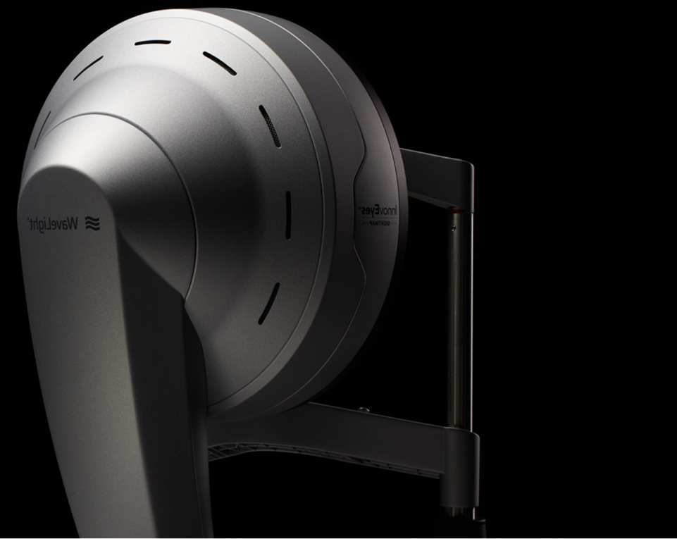



Conclusion
Modern LASIK is an outstanding option — safer and better than ever.
Wavelight Plus Looks Promising.
We expect to offer Wavelight Plus later this summer.
  Updates to come!
Thank you for taking time to listen!
Please share your honest feedback and any concerns.
We want to know what you (and your patients) think!

Slide 29
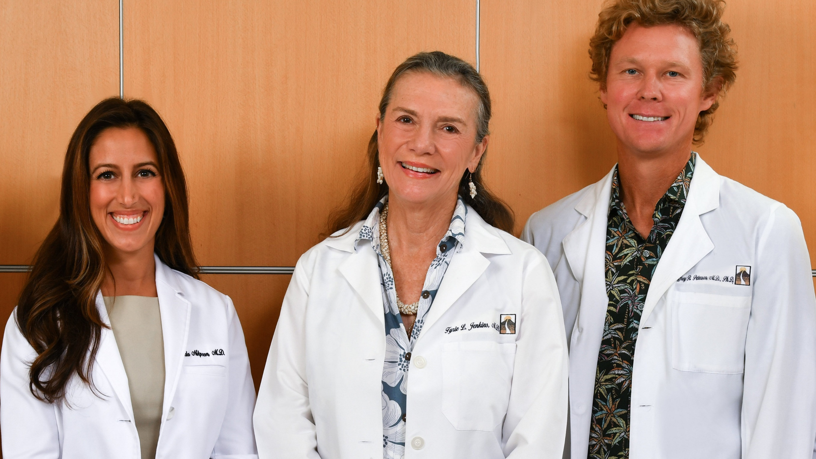
drnikpoor@jenkinseyecare.com
405.919.6659
Thank You!

