Slide 1

Contact Lens 2.0
Fit for the future
Mile Brujic, OD, FAAO
Premier Vision Group
https://www.clientresourcesinc.com/2018/11/13/top-3-emerging-technologies/

Slide 2
Disclosure
I have received honoraria in the past 2 years for speaking, writing, participating in an advisory capacity, research or meeting support from: Apellis (consultant, speakers bureau), ABB Optical (received meeting support), Abbvie (consultant), Alcon (consultant, speakers bureau), Art Optical (received meeting support), Azura (consultant), Bruder Healthcare (consultant), Bausch + Lomb Health (consultant, speakers bureau), Contamac (received meeting support), CooperVision (received meeting support), Knack Global (consultant), Dompe (consultant, speakers bureau), Dopavision (consultant), Eyepromise (consultant), Johnson & Johnson Vision Care (received meeting support), Lentechs (received research support), MDElite (consultant), Mediprint (consultant, research), Nordic Pharma (consultant, speakers bureau), Orasis (consultant, speakers bureau), Radius XR (consultant), Rinsada (consulting), SCOPE (consultant), Tangible Science (received meeting support), Tarsus (consultant, speakers bureau), Théa Pharma (consultant), Tenpoint Pharmaceuticals (consultant, speakers bureau), Viatris (consultant, speakers bureau), Visionix (consultant), Walman Optical (received meeting support).
These relationships have been mitigated and will not influence the content of this presentation

Slide 3
Surface Treatments
https://www.clientresourcesinc.com/2018/11/13/top-3-emerging-technologies/

Slide 4
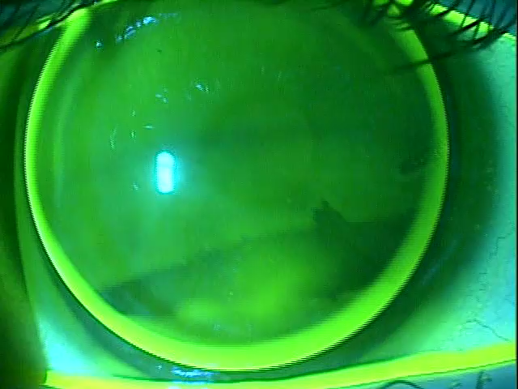
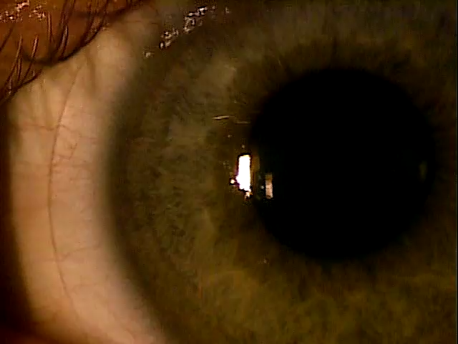
GP Lenses

Slide 5
Tangible Hydra-PEG
Polymer encapsulates lens
Improves wettability
Increases surface water retention
Increases lubricity
Reduces deposits

Slide 6
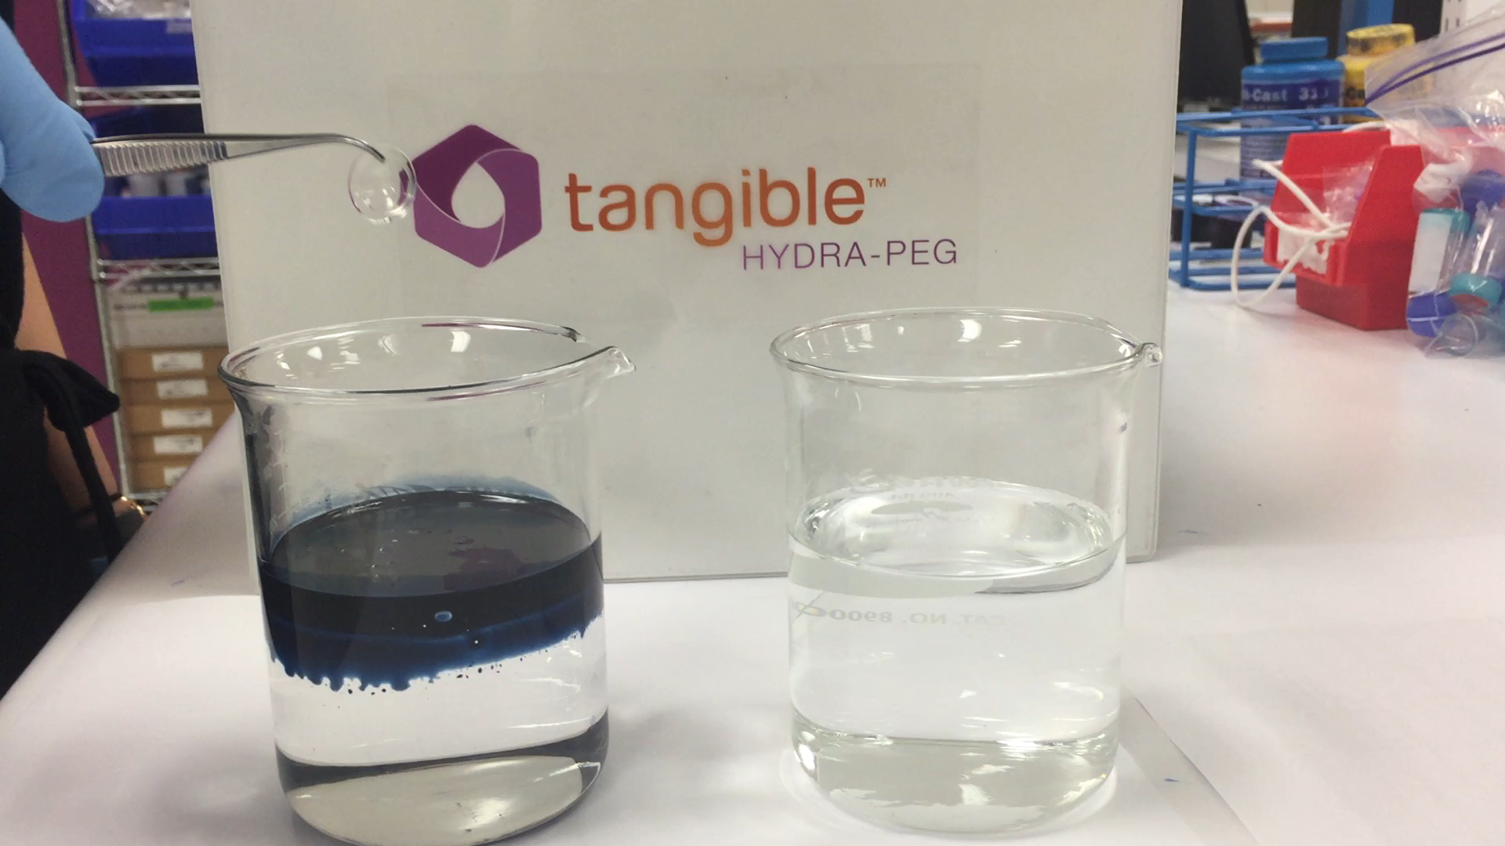
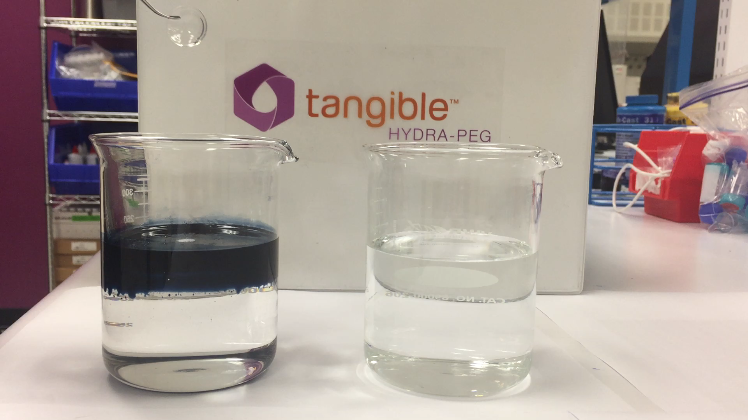
Tangible Hydra-PEG
Without Tangible Hydra-PEG
With Tangible Hydra-PEG

Slide 7
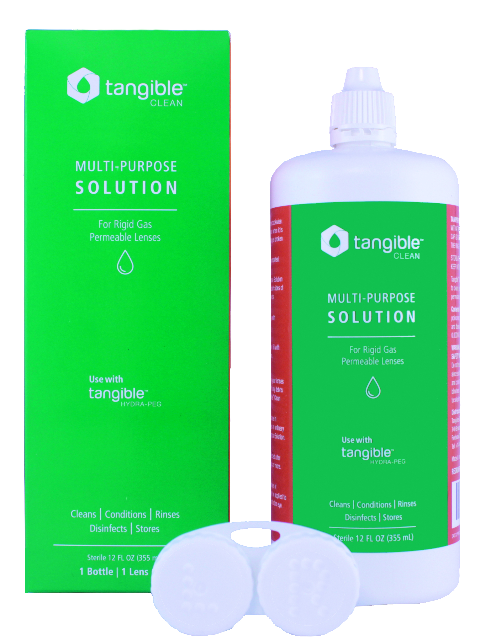
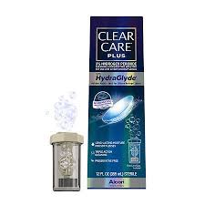
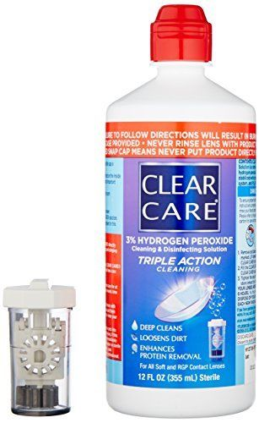
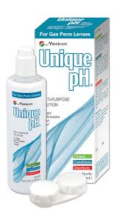
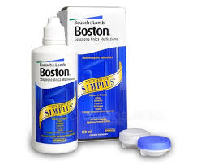
Lens Cleaning Regimen
Compatible Multi-Purpose Solutions
Compatible Peroxide Solutions

Slide 8
Tangible Hydra-PEG
Cannot use abrasive cleaners
Cannot use water to rinse lenses
Tangible Boost – coming soon
  Will re-build the tangible coating on the lens

Slide 9
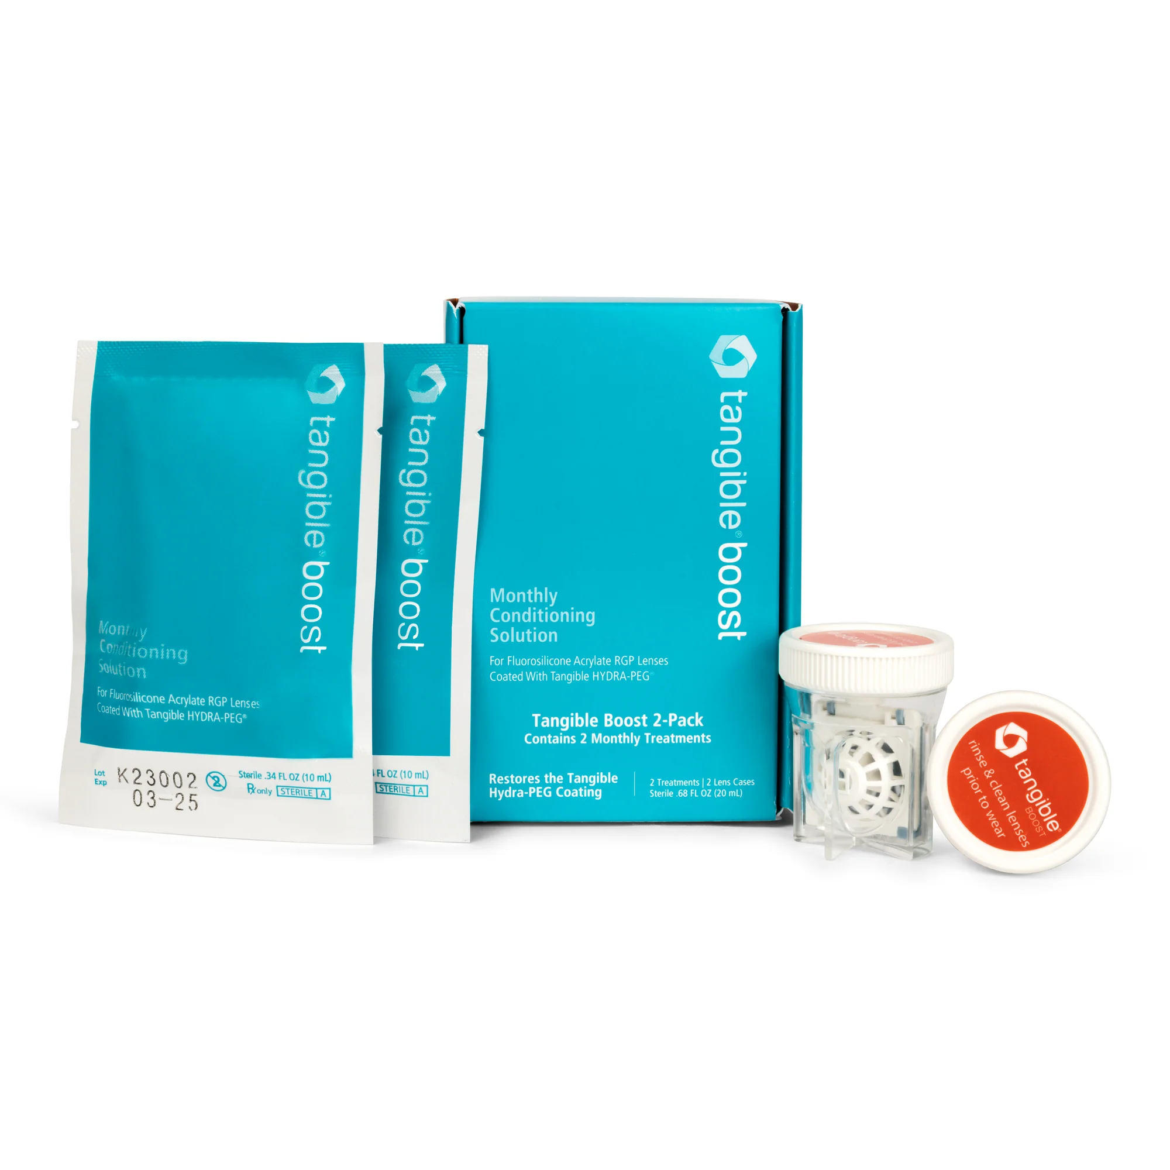
Tangible Boost

Slide 10
Tools for scleral lenses
https://www.clientresourcesinc.com/2018/11/13/top-3-emerging-technologies/

Slide 11
Scleral Lens Wearer
Dr. B, there is too much stuff to wearing scleral lenses…..
-Care solutions
-Peroxide systems
-Filling solutions
-Contact lens cases
-Contact lens applicators
-Contact lens removers

Slide 12
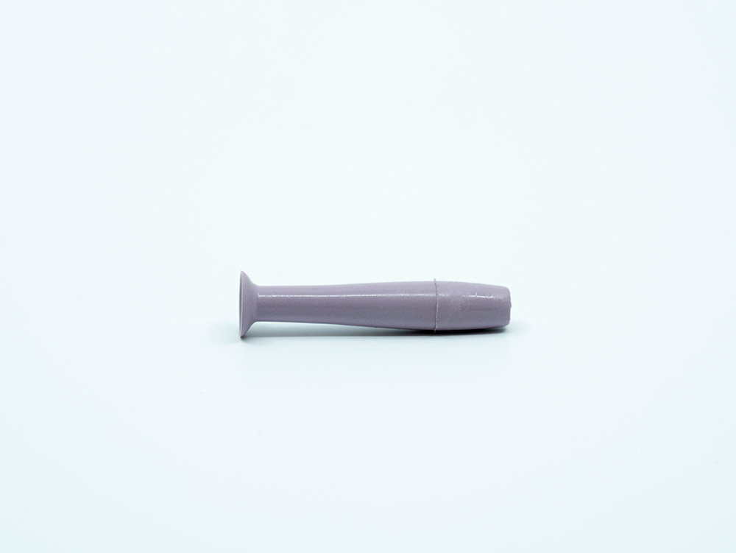
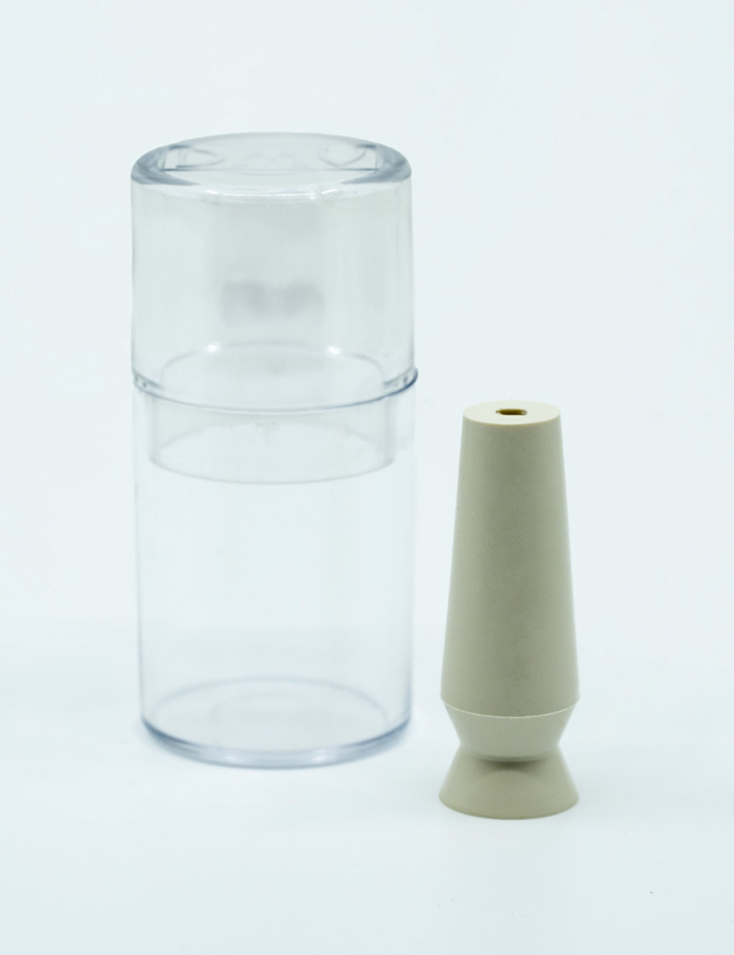
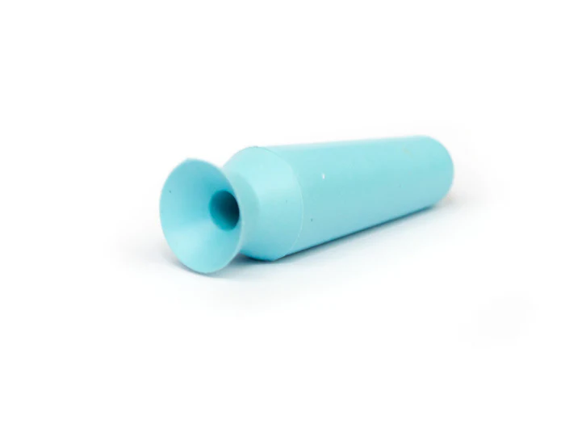
Current Devices for Scleral Lenses
What is the recommended replacement schedule for support devices?

Slide 13
What was the process?
Initial drawing
Finding out if it exists
Creating the prototype (Combing the large and small device)
Who will help with the project?
How will manufacturing occur?
Where will manufacturing occur?
Where will patients be able to access technology?

Slide 14
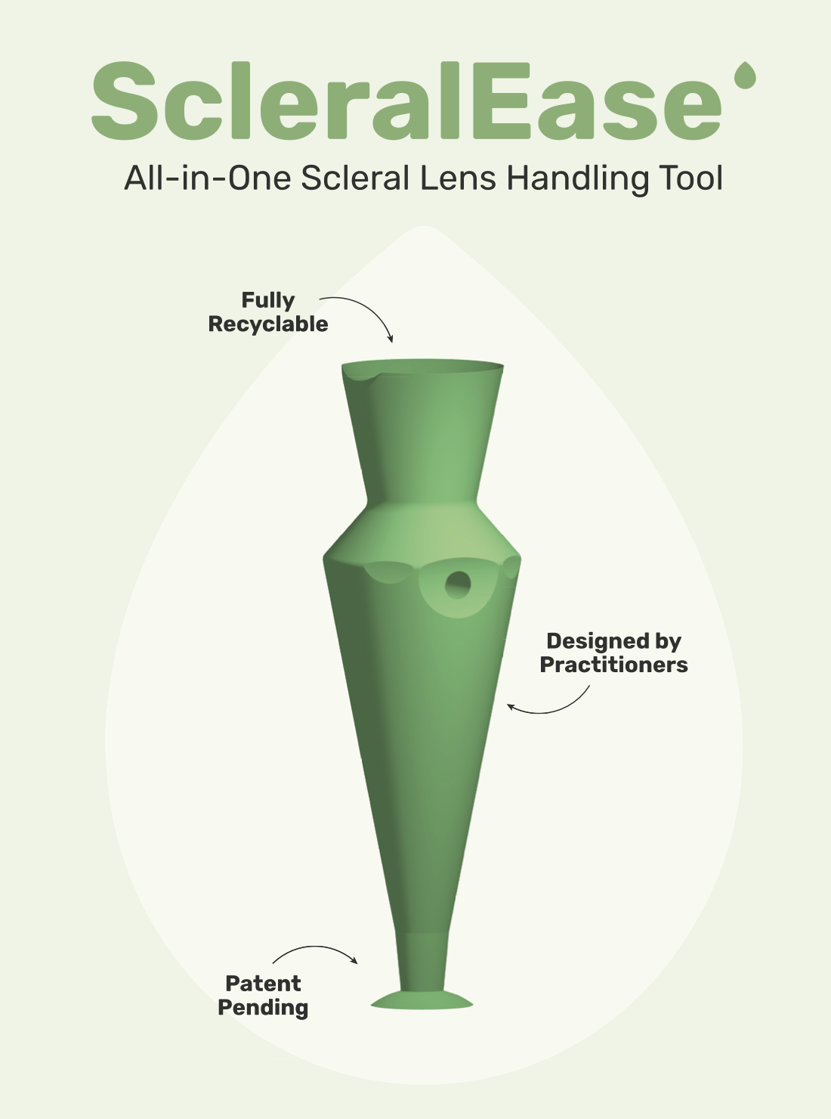
Application
Removal
Suction for application
No suction for application
Flat regions for stability

Slide 15
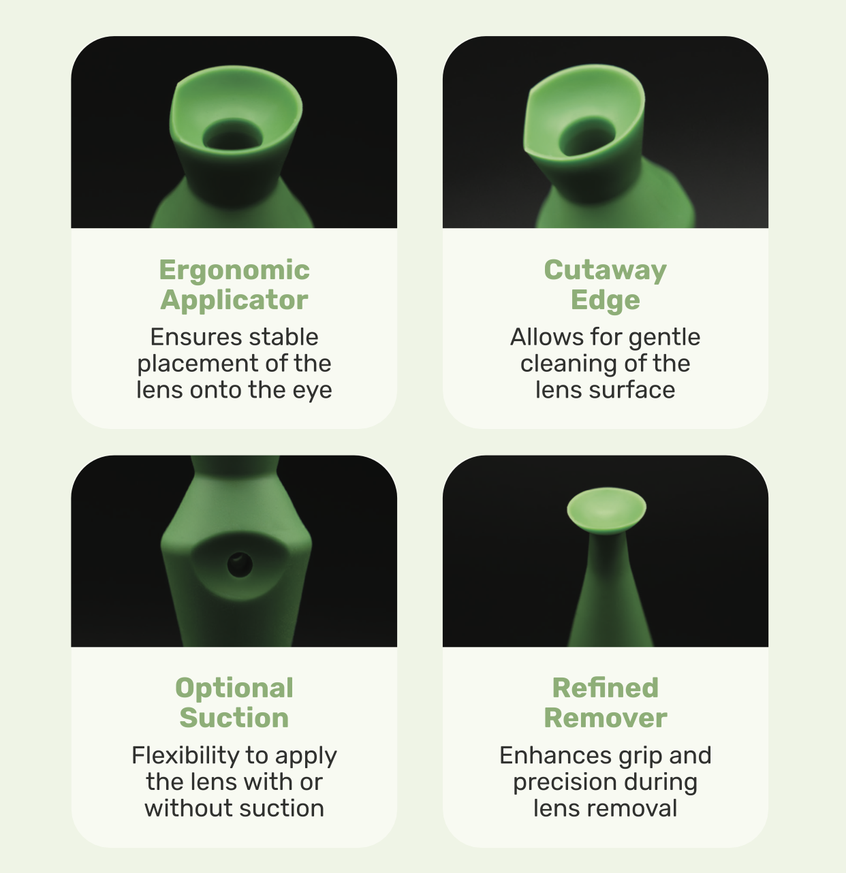

Slide 16
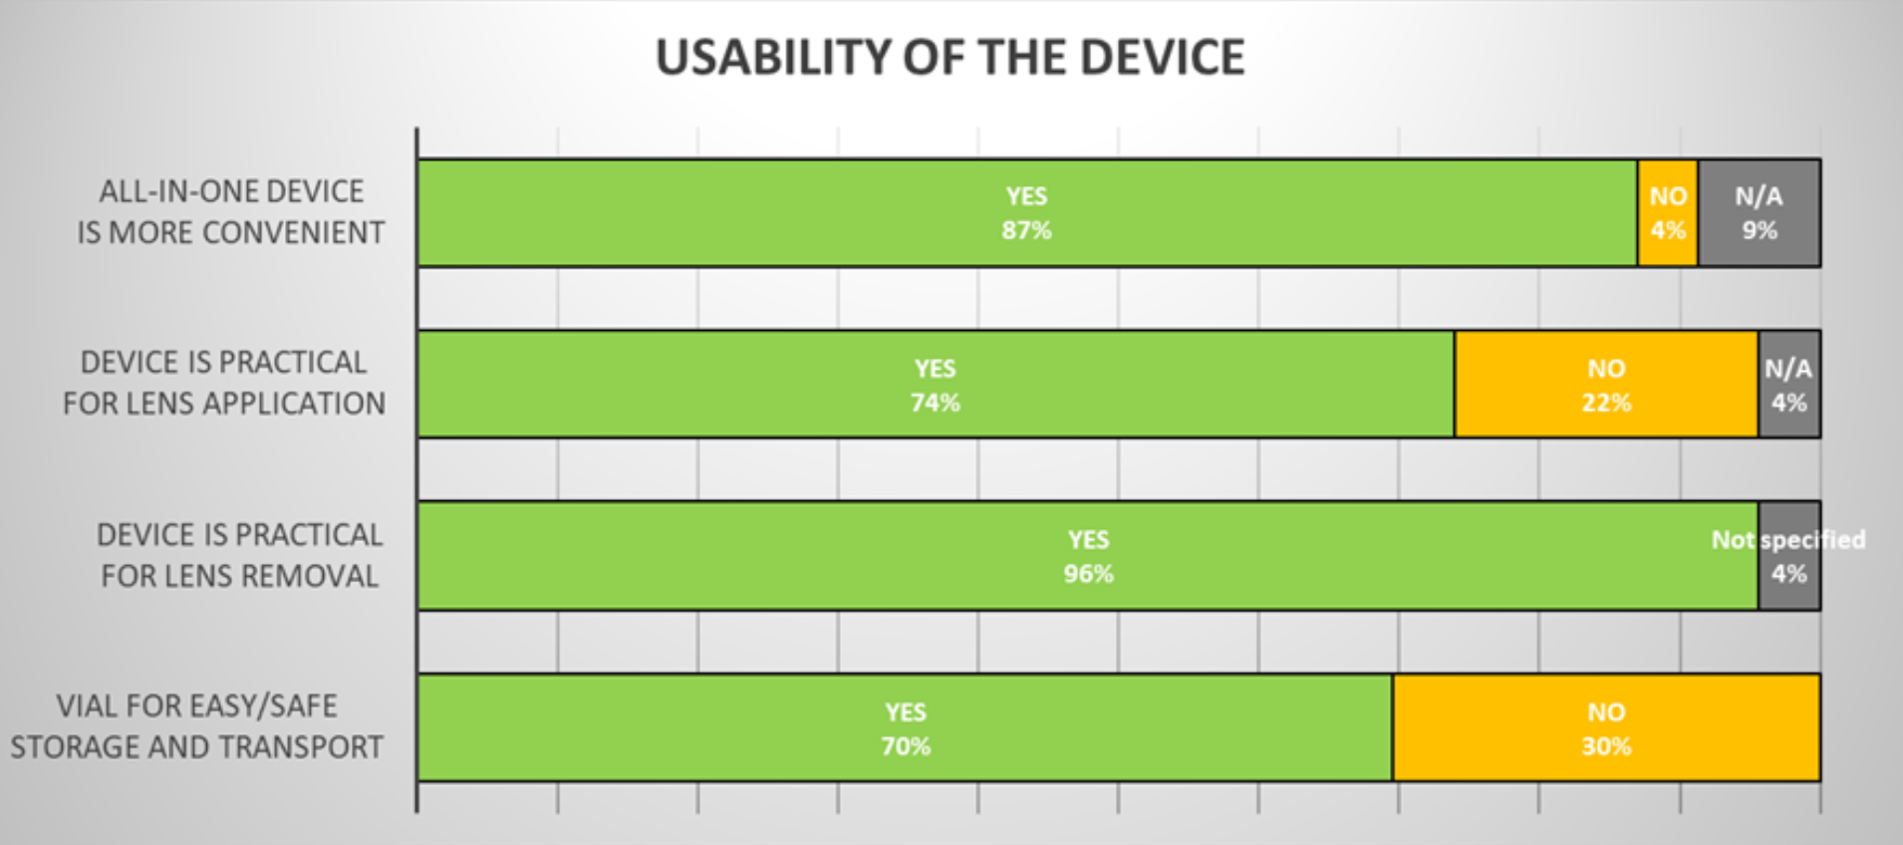

Slide 17
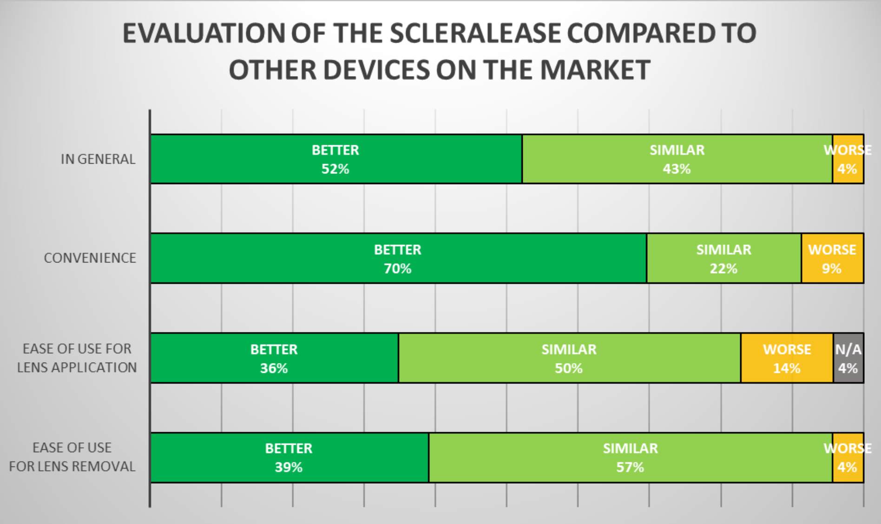

Slide 18
New Diagnostics for Disease Detection
https://www.clientresourcesinc.com/2018/11/13/top-3-emerging-technologies/

Slide 19
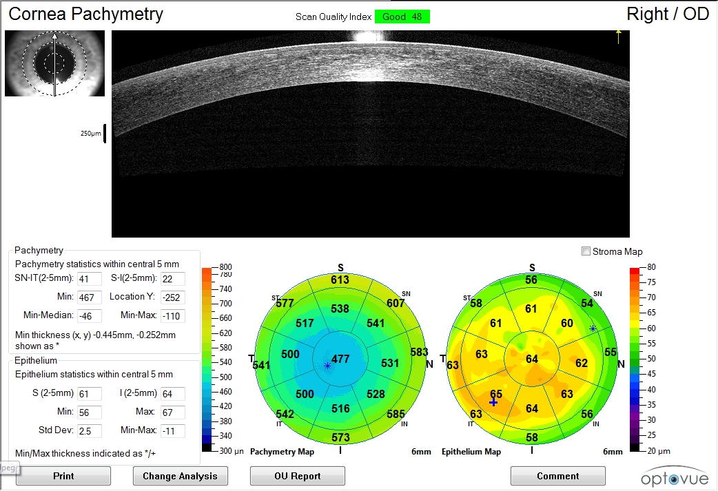
Post LASIK
Thin centrally

Slide 20
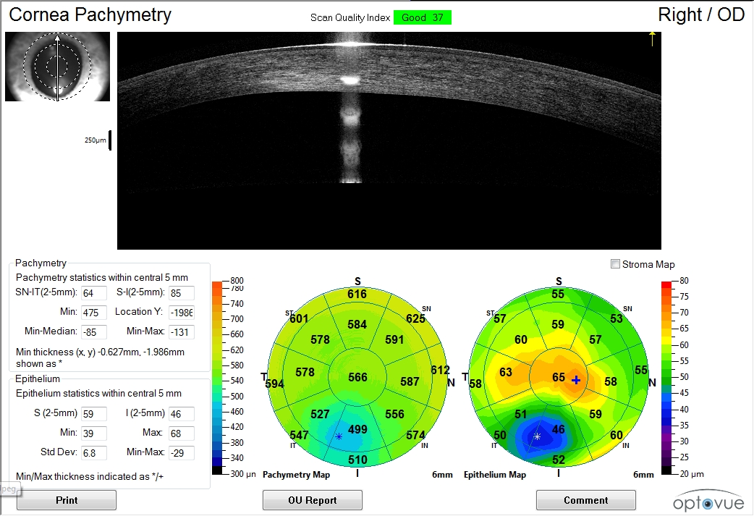
Post LASIK
ectasia

Slide 21
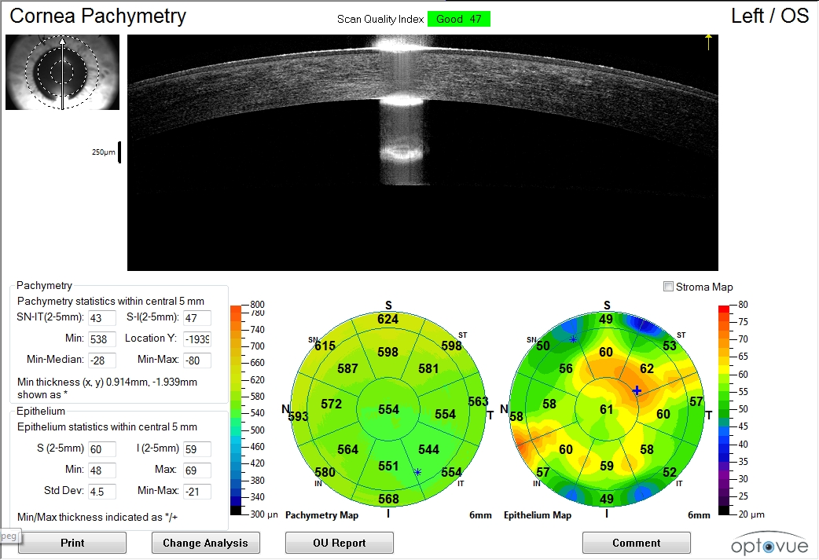
Radial
Keratotomy
(more visual complaints)

Slide 22
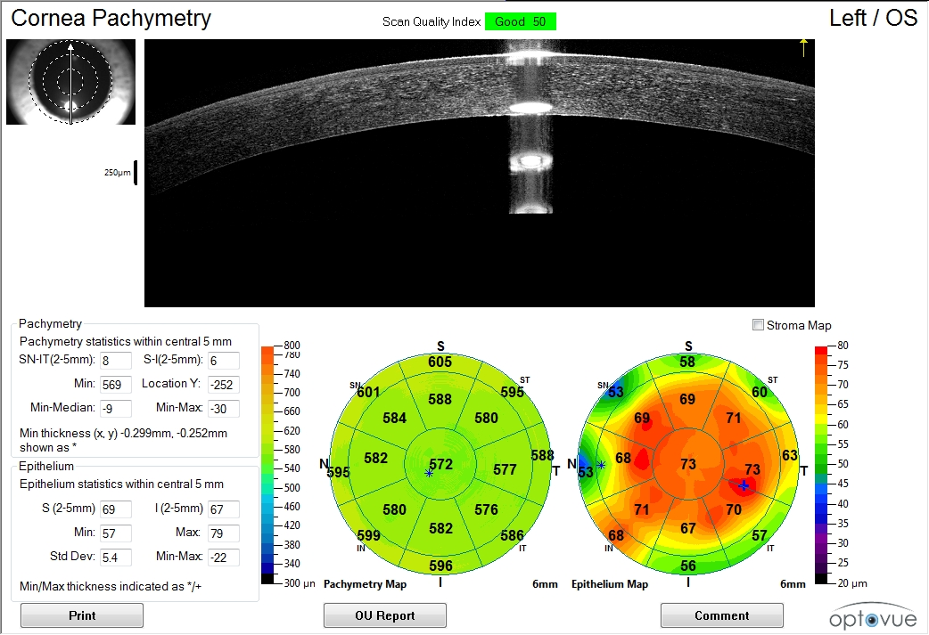
Radial
Keratotomy
(significant visual complaints)

Slide 23
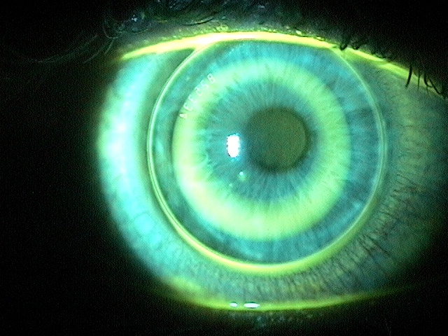
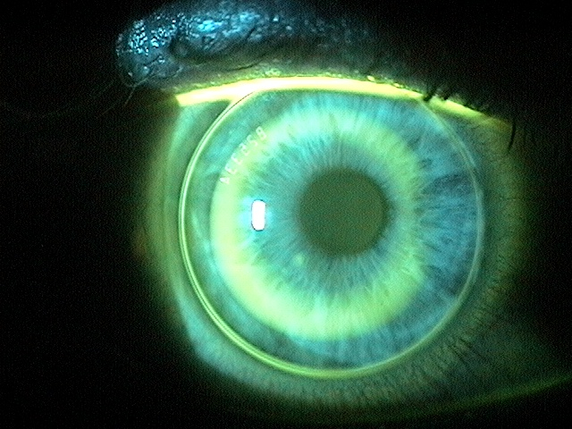
Orthokeratology

Slide 24
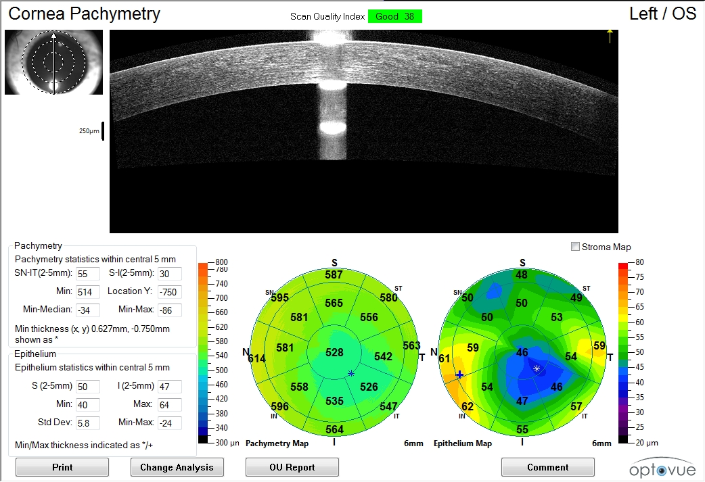
Ortho K

Slide 25
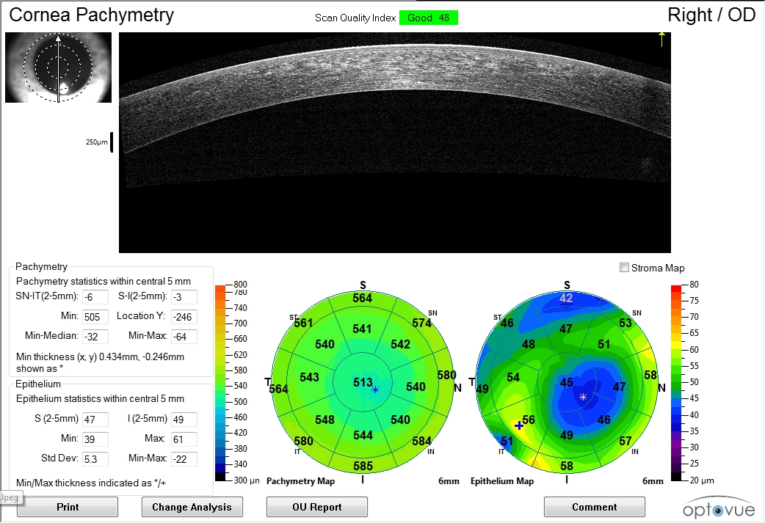
Ortho K

Slide 26
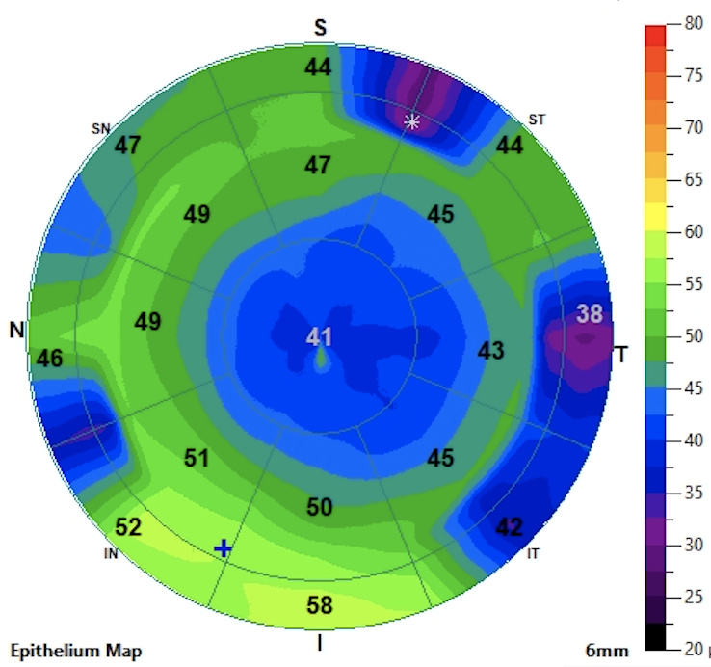
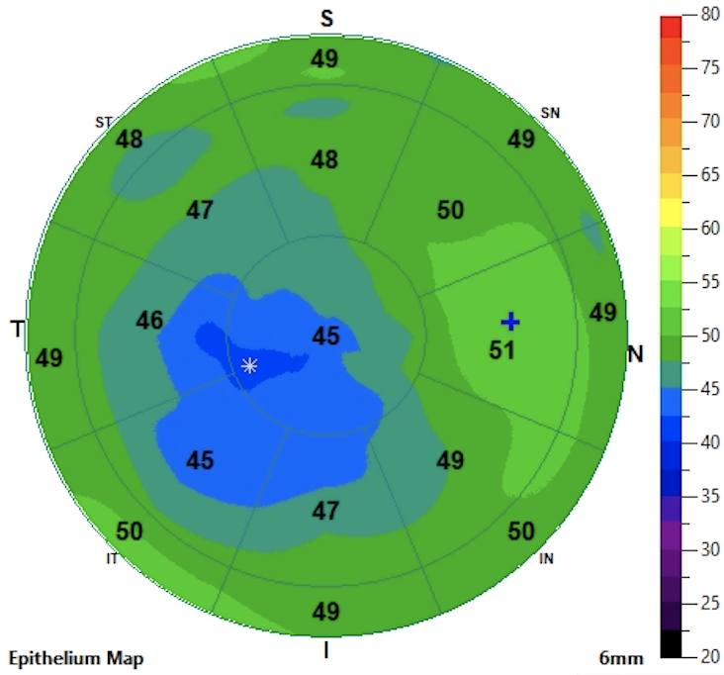
Anterior Segment OCT for Orthokeratology

Slide 27
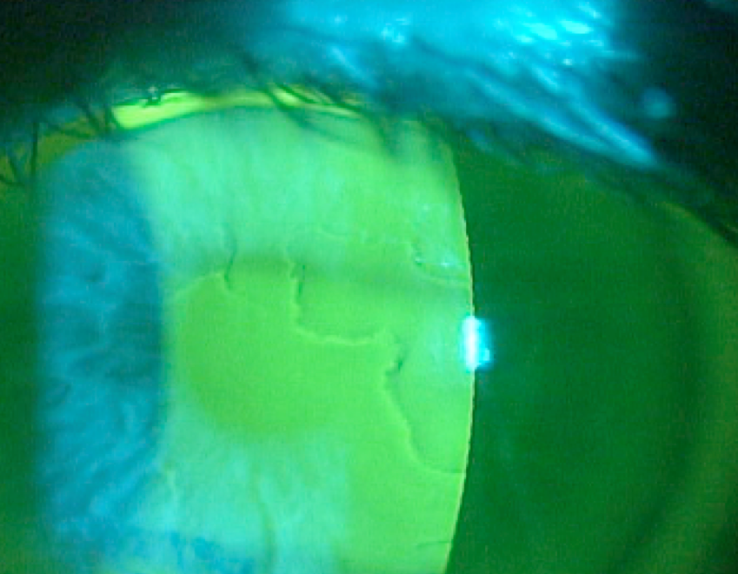
Epithelial Basement Membrane Dystrophy

Slide 28
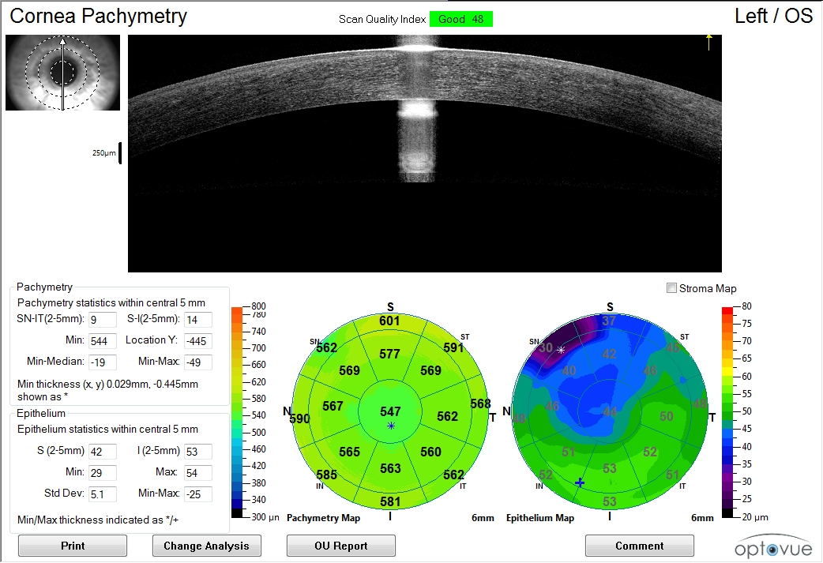
EBMD

Slide 29
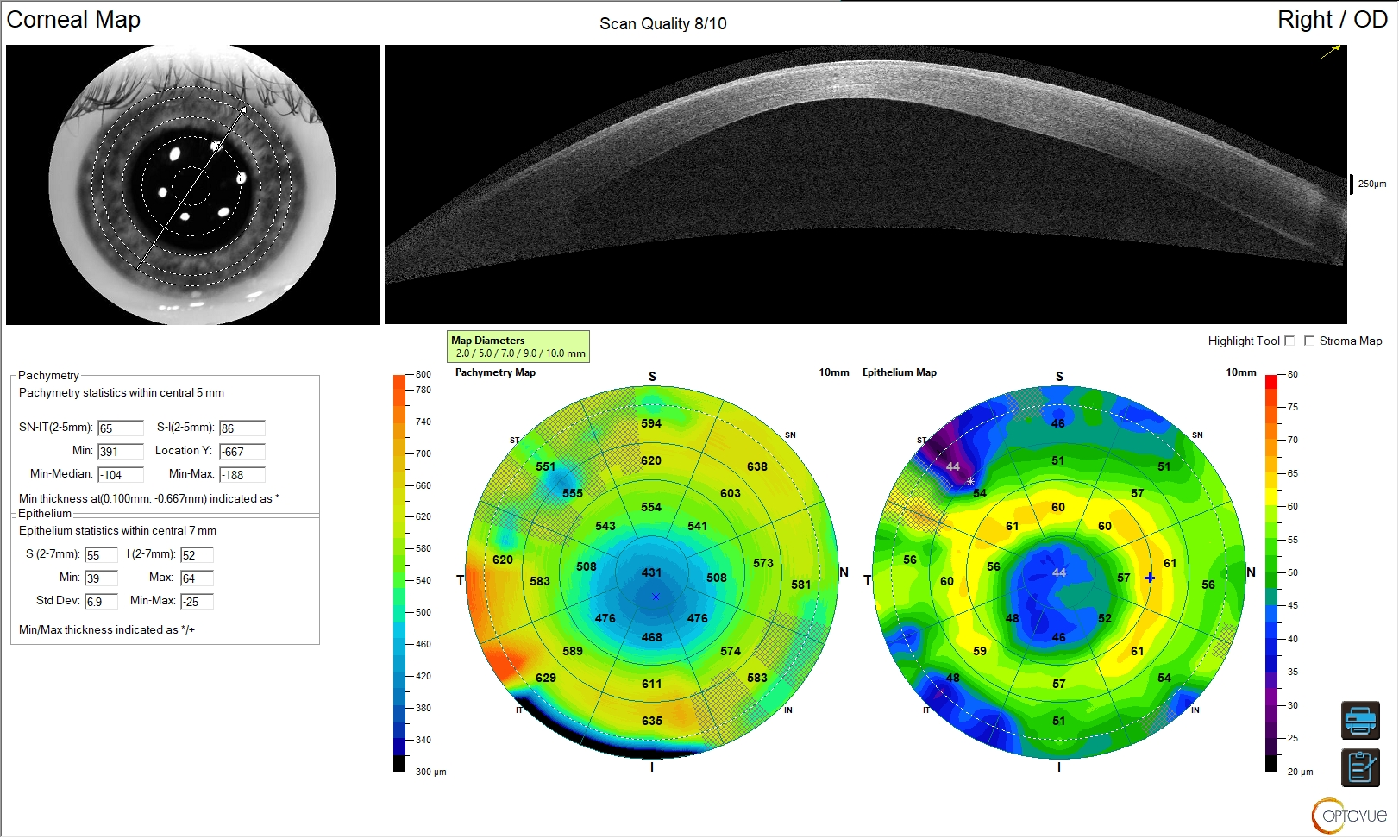

Slide 30
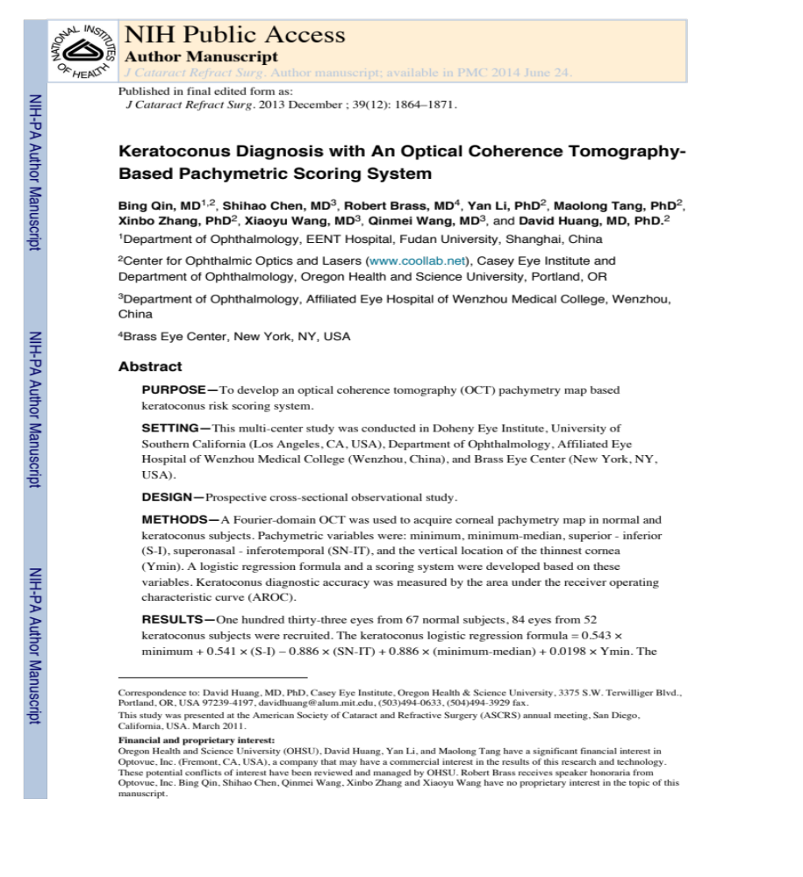

Slide 31
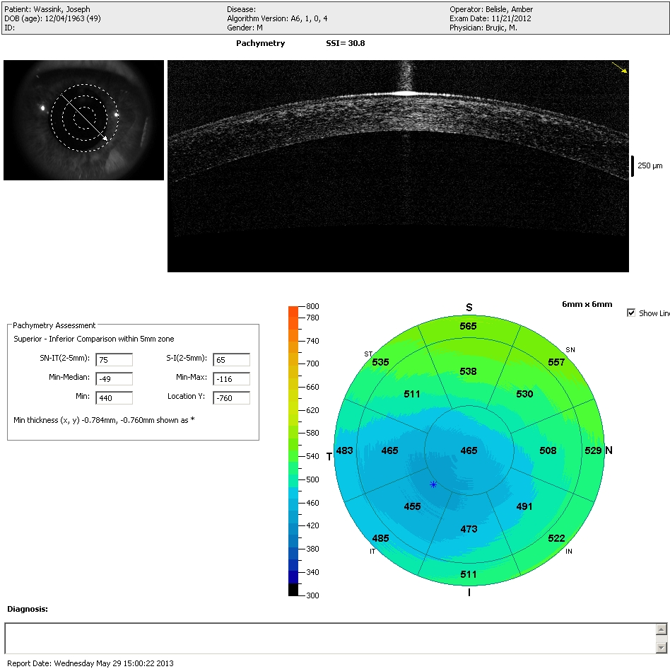

Slide 32
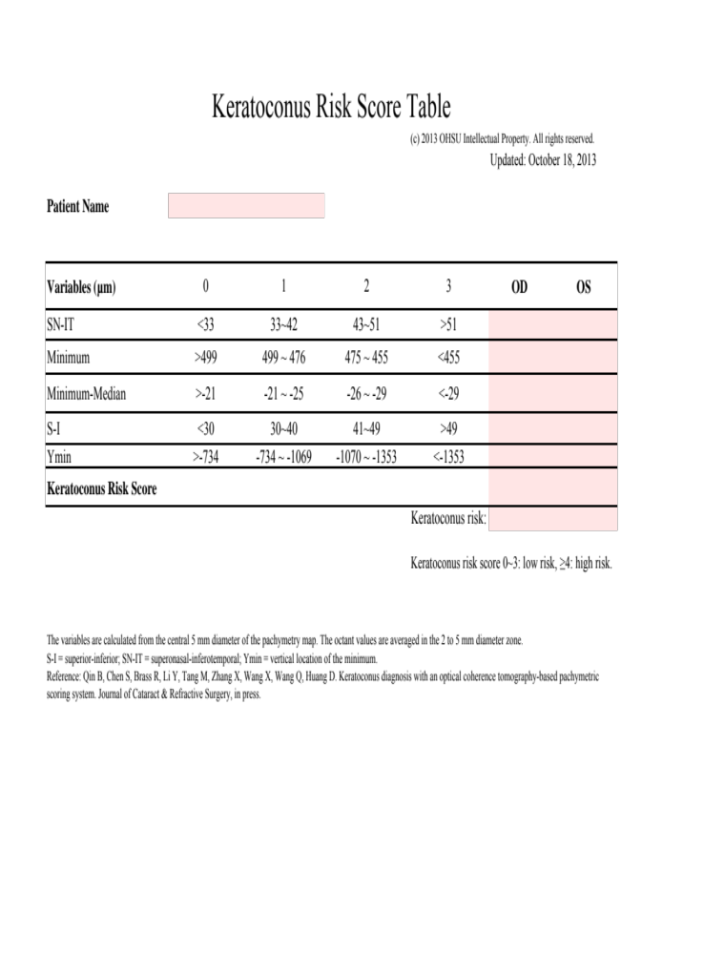
3
3

Slide 33
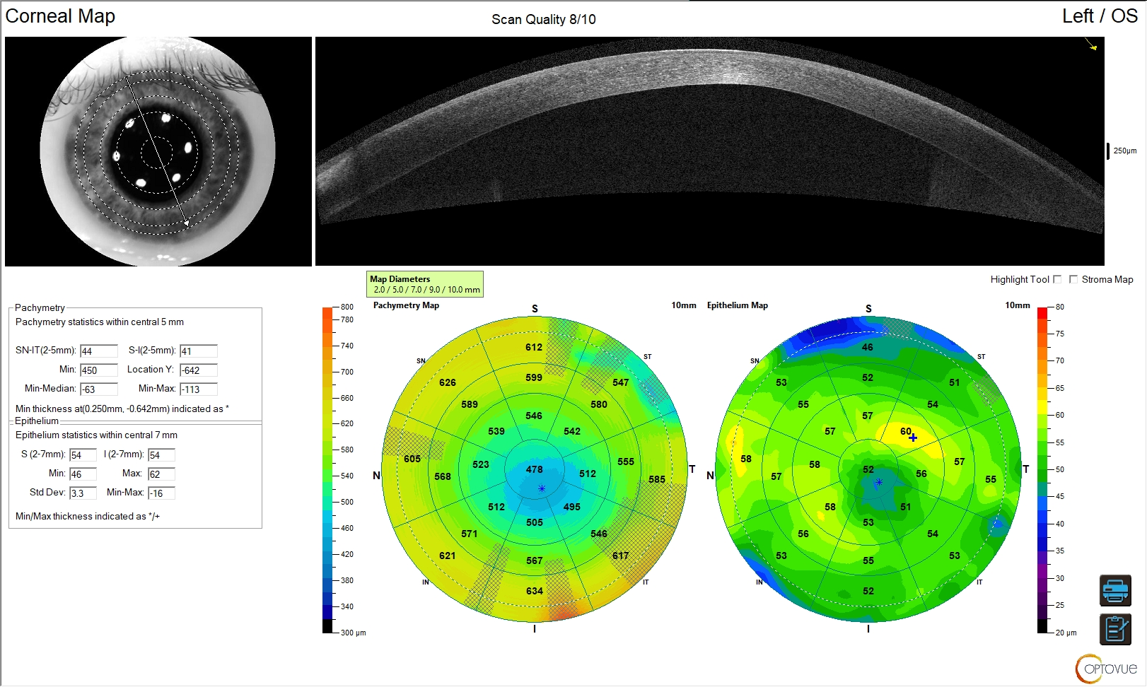

Slide 34
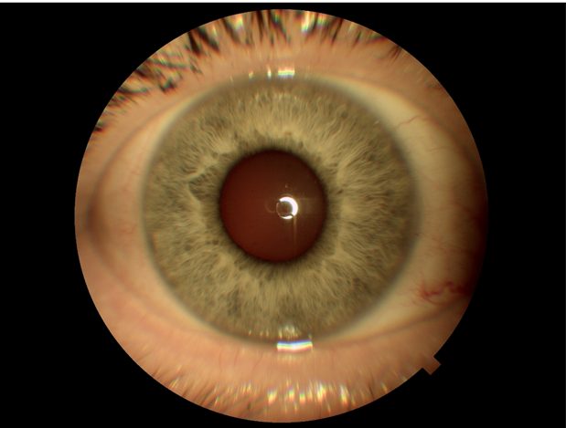
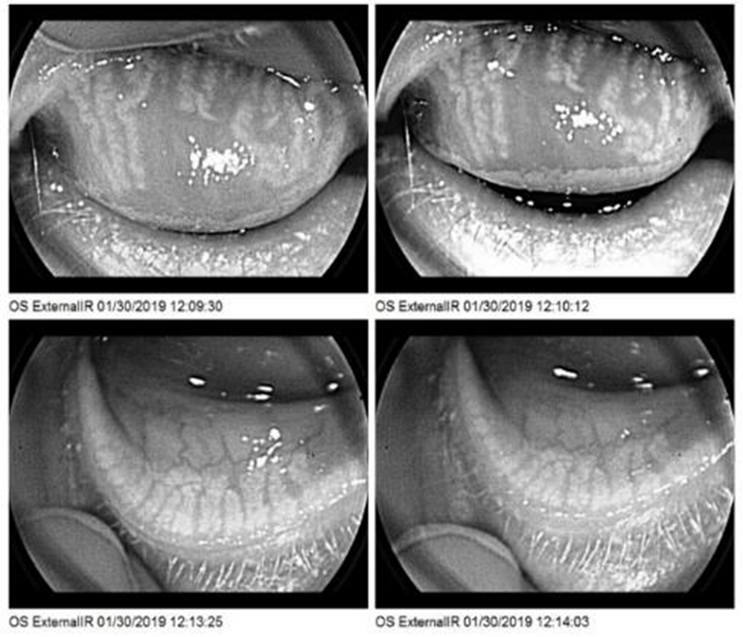
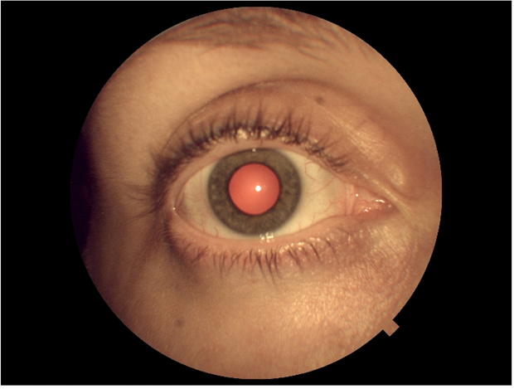
External color photography & IR imaging
External Color Photograph
External Color Photograph with Red Reflex
Notes:
Document ocular surface conditions without moving the patient to the slit lamp for examination.
Evaluate external structure of the upper and lower lids without a dedicated instrument

Slide 35
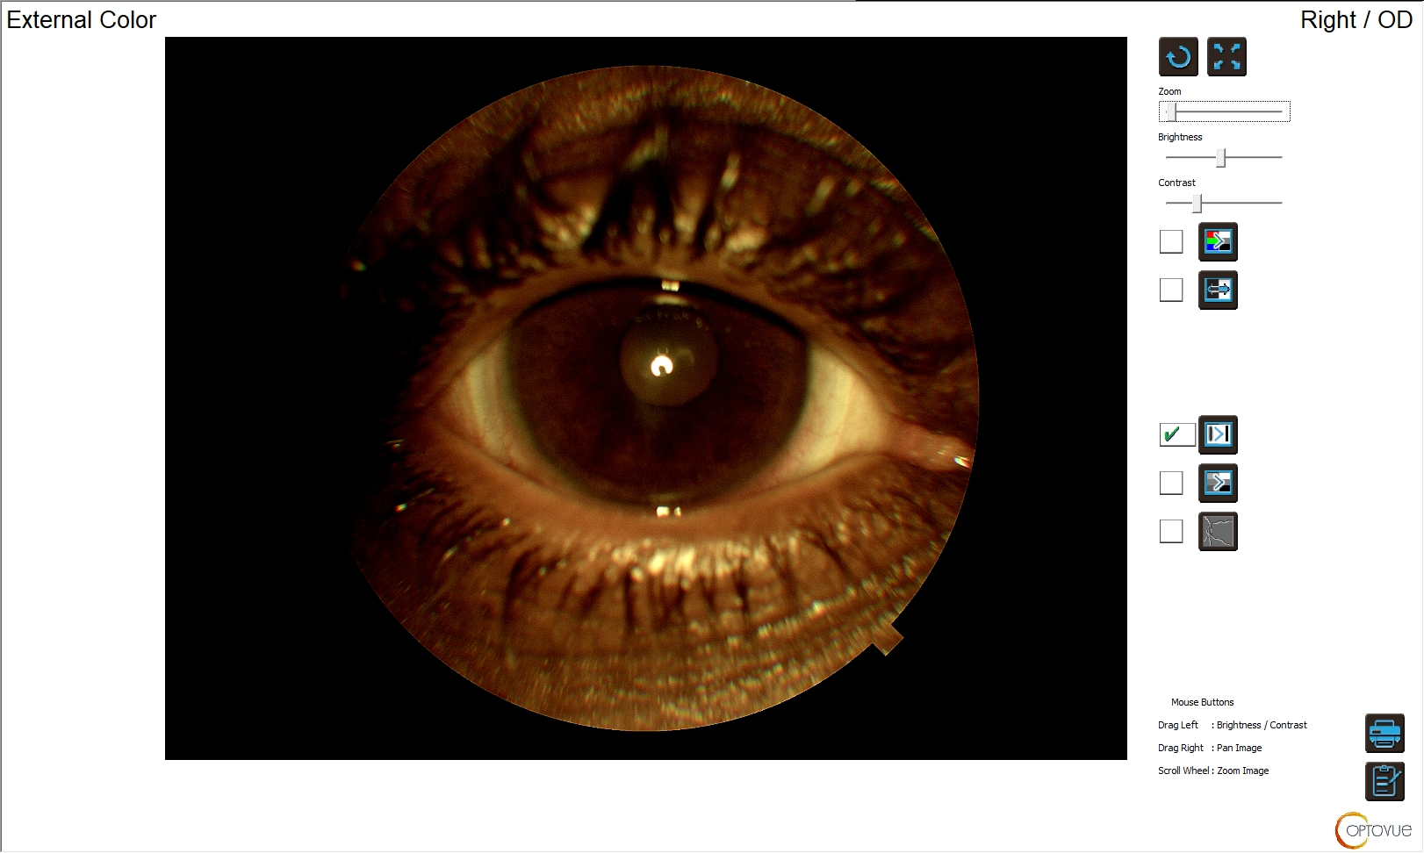
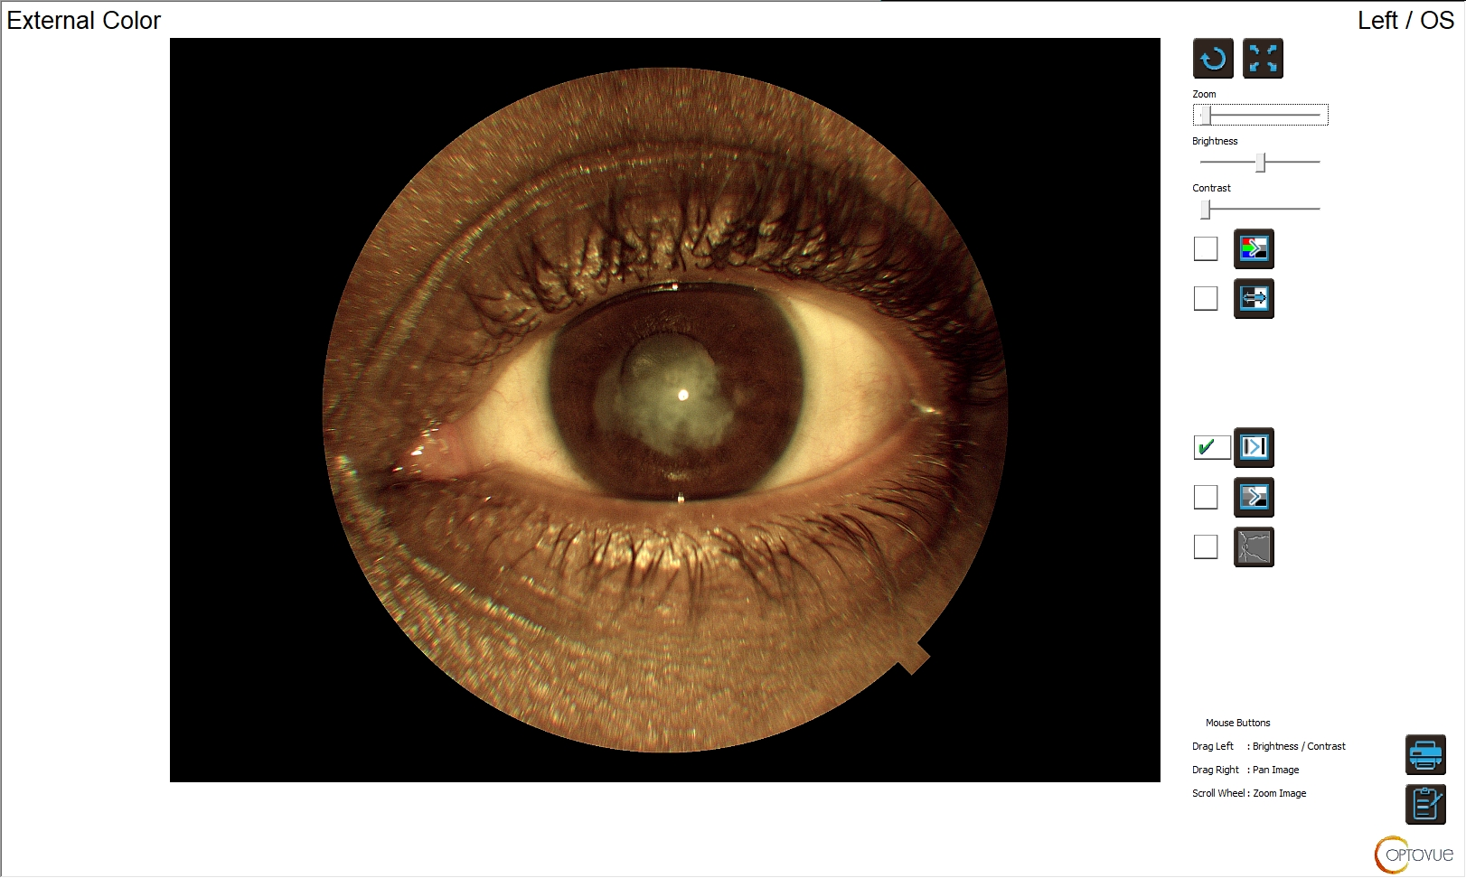

Slide 36
OCT Sagittal Depth Measurements
https://www.clientresourcesinc.com/2018/11/13/top-3-emerging-technologies/

Slide 37
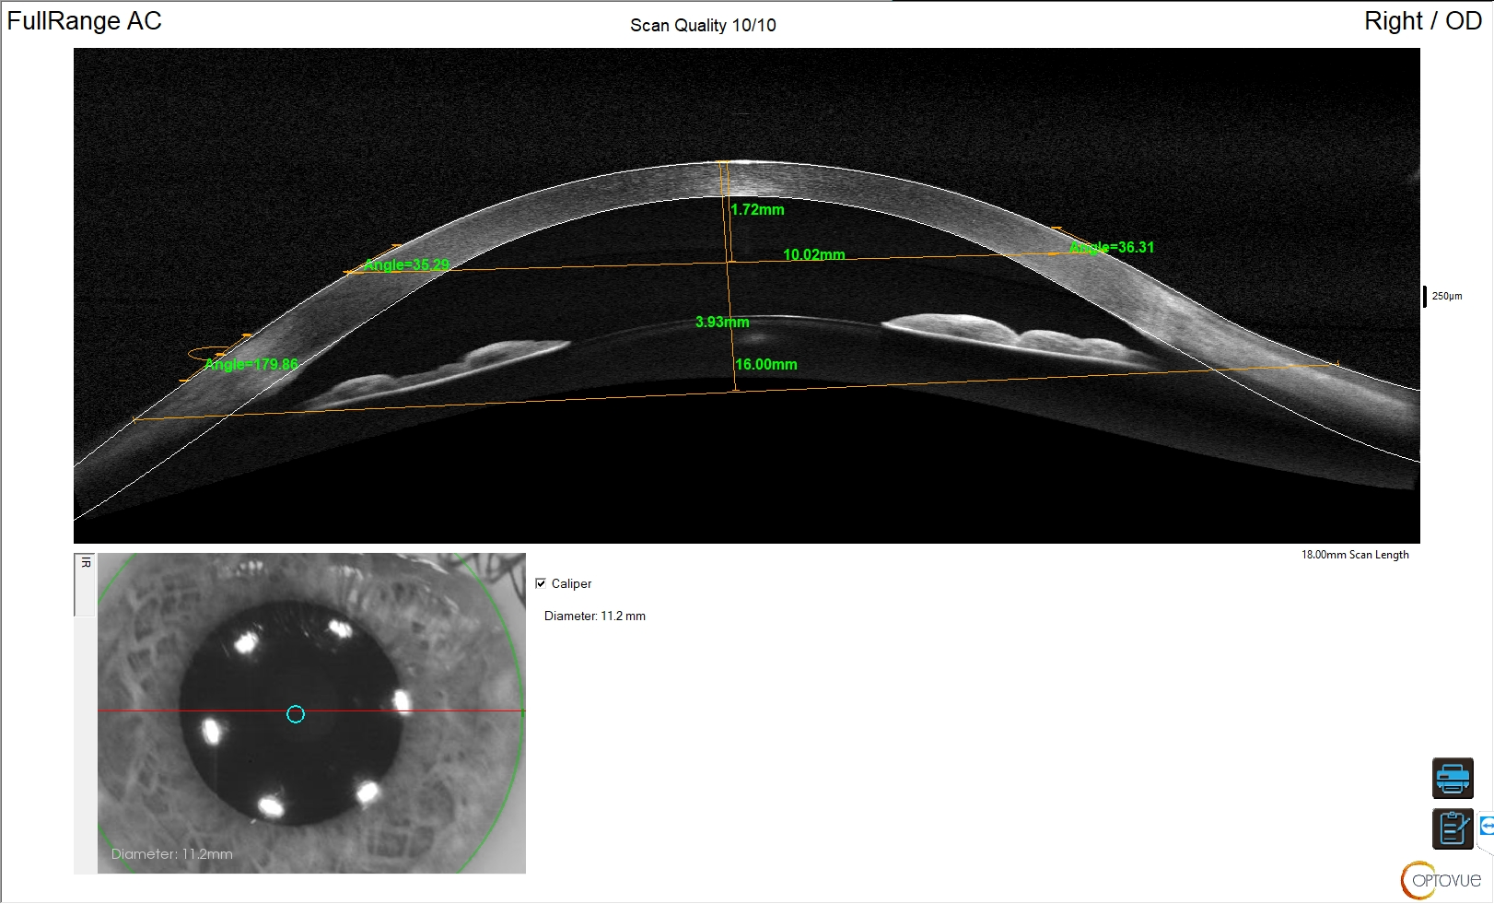
Structural measurement 16mm Chord
Structural measurement to assist in lens selection
10mm Chord, 16 mm Chord with
Sagittal depths
1.72mm
3.93mm
WTW or pupil width
Not available on Solix Essential
Notes:
Internal image only-Solix can be promoted as a tool to get measurements for the fitting of scleral lens but we currently do not have FDA clearance to promote as a Scleral fitting device.

Slide 38
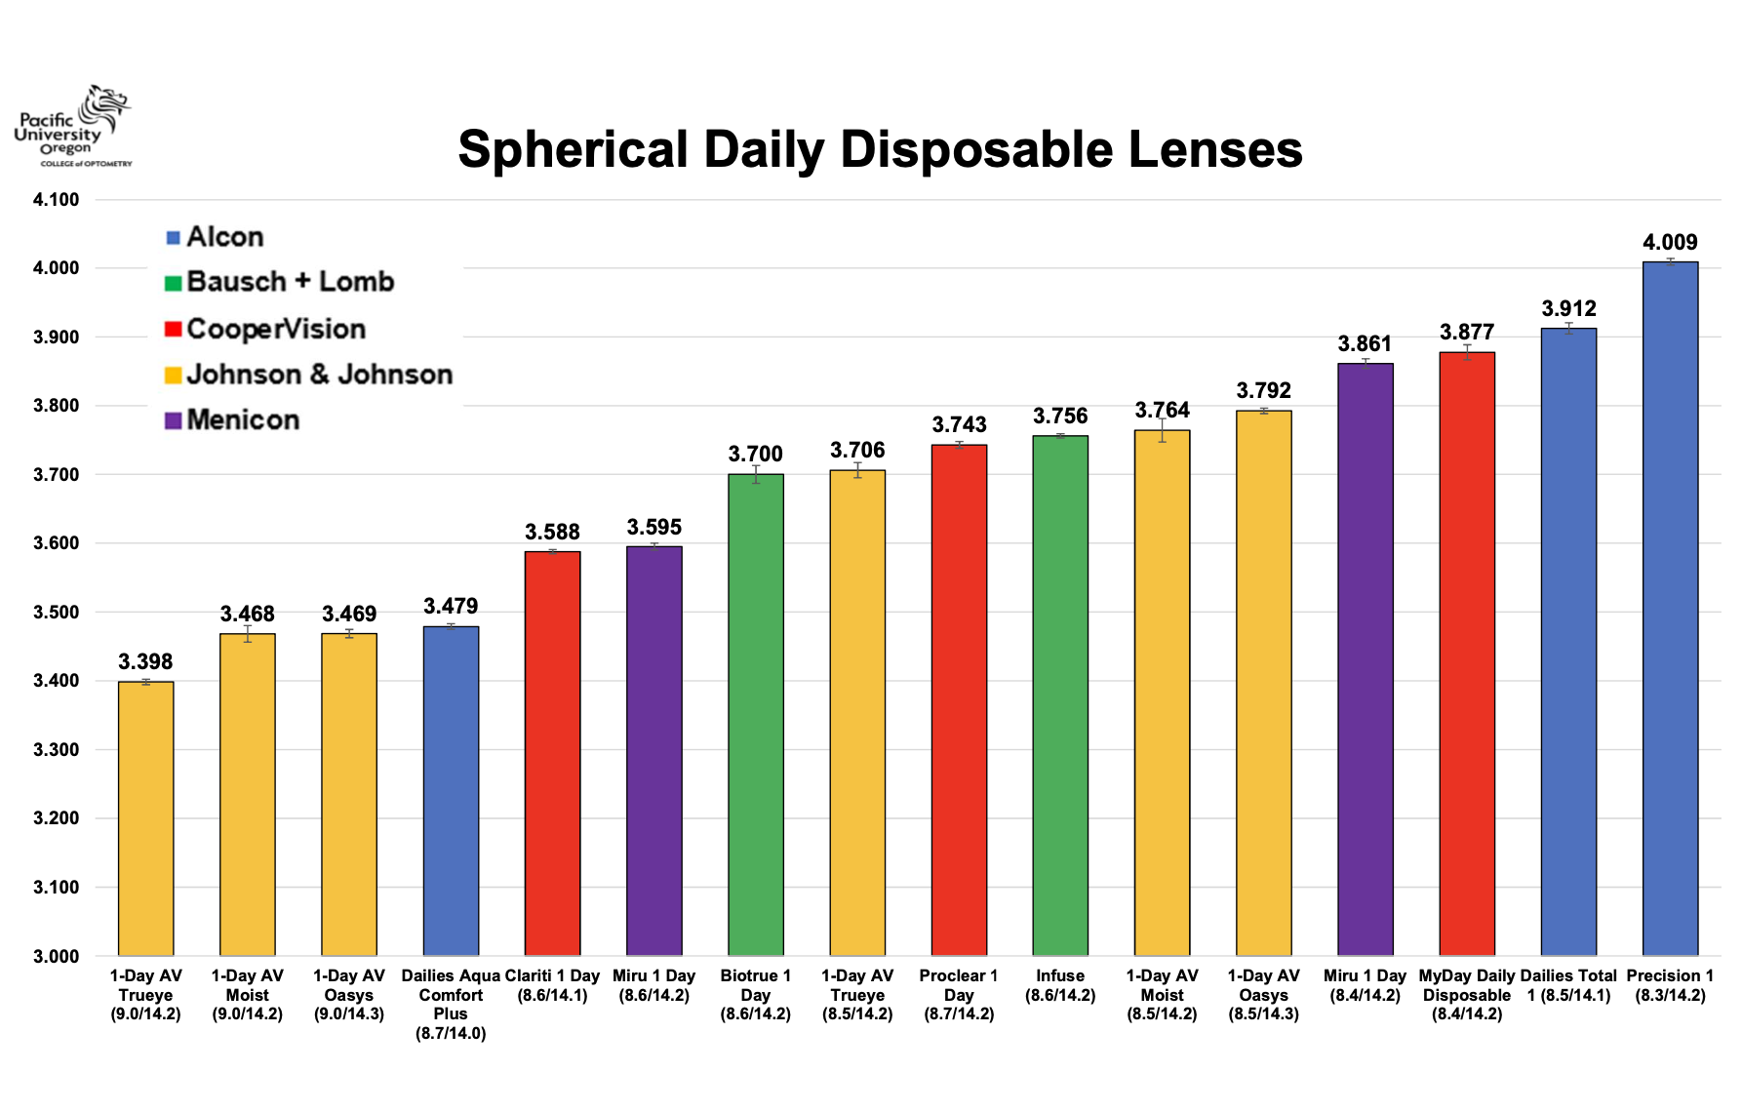
https://commons.pacificu.edu/work/ns/380b99ad-5f0b-4e77-a286-a8d1f74bdfe9

Slide 39
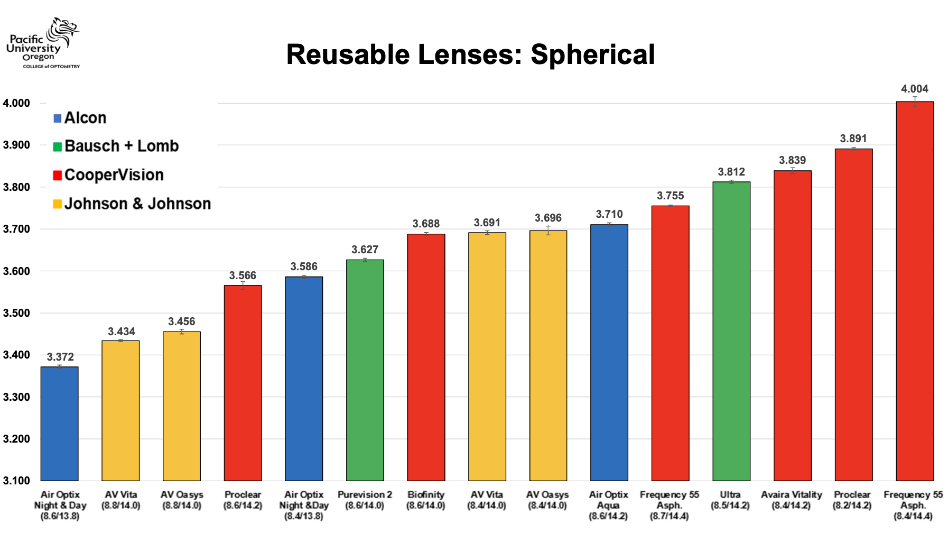
https://commons.pacificu.edu/work/ns/380b99ad-5f0b-4e77-a286-a8d1f74bdfe9

Slide 40
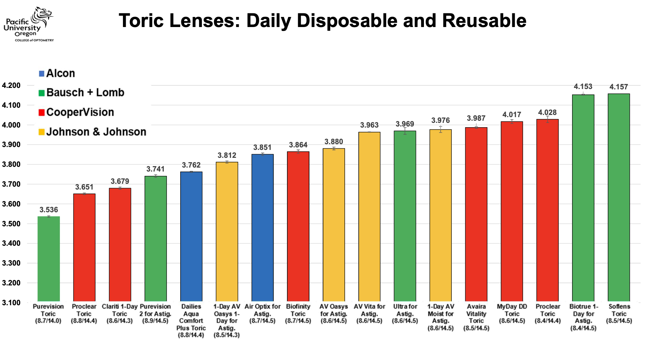
https://commons.pacificu.edu/work/ns/380b99ad-5f0b-4e77-a286-a8d1f74bdfe9

Slide 41
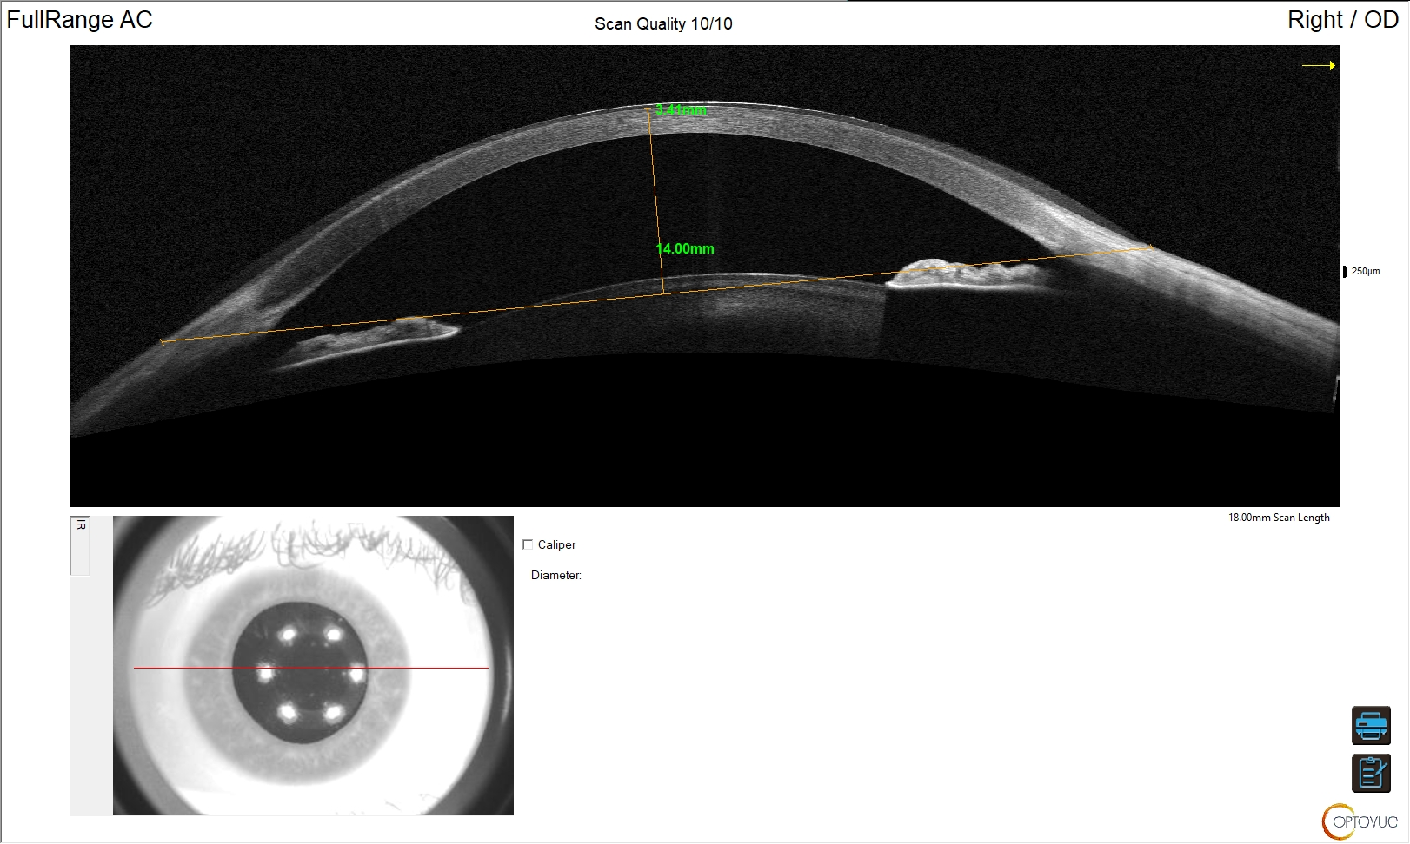
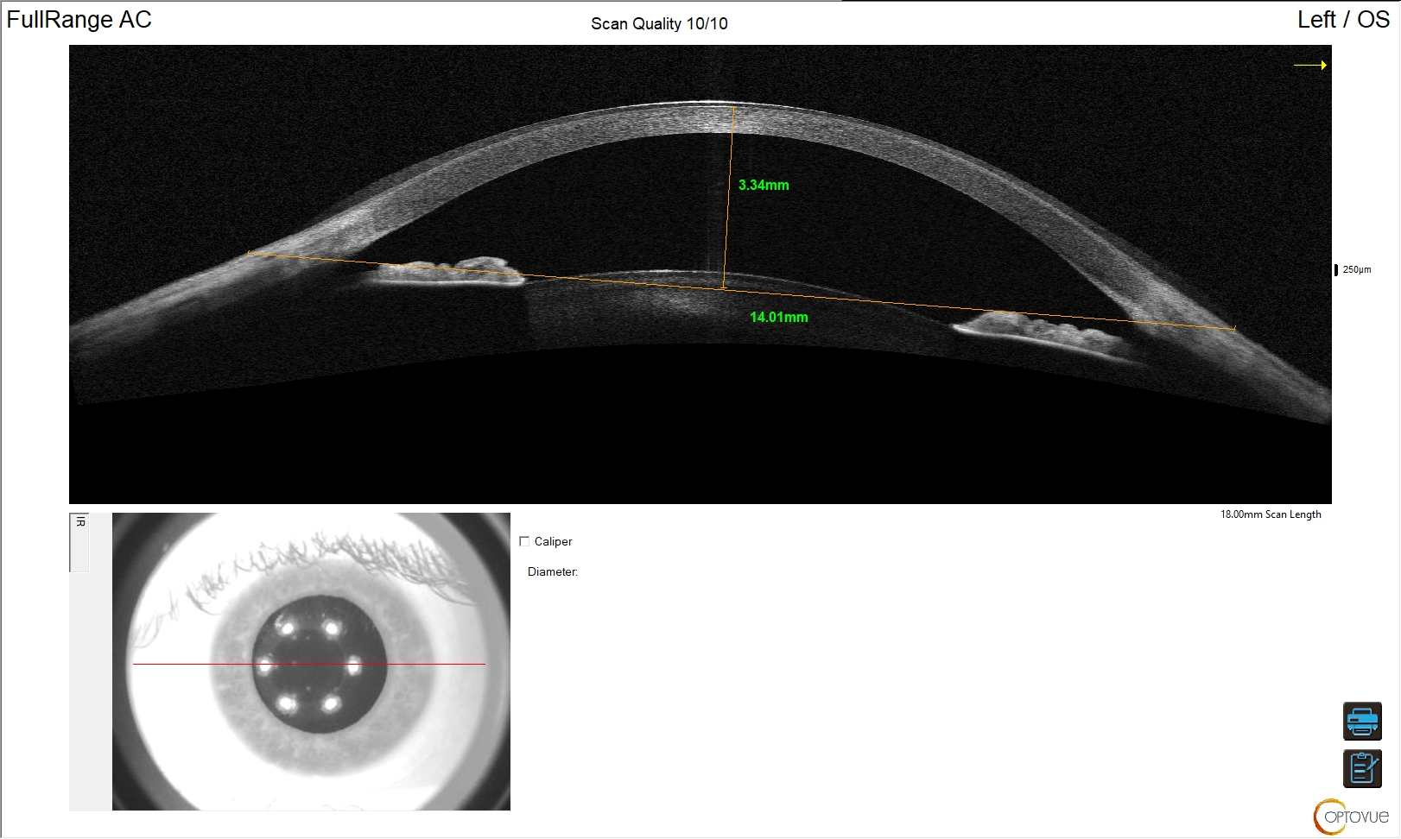
Sagittal depth: OD 3.41mm, OS 3.36mm

Slide 42
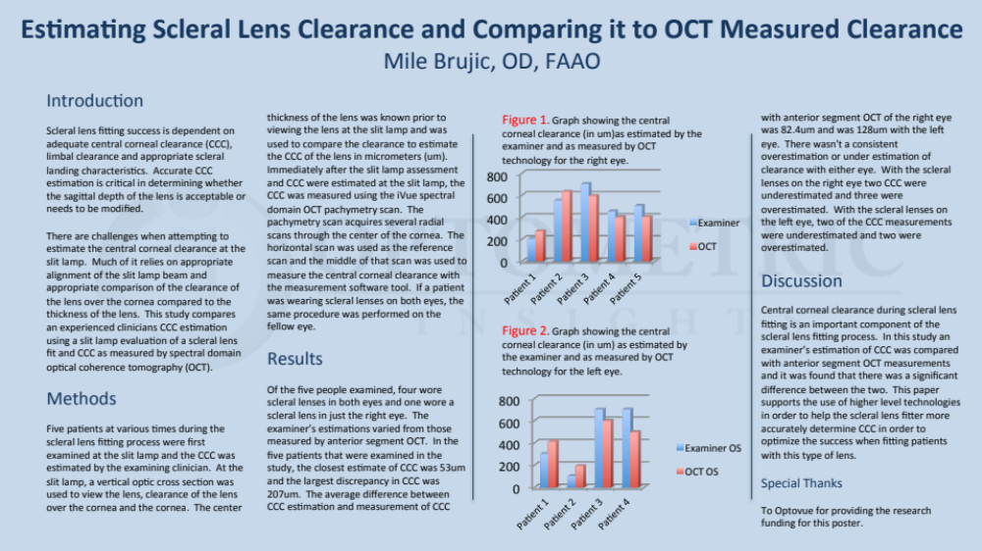

Slide 43
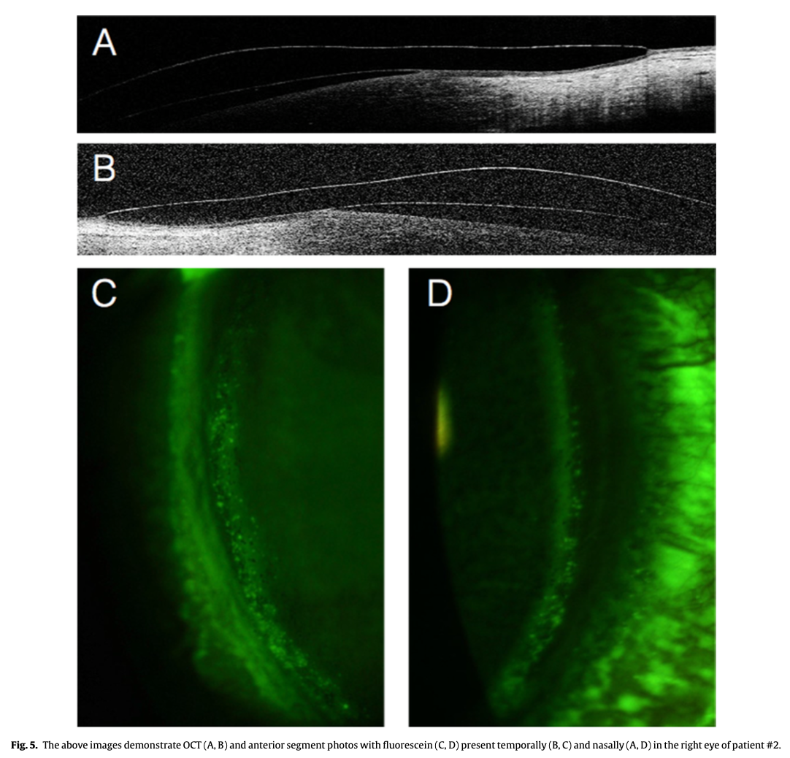
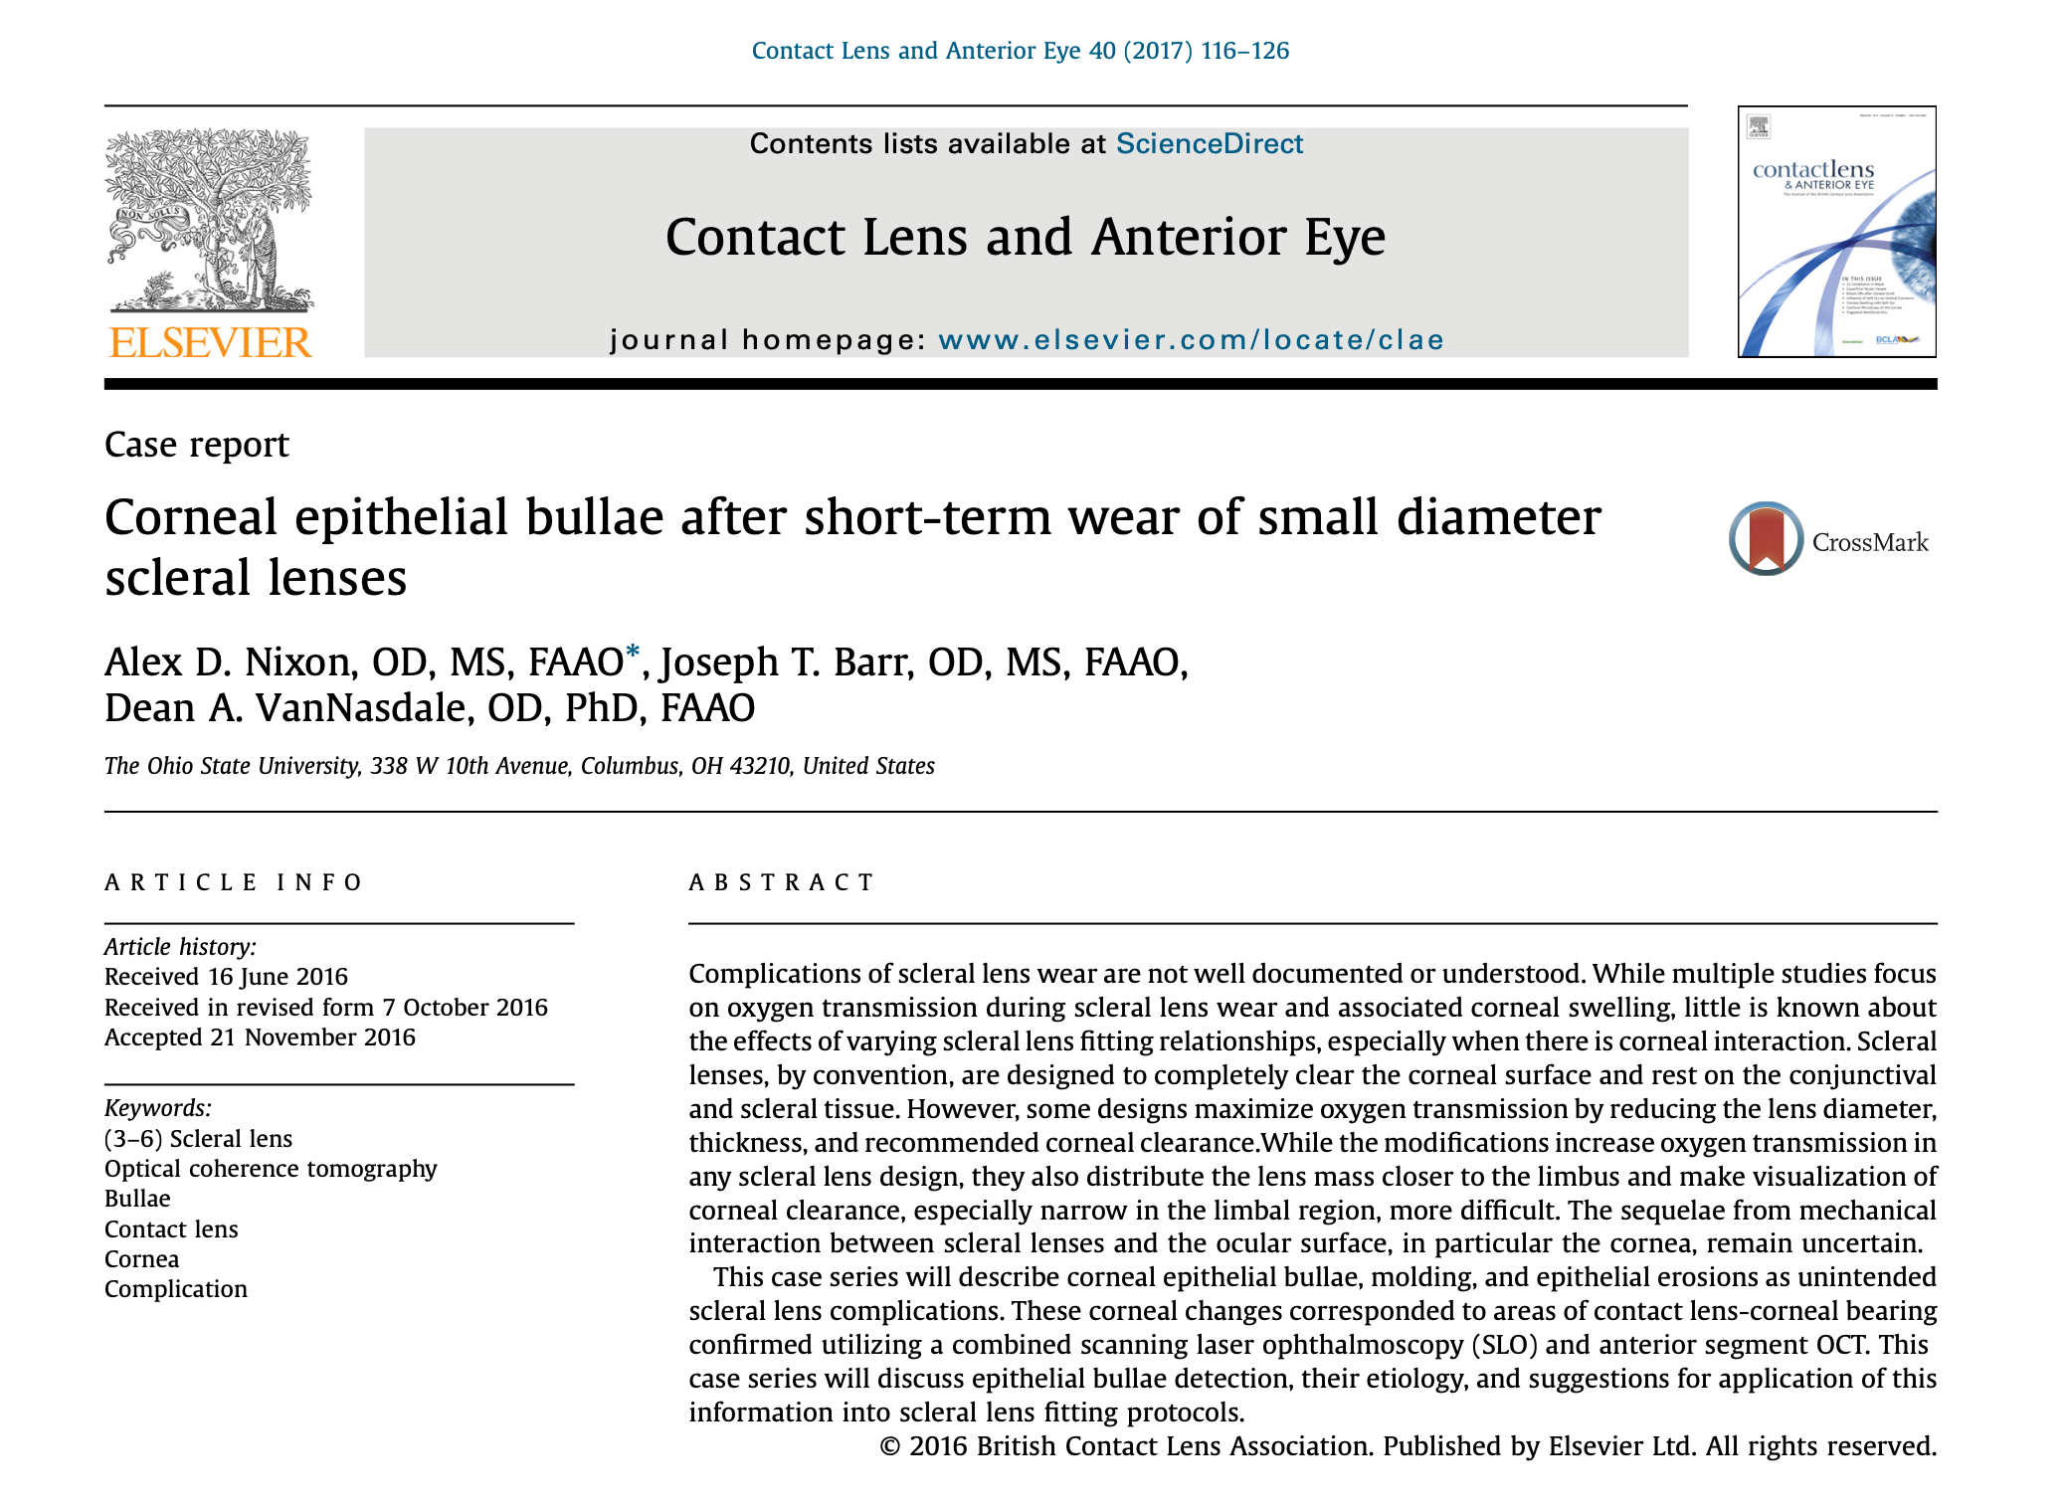
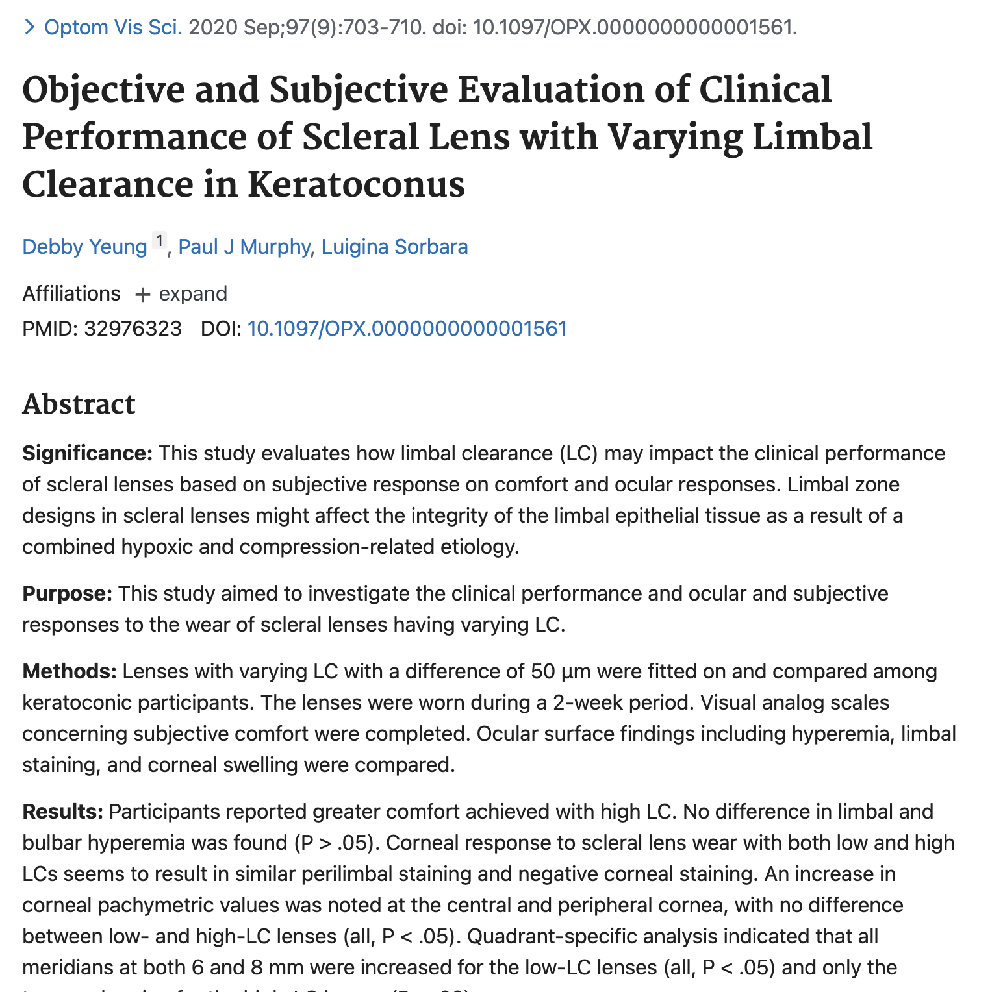
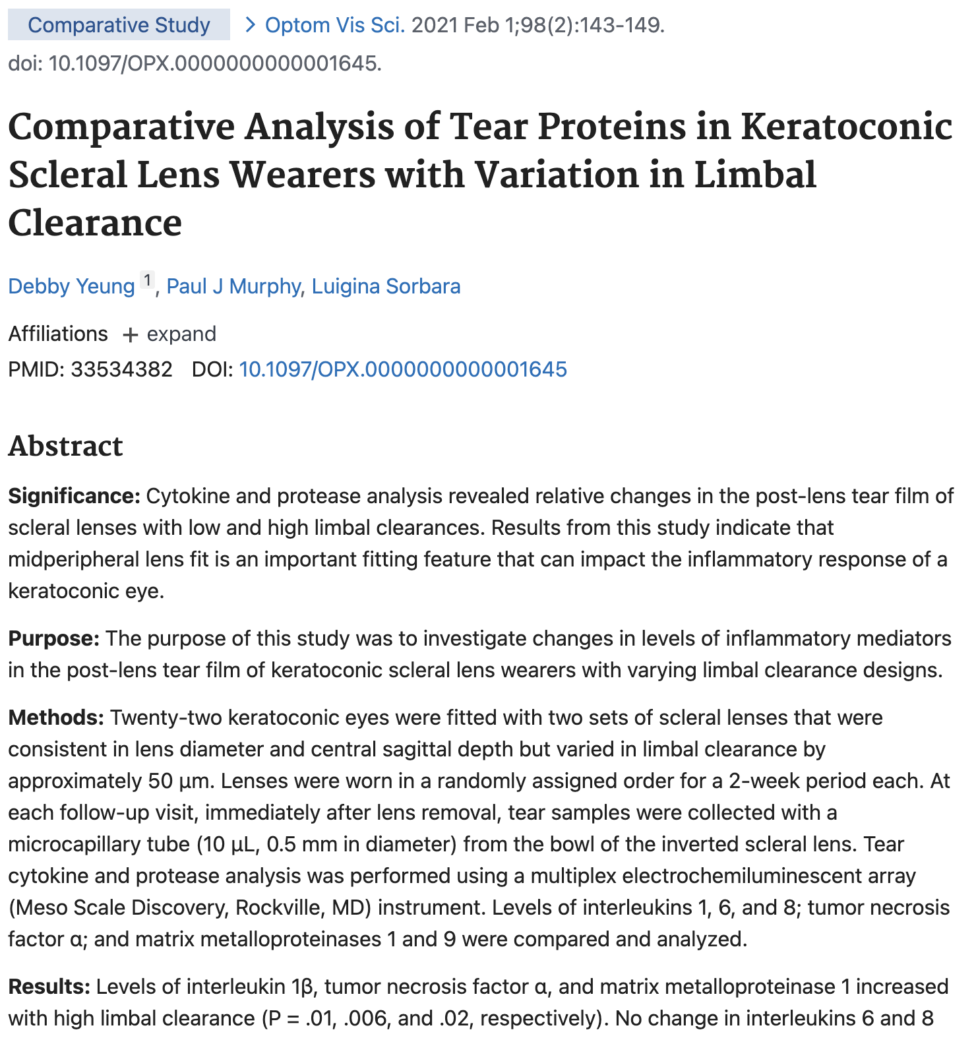


The Limbus

Slide 44



The Limbus

Slide 45

OCT of Central Corneal Clearance

Slide 46


20 minutes
20 min
10 hours
12 hours

Slide 47


Slide 48

THIS IS PERFECT

Slide 49

Limbal Clearance Zone

Slide 50
Scleral Landing Zone Advancements
https://www.clientresourcesinc.com/2018/11/13/top-3-emerging-technologies/

Slide 51
The Measurements

Slide 52
Structural measurement 16mm Chord
Structural measurement to assist in lens selection
10mm Chord, 16 mm Chord with
Sagittal depths
1.72mm
3.93mm
WTW or pupil width
Not available on Solix Essential
Notes:
Internal image only-Solix can be promoted as a tool to get measurements for the fitting of scleral lens but we currently do not have FDA clearance to promote as a Scleral fitting device.

Slide 53


Slide 54



Slide 55


Slide 56


Slide 57


Slide 58


Slide 59


Slide 60


Slide 61
Specialty Lenses
Keratoconus
Pellucid marginal degeneration
Corneal transplant
Corneal scarring (post infection, post LASIK)
Corneal GP intolerance
Ocular surface disease (dry eye, EBMD)
High astigmatic patients

Slide 62
Specialty Lenses
V2510 - Contact lens, gas permeable, spherical, per lens
V2511 - Contact lens, gas permeable, toric, prism ballast, per lens
V2512 - Contact lens, gas permeable, bifocal, per lens
V2520 - Contact lens, hydrophilic, spherical, per lens
V2521 - Contact lens, hydrophilic, toric, or prism ballast, per lens
V2522 - Contact lens, hydrophilic, bifocal, per lens
V2523 - Contact lens, hydrophilic, extended wear, per lens
V2531 - Contact lens, scleral, gas permeable, per lens
V2599 - Contact lens, other type

Slide 63
Specialty Lens Services
92071 - Fitting of contact lens for treatment of ocular surface disease
92072 - Fitting of contact lens for management of keratoconus; initial fitting
92310 - corneal lens, both eyes, except for aphakia
92311 - corneal lens for aphakia, one eye
92312 - corneal lens for aphakia, both eyes
92313 - corneoscleral lens

Slide 64

Specialty Lenses
Notes:
VSP

Slide 65

Specialty Lenses
Notes:
Annual replacement – fitting fee and CL materials
VSP

Slide 66

Specialty Lenses

Slide 67

Specialty Lenses

Slide 68

Specialty Lenses
Notes:
New 6/1/2024

Slide 69

Specialty Lenses

Slide 70

Specialty Lenses
Notes:
Eyemed based on condition, not type of lens

Slide 71

Specialty Lenses
Notes:
Exceeding

Slide 72

Specialty Lenses

Slide 73

Specialty Lenses
Notes:
Up to $2500

Slide 74

Specialty Lenses
Notes:
$2500 reimbursement

Slide 75
3-D Printed Lenses
https://www.clientresourcesinc.com/2018/11/13/top-3-emerging-technologies/

Slide 76






MediPrint™ Harnesses the power of Digital Printing for Ophthalmic Drug Delivery
Through the use of its patented inkjet printing approach and advanced chemistry, Mediprint treats the contact lens surface with extended release agents without impacting the wearer’s field of vision
1
FDA Approved Drugs and/or OTC Agents
2
High Speed, Automated Drug Printing (not embedded in lens)
Drug + HA Reservoir
3
Printed to avoid the optical zone of the contact lens
FDA Approved Contact Lens
3

Slide 77
Mediprint drug delivery lenses are set to open a new category in Eyecare with potential for enhanced contact lens comfort and drug delivery in high impact clinical indications
Comfort Lens
Daily Disposable & 24/7 Weekly Wear Lens
Glaucoma Lens (HA + Bimatorprost)
24/7 Weekly Wear Lens
1.6m Wearer Target Segment
(Comprised of 45+, Dry Eye, Other Discomfort)
800k – 1m
Early Onset Glaucoma
25% Uptake in Patient Population
1.6m Daily
Lens Wearers
500k Weekly
Lens Wearers
$1,500 ASP
($500 for Contact Lens, $1,000 Pharma)
$400-500
Wholesale ASP
$400-500
Wholesale ASP
$150m Peak Sales
$675m NPV
$50m Peak Sales
$315m NPV
$325m Peak Sales Potential
$1.5bn NPV Potential
(80% Pharma / 20% Contact Lens
4

Slide 78
Higher Order Aberrations
https://www.clientresourcesinc.com/2018/11/13/top-3-emerging-technologies/

Slide 79

Vision is dependent on several things….
Refractive correction
Tear film
Corneal clarity
Pupil dynamics
Lens
Vitreous
Retinal health

Slide 80
Lower-Order Aberrations (LOAs)
Are readily corrected with spectacles or conventional contact lenses
Myopia
Hyperopia
Regular astigmatism
Despite perfect correction of LOAs, some patients continue to report poor visual quality, suggesting the presence of higher-order aberrations

Slide 81
Higher Order Aberrations
Subtle optical imperfections that cannot be corrected with traditional spectacles or standard contact lenses
They can have a profound effect on quality of vision, especially under mesopic and scotopic conditions
Halos, Glare, Starbursts, Ghost images, Monocular diplopia, Poor night vision, Reduced contrast sensitivity, Difficulty driving at night despite 20/20 acuity

Slide 82

Higher Order Aberrations

Slide 83

Higher Order Aberrations

Slide 84
Higher Order Aberrations
Coma
Trefoil
Spherical aberration
Secondary astigmatism
Tetrafoil
Pentafoil

Slide 85
Coma
Coma occurs when peripheral light rays focus asymmetrically around the retina instead of converging to a single focal point
Instead of producing a sharp point of light, the image develops a comet-like tail
Common causes
  Keratoconus
  Lens decentration
  Scleral lens decentration
  Corneal ectasia
  Decentered ablation after LASIK

Slide 86
Trefoil
Trefoil results from three-fold rotational asymmetry of the optical system.
Patients commonly notice:
  Starburst patterns
  Mild ghosting
  Reduced image sharpness

Slide 87
Spherical Aberration
Normally, peripheral rays focus at a different location than central rays
Positive spherical aberration
  Peripheral rays focus anterior to central rays
Negative spherical aberration
  Peripheral rays focus posterior to central rays
Clinical symptoms
  Halos
  Reduced contrast
  Poor night vision
  Reduced depth of focus

Slide 88
Quantifying Higher-Order Aberrations
Zernike Polynomials
  The universal mathematical language of ocular optics.
  Instead of describing the eye as simply "nearsighted" or "astigmatic," Zernike polynomials break the wavefront into dozens of individual optical components
Root Mean Square (RMS)
  It represents the overall magnitude of optical error present in the eye.
  Normal eye 0.20–0.35 µm
  Keratoconus often exceeds 1.0 µm
Wavefront Error
  The ideal optical system produces a perfectly flat wavefront.
Point Spread Function (PSF)
Modulation Transfer Function (MTF)

Slide 89
Prevalence of Residual Higher Order Aberrations (HOAs) in Final, Dispensed Scleral Lenses
Questions:
  How do we improve the 6% (or 10%)?
  Dry eye- have not yet eliminated dry eye patients
  Rotational instability of lenses
  Parsing out monovision patients

Slide 90
Contact Lens Communication Platforms
https://www.clientresourcesinc.com/2018/11/13/top-3-emerging-technologies/

Slide 91
1 Patient walking!!
1 patient per day x 5000 doctors = 5000/day
3.5 days = 17,500/week
45 weeks = 787,500/year
$236 Million

Slide 92


Slide 93

© 2024 Dr. Contact Lens. All rights reserved. Confidential.

Slide 94









© 2024 Dr. Contact Lens. All rights reserved. Confidential.

Slide 95
Thank You mile.brujic75@gmail.com

