Slide 1
ELEVATING PATIENT OUTCOMES
THROUGH AI & TECHNOLOGY
How Technology Changes Management
Mile Brujic, OD, FAAO | Ron Melton, OD, FAAO

Slide 2
Disclosure
Dr. Brujic has the following relevant financial relationships: Apellis (consultant, speakers bureau), ABB Optical (received meeting support), Abbvie (consultant), Alcon (consultant, speakers bureau), Art Optical (received meeting support), Bausch + Lomb Health (consultant, speakers bureau), Contamac (received meeting support), CooperVision (received meeting support), CSEye (consultant), Dompe (consultant), Dopavision (consultant), Glaukos (consultant), Johnson & Johnson Vision Care (received meeting support), Lentechs (received research support), MDElite (consultant), Nordic Pharma (consultant), Orasis (consultant, speakers bureau), Radius XR (consultant), Sun Pharma (speakers bureau), Tangible Science (received meeting support), Tarsus (consultant, speakers bureau), Viatris (consultant, speakers bureau), Visionix (consultant), Walman Optical (received meeting support).
Dr. Melton has the following relevant financial relationships: Bausch + Lomb (consultant), iCare (consultant)
These relationships have been mitigated and will not influence the content of this presentation

Slide 3

Before We Get Started….
Who is currently using a phone system that integrates phones with messaging, recall, etc?
Who currently has virtual employees? (people off site)
Who currently has standard operating procedures (SOP) in their practice?
Who uses Artificial Intelligence (chatgpt, etc)? How are you using it?
Are you a practice owner?

Slide 4
Course Objectives
Three practical outcomes for clinicians
• Describe applications of AI and emerging technology in diagnostic accuracy, disease detection, and clinical decision-making
• Identify ways to improve workflows, patient communication, and administrative operations
• Implement technology responsibly while preserving clinical judgment and evaluating return on investment
ELEVATING PATIENT OUTCOMES • AI & TECHNOLOGY
2

Slide 5
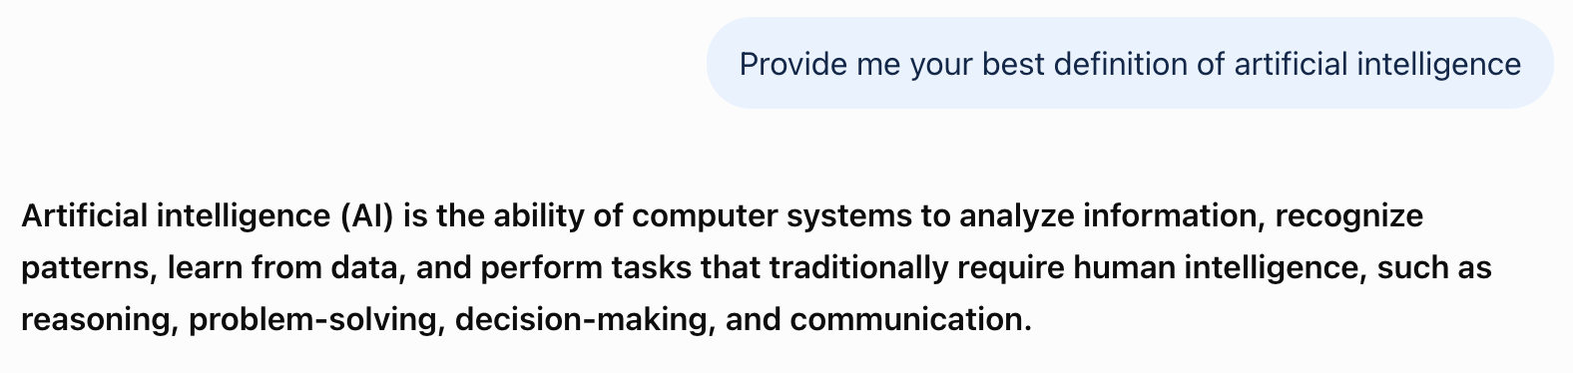
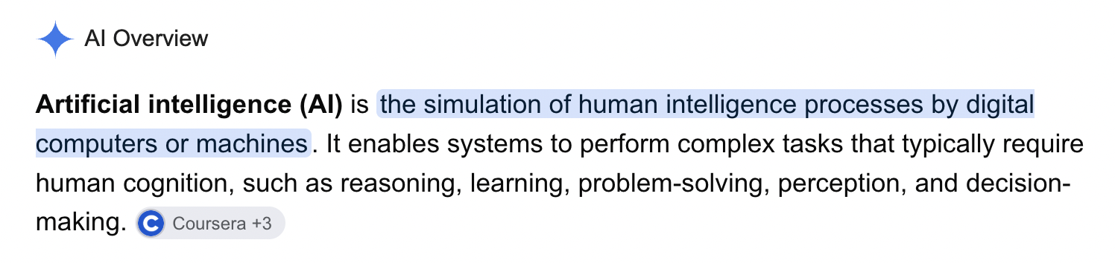
I asked the experts what artificial intelligence is and here’s what they told me…

Slide 6
The Opportunity: Better Decisions, Better Systems
AI is a tool within a clinical system — not a replacement for the clinician
CLINICAL
OPERATIONAL
PATIENT
Find disease earlier and synthesize more information.
Reduce avoidable friction in care delivery.
Improve understanding, access, and follow-through.
ELEVATING PATIENT OUTCOMES • AI & TECHNOLOGY
3

Slide 7
SECTION 01
The Evolution of Technology in Optometry
From instruments that collect data to systems that help interpret it

Slide 8
How the Exam Has Evolved
TRADITIONAL
TECHNOLOGY-ASSISTED
• Clinician gathers and interprets each data source
• Manual documentation and follow-up
• Information dispersed across devices
• Imaging and structured data capture
• Automated flags and longitudinal comparisons
• Connected workflows and decision support
ELEVATING PATIENT OUTCOMES • AI & TECHNOLOGY
5

Slide 9
Opportunities — and Limitations
• Potential: faster triage, consistency, access, and reduced administrative burden
• Limitations: imperfect training data, false positives and negatives, workflow mismatch
• The quality of an AI output depends on its intended use and validation
• Clinical context and professional oversight remain essential
ELEVATING PATIENT OUTCOMES • AI & TECHNOLOGY
6

Slide 10
Explore the technologies | Live links
RevolutionEHR AI Scribe
MaximEyes EVAA Scribe
LumineticsCore
EyeArt (Eyenuk)
AEYE-DS
Product descriptions verified from manufacturer materials, October 2026. All on-slide software interfaces are labeled illustrative.
AI in Optometry • October 2026

Slide 11
BARTI
AI-POWERED OPTOMETRY EHR
From patient conversation to clinical chart
Quinn AI tools + integrated practice management
01
02
03
04
CAPTURE
RETRIEVE
SUPPORT
OPERATE
Quinn Scribe listens to the visit and creates a clinical note.
Quinn History finds prior exams, prescriptions and relevant history.
Quinn Guidelines surfaces AOA clinical guidance within the chart.
Scheduling, messaging, billing and optical workflows in one platform.
ILLUSTRATIVE CLINICAL EXAMPLE
“Patient reports worsening dryness…” → AI-generated draft note → Clinician reviews and signs
Vendor-reported features; clinician verification remains essential. Barti is an EHR, not an autonomous diagnostic AI.

Slide 12
What is available for charting demo
Complex dry eye
Complex glaucoma
Complex macular degeneration

Slide 13
SECTION 02
AI in Clinical Decision-Making
Where might algorithms improve detection, interpretation, and follow-up?

Slide 14
Clinical Imaging Applications
RETINA
GLAUCOMA
OCT
CORNEA
AI-assisted retinal disease detection and referral prioritization.
Risk assessment using structural and functional data.
Pattern recognition and progression analysis.
Topography / tomography support for ectasia screening.
ELEVATING PATIENT OUTCOMES • AI & TECHNOLOGY
8

Slide 15
Predictive Analytics
POTENTIAL USES
VALIDATION QUESTIONS
• Risk stratification
• Progression estimates
• Follow-up prioritization
• Trend identification
• Who was included in the study population?
• What are sensitivity, specificity and error rates?
• Was performance tested in similar patients?
• Does it improve clinical decisions?
ELEVATING PATIENT OUTCOMES • AI & TECHNOLOGY
9

Slide 16
Clinical Scenario: An AI Flag on OCT
Discussion: When should an algorithm change management?
• An algorithm flags possible progression despite a stable visual field
• Review scan quality, segmentation, artifacts, and longitudinal comparability
• Compare with IOP, examination, prior imaging, and risk profile
• Decide whether to repeat testing, alter monitoring, or modify care
Create documentation that is clinically reliable
ELEVATING PATIENT OUTCOMES • AI & TECHNOLOGY
10

Slide 17
SECTION 03
Artificial Intelligence in the Exam Room
Use AI to support the visit without outsourcing judgment

Slide 18
At the Point of Care
DOCUMENT
SYNTHESIZE
SUPPORT
EXPLAIN
AI scribes and note drafting.
Chart summaries and clinical histories.
Decision support and risk stratification.
Patient-friendly education and visuals.
ELEVATING PATIENT OUTCOMES • AI & TECHNOLOGY
12

Slide 19
A Practical AI-Supported Visit
Illustrative workflow — requires approved tools and privacy controls
• Before: summarize chart history and identify missing data
• During: assist with documentation and patient explanations
• After: draft instructions, referral letters, and follow-up plans
• At every stage: clinician verifies accuracy, context, and final record
ELEVATING PATIENT OUTCOMES • AI & TECHNOLOGY
13

Slide 20
What is available for letters to referring doctors demo
Complex dry eye
Complex contact lens fit

Slide 21
Prior Authorization Assistance
POTENTIAL BENEFITS
GUARDRAILS
• Gather required clinical documentation
• Draft structured medical necessity narratives
• Identify missing fields
• Verify payer-specific requirements
• Do not fabricate indications or prior treatment
• Review all clinical and billing claims before submission
ELEVATING PATIENT OUTCOMES • AI & TECHNOLOGY
14

Slide 22
What is available for letters of medical necessity demo
Complex dry eye

Slide 23
SECTION 04
Administrative Applications
Efficiency gains often begin outside the exam lane

Slide 24
Front Office & Revenue Cycle
ACCESS
COVERAGE
REVENUE
OPERATIONS
Appointment optimization, scheduling, recalls.
Insurance verification and eligibility workflows.
Coding support and claim review.
Inventory and staff task routing.
ELEVATING PATIENT OUTCOMES • AI & TECHNOLOGY
16

Slide 25
Dashboards That Matter
EXAMPLE KPIs
HOW TO USE THEM
• Patient wait time
• No-show rate
• Recall completion
• Claim denial rate
• Exam-to-dispense conversion
• Set baseline metrics
• Define a realistic improvement goal
• Review trends with staff
• Validate whether changes help patients
ELEVATING PATIENT OUTCOMES • AI & TECHNOLOGY
17

Slide 26
Operational Case: Reducing Appointment Friction
Discussion: Which workflow would you automate first?
• Identify a bottleneck: repeated insurance checks and rescheduling
• Pilot one workflow automation with a defined staff owner
• Measure turnaround time, errors, and patient experience
• Retain human escalation for ambiguous benefits and exceptions
ELEVATING PATIENT OUTCOMES • AI & TECHNOLOGY
18

Slide 27
Building Capacity Through Delegation
1
2
Identify Key Bottlenecks
Delegate Administrative Tasks
Track where tasks pile up or slow down. Common areas include insurance verification, patient check-in, and clinical documentation.
Shift inboxes, calls, and pre-authorizations to virtual team members who specialize in these functions, freeing up your on-site staff for patient-facing activities.
3
4
Use AI to Draft SOPs
Record Training Sessions
Leverage AI tools to help document processes. Start with a rough outline of your current workflow, then use AI to expand it into comprehensive, step-by-step instructions.
Create reusable training videos for common procedures. This builds a library of institutional knowledge that stays with your practice even when staff changes.
These steps create space for doctors and practice leaders to work on the business rather than just in it, leading to strategic growth rather than just daily survival.
Notes:
8

Slide 28
What is available for standard operating procedures demo
Pretesting

Slide 29
SECTION 05
Improving the Patient Experience
Technology should make care clearer, easier, and more personal

Slide 30
Patient Journey
BEFORE
DURING
AFTER
Digital intake and online scheduling.
Personalized education and clearer explanations.
Automated reminders and follow-up communication.
ELEVATING PATIENT OUTCOMES • AI & TECHNOLOGY
20

Slide 31
Reduce Chair Time — Preserve Connection
• Collect routine history and administrative details before the visit
• Use visual explanations to make clinical findings understandable
• Tailor education to diagnosis, treatment, and health literacy
• Use virtual follow-up selectively where appropriate
• Measure patient understanding and satisfaction — not speed alone
ELEVATING PATIENT OUTCOMES • AI & TECHNOLOGY
21

Slide 32
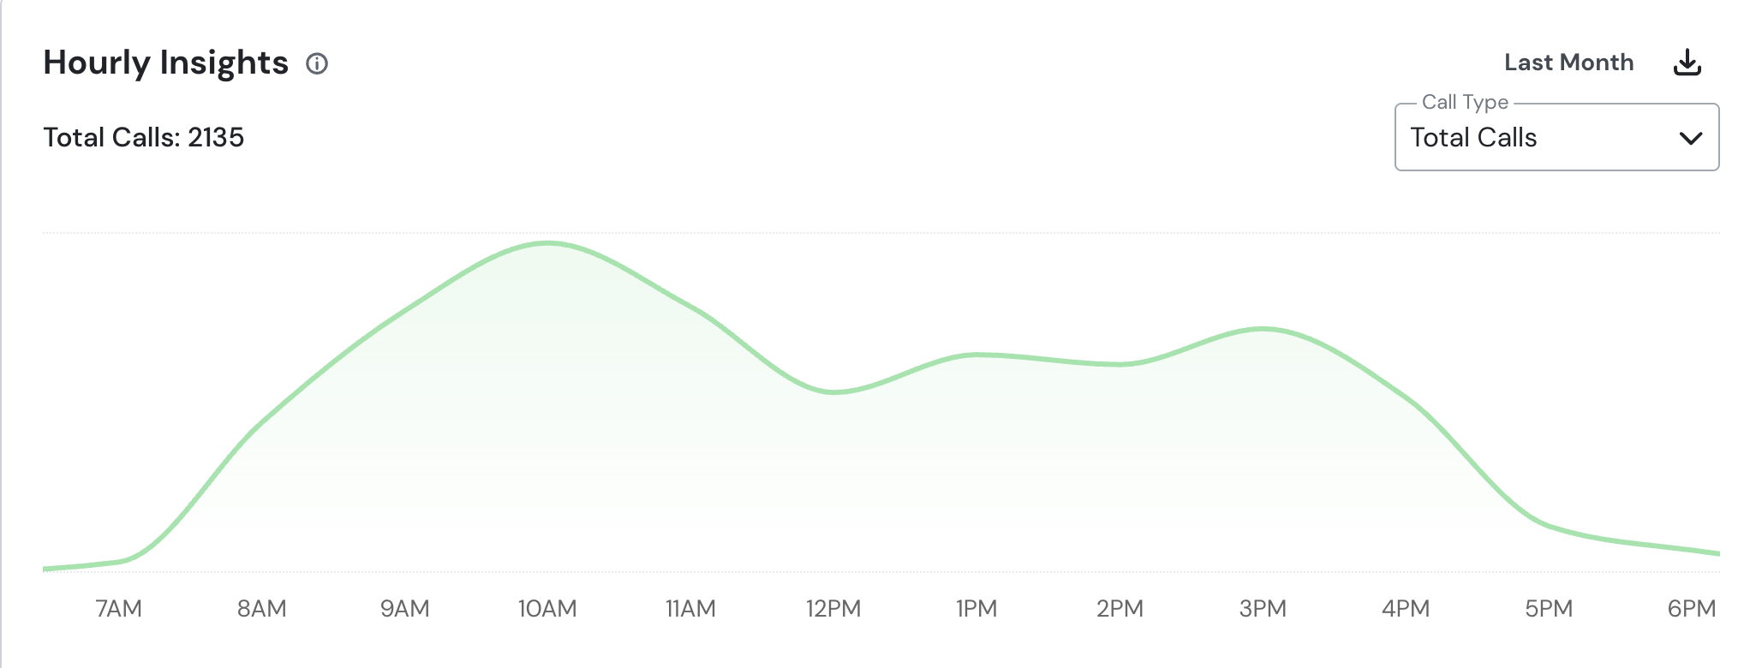
Last Months Stats

Slide 33
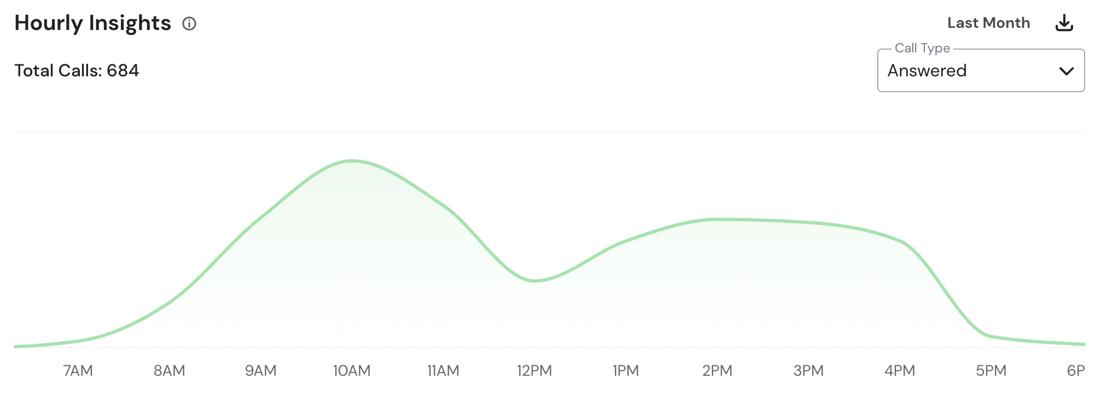
Last Months Stats

Slide 34
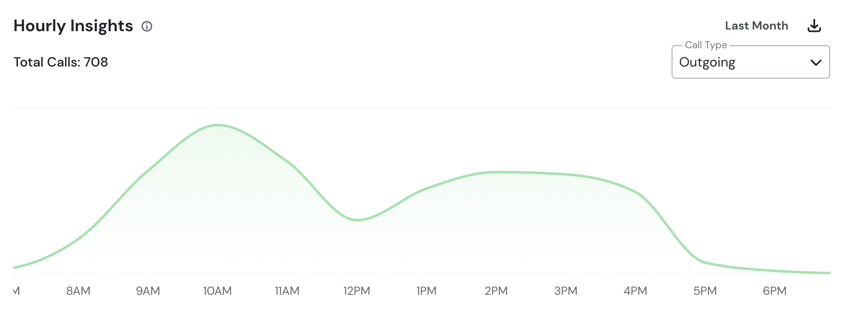
Last Months Stats

Slide 35
SECTION 07
Evaluating New Technology
Adopt technology because it solves a problem — not because it is new

Slide 36
The Adoption Test
EVIDENCE
FIT
ECONOMICS
PEOPLE
Is the claimed benefit clinically demonstrated?
Does it work in our patient population and workflow?
What are total costs and reimbursement implications?
Can staff learn, maintain, and use it reliably?
ELEVATING PATIENT OUTCOMES • AI & TECHNOLOGY
27

Slide 37
ROI Is More Than Revenue
COSTS
RETURNS
• Purchase / subscription
• Integration and maintenance
• Training and downtime
• Staff time and oversight
• Clinical outcomes and access
• Time saved and capacity
• Patient experience
• Revenue or cost avoidance
ELEVATING PATIENT OUTCOMES • AI & TECHNOLOGY
28

Slide 38
Pilot Before You Scale
Avoid technology overload: fewer tools, better integrated
• Define the clinical or operational problem
• Choose a small set of meaningful measures
• Train a designated champion and establish safeguards
• Pilot, audit errors, and gather staff feedback
• Expand only if results justify the complexity
ELEVATING PATIENT OUTCOMES • AI & TECHNOLOGY
29

Slide 39


Slide 40
What is available for office meeting notes streamlining demo

Slide 41
SECTION 08
Ethical and Legal Considerations
Trust, privacy, and accountability are non-negotiable

Slide 42
Responsible AI Principles
PRIVACY
FAIRNESS
TRANSPARENCY
OVERSIGHT
Protect patient information and use approved workflows.
Examine bias and unequal performance across populations.
Know the tool’s intended use and limitations.
Keep clinician review and accountability in place.
ELEVATING PATIENT OUTCOMES • AI & TECHNOLOGY
31

Slide 43
Clinical Governance Checklist
• Assess HIPAA obligations and vendor data handling
• Confirm documentation standards and consent needs
• Define who reviews and signs AI-assisted outputs
• Create a process for errors, incident reporting, and periodic audit
• Reevaluate tools when their features or intended uses change
ELEVATING PATIENT OUTCOMES • AI & TECHNOLOGY
32

Slide 44
SECTION 09
The Future of AI in Optometry
What will change — and what should remain constant?

Slide 45
Emerging Directions
GENERATIVE AI
AUTONOMOUS SYSTEMS
PREDICTION
AUTOMATION
More integrated clinical and administrative assistance.
Expanded use of validated diagnostic workflows.
More personalized disease modeling.
Robotics and connected care processes.
ELEVATING PATIENT OUTCOMES • AI & TECHNOLOGY
34

Slide 46
Preparing for the Next Decade
• Build structured, reliable data capture today
• Train staff to question and verify AI output
• Evaluate tools against patient-centered outcomes
• Design workflows that can evolve without compromising care
• Preserve empathy, professional judgment, and accountability
ELEVATING PATIENT OUTCOMES • AI & TECHNOLOGY
35

Slide 47
Five Take-Home Messages
Technology changes management only when it changes decisions and care
1
Start with a clinical or operational problem
2
Demand evidence appropriate to the use case
3
Integrate tools into real workflows
4
Measure outcomes, errors, and total cost
5
Keep the clinician accountable for care
ELEVATING PATIENT OUTCOMES • AI & TECHNOLOGY
36

Slide 48
Audience Discussion
Which single technology change could improve your patients’ experience in the next 90 days?
Choose one workflow.
Define one outcome.
Commit to one measured pilot.
Mile Brujic, OD, FAAO • Ron Melton, OD, FAAO
ELEVATING PATIENT OUTCOMES • AI & TECHNOLOGY
37

