Slide 1

Pediatric & Adolescent Eye Care: Practical Strategies for Today's Youngs
Mile Brujic, OD, FAAO
Premier Vision Group
https://www.clientresourcesinc.com/2018/11/13/top-3-emerging-technologies/

Slide 2
InfantSEE
    Child’s first eye exam
    www.infantsee.org
    The exam (special considerations)
    Visual acuity
    Retinoscopy – dry and cycloplegic
    Color vision
    Stereopsis
    Cover test

Slide 3
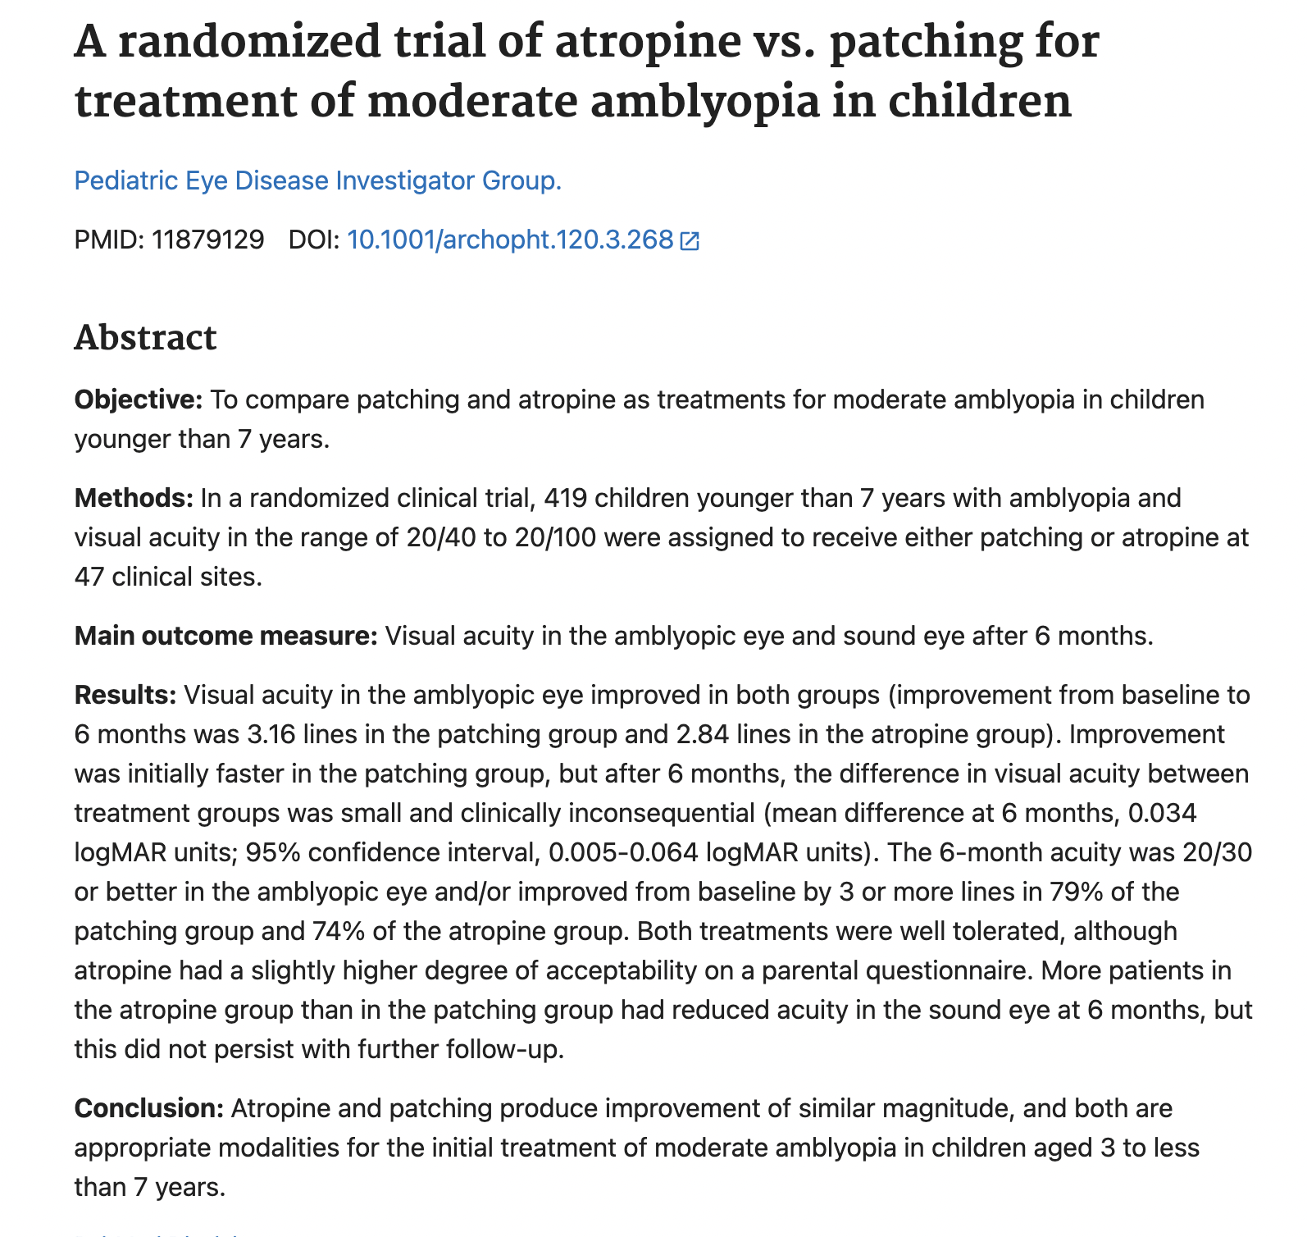

Slide 4
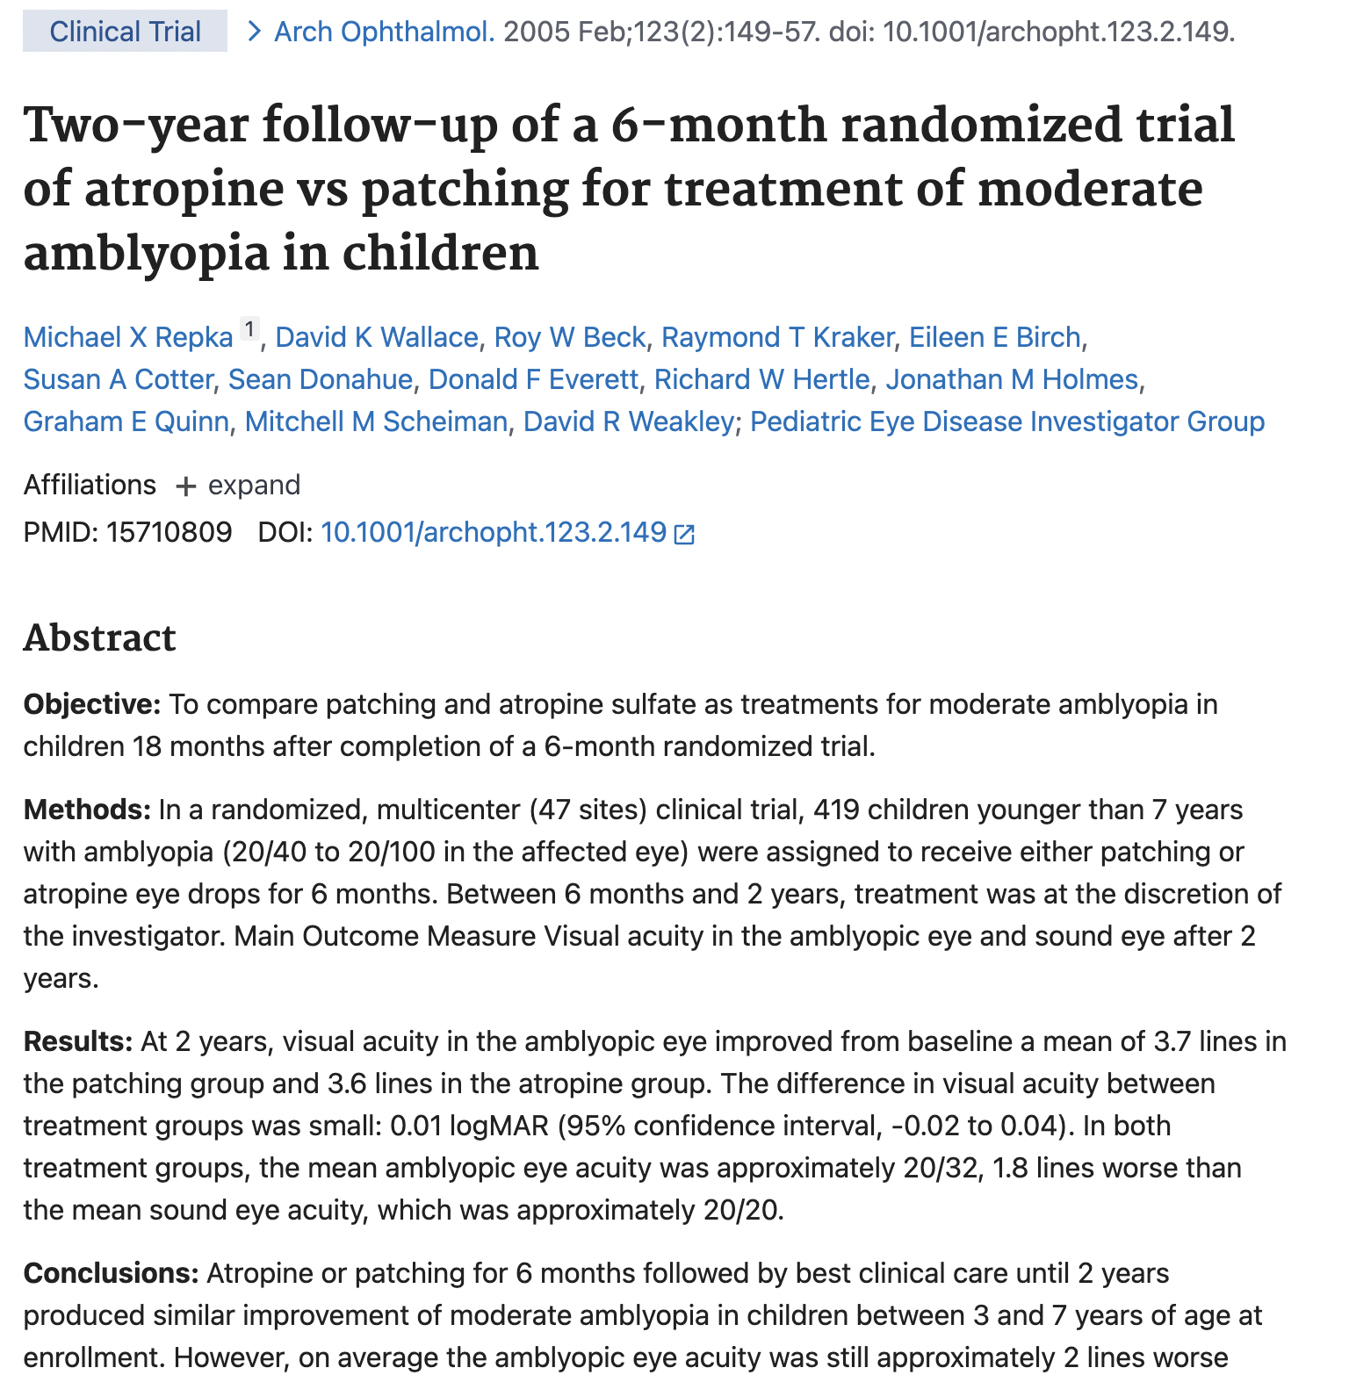
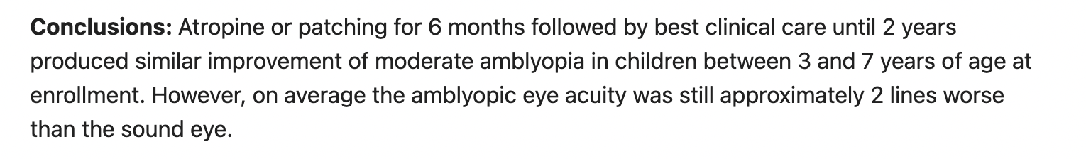

Slide 5
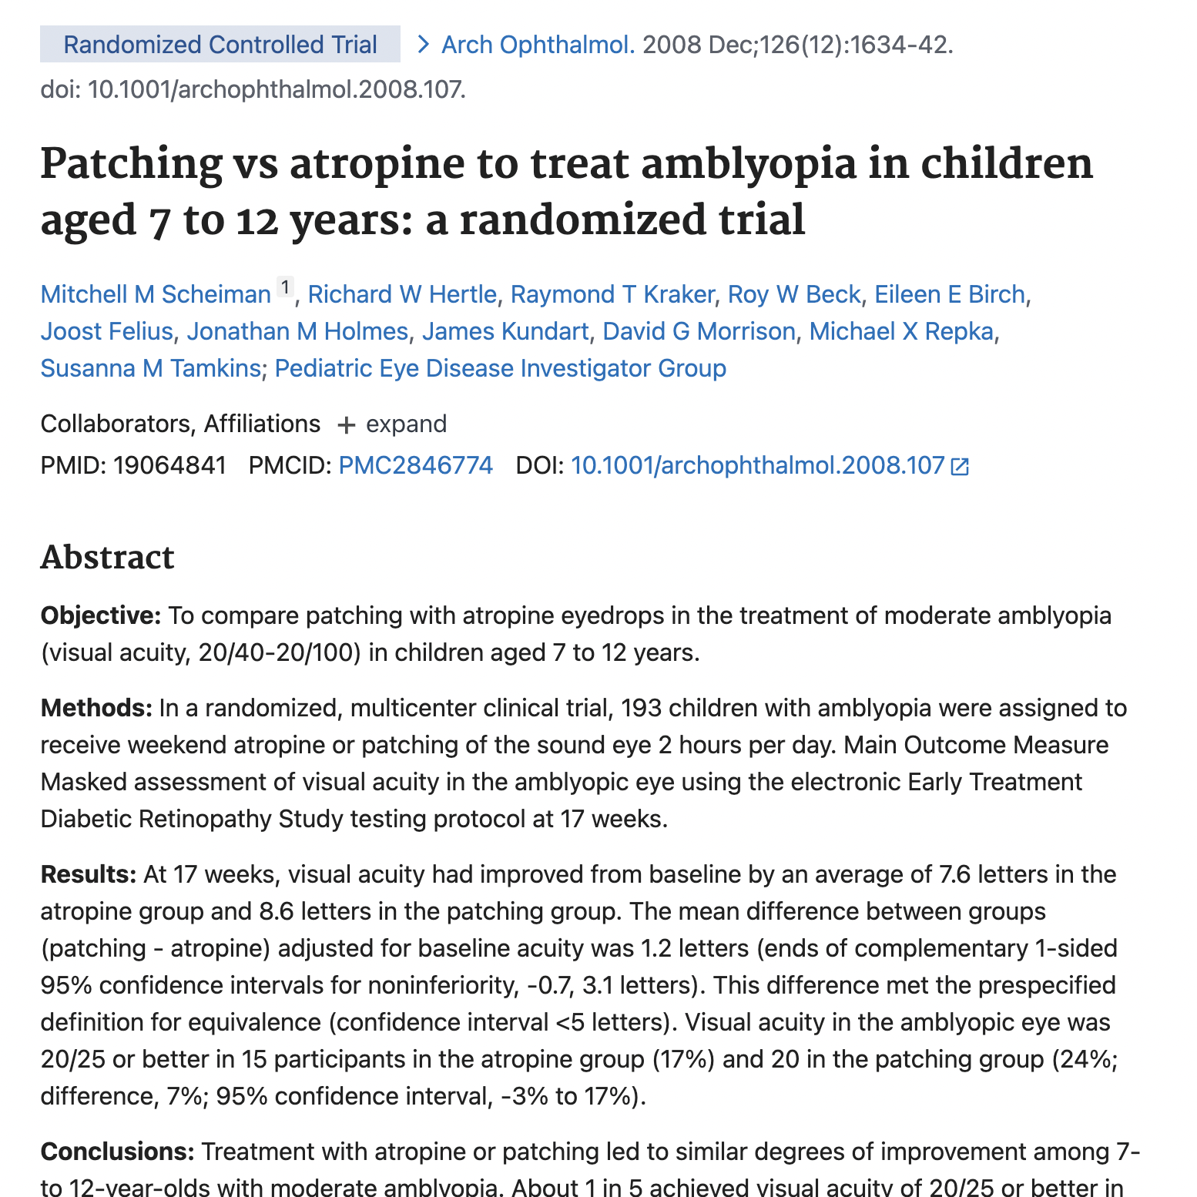
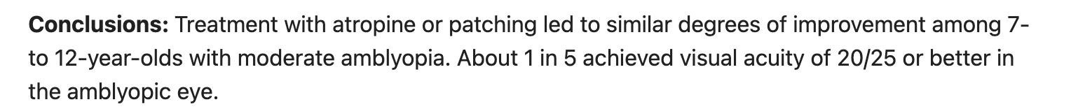

Slide 6
Myopia Progression Management Advances
https://www.clientresourcesinc.com/2018/11/13/top-3-emerging-technologies/

Slide 7
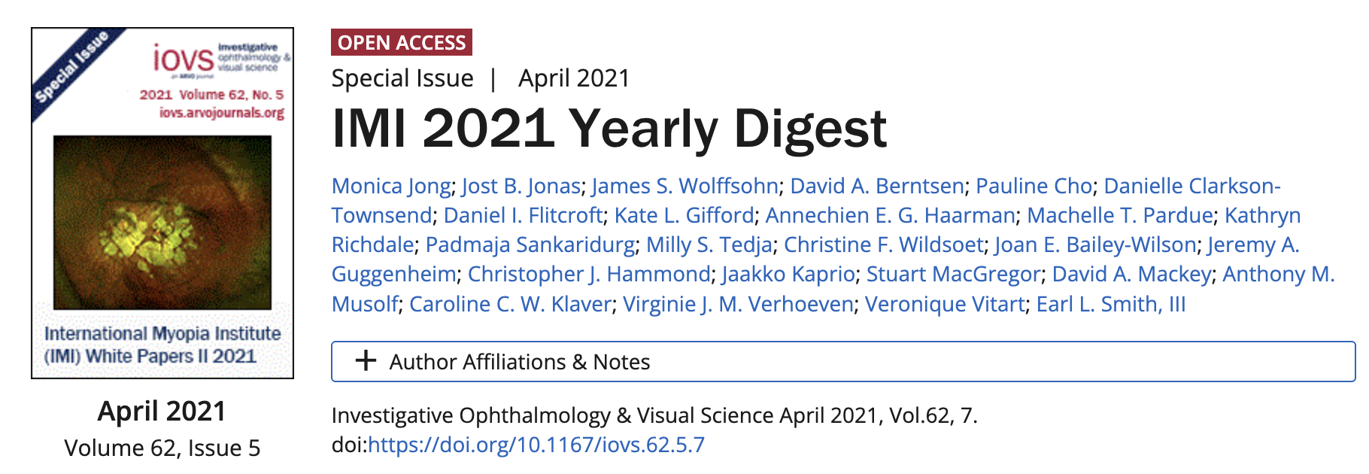
The Definition of Myopia Has Changed
The International Myopia Institute states:
“Previously, over 400 definitions had been used in the literature”
Myopia = spherical equivalent refractive error ≤ −0.50 diopters
A progressive disease that causes eyeball stretching
Which results in:
Higher Disease Risks, Blurry Vision, Changing Prescriptions

Slide 8
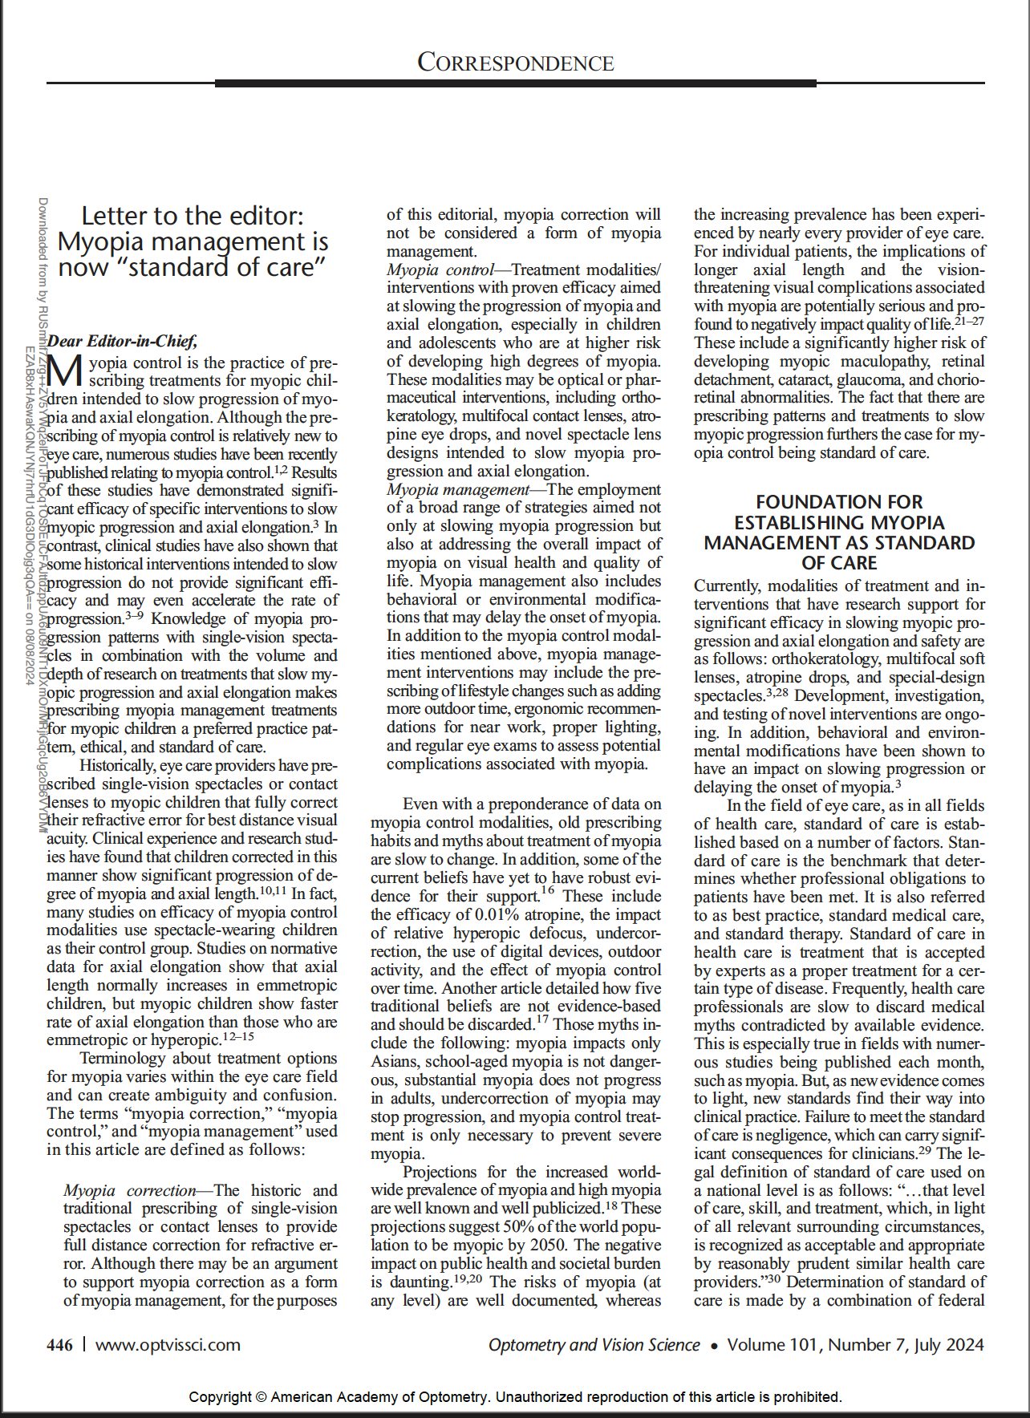
Myopia Treatments
Myopia Correction: traditional approach to prescribing SV correction for refractive error
Myopia Control: Treatment modalities/intervention (optical or pharmaceutical)with proven efficacy aimed at slowing myopia progression
Myopia Management: employment of a broad range of strategies aimed at slowing progression AND addressing overall impact on visual health and quality of life. Includes behavioral and environmental modifications

Slide 9
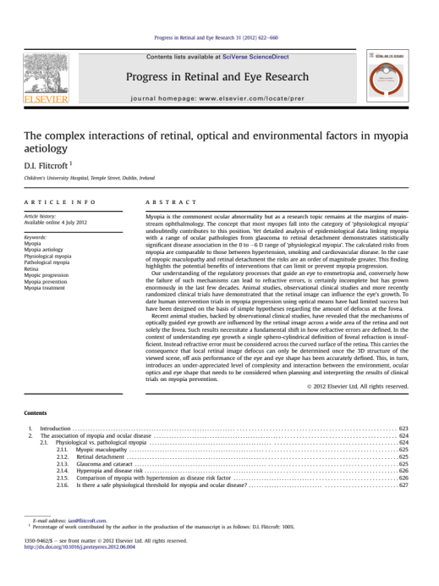
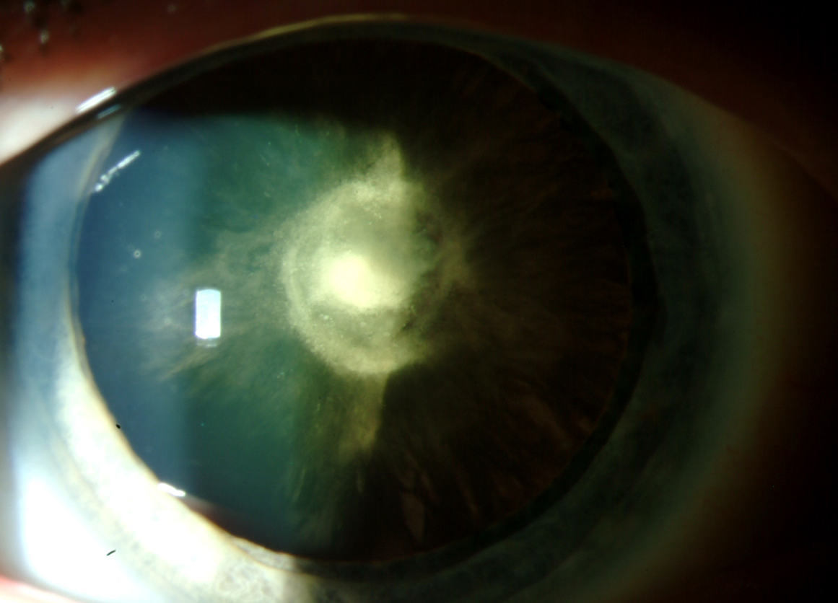
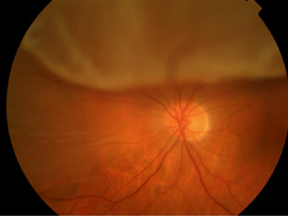
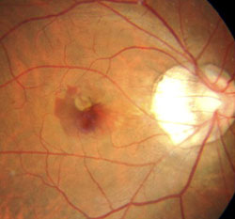
IS THERE A SAFE LEVEL OF MYOPIA?
INCREASED RISK
 | Glaucoma | Cataract (PSCC) | Retinal detachment | Myopic Maculopathy
-1.00 to -3.00 | 2.3 | 2.1 | 3.1 | 2.2
-3.00 to -5.00 | 3.3 | 3.1 | 9.0 | 9.7
-5.00 to -7.00 | 3.3 | 5.5 | 21.5 | 40.6
>-7.00 |  |  | 44.2 | 126.8
Younan et al 2002, Ogawa & Tanaka 1988, Vongphanit et al 2002 in Flitcroft 2012.

Slide 10
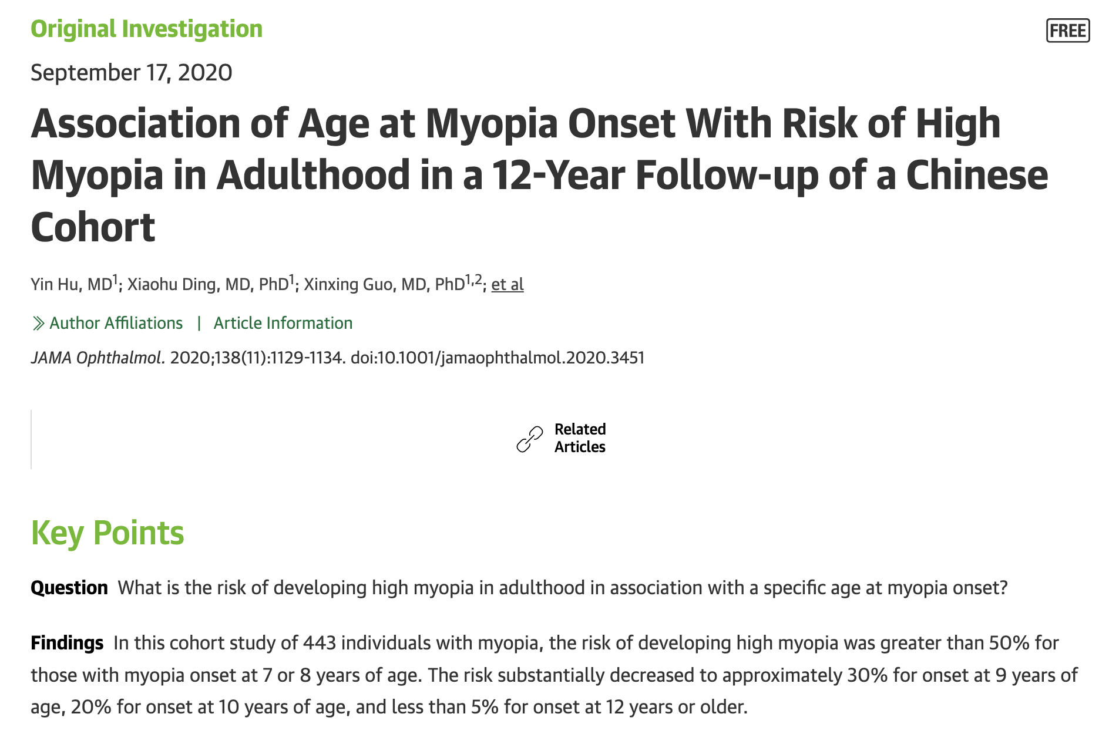
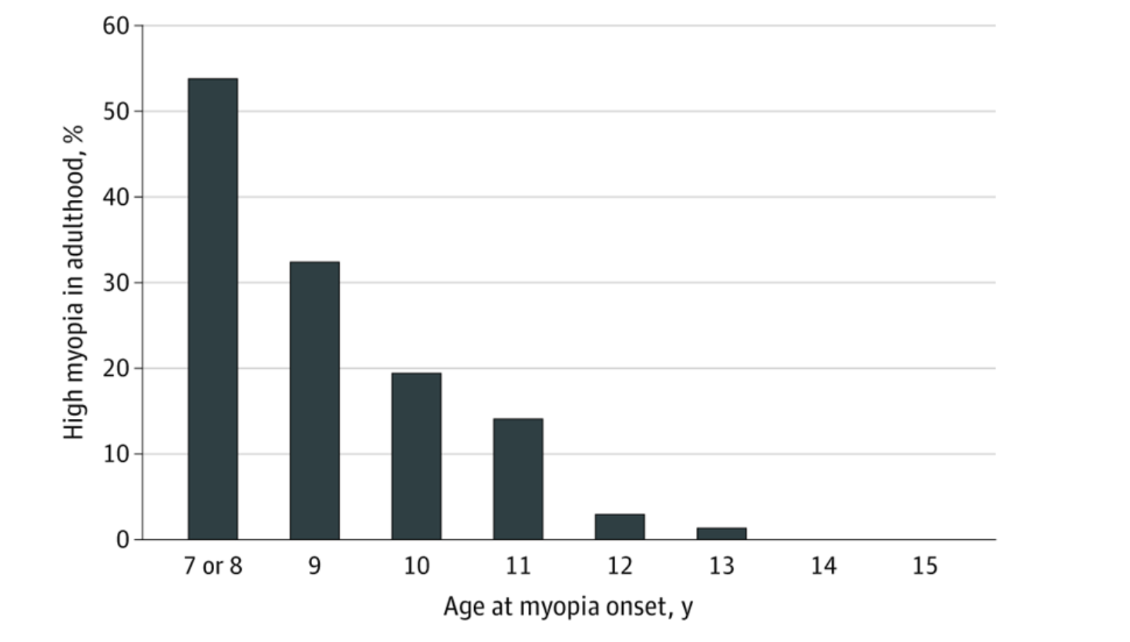
JAMA Ophthalmol. 2020;138(11):1129-1134. doi:10.1001/jamaophthalmol.2020.3451

Slide 11
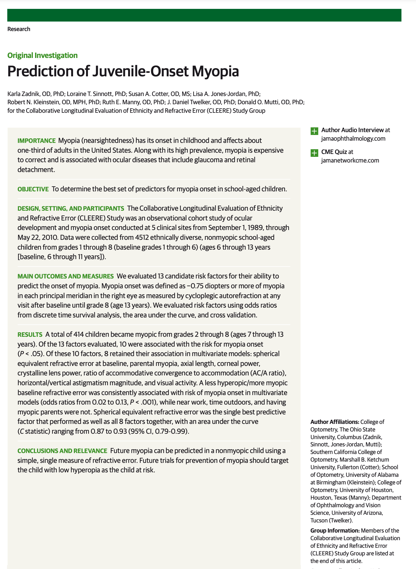

Zadnik K, Sinnott LT, Cotter SA, et al. Prediction of Juvenile-Onset Myopia. JAMA Ophthalmology.2015;133(6):683-689
Age (years) | Refraction cut point for future myopia risk (D)
6 | Less than +0.75
7-8 | +0.50 or less
9-10 | +0.25 or less
11 | Plano

Slide 12
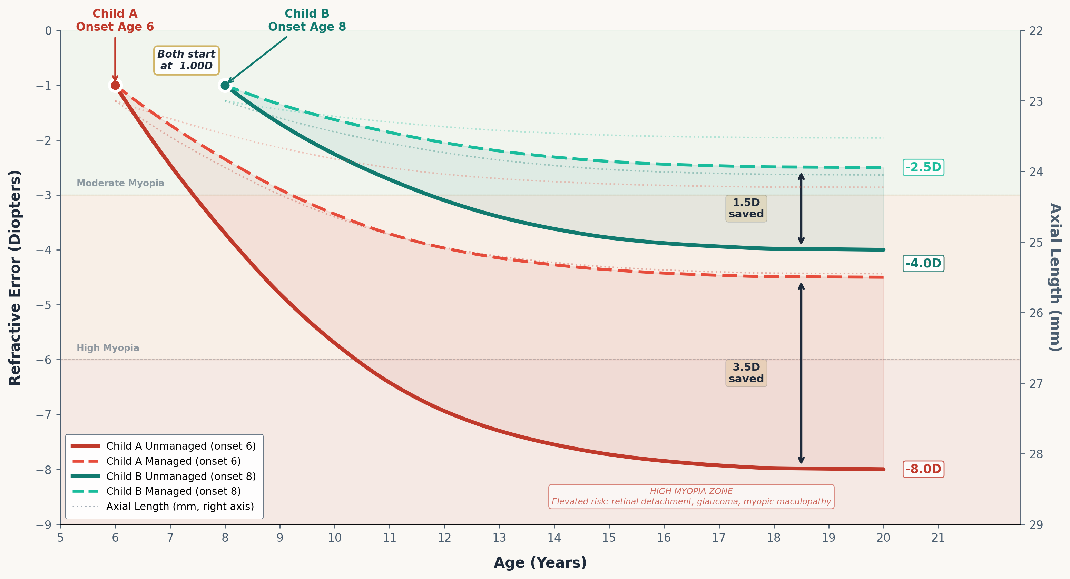
Earlier Onset, Faster Progression: Managed vs. Unmanaged
Model based on Goss 1996, Donovan et al 2012, COMET 2013, Moore et al 2024 | ~50% treatment efficacy applied | Specialty Eye

Slide 13
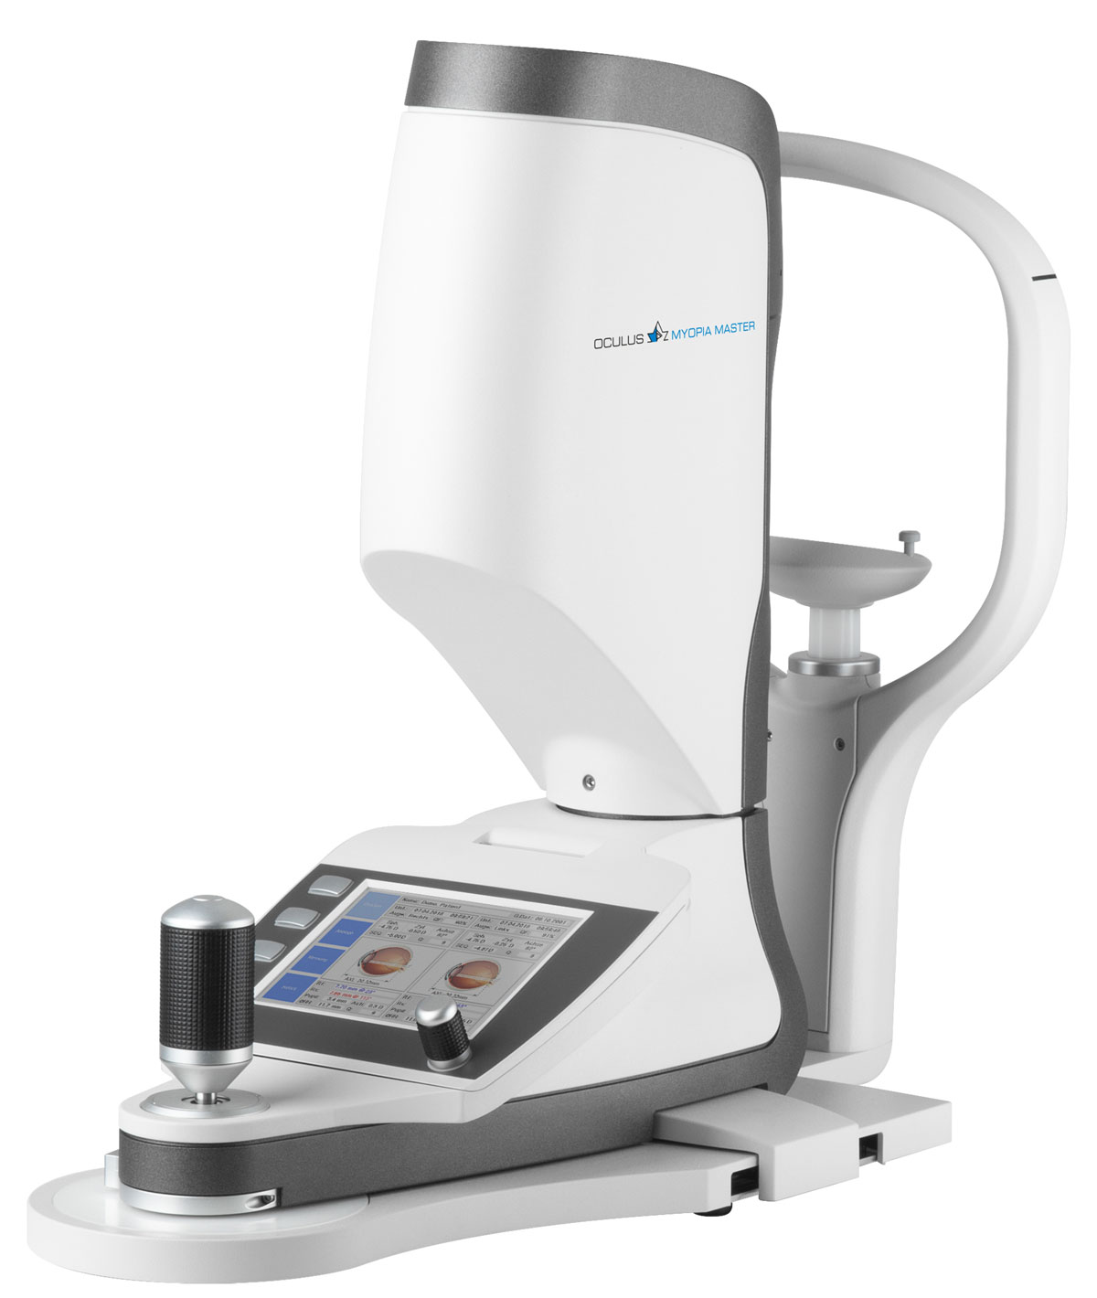
Axial Length Measurement is the new Gold Standard
As the eye grows longer, the retina stretches — and the risk of irreversible damage rises

Slide 14
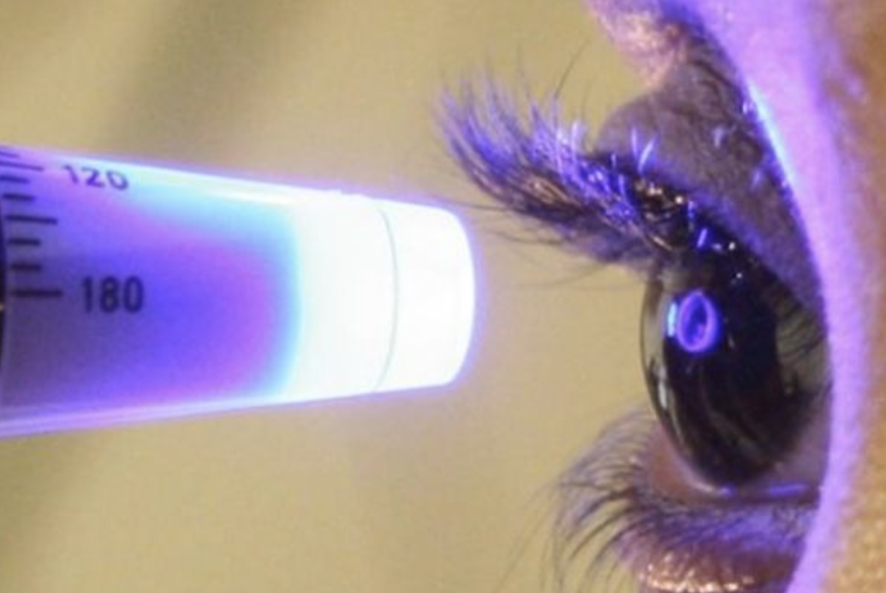
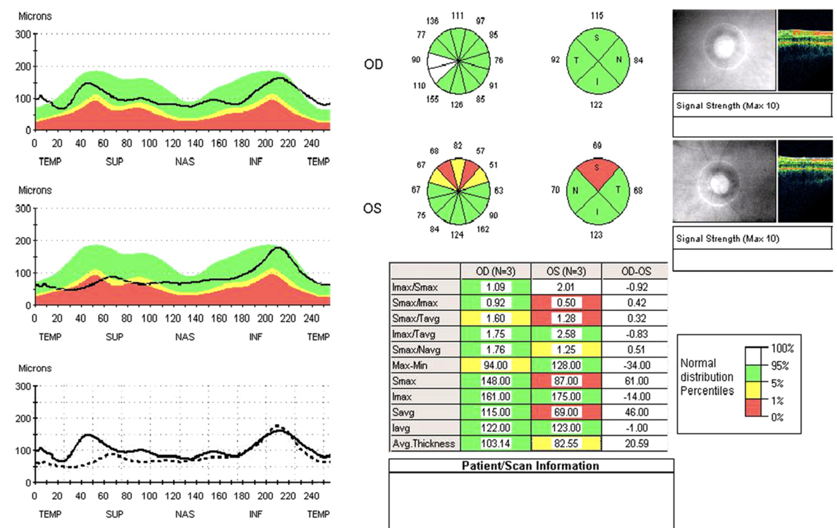
Why is Glaucoma Bad?
If you could have just one test for Glaucoma, what would it be and why?

Slide 15
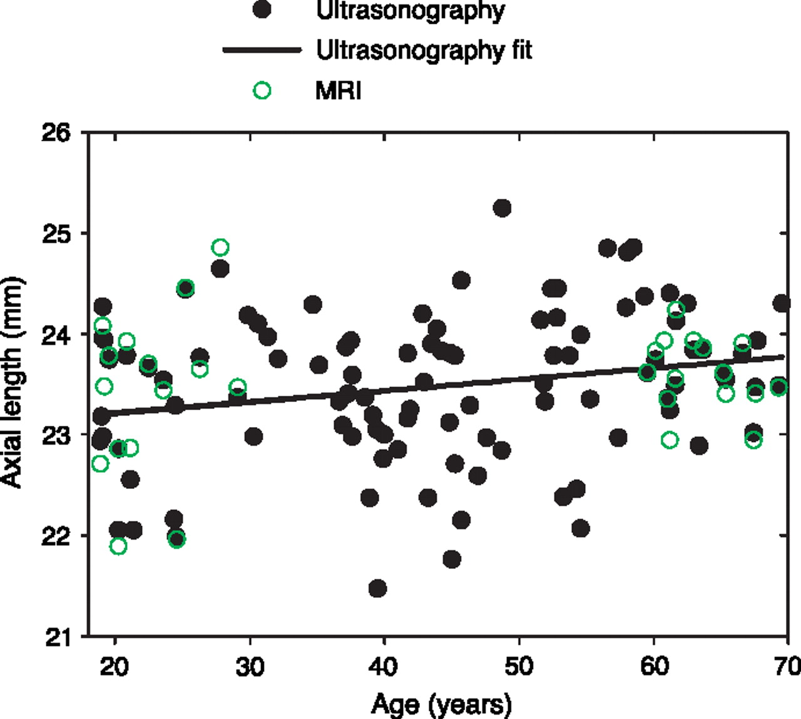
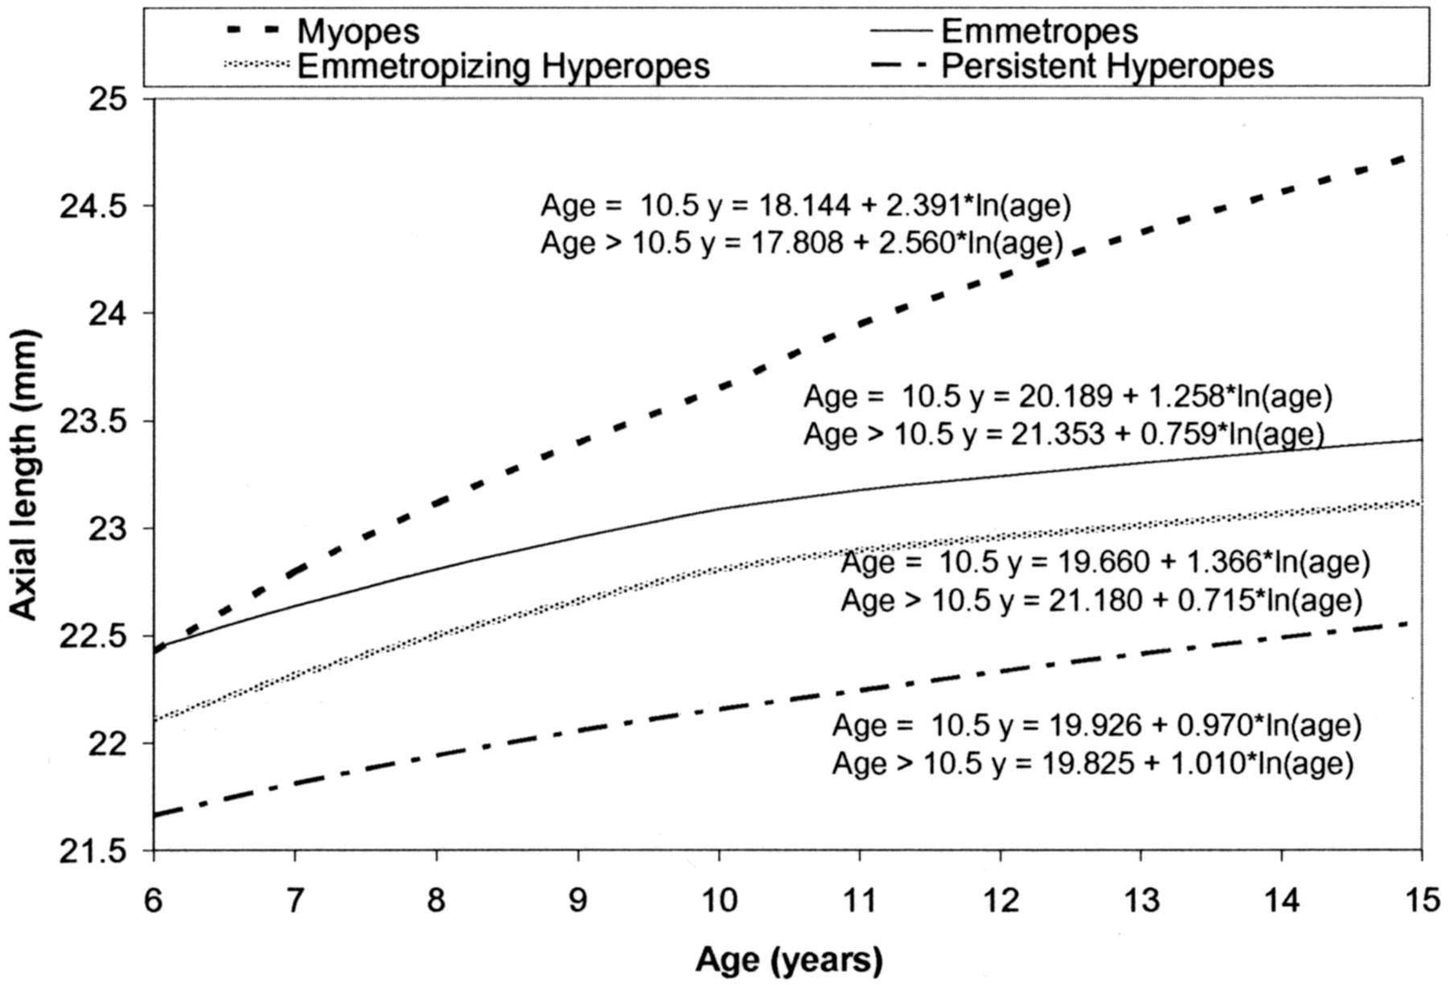
NORMAL Emmetropes over a lifetime

Slide 16
MONITORING AL CAN LEND PREDICTIVE VALUE REGARDING ONSET OF MYOPIA
Axial elongation occurs at an accelerated pace in younger children (age 6-10) compared to older children (Age 12-16).
(Breslin et al. 2013)
Axial elongation
3 years prior to onset
1 year prior to onset
Onset of Refractive Myopia
5 years after onset
Growth trends of an eye destined for Myopia: Accelerated growth 3 years prior to and 5 years after onset of refractive myopia. Greatest acceleration occurs 1 year prior to onset of refractive myopia.
Mutti et al. 2007

Slide 17
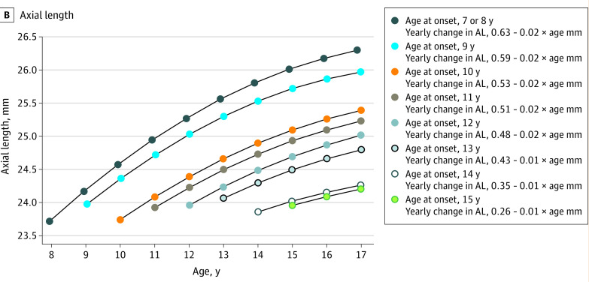
JAMA Ophthalmol. 2020;138(11):1129-1134. doi:10.1001/jamaophthalmol.2020.3451

Slide 18
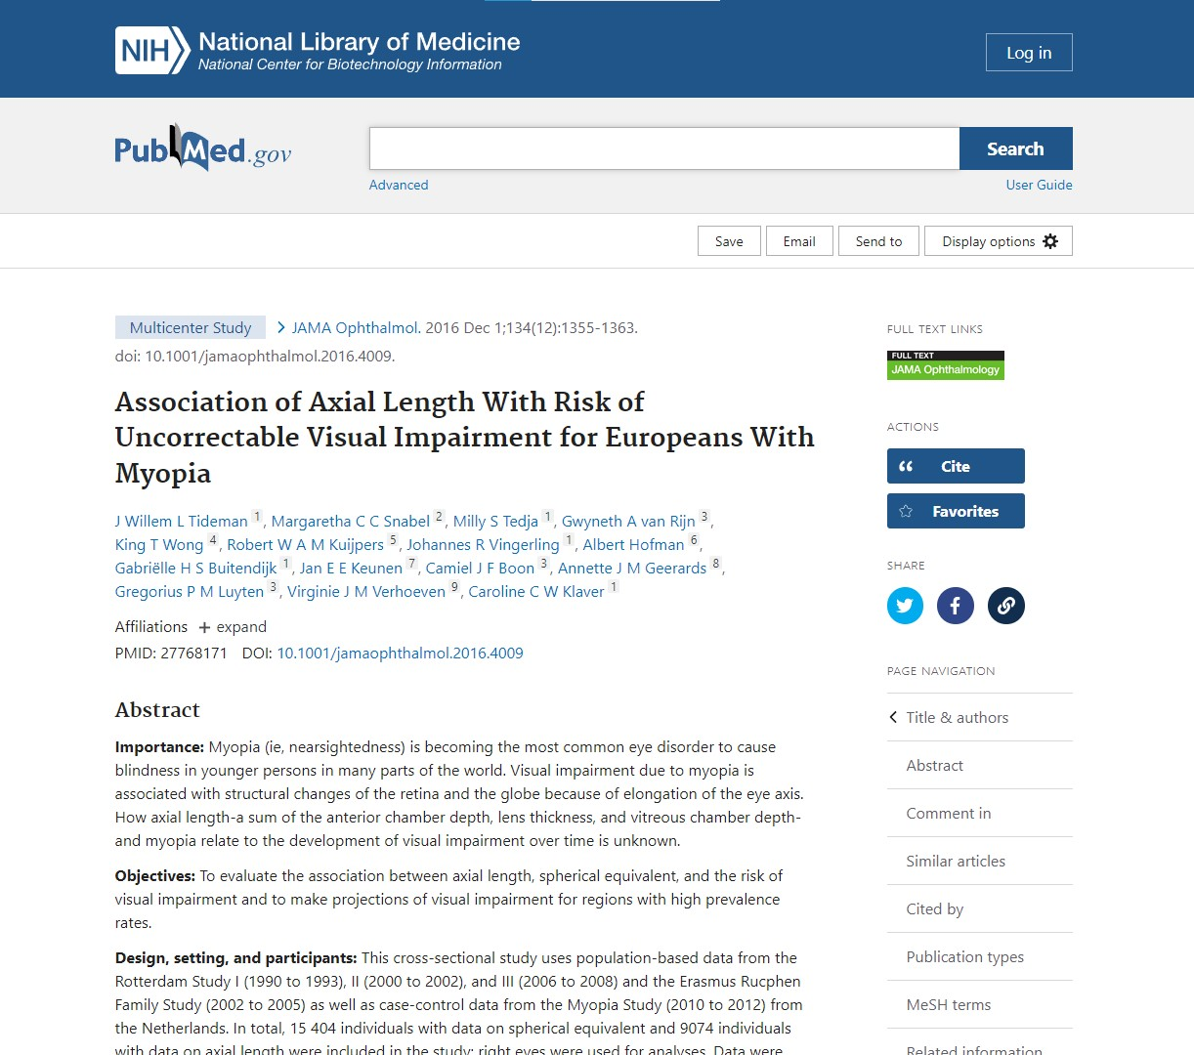
INCREASED RISK OF PATHOLOGY > 75 YEARS OLD
Cross sectional study (Tideman et al. 2016)
Analyzed study data from 1990-2012
15,404 eyes spherical equivalent data
9,074 eyes axial length data
Visual Impairment: approx. 20/60 to 20/400
Axial Length | Incidence of Visual Impairment
< 26mm | 3.8%
> 26mm | 25%
> 30mm | 90%
26&30

Slide 19
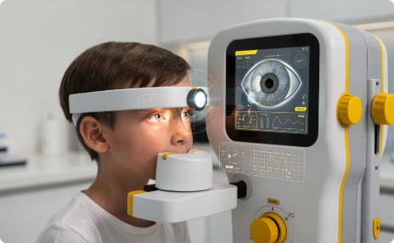
We must re-Define Progression and Treatment Success
Measuring Progression
Redefining Success

Slide 20
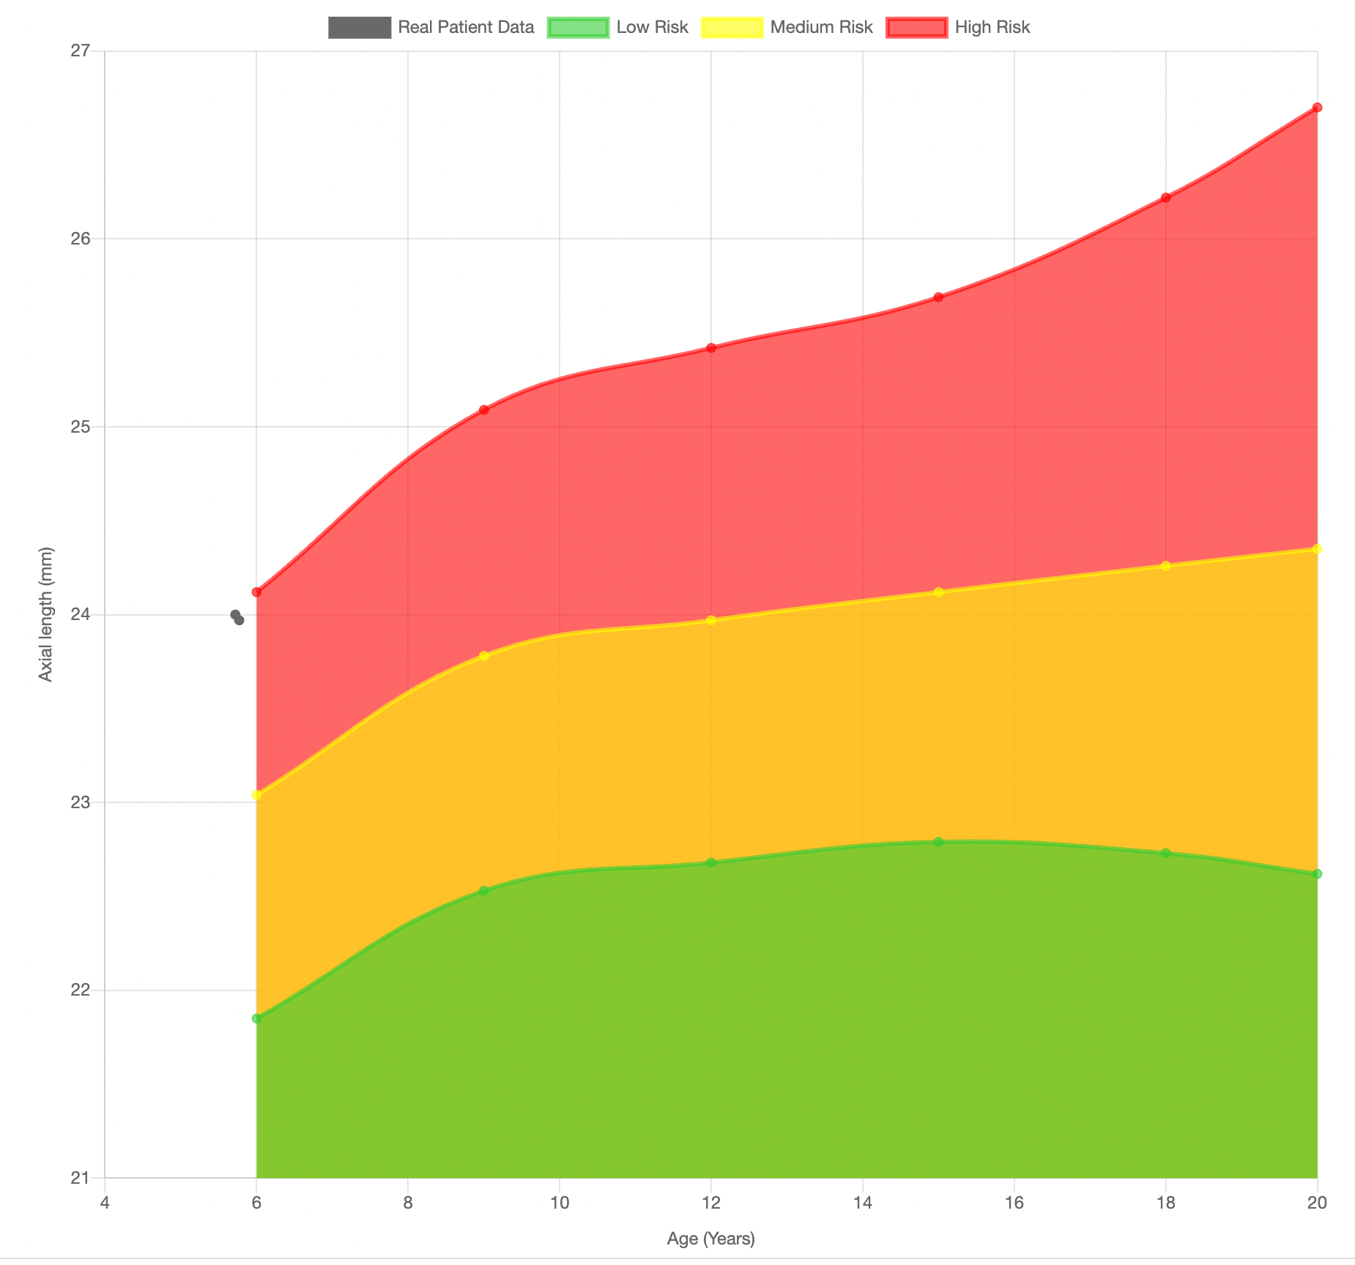
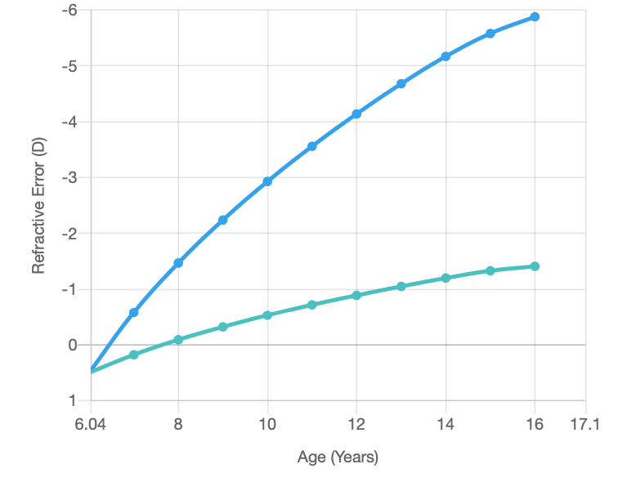
5Y Male
+0.50 OU / Ks=41.00
SHOULD WE TREAT?
HOW WOULD YOU TREAT?
HOW WOULD YOU MONITOR?
WHAT WOULD YOU SAY TO THE PARENTS?

Slide 21
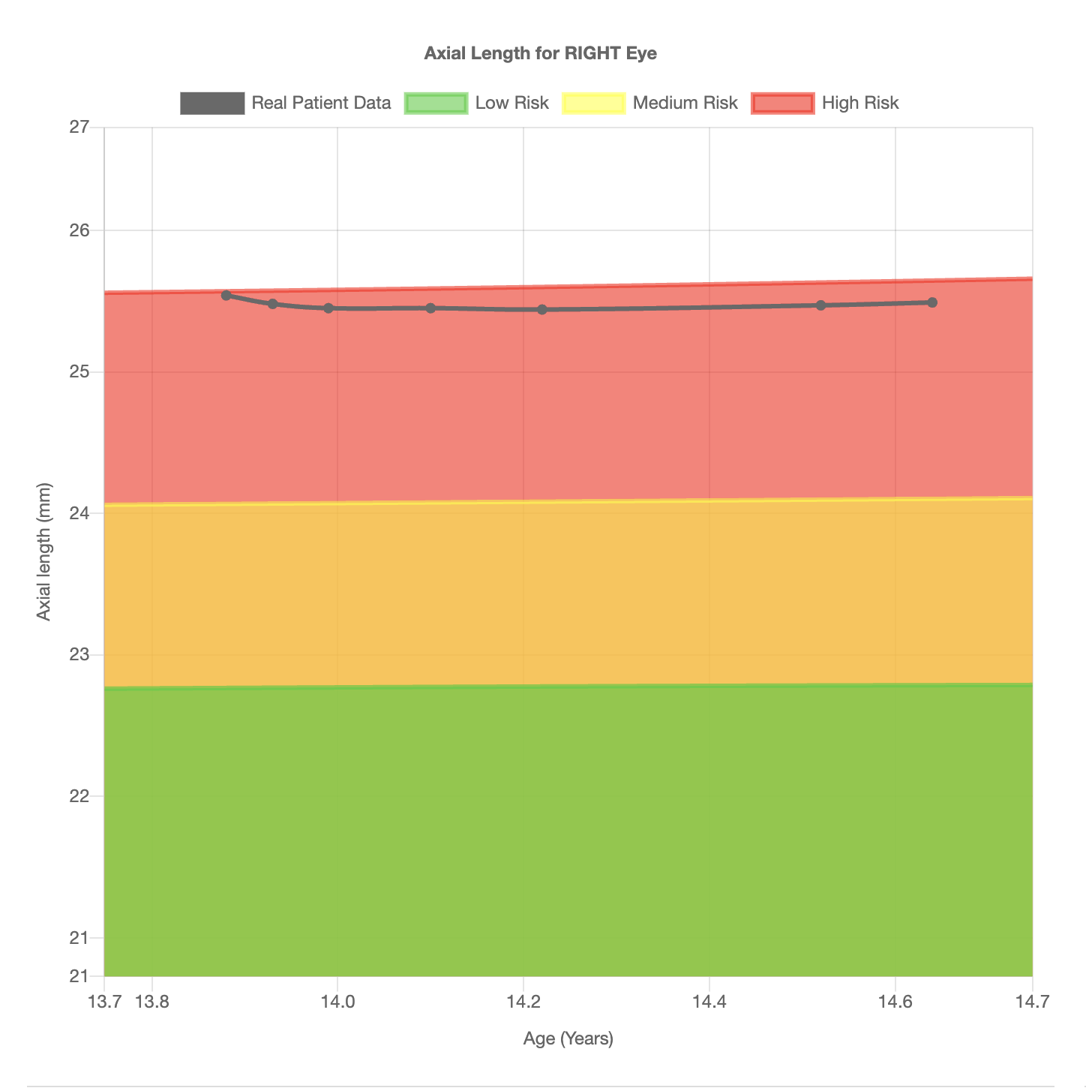
CAN WE MEASURE?
CAN WE SLOW IT?

Slide 22
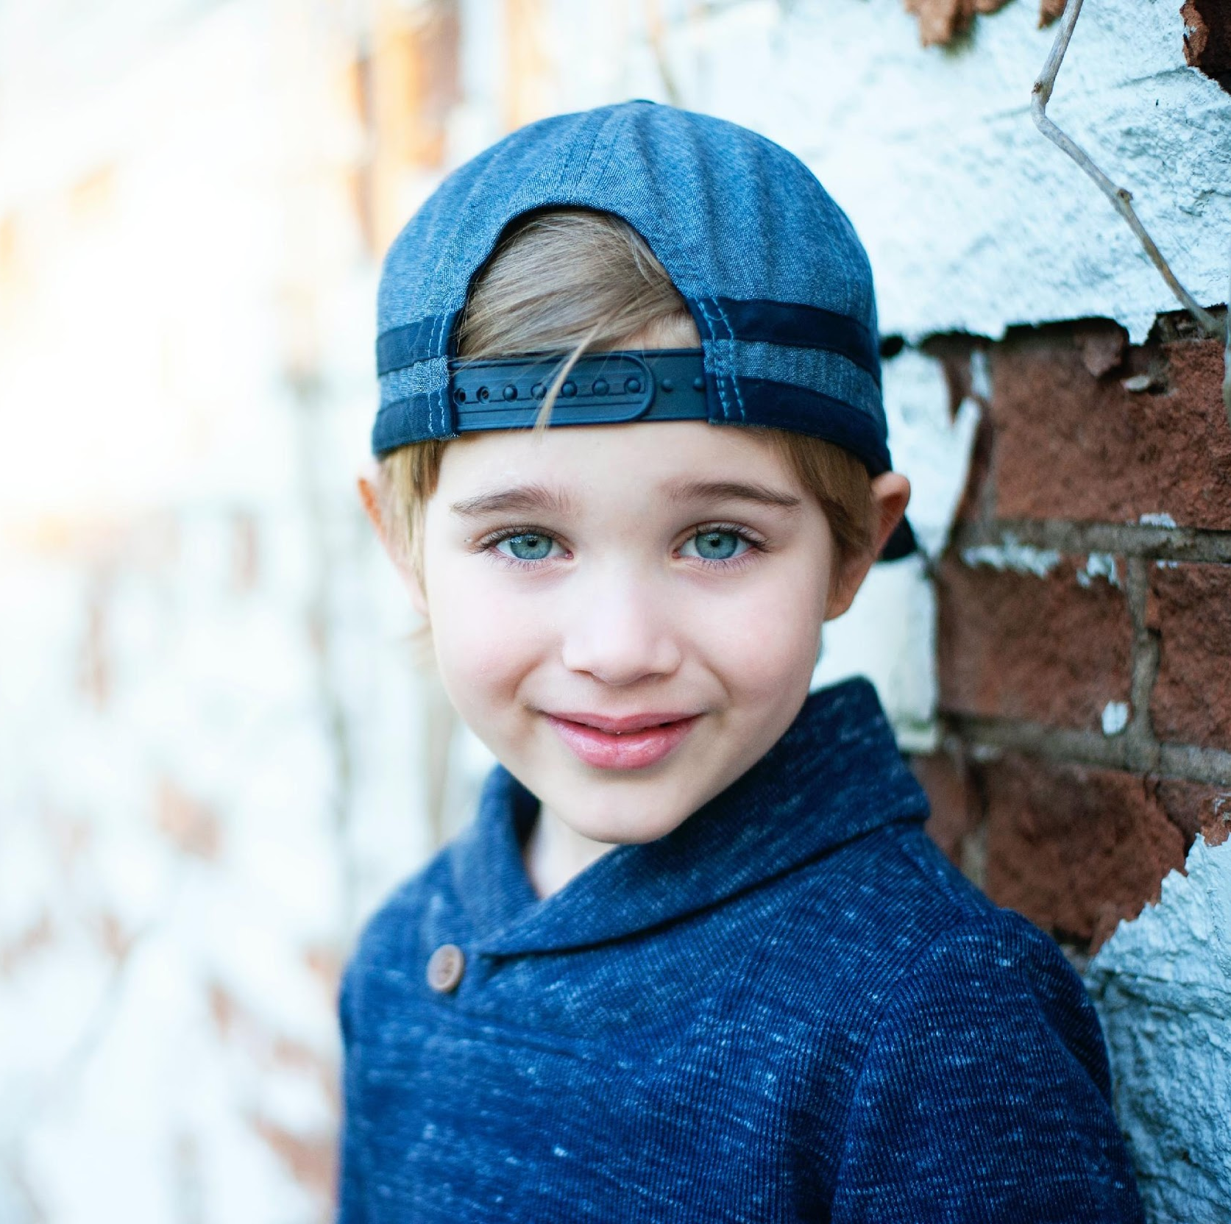
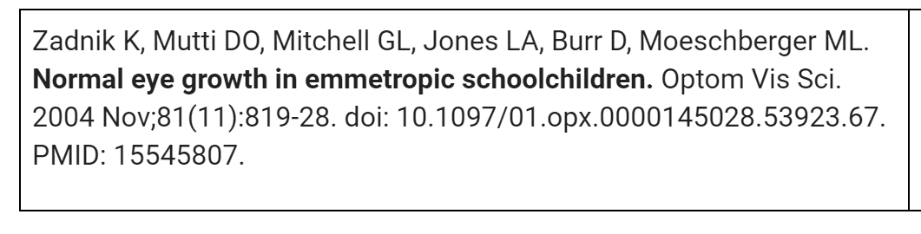
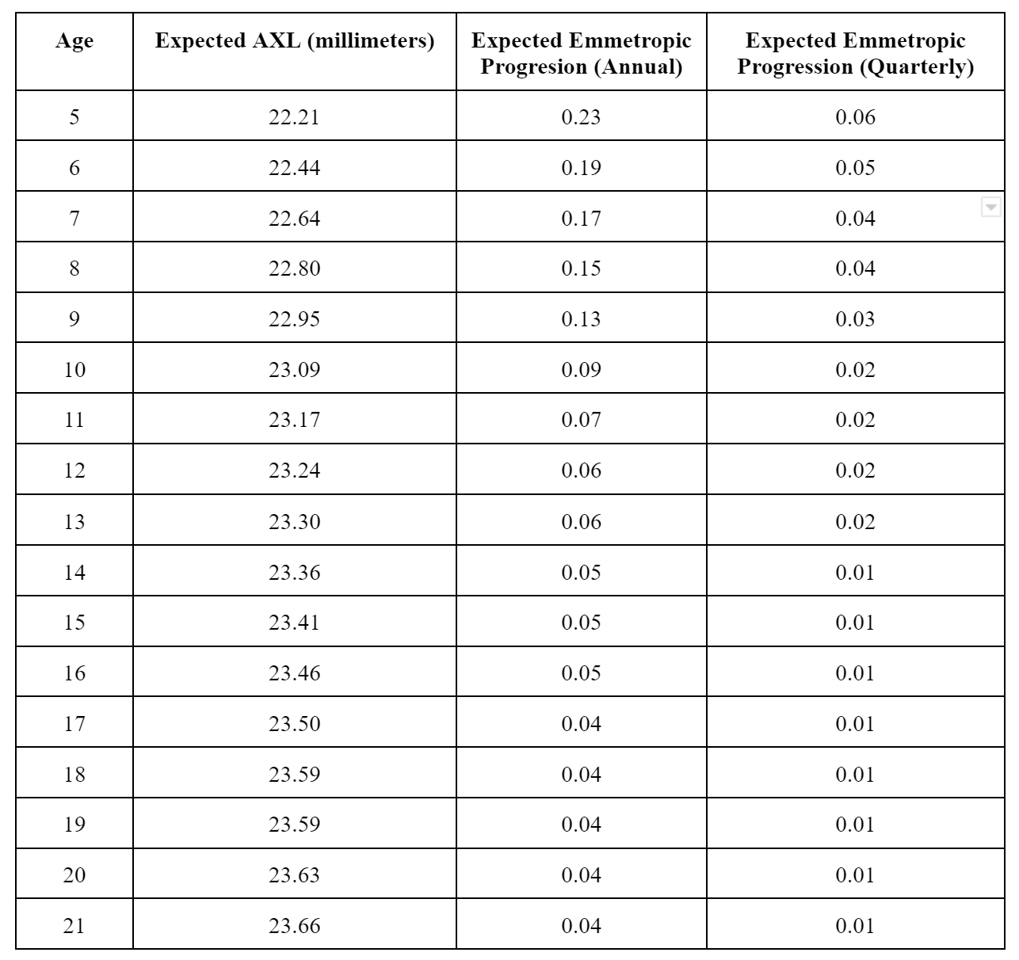

Slide 23
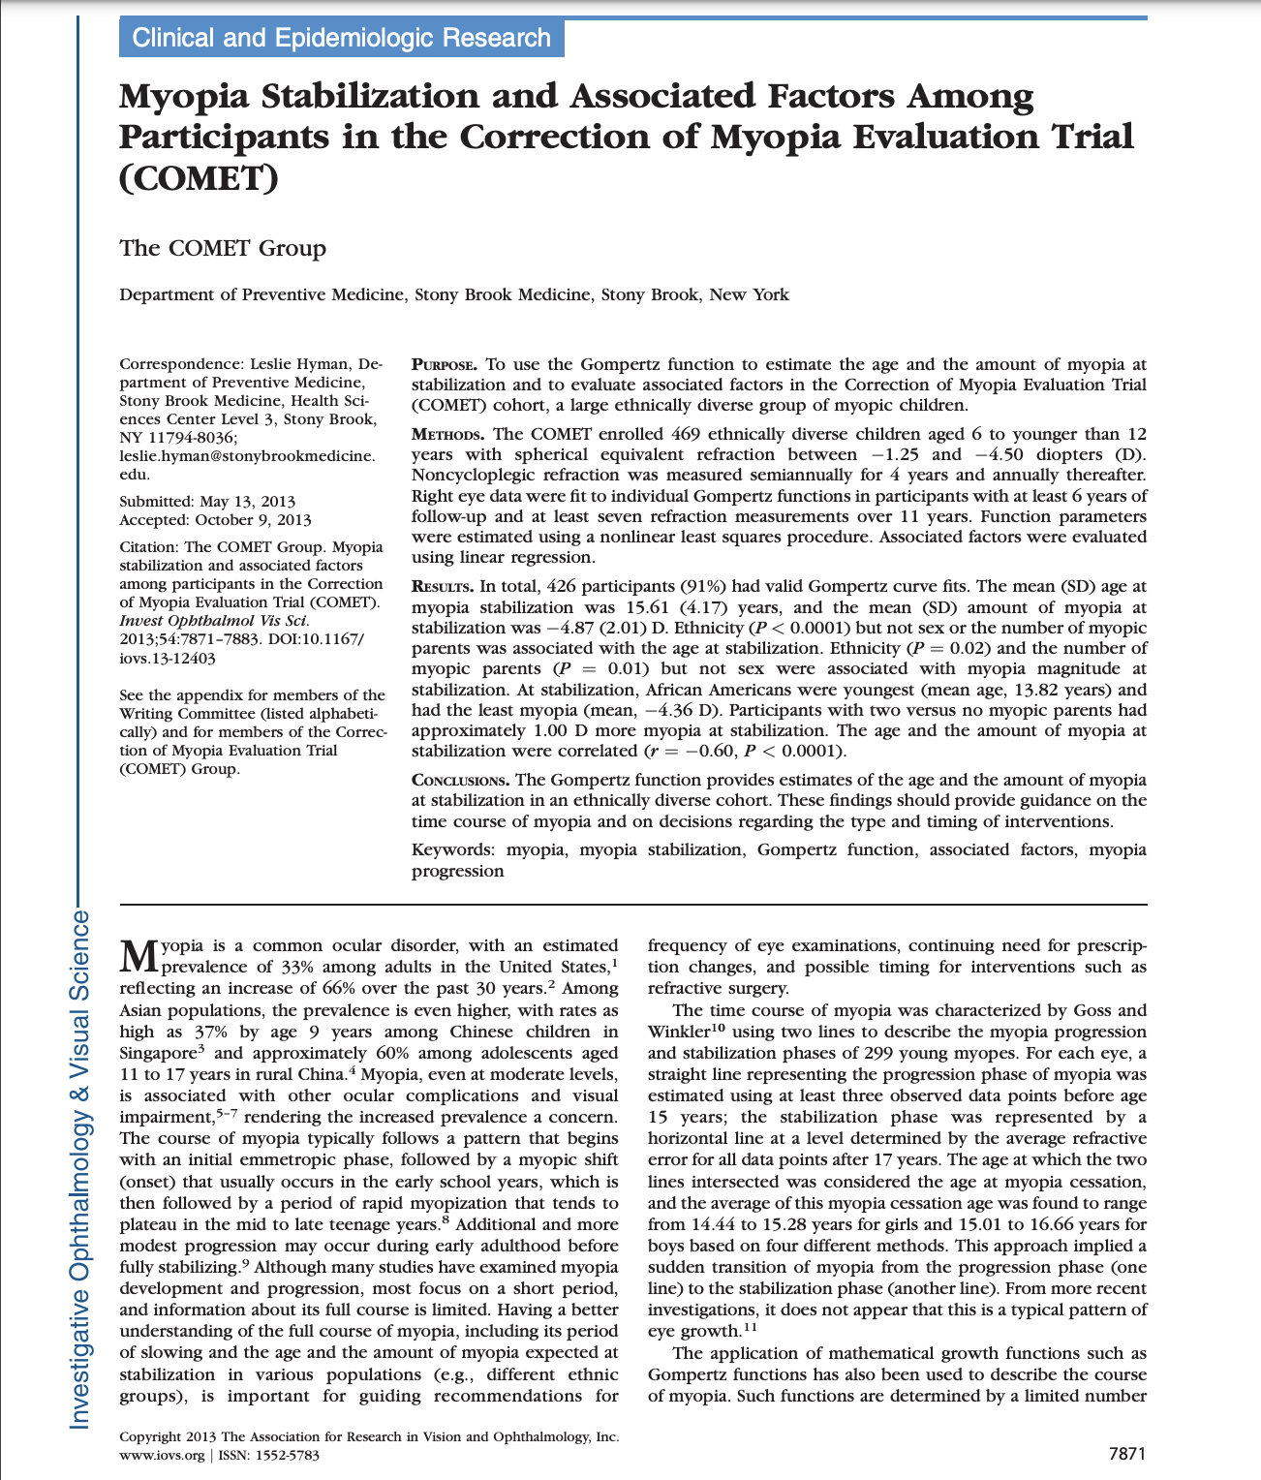
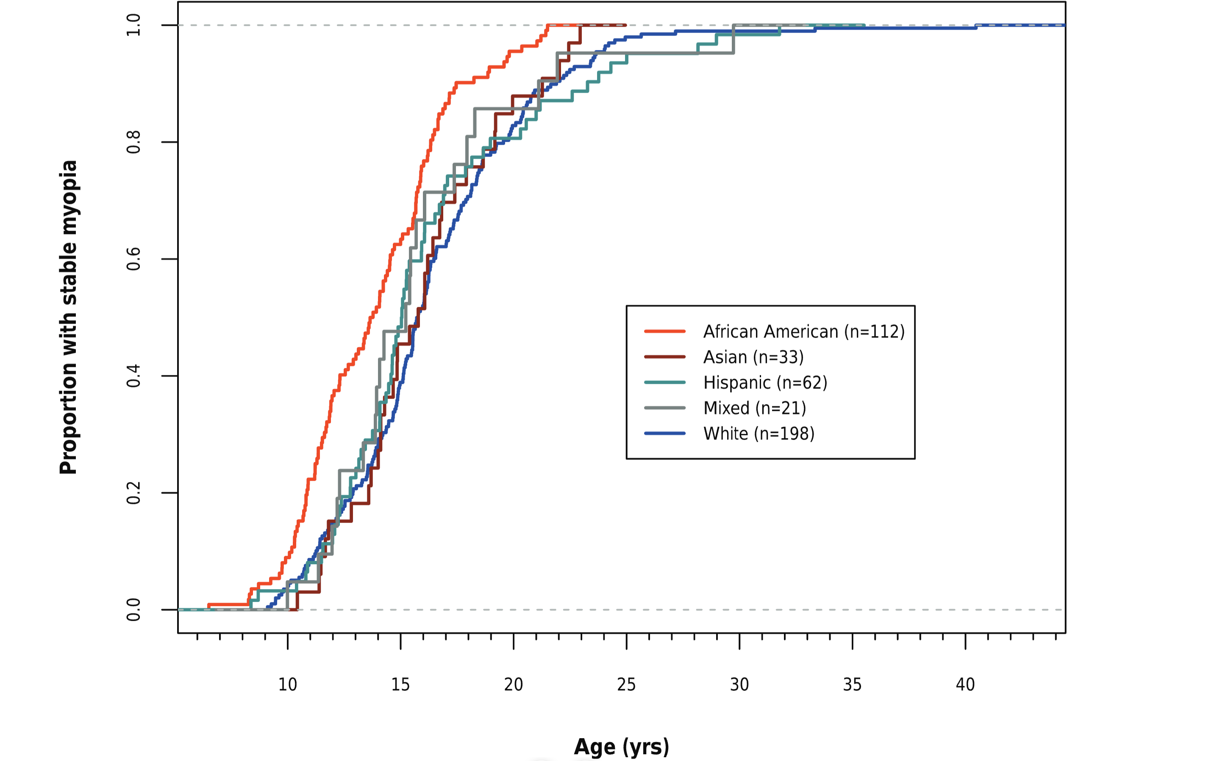
At what age does Myopia Stabilize
Age 15: 48%
Age 18: 77%
Age 21: 90%
Age 24: 96%
2013

Slide 24
Evidence Summary: Approved Myopia Control Modalities
The following table summarizes landmark evidence, approximate efficacy ranges, and current U.S. regulatory status for each major myopia management treatment category.
Modality
Landmark Evidence
Follow-Up
Refractive Slowing
Axial Length Slowing
FDA Status (U.S.)
Soft Multifocal Contact Lenses
FDA pivotal 3-year RCT (dual-focus daily); BLINK 3-year RCT (high-add multifocal)
3 years
~43–59%
~35–52%
Yes — FDA device category for daily wear soft CL to reduce myopia progression in children
Orthokeratology
ROMIO 2-year randomized clinical trial
2 years
Not ideal metric (corneal reshaping alters refraction directly)
~43%
No FDA approval for myopia control; approved for temporary reduction of refractive error only
Myopia Control Spectacle Lenses
2-year DIMS RCT; FDA-reviewed spectacle data for 2025 authorization
2 years
~52–71%
~53–62%
Yes — FDA authorized first spectacle lenses to slow pediatric myopia (Sept. 25, 2025)
Atropine
LAMP RCT and 3-year continuation/washout; mixed U.S. data for 0.01%
1–3 years
Dose-dependent: ~27% (0.01%) to ~67% (0.05%) at 1 year
Dose-dependent: ~12% (0.01%) to ~51% (0.05%) at 1 year
No FDA-approved atropine for myopia control; branded low-dose application received CRL in 2025

Slide 25
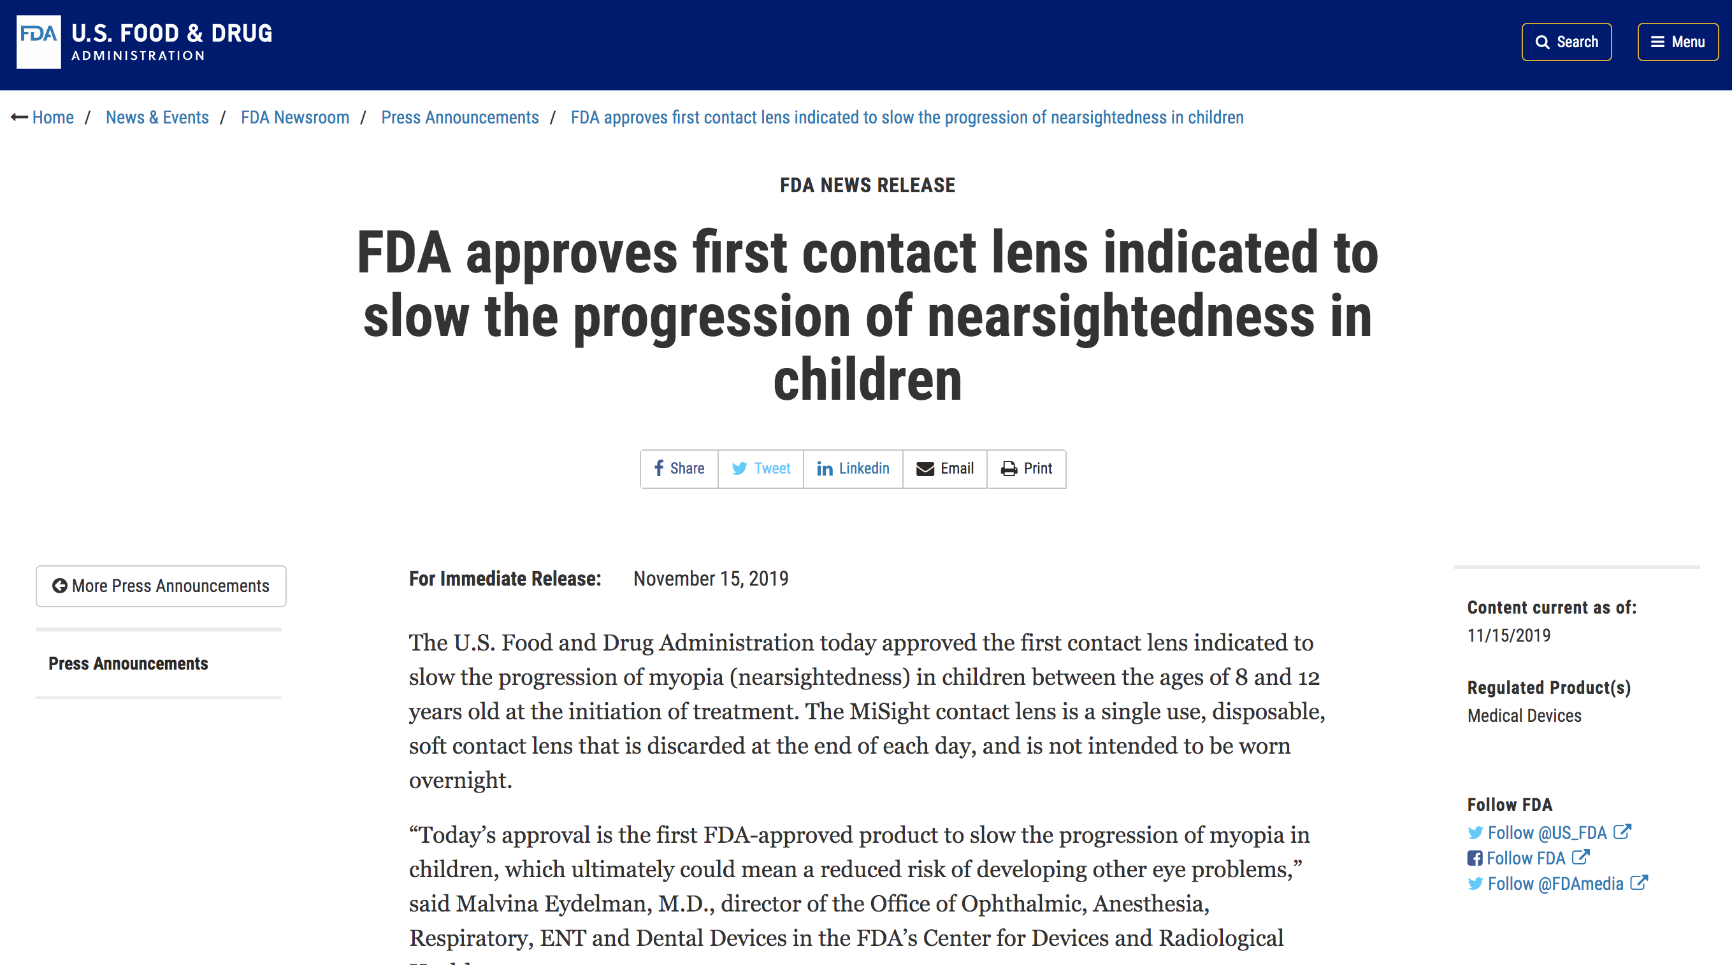
Myopia Management

Slide 26
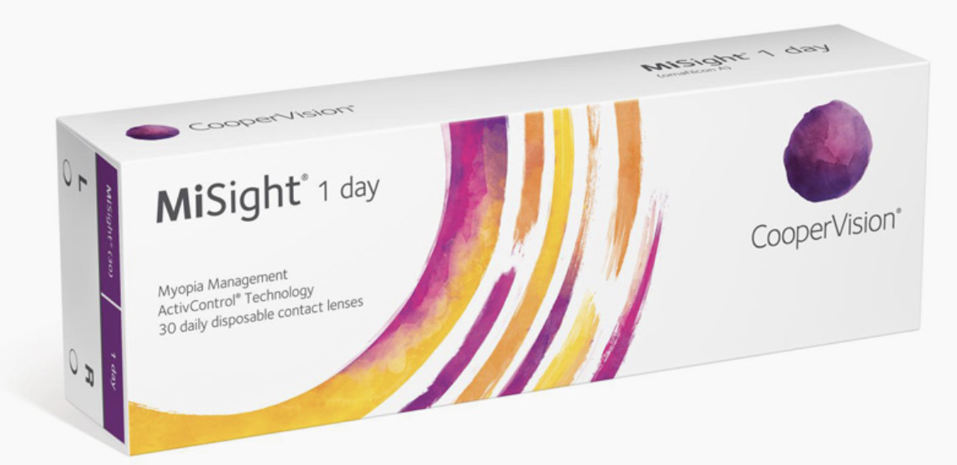
MiSight
First FDA approved contact lens that slows myopic progression in children ages 8-12
  Approved on November 18, 2019
Launch in US March 2020
Notes:
Currently already being worn in Canada, United Kingdom, Spain, Australia

Slide 27
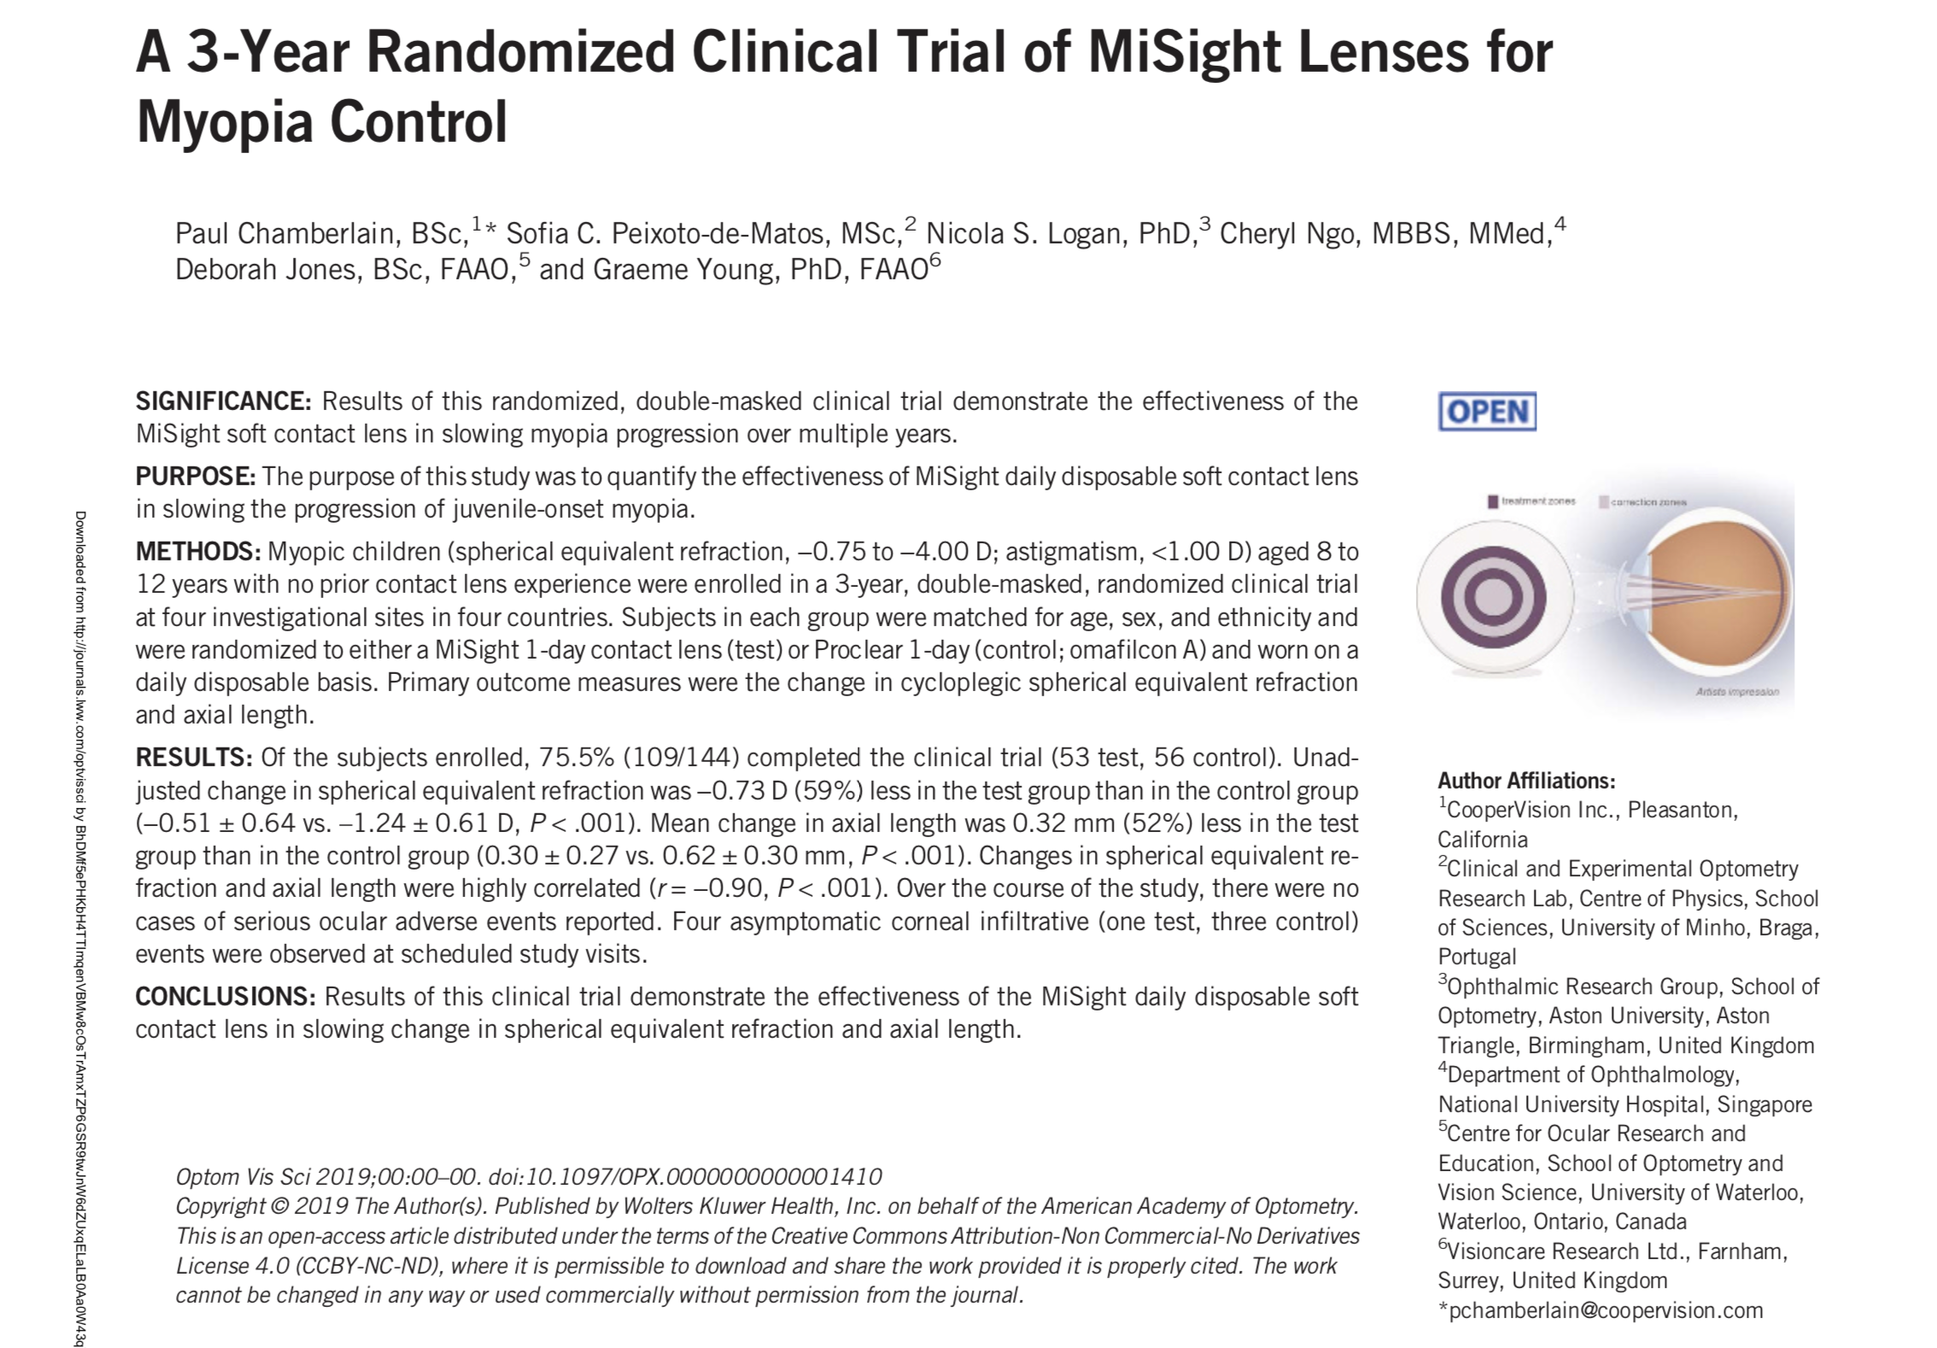

Slide 28
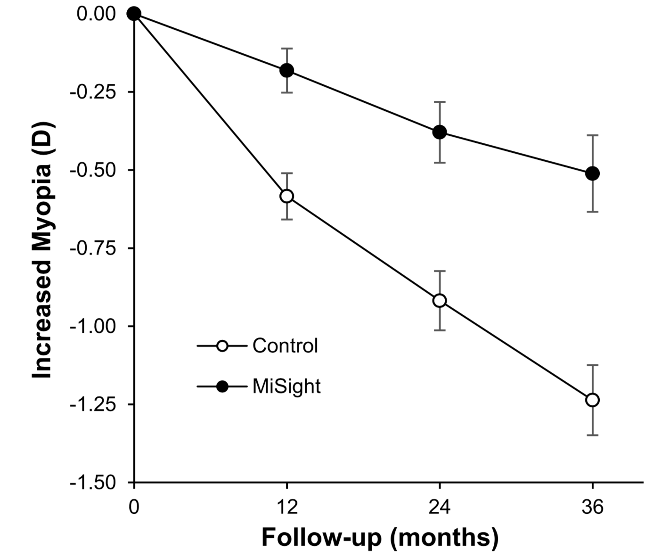
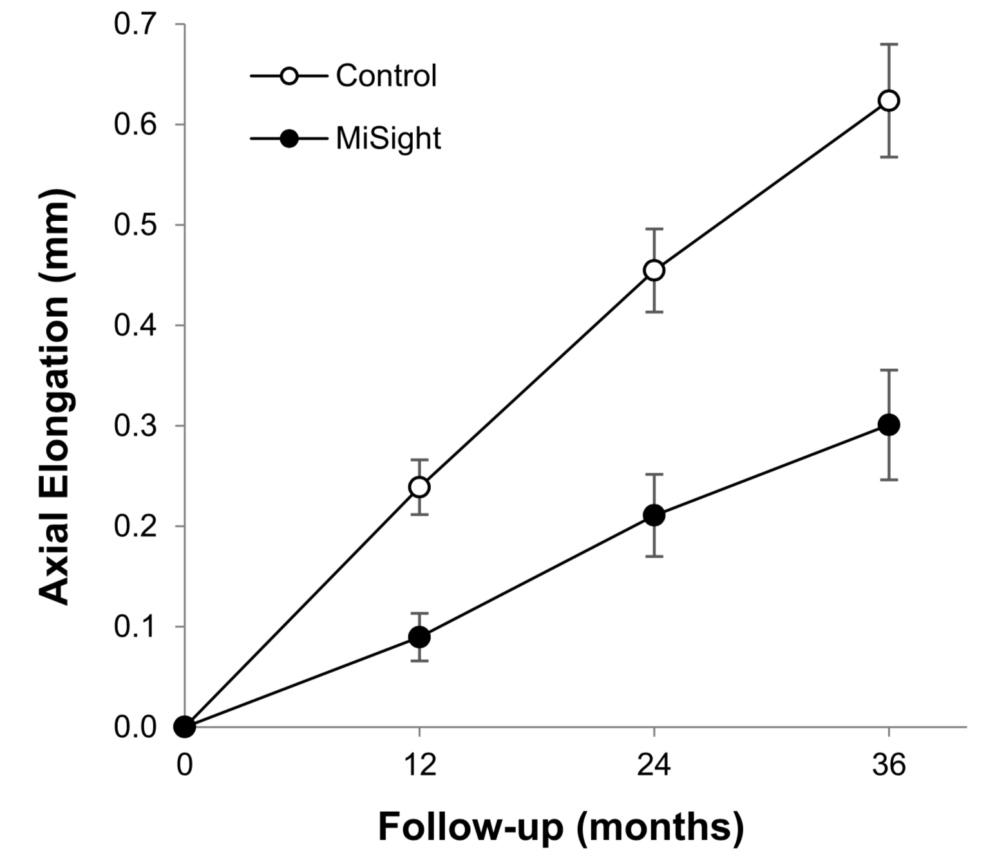
Misight Data

Slide 29
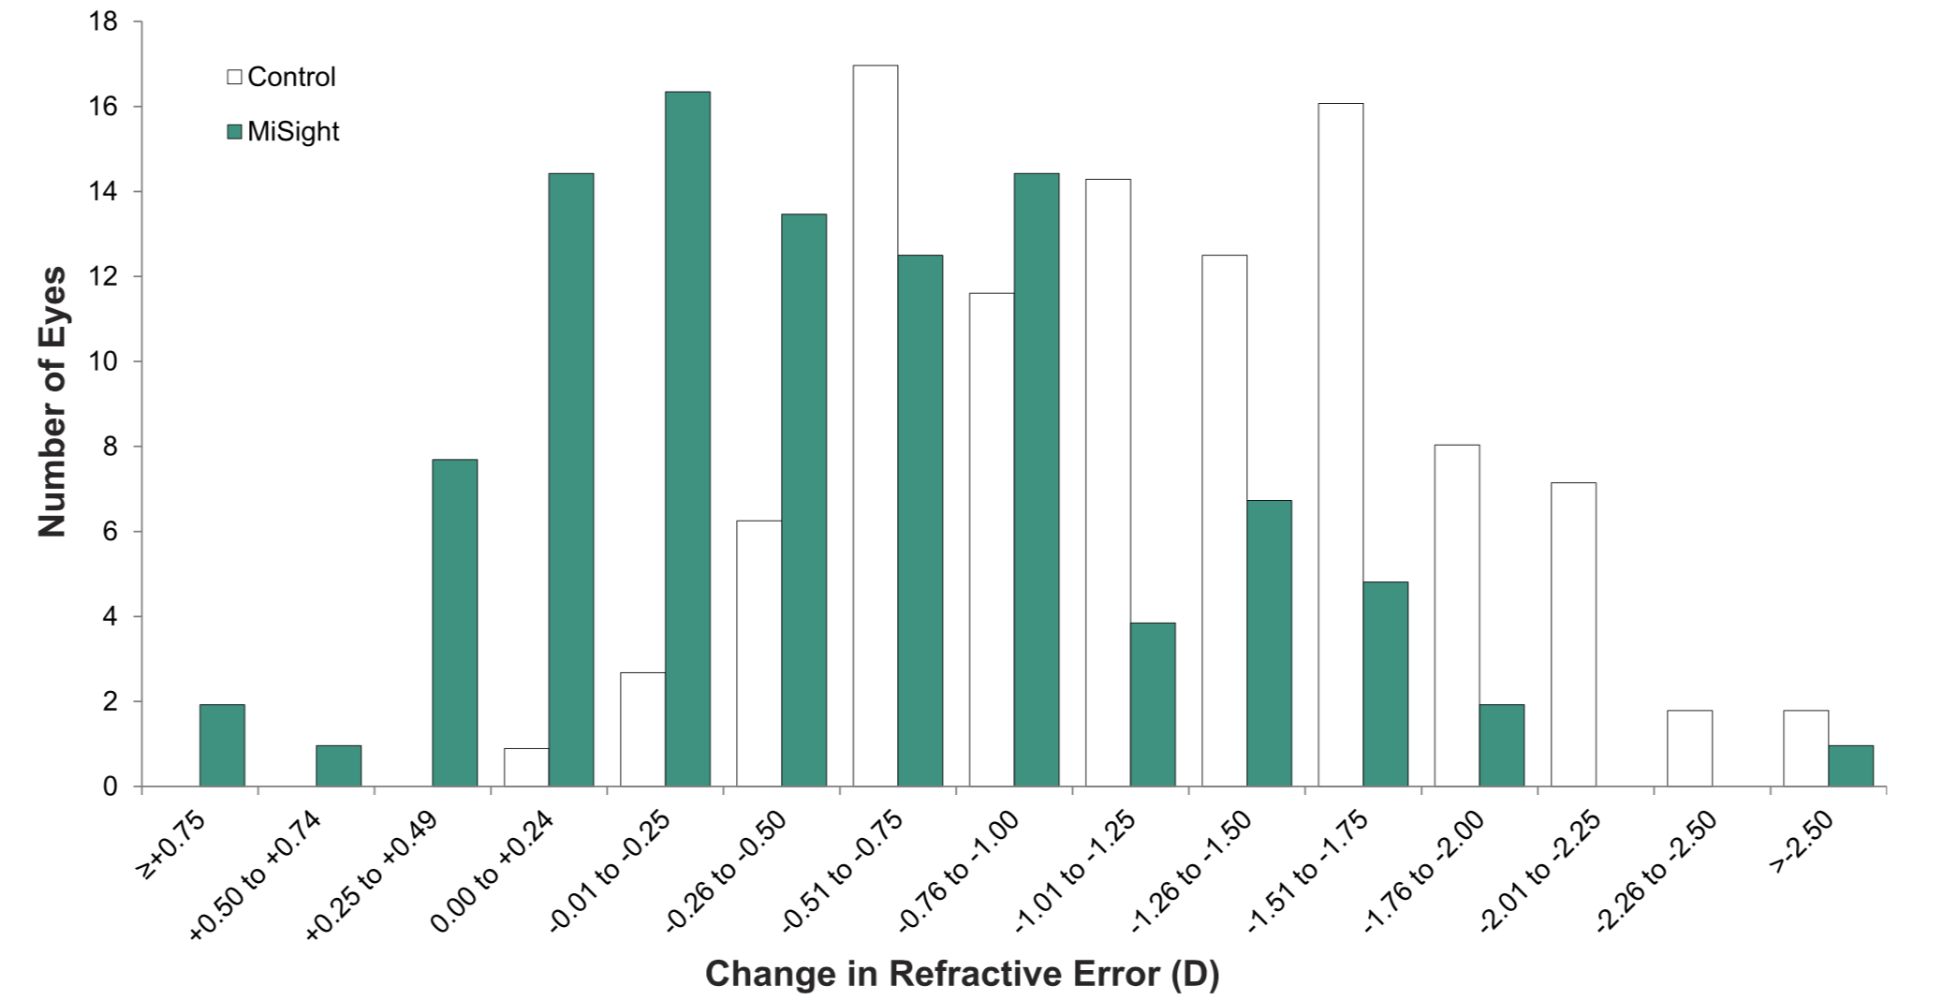
Misight Data

Slide 30
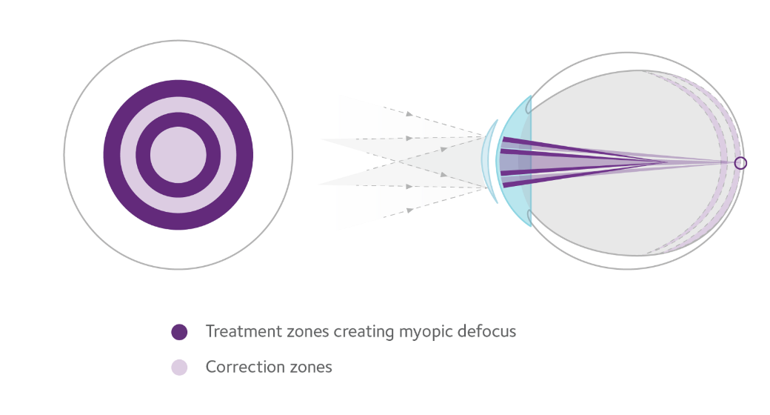
Parameters
Daily wear, daily disposable lens
Material: Omafilcon A
8.7mm base curve, 14.2mm diameter
ActivControl Technology
  Central correction area of 3.36mm
  Concentric zones of alternating distance and near powers
Notes:
-same material as Proclear 1 day
-Dk/t 36
-Activ Control Technology – presents a 2D add power which renders second focus approximately 0.6mm in front of distance focus (in front of retina)
-No toric
-Readily available, cost efficient

Slide 31
Options for Myopia Progression Management
MiSight (FDA Approved)
Orthokeratology
NaturalVue Multifocal
Hybrid Lens (Multifocal with distance center)
Biofinity Multifocal (D Lens)

Slide 32

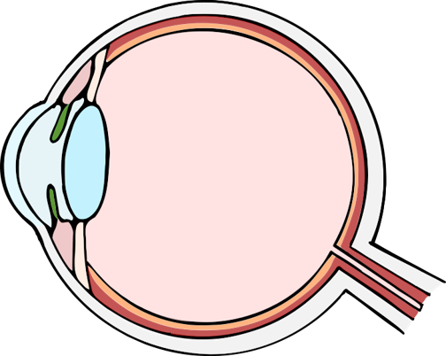



Myopia develops when normal eye growth regulation is disrupted
Time outdoors prevents shortage of dopamine, a key regulator of eye growth
Once started, normal glasses alone are unable to break this cycle
Anatomy of the eye
Sclera
Blurry vision
Altered retinal processing
Dopamine shortage
Scleral remodeling
Axial elongation
Dopamine shortage
Scleral remodeling
Axial elongation
Opportunity to break the cycle of progression
Retina
Blind spot
Dopamine is a key regulator of eye growth
Time outdoors
Melanopsin
(photopigment)
Dopamine release

Slide 33
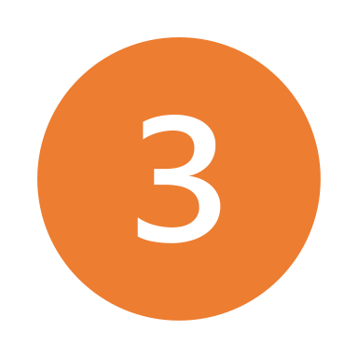




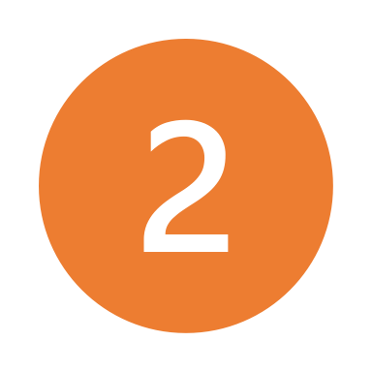


MyopiaX® regulates the eye’s innate growth mechanisms with blue light
Scientific evidence supports the use of targeted light stimulation to slow myopia progression
ipRGC
DAC
blind spot
MyopiaX delivers a blue light to the blind spot
Blue light activates melanopsin at the blind spot
Melanopsin-expressing ipRGCs signal to DACs
DACs increase dopamine release
elevated dopamine triggers ChT increase
increased ChT supports reduced axial length
Schilling et al. (2020)
Amorim de Sousa et al. (2021)
Schilling et al. (2022)
Schilling et al. (2023)
Chakraborty et al. (2024, abstract)
Chakraborty et al. (2024, abstract)

Slide 34
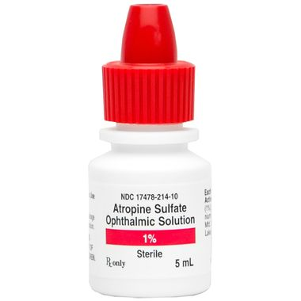

Slide 35
Atom 2 Study
Chia, et.al. Ophthalmology 2011
Atropine for the Treatment of Childhood Myopia
400 children ages 6 – 12 with greater than -2.50 D.
Myopia %
ATOM 1 Progression Reduction
Placebo -1.20 D.
Atropine 1% -0.28 D. 77%
ATOM 2
Atropine .5%
(2 x less concentration) -0.30 D. 75%
Atropine .1%
(10 x less concentration) -0.38 D. 68%
Atropine .01%
(100 x less concentration) -0.49 D. 59%
Notes:
MELCHIONE
Two large studies looking at effect of atropine on MM
Atom 1 was with 1%, ran from 1999 to 2004
One eye was treated with 1% atropine, other eye was untreated
showed good control, 77% less progression
Side effects of light sensitivity and near blur at high concentration
After two years and discontinuation, washout year showed significant rebound
Atom 2 compared different concentrations
Two years of bilateral treatment, one washout year, then two years continued treatment for those who continued to progress
First two years showed no sig difference among the three concentrations
Rebound was concentration dependent – higher rebound with higher concentration used
After year washout, all were offered 0.01%. At end of the fifth year, it had the most significant lowest progression (the original group in 0.01%)
Smallest amount of side effects

Slide 36
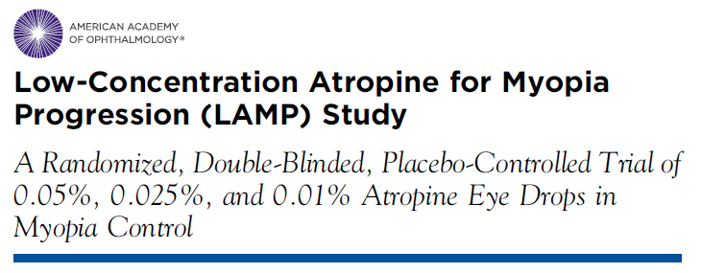
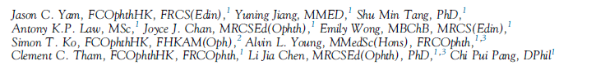
Ophthalmology 2018
Conclusions: The 0.05%, 0.025% and 0.01% atropine eye drops reduced myopia progression along a concentration-dependent response.
All concentrations were well tolerated without an adverse effect on vision or quality of life.
Of the 3 concentrations used… 0.05% atropine was most effective in controlling axial length elongation over a period of one year.
Notes:
MELCHIONE
LAMP explored different low concentrations
Dose dependent effect
Even 0.05% did not have sig side effects
They are repeating ATOM2 design
First phase is done, side effects are not significant and 0.05% is most effective
First phase was year one

Slide 37
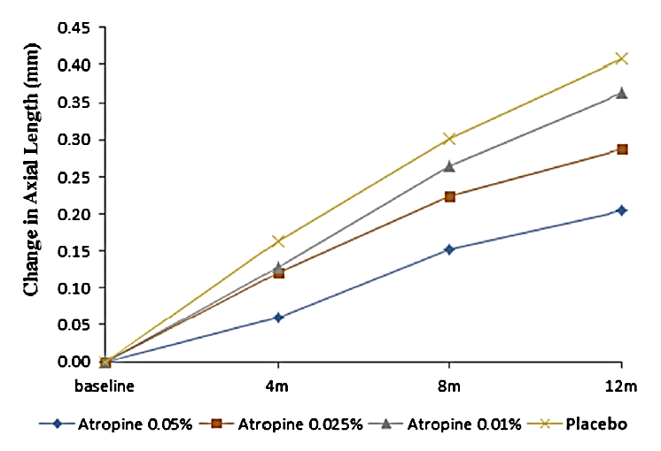
Change in
Axial Length
Placebo
0.01%
0.025%
0.05%
Notes:
MELCHIONE

Slide 38



MyopiaX® is a groundbreaking approach to manage progression of myopia
Targetedcontrol of progression through a novel mechanism and acceptance by children/parents
MyopiaX® delivers the blue light stimulus alongside a game app run on a standard smartphone
Safe
Positive safety profile: light stimulus is targeted and low-intensity. No safety signals in ongoing pediatric clinical study
Customizable and engaging for children
Supports individualized medical settings and games designed for children
Accessible
Compatibility with consumer electronics reduces barriers to access
MyopiaX-1 first-in-human clinical trial of MyopiaX has achieved its 6-month readout and is scheduled to complete in September 2024

Slide 39



Compounding Pharmacies
Not a Long-term Solution for Kids
Compounded LDA Challenges:
Higher pH results in an unstable product
Lack of regulation, no FDA oversight
Nobody knows what’s in the bottle (no product label, is it preserved?)
Inconsistent product quality. Variability of products concerning for all stakeholders
Not tested for safety or efficacy in a clinical trial (in kids)
Compounded prescriptions are a liability for HCP once an approved product exists
2023
Analyzed samples obtained from compounding pharmacies
Results:
Shelf life ranged from 7 - 175 days
pH range from 5.5 - 7.8
25% samples <90% concentration stated on bottle
27% of products did not include preservatives!

Slide 40
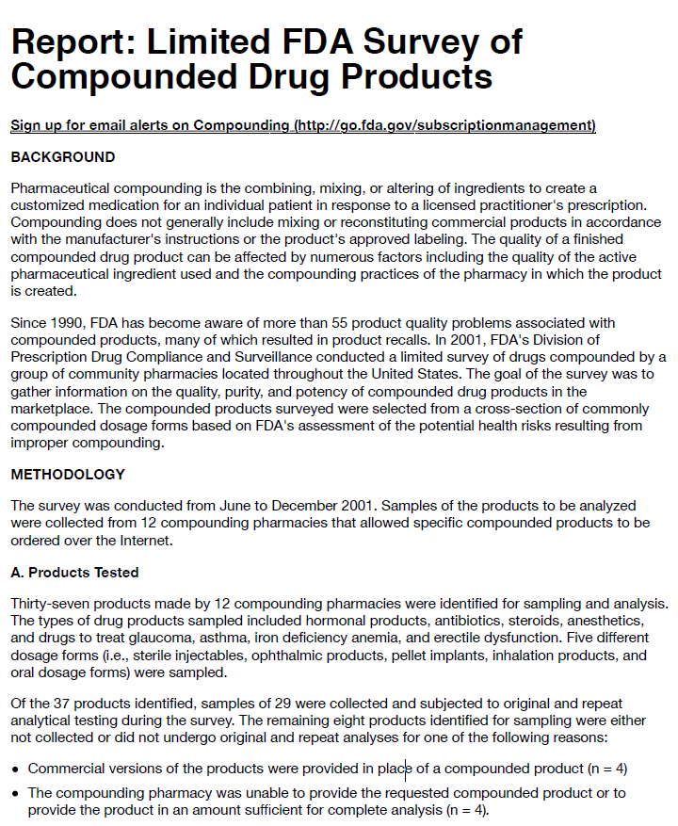
The FDA Survey of Compounded Drug Products
Quality standards and active ingredient(s) were less than expected
Key Take Aways:
“Ten (34%) of the 29 sampled products failed one or more standard quality tests performed.”
“Products analyzed contained less of the active ingredient(s) than expected (as described in the product's label). The average percent of declared potency for these nine products was calculated from the original and repeat analyses performed for each sample, with a range of 59 percent to 89 percent of expected potency.”
“The analytical testing failure rate for commercially produced samples has been less than 2 percent. When compared to this failure rate, the percentage of sampled compounded products failing analytical testing in this survey (i.e., 34 percent) was higher than expected.”

Slide 41

  Who and What is SYDNEXIS?
The
Company
Founded in 2014, Sydnexis Inc. is a privately held biopharmaceutical company based in San Diego. Sydnexis is currently evaluating its patented eyedrop formulation, SYD-101, in a Phase III pivotal trial to decrease myopia progression in children
The
Mission
Sydnexis was founded with the goal of developing a proprietary, stable, accurate, comfortable and safe topical eyedrop to treat the progression of myopia in children and minimize the risk of co-morbidities.

Slide 42


  Sydnexis has the Premium Low Dose Atropine Product
Backed by the Largest Pharmaceutical Treatment Study Ever Done in Myopia
SYD-101 Low Dose Atropine and the STAR Study
  Robust Clinical Trial Design
  852 pediatric patients; the largest prospective study for a myopia pharmacologic treatment ever conducted
  Single, pivotal, Phase 3 study
  Primary endpoint readout summer 2024

Slide 43
Thank You mile.brujic75@gmail.com

