Slide 1
Contemporary Treatment Options for Presbyopia
Mile Brujic, OD, FAAO

Slide 2
Disclosure
I have received honoraria in the past 2 years for speaking, writing, participating in an advisory capacity, research or meeting support from: Apellis (consultant, speakers bureau), ABB Optical (received meeting support), Abbvie (consultant), Alcon (consultant, speakers bureau), Art Optical (received meeting support), Azura (consultant), Bruder Healthcare (consultant), Bausch + Lomb Health (consultant, speakers bureau), Contamac (received meeting support), CooperVision (received meeting support), CSEye (consultant), Dompe (consultant), Dopavision (consultant), Eyepromise (consultant), Glaukos (consultant), Johnson & Johnson Vision Care (received meeting support), Lentechs (received research support), MDElite (consultant), Nordic Pharma (consultant), Orasis (consultant, speakers bureau), Radius XR (consultant), SCOPE (consultant), Sun Pharma (speakers bureau), Tangible Science (received meeting support), Tarsus (consultant, speakers bureau), Théa Pharma (consultant), Viatris (consultant, speakers bureau), Visionix (consultant), Walman Optical (received meeting support).
These relationships have been mitigated and will not influence the content of this presentation.

Slide 3
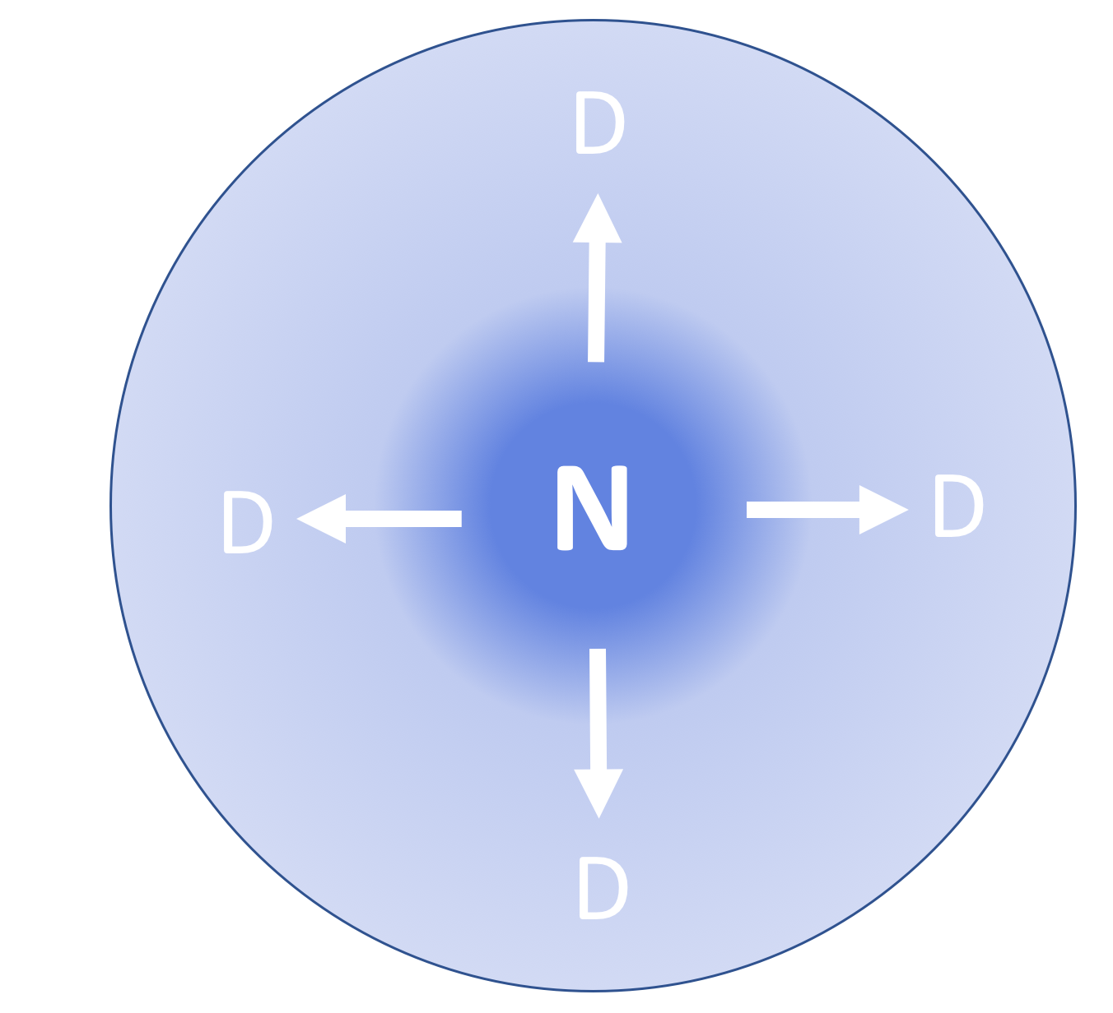
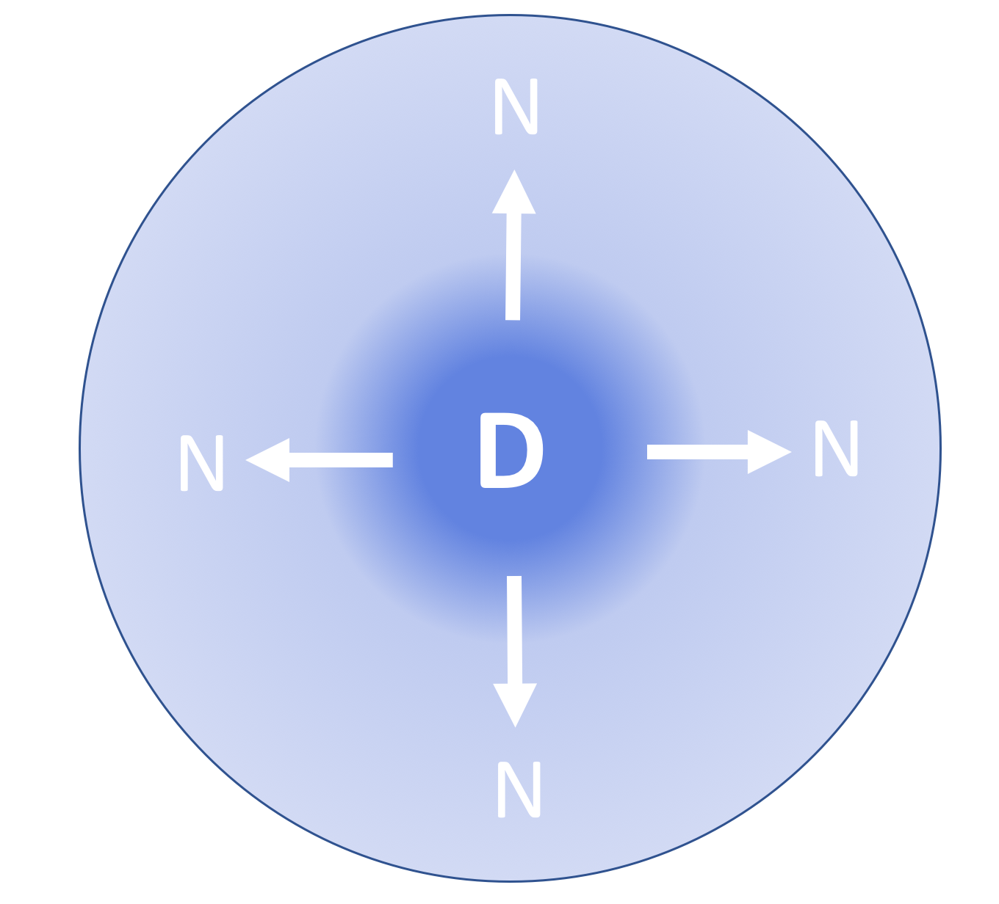
Multifocal Lens Design
- - - - - - - - - - - - - - - - - - - - -
- - - - - - - - - - - - - - - - - - - - -
- - - - - - - - - - - - - - - - - - - - -
- - - - - - - - - - - - - - - - - - - - -

Slide 4

In Office Availability
Near center-distance periphery design
Silicone hydrogel – samfilcon A
46% water
Sphere: +4.00 to -6.00 in 0.25D steps
Cyl: -0.75, -1.25, -1.75, -2.25, -2.75
Axes: 10 to 180 in 10º Steps
Low Add (up to +1.50 add)
High Add (greater than +1.50 add)

Slide 5
Nasal
Temporal

Slide 6
Multifocal Lens Design
N
D
D
D
D

Slide 7
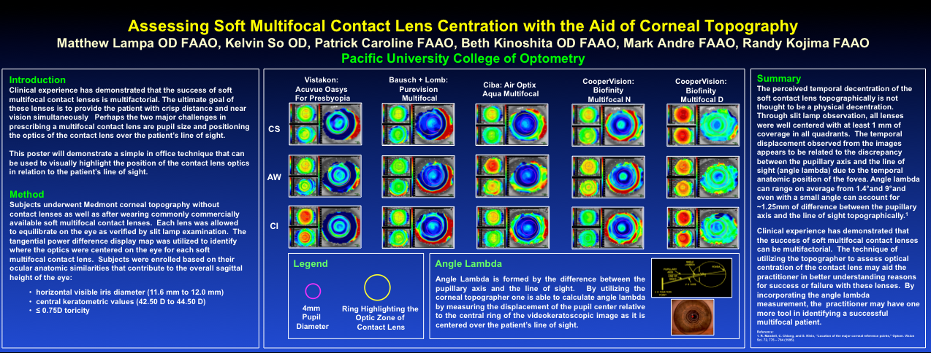

Slide 8
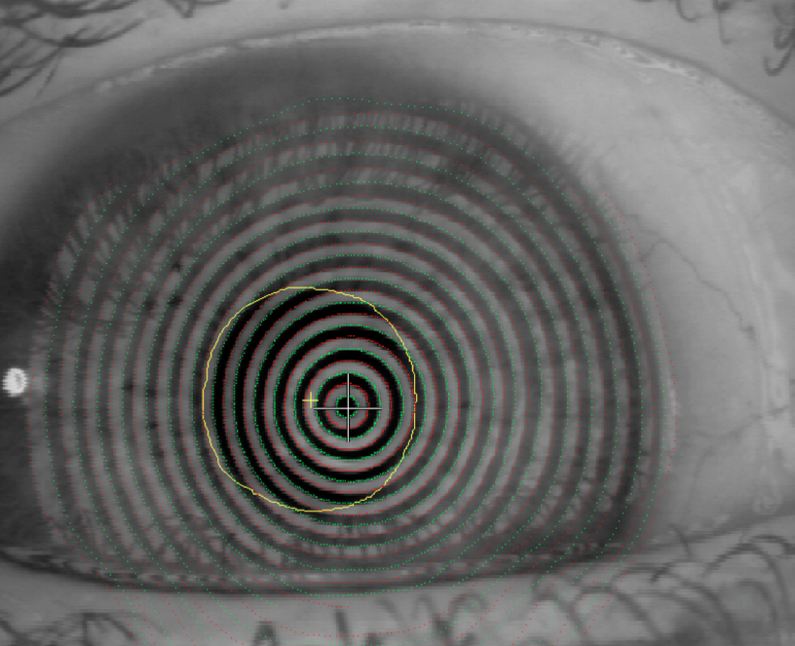
Center of pupil
Angle lambda at
cornea (0.61mm)

Slide 9
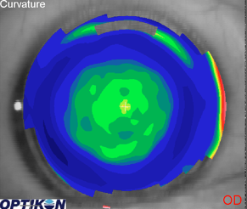
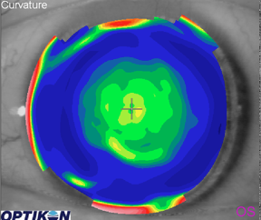
The Multifocal Success!
Notes:
Jim Grass – Air Optix multifocals

Slide 10
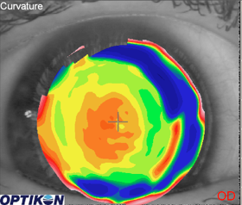
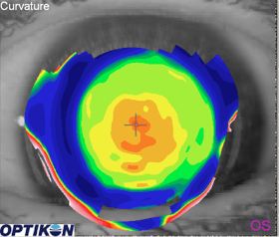
The “OK” Multifocal Experience…
Notes:
Lori Schultz – air optix multifocal

Slide 11
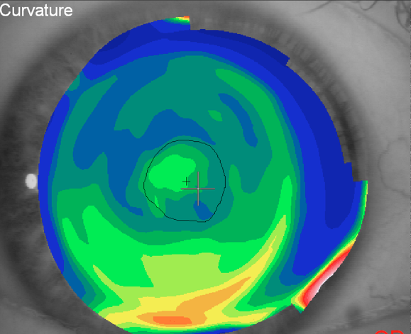
Is this significant?
x

Slide 12


Slide 14

OptiSync Technology
Offset of multifocal optics nasally in a soft lenses
https://specialeyesqc.com/optisync-technology.php

Slide 15
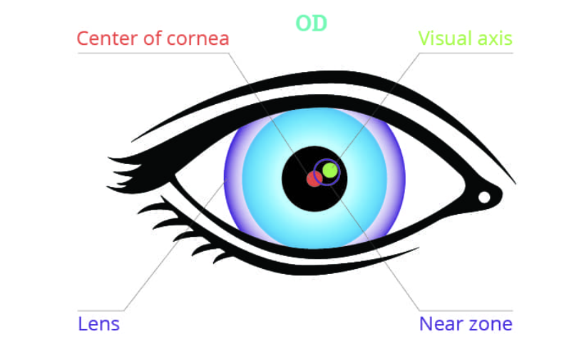
Scleral Lens With Off Center Near Optics
Available in scleral lenses
http://www.aldenoptical.com/products/soft-specialty/zen-multifocal/zen-multifocal/

Slide 16
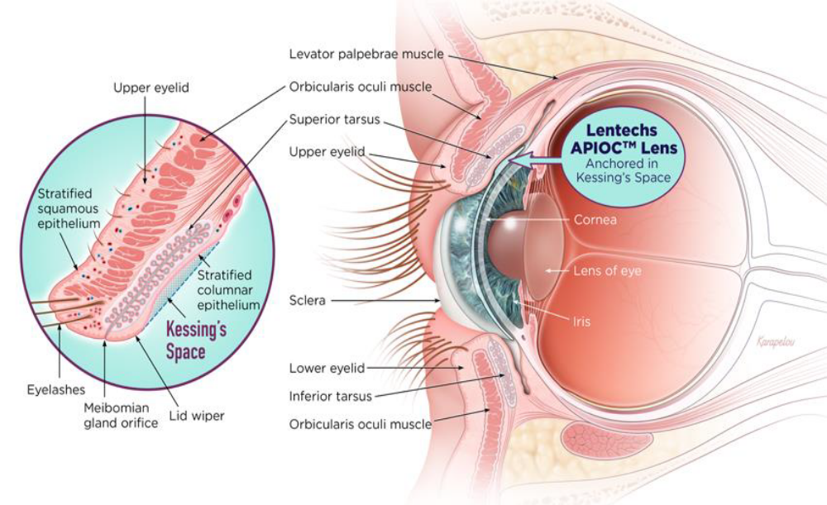
APIOC™ Leverages Lid Anatomy
Recent advances in material, engineering knowledge, and manufacturing techniques allow for suspension of soft lenses
Uses the lid wiper as the inspiration for the unique design feature: The Stabilizing CrestTM
Balance Zones help ensure rotational stability and centration
The unique features and optical zone allow for discrete vision correction at distance, intermediate and near

Slide 17

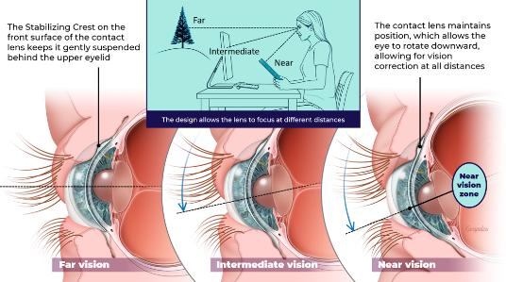
The APIOC™ Design

Slide 18

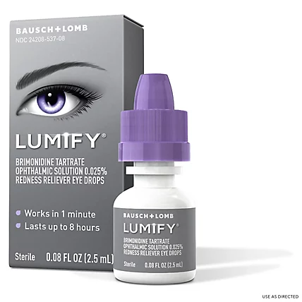
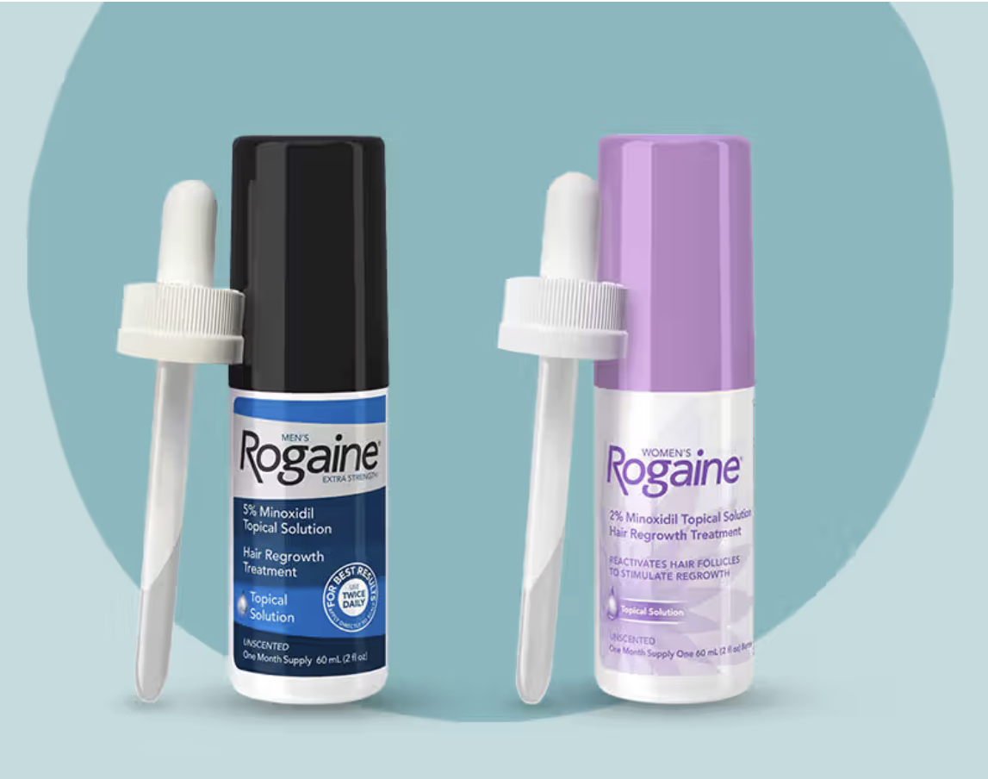
Formulation Matters
Examples of Indication Expansion Through Reformulation or Reformulated Drugs:
From Original Use to New Market Success
Botulinum Toxin Type A
Brimonidine
Minoxidil
[Original]
[Original]
[Original]
Oculinum: Used to treat strabismus and blepharospasm
Botox: Most commonly used for cosmetic purposes
Alphagan (0.1% – 0.2%): Prescribed to reduce intraocular pressure in glaucoma patients
Lumify (0.025%): Used for
over-the-counter eye redness relief
Loniten: Used to treat
severe hypertension
Rogaine: Used to promote
hair growth
[Reformulated]
[Reformulated]
[Reformulated]

Slide 19
PRESBYOPIA: US Impact
128 million Americans are presbyopes^{1-3,*}
83 to 89% of adults ≥45 years⁴
30.9 million buy OTC readers⁵
1. American Optometric Association website. Accessed 2019; 2. Zebardast et al. Am J Ophthalmol. 2017; 3. U.S. Census Bureau. 2014;
4. Berdahl J et al. Clin Ophthalmol. 2020; 5. Vision Council website. Accessed 2020. *Determined based on U.S. Census data.

Slide 20
Is it really presbyopia?
Conditions that can mimic:
Uncorrected hyperopia
Accommodative Insufficiency
Ocular surface disease
Medication induced changes
  anticholinergics, sympathomimetics, antidepressants, antihistamines - can reduce amplitude
Convergence insufficiency or decompensated phorias
Systemic Conditions - DM, TBI
Cataract changes

Slide 21
PRESBYOPIA CURRENT SOLUTIONS HAVE DRAWBACKS
Glasses | Negatively impacts self confidence. Inconvenient, fogging
Contact Lenses | Inconvenience, CL-related dry eye, compliance issues, adjustment to monovision and lack of depth perception, adaptation to multifocal
Multifocal IOLs | Glare/halos, not usually an option for early presbyopes
Refractive Lens Exchange (RLE) | Especially for early presbyopes, the cost and risk of surgery may not outweigh benefits
Corneal Inlay | Expensive, complications, adjustment to monovision, reduced distance vision
Monovision Laser Vision Correction | Hyperopic treatments less predictable, irreversible, dry eye, adjustment to monovision, loss of binocularity and depth perception
Burke Healthcare Research April 2020, n = 1,000 presbyopes ages 40-80 years old.

Slide 22
Patient Myths On Presbyopia
Myth #1: LASIK can fix presbyopia
Monovision correction can improve but does not stop progression
Patients may still need readers post-procedure
Myth #2: Using readers creates dependency
Presbyopia will progress at the same rate with or without them
Myth #3: With presbyopia drops, I can stop wearing glasses completely
Reality: Many still need glasses for certain tasks (e.g., prolonged reading, night driving)

Slide 23
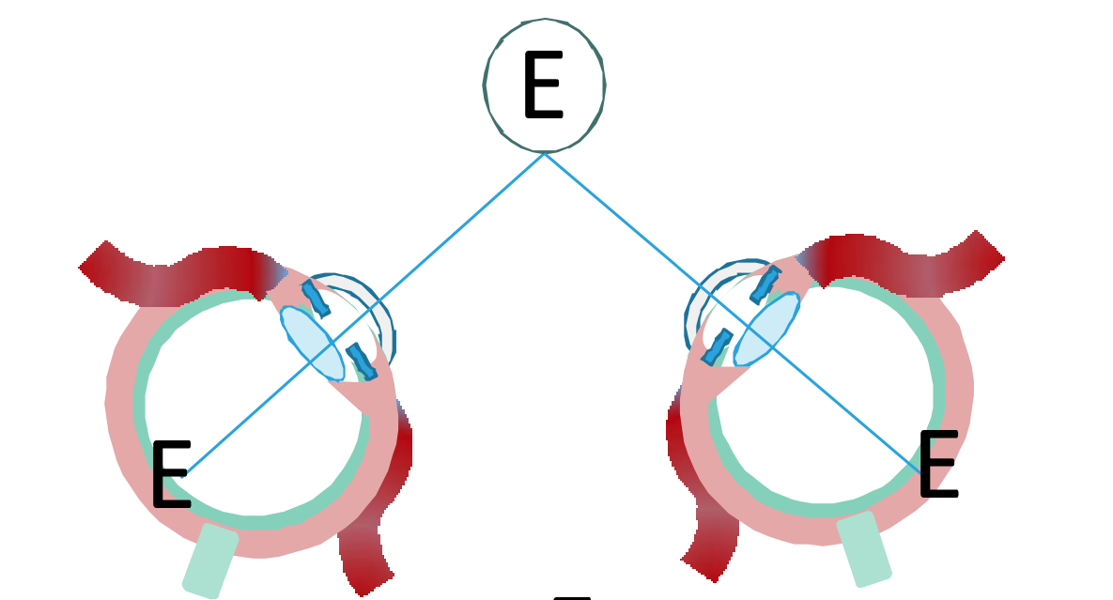
THE NEAR TRIAD
1. Accommodation
2. Convergence
3. Miosis
Bhola R. 23 January 2006. EyeRounds.org: Tutorial: Binocular Vision. webeye.ophth.uiowa.edu. University of Iowa. Retrieved 11 September 2020. https://www.bouldervt.com/wp-content/uploads/sites/478/2017/03/The-Near-Triad.pdf
Notes:
Hom

Slide 24
Clinical Trends in
Emerging Presbyopia Therapies
Miotic drop formulations
  Shift from single agent to multi-mechanism formulations (eg, carbachol + brimonidine, aceclidine + brimonidine) for safety and tolerability
  Use of preservative-free solutions (eg, pilocarpine 0.4%) to reduce ocular surface irritation
Optimizing duration and pupil size
  New agents focus on sustained miosis with minimal impact on distance vision
Mechanistic differentiation
  Direct cholinergic agents (eg, pilocarpine, aceclidine) vs adrenergic modulators (eg, brimonidine, phentolamine) to target pupil control and visual enhancement

Slide 25
Pharmacological Agents for Refractive Correction
Aceclidine
  Parasympathetic
Carbachol and brimonidine
  Drop, dual-acting cholinergic agent and alpha agonist, Preservative-Free (PF)
Phentolamine 0.75%
  Synthetic imidazoline with alpha-adrenergic antagonist activity
Pilocarpine 1.25%
  Drop, BAK, proprietary vehicle
Pilocarpine 0.4%
  Drop, Preservative-Free (PF), proprietary vehicle
Notes:
Extra Information
GLK-302: iLution ophthalmic topical cream-based drug formulation
Applied to the outer surface of the eyelids
for transdermal delivery of pilocarpine
through the dermis of the eyelid to the eye
Nyxol+Pilo (0.4%)
Nyxol: 0.75% Phentolamine
Phentolamine is a synthetic imidazoline with alpha-adrenergic antagonist activity.
As a competitive alpha-adrenergic antagonist, phentolamine binds to alpha-1 and alpha-2 receptors, resulting in a decrease in peripheral vascular resistance and vasodilatation.

Slide 26
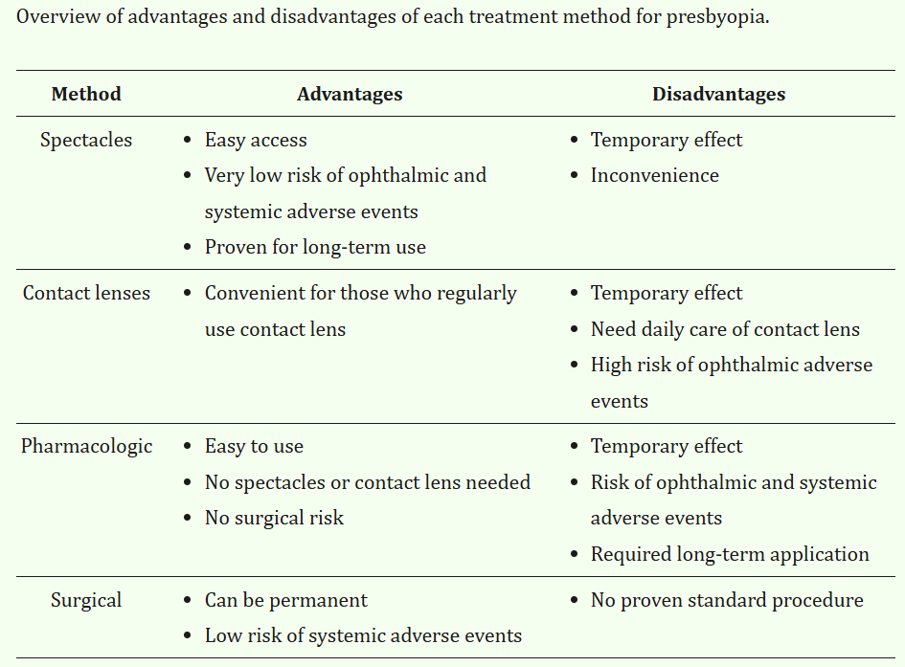
Grzybowski A et al. J Clin Med. 2022;11(5):1385.

Slide 27
Dilator muscle
(Adrenergic receptor)
Sphincter muscle
(muscarinic acetylcholine receptor)

Slide 28
Dilator muscle
(brimonidine, phentolamine)
Sphincter muscle
(Pilocarpine, carbachol, aceclidine)

Slide 29
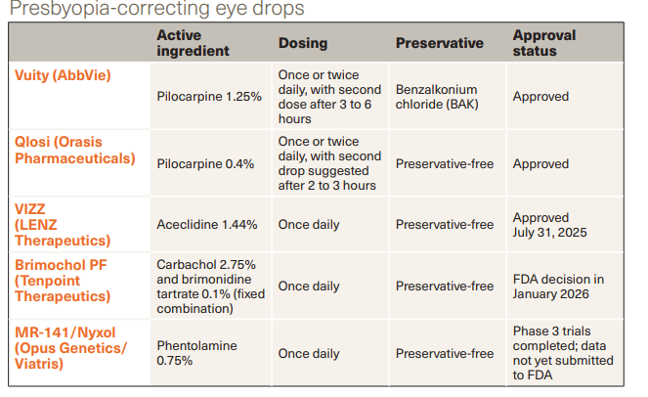
McCabe C and Schmidt E. Ophthalmology Times. 2025;50:15-16.

Slide 30
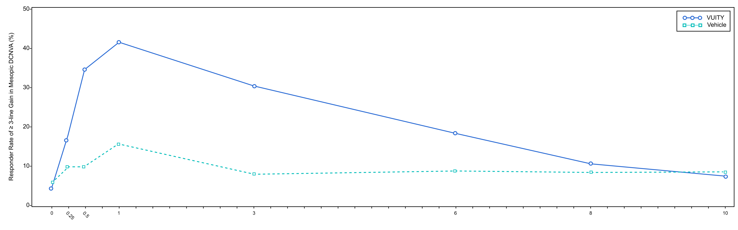
Pilocarpine 1.25% Primary Endpoint Results (Gemini)
Figures 1 presents the proportion of participants who gained 3-lines or more in mesopic DCNVA at Day 30.
Figure 1: Proportion of Participants Achieving 3-Lines or More Improvement in Mesopic, High Contrast, Binocular DCNVA at Day 30 in GEMINI 1 (Intent-to-Treat Population)
Timepoint | Hour 0 | Hour 0.25 | Hour 0.5 | Hour 1 | Hour 3 | Hour 6 | Hour 8 | Hour 10
Pilo 1.25% (%) | 4.3 | 17.7 | 34.8 | 41.6 | 30.7 | 18.4 | 10.6 | 7.5
Vehicle (%) | 5.9 | 9.8 | 9.8 | 15.7 | 8.1 | 8.8 | 8.5 | 8.6
Difference (95% CI) | -1.5 (-6.4, 3.3) | 7.9 (0.3, 15.5) | 25.0 (16.2, 33.8) | 25.9 (16.4, 35.5) | 22.5 (14.3, 30.8) | 9.7 (2.3, 17.0) | 2.1 (4.4, 8.5) | -1.1 (-7.1, 5.0)
VUITY® USPI. Abbvie Inc. March 2023

Slide 31
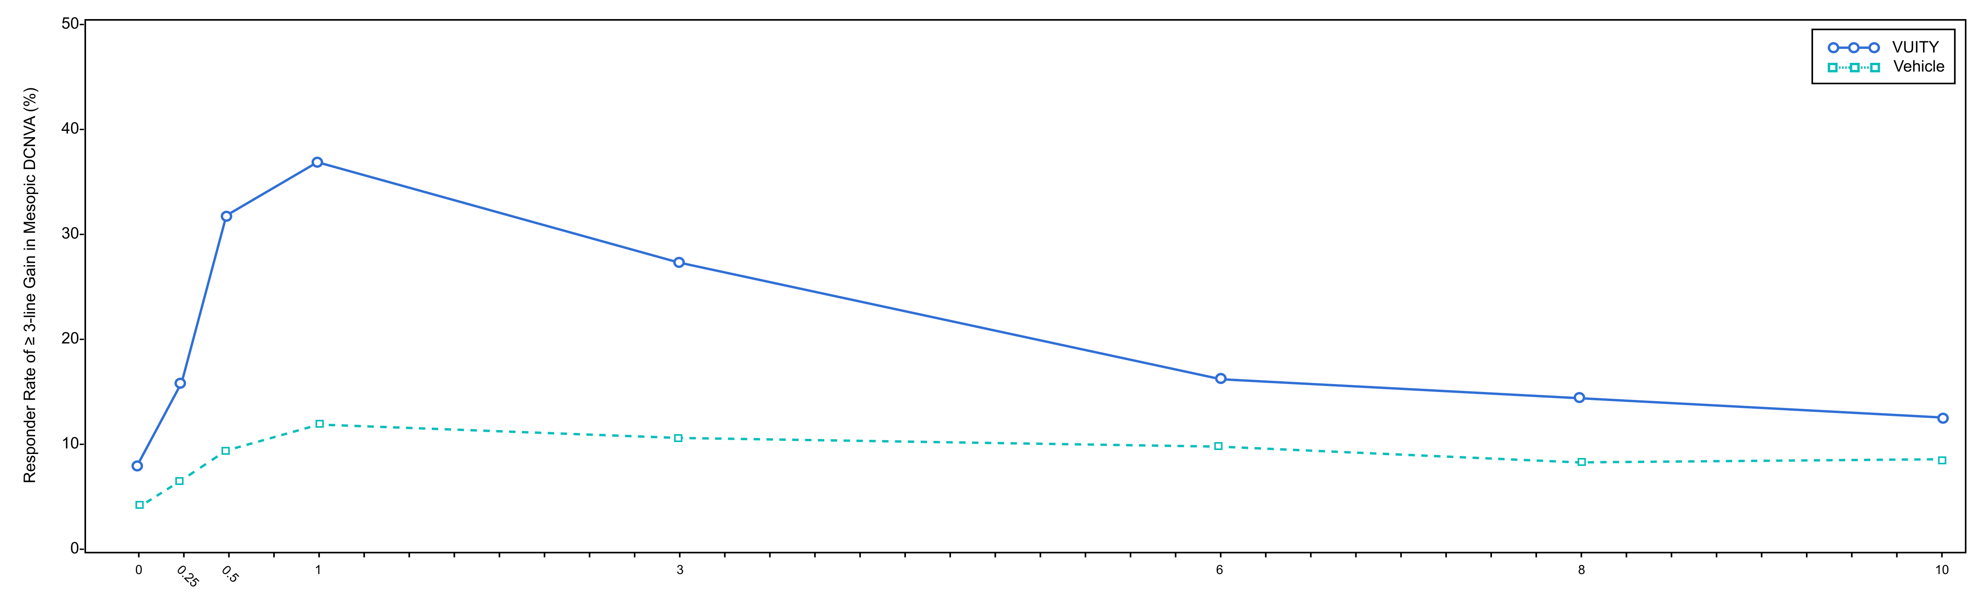
Pilocarpine 1.25% Primary Endpoint Results (Gemini)
Figures 2 presents the proportion of participants who gained 3-lines or more in mesopic DCNVA at Day 30.
Figure 2: Proportion of Participants Achieving 3-Lines or More Improvement in Mesopic, High Contrast, Binocular DCNVA at Day 30 in GEMINI 2 (Intent-to-Treat Population)
Timepoint | Hour 0 | Hour 0.25 | Hour 0.5 | Hour 1 | Hour 3 | Hour 6 | Hour 8 | Hour 10
Pilo 1.25% (%) | 7.8 | 16.1 | 32.1 | 37.3 | 27.6 | 16.3 | 14.5 | 12.6
Vehicle (%) | 4.0 | 6.6 | 9.6 | 12.1 | 10.8 | 9.9 | 8.6 | 8.7
Difference (95% CI) | 3.8 (-0.9, 8.4) | 9.4 (3.2, 15.7) | 22.5 (14.7, 30.3) | 25.2 (17.0, 33.4) | 16.7 (9.1, 24.3) | 6.5 (-0.1, 13.1) | 5.9 (-0.5, 12.2) | 3.8 (-2.3, 10.0)
VUITY® USPI. Abbvie Inc. March 2023
Notes:
,

Slide 32
Pilocarpine 1.25% Safety Results (Gemini)
Most AEs were reported as mild and transient in clinical trials.^{1,2}
The majority of treatment-emergent adverse events (TEAEs) were deemed by the investigator to be mild in severity. TEAEs of moderate severity were reported for 4.0% of participants [15/375] in the Pilo 1.25% group and 2.4% of participants [9/374] in the vehicle group. Severe TEAEs were reported for 1.1% [4/375] of participants in the Pilo 1.25% group and 0.5% [2/374] of participants in the vehicle group. ²
Rate of TEAEs in GEMINI 1 and GEMINI 2 (pooled data)^{1,2}:
TEAES | Headache | Conjunctival Hyperemia | Blurred Vision | Eye Pain | Visual Impairment | Eye Irritation | Increased Lacrimation
Pilo 1.25% [n-375) | 15% (56/375) | 5% (19/375] | 5% [17/375) | 4% (16/375) | 3% [10/375] | 3% (9/375) | 2% (6/375)
Vehicle (n=374] | 7% (26/374) | 4% (15/374) | 1% (3/374) | 1% (4/374) | <1% (1/374] | <1% [2/374) | <1% (2/374)
1. VUITY® USPI. Abbvie Inc. March 2023 2. Waring G et al. BID vs OD Pilo 1.25% for Presbyopia.:Safety Profiles from Phase 3 Studies Paper Presentation. ASCRS 2023

Slide 33
Pilocarpine 1.25% Primary Efficacy Results (VIRGO)
Table 2: Primary Efficacy Results from VIRGO (Intent-to-Treat Population)
 | VIRGO
 | Pilo 1.25% BID N=114 | Vehicle BID N=116 | p-value
Proportion of participants gaining 3-lines or more in mesopic DCNVA, without losing more than 1 line (5 letters) of CDVA at Day 14, Hour 9 (3 hours after the second dose) | 35% | 8% | p<0.01
VUITY® USPI. Abbvie Inc. March 2023

Slide 34

1.25% Pilocarpine Hydrochloride
Percentage of ≥3-line gain at Hour 3 (GEMINI 1) and percentage of ≥3-line gain at Hour 9 (VIRGO)
G1
V
Primary efficacy endpoint measured
Prespecified other endpoints at
Hour 3 on Days 1, 3, 7, and 14*
Day 1 and 7 were not
prespecified endpoints†
DAY 14
Primary efficacy endpoint measured
HR 9
DAY 30
HR 3
Percentage (%) of Responders
Vehicle
Vehicle
Between Group Difference (%)
17.7 | 13.9 | 14.4 | 21.4 | 22.5
Between Group Difference (%)
21.4 |  | 30.2 |  | 28.1
Day
Day
At Day 30, Hour 3 (prespecified secondary endpoint).^{‡1,2}
GEMINI 2 (not shown): Percentage of responders at Days 1, 3, 7, 14, and 30 taking VUITY® were 12.2%, 16.8%, 21.4%, 28.0%, and 27.6%, respectively.
GEMINI 2 (not shown): Percentage of responders at Days 1, 3, 7, 14, and 30 using the vehicle were 1.0%, 8.8%, 7.6%, 7.2%, and 10.8%, respectively.
*LIMITATIONS: Percentage of participants gaining ≥3 lines of mesopic DCNVA at Hour 3 on Days 1, 3, 7, and 14 were prespecified, nonranked endpoints that were not adjusted for multiplicity. Therefore, treatment differences cannot be regarded as statistically significant.
Data was not collected beyond Day 14 for VIRGO or Day 30 for GEMINI; no conclusions regarding efficacy beyond the trial end dates should be made.
†LIMITATIONS: Percentage of participants gaining ≥3 lines in mesopic DCNVA with no more than 5 letter loss in mesopic CDVA at hour 9 on day 1 and 7 was not a prespecified endpoint, not adjusted for multiplicity. Therefore, treatment differences cannot be regarded as statistically significant.
‡The results for GEMINI 1 and GEMINI 2 were consistent at all timepoints.
CDVA=corrected distance visual acuity; DCNVA=distance-corrected near visual acuity.
1. VUITY® Prescribing Information. North Chicago, IL: AbbVie, Inc. 2. Data on file. ABVRRTI74717. 3. Data on file.
G1
GEMINI 1
(N=323)
G2
GEMINI 2
(N=427)
V
VIRGO
(N=230)
Notes:
This slide shows the results of prespecified other endpoints at Hour 3 from GEMINI 1 (left). The blue line shows the percentage of participants on VUITY® who achieved a ≥3-line gain on Days 1, 3, 7, 14, and 30. The vehicle group is represented by the gray line. Please keep in mind the primary efficacy endpoint for the GEMINI 1 and GEMINI 2 studies was Day 30, Hour 3.
[CLICK] On the right, the blue line shows the percentage of participants on VUITY® in the twice-a-day dosing trial, VIRGO, that achieved a ≥3-line gain on Days 1, 7, and 14. The primary efficacy endpoint for this trial was Day 14, Hour 9.
LIMITATIONS (GEMINI): Percentage of participants gaining ≥3 lines of mesopic DCNVA at Hour 3 on Days 1, 3, 7, and 14 were prespecified, nonranked endpoints that were not adjusted for multiplicity. Therefore, treatment differences cannot be regarded as statistically significant.
LIMITATIONS (VIRGO): Percentage of participants gaining ≥3 lines in mesopic DCNVA with no more than 5 letter loss in mesopic CDVA at hour 9 on day 1 and 7 was not a prespecified endpoint, not adjusted for multiplicity. Therefore, treatment differences cannot be regarded as statistically significant.

Slide 35
Dilator muscle
(brimonidine, phentolamine)
Sphincter muscle
(Pilocarpine, carbachol, aceclidine)

Slide 36



Optimizing The Presbyopia Solution
Enhanced near visual acuity
Attempt to reduce distance vision and night vision
Favorable safety and tolerability profile
Improved comfort
Preservative free
Efficacy
LOW CONCENTRATION PILOCARPINE
PROPRIETARY VEHICLE
+
Comfort
Safety
Curcio CA et al. In: Ryan SJ et al, eds. Retina, Vol 1, Part 2: Basic Science and Translation to Therapy. 5th ed. 2013.

Slide 37
NEAR 1 and 2 Phase 3 Studies
Parallel-group study pilocarpine HCl 0.4% vs vehicle
A 2-week study, Daily BID administration
613 patients
Primary and key secondary endpoints: percentage of participants with ≥ 3-line gain in mesopic, distance-corrected near visual acuity (DCNVA), 1-HR and 2-HR post-dose 1 and post-dose 2 on Day 8 (4 time points)
Other secondary endpoints: ≥ 3-line gain in DCNVA on Days 1 and 15
Exploratory endpoints: ≥ 2-line gain in DCNVA, and pupil diameter
Holland E et al. Clin Ther. 2024;46(2):104-113.

Slide 38

Pilocarpine hydrochloride 0.4% (CSF-1) Primary & Key Secondary Endpoints
POOLED Day 8 – Proportion of participants achieving ≥ 3-line improvement DCNVA, and no loss of 1-line or more in distance visual acuity (study eye)
Dose 1
Dose 2, 2 HRs Post-Dose 1
N=613
*
*
*
*
*
*
*
*
* p<0.0001 for CSF-1 vs. Vehicle

Slide 39
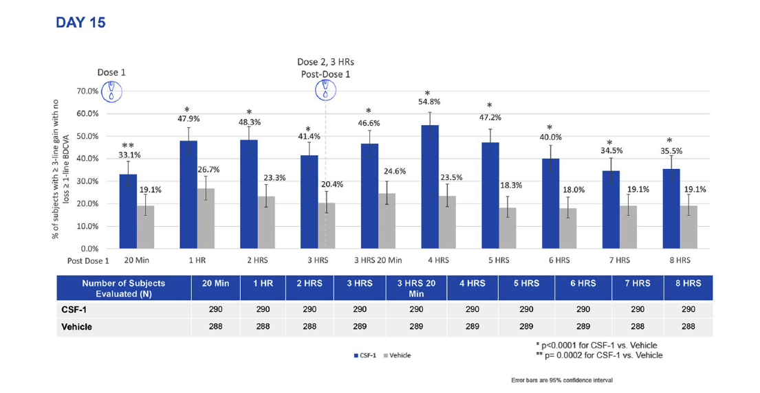
NEAR 1 and 2: Efficacy
Holland E et al. Clin Ther. 2024;46(2):104-113.

Slide 40
Functional Vision (DCNVA 20/40 Or Better) Was Achieved Up To 8 Hours (Study Eye Vs Binocular)
POOLED DAY 15 – Proportion of participants achieving DCNVA 20/40 or better in study eye versus binocular vision in those with DCNVA worse than 20/40 OU at baseline
Dose 1
Dose 2, 3 HRs Post-Dose 1
N=206
*
*
*
*
*
*
*
*
*
*
*
*
*
Post Dose 1
Error bars are 95% confidence interval
Note: Primary efficacy results in NEAR-1 and NEAR-2 are with study eye.
* p<0.0001 for Binocular vs Study Eye

Slide 41

Safety: Majority Of Adverse Events Were Mild, Transient And Self-resolving
POOLED DAYS 1, 8 & 15 – Treatment related adverse events
Treatment Related Adverse Events
 | CSF-1 N=308 n (%) | Vehicle N=305 n (%)
Non-Ocular TRAEs
Headache | 21 (6.8%) | 2 (0.7%)
Eye/facial pain | 6 (1.9%) | 1 (0.3%)
Nausea | 4 (1.3%)
Ocular TRAEs
Instillation site pain | 18 (5.8%) | 1 (0.3%)
Vision blurred | 11 (3.6%) | 2 (0.7%)
Conjunctival hyperemia | 5 (1.6%) | 1 (0.3%)
Installation site pruritis | 3 (1.0%) | 1(0.3%)
Visual impairment | 3 (1.0%)
1.3% (n=4) of all CSF-1 participants reported moderate treatment related adverse events
All other treatment related adverse events were mild (no severe)
No serious treatment related adverse events occurred with CSF-1
*All TRAEs ≥ 1% ; Suspected Treatment Related Adverse Event means any adverse event for which there is a reasonable possibility that the drug caused the adverse event.

Slide 42
Dilator muscle
(brimonidine, phentolamine)
Sphincter muscle
(Pilocarpine, carbachol, aceclidine)

Slide 43
CLARITY-1 and -2 Trials
Randomized, double masked, controlled studies conducted for 42 days
466 participants aged 45 to 75 years old with presbyopia were randomized. Participants had a refractive range from -4.00 to +1.00 D sphere, with astigmatism up to 2.00 D, and a spherical equivalent no more myopic than -4.00 D.
Included participants who were post-refractive surgery and/or pseudophakic.
Participants instilled 2 drops of aceclidine or control in each eye once daily, one drop in each eye followed by a second drop in each eye 2 minutes later.
Ophthalmic efficacy assessments were conducted on Day 1, Day 15, and Day 28 at various timepoints post dose.
VIZZ. Product Information. LENZ Therapeutics, Inc; 2025.

Slide 44
Aceclidine 1.44% Primary Endpoint Results (Clarity 1 & 2 Studies)
Figure 1
Figure 2
Percentage of Participants Achieving 3 Lines or More Improvement in High Contrast, Monocular Near Vision (DCNVA at 40 cm) and No Loss of 1 or More Lines (DCDVA at 4 m) on Day 1 at All Measured Time Points (CLARITY-2, FAS population with Observed data)
Percentage of Participants Achieving 3 Lines or More Improvement in High Contrast, Monocular Near Vision (DCNVA at 40 cm) and No Loss of 1 or More Lines (DCDVA at 4 m) on Day 1 at All Measured Time Points (CLARITY-1, FAS population with Observed data)
73
72
71
71
69
62
64
57
49
49
48
Percentage (%)
40
Percentage (%)
39
38
38
27
14
17
12
9
11
12
7
8
7
8
8
8
5
6
6
4
Primary
Endpoint
Primary
Endpoint
Time
Time
Vizz™ USPI. Lenz Therapeutics Inc, 2025

Slide 45

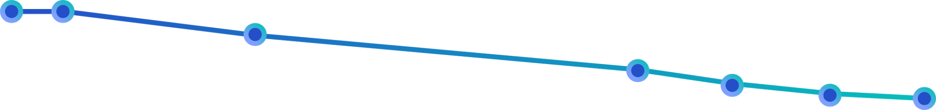


Aceclidine 1.44% Functional Vision (20/40 or Better)
93%
Functional near vision:
100%
93%
87%
~7 out of 10 patients achieved 20/40 (J3) at 10 hours.
78%
74%
71%
69%
80%
60%
40%
20/40 (J3) or better
20%
0
1
2
3
4
5
6
7
8
9
10
Day 1, Clarity 1 & 2, Analysis of Binocular Distance Corrected Near Vision with logMAR ≤ 0.3 (-20/40 or J3)
Patients may experience dim or dark vision. Dim vision was reported in 16% of study participants.
https://lenz-tx.com/

Slide 46
Aceclidine 1.44% Adverse Events
 | Adverse Events
 | Aceclidine 1.44% | Vehicle
 | N=234 | N=76
 | n(%) | n(%)
Non-Ocular TRAEs
Headache | 30 (13.0%) | 3 (3.9%)
Ocular TRAEs
Instillation site pain | 47 (20.0%) | 8 (10.5%)
Visual impairment | 37 (16.0%) | 1 (1.3%)
Conjunctival hyperemia | 19 (8.0%) | 2 (2.6%)
Ocular hyperemia | 16 (7.0%)
Vizz™ PI. Lenz Therapeutics Inc, 2025

Slide 47
Dilator muscle
(brimonidine, phentolamine)
Sphincter muscle
(Pilocarpine, carbachol, aceclidine)

Slide 48
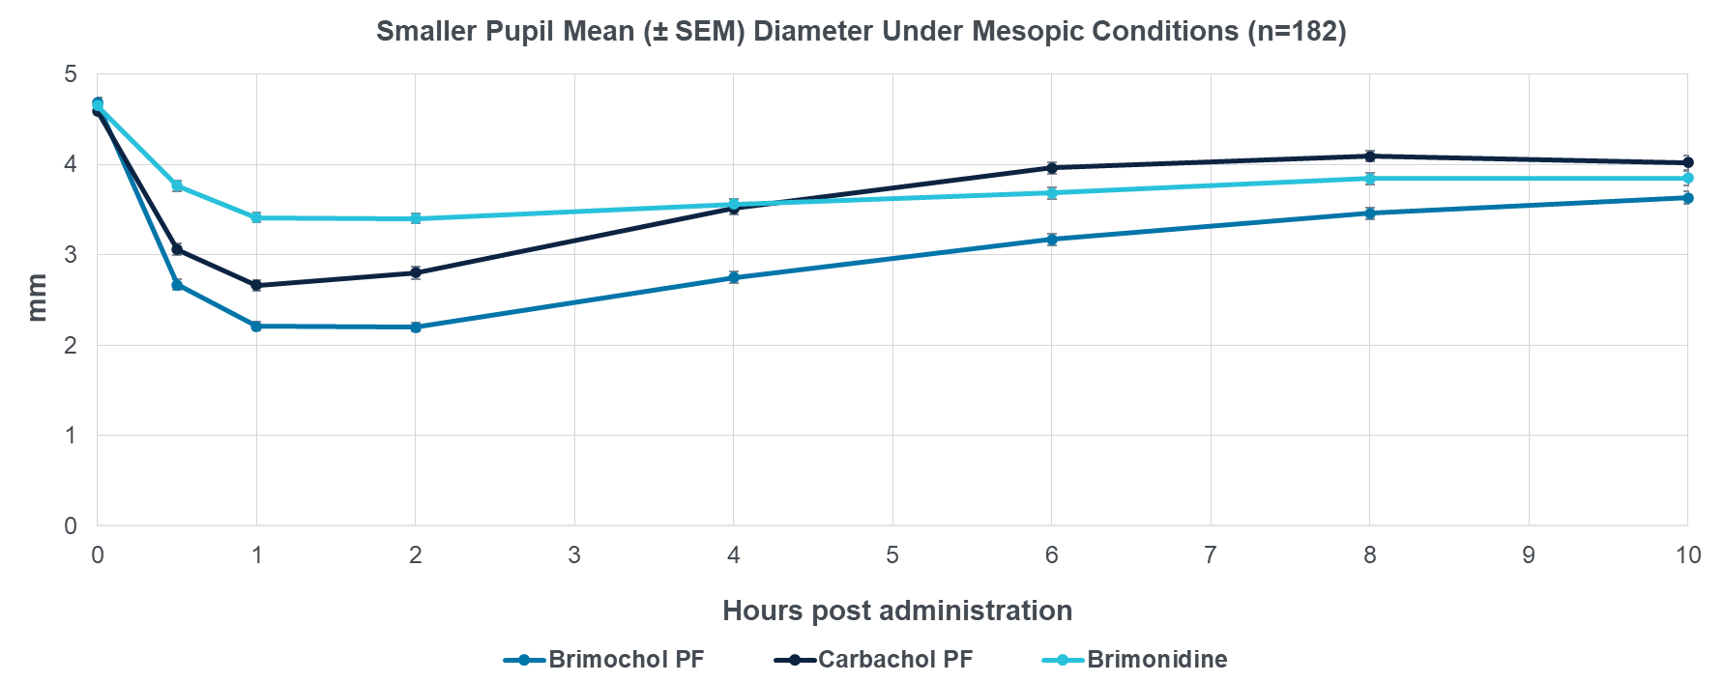
BRIMOCHOLTM PF Significantly Superior to Carbachol &
Brimonidine in Pupil Diameter Reduction: 30mins to Hour 10
All Differences Between BRIMOCHOLTM PF and Monotherapies Highly Significant (p<0.001) at All Timepoints
Gradual offset of BRIMOCHOLTM PF miosis balances near vision improvement with minimizing night-time vision risks

Slide 49
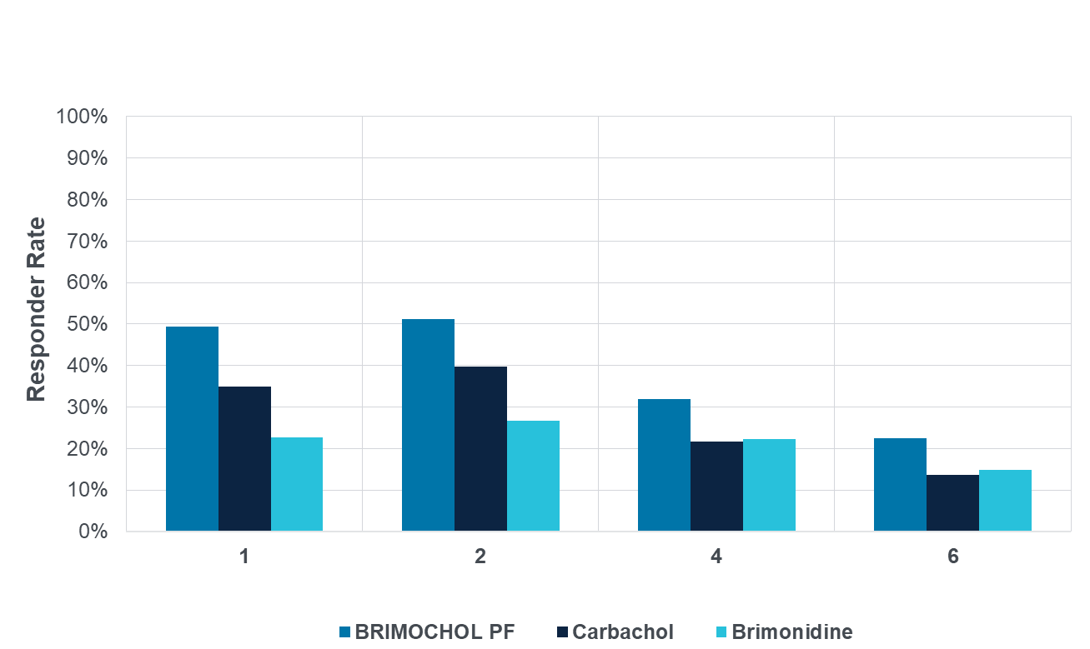
US FDA Primary Endpoint Met at Hours 1, 2, 4, and 6
Primary for US FDA: Proportion of Subjects with a ≥15 ETDRS Letter Gain from Pre-dose Baseline in BUCNVA without a ≥5 ETDRS Letter Loss in BUCDVA under Mesopic Conditions (n=182)
BRIMOCHOLTM PF superior to Carbachol and Brimonidine at multiple timepoints – 1,2,4 and 6 hours
BRIMOCHOLTM PF has higher peak efficacy and longer duration than only marketed product
BRIMOCHOLTM PF is being evaluated against vehicle as part of ongoing Phase 3 Program – evaluating 8+ hour performance
Hours Post Administration
P-values | Hr1 | Hr2 | Hr4 | Hr6
vs. Carbachol | <0.001 | 0.008 | 0.012 | 0.006
vs. Brimonidine | <0.001 | <0.001 | 0.022 | 0.039

Slide 50
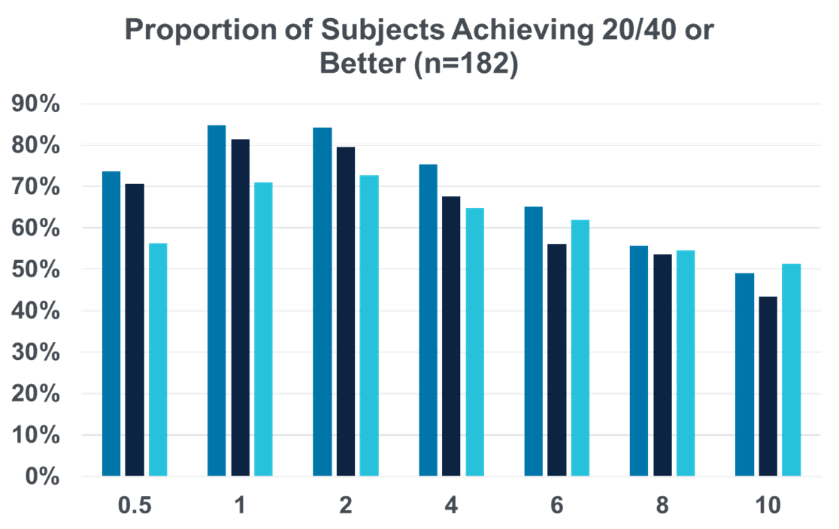
Percent of Subjects Achieving 20/40 or Better in BUCNVA
Approximately 50% of subjects have improved from moderate to mild presbyopia out to hour 10 with BRIMOCHOLTM PF
BRIMOCHOLTM PF outperforms Carbachol PF and Brimonidine PF arms out to 8 hours
Near Visual Acuity of 20/40 is adequate for most near vision tasks¹
Responder Rate
Hours Post Administration
Carbachol PF
BRIMOCHOLTM PF
Brimonidine
P-values | Hr0.5 | Hr1 | Hr2 | Hr4 | Hr6
vs. Carbachol | 0.443 | p=0.129 | p=0.036 | p=0.276 | p=0.020
vs. Brimonidine | <0.001 | p<0.001 | p<0.001 | p=0.006 | p=0.313
McDonald MB et al. Ophthalmol Ther 2022;11(1):1-11.

Slide 51

Phentolamine Mesylate + LDP
Source: VEGA-1 TLR Table 14.2.2.2 Percent of Subjects with >= 15 Letters of Improvement in Photopic DCNVA and < 5 Letters of Loss in Photopic Binocular BCDVA by Time Point (PP Population); Table 14.2.1.2 Percent of Subjects With Improvement From Baseline in Photopic DCNVA by Time Point (PP Population)
Nyxol + LDP combination achieved statistical superiority to LDP and Nyxol alone arms even with a small sample size
77%
of subjects achieved
≥ 10 letter improvement in DCNVA at 30 minutes
(P = .015 vs placebo) and similar trend at other timepoints
P = .03
P = .008
P = .015
Pepose JS et al. 2021 ASCRS Meeting. Paper #76645.

Slide 52
Case
49 y/o female
Works as a marketing executive; frequent use of smartphone, laptop, and printed materials
Active lifestyle, often attending evening networking events
Chief Complaint:
“I’m constantly putting on and taking off my readers - it’s frustrating, especially in meetings and social settings.”
Notes difficulty reading menus in dimly lit restaurants

Slide 53
Case
Ocular & Medical History:
No history of ocular surgery or trauma
No systemic medications affecting accommodation
No significant dry eye symptoms
Refraction:
OD: -0.50 -0.25 x 075, 20/20
OS: -0.25 -0.25 x 085, 20/20
Add: +1.75
Normal SLE, normal DFE

Slide 54
Functional near vision
Discussion:
Is this patient a good candidate?
What does functional near vision mean to this patient?

Slide 55
What are the most important factors for success?
Patient motivation
Patient education
  side effects
  vision expectations
Discussion:
How should clinicians address patient expectations and potential visual compromises associated with miotic therapies?

Slide 56
Thank You!
mile.brujic75@gmail.com

