Slide 1

Systemic Sightlines: When the Body Speaks Through the Eye
Mile Brujic, OD, FAAO
Bowling Green, OH
Mile Brujic, OD, FAAO
Bowling Green, OH

Slide 2
Disclosure
I have received honoraria in the past 2 years for speaking, writing, participating in an advisory capacity, research or meeting support from: Apellis (consultant, speakers bureau), ABB Optical (received meeting support), Abbvie (consultant), Alcon (consultant, speakers bureau), Art Optical (received meeting support), Azura (consultant), Bruder Healthcare (consultant), Bausch + Lomb Health (consultant, speakers bureau), Contamac (received meeting support), CooperVision (received meeting support), CSEye (consultant), Dompe (consultant), Dopavision (consultant), Eyepromise (consultant), Glaukos (consultant), Johnson & Johnson Vision Care (received meeting support), Lentechs (received research support), MDElite (consultant), Nordic Pharma (consultant), Orasis (consultant, speakers bureau), Radius XR (consultant), SCOPE (consultant), Sun Pharma (speakers bureau), Tangible Science (received meeting support), Tarsus (consultant, speakers bureau), Théa Pharma (consultant), Viatris (consultant, speakers bureau), Visionix (consultant), Walman Optical (received meeting support).
These relationships have been mitigated and will not influence the content of this presentation

Slide 3
Neurotrophic Keratitis: Classification by Disease Severity (Mackie Stages I–III)
Stage I – Epithelial Changes (Mild NK)
Key Clinical Findings
Punctate epithelial erosions
Reduced tear film stability
Early epithelial irregularity
Decreased corneal sensitivity
Stage II – Persistent Epithelial Defect (Moderate NK)
Key Clinical Findings
Non-healing epithelial defect
Rolled or thickened epithelial edges
Minimal pain despite significant surface breakdown
Stage III – Corneal Ulceration & Stromal Involvement (Severe NK)
Key Clinical Findings
Stromal melting
Corneal ulceration
Thinning ± impending or actual perforation
Sacchetti M, Lambiase A. Diagnosis and management of neurotrophic keratitis. Clinical Ophthalmology. 2014;8:571–579.

Slide 4
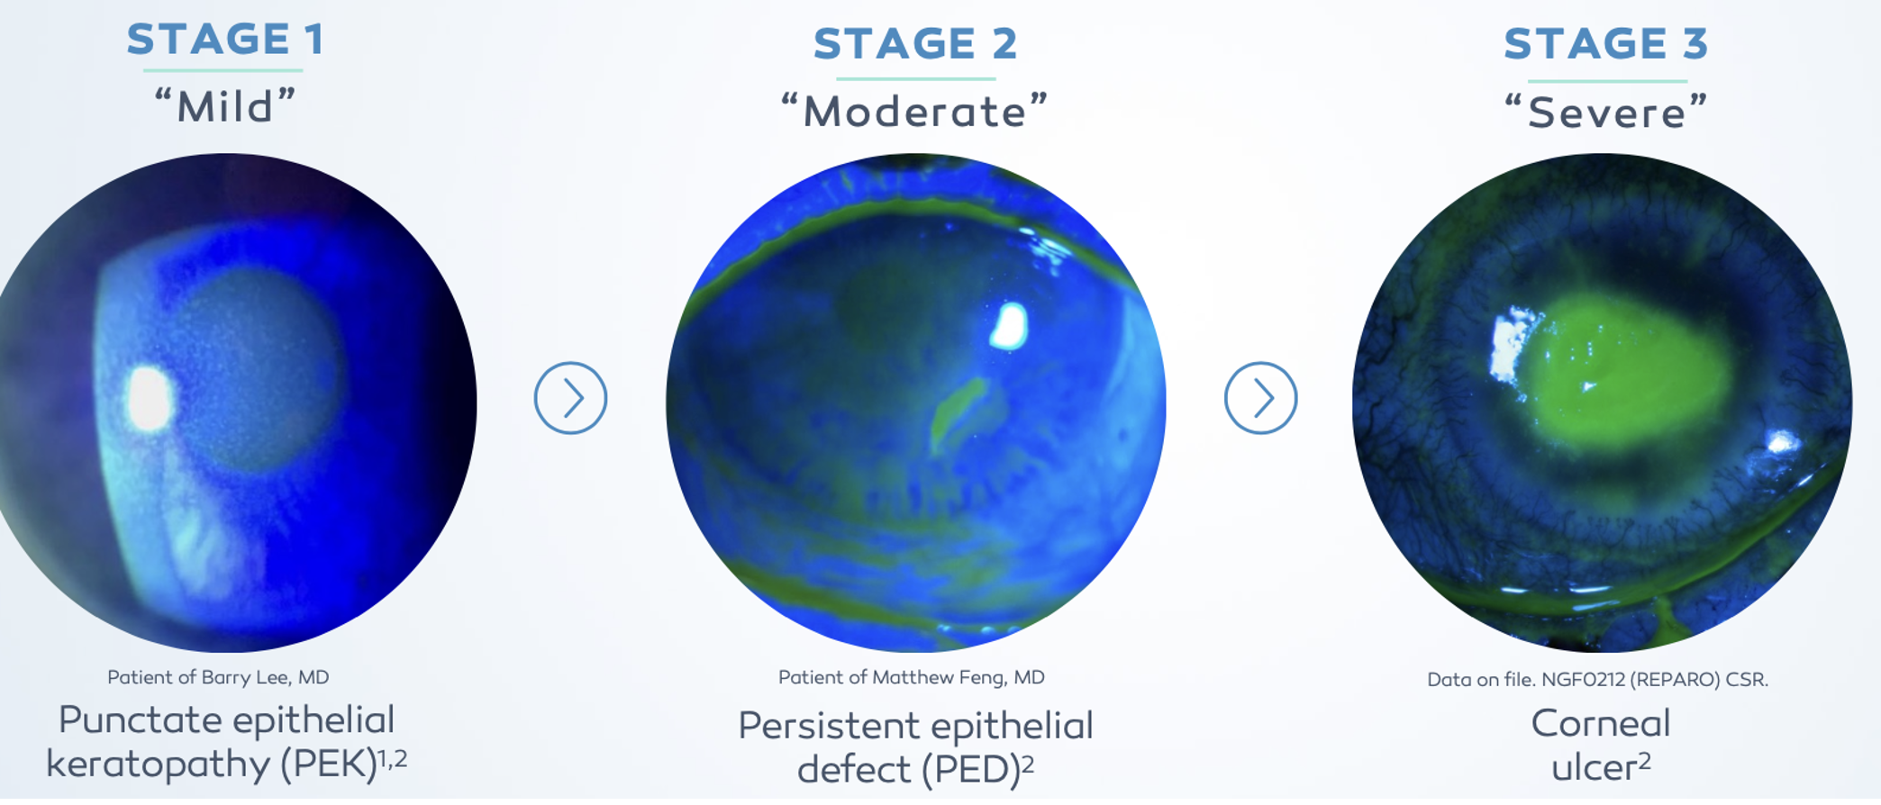
Neurotrophic Keratitis: Classification by Disease Severity (Mackie Stages I–III)

Slide 5
Common NK Etiologies
Post-herpetic infection (VZV, HSV)
Chronic dry eye disease
Contact lens wear
Ocular surgery (eg, cataract, refractive, PKP)
Topical ophthalmic drug toxicity (eg, glaucoma drops)
Diabetes
Stroke
Multiple sclerosis

Slide 6
65.2% of Patients Had Complete Corneal Healing at week 8
P<0.001
P<0.012
Percentage of Patients Completely Healed (%)
Endpoint of complete corneal healing: 0 mm staining in the lesion area and no persistent staining in the rest of the cornea (last post-baseline observation carried forward; chi-squared test).
cenegermin 20mcg/ml (n=24)
Vehicle (n=24)
Pflugfelder SC, Massaro-Giordano M, Perez VL, Hamrah P, Deng SX, Espandar L, Foster CS, Affeldt J, Seedor JA, Afshari NA, Chao W, Allegretti M, Mantelli F, Dana R, Topical Recombinant Human Nerve Growth Factor (Cenegermin) for Neurotrophic Keratopathy: A Multicenter Randomized Vehicle-Controlled Pivotal Trial, Ophthalmology (2019), doi: https:// doi.org/10.1016/j.ophtha.2019.08.020.

Slide 7
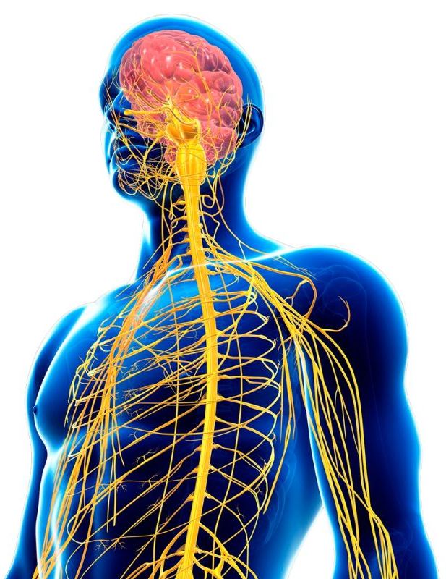


CORNEA INNERVATION AND SENSITIVITY
Trigeminal Nerve (CN V)
  Opthalmic (V1)
  Maxillary (V2)
  Mandibular (V3)
Nasociliary Nerve
  Branch of opthalmic
Long Ciliary Nerve
  Branch of the nasociliary
The cornea is the human tissue with the highest density of free nerve fiber endings
  300 to 600 times more than skin
  20 to 40 times more than dental pulp
1. Marfurt CF, Kingsley RE, Echtenkamp SE. Sensory and sympathetic innervation of the mammalian cornea. A retrograde tracing study. Invest Ophthalmol Vis Sci. 1989;30(3):461–72.
Notes:
The cornea is the most densely innervated tissue in the body, with approximately 7,000 nociceptors per square millimeter. For example, the nerve density of the corneal epithelium is 300 to 600 times greater than skin, and 20 to 40 times greater than dental pulp.
This abundant sensory endowment allows the cornea to have the ability to transduce various thermal, mechanical and chemical stimuli in the conscious perception of ocular dryness, discomfort or pain.
NOCICEPTOR: Receptor / nerve ending that is stimulated by tissue damage or injury. It is found in all organs, although the stimulus that excites them is different (heat, hypoxia, pressure, chemicals such as bradykinin and some prostaglandins, etc.).

Slide 8
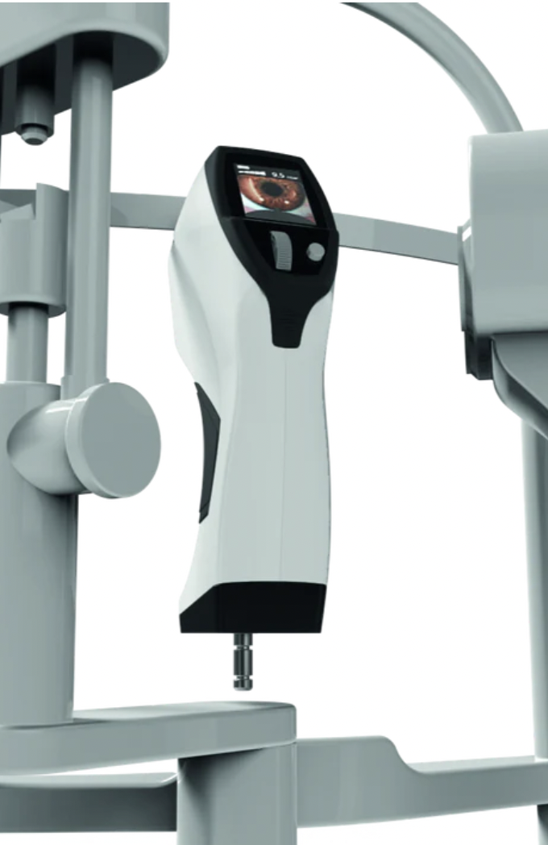
Corneal Esthesiometer
Objectively assesses corneal sensitivity
Five stimulus levels ranging from 1 mbar to 10 mbar
NCT 250 to 300mbar
Device is 4mm from the patient’s ocular surface
https://esthesiometer-brill.com/

Slide 9
Proparacaine Challenge Test
1) Assess comfort of patient at time of visit (0 to 10)
2) Place drop of proparacaine in eyes
3) Assess comfort of patient about 90 seconds after drop instillation

Slide 10
Kearns-Sayre Syndrome
  -Affects many parts of the body
  -Usually appears before 20 years old
  -Caused by mitochondrial DNA abnormalities
  -Causes progressive external ophthalmoplegia
    Paralysis of extraocular muscles
    Ptosis
  -Pigmentary retinopathy

Slide 11
Kearns-Sayre Syndrome
  Other systemic findings
    Cardiac conduction defects
    Ataxia
    Other muscle weakness
    Deafness
    Kidney problems
  Occurs because of mitochondrial deficiencies
  Prevalence: 1-3/100,000

Slide 12
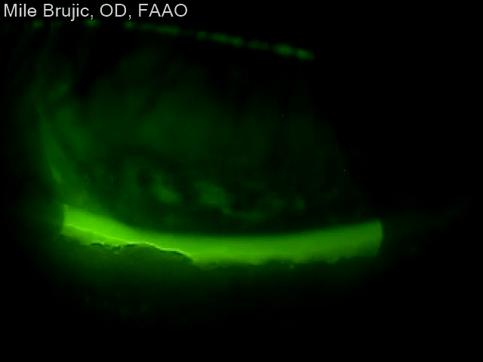
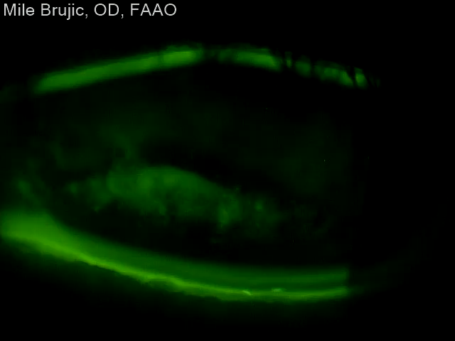
Kearns-Sayre Syndrome

Slide 13
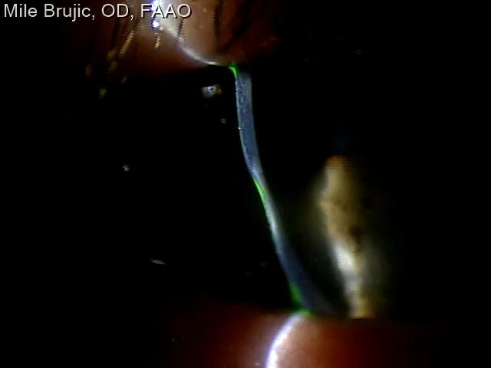
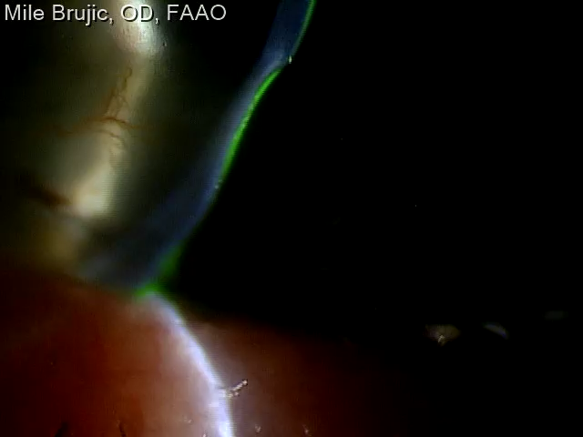
Kearns-Sayre Syndrome

Slide 14
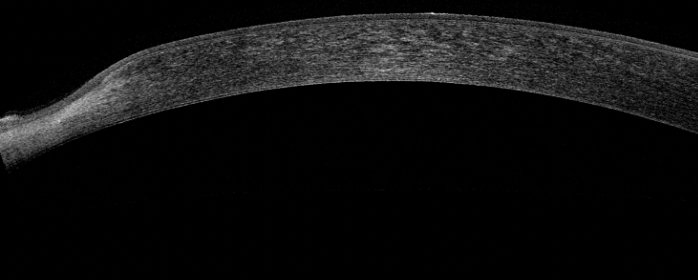
Kearns-Sayre Syndrome

Slide 15
Kearns-Sayre Syndrome
    Ointment in the evening
    Sleep rite
    Eye mask in the evening
    Blepharoplasty
    Punctal occlusion

Slide 16
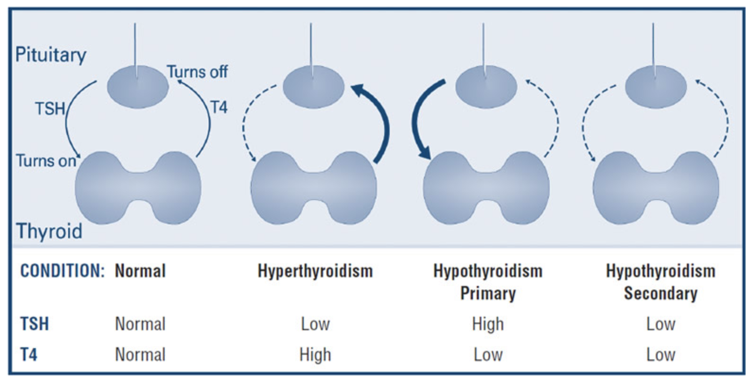
Thyroid Gland Function
TSH is produced by pituitary gland
Thyroid Gland Produces T4 which is converted to T3
Alterations in hormonal balance can cause problems to arise
https://www.thyroid.org/thyroid-function-tests/

Slide 17
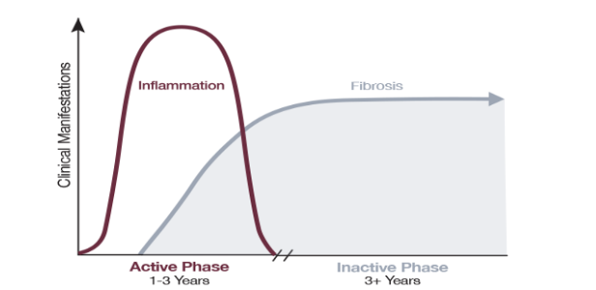
Inflammation During Progressive TED Advances to Chronic Fibrosis¹
Progressive (active), inflammatory phase of TED can last up to 3 years^{1,2}
Patients eventually progress to the fibrotic (inactive) phase of TED, which is characterized by irreversible fibrosis¹
Fibrosis begins during the progressive (active) phase and leads to the lasting sequelae associated with permanent disfigurement and functional visual impairment^{1,3}
Progressive
Fibrotic
Clinical Manifestations
1–3 Years
3+ Years
Adapted with permission from the North American Neuro-Ophthalmology Society: Bhatti MT, Dutton JJ. J Neuroophthalmol. 2014;34(2):186-197
1. Bhatti MT, et al. J Neuroophthalmol. 2014;34(2):186-197. 2. Barrio-Barrio J, et al. J Ophthalmol. 2015;2015:249125. 3. Bothun ED, et al. Clin Ophthalmol. 2009;3:543-551.

Slide 18
Thyroid Eye Disease (TED): Common Symptoms
Ocular irritation, burning, or foreign body sensation
Dryness and fluctuating vision
Photophobia
Excessive tearing (reflex tearing)
Pressure or pain behind the eyes
Diplopia
Cosmetic concerns related to eye appearance

Slide 19
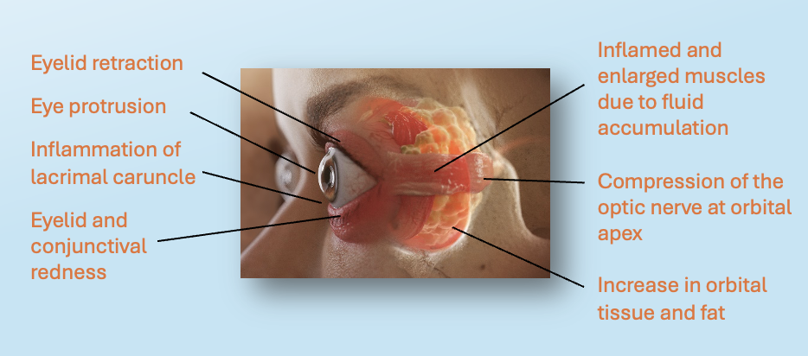
Thyroid Eye Disease (TED): Common Signs
External / Anterior Segment
Eyelid retraction (scleral show)
Periorbital edema and erythema
Conjunctival injection and chemosis
Globe / Motility
Decreased ocular motility
Strabismus secondary to muscle fibrosis
Cornea
Inferior punctate epithelial erosions
Optic Nerve
Compressive optic neuropathy
1. Khazaeni LM. Merck manual professional website. https://www.merckmanuals.com/professional/eye-disorders/approach-to-the-ophthalmologic-patient/ophthalmic-anatomy?query=ophthalmic%20anatomy. Updated March, 2019. Accessed January 9, 2020. 2. Bahn RS. N Engl J Med. 2010;362:726-738. 3. Smith TJ, et al. J Clin Endocrinol Metab. 2004;89:5076-5080. 4. Smith TJ, et al. N Engl J Med. 2016;375(16):1552-1565. 5. Pritchard J, et al. J Immunol. 2003;170:6348-6354.

Slide 20
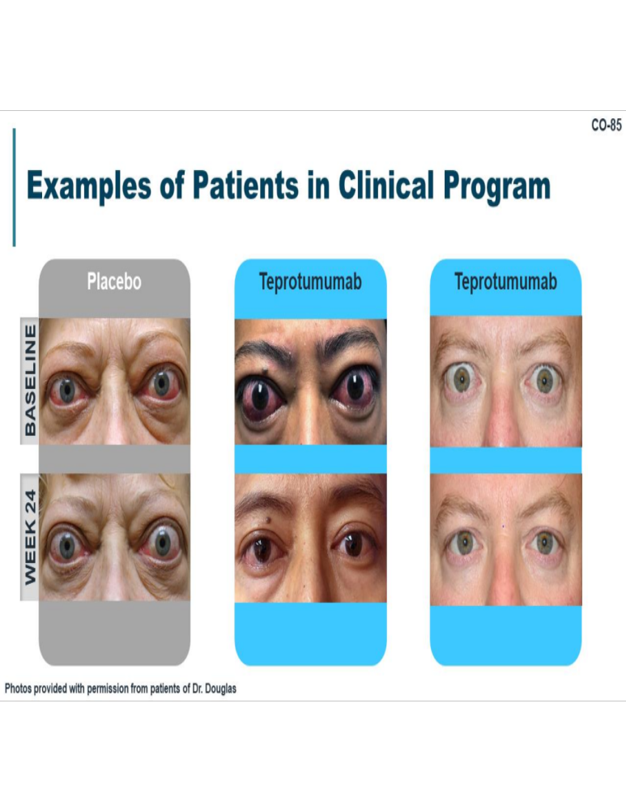

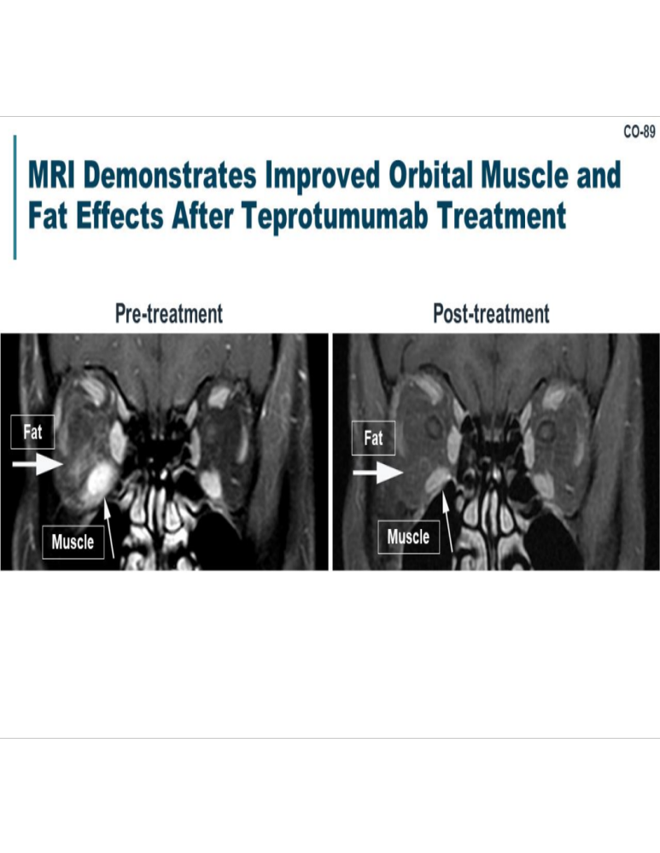
Treatment – Teprotumumab

Slide 21
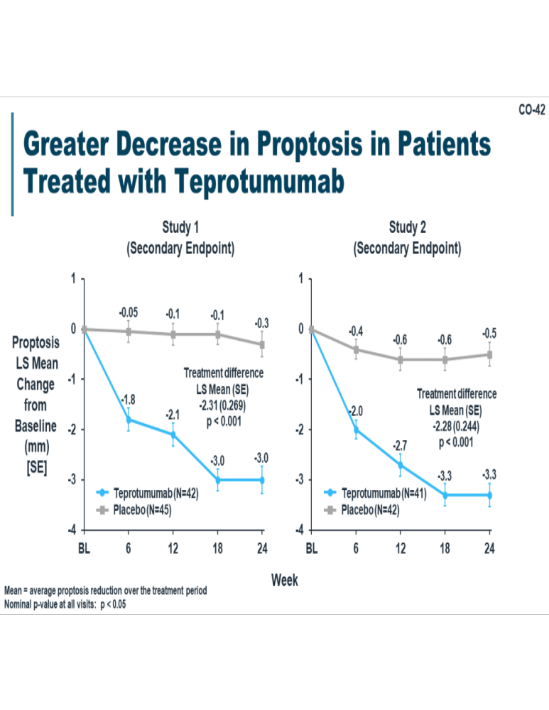
Treatment – Teprotumumab
8 infusions - Treatments every 3 weeks

Slide 22
Floppy Eyelid Syndrome
    Extensive lid laxity secondary to decreased elastin content in tarsal plate
    Spontaneous eversion of the lid can occur while sleeping
    Can lead to chronic irritation of the lid
    Critical to perform lid eversion on eye examination

Slide 23
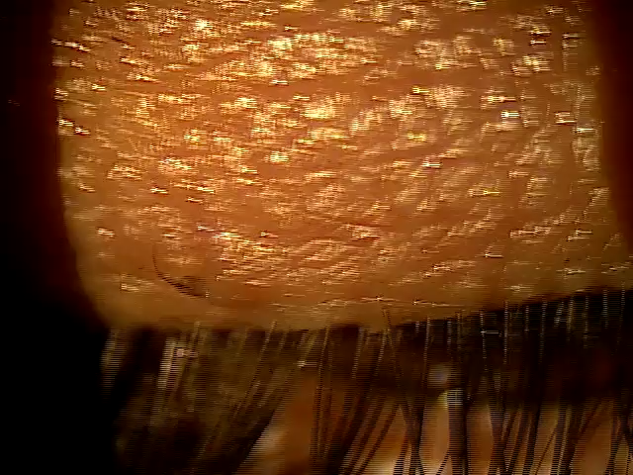
Floppy Eyelid Syndrome

Slide 24
Floppy Eyelid Syndrome
    Has a strong association obstructive sleep apnea
    Also associated with keratoconus, down syndrome
    Refer to physician for appropriate testing
    Monitor optic nerves carefully for risk of glaucoma

Slide 25
Obstructive Sleep Apnea (OSA)
A sleep disorder characterized by recurrent upper airway collapse during sleep
Leads to intermittent hypoxia, sleep fragmentation, and sympathetic activation
Common Signs & Symptoms: Loud snoring, excessive daytime sleepiness, morning headaches, poor concentration and fatigue
Increased risk of:
  Hypertension
  Cardiac arrhythmias
  Stroke
  Coronary artery disease
  Type 2 diabetes

Slide 26
Floppy Eyelid Syndrome
    Ointment in the evening
    Sleep rite
    Eye mask in the evening
    Blepharoplasty
    Lacriserts
    Punctal occlusion

Slide 27
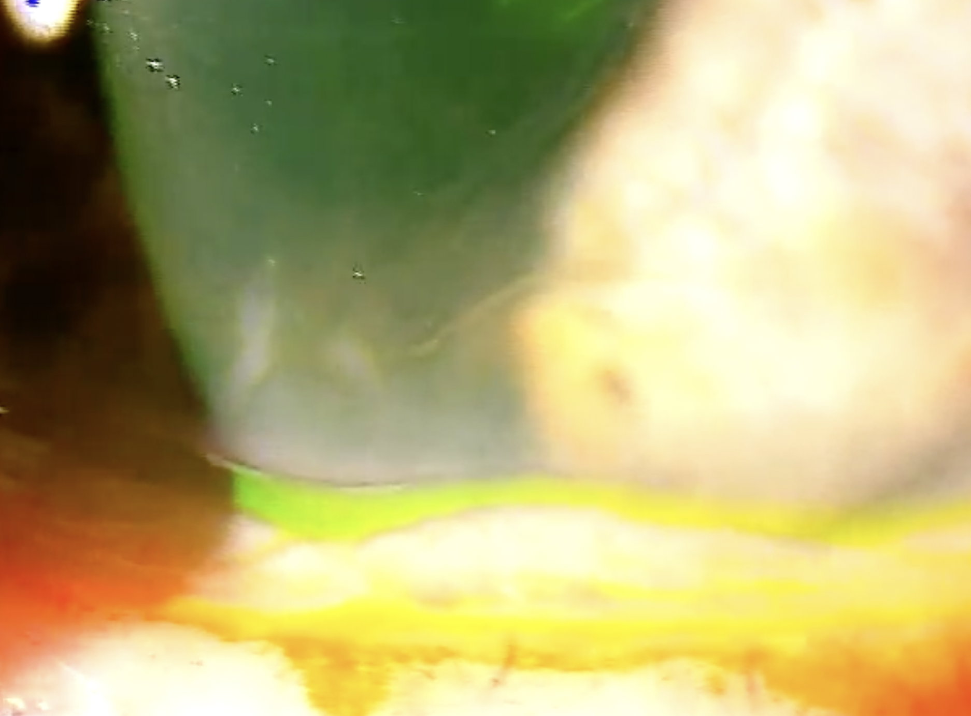
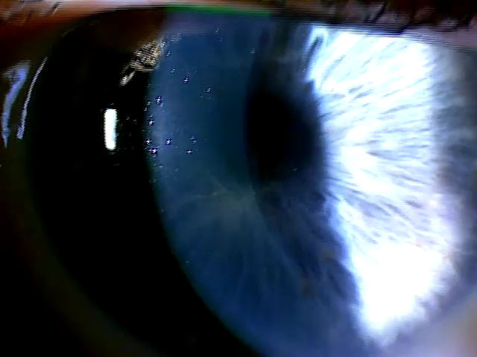
Corneal Verticillata
Also called Fleischer vortex, vortex keratopathy or whorl keratopathy
Corneal deposits at the level of the basal epithelium forming a faint golden-brown whorl pattern

Slide 28
Cause of Corneal Verticillata
Amiodarone
Chloroquine
Hydroxychloroquine
Indomethacin
Rho-kinase (ROCK) inhibitor - Netarsudil

Slide 29
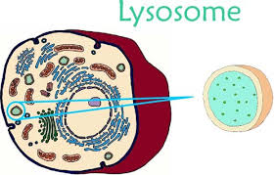
Fabry’s Disease
      Genetic lysosomal storage disease
        Deficiency of the enzyme alpha-galactosidase A
        Causes glycolipids to accumulate within blood vessels, tissue and organs

Slide 30
Fabry’s Disease
      Symptoms can initially appear in early childhood
      Pain to the extremeties and/or GI tract
      Kidney and cardiac involvement
      Angiokeratomas, anhidrosis
      Generalized fatigue and neuropathy
      Diagnosed through measuring enzyme activity
      Enzyme assay for alpha-GAL
      Is X linked so in females will often times require a genetic test
      Treated with Fabrazyme (alpha-galactosidase) delivered through intravenous infusion every 2 weeks

Slide 31
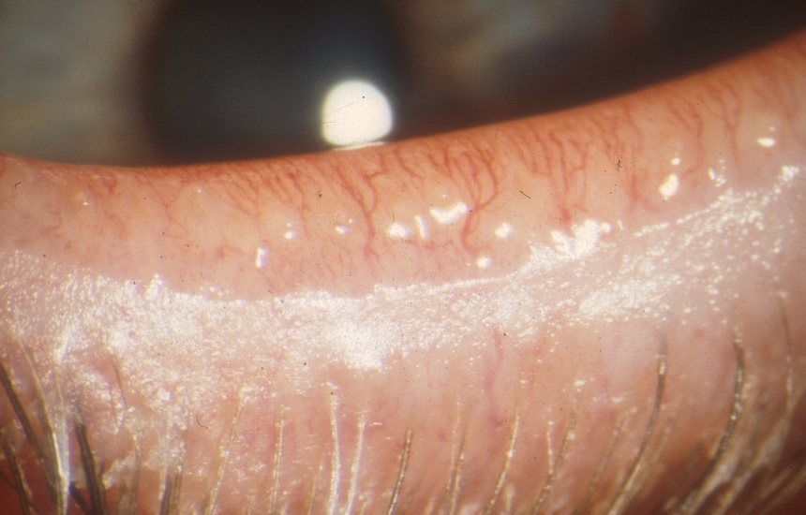
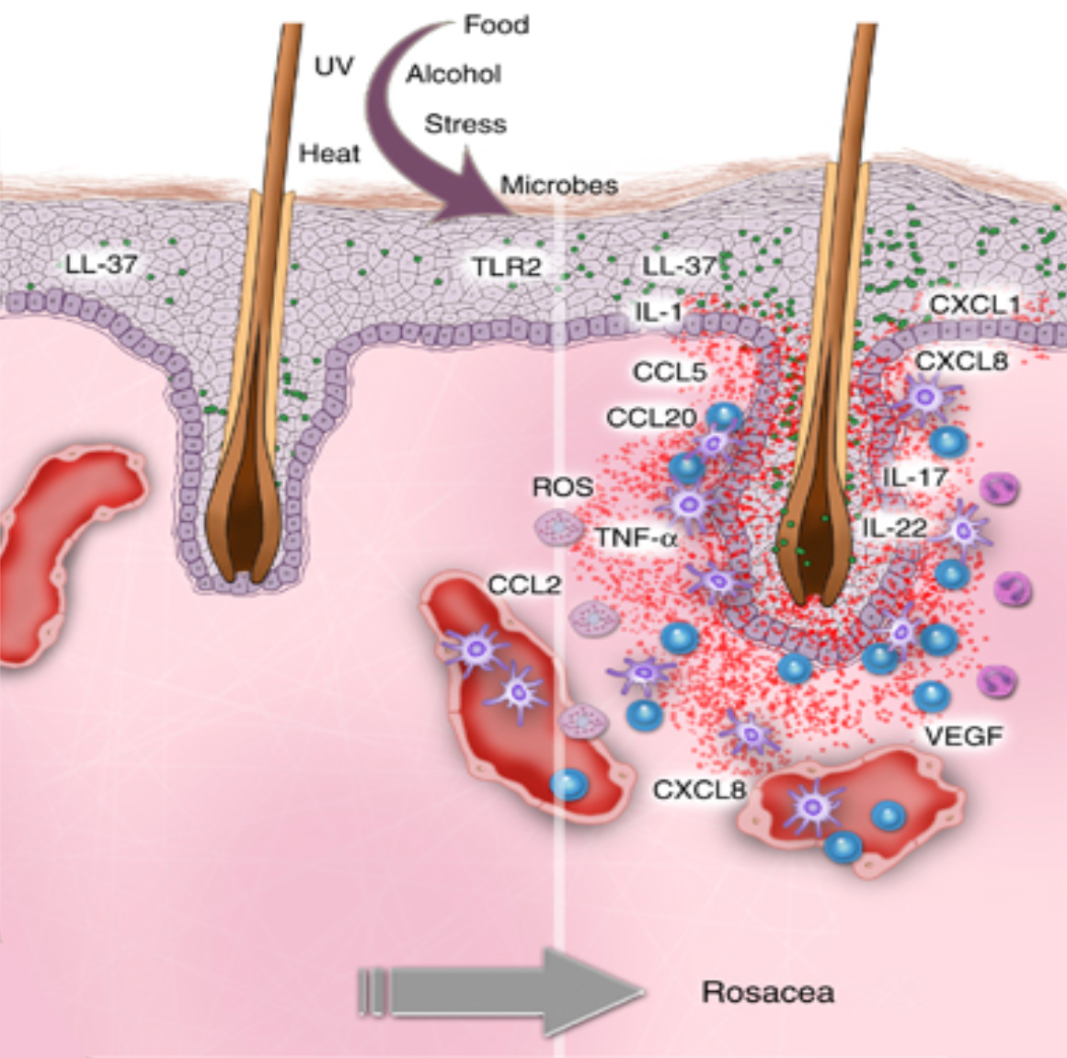
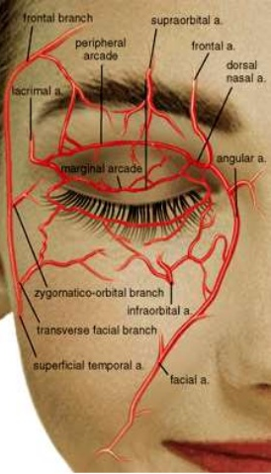

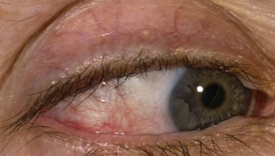
Dry eye due to MGD is an inflammatory disease
MGD is often a skin gland disease
Healthy
abnormal blood vessels release pro inflammatory agents
These inflammatory agents propagate to the eyelids via the orbital vasculature
Source: Gerber et al, J Invest Dem Sym Proc 2011
Notes:
Around 20 years ago patients with Rosacea started getting treated with intense pulse light for their telegectasia. Many of them reported that their eyes started to feel better. IPL started to be used more and more for Rosacea. When telegectatic vessels develop around the eye they release pro-inflammatory agents. The orbital vasculature is the driving force for this process. Just like other parts of the body, abnormal blood vessels are NOT our friends. In OSD, they drive the inflammatory process.

Slide 32
What Is Rosacea?
A chronic inflammatory skin disorder
Primarily affects the central face
Characterized by:
  Facial flushing
  Persistent erythema
  Telangiectasia
  Papules and pustules (in some subtypes)
  Most common in fair-skinned adults, but occurs across all skin types

Slide 33
What Is Rosacea?
Neurovascular Dysregulation
  Abnormal vasodilation and flushing
  Heightened response to heat, stress, alcohol, and spicy foods
Innate Immune Dysfunction
  Exaggerated inflammatory response to environmental triggers
Microbial Factors
  Increased density of Demodex mites
  Bacterial antigens (e.g., Bacillus oleronius) trigger inflammation
Inflammatory Cascade
  Elevated cytokines and matrix metalloproteinases
  Chronic tissue inflammation and damage

Slide 34
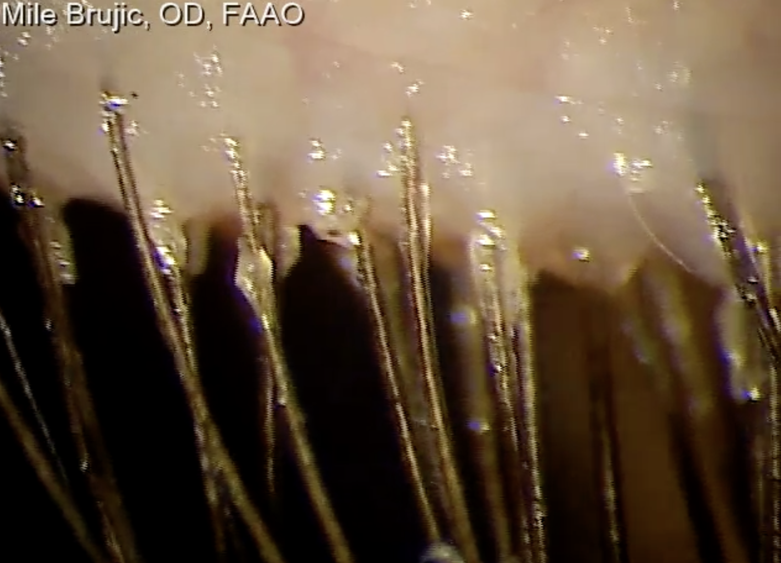
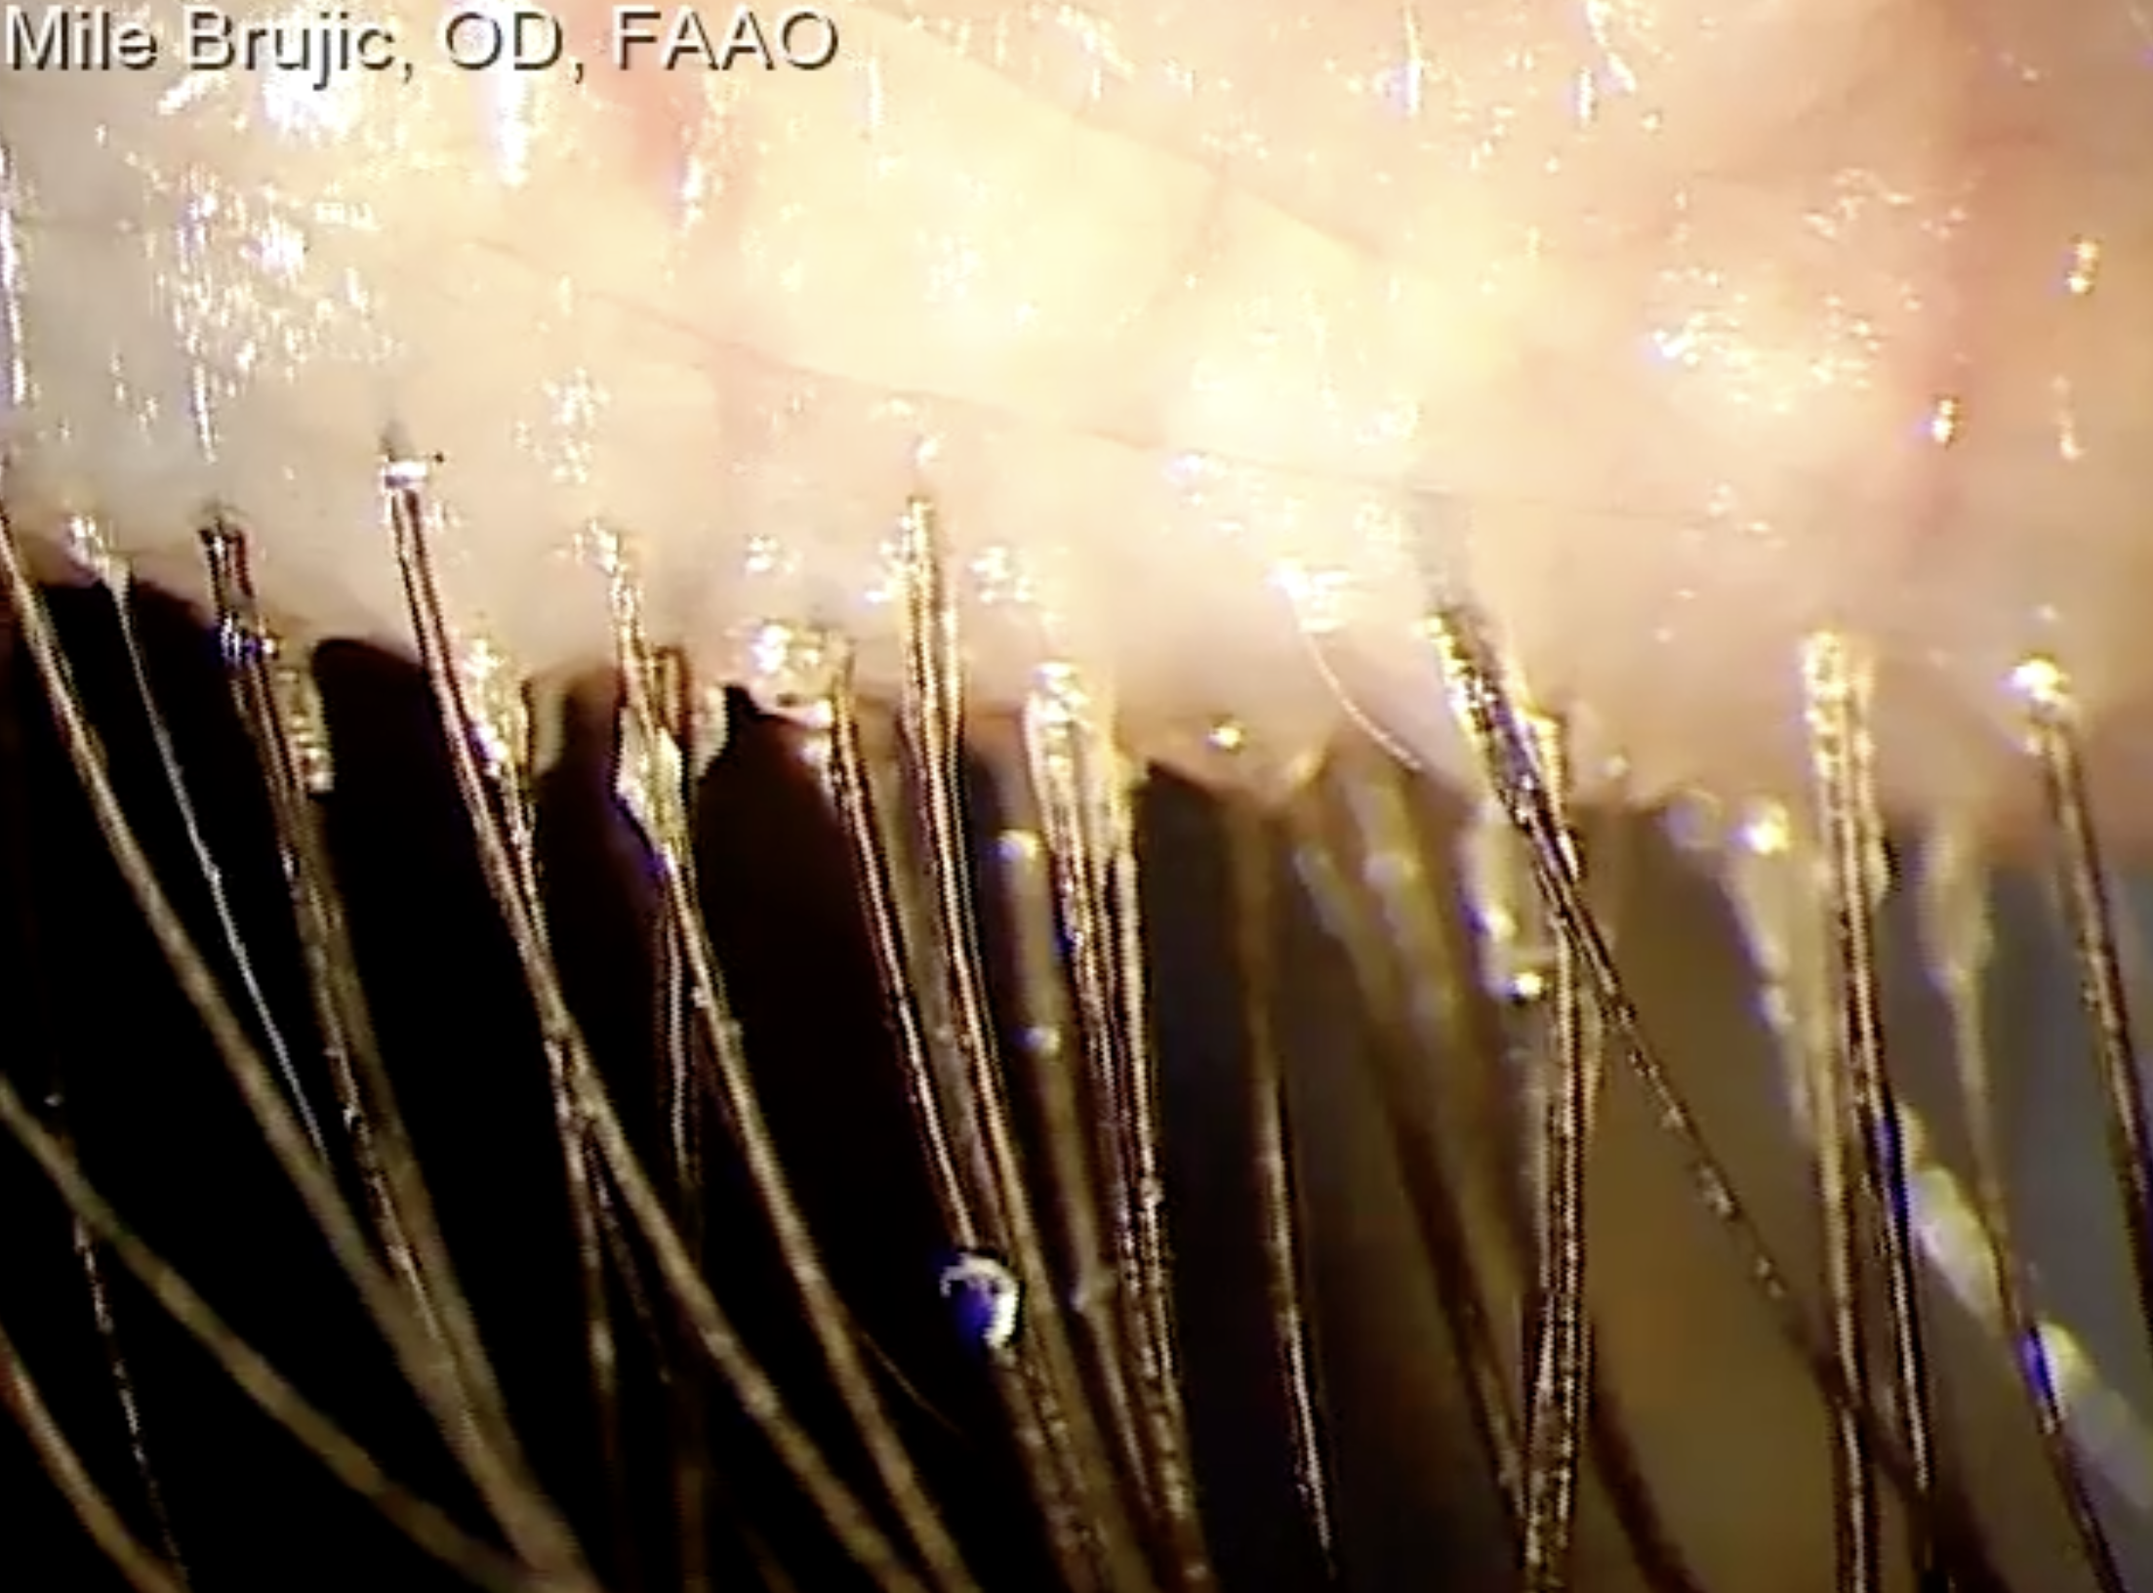
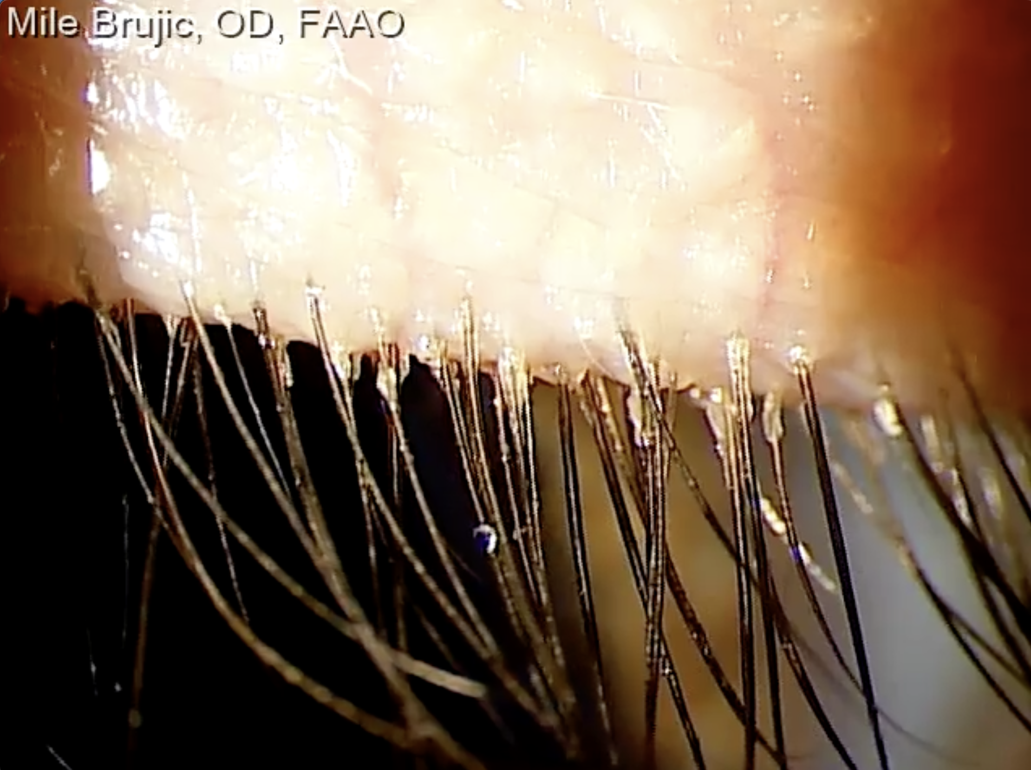
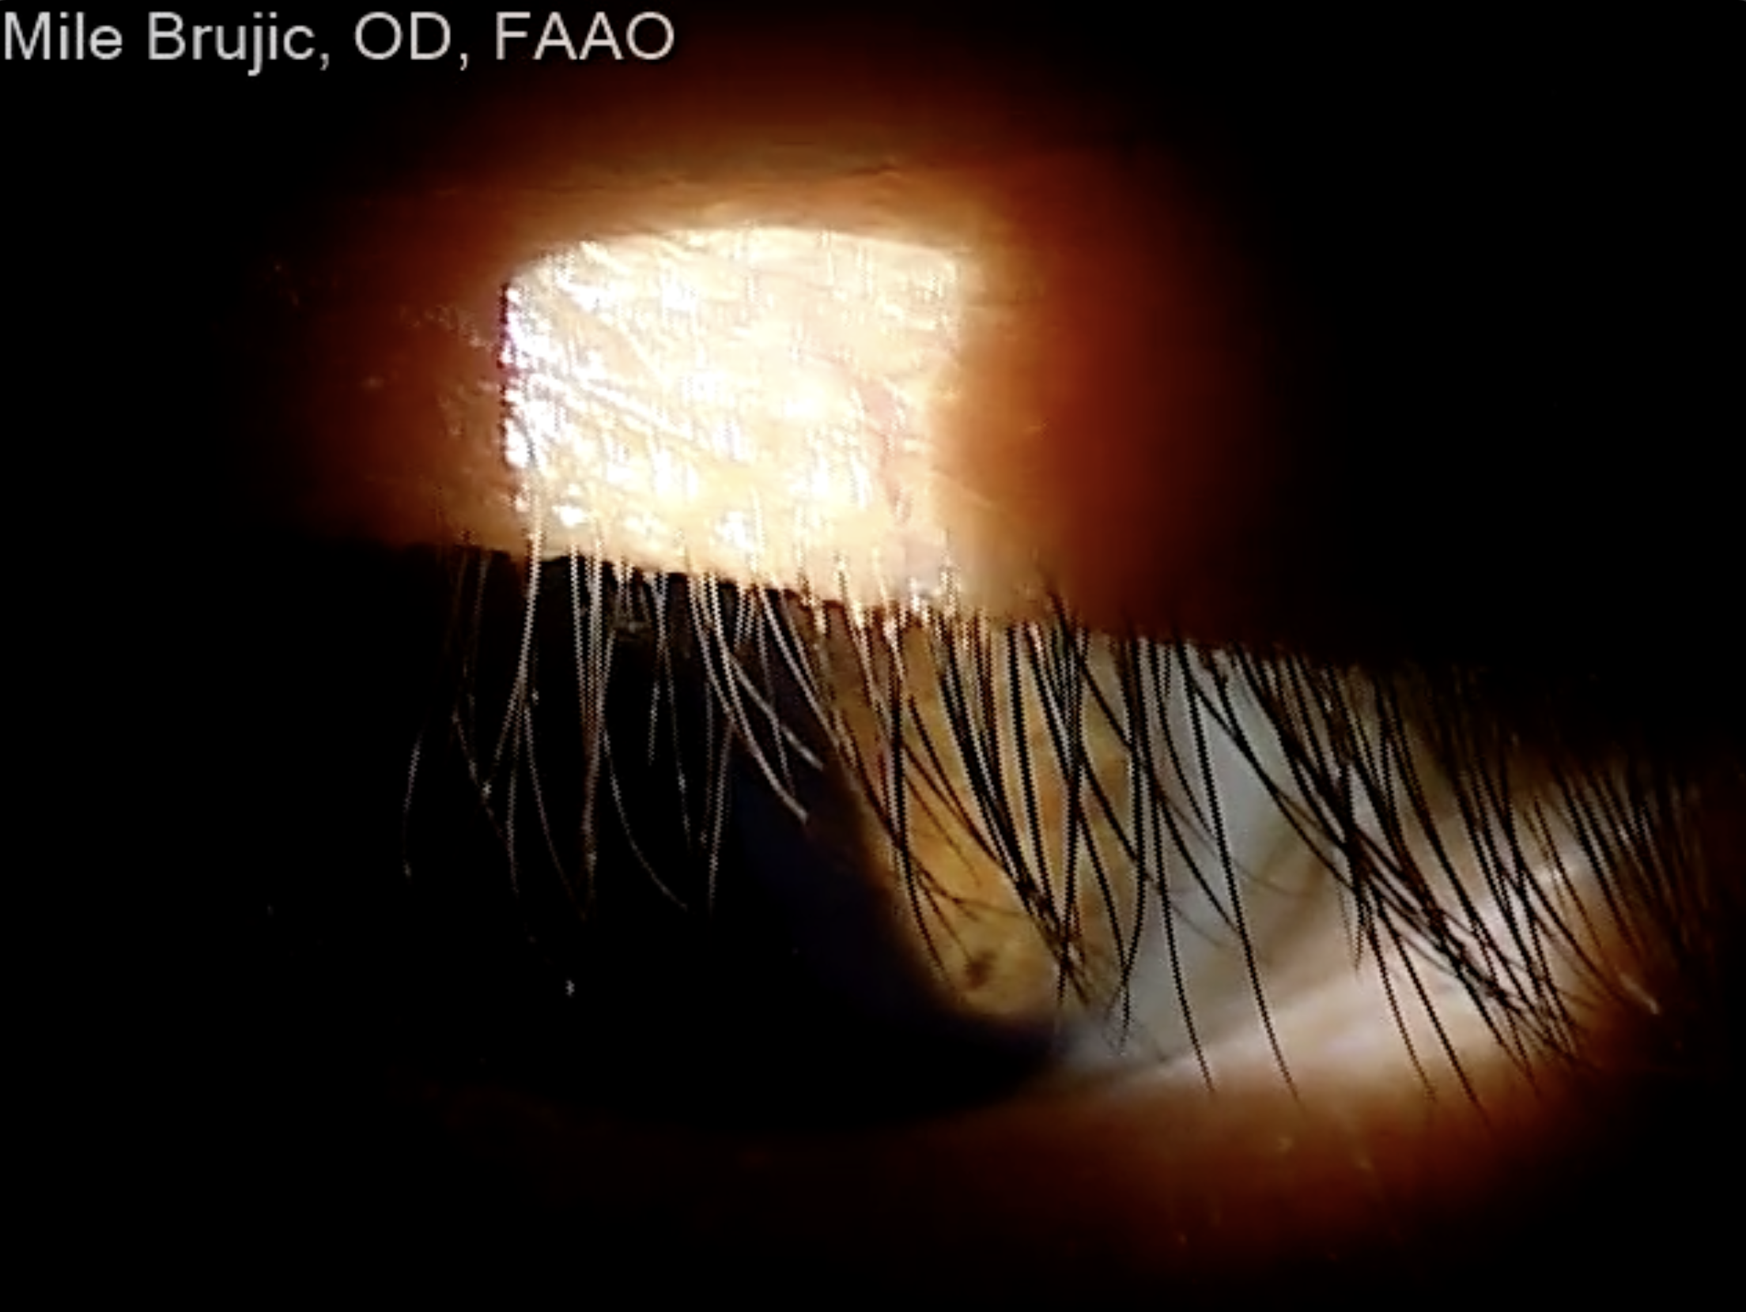

Slide 35
Options for Blepharitis
Lid scrubs
Tea tree oil
Warm compresses
Antibiotic/steroid combinations
Microblepharoexfoliation
Lotilaner ophthalmic solution 0.25%

Slide 36
Intense Pulsed Light
Warms Meibum
Emits Energy that absorbed by chromophores in hemoglobin and closes abnormal vessels in the eyelid margin and adjacent conjunctiva. Prevents release of inflammatory factors by the vessels
Reduces inflammatory factors in tears (interleukin 17A. Interleukin-6, prostaglandin E2) (up-regulates expression of anti-inflammatory agents while downregulating pro-inflammatory argents)
Activates fibroblasts and enhance collagen production
Reduce inflammatory or neurogenic pain
Reduction in bacterial load and demodex to reduce inflammation
Notes:
Warms Meibum
Emits Energy that absorbed by chromophores in hemoglobin and closes abnormal vessels in the eyelid margin and adjacent conjunctiva. Prevents release of inflammatory factors by the vessels
Reduces inflammatory factors in tears (interleukin 17A. Interleukin-6, prostaglandin E2) (up-regulates expression of anti-inflammatory agents while downregulating pro-inglammatory agrents)
Activates fibroblasts and enhance collagen production
Reduce inflammatory or neurogenic pain
Reduction in bacterial load and demodex to reduce inflammation
IPL has been used dermatology for over a decade for the treatment of rosacea, acne and skin lesions. relatively novel treatment for MGD in the states.
Improved TBUT time found for 87% of patients with 7 tx visits and 4 maintenance visits along with improvement in post tx symptoms.

Slide 37
Electromagnetic Radiation
The power of light
Ultraviolet range (<400nm)
  UVA 315-400nm
  UVB 280-315nm
  UVC <280nm
Visible spectrum (400-700nm)
Infrared spectrum (>700nm)
Caerwyn Ash, Michael Dubec, Kelvin Donne, Tim Bashford. Effect of wavelength and beam width on penetration in light-tissue interaction using computational methods. Lasers Med Sci. 2017 Nov;32(8):1909-1918.
Antero Salminen, Kai Kaarniranta, Anu Kauppinen. Photoaging: UV radiation-induced inflammation and immunosuppression accelerate the aging process in the skin. Inflamm Res. 2022 Jun 24;71(7-8):817–831.
Pinar Avci et al. Low-level laser (light) therapy (LLLT) in skin: stimulating, healing, restoring. Semin Cutan Med Surg. 2013 Mar;32(1):41–52.

Slide 38
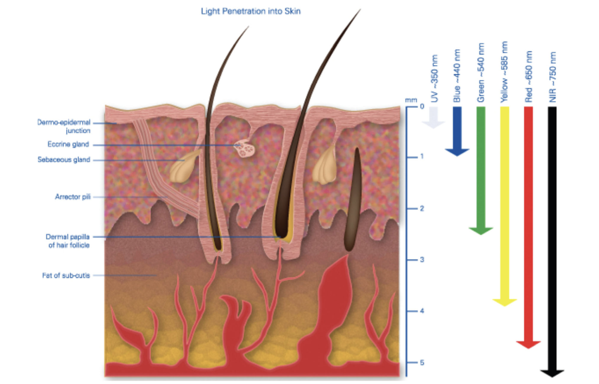
Light Penetration Into the Skin
Eyelid:
Skin – 1 mm
Obicularis – 2.2 mm
Tarsal plate – 1 mm
Palp conj 33-34um
Caerwyn Ash, Michael Dubec, Kelvin Donne, Tim Bashford. Effect of wavelength and beam width on penetration in light-tissue interaction using computational methods. Lasers Med Sci. 2017 Nov;32(8):1909-1918.

Slide 39
Low Level Light Therapy
Cytochrome C oxidase (CCO) is an enzyme located in the mitochondria of cells
Acts as a chromophore for red and near infrared light
Absorption of this light energy by CCO enhances enzymatic activity, mitochondrial respiration, and adenosine triphosphate (ATP) production
Can alter transcription properties within the cell
Pinar Avci et al. Low-level laser (light) therapy (LLLT) in skin: stimulating, healing, restoring. Semin Cutan Med Surg. 2013 Mar;32(1):41–52.

Slide 40
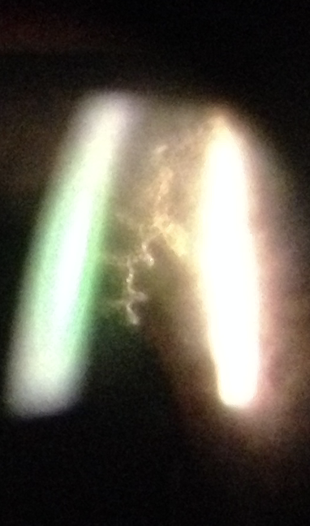
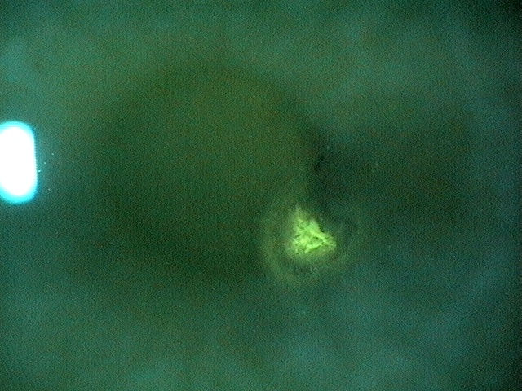
Herpetic Keratitis Disease
Herpetic keratitis infection is one of the leading cause of corneal transplants in the U.S.
Herpes Simplex Virus (HSV-type 1 and HSV-type 2) and Herpes Zoster cause herpetic keratitis.
A 2002 report estimated that 400,000 Americans had experienced ocular HSV infection
  Estimated 20,000 primary infections per year in the U.S.
  Estimated 28,000 relapses in the U.S. per year

Slide 41
Pathophysiology
Neural Spread to the Trigeminal System
After primary infection, HSV-1:
  Enters sensory nerve endings
  Travels retrograde along sensory axons
Virus localizes and becomes latent in the:
  Trigeminal ganglion
The trigeminal ganglion houses sensory neurons for:
  Ophthalmic (V1)
  Maxillary (V2)
  Mandibular (V3) divisions

Slide 42
Treatment of Herpes Epithelial Keratitis
Ganciclovir 0.15% ophthalmic gel
  1 drop in the affected eye 5 times/day until the ulcer heals, then 3 times/day for 7 days.
Trifluridine 1% solution
  1 drop up to 9 times/day during acute treatment; do not exceed 21 days due to epithelial toxicity risk.
Acyclovir
  400 mg PO 5 times/day for 7–10 days
Valacyclovir
  500 mg PO TID for 7–10 days
Famciclovir
  250 mg PO BID for 7–10 days

Slide 43
HSV Prophylaxis
Acyclovir 400mg bid
Valacyclovir 500mg qd
History of severe stromal keratitis
Those who experience more than one episode epithelial keratitis per year
Those receiving corneal transplant for vision loss related to herpetic scarring
1 week prior to cataract or glaucoma surgery and 1 to 6 months postoperatively

Slide 44
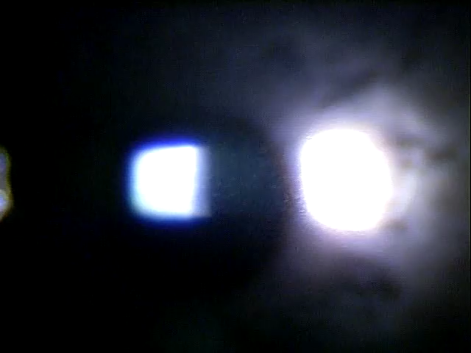
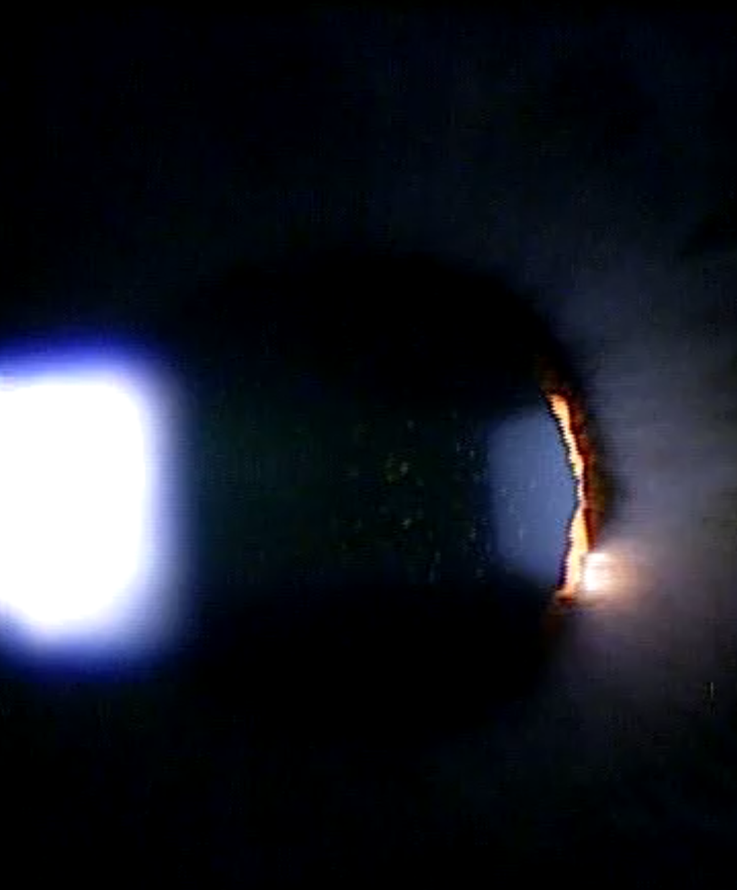
Anterior Uveitis
8 per 100,000
90% are acute anterior uveitis
Majority of primary cases are idiopathic

Slide 45
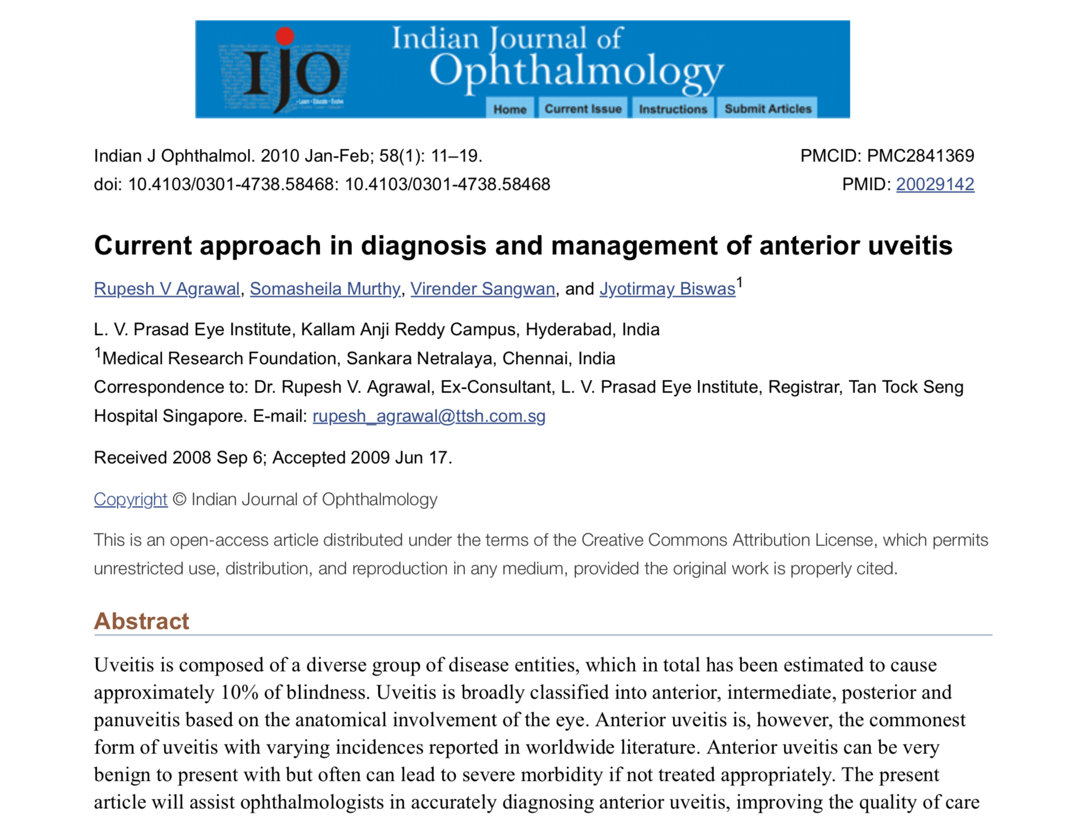

Slide 46
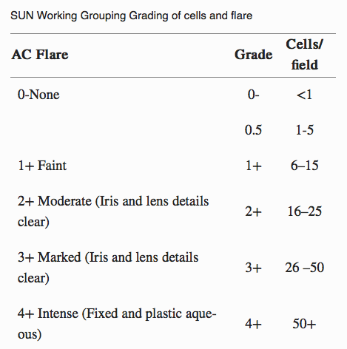
Standardization of Uveitis Nomenclature

Slide 47
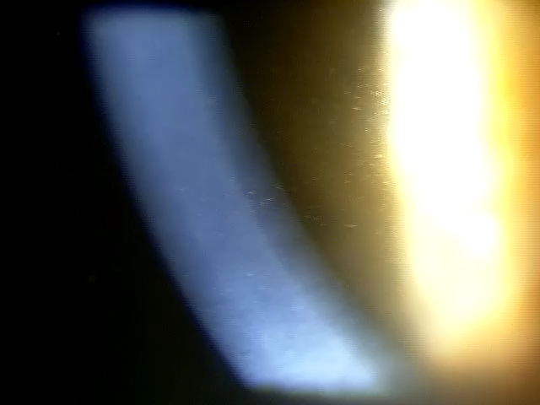
Anterior Uveitis
Keratic Precipitates
  Granulomatous vs. non-granulomatous
Constricted Pupil
Iris Nodules
  Koeppe’s nodules
    Pupillary margin
  Busaca’s nodules
    Anterior iris stroma

Slide 48
Posterior Synechiae
Attachment of the iris to the lens
Usually secondary to excessive inflammatory components in the anterior chamber
Can create an angle closure through pressure that builds up behind the iris causing it to bow anteriorly causing a physical obstruction to the angle
Visible white inflammatory debris seen on the lens at the edge of the iris

Slide 49
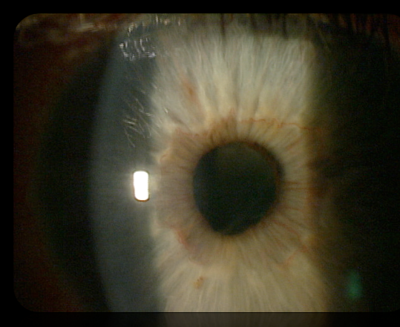
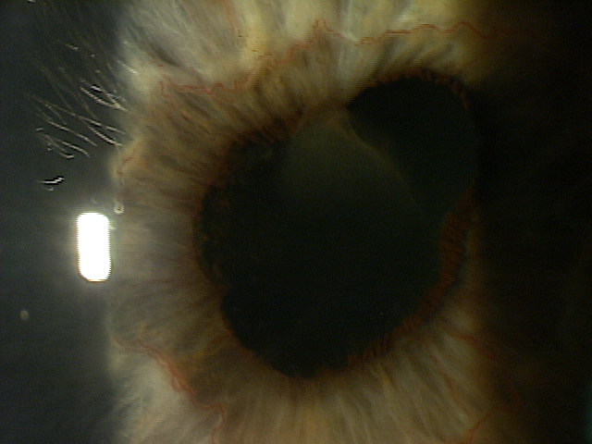
Slit Lamp Evaluation
posterior synechiae

Slide 50
Systemic Conditions
Idiopathic
Isolated inflammation of anterior segment
Non-granulomatous
Most common reason reason is no known reason
>50% of cases
Ankylosing Spondylitis
HLA-B27 related
More common in males
Younger age of onset
Sacroilitis with morning stiffness that improves with exercise

Slide 51
Systemic Conditions
Reiter’s Syndrome
Young males (15-35 years old)
Classic triad includes arthritis, urethritis and conjunctivitis
Acute non-granulomatous recurrent uveitis is hallmark
Can have mucopurulent conjunctivitis
Inflammatory Bowel Disease
Crohn’s disease
Ulcerative colitis

Slide 52
Systemic Conditions
Psoriatic Arthritis
Recurrent acute iridocyclitis
Psoriatic skin
Erosive arthritis in small joints
Traumatic Iridocyclitis
Due to blunt trauma or post-surgical
Due to the breakdown of the blood-aqueous barrier
Self limiting in nature

Slide 53
Juvenile Idiopathic Arthritis
Polyarticular onset (5 or more joints involved)
  7 to 14% of patients develop acute anterior uveitis
Pauciarticular onset (less then 5 joints involved)
  Commonly associated with anterior uveitis
  Type I –ANA positive in young girls
  Type II – in older boys; 75% are HLA-B27 positive
  More common in girls
  Very little circumlimbal congestion

Slide 54
Infectious Uveitis
Herpetic Keratouveitis
  Onset of blurred vision with pain and redness
  Corneal edema with fine KP’s
  Reduced corneal sensation
  AC reaction
  IOP is usually raised
  Treatment includes oral and topical anti-viral agents along with other treatments for uveitis

Slide 55
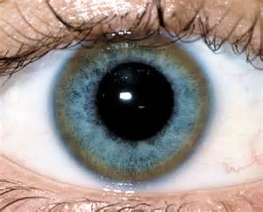
Kayser-Fleischer Ring
    Brown/yellow ring around the periphery of the cornea
    Copper deposits in Descemet’s membrane
    Usually seen bilaterally when associated with systemic disease
    Fades as you move toward the central cornea

Slide 56
Wilson’s Disease
Genetic disorder
Copper builds up in the body
Copper is a co-enzyme
Kayser-Fleischer ring seen 66% of the time
Liver affected
Neurological issues
Treated with low copper diet and chelating agents

Slide 57
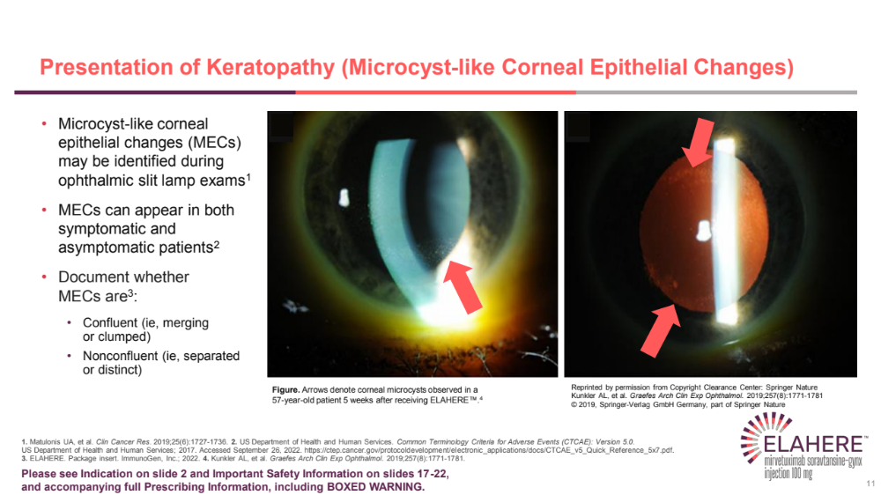


Slide 58
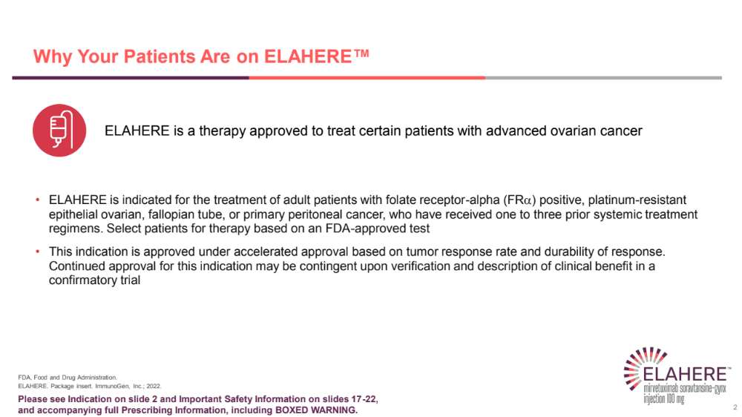

Slide 59
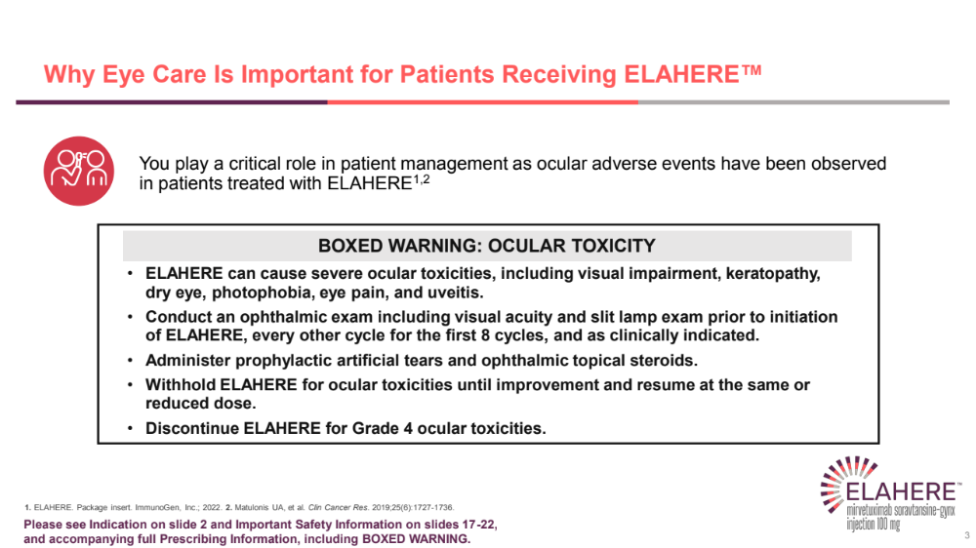

Slide 60
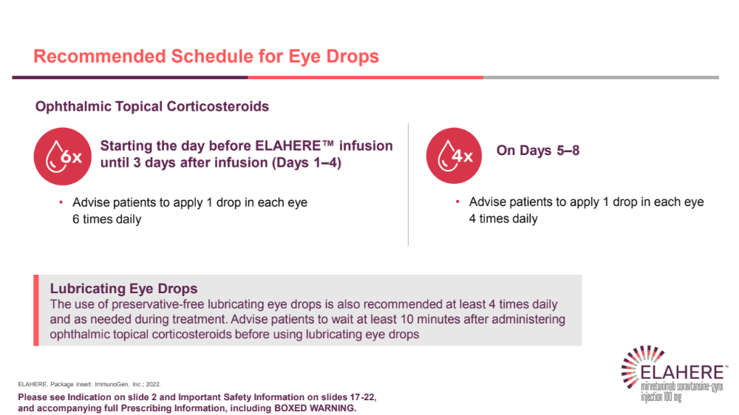

Slide 61
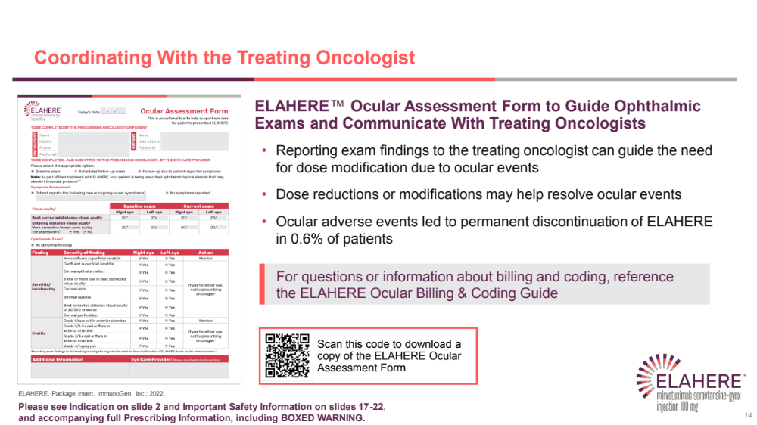

Slide 62
Thank You!
mile.brujic75@gmail.com

