Slide 1

When Formulas Matter: Pharmacology's Role in Dry Eye Success
Mile Brujic, OD, FAAO
Premier Vision Group

Slide 2
Disclosure
I have received honoraria in the past 2 years for speaking, writing, participating in an advisory capacity, research or meeting support from: Apellis (consultant, speakers bureau), ABB Optical (received meeting support), Abbvie (consultant), Alcon (consultant, speakers bureau), Art Optical (received meeting support), Azura (consultant), Bruder Healthcare (consultant), Bausch + Lomb Health (consultant, speakers bureau), Contamac (received meeting support), CooperVision (received meeting support), CSEye (consultant), Dompe (consultant), Dopavision (consultant), Eyepromise (consultant), Glaukos (consultant), Johnson & Johnson Vision Care (received meeting support), Lentechs (received research support), MDElite (consultant), Nordic Pharma (consultant), Orasis (consultant, speakers bureau), Radius XR (consultant), SCOPE (consultant), Sun Pharma (speakers bureau), Tangible Science (received meeting support), Tarsus (consultant, speakers bureau), Théa Pharma (consultant), Viatris (consultant, speakers bureau), Visionix (consultant), Walman Optical (received meeting support).
These relationships have been mitigated and will not influence the content of this presentation

Slide 3
Demodex-Targeted Pharmacologic Therapy
Core pharmacologic mechanism
  Inhibits GABA-gated chloride channels in ectoparasites
  Selectively targets Demodex mites without antimicrobial activity
  Reduction of Demodex-related lid margin inflammation
  May show improvement in meibomian gland function and lid margin health
  May show indirect improvement in evaporative dry eye parameters
First FDA-approved pharmacologic treatment for Demodex blepharitis
Defined treatment course rather than chronic therapy

Slide 4
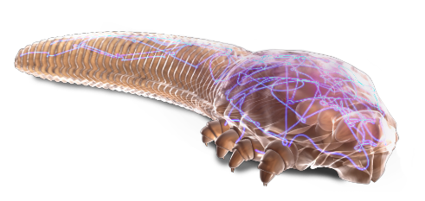
Lotilaner 0.25%
-Kills demodex mite
-Paralyze the mite nervous system through parasite-specific GABA inhibition
-Clinical trials showed improvement in collarettes, lid margin hyperemia, mite count, MGYLS, improvement in fluctuating vision

Slide 5
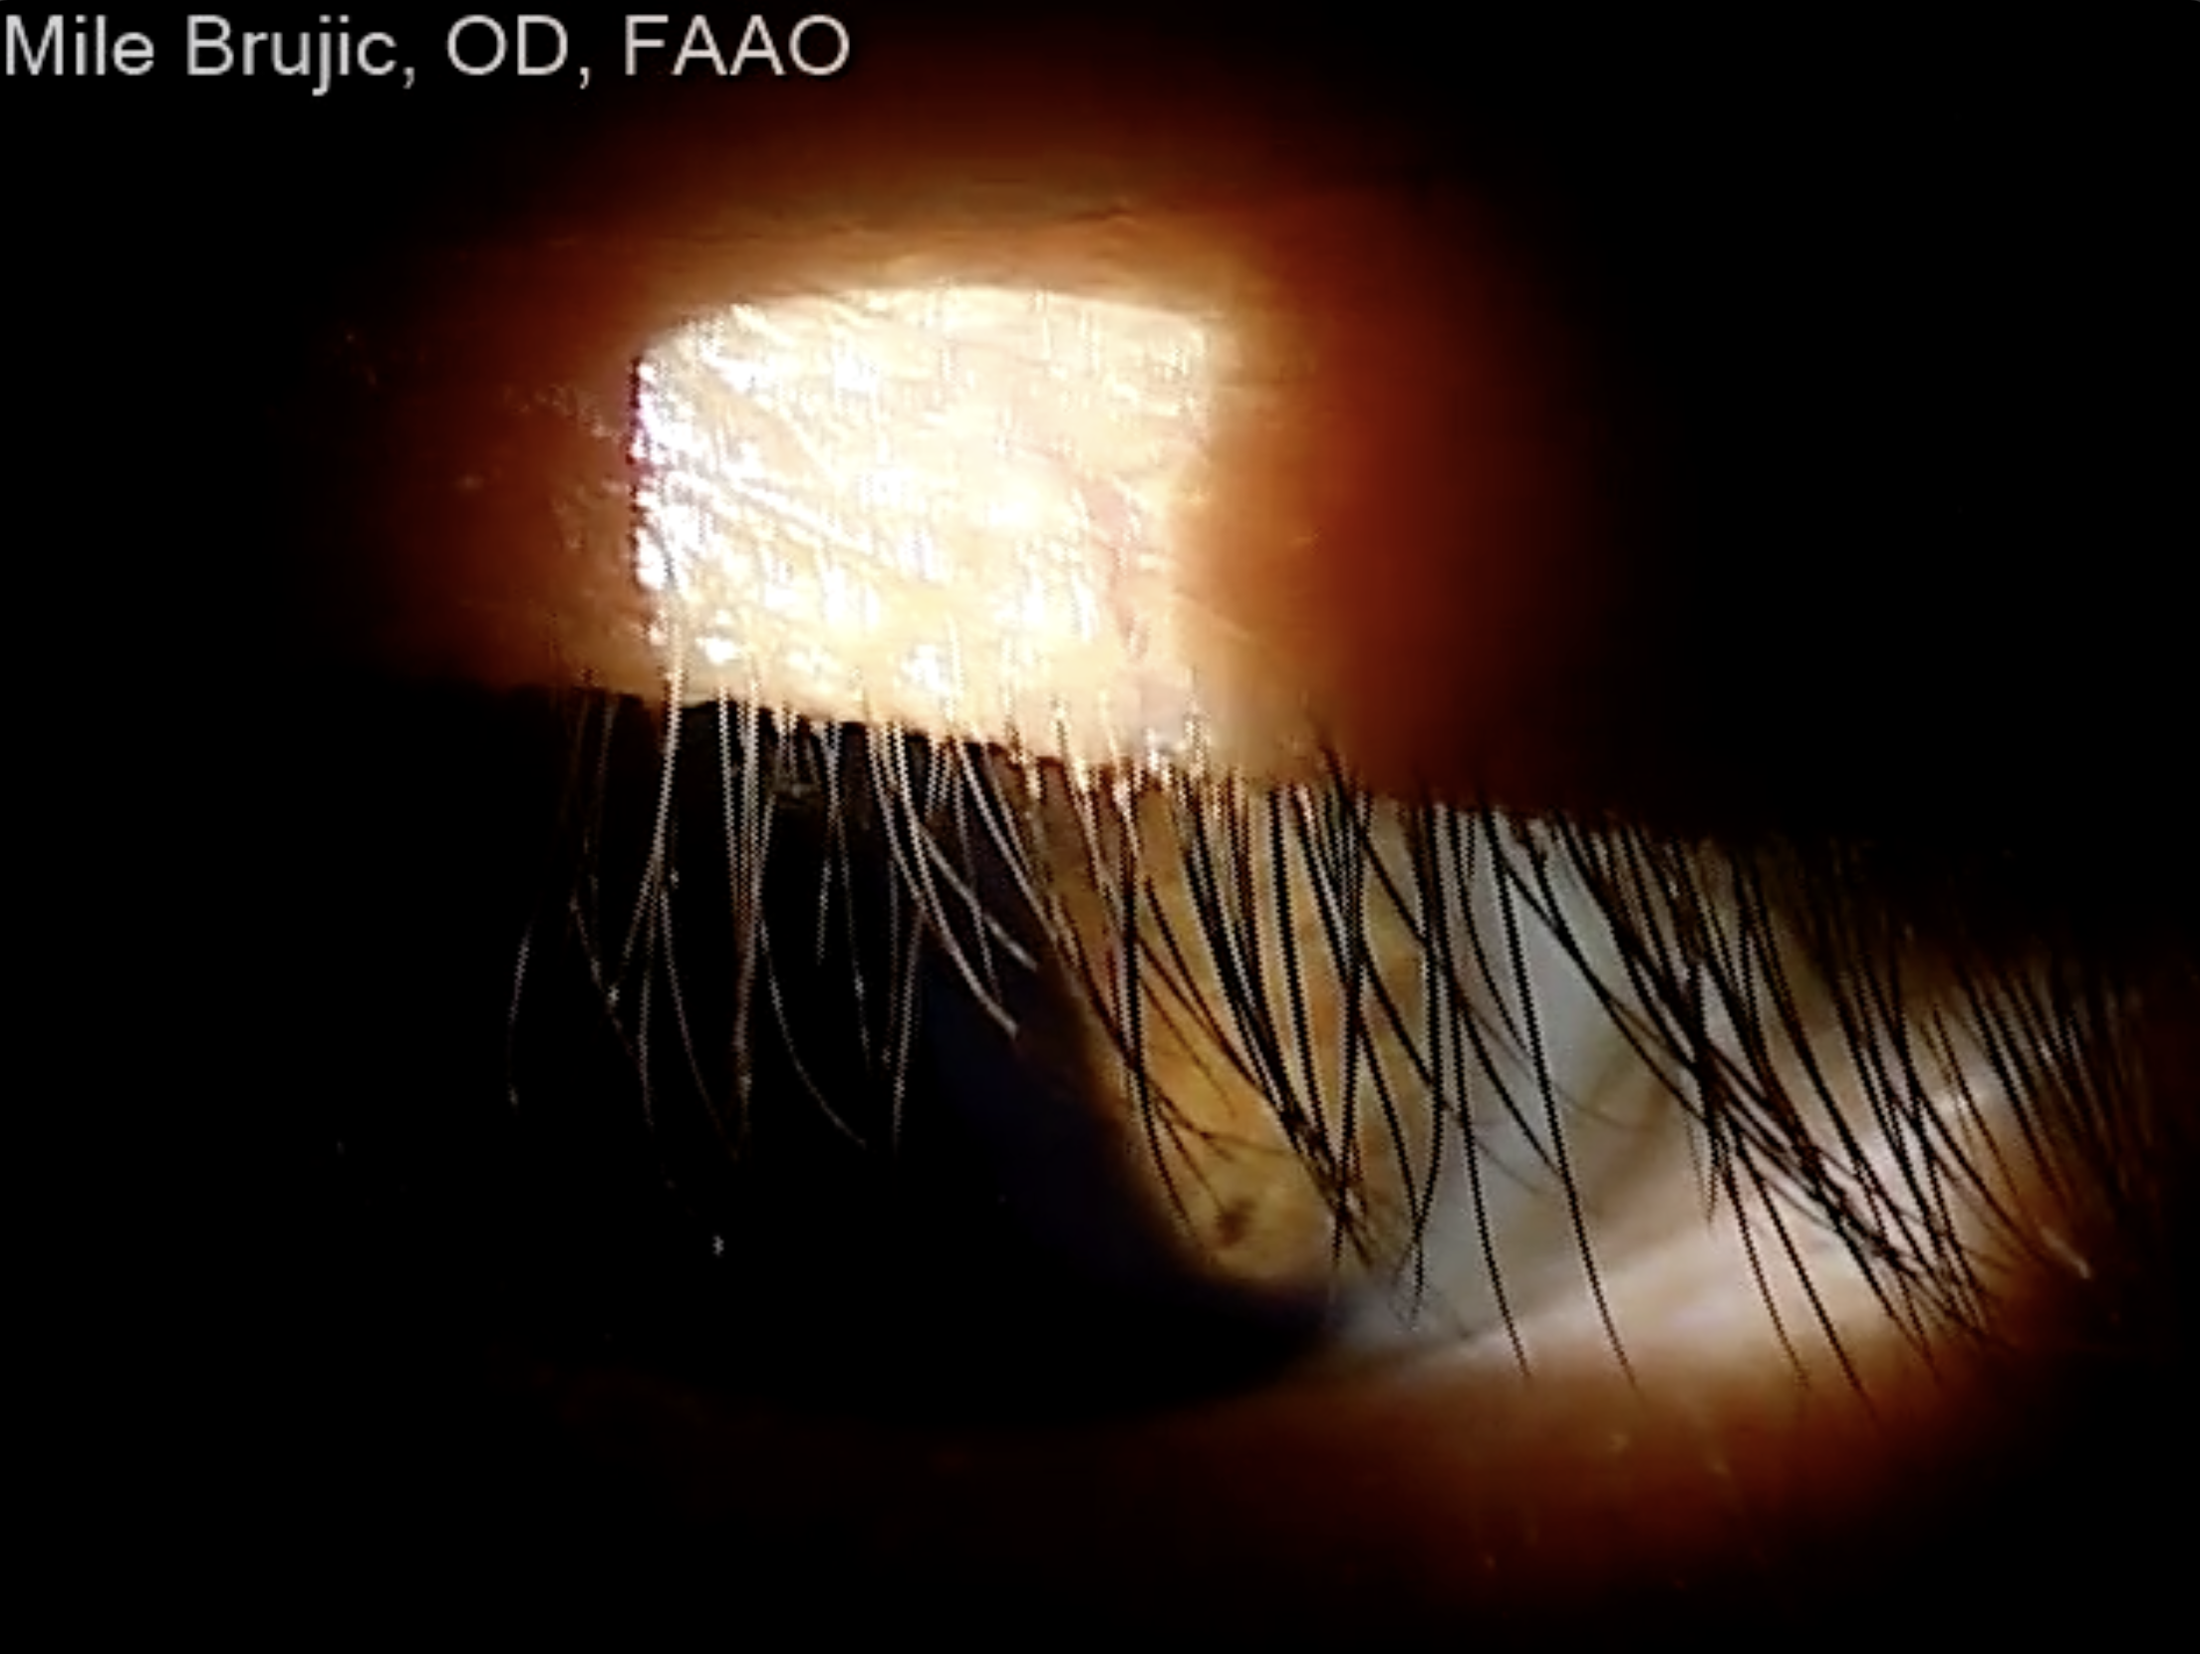
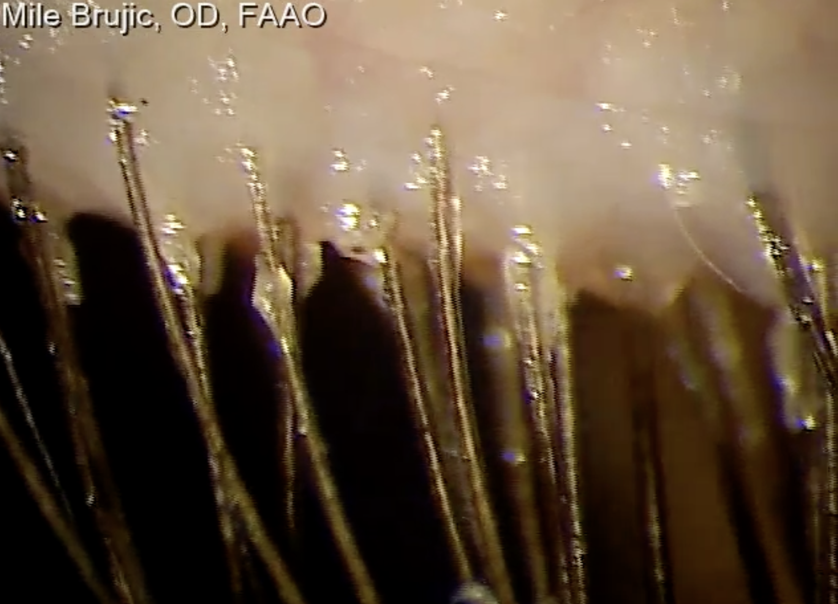
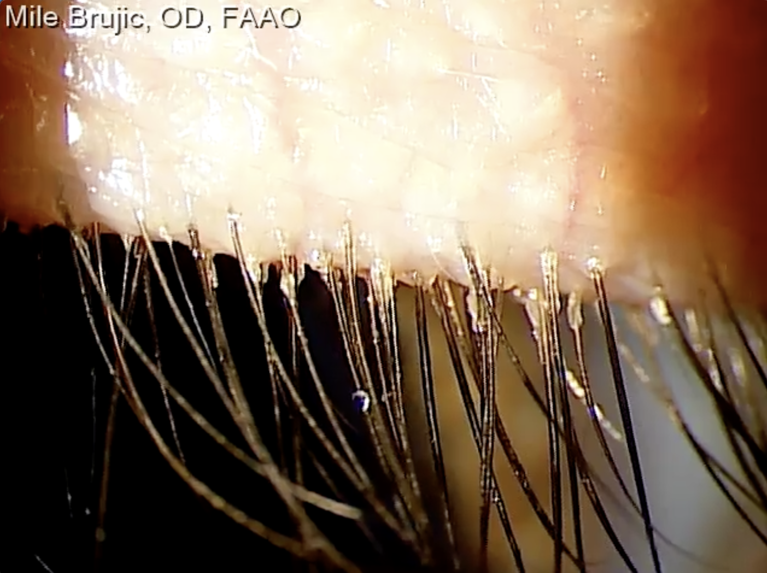
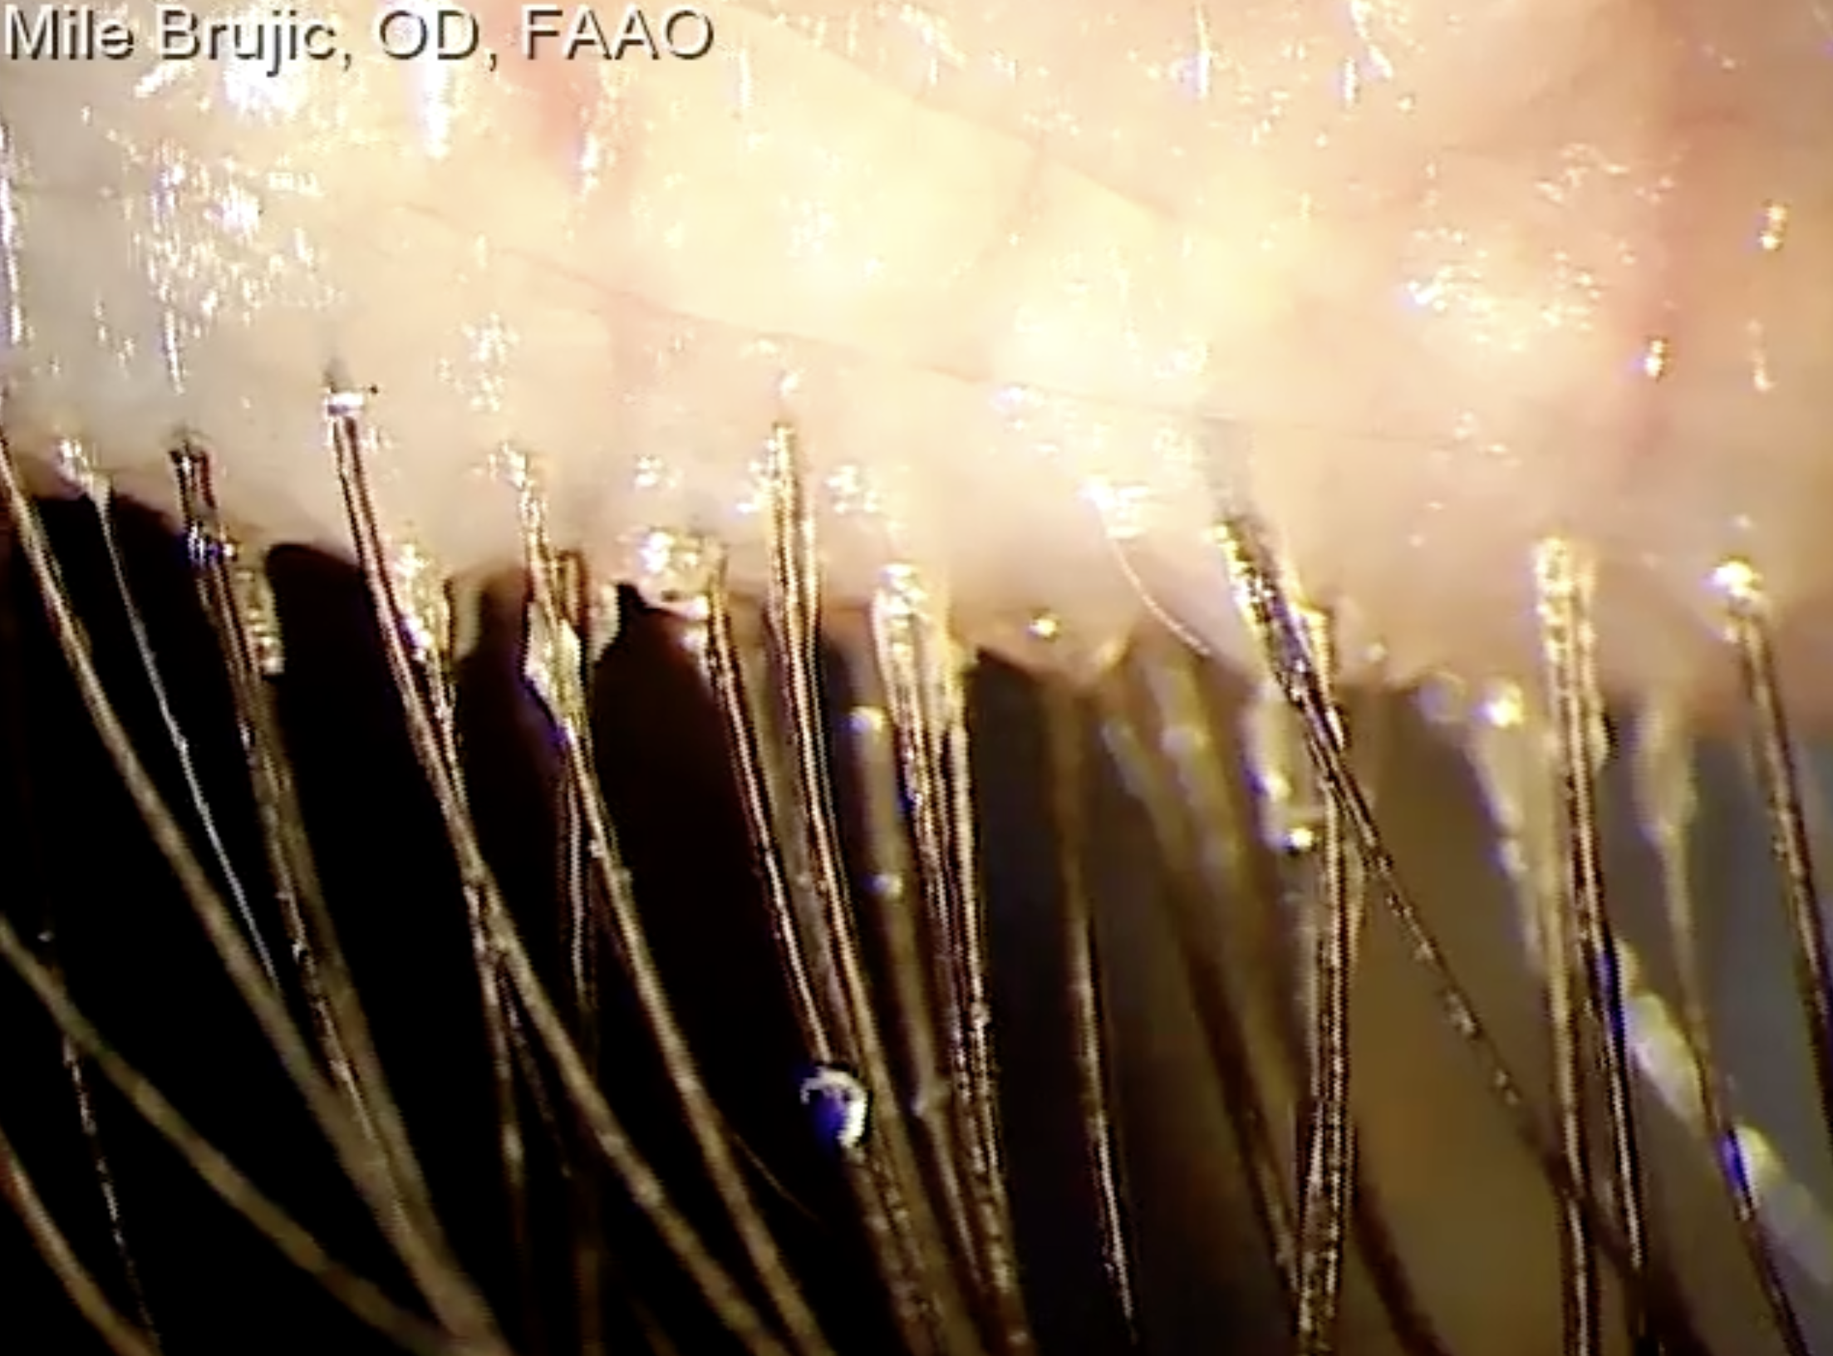

Slide 6
Evaporation-Barrier and Tear Film Stabilization Agents
Perfluorohexyloctane 100%
Core physicochemical mechanism
  Semifluorinated alkane with low surface tension
  Spreads rapidly across the tear film surface
  Forms a stable evaporation-resistant layer reducing tear evaporation
  Particularly useful in meibomian gland dysfunction–associated disease
Water-free formulation
No preservatives or aqueous vehicle

Slide 7
Perfluorohexyloctane 100%
Mechanism of action: Sole ingredient is perfluorohexyloctane, which covers the tear film to limit aqueous evaporation and penetrates meibomian glands, reportedly dissolving altered meibum
Safety/efficacy:
  Results of the phase 3 double-masked GOBI study presented at the 2022 ASCRS annual meeting showed that adults with MGD-related DED in the treatment group vs placebo group had significantly improved total corneal fluorescein staining (2.0 vs -1.0) and visual analog scale dryness score (-27.4 vs -19.7), P<.001 for both) on Day 57.
    Blurred vision was the only adverse event more likely in treated subjects (3.0% vs 0.3%).
  Topline data of the phase 3 MOJAVE trial announced in 2021 also included significant change on these efficacy outcomes versus control on day 57 (P<.001 for both)
Tauber J et al. Cornea. 2021;40(9):1132-1140. https://ascrs.confex.com/ascrs/22am/meetingapp.cgi/Paper/81754. https://ir.bauschhealth.com/news-releases/2021/09-30-2021-115908876

Slide 8
AZR-MD-001
Mechanism of action: Contains selenium sulfide, a keratolytic agent also found in some anti-dandruff shampoos.
Safety/efficacy:
  An interim data analysis from a double-masked, vehicle-controlled trial presented at ARVO 2021 found a significantly greater change in OSDI score of at least 4.5 units in the group receiving 1.0% AZR concentration (85.7%) vs vehicle group (22.2%, P=.03)
    Change from baseline in Meibomian Gland Score was also significantly higher with 1.0% AZR vs control (P=.03)
Gupta PK et al. Clin Ophthalmol. 2021;15:4399-4404. https://iovs.arvojournals.org/article.aspx?articleid=2774724. https://clinicaltrials.gov/ct2/show/NCT03652051?term=azr-md-001&draw=2&rank=4

Slide 9
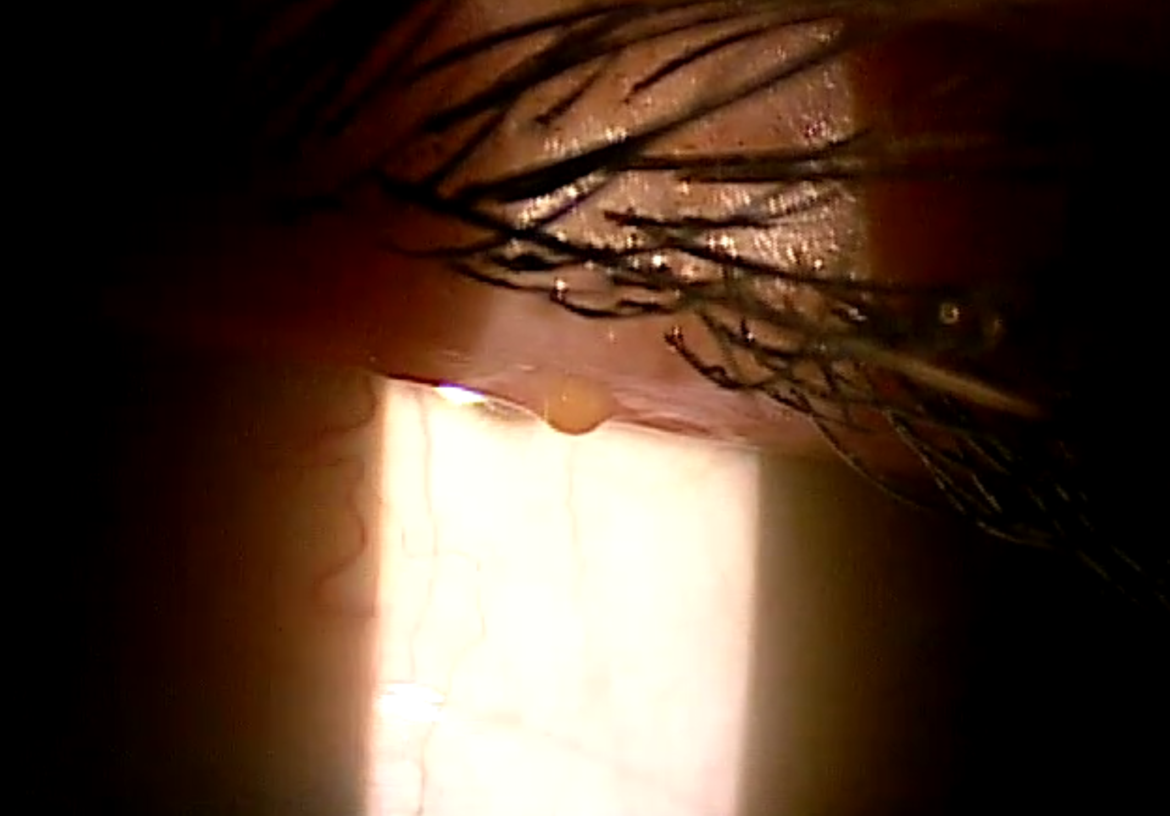

Slide 10
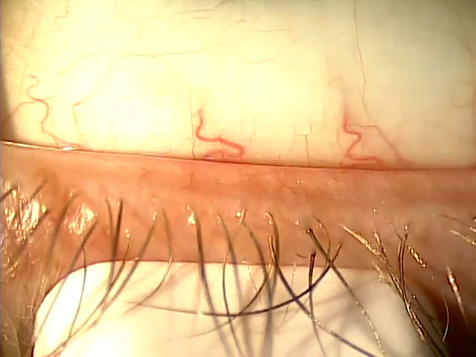
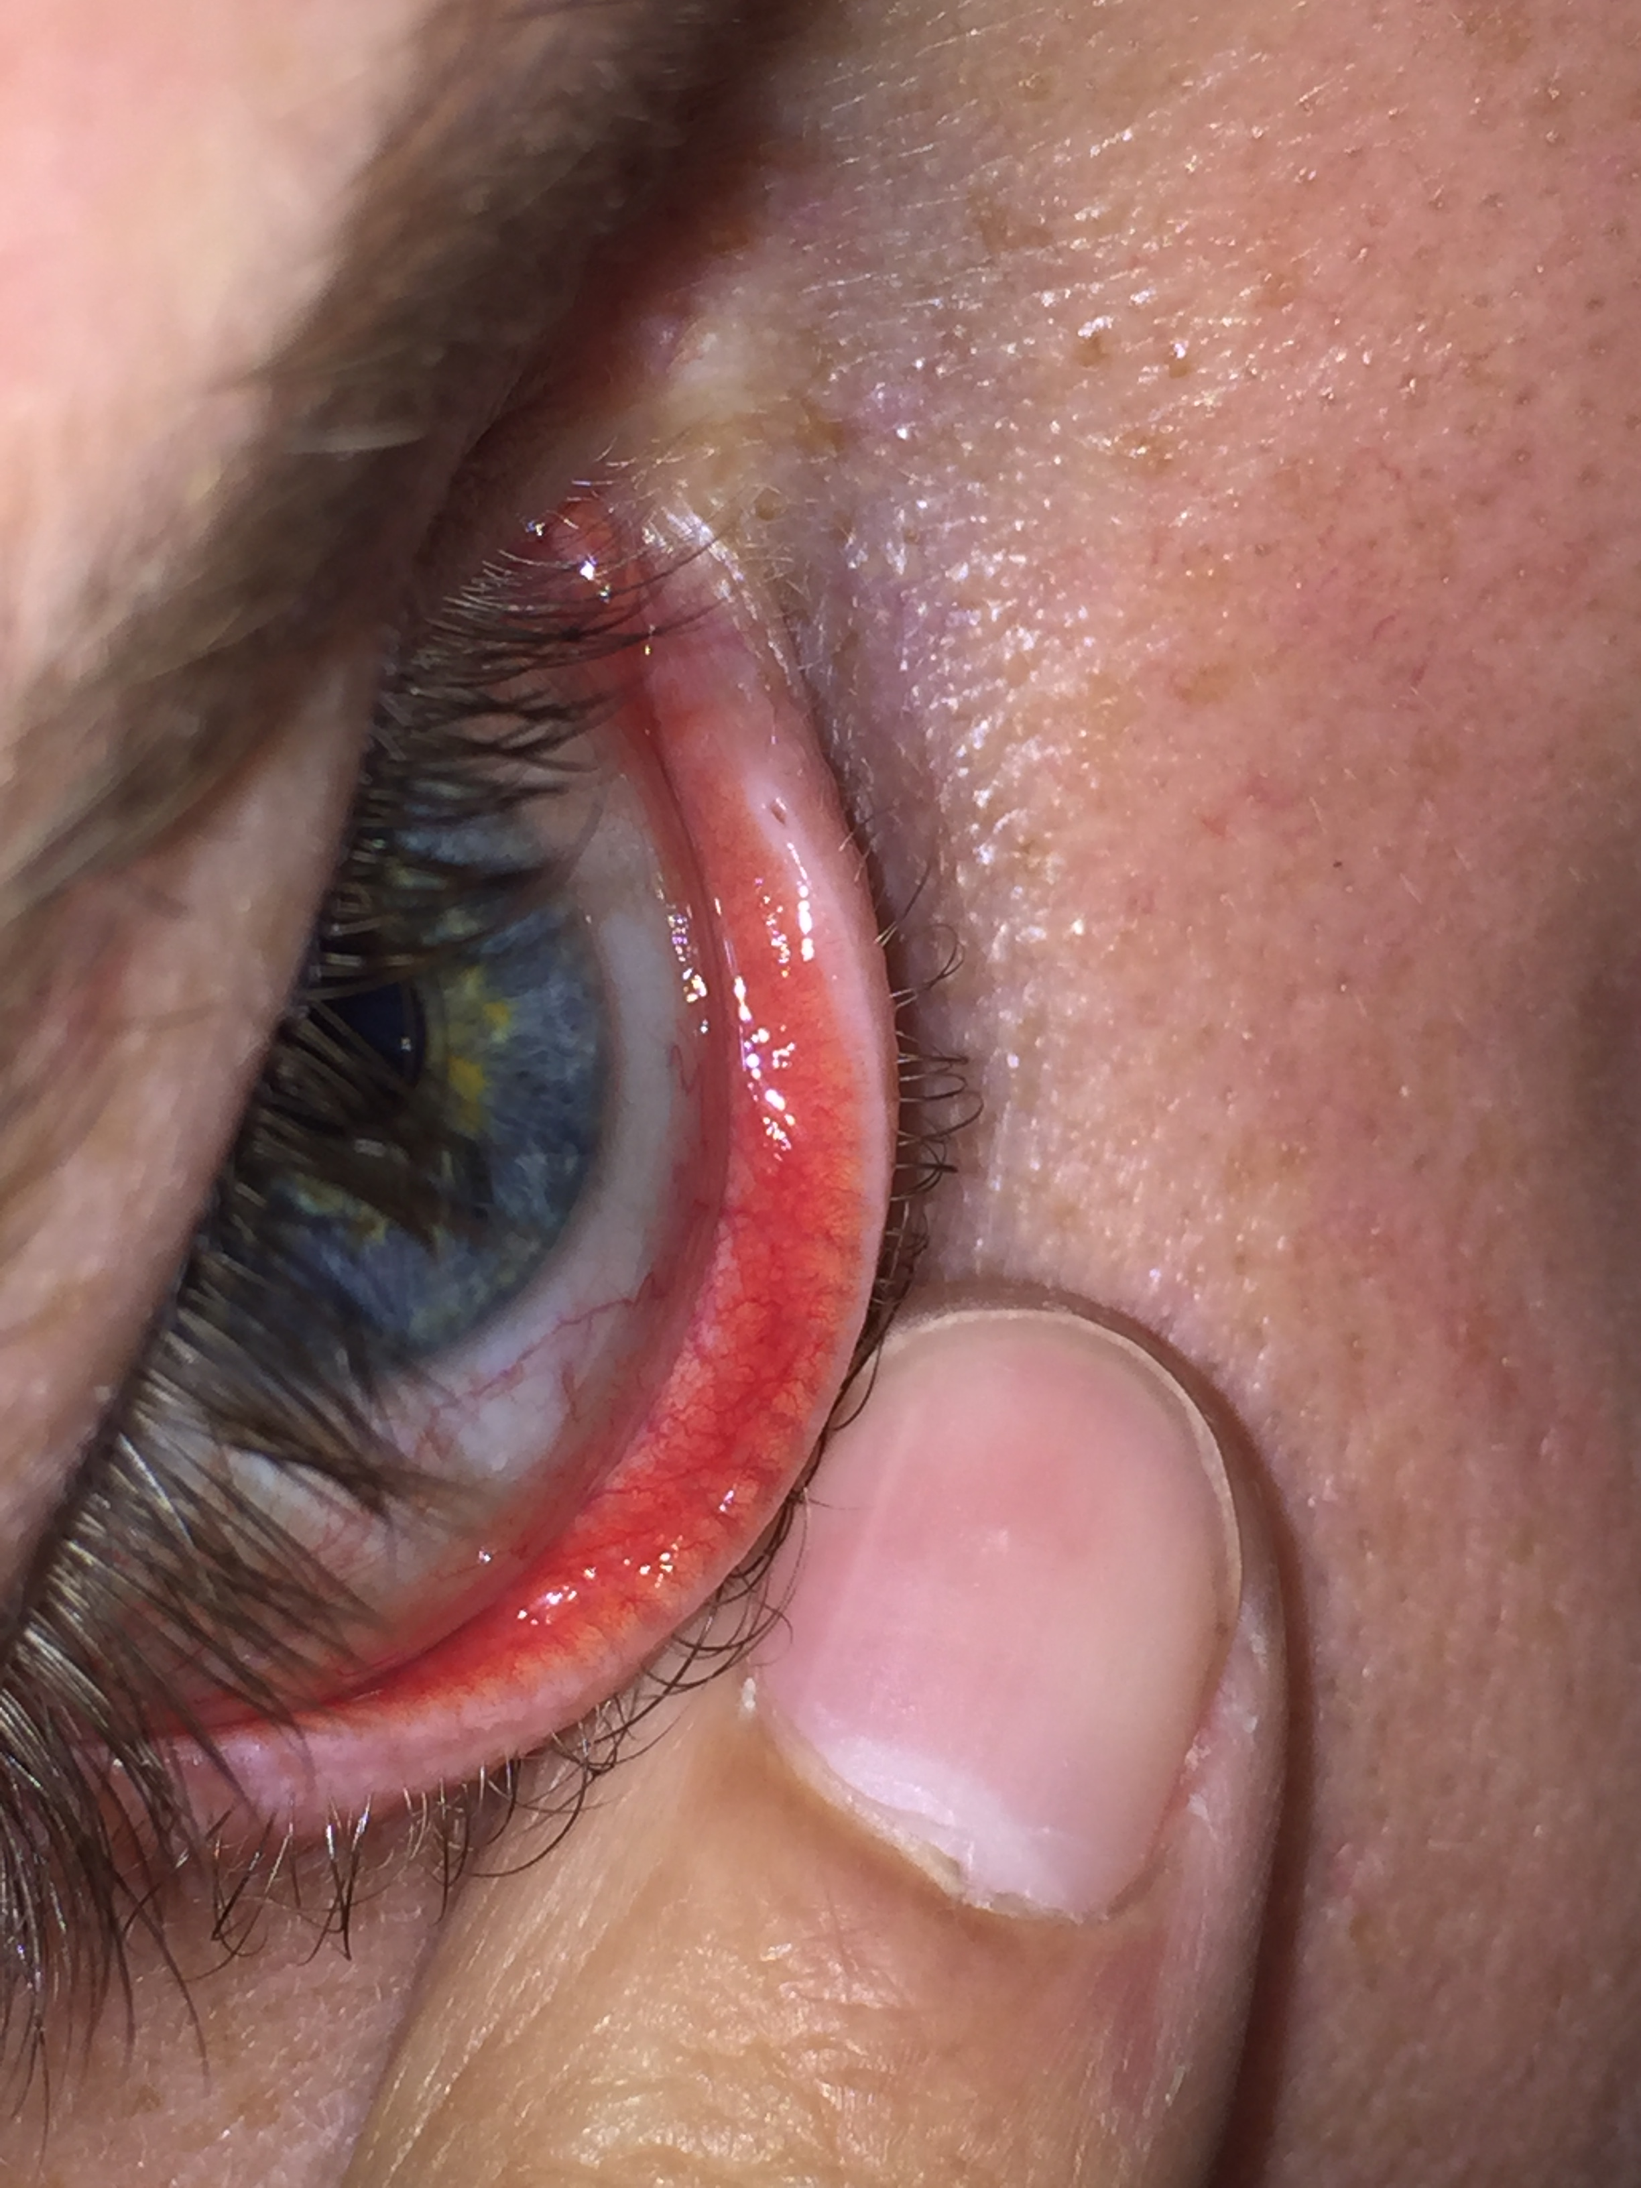
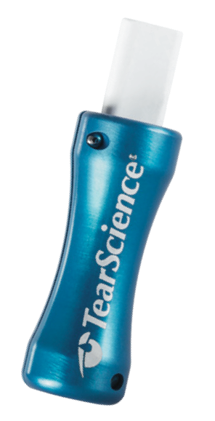
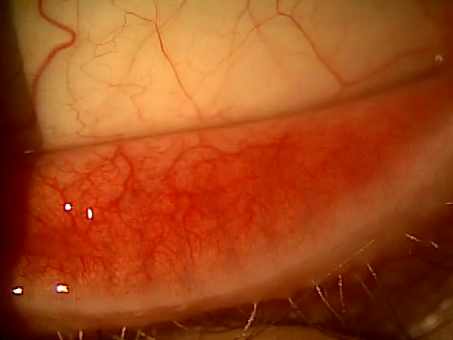
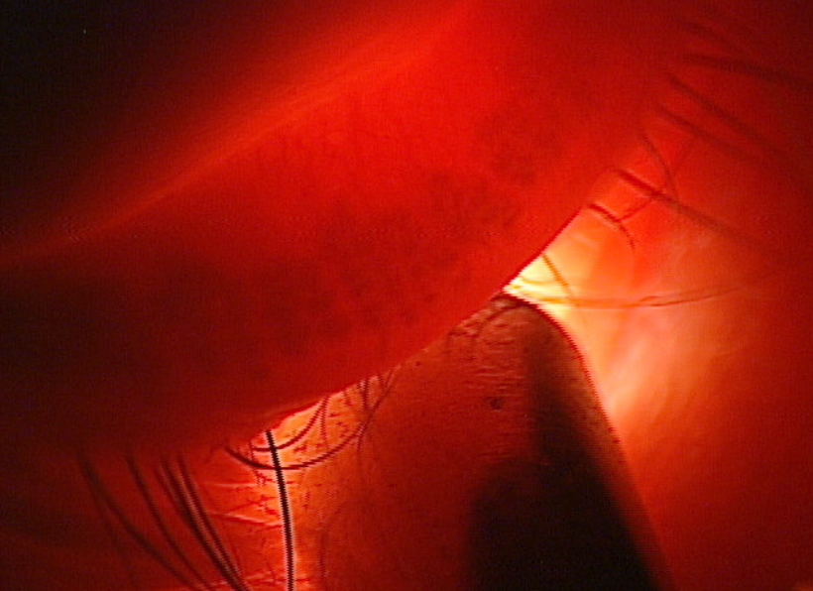

Slide 11
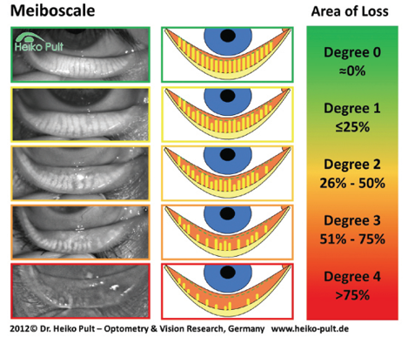

Slide 12
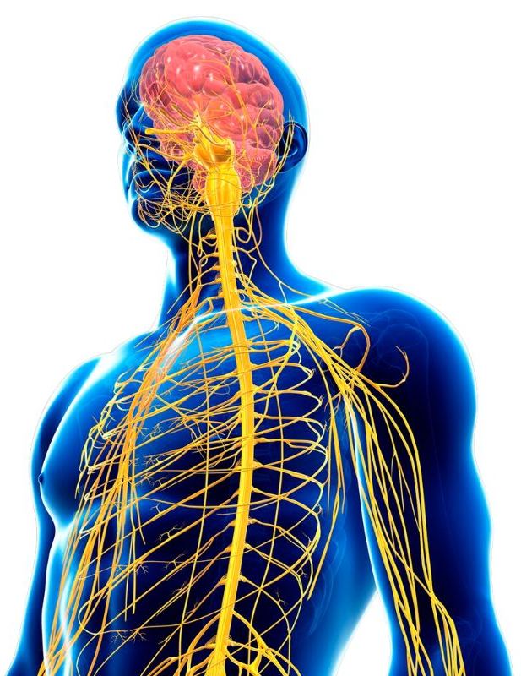


CORNEA INNERVATION AND SENSITIVITY
Trigeminal Nerve (CN V)
  Opthalmic (V1)
  Maxillary (V2)
  Mandibular (V3)
Nasociliary Nerve
  Branch of opthalmic
Long Ciliary Nerve
  Branch of the nasociliary
The cornea is the human tissue with the highest density of free nerve fiber endings
  300 to 600 times more than skin
  20 to 40 times more than dental pulp
1. Marfurt CF, Kingsley RE, Echtenkamp SE. Sensory and sympathetic innervation of the mammalian cornea. A retrograde tracing study. Invest Ophthalmol Vis Sci. 1989;30(3):461–72.
Notes:
The cornea is the most densely innervated tissue in the body, with approximately 7,000 nociceptors per square millimeter. For example, the nerve density of the corneal epithelium is 300 to 600 times greater than skin, and 20 to 40 times greater than dental pulp.
This abundant sensory endowment allows the cornea to have the ability to transduce various thermal, mechanical and chemical stimuli in the conscious perception of ocular dryness, discomfort or pain.
NOCICEPTOR: Receptor / nerve ending that is stimulated by tissue damage or injury. It is found in all organs, although the stimulus that excites them is different (heat, hypoxia, pressure, chemicals such as bradykinin and some prostaglandins, etc.).

Slide 13
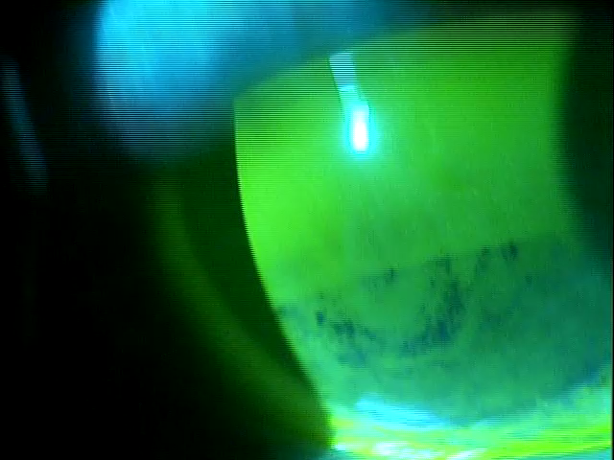
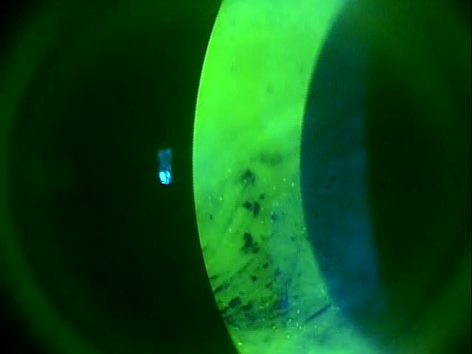
TBUT – Normal range
> 10 seconds

Slide 14
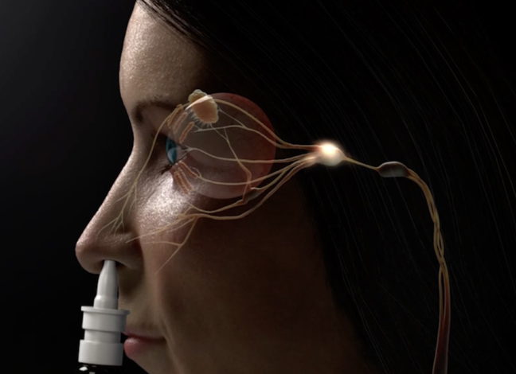
Varenicline Mechanism of Action
Believed to activate the trigeminal parasympathetic pathway resulting in increased production of basal tear film.
The trigeminal nerve is the pathway for parasympathetic stimulation of the lacrimal functional unit (LFU).
Upon trigeminal nerve activation, the LFU is stimulated to produce a complete tear film.
This pathway innervates the lacrimal glands, meibomian glands, and goblet cells, resulting in increased production of basal tears as a treatment for dry eye disease.
34% of basal tear production is due to inhaling air through the nose.³
References:
TYRVAYA® (varenicline solution) nasal spray. Prescribing Information. Oyster Point Pharma, 2024.
Bron AJ et al. TFOS DEWS II pathophysiology report. Ocul Surf. 2017;15(3):438-510.
Gupta A, Heigle T, and Pflugfelder SC. Nasolacrimal stimulation of aqueous tear production. Cornea, 1997;16(6):645-648.

Slide 15
  Transient receptor potential melastatin 8 (TRPM8)
  Acoltremon 0.003% is a first-in-class TRPM8 receptor agonist approved by the FDA in 2025 for the treatment of dry eye disease.
    One drop in each eye twice daily, approximately 12 hours apart
  Represents a novel, neurostimulatory approach that enhances natural tear secretion
  Activates transient receptor potential melastatin 8 (TRPM8) receptors located on corneal cold-sensing nerves.
  Phase 3 COMET-2 and COMET-3 trials showed significantly greater increases in Schirmer’s scores compared to vehicle as early as Day 14.
  Most common side effect: mild, transient instillation site discomfort.

Slide 16
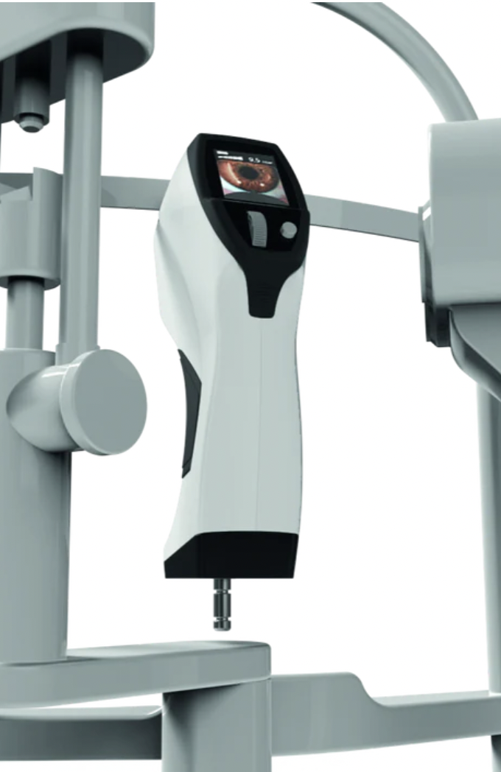
Corneal Esthesiometer
Objectively assesses corneal sensitivity
Five stimulus levels ranging from 1 mbar to 10 mbar
NCT 250 to 300mbar
Device is 4mm from the patient’s ocular surface
https://esthesiometer-brill.com/

Slide 17
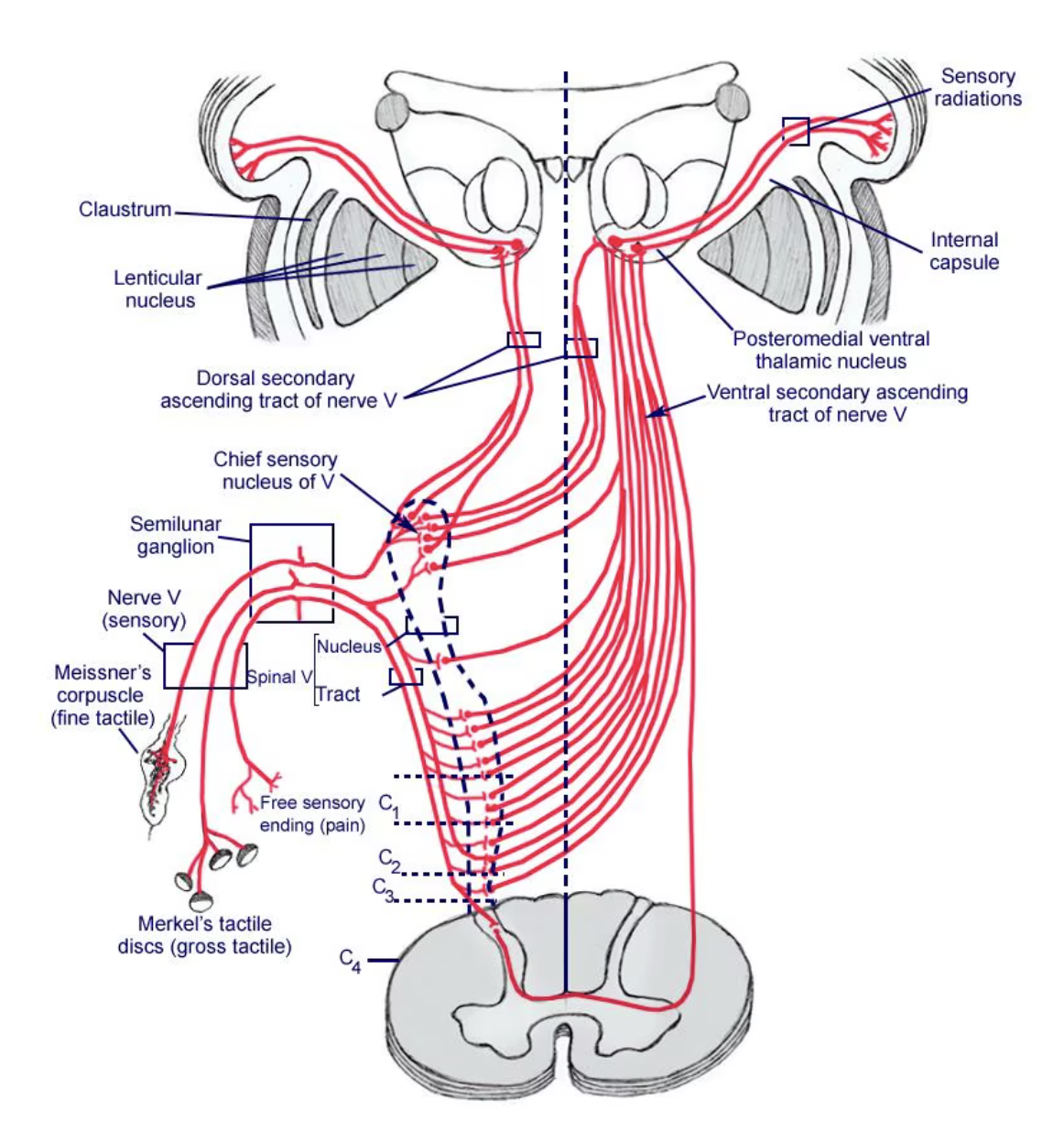
Trigeminal Nerve
3
1
2
https://emedicine.medscape.com/article/1873373-overview

Slide 18
Proparacaine Challenge Test
1) Assess comfort of patient at time of visit (0 to 10)
2) Place drop of proparacaine in eyes
3) Assess comfort of patient about 90 seconds after drop instillation

Slide 19
OKYO Pharma: Neuropathic Ocular Pain
Lead candidate: OK-101 (Urcosimod)
Topical therapy
Targets dry eye + neuropathic corneal pain
Targets ChemR23 receptor
Immune modulation
Reduces inflammation and pain

Slide 20
Pain Modulation
Direct effect on pain signaling
Comparable to gabapentin in models
Targets neuropathic pathways
Improved TBUT
Reduced symptoms
Pain reduction observed

Slide 21
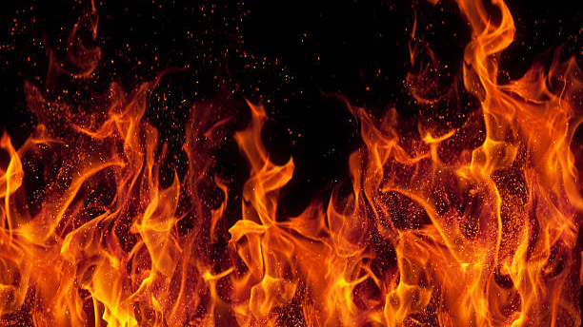
INFLAMMATION

Slide 22
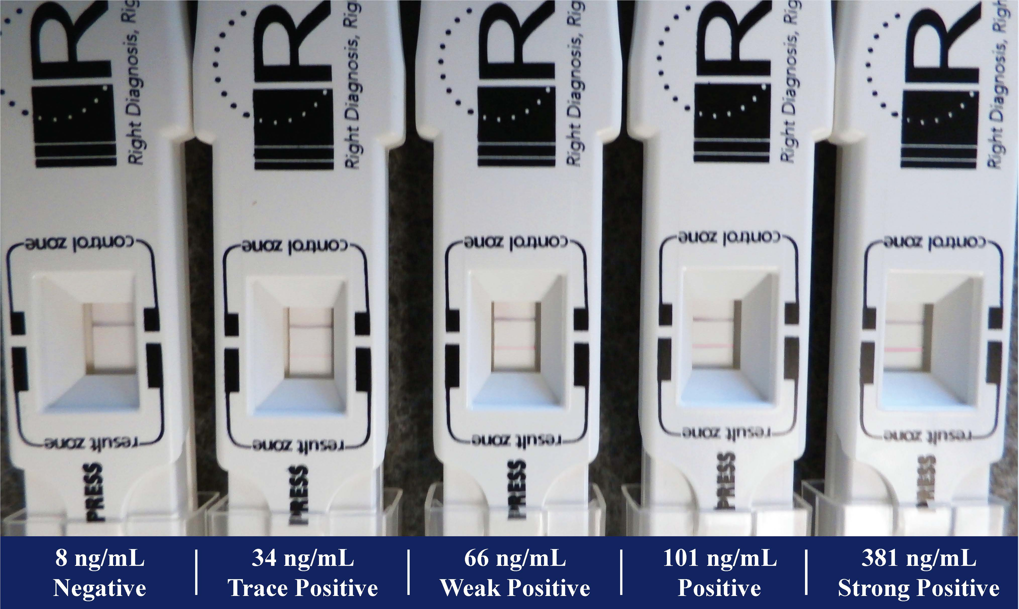
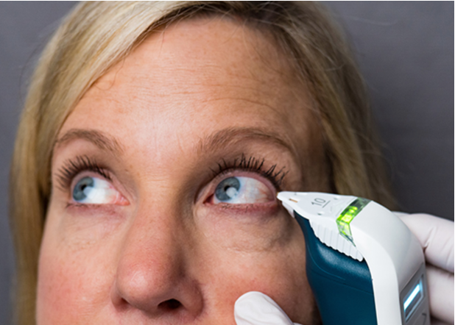

Slide 23
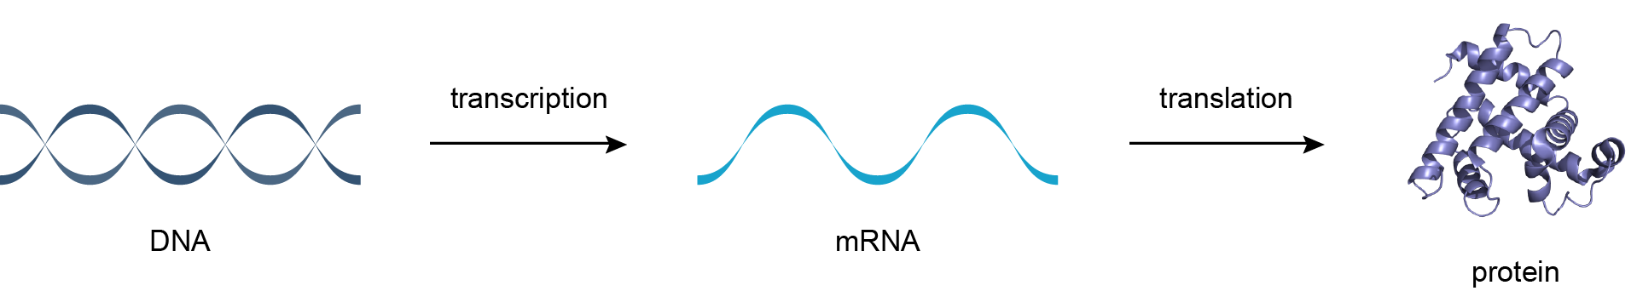
Steroids affect this step

Slide 24
Loteprednol 0.2% 0.25%, 0.38%, 0.5%, 1%
Fluorometholone (FML) 0.1%, 0.25%
Prednisolone Acetate 1%, 0.12%
Difluprednate 0.05%

Slide 25
Cyclosporine
  Cyclosporine binds to cyclophilin within activated T lymphocytes
  The cyclosporine–cyclophilin complex inhibits calcineurin
  Calcineurin inhibition prevents activation of nuclear factor of activated T cells Reduced NFAT activation leads to decreased transcription of interleukin-2 (IL-2) and other pro-inflammatory cytokines
  Suppression of T-cell activation and downstream ocular surface inflammation
  Reduced inflammatory damage to the lacrimal functional unit
  Improvement in goblet cell density over time
  Gradual increase in endogenous tear production with continued therapy

Slide 26
Ocular Surface Inflammation
  Commercially available as Restasis
    0.05% concentration
    Preservative free
      Single vials
      Multi-dose bottle
        Patented non-preserved system that maintains its sterility
  Is an immunosuppressive agent
  Available as generic

Slide 27
Cyclosporine 0.09%
Nanomicellar aqueous formulation
Micellar delivery enhances the solubilization of hydrophobic cyclosporine
Improve corneal and conjunctival penetration

Slide 28
Cyclosporine 0.1%
  Uses a water-free semifluorinated alkane (SFA) vehicle to improve comfort, penetration, and bioavailability.
  Inhibits T-cell activation and inflammatory cytokine release.
  SFA carrier enhances corneal absorption
  Phase 3 trial: significant improvement in corneal staining and symptoms vs vehicle.
  Enhances comfort, adherence, and long-term ocular surface stability.

Slide 29
Ocular Surface Inflammation
  Lifitegrast applied topically is believed to prevent the interaction between LFA-1 on T-cells and ICAM-1 on the ocular surface
  Has been shown to improve both signs and symptoms of dry eye within a 12 week time period
  Commercially available as Xiidra
    5% concentraton
    non-preserved sterile unit dose vials
  It is a lymphocyte functioning antigen-1 (LFA-1) antagonist

Slide 30
RASP Inhibitors
www.aldeyra.com
Aldehyde is a product of metabolism
Normally rapidly broken down
With inflammation, is produced in quantities that are difficult to breakdown efficiently
RASP – Reactive aldehyde species
Reproxalap – Is a RASP inhibitor

Slide 31

Prescription Journey - Commercial
Prescription written
PA/ST Needed
PA Approved
(Co-Pay Card Applied)
Appeal
Change Medications
Benefits Verification
PA Not Approved
Product Covered
No PA/ST Needed
(Co-Pay Card Applied)
Product Not Covered
Letter of Medical Necessity to secure coverage
Approved (see Product covered path)
(Co-Pay Card Applied)
Not approved
Request Peer Review
PA = Prior Authorization
ST = Step Therapy or Step Edits

Slide 32
Electronic Prescribing
Manufacturers created relationships with specialty pharmacies
Pharmacies are trained to help access medications at best prices
Contacts the patient to discuss costs
Will mail medications directly to patients

Slide 33
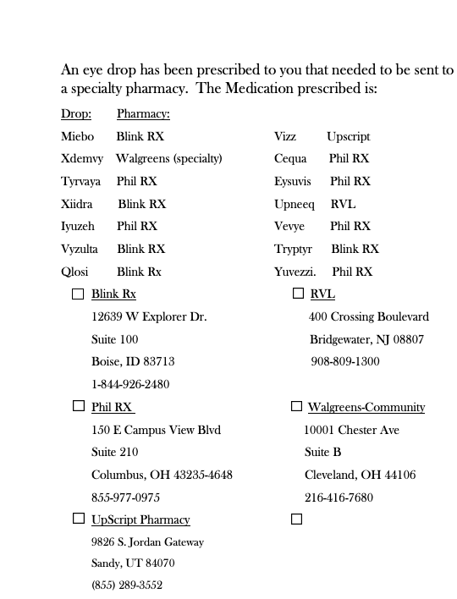
Electronic Prescribing

Slide 36
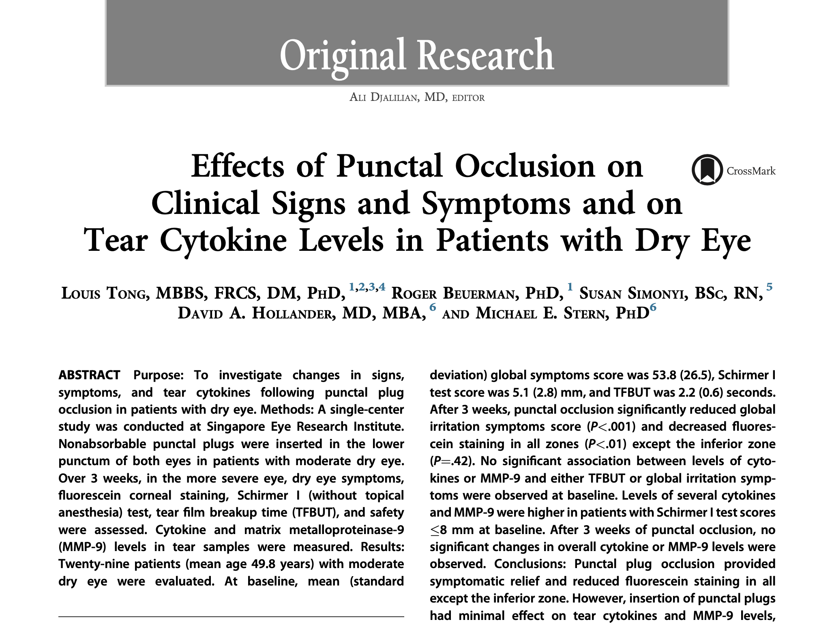
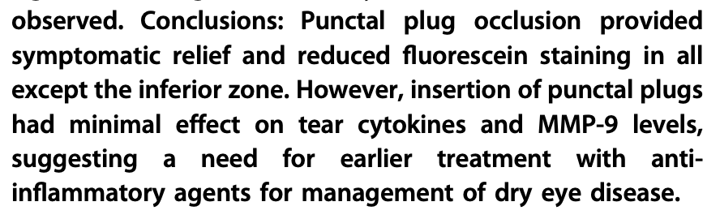

Slide 37
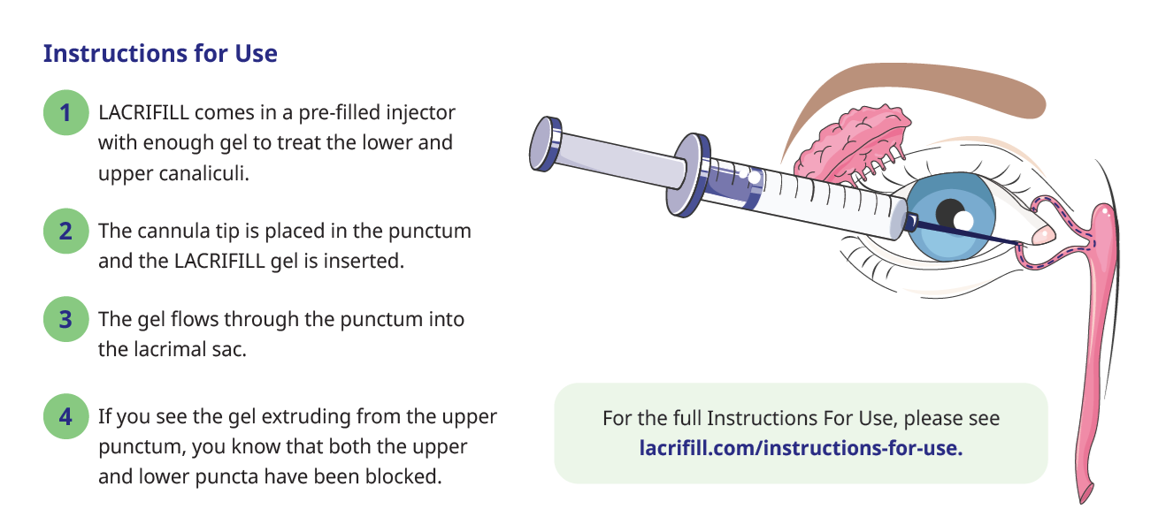
Procedure

Slide 38
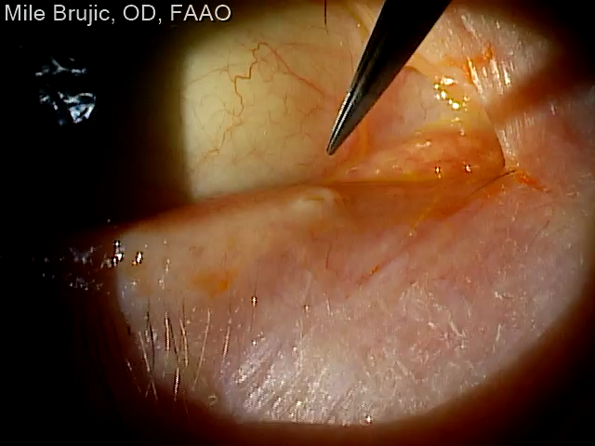
Punctal Dilation

Slide 39
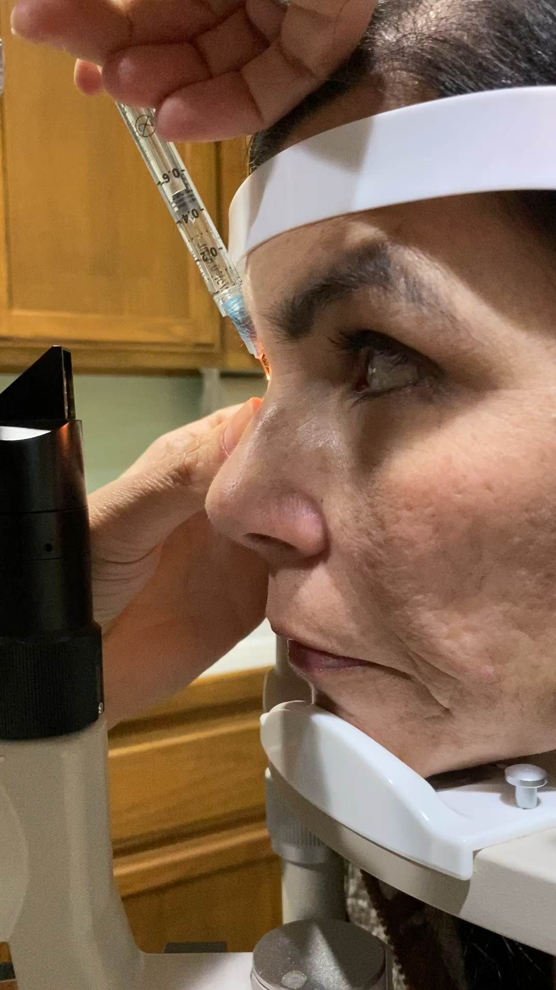
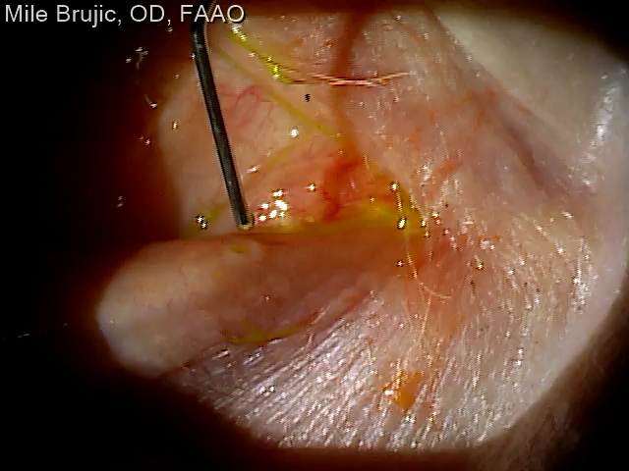
Introducing Gel Into Canalicula

Slide 40
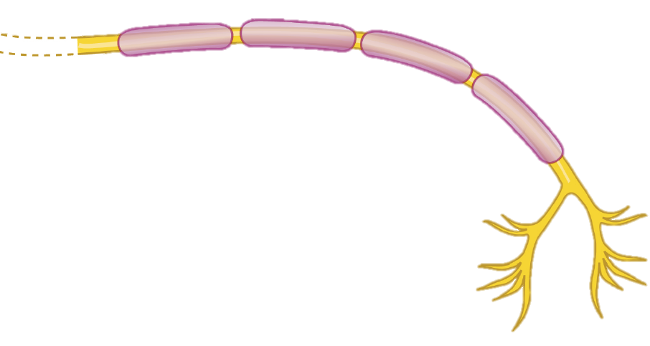
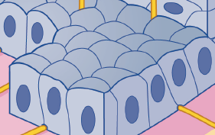

Ocular Surface BEYOND the TEARS
Interaction between corneal nerves and epithelial cells/keratocytes mediates corneal homeostasis
Neuromediators provide trophic support to ocular surface tissues (particularly epithelial cells & keratocytes) that:
Stimulates wound healing
Maintains anatomic integrity
Corneal nerve
Corneal nerves stimulate blinking and tear production
Neurotrophins, neuropeptides and growth factors (e.g., NGF) from epithelial cells and keratocytes mediate nerve fibre survival, differentiation and maturation
Tear gland
Tears contain growth factors and nutrients that stimulate epithelial cells
Epithelial cells and keratocytes
Tear secretion
Adapted from Mastropasqua L, et al. J Cell Pathol. 2017;232:717–24.
Notes:
Talk about how vicious cycle can go to next step and affect the cornea. This is how the cornea is SUPPOSED to act

Slide 41
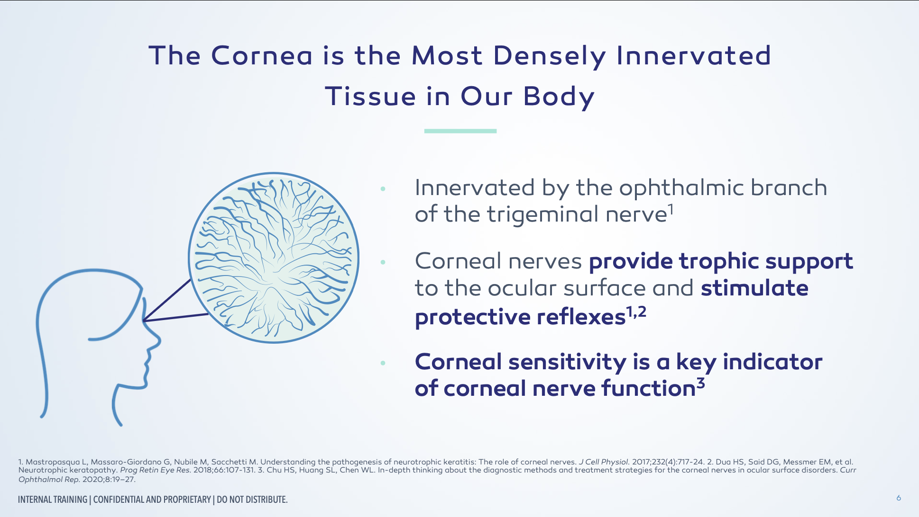

Slide 42
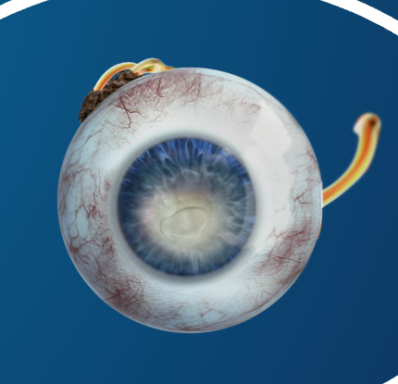
Endogenous NGF is Believed to Support Corneal Integrity Via Three Mechanisms
SHOWN IN PRECLINICAL MODELS¹
CORNEAL INNERVATION
Nerve Growth Factor (NGF) plays a role in nerve function and stimulates the regeneration and survival of the sensory nerves^{2,3}
NGF binds receptors on lacrimal glands and promotes sensory-mediated reflex tearing secretion^{1,4}
CELL PROLIFERATION AND DIFFERENTIATION
TEAR SECRETION
NGF stimulates proliferation, differentiation, and survival of corneal epithelial cells¹
[1] Mastropasqua L, Massaro-Giordano G, Nubile M, Sacchetti M. Understanding the pathogenesis of neurotrophic keratitis: the role of corneal nerves. J Cell Physiol. 2017 Apr;232(4):717-724. [2] Müller LJ, Marfurt CF, Kruse F, Tervo TM. Corneal nerves: structure, contents and function. Exp Eye Res. 2003 May;76(5):521-42. [3] Sacchetti M, Lambiase A. Diagnosis and management of neurotrophic keratitis. Clin Ophthalmol. 2014;8:571-9. [4]Muzi S, Colafrancesco V, Sornelli F, et al. Nerve Growth Factor in the Developing and Adult Lacrimal Glands of Rat With and Without Inherited Retinitis Pigmentosa. Cornea. 2010;29:1163–1168

Slide 43
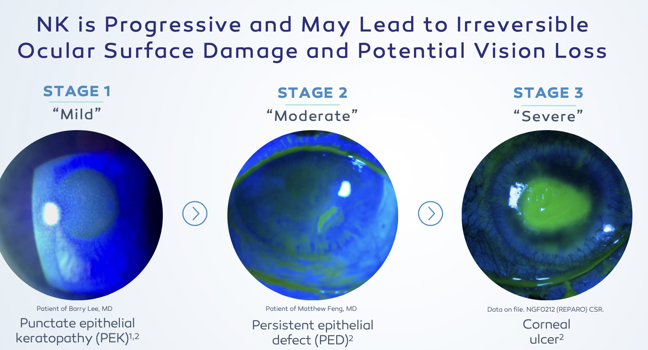

Slide 44
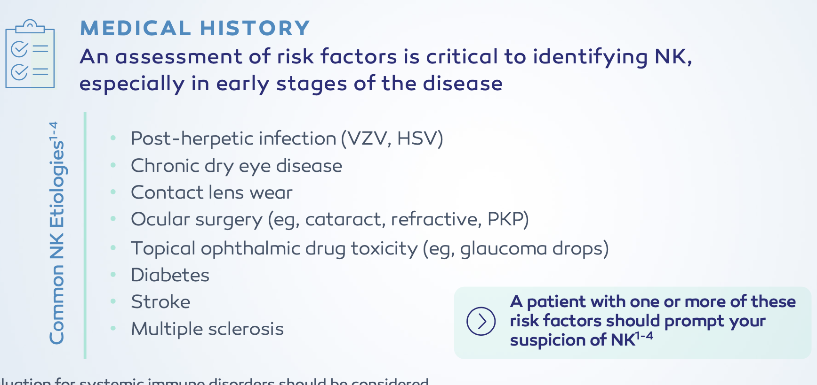

Slide 45
65.2% of Patients Had Complete Corneal Healing at week 8
P<0.001
P<0.012
Percentage of Patients Completely Healed (%)
Endpoint of complete corneal healing: 0 mm staining in the lesion area and no persistent staining in the rest of the cornea (last post-baseline observation carried forward; chi-squared test).
cenegermin 20mcg/ml (n=24)
Vehicle (n=24)
Pflugfelder SC, Massaro-Giordano M, Perez VL, Hamrah P, Deng SX, Espandar L, Foster CS, Affeldt J, Seedor JA, Afshari NA, Chao W, Allegretti M, Mantelli F, Dana R, Topical Recombinant Human Nerve Growth Factor (Cenegermin) for Neurotrophic Keratopathy: A Multicenter Randomized Vehicle-Controlled Pivotal Trial, Ophthalmology (2019), doi: https:// doi.org/10.1016/j.ophtha.2019.08.020.

Slide 46
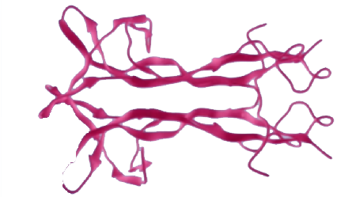
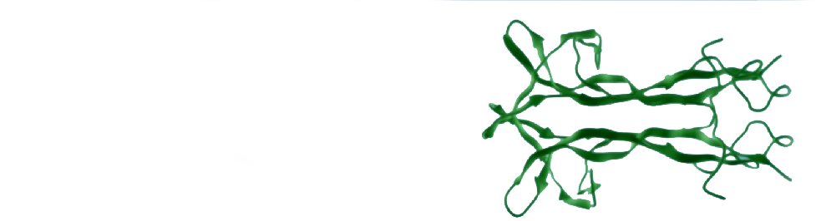
Cenegermin Mimics the Structure of Endogenous NGF in the Ocular Tissues
Cenegermin Endogenous NGF
Cenegermin-bkbj, the active ingredient in the FDA-approved OXERVATE™ (cenegermin-bkbj ophthalmic solution) 0.002% (20 mcg/mL), is structurally identical to the human NGF protein found in ocular tissues
Voelker R. New Drug Treats Rare, Debilitating Neurotrophic Keratitis. JAMA. 2018;320(13):1309.

Slide 47
Autologous Serum Tears
Biologic composition
  Growth factors, vitamins, immunoglobulins, and anti-inflammatory mediators
  Mimics natural tear biochemistry
Clinical role
  ocular surface disease
  Persistent epithelial compromise
  Neurotrophic or refractory dry eye

Slide 48

Thank You mile.brujic75@gmail.com

